Slide 1
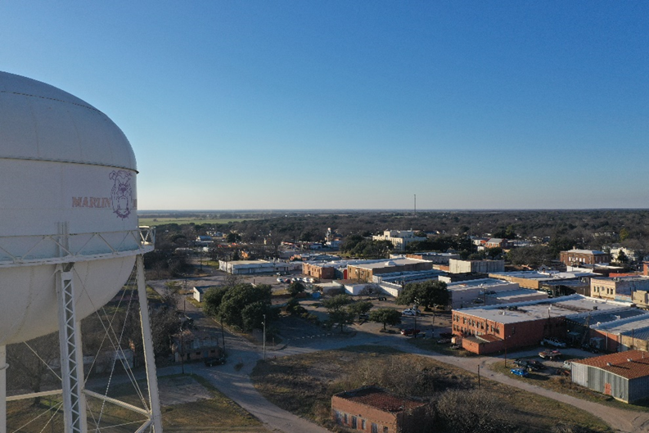
City of Marlin
Planning & Capacity Studies 2022-2032
Contract #7220064
Volume II: Maps
FINANCED THROUGH THE TEXAS DEPARTMENT OF AGRICULTURE. The preparation of this document was financed through provisions of a Texas Community Development Block Grant Program (TxCDBG) grant from the U.S. Department of Housing and Urban Development.

