Slide 1
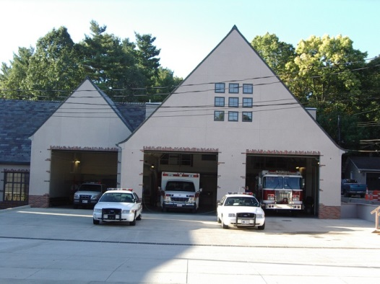
Public Safety Update
July 20, 2020
Capital Equipment
Personnel Changes
Department Operations Statement
Officer Recruitment
Use of Force
Ohio Collaborative
Citizen Police Academy

Slide 2
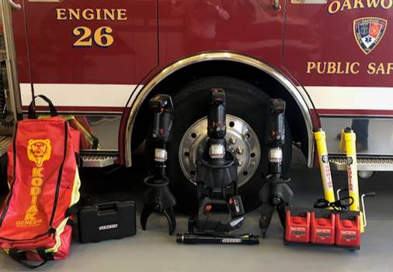
2020 Capital Equipment
Complete Replacement of Extrication Tools /
Vehicle Stabilization Equipment

Slide 3
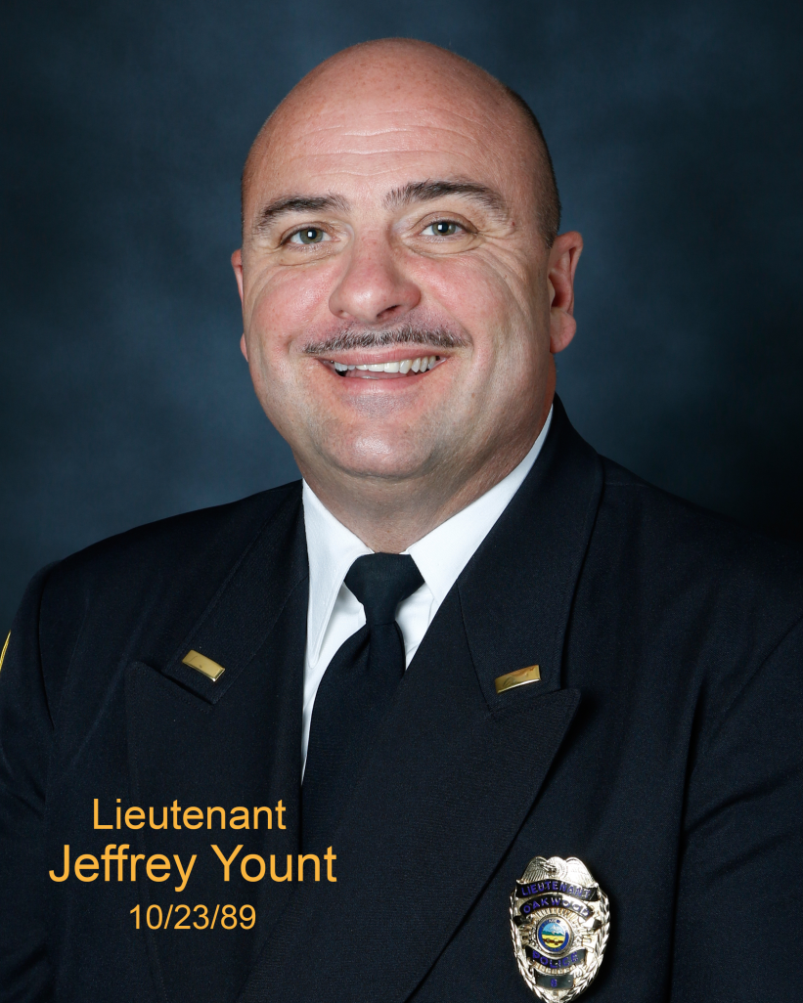
Personnel Changes
Departures
Lt. Jeff Yount – On April 2, Lt. Yount retired with over 30 years of service. At the time of his retirement, Lt. Yount was the longest tenured public safety officer working for five different chiefs (note there have only been seven chiefs since the 1950’s), and saw two generations of public safety officers retire.
Lt. Yount had a long, successful and rewarding career.
We all wish Jeff well in retirement.
Lt. Jeff Yount

Slide 4
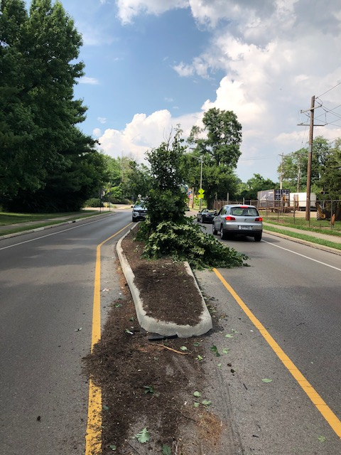
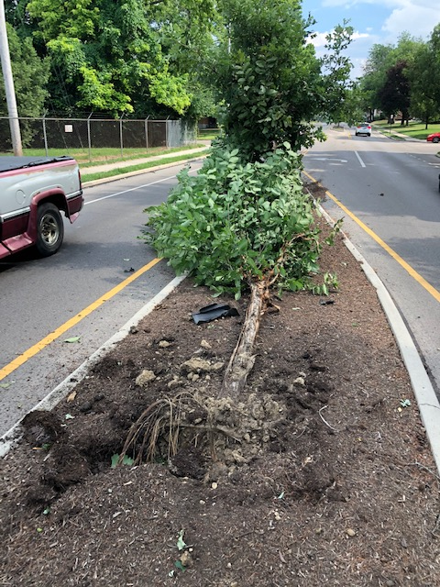
Recent Hit and Run Accident

Slide 5
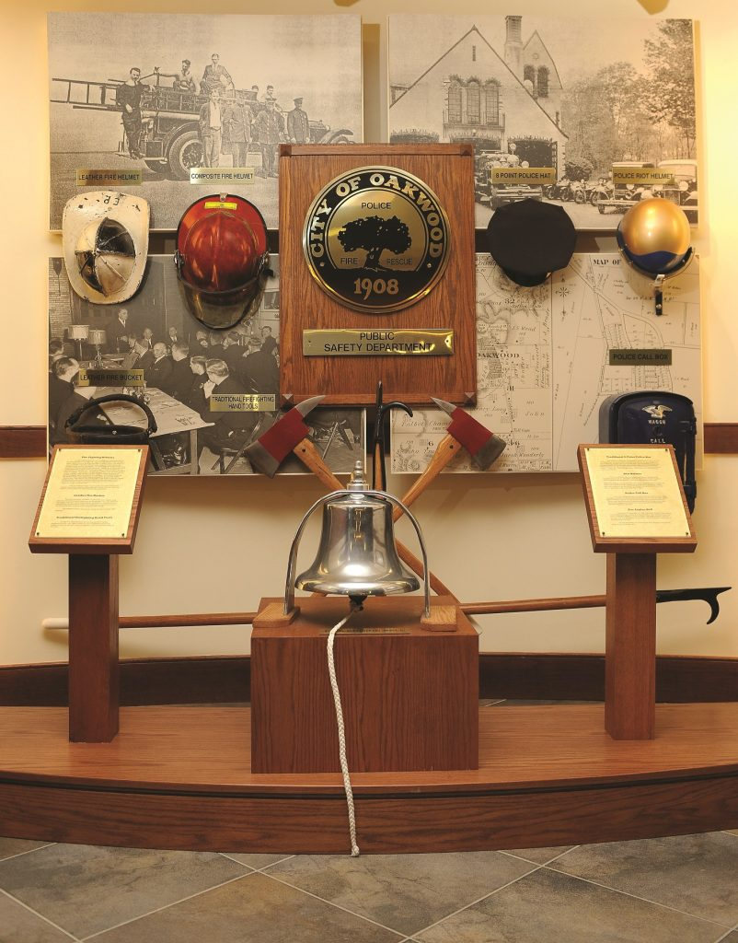
Mission Statement
Our mission is to work in a partnership with all citizens and to enhance the quality of life by providing superior police, fire, and emergency medical services.

Slide 6
Core Values
Integrity – committed to integrity by upholding community trust.
Dedication – through loyalty to the community.
Respect - treating all people with dignity and in an unbiased manner.

Slide 7
Principles of Operation
Protection of life and property.
Promotion of a safe and secure environment.
Provide superior police, fire, and emergency medical services.

Slide 8
Officer Recruitment
U.S. citizen;
21 years of age;
Valid driver’s license;
Lateral Entry Hiring Process;
Certified in one of the three disciplines;
Successfully completed 12 months of full-time service and currently employed as a full-time police officer, career firefighter or paramedic.

Slide 9
Officer Selection Process
Completion of 50+ page application packet;
Two oral interview boards;
Comprehensive character background investigation;
Two truth verification tests;
Psychological exam;
Medical exam.

Slide 10
Where do we attract
candidates from?
Amberly Village Public Safety Department
Beavercreek Fire Department
Bellbrook Fire Department
Dayton Fire Department
Dayton Police Department
Fairborn Fire Department
Kettering Fire Department
Kettering Police Department
Mason Police Department
Miami Valley Fire District
Miamisburg Police Department
Middletown Fire Department
Montgomery County Sheriff’s Office
Moraine Police Department
Ohio State Highway Patrol
Riverside Police Department

Slide 11
Use of Force
A Culture of Accountability
The Oakwood Public Safety Department has a comprehensive use of force policy covering all facets of the application of force, documentation of use of force incidents, and the administrative review of Use of Force incidents.

Slide 12
Use of Force Incidents
2016 – 6
2017- 6
2018 – 3
2019 – 3
2020 (YTD) – 0
Note - During same time period, the Safety Department has made over 1,000 arrests and conducted in excess of 15,000 traffic stops.

Slide 13
Use of Force
Following the tragic death of George Floyd, much discussion has occurred locally, statewide, and nationally with regards to Use of Force polices.

Slide 14
Use of Force

Slide 15
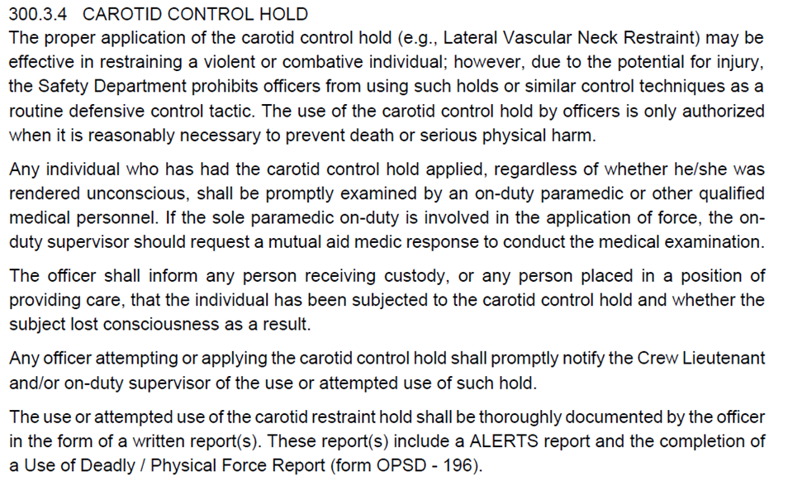
Chokeholds

Slide 16
De-escalation
De-escalation and de-escalation training is nothing new to the Oakwood Pubic Safety Department. Over the past several years, the Safety Department has provided periodic de-escalation trainings through various in-service trainings.
Most recently, Public Safety Officers completed law enforcement de-escalation trainings in June and July of 2020.

Slide 17
Require Warning Before Shooting
There is no legal requirement to do so. The courts have recognized that law enforcement encounters are fast-evolving and rapidly changing dynamic situations and a warning may not always be feasible.

Slide 18
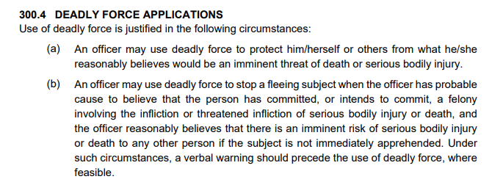
Exhaust All Alternatives
Before Shooting

Slide 19
Duty to Intervene

Slide 20
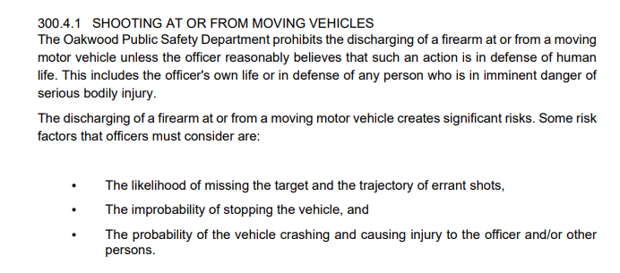
Ban Shooting at Moving Vehicles

Slide 21
Use of Force Continuum

Slide 23
Require Comprehensive Reporting

Slide 24
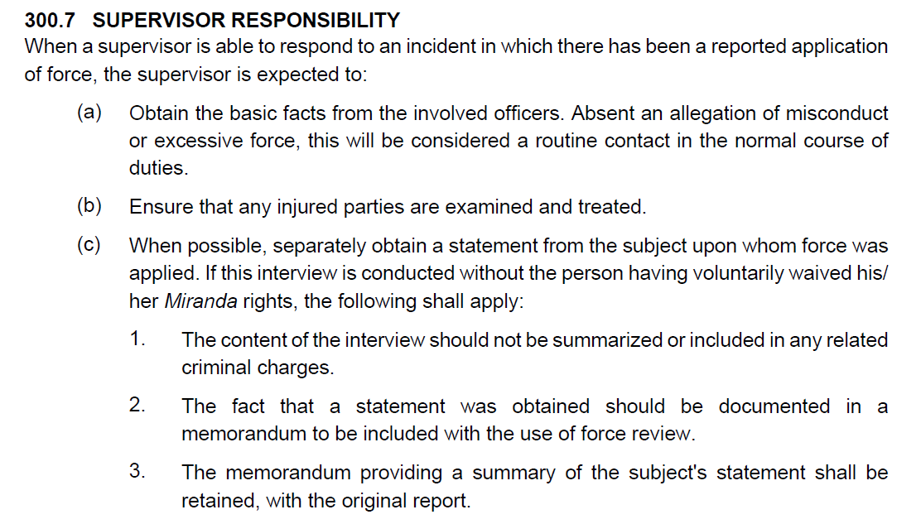
Require Comprehensive Reporting

Slide 25
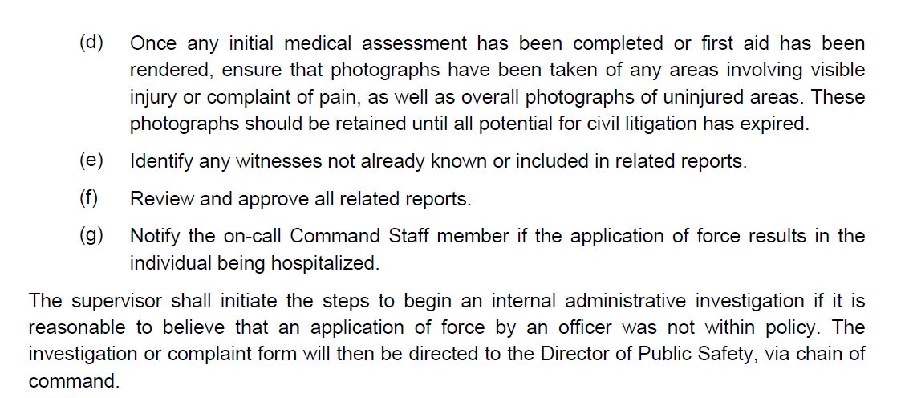
Require Comprehensive Reporting

Slide 26
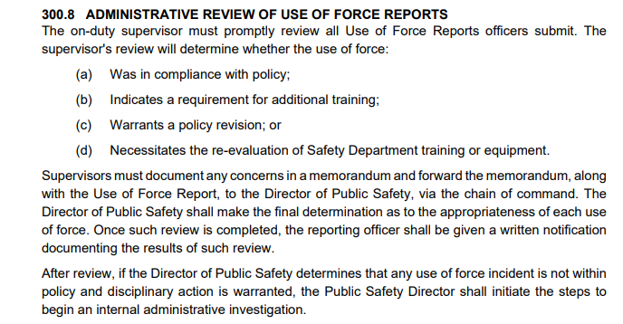
Require Comprehensive Reporting

Slide 27
Require Comprehensive Reporting

Slide 28
Ohio Collaborative
Established in December 2014, the Ohio Collaborative Community – Police Advisory Board (Ohio Collaborative) was created to oversee implementation of recommendations for statewide policing standards in a variety of areas.
www.ocjs.ohio.gov/ohiocollaborative/

Slide 29
Ohio Collaborative
Although voluntary, the Ohio Collaborative certification process provides for a independent review of a police agency to demonstrate transparency, modern methods and standards, and open critique and feedback from accessors.

Slide 30
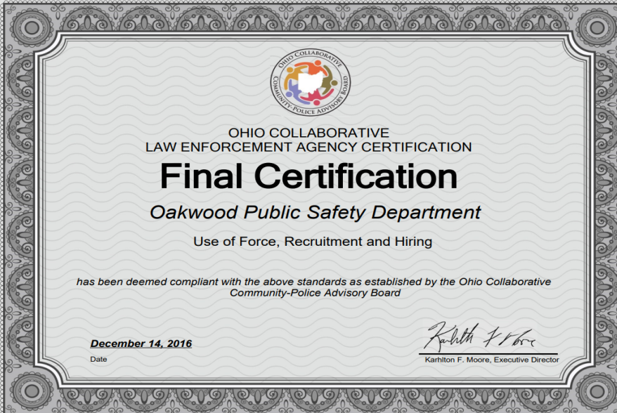
Ohio Collaborative
In 2016, the Oakwood Public Safety Department received it’s initial certification for the Use of Force/ Recruitment and Hiring Group 1 standards.

Slide 31
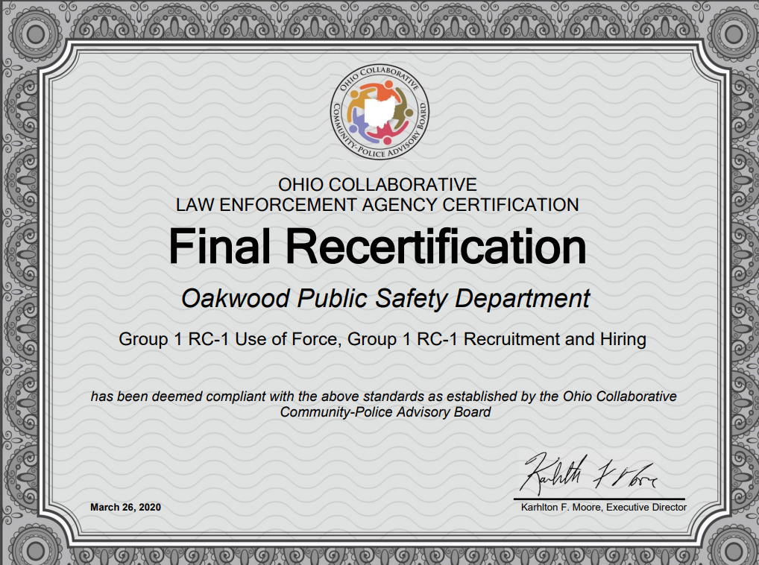
Ohio Collaborative Recertification

Slide 32
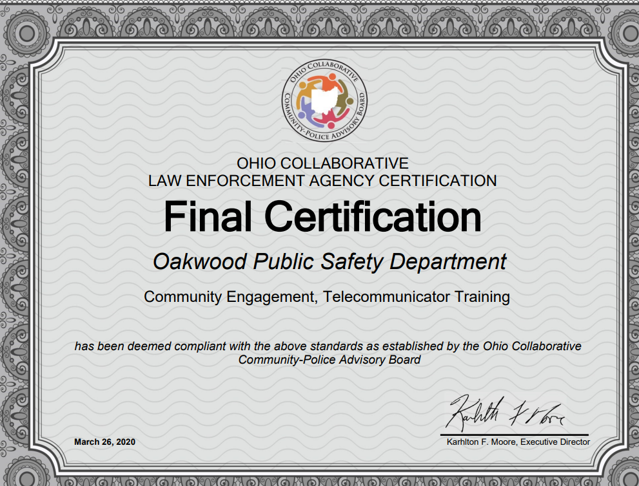
Ohio Collaborative
Group 2 Standards

Slide 33
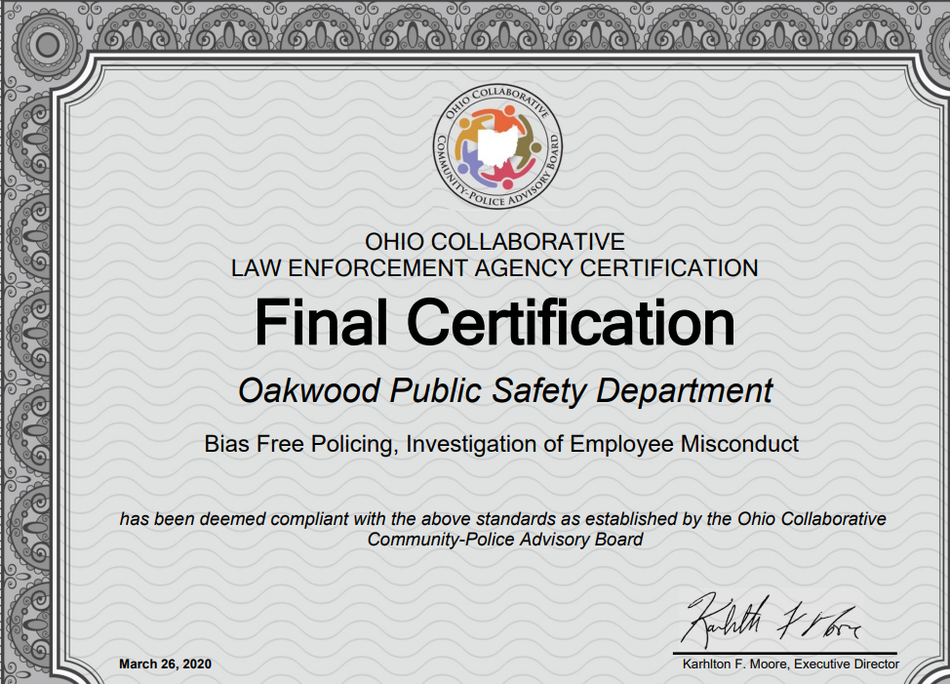
Ohio Collaborative Group 3 Standards

Slide 34
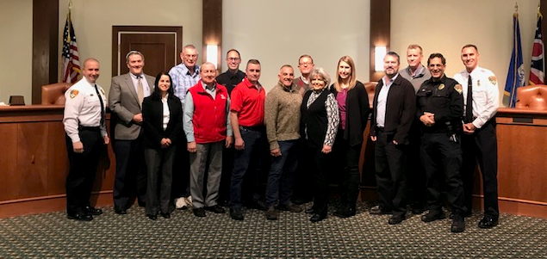
Oakwood Citizen Police Academy
In September 2020, the Oakwood Public Safety Department will host its third Citizen Police Academy (CPA).

Slide 35
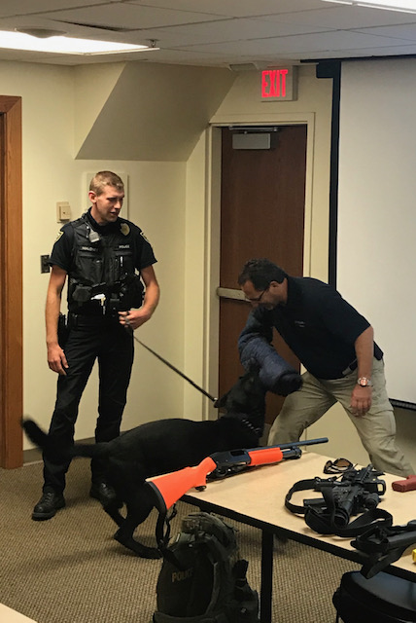
Oakwood Citizen Police Academy (cont.)
The CPA will run from September 9 through November 11. The academy will last 10 weeks and will meet one night per week for two hours. Topics to be covered during the academy include:
Safety Department Introduction/ Orientation
Patrol Operations
Traffic Enforcement
Use of Force
Active Shooter Training
Evidence Collection and Processing
Fire Prevention/Education

Slide 36
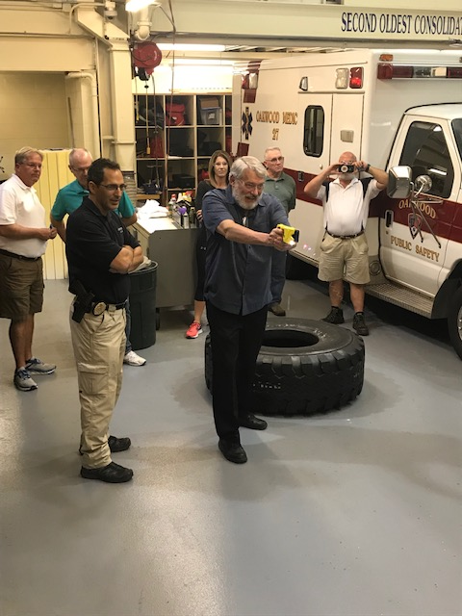
Oakwood Citizen Police Academy (cont.)
The CPA is free of charge and is open to any Oakwood resident or individual working within the city of Oakwood.
Due to COVID-19, class size will be limited to eight participants for social distancing purposes, and we will begin accepting applications for the CPA on Thursday, July 23.

