Slide 1
Fiscal & Organizational sustainability (“FOS”)
Introduction, Purpose and Process
December 2, 2019

Slide 2
Agenda
Fiscal and Organizational Sustainability Process
Provide context on what it means to achieve fiscal and organizational sustainability (“FOS”)
Provide an overview of the FOS process – next 12 months
Receive input from Council and public on process
Provide example “fiscal sustainability options tool”
Notes:
stabilize the organization and the City budget. While the City continues to feel lingering impacts of the Great Recession, there are signs that the economy is slowly improving. City revenues are beginning to recover from the sharp decreases we experienced in recent years. This recovery provides an opportunity to maintain our current service levels, make some targeted investments and continue financial planning for the future.
I am proud that this budget does not include staff layoffs. Over the last four years, we have made significant staffing reductions. These reductions have translated into a loss of 50 positions citywide. While these reductions were necessary due to limited resources, I am pleased that we are not forced to contemplate further staffing reductions in the 2012/2013 budget.

Slide 3
Overall Goals of FOS Process
Learn more about the organization – “uncover every rock”
  Fact-based data gathering
  Not based on assumptions
Educate the community about our services and service levels
Determine what it means for Petaluma to be sustainable
Quantify budgetary impacts / revenue requirements
Provide policy options and decisions
Determine a plan to achieve sustainability

Slide 4
Fiscal sustainability defined
How others have defined the term
Fiscal Sustainability means:
Achieving a strategic balance of available long-term revenues with agreed-upon service levels, infrastructure maintenance needs, and a talented & capable workforce.

Slide 5
Fiscal sustainability – a balancing act
#1 - Managing Employee Compensation Balanced with Sustaining a Talented Work Force
#2 - Commercial & Residential Development Balanced with Retaining Community Character and Neighborhoods
#3 - Increase Revenue and Fees to Ensure Cost Recovery Balanced with Ensuring Access and Overall Competitiveness
#4 - Control Operating Expenses & Improve Efficiency Balanced with Retaining Flexibility and Resources to be Responsive and Creative
#5 - Maintaining Long-Term Assets / Facilities Balanced with Meeting Immediate Resource Needs

Slide 6
Long-Term Sustainability

Slide 7
Strategy to date
2008 - 2012
2013 - 2018
2019 - 2020
Address
the Crisis
Sustainability Planning
Survival

Slide 8
Address the crisis – 2008-2012
General Fund Services Cut by 33%
Reduced 1/3 of all staff (90 positions)
Depleted General Fund Reserve
$1M Employee pay / benefit cuts & furloughs
No salary Increases from 2009-2017
Legally allowable pension reform undertaken
Aggressive outsourcing of City services
Departments consolidated and reorganized

Slide 9
Survival – 2013 - 2018
Budget balanced year-to-year
PEPRA - additional pension reform / new CalPERS policies
No cost-of-living adjustments for staff
No new local revenue sources implemented
No General Fund investment in roads / infrastructure
Negligible investment in technology
Slow build-up of reserves – currently at about 9%

Slide 10
ONGOING SERVICE IMPACTS
Where we are today
47 positions fewer than 2008 levels; City is non-competitive in talent retention/attraction
Loss of police programs
Homeless outreach
Proactive patrol
Emergency Reserve Insufficient
Maintenance Shortfalls
5 staff, 46 parks / 400 acres
2 staff , city facilities / 40+ buildings
Fire & police stations are dilapidated and inadequate
Aging equipment & failing vehicles (no replacement funds)
Roads Failing
River unnavigable
Costing city $10M in economic impacts
Emergency response times slower by 1 minute (compared to industry standard)
Notes:
Bare minimum = 15%. We are not meeting that. Unless you have a large amount of elastic revenues in which case you should have more. We are at least $2 ;million short.

Slide 11
Fiscal and Organizational Planning
What kind of organization do we want to be?
What are our goals?
What is our vision?
What service levels are we trying to achieve?
Do we have the right amount and levels of staffing?
What is a sustainable level of infrastructure investment?
What is a sustainable level of technology investment?
How much should we have in reserves?
What is our employee compensation philosophy?
How competitive can we be in the labor market?
What level of revenue can support all of the above?
Do we need additional revenue, or do we need to adjust expectations?

Slide 12
Public / Council work sessions - Tentative
December 2, 2019
FOS Work Plan and Process Roll-Out
December 9, 2019
Department Reviews
December 9, 2019
Revenues
January 13, 2020
February 10, 2020
February 10, 2020
March 7, 2020 (Sat.)
April 13, 2020
Human Resources I – Pension / OPEB Benefits
Human Resources II – Comp / Benefits / WC
Human Resources III – Staffing Levels
All City Infrastructure (3 sessions)
Options Tool Review
May 11, 2020
Draft Fiscal Sustainability Plan
June-August 2020
Deliberation and Decisions
February 3, 2020
  Technology Investments

Slide 13
Proposed council Sessions
Fiscal and Organizational Sustainability Process
Education and background about the topic areas
Draft options and strategies
Focus to be on broader policy choices - not a laundry list
Council to provide direction to staff on which options to include in options tool
Goal – finalize 3-5 options within each topic area to add to tool
Options tool will be updated with final selections
Notes:
stabilize the organization and the City budget. While the City continues to feel lingering impacts of the Great Recession, there are signs that the economy is slowly improving. City revenues are beginning to recover from the sharp decreases we experienced in recent years. This recovery provides an opportunity to maintain our current service levels, make some targeted investments and continue financial planning for the future.
I am proud that this budget does not include staff layoffs. Over the last four years, we have made significant staffing reductions. These reductions have translated into a loss of 50 positions citywide. While these reductions were necessary due to limited resources, I am pleased that we are not forced to contemplate further staffing reductions in the 2012/2013 budget.

Slide 14

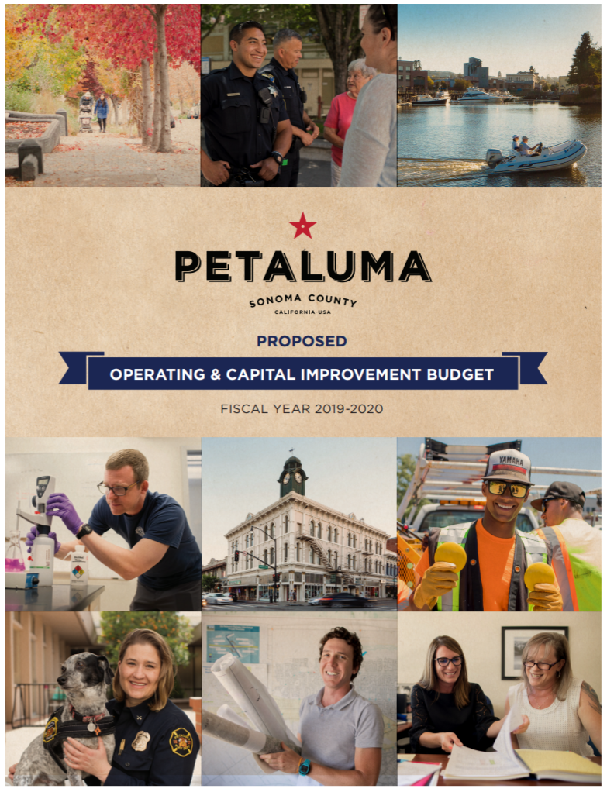
Fiscal & Organizational planning
Petaluma
Web
Options Tool
Fiscal & Organizational Sustainability Plan
Notes:
12 public workshops
156 page Fiscal Options Report
On-line Options Tool
Community Outreach this Fall
Council decisions in Jan/Feb 2014

Slide 15
Fiscal sustainability report
Example Contents
Background and History
What Petaluma has done to-date
Updated Forecast and assumptions
Overview / analysis of each topic area (revenues, compensation, etc)
Description of choices included in the options tool
Recommend scenario(s)
Final plan – includes the final options that Council selects

Slide 16
Options Tool Overview and Purpose
Decision modeling tool
Demonstrates the impacts, tradeoffs, and financial implications of a variety of future choices
4-dimensional puzzle:
  Dollars; Time; Values, service levels, tradeoffs; Probability/likelihood
30-40 major choices at a broad, city-wide level
Allows the user to select/unselect various options
Deficit / Surplus / Reserves update automatically
Qualitative – pros / cons / service impacts of choices

Slide 17
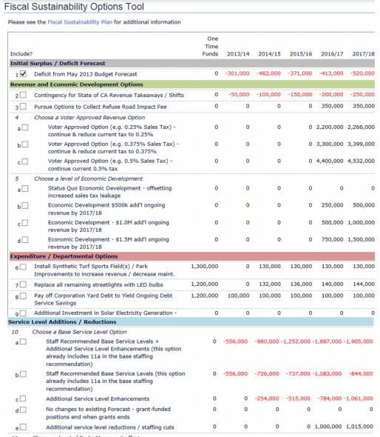
Sustainability Options Tool (Sample)
SAMPLE

Slide 18
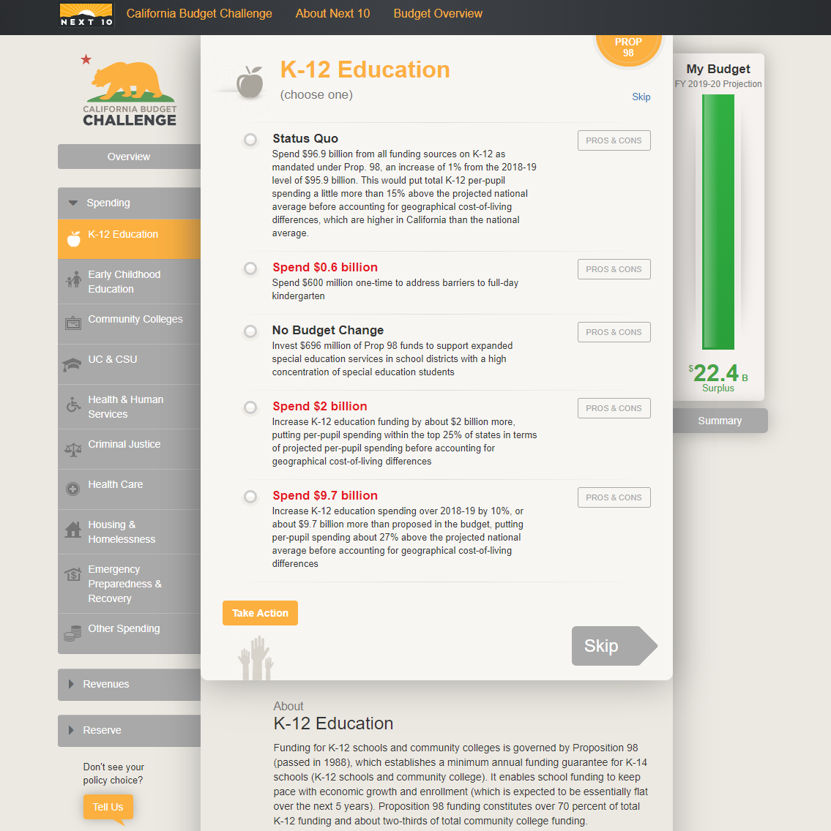
California Budget challenge
Online tool will provide Petalumans the opportunity to weigh-in on the City’s FOS options
SAMPLE

Slide 19
Proposed public & employee outreach
Fiscal and Organizational Sustainability Process
Council meetings / workshops
Social media / website promotion to encourage participation
Featured in upcoming City newsletters
Options tool
“World Tour” presentation to community groups
Updates to labor groups and employees
Town hall / open house meetings with options tool
Notes:
stabilize the organization and the City budget. While the City continues to feel lingering impacts of the Great Recession, there are signs that the economy is slowly improving. City revenues are beginning to recover from the sharp decreases we experienced in recent years. This recovery provides an opportunity to maintain our current service levels, make some targeted investments and continue financial planning for the future.
I am proud that this budget does not include staff layoffs. Over the last four years, we have made significant staffing reductions. These reductions have translated into a loss of 50 positions citywide. While these reductions were necessary due to limited resources, I am pleased that we are not forced to contemplate further staffing reductions in the 2012/2013 budget.

Slide 20
Request to council tonight
Fiscal and Organizational Sustainability Process
Provide feedback on process and timeline
Provide ideas and input for community outreach
Notes:
stabilize the organization and the City budget. While the City continues to feel lingering impacts of the Great Recession, there are signs that the economy is slowly improving. City revenues are beginning to recover from the sharp decreases we experienced in recent years. This recovery provides an opportunity to maintain our current service levels, make some targeted investments and continue financial planning for the future.
I am proud that this budget does not include staff layoffs. Over the last four years, we have made significant staffing reductions. These reductions have translated into a loss of 50 positions citywide. While these reductions were necessary due to limited resources, I am pleased that we are not forced to contemplate further staffing reductions in the 2012/2013 budget.

Slide 21
Questions/Comments

