Slide 1
Survey Update
Opened Survey
Sent Out to Committees & Commissions
Increase survey responses from 669 to 841
Changes in results were nominal
Hand written survey results - 61

Slide 2
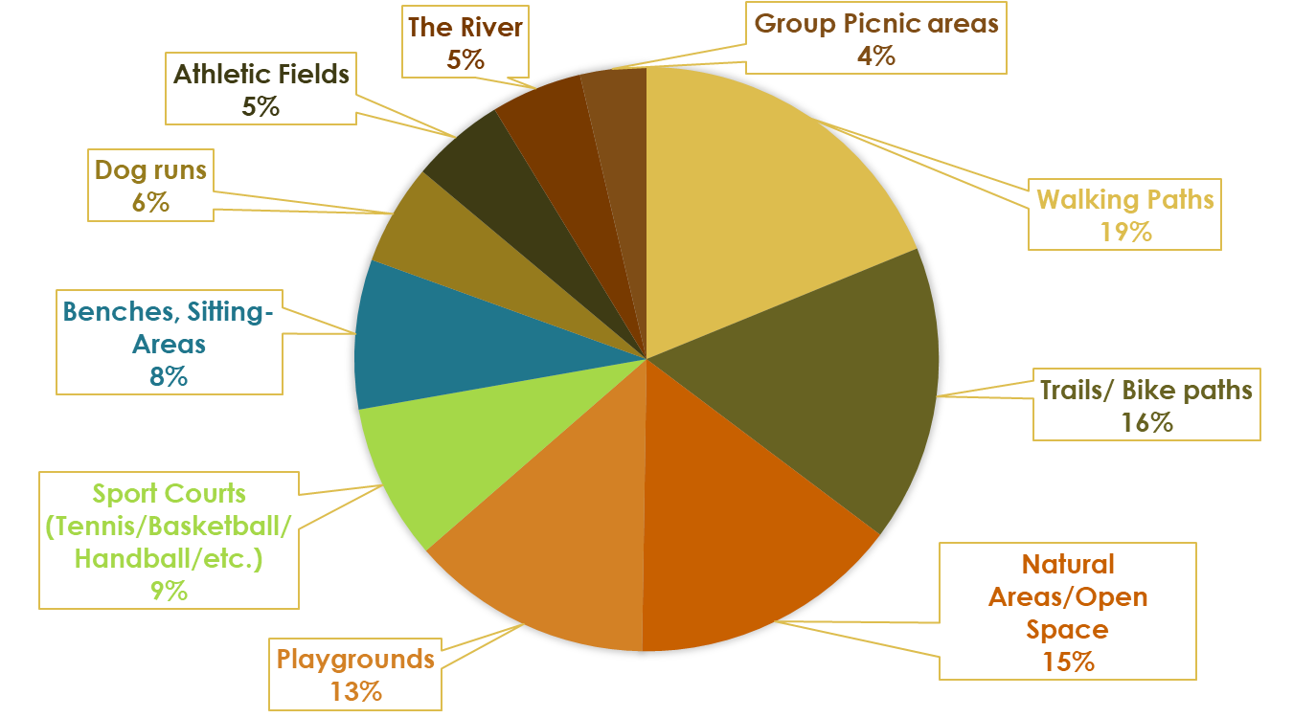
What park features to you use most often?
Notes:
Benches were more important to this group, and the river was slightly more important and both groups favored walking paths and playgrounds. The hand written responses favored the trails and bike paths less than the online group.

Slide 3
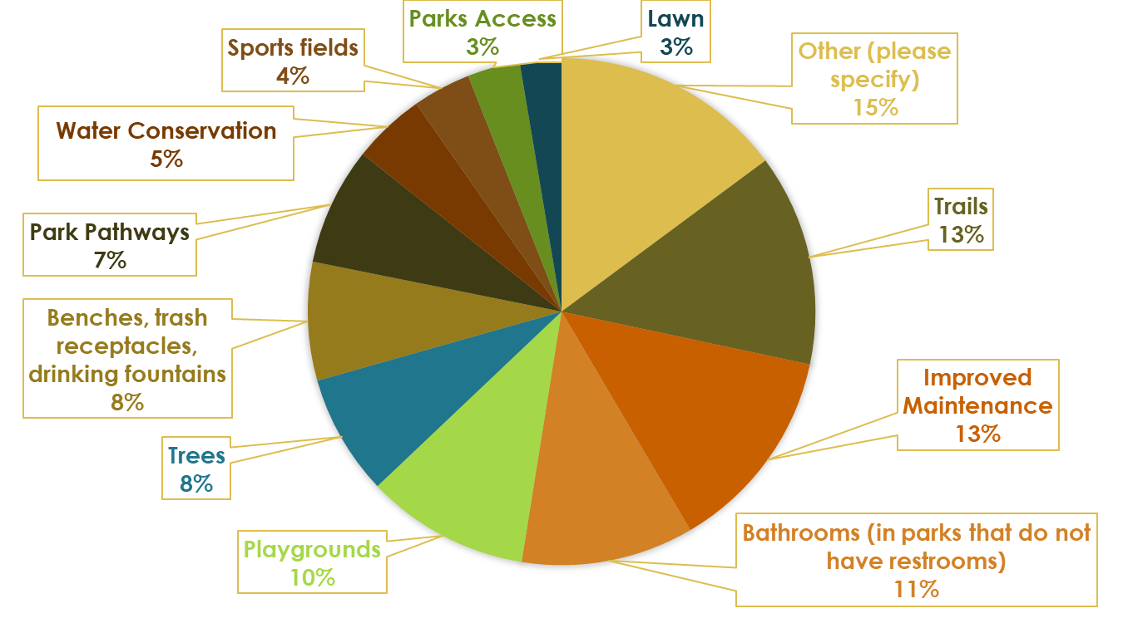
What park amenities or recreation features would you like to see most improved in Petaluma?
Notes:
Bathrooms, Benches and water conservation were highly favored by the write in group, whereas the online group favored trails and sports fields

Slide 4
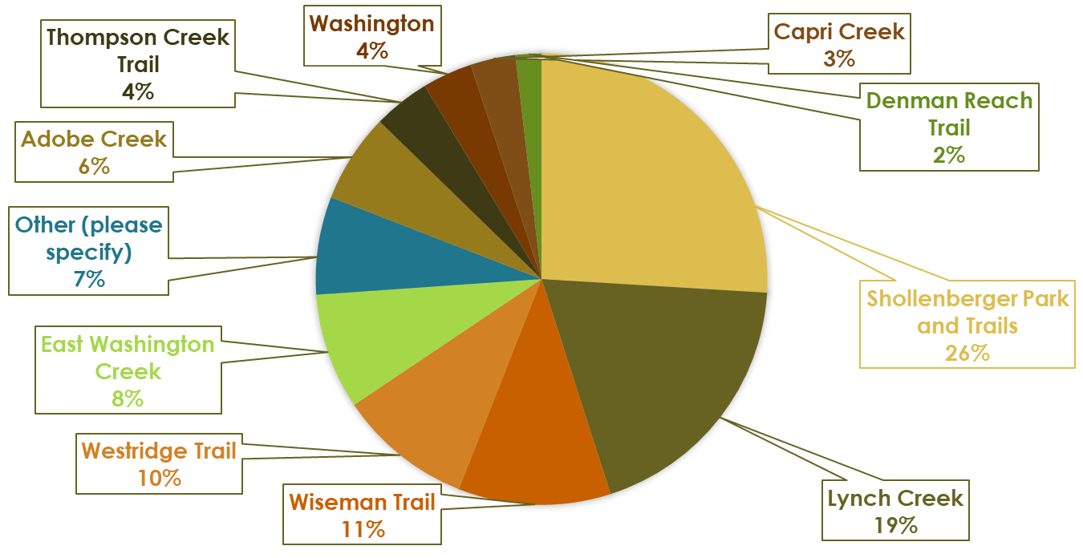
What pathways do you currently use or would use if improved?
Notes:
Schellenberger and Lynch creek were favored by both groups. This group seemed to favor east Washington creek and adobe creek slightly more than the write in group

Slide 5
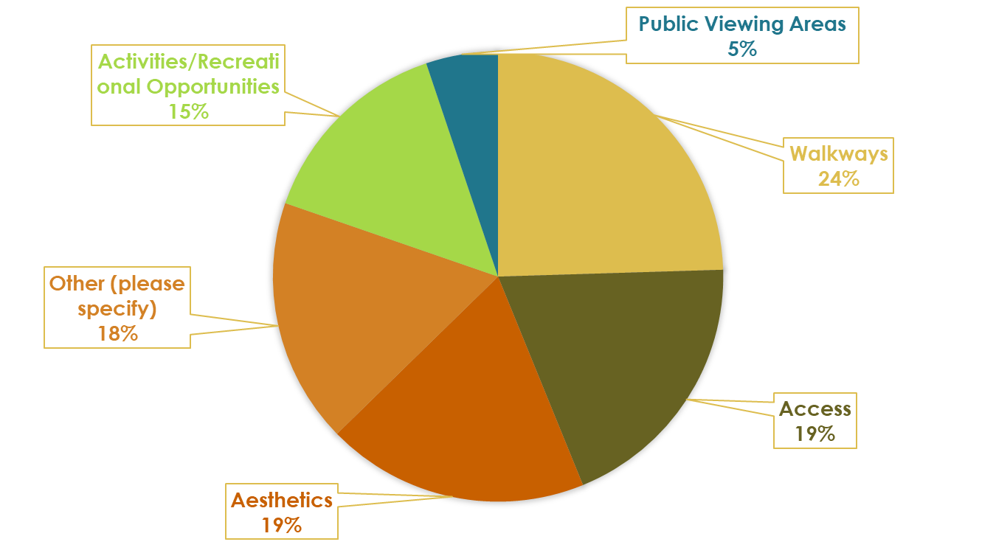
What about the River would you most like to see improved?

Slide 6
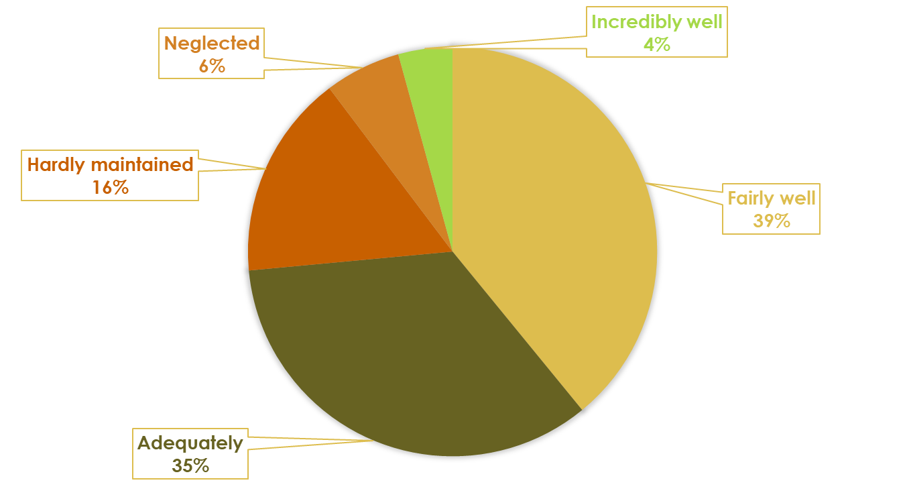
How well are the parks you visit maintained?

