Slide 1
Goals & Priorities
Prioritizing our 2-year workplan
February 26, 2024
Notes:
Tonight staff are excited and duly prepared to discuss the City Councils Goals and Priorities for the next two fiscal years. As is the City Council's practice, annually we review and prioritize goals and priorities in alignment with our budget cycle, to ensure the workplan is set for the new fiscal year on July 1.

Slide 2
Considerations for Tonight
Goal for tonight: establishing the priorities for FY 24/25 & FY 25/26
Are these the correct initiatives?
Did we miss anything?
Is anything no longer a priority?
Within the categories, what is the preferred order of implementation?
Notes:
Tonight, our goal is to come away with a clear set of objectives that staff can then prepare proposed timelines, outline budgets, and identify other resources necessary to complete each initiative to return to Council and the community on April 15 for further consideration. This will also allow time for community outreach and solicit feedback from our commissions and committees.

Slide 3
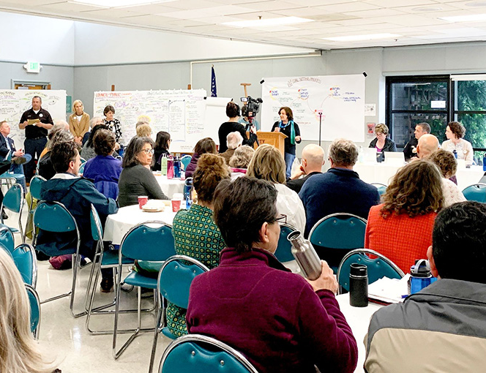
Background
2019 Goals & Priorities
2021 Review / Refine
2022 Top 10 Initiatives
2023 Priority Workplans Identified
2024 Categorization and Prioritization – with Updated Workplans
Notes:
our historic G&P setting in 2019—which provided us a roadmap of our community's vision for Petaluma) if you were with us at that workshop, then you are familiar of our evolution, which resulting in 256 priorities; whittled that down to 157 priorities; in 2022, we landed on a top 10 to focus our efforts and continued that second year of our workplan in 2023.
Because of the work we are undertaking to address the many deferred and future needs of this City, and because most of that work is non-discretionary—meaning we are required either by law/regulatory reqs, immediate public health and safety, our discretionary time is negligible. Thus we are a City in need of careful and thoughtful prioritization, to ensure our precious resources—our people power, city funding—are effectively and efficiently utilized to the maximum benefit of our community. Our City has never been stronger and more fiscally & organizationally sound than it is now—and our focus should be on doing a few things really well and knocking it out of the park, rather than diluting our efforts and taking too long to achieve what can and needs to be done now. That is what tonight is about. To make those thoughtful decisions, knowing that we have all the ingredients we need for success: people-powered Petaluma

Slide 4
MEASURING UP TO CITY GOALS
 | A CITY THAT WORKS | A SAFE CITY THAT THRIVES | OUR ENVIRONMENTAL LEGACY | AN ECONOMY THAT PROSPERS | SPACES AND PLACES THAT INSPIRE
DEI & POLICE OVERSIGHT
RETAIL CANNABIS
ELECTRIFICATION PLAN
TENANT PROTECTIONS
FAIRGROUNDS TRANSITION
PUBLIC SAFETY FACILITIES
INTERGRATED PEST MGMT PLAN
TREE PRESERVATION ORDINANCE
TRESTLE
SAFE MOBILITY & CONNECTIVITY
Notes:
These are our current top 10 priorities organized by our 5 overarching goals. Tonight we will discuss these priorities, there status, and other initiatives that require City focus over these next two years.

Slide 5
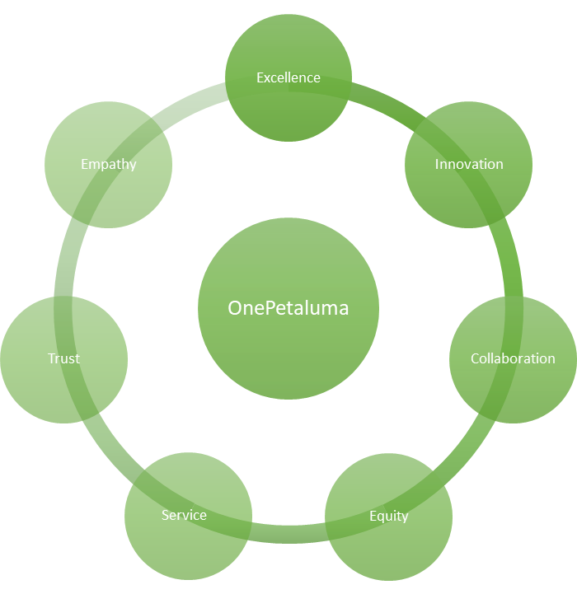
OnePetaluma – Our City’s Values
Notes:
'OnePetaluma' emerges from a collaborative staff leadership retreat held in November 2023, reflecting a unified vision for our City—that everything we do is integrated with our community. One Petaluma crystallizes the values of Empathy, Equity, Innovation, Collaboration, Trust, Service, and Excellence, carefully shaped by our leadership and executive teams—While initiated by staff, 'OnePetaluma' is intended to embody the aspirations and spirit of our entire community. Rather than a laundry list of tasks to complete, staff envision OnePetaluma as a comprehensive set of Mission / Vision / Values to guide our organizational culture, our interactions, our customer service, and ultimately how we deliver city services.to ensure that our actions and priorities align with these foundational principles, fostering a cohesive and value-driven approach to serving Petaluma. Soon to follow will be an integrated Mission and Vision that we will work with Council to develop over the next year.

Slide 6
EVOLUTION OF A POLICY / PROGRAM / PROJECT
OUTREACH / EDUCATION
RESEARCH
POLICY / DESIGN
VISION / INTENT
IMPLEMENTATION
OPTIONS
DIRECTION
OUTREACH / ENGAGEMENT
Notes:
As we develop our workplan for the next two years, we always consider how best to deliver. What departments will be lead, what resources will be required, what other initiatives can be piggybacked on or are required prior to starting the work, and what, if any, unintended consequences exist. The most important questions we can ask is what are we trying to solve, who benefits, and is the outcome measurable, achievable, and sustainable?

Slide 7
OUR GOALS – REALIGNED
CAPITAL PROJECTS
LEGISLATIVE
PROGRAMS, POLICIES, PLANS
ORGANIZATIONAL HEALTH
Notes:
In a response to our evolving needs and the insights garnered from 'OnePetaluma', we've realigned our priorities. Staff also felt that we needed to better reflect the actual type of work that staff are accomplishing by incorporating many of the critical initiatives that are ongoing (or will be achieved in the next few years) rather than artificially limiting the focus to a Top Ten. we have established four categories of initiatives, which we will discuss with the Council tonight, these are:
Not all priorities are created equal. While we will discuss some of our capital projects tonight, our goal is to prioritize all capital projects holistically and as part of the Capital Improvement Plan discussion in May.

Slide 8
CAPITAL PROJECTS*
Original Top 10
Smart-owned Trestle
Public Safety Facilities Plan
Additional
Caulfield Crosstown Connector
Primary Influent Pump Station
Safe Streets / Pavement
*Capital projects are and should be prioritized with like projects within the CIP budget. The budget workshop in May will present the 24/25 updated CIP. Staff recommend decoupling CIP from the top ten priorities to ensure informed prioritization of all projects in the 5-year CIP plan.
Notes:
In each of these categories, we have added additional projects that we are currently working on that should be considered this evening as we prioritize
Even though these weren't called out in the top 10, they are nevertheless essential and command significant staff time and resources, and have lasting benefits for our community

Slide 9
LEGISLATION / POLICY
Original Top 10
Retail Cannabis Regulations
Additional
Zoning Ordinance Update
Tree Preservation Regulations
Tenant Protection Regulations
Parking Ordinance Update
Housing Element Implementation
Parking Management
Charter Amendments
Urban Growth Boundary

Slide 10
POLICIES, PROGRAMS, PLANS
Original Top 10
Fairgrounds
Additional
General Plan
Integrated Pest Management Plan
Downtown Investments / Beautification*
Open Space Acquisition
Active Transportation Plan
Electrification Plan (Now Blueprint for Carbon Neutrality)
*Investments also reflected in CIP project

Slide 11
POLICIES, PROGRAMS, PLANS (CONT.)
Original Top 10
Additional
Plan to End Homelessness
Sea Level Rise
Petaluma North Specific Plan
City Hall – West Wing Utilization

Slide 12
ORGANIZATIONAL HEALTH
Original Top 10
Police Oversight
Additional
Diversity, Equity, Inclusion & Belonging (Separated from Police Oversight)
Organizational Development
Enterprise Resource Planning Software
Strategic Plan
Purchasing Regulations / Policy and SOP Update

Slide 13
Considerations for Tonight
Goal for tonight: establishing the priorities
Are these the correct initiatives?
Did we miss anything?
Is anything no longer a priority?
Within the categories, what are the top priorities?

Slide 14
For Next Meeting--April 15
Staff to develop:
Clear list of priorities based upon Council feedback
More detailed workplans for FY 24/25 and FY 25/26 including resources required & timelines
Staff recommendations for implementation
Council to consider final priority list
Budget workshop in May 2024 (including 5-year Capital Improvement Plan)
Once goals are approved – quarterly updates to Council and Community

Slide 15
Feedback & Next Steps
Notes:
We realize that this may be a bit anticlimactic, but because of the large amount of staff effort that has gone and is still going into completing these initiatives, we recommend continuing to see these initiatives to fruition before taking on any major new discretionary initiatives.

