Slide 1
South sound 911 overview
Ruston City Council
October 4, 2022

Slide 2
WHO WE ARE

Slide 3
SOUTH SOUND 911
PUBLIC SAFETY ANSWERING POINT (PSAP) Police, fire, and medical Serving 38 agencies in Pierce County
911 PROGRAM OFFICE
RECORDS AND TECHNICAL SERVICES

Slide 4
OUR JOURNEY

Slide 5
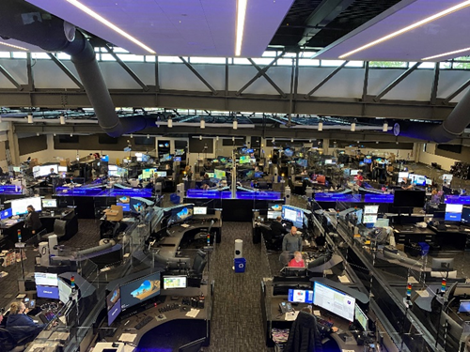
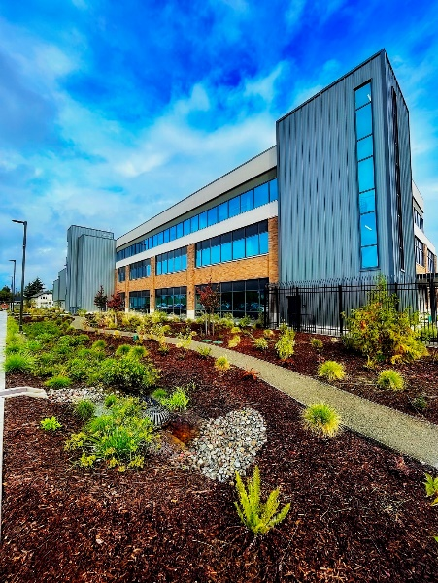
SOUTH SOUND 911 HISTORY
2010
Six 911 Centers
2011
Proposition 1
2012-2021
Law Enforcement Support Agency (LESA) became South Sound 911
Strategic study conducted
Call processing
Governance
Radio systems
Facility completed at 3580 Pacific Ave.
-VISION REALIZED!

Slide 6
BOARD OF DIRECTORS

Slide 7
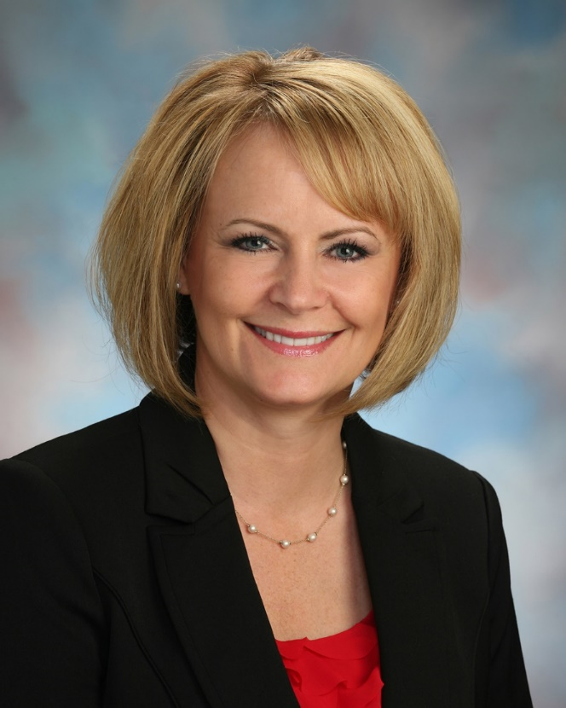
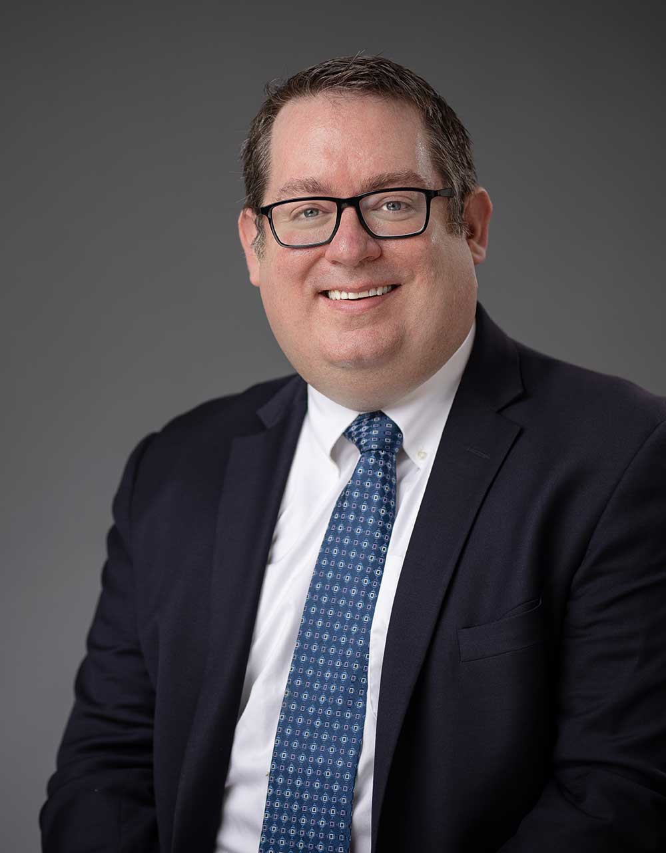
Julie Door, Board Chair
City of Puyallup Councilmember
Derek Young, Board Vice-Chair
Pierce County Councilmember

Slide 8
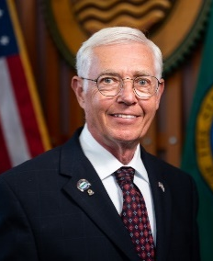
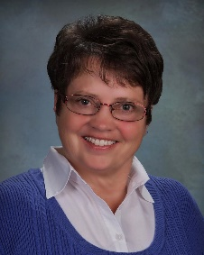
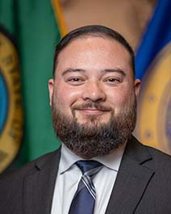
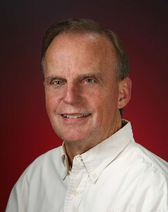
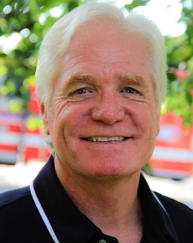
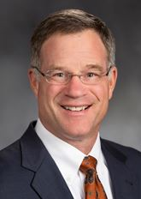
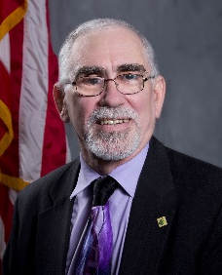
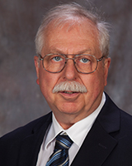
BOARD OF DIRECTORS
Michael Brandstetter
City of Lakewood Councilmember
Kathy Hayden
City of Sumner Mayor
Sarah Rumbaugh
City of Tacoma Councilmember
Joe Bushnell
City of Tacoma Councilmember
Matt Holm
CPF&R Commissioner
Pat McElligott
EPF&R Commissioner
Bruce Dammeier
Pierce County Executive
Pat Hulcey
City of Fife Councilmember
Dan Rankin
WPF&R Commissioner

Slide 9
BOARD OF DIRECTORS
Board members are elected officials with representation that is reflective of the agency’s customer base. Seats on the board are allocated among South Sound 911’s member agencies based on the relative size of the most recently approved annual Communications Assessments payable by member agencies. Board members are appointed for three-year terms and there are no term limits.
Responsibilities of the Board of Directors include:
Confirm appointment of executive director
Approve contracts over $50,000
Ratify collective bargaining agreements
Adopt annual budget (including cost allocation formula)
Authorize capital projects
Direct policy and strategic objectives

Slide 10
WHAT WE DO
Operations &
Support Services

Slide 11
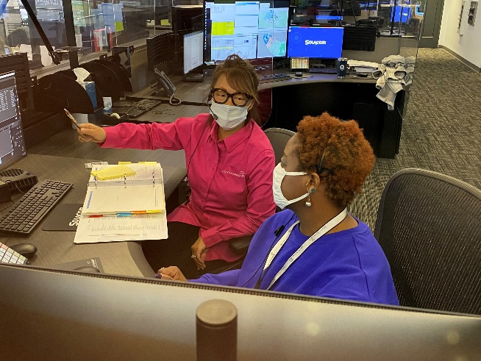
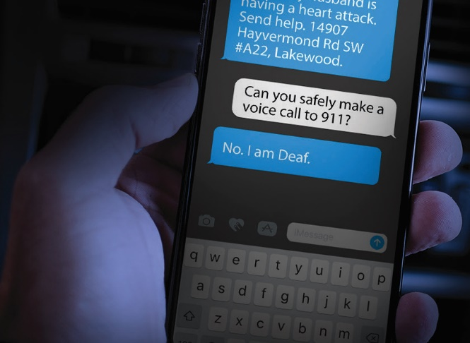
OPERATIONS
911 and non-emergency call processing
Text-to-911
Primary radio dispatch – police, fire, and medical
Protocols set by partner agencies
Secondary radio – data dispatch
Communication Center telephone reports

Slide 12
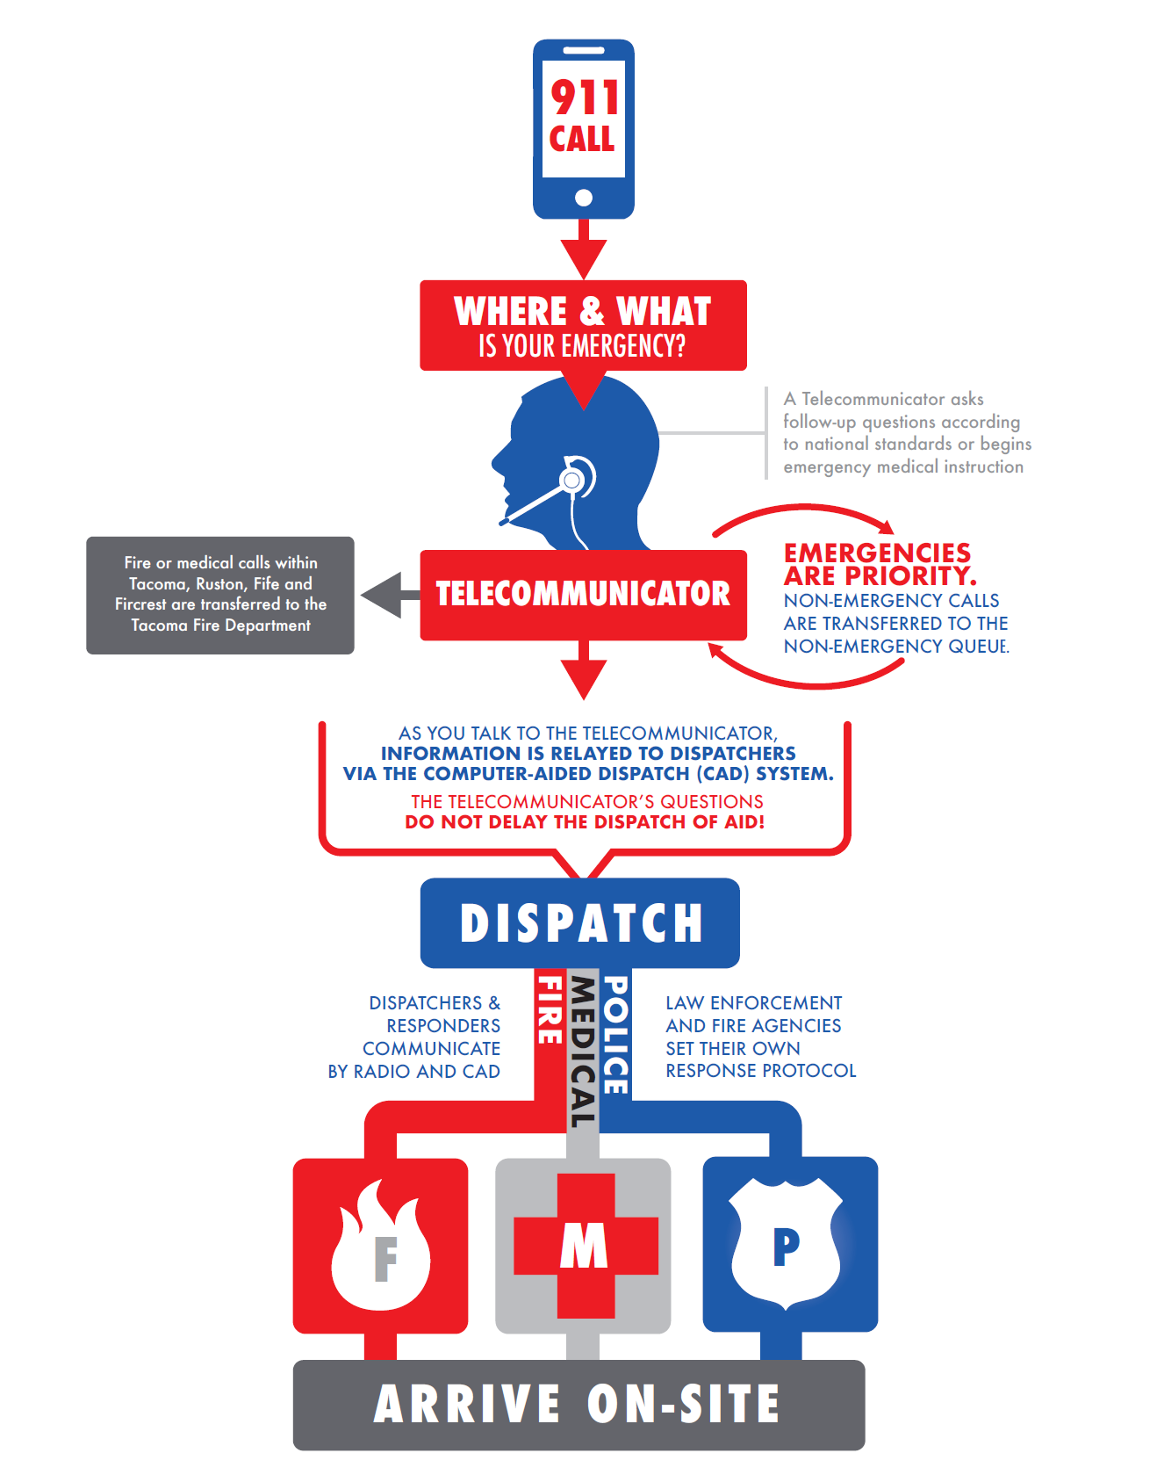

Slide 13
SOUTH SOUND 911 – CALL TAKING & DISPATCH
2017
2018
2019
2020
2021

Slide 14
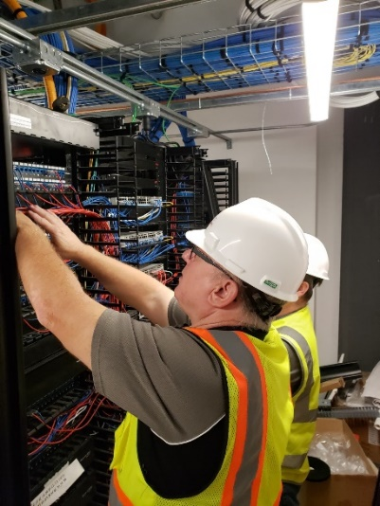
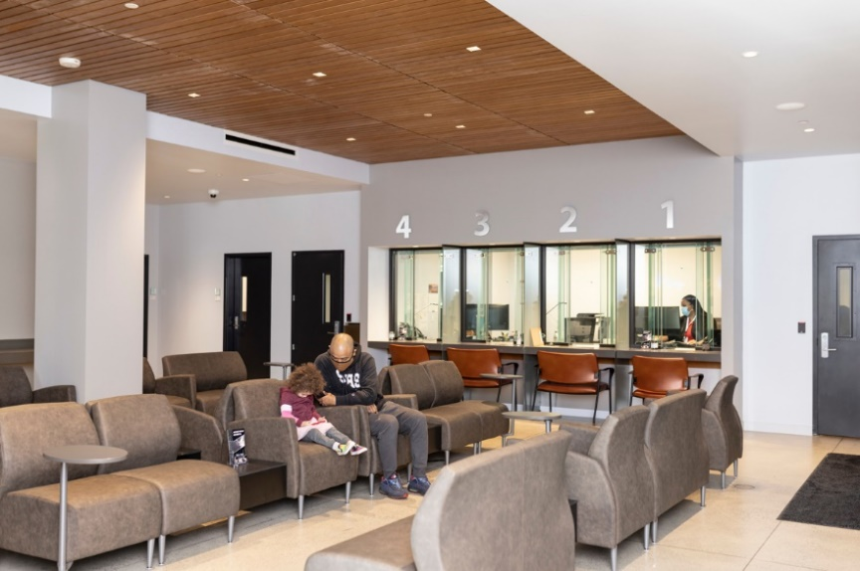
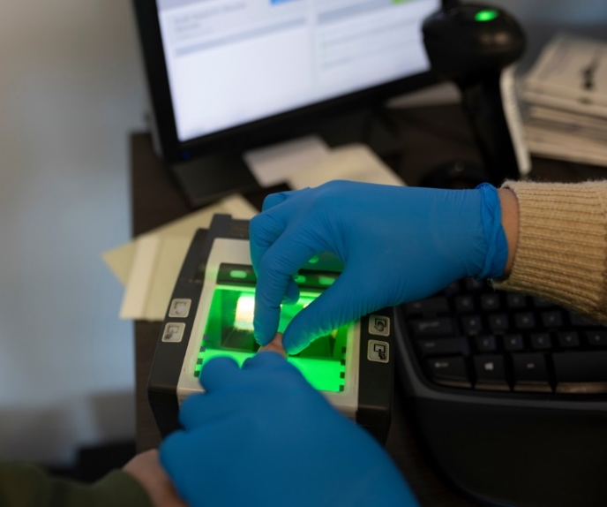
SUPPORT SERVICES
Records Department
Public counter
Law enforcement records
Technical Services

Slide 15
FINANCE
&
HUMAN RESOURCES

Slide 16
BUDGET & FINANCE
57% - Ops
25% - Radio Debt
18% - Facility Debt

Slide 17
BUDGET & FINANCE

Slide 18
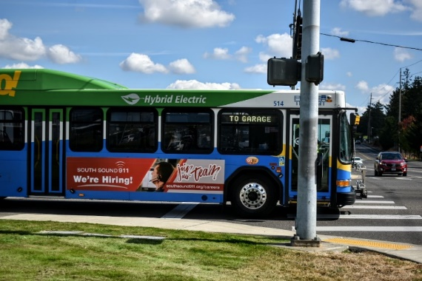
PERSONNEL & RECRUITMENT
Current Employee Count 230
Budgeted 245

Slide 19
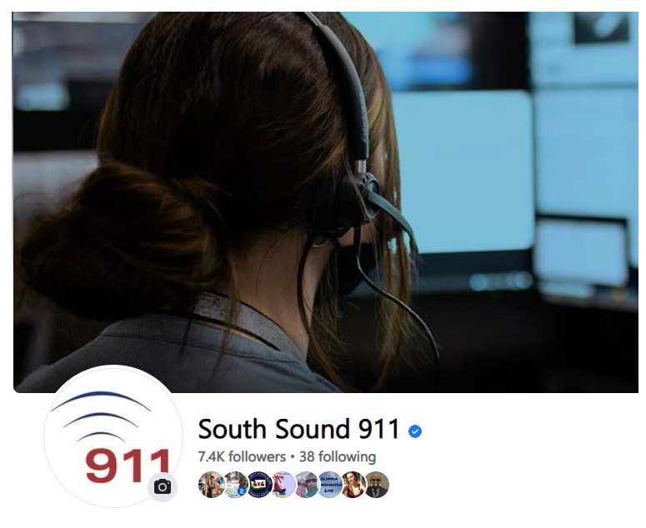
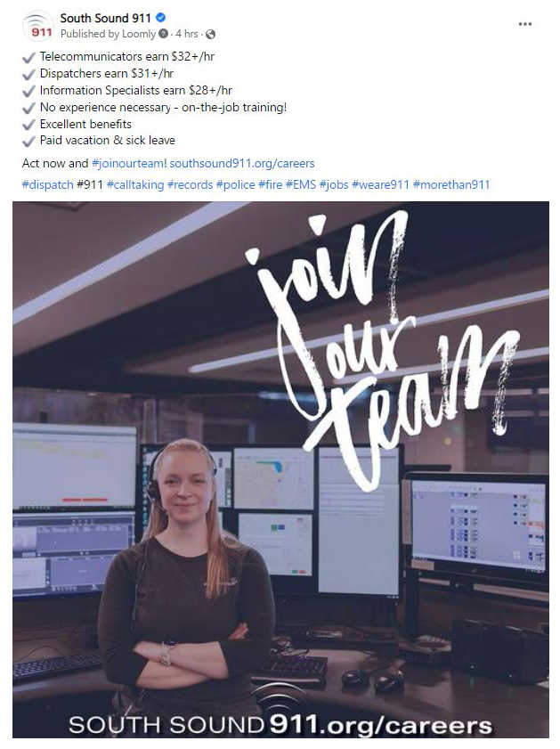
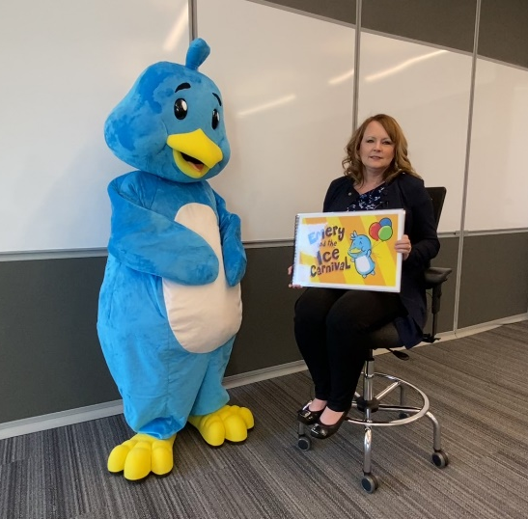
COMMUNITY RELATIONS
Social Media
@SouthSound911 (FB & Twitter)
@OfficialSouthSound911 (IG)
Media Relations
Website
911 Education
Volunteer Program

Slide 20
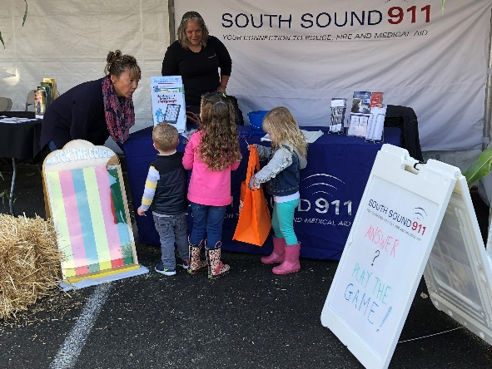
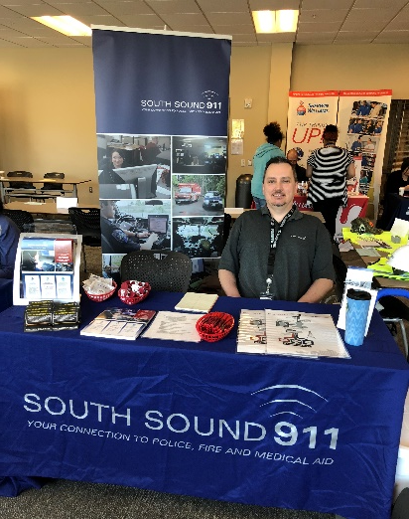
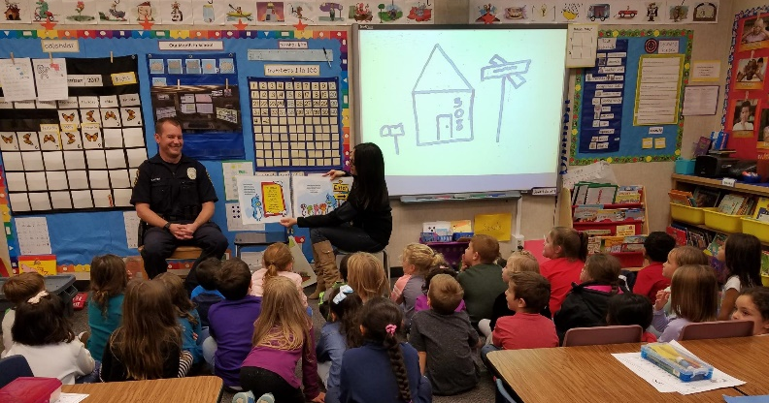
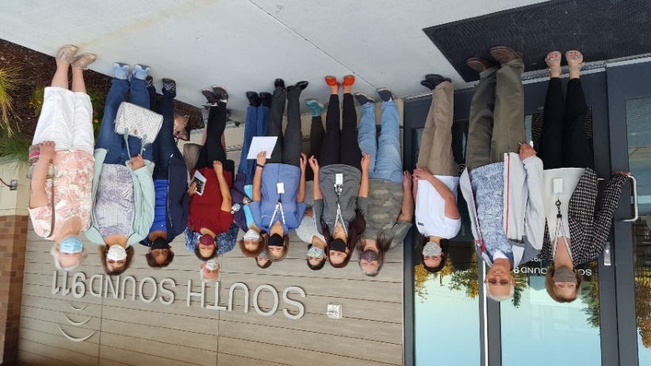
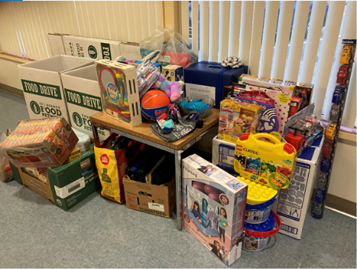
COMMUNITY INVOLVEMENT
Community Relations Team
Educational speaking engagements, tours, event reps, Safe Streets partner
South Sound 911 Cares
Employee-driven charitable giving

Slide 21
OUR FUTURE

Slide 22
THE FUTURE OF SOUTH SOUND 911
RECORDS MANAGEMENT SYSTEM (RMS) REPLACEMENT | NEXT GENERATION (NG) 911
REGIONAL COLLABORATION FOR OUTAGES | 988 AND CRISIS CALLS
REMODEL OF 35TH STREET BACKUP FACILITY | PATH TO A SINGLE RADIO SYSTEM - JUNE 8, 2022 – RETREAT - SEPTEMBER 14, 2022 – STUDY SESSION

Slide 23
QUESTIONS?

