Slide 1

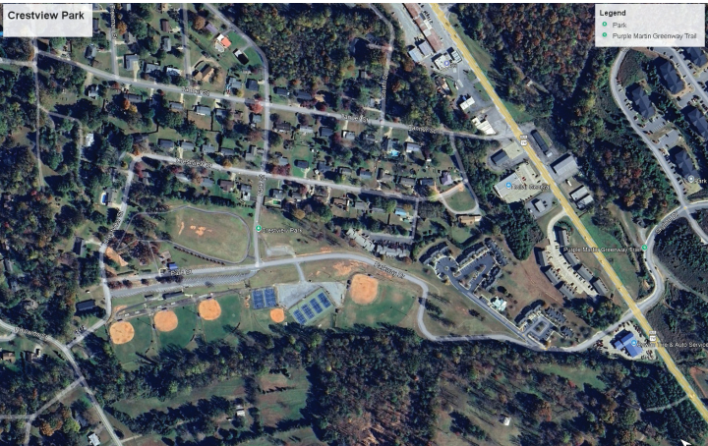

INSERT PHOTO
Town of Rutherfordton, NC
Crestview Park Master Plan
Design Direction: PARC Committee and Public Meeting June 2, 2026
Town Council Workshop and Town Council Public Meeting June 3, 2026

Slide 2
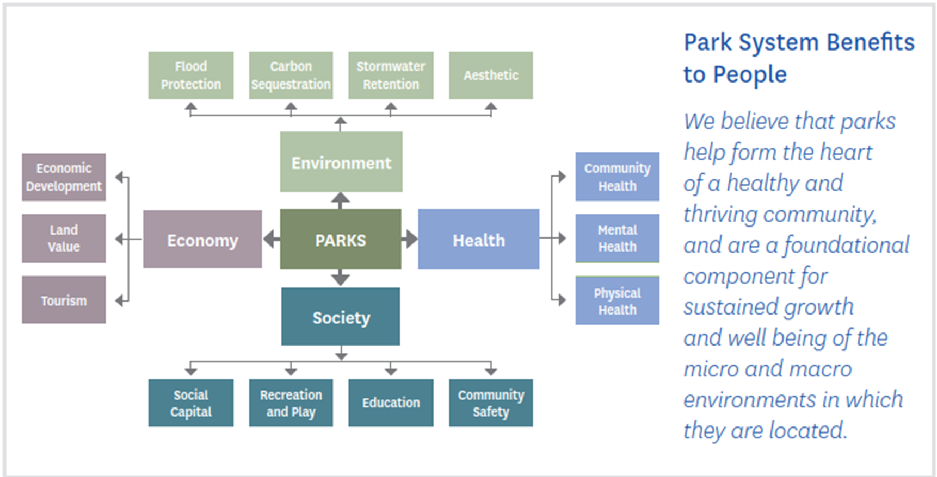

Slide 3
Project Goals
Develop a site-specific park master plan in accordance with NC Parks and Recreation Trust Fund (PARTF) standards for Crestview Park.
With funding from the RHI Legacy grant, the town plans to develop a site-specific master plan for Crestview Park, laying the groundwork for phased improvements and future state and federal funding opportunities.

Slide 4
Crestview Park Site-Specific Master Plan Schedule
Phase 1. Direction Setting, Research, and Analysis
Phase 2. Preliminary Design and Public Input
Phase 3. Final Master Plan Presentation – July 2026

Slide 5
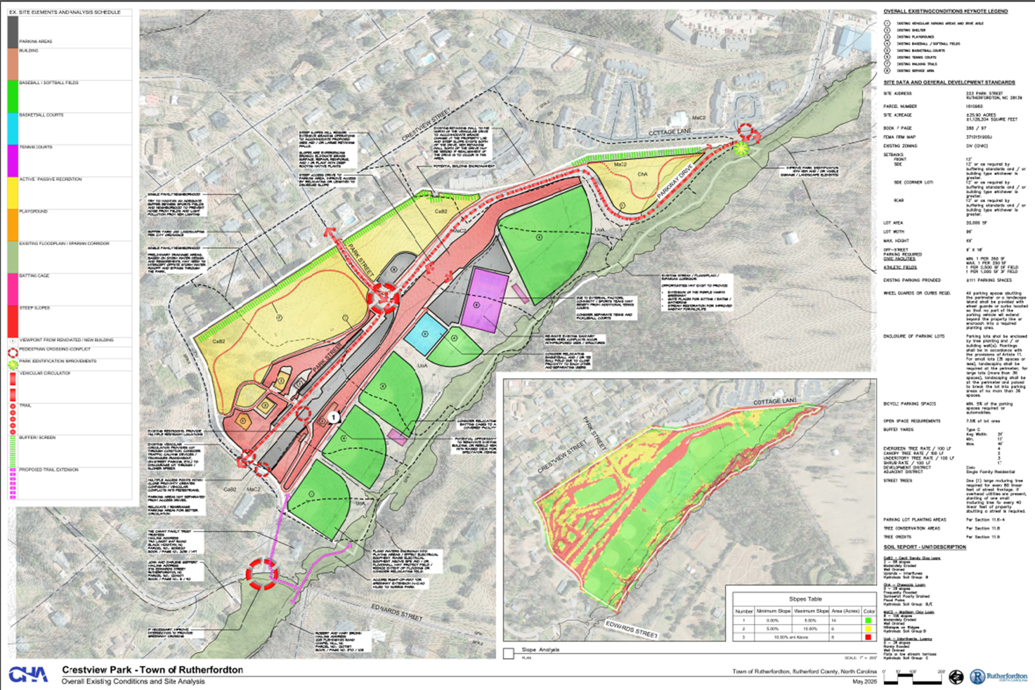
Current Conditions

Slide 6
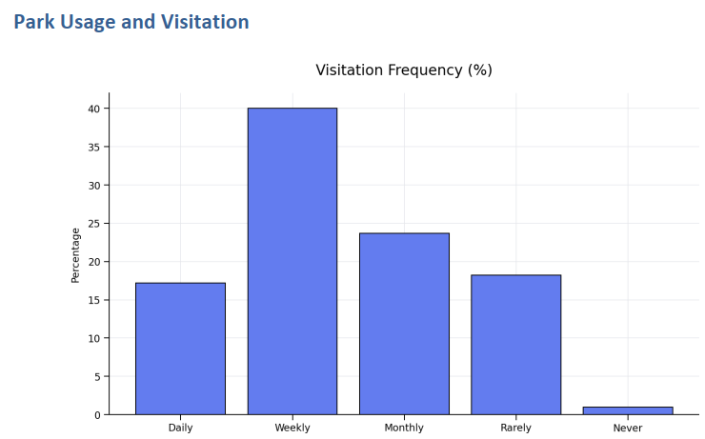
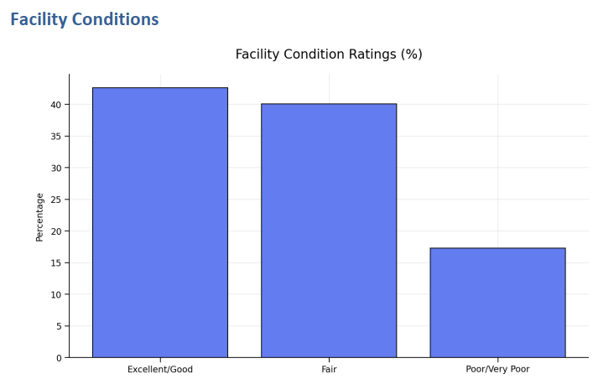
Community Input - 526 Respondents!
57% of respondents visit Crestview Park at least weekly
Over half of respondents rated facilities as fair or worse,
indicating a clear need for reinvestment.

Slide 7
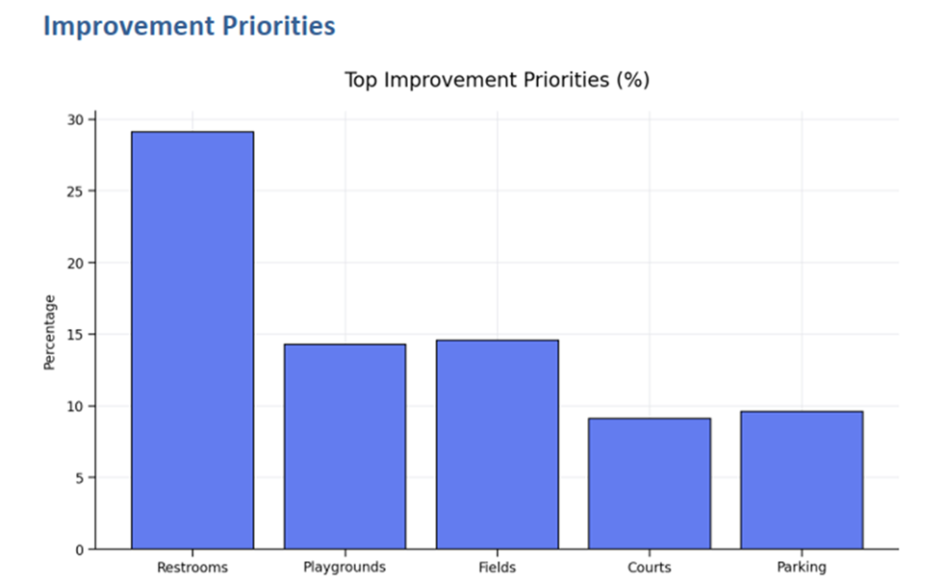
Community Input – Community Needs Identified
Upgraded and additional restrooms, including improved cleanliness and accessibility.
Reconfigured and expanded parking to address congestion and pedestrian safety.
Investment in baseball and softball fields, including surfaces, dugouts, lighting, and seating.
Improved accessibility through ramps, safer steps, and inclusive playground design.
Additional shade, seating, water fountains, and bottle-filling stations.
Better separation of conflicting uses (e.g., basketball courts near T‑ball fields).

Slide 8
Community Input – Key Findings
Walking/running, playground use, and youth baseball/softball most common activities.
Restrooms and parking were identified as the single most important improvement need.
A strong majority (58%) support Crestview Park remaining a balanced park serving both sports and general recreation.
Safety concerns are present, with most users reporting they feel safe only when others are present.
Parking congestion creates safety concerns during peak sports usage.
Baseball and softball facilities remain a cornerstone of community use.
Accessibility for people with physical and developmental limitations was rated significantly lower than for children.

Slide 9
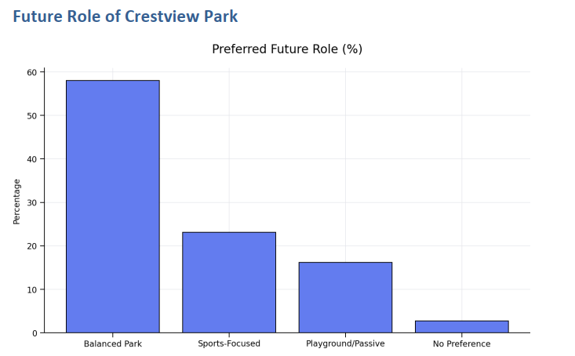
Community Input – Recommendations
Prioritize near-term capital improvements to restrooms, parking, and pedestrian circulation to address safety and accessibility concerns.
Implement a phased rehabilitation plan for baseball and softball facilities to support youth sports and tournament potential.
Enhance accessibility and inclusivity through ADA-compliant routes and universally designed playground equipment.
Maintain Crestview Park’s role as a balanced, multi‑use park serving organized sports, families, and passive recreation.
Continue proactive public engagement as designs and funding strategies are developed to ensure transparency and trust.

Slide 10
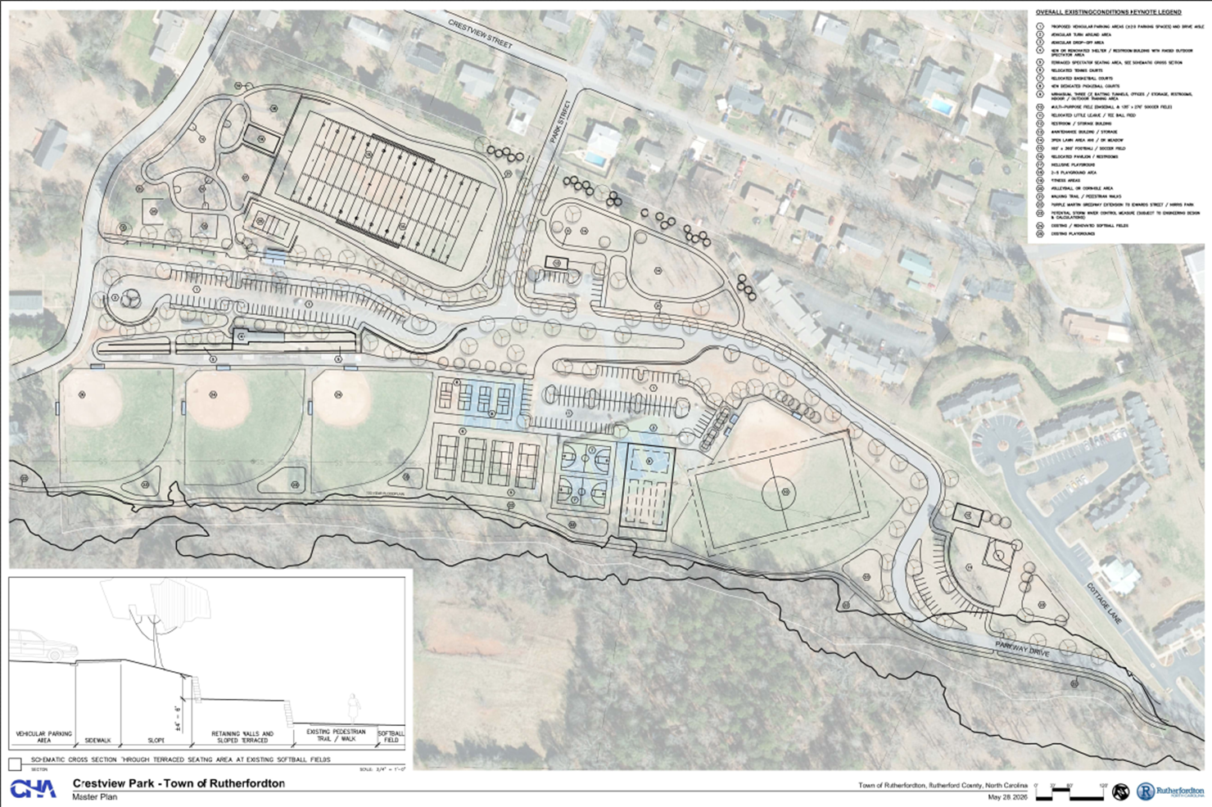
Proposed Concept

Slide 11
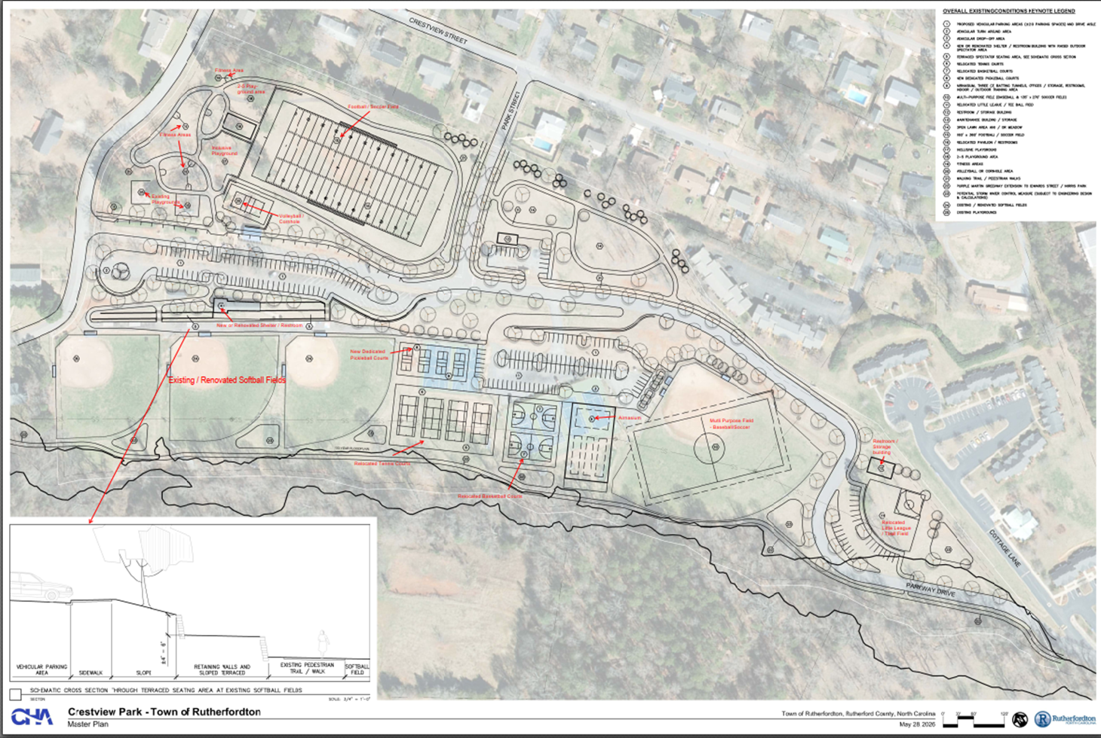
Proposed Concept (with call outs)

Slide 12
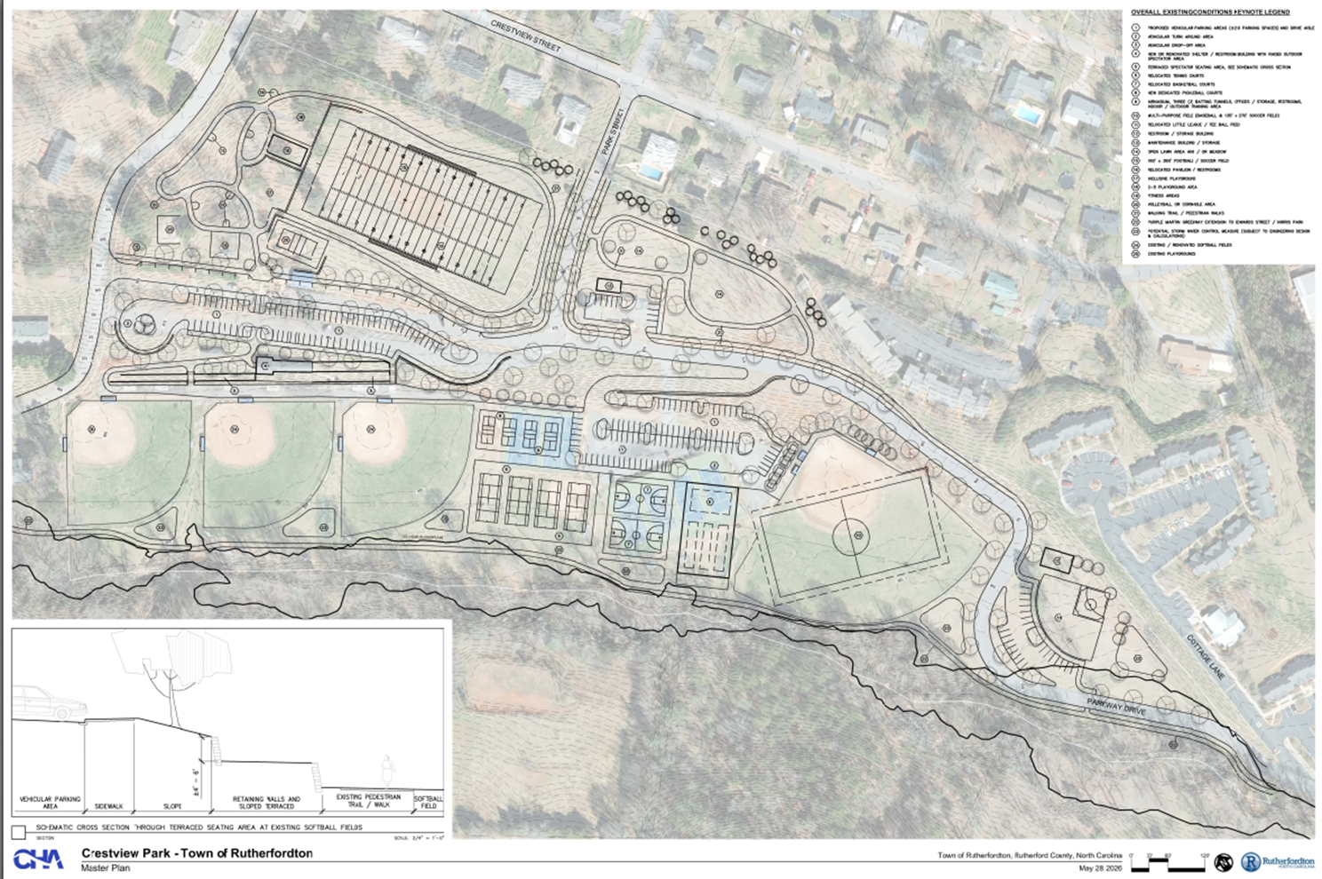
Proposed Concept (with topography)

Slide 13


Thank You - Open Discussion

