Slide 1
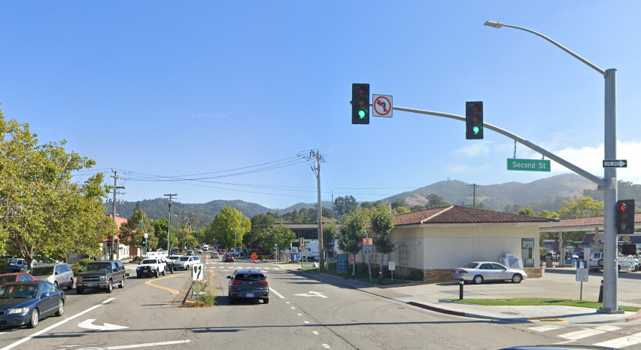
Grand Avenue Cycle Track Project Update

Slide 2
Project Overview
Create Cycle Track on Grand Ave (between 2nd and 4th Street)
New two-way protected bikeway & sidewalk (east side)
Extension to San Francisco Bay Trail
Connection to San Rafael Downtown, Transit Center, and Canal Neighborhood

Slide 3
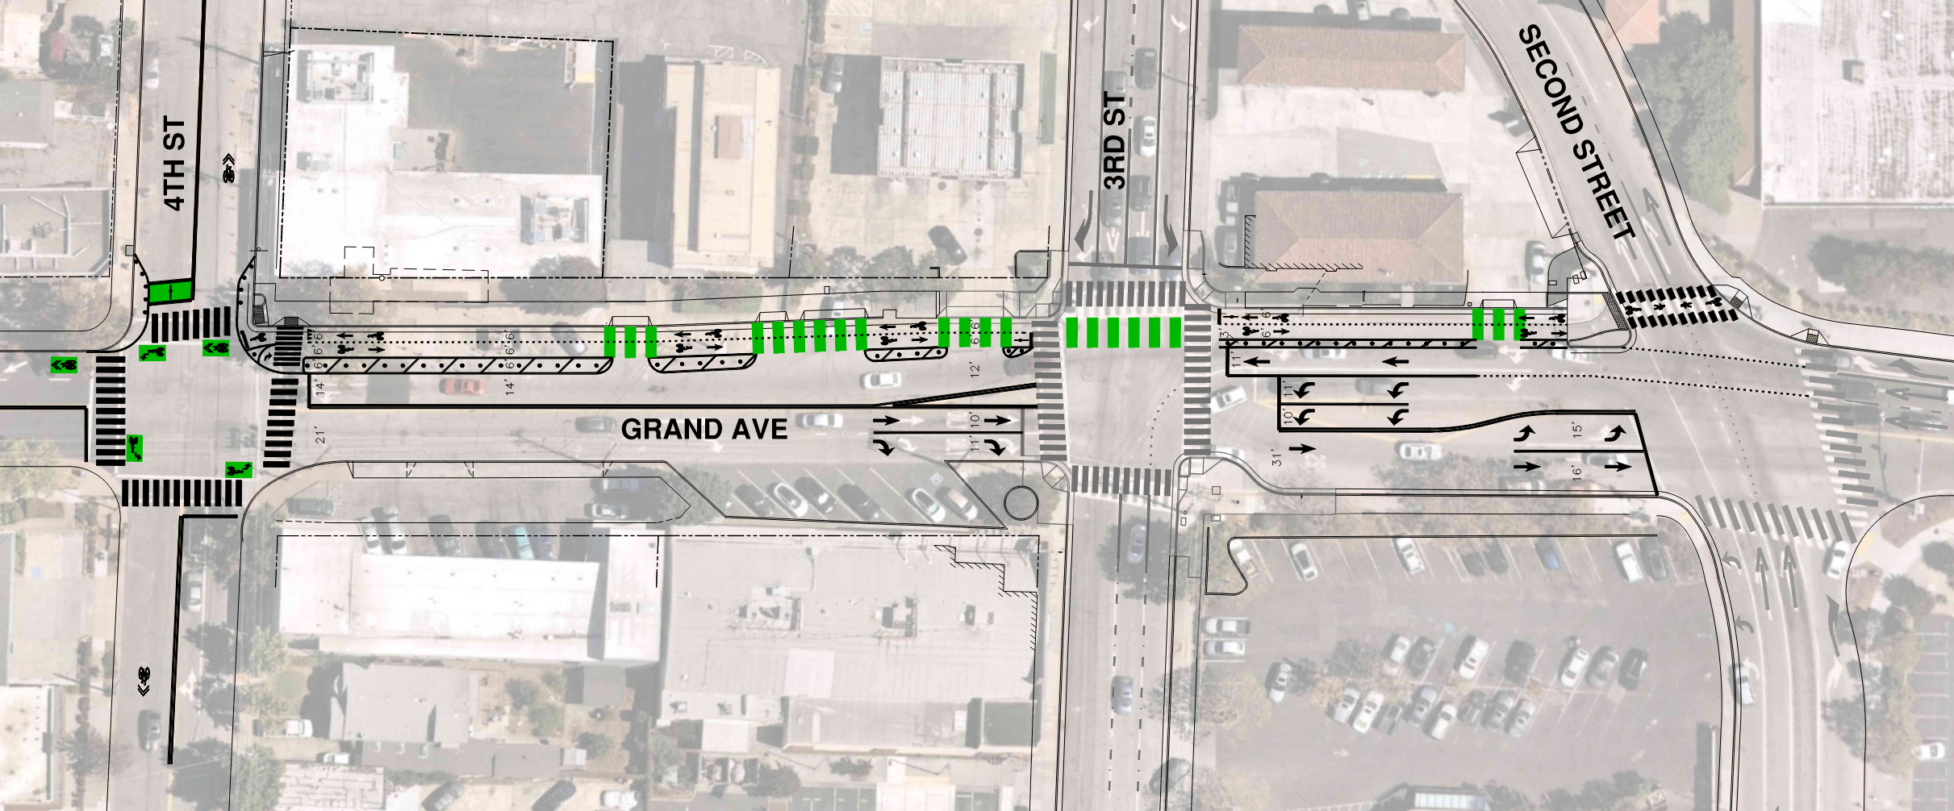
Design Update

Slide 4
Anticipated Timeline
Grant Funding Confirmed – 2022
~$560,000 for Construction
BPAC Update – Feb 2023
Public Outreach – Feb/March 2023
Final Project Documents – Spring 2023
Construction – Summer 2023
Requires coordination with active construction projects

Slide 5
For Project Updates, please visit:
https://www.cityofsanrafael.org/grand-ave-cycle-track/
RECOMMENDED ACTION:
Receive public feedback and accept informational report.

Slide 6
Design Update

