Slide 1
City of Santa Ana Planning Commission
March 6, 2025 at 6:30 p.m.
Join us online at https://santa-ana.primegov.com/public/portal

Slide 2
Background
Tonight’s meeting is a special meeting, continued from the February 24, 2025 meeting, to discuss the Transit Zoning Code (SD-84) Proposed Ordinances
Project Components include:
    Map Change (removal of the M1 and M2 industrial overlays)
    Adoption of Nonconforming Provisions and Operating Standards
    Updates to Permitted Uses
    Adoption of a New Amortization Section

Slide 3
Presentation Overview
At the February 24th meeting, the Planning Commission received a staff presentation, posed questions, opened and closed the public hearing, and continued the item to tonight’s special meeting.
Following deliberation, the Planning Commission directed staff to complete the following deliverables and report back to the Planning Commission:
  Hold an additional community meeting with businesses and owners, and Feb. 24th public hearing attendees, to identify areas of commonality and compromise on the proposed amendments
  Provide financial information on possible effects of the ordinance on City revenues
  Provide a legal analysis on potential challenges

Slide 4
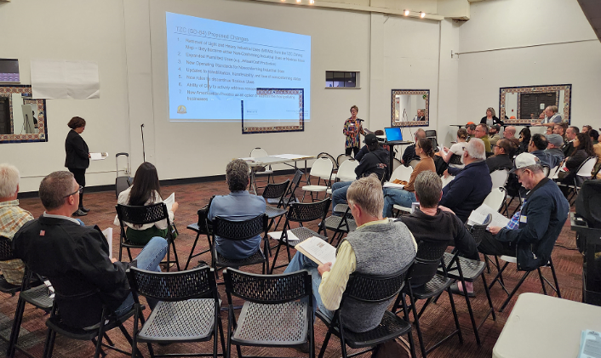
Community Meeting - March 3, 2025
Outreach
  Direct contact via emails to individuals and personal phone calls to those without email
  Voice message and email reminders
  Spanish interpretation services
Attendance
  120 people comprising residents, businesses, property owners, real estate brokers, community organizations, and elected official staff
  Approximately 58% businesses and 36% residents

Slide 5
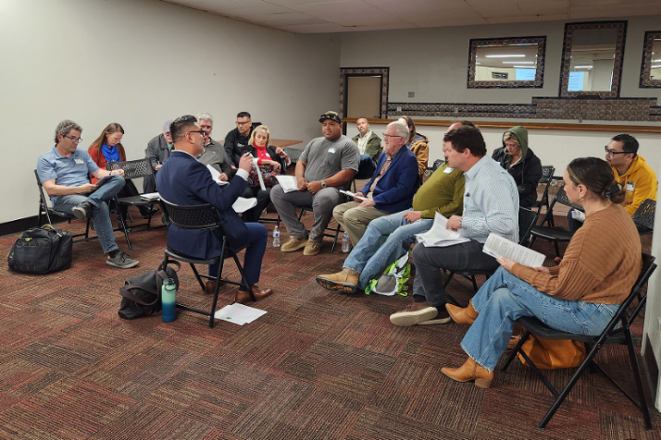
Community Meeting - March 3, 2025
Small Group Discussions
  Randomly-assigned small groups
  Seven small groups, including one with Spanish-speaking participants
  Focused on identifying areas of agreement between residents and businesses
Outcomes
  Consensus on addressing impactful businesses
  Disagreement on land use changes for resulting from proposed amendments
  Feedback on hours of operation, “legal” nonconforming use, definitions

Slide 6
Financial Information
Fiscal data is for general information, not a definitive impact analysis
Information reflects businesses that would be legal nonconforming industrial businesses in the TZC (SD-84)
Revenue details are aggregated to protect individual business privacy
Actual fiscal impact varies due to economic changes and business operations
Data sources based on City's Business Tax, Sales Tax, Property Tax, and Utility Users’ Tax (2023-2024)

Slide 7
Financial Information
Financial Data Source | Fiscal Information Reported
1. Business Tax | Calendar Year 2024 $136,233
2. Sales Tax | Fiscal Year 2023-24 $211,400
3. Property Tax | Fiscal Year 2024-25 $65,400 (Projection)
4. Utility User’s Tax (UUT) | Fiscal Year 2023-24 Water: $8,177 Gas & Electric: aggregate data expected in April 2025

Slide 8
Legal Analysis
City Attorney’s Office provided a Confidential Memorandum to the Commission summarizing legal questions
Information is considered client-privileged and confidential due to litigation risk

Slide 9
Clarifications to the ZOA
Staff has incorporated feedback received from busineses and residents at the March 3rd community meeting through the following changes to the proposed ordinance found in Exhibit 2
  Hours of Operation: staff no longer proposes any changes to the existing Transit Zoning Code that address hours of operation
  Definition of “Legal Nonconforming Use” and “Nonconforming Use”: staff has added a clarifying clause to the definition of “Nonconforming Use” stating that it has the same meaning as “Legal Nonconforming Use.”
  Definition of “Craft and specialized automotive restoration service” has been fine-tuned per Commission and community feedback.
Clarifications also include changes that address typographical errors related to numeric/alphanumeric labeling of sections and subsections and clerical errors.

Slide 10
CEQA and Fiscal Impact
ZOA No. 2024-02 and AA No. 2024-03 are considered a project as defined by the CEQA. The City, as the Lead Agency, has determined that it is subject to CEQA guidelines and regulations (Public Resources Code (PRC) Sections 21000-21177). An Addendum to the Transit Zoning Code Environmental Impact Report (EIR) (State Clearing House (SCH) No. 2006071100) has been prepared by the City. Based on its independent review and analysis, and the administrative record as a whole, and, in the exercising its independent judgement, hereby finds that pursuant to CEQA Guidelines Section 15162, no subsequent EIR would be required for the proposed project; and pursuant to CEQA Guidelines Section 15164, an addendum to the Transit Zoning Code EIR is required for the adoption of the Ordinances.
The City, as the Lead Agency, has determined that the proposed ordinance and map amendment are subject to CEQA guidelines and regulations (Public Resources Code (PRC) Sections 21000-21177). An Addendum to the Transit Zoning Code Environmental Impact Report (EIR) (State Clearing House (SCH) No. 2006071100) has been prepared by the City to evaluate the impacts of the proposed ordinance amendments.
There is no fiscal impact associated with this project

Slide 11
Recommended Actions
  Adopt a resolution to make findings pursuant to Public Resources Code Section 21166 and adopt the Addendum to the Transit Zoning Code Environmental Impact Report (State Clearinghouse Number No. 2006071100)
  Adopt an ordinance to approve Zoning Ordinance Amendment (ZOA) No. 2024-02 amending certain sections of Article XIX (The Transit Zoning Code, Specific Development No. 84 (SD-84)) of Chapter 41 (Zoning) of the Santa Ana Municipal Code
  Adopt an ordinance to approve Amendment Application (AA) No. 2024-03 amending the zoning by removing the M1 (Light Industrial) and M2 (Heavy Industrial) suffixes from certain properties within the SD-84 zoning district boundary as designated on the City of Santa Ana Zoning Map

Slide 12
Discussion

