Slide 1
Comprehensive Zoning Code Update Community Workshops Round 3
September 23-26, 2025

Slide 2





Why we’re here today
To learn how the updated Zoning Code will:
Protect existing, established
neighborhoods
Encourage walkable mixed-use districts
Create buffers between
industry and homes
Address
parking needs

Slide 3
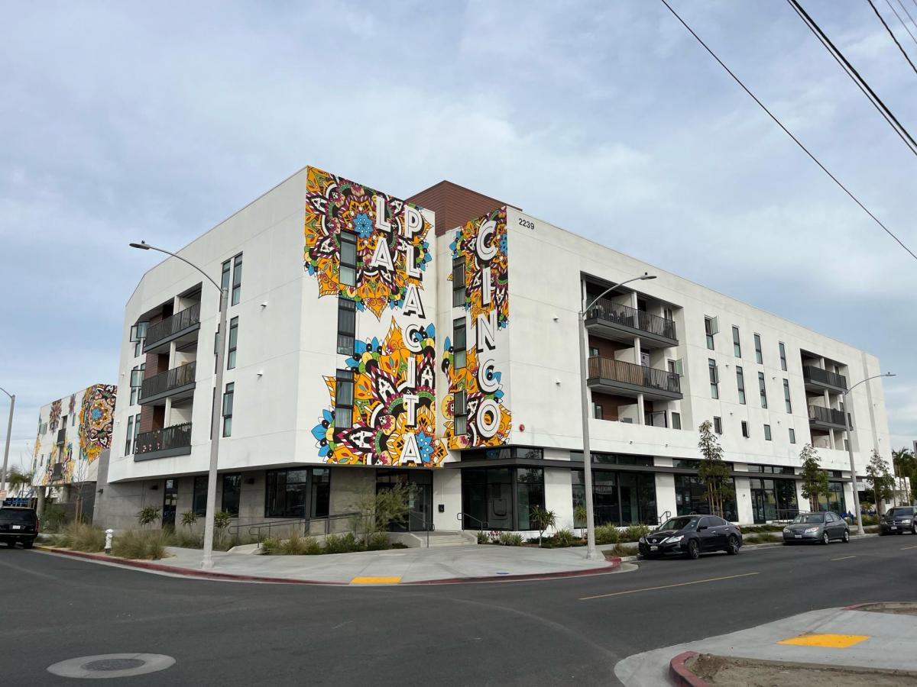
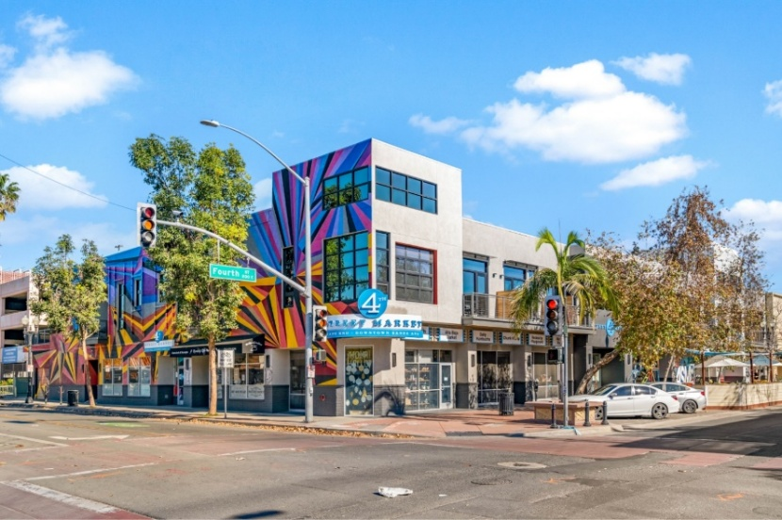
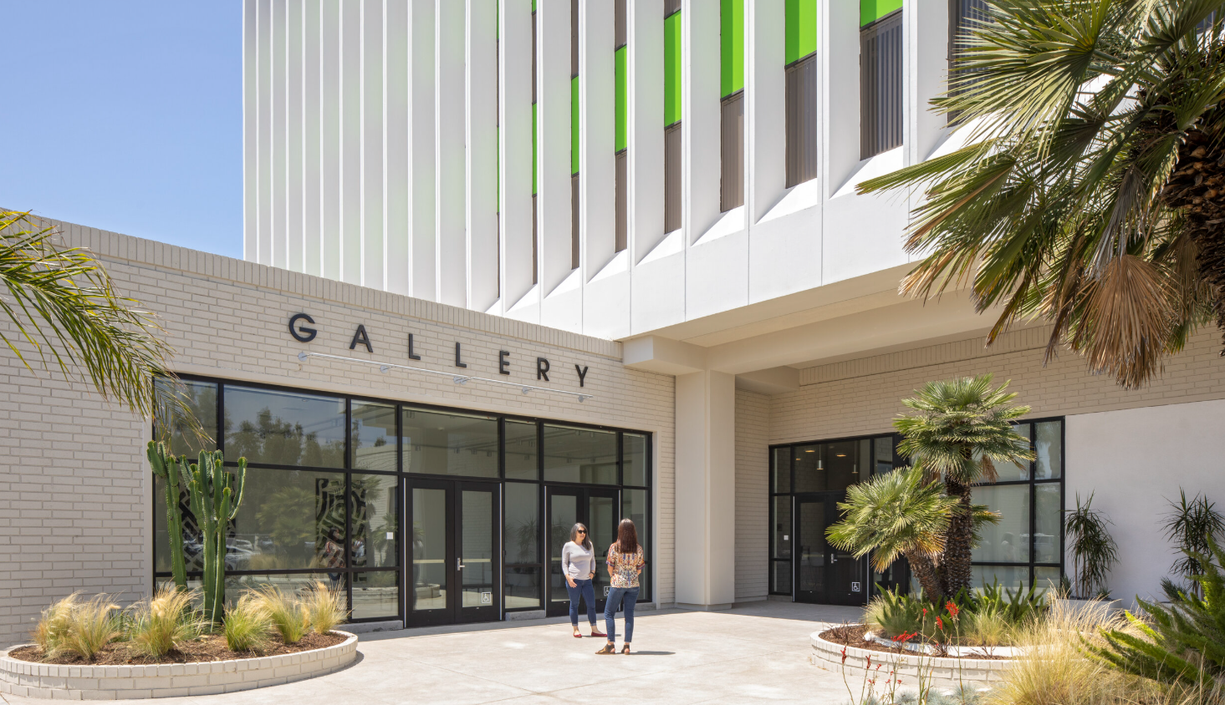
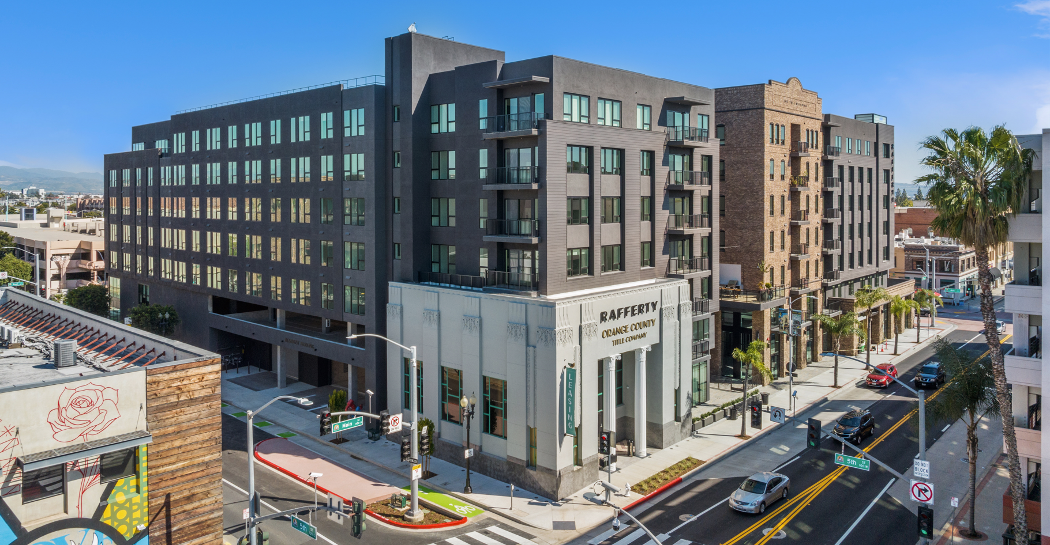
What is Zoning?
Zoning identifies what can be built and where
Jobs
Homes
Good Codes
Make
Good Communities
Businesses
Amenities

Slide 4




Why we zone
To implement the General Plan vision, including the following goals:
Preserve existing neighborhoods
Promote health and buffer incompatible uses
Foster growth and vibrant districts
Streamline review and development processes

Slide 5




What zoning does
How you can use your property (for example: residential, commercial, industrial)
What development standards apply (for example: building height, number of parking spaces, setbacks)
What types of permits are required (for example: conditional use permit, variance)

Slide 6
Why update the Zoning Code?
Reflect contemporary uses, standards, and processes
Reduce potential for adverse land use impacts
Make the Code easier to use with graphics, tables, and simple language
Incorporate new State laws
Create greater transparency and predictability
Streamline development processes

Slide 7






Benefits of modernization
New and
expanded permitted uses to support
business activity
Focus new development in targeted areas
Systemic approach to economic development and investment in our community
New, cleaner jobs and opportunities for upward mobility
Retain and attract businesses and residents
Create a user-friendly code and processes that entice proactive application submittals

Slide 8
Benefits of streamlining
Facilitate economic development
Sustain housing production for all income levels
Reduce costs by shortening review and approval timeline
Use City resources efficiently
Achieve consistency with State law

Slide 9




What you’ve said is needed
+
Parking (some want more, some want less)
Other
Transitions between new development and existing neighborhoods
Community benefits and amenities
Diverse housing types
Open spaces for residents
Make it easy for businesses to thrive
Ensure high-quality, vibrant, walkable districts
Buffer homes from industrial uses

Slide 10






Your participation today
View the citywide draft zoning map and proposed zoning for specific properties
Learn about proposed allowed uses in the new zoning districts
Learn how the new Flex and Business Park zoning districts address residential/industrial buffering
Learn about preservation of existing neighborhoods
Review proposed parking regulations

Slide 11




Timeline for public meetings & hearings
Planning Commission Study Session
Fall
2025
City Council Study Session
Winter 2025/26
Planning Commission Hearings
Winter 2025/26
City Council Hearings
Spring 2026

Slide 12

Stay Connected!
For more information, visit our project website by scanning the QR code below
SAZC
To schedule a meeting with staff,
contact Siri Champion, Senior Planner Schampion@santa-ana.org or 714-667-2751

Slide 13

Thank you!

