Slide 1
Understanding Displacement
PRESENTATION TEMPLATE - PURPOSE & USE
DELETE THIS INSTRUCTION SLIDE FROM YOUR FINAL PRESENTATION
Use the following slides to introduce core ideas about what displacement is and its impacts -- for elected officials as well as the general public.
Integrate with engagement activities to understand community perspectives and priorities.
Customize to reflect local community context, existing policies/programs and/or proposed work program priorities (more about customization on the next slide!)

Slide 2
Understanding Displacement
PRESENTATION TEMPLATE - CUSTOMIZING
DELETE THIS INSTRUCTION SLIDE FROM YOUR FINAL PRESENTATION
ADD your jurisdiction’s name and logo to the title slide along with info about the time/date of your presentation.
DELETE this and the previous slide, and any other slides that are not pertinent to your audience or your jurisdiction.
MODIFY specific terms, photos and content to ensure it reflects your jurisdiction’s or audience’s perspectives and priorities.
ADD slides that provide more info about displacement in your community and existing policies or work program priorities to address displacement.

Slide 3


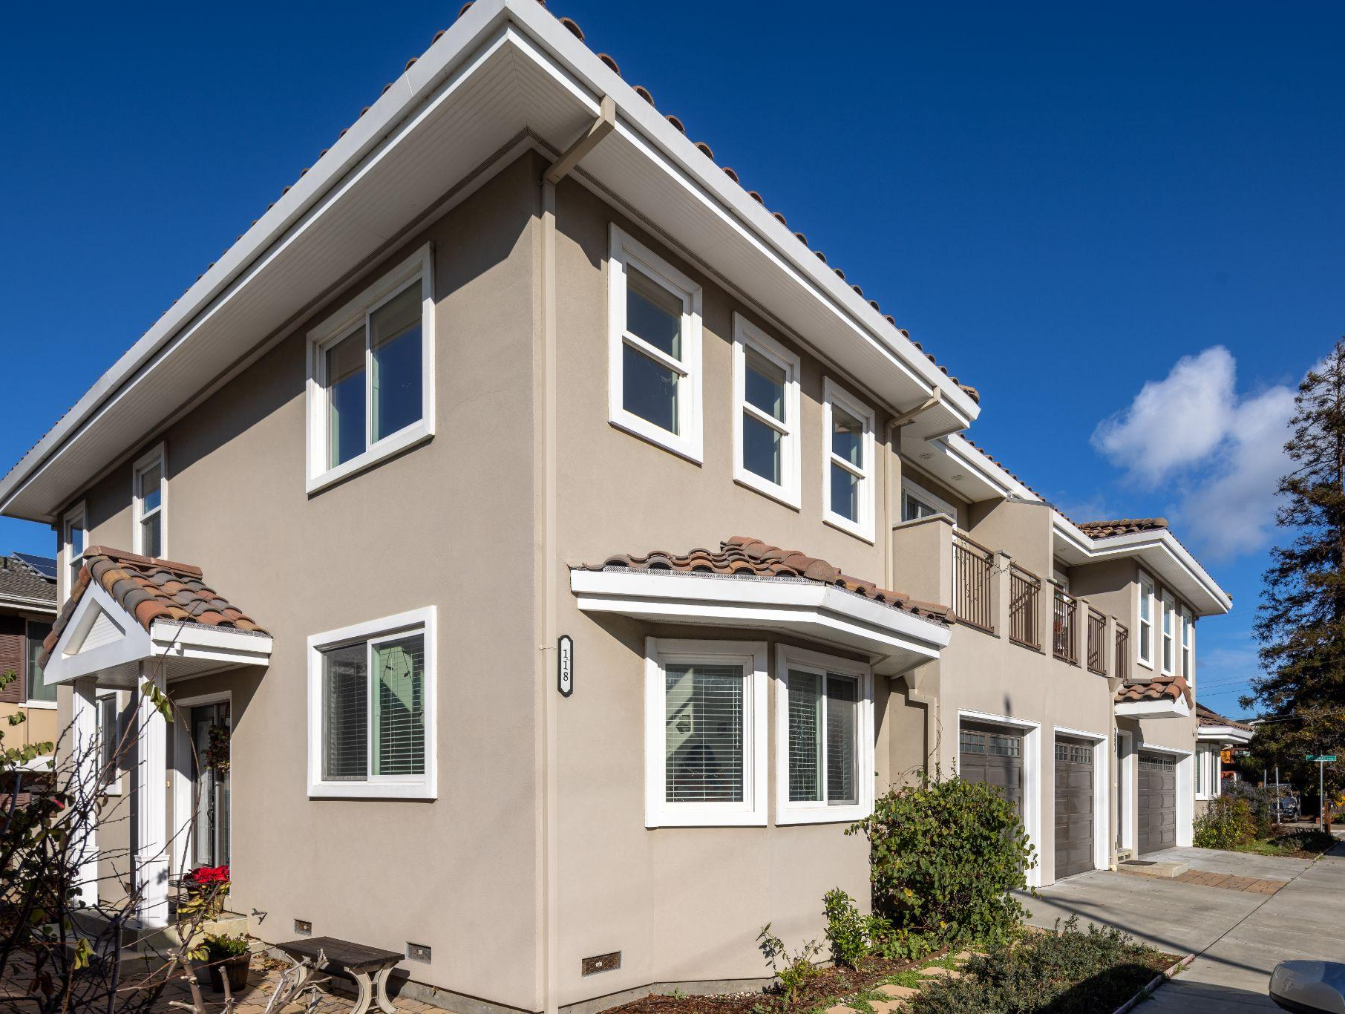

Understanding Displacement
CAUSES | IMPACTS | SOLUTIONS
Update with local seal/logo or remove
Meeting name / date / time

Slide 4
Presentation Overview
1
3
What are we talking about when we talk about displacement?
What can we do about displacement?
2
4
What are the impacts of displacement?
Building more housing—and better systems—to keep people in place

Slide 5
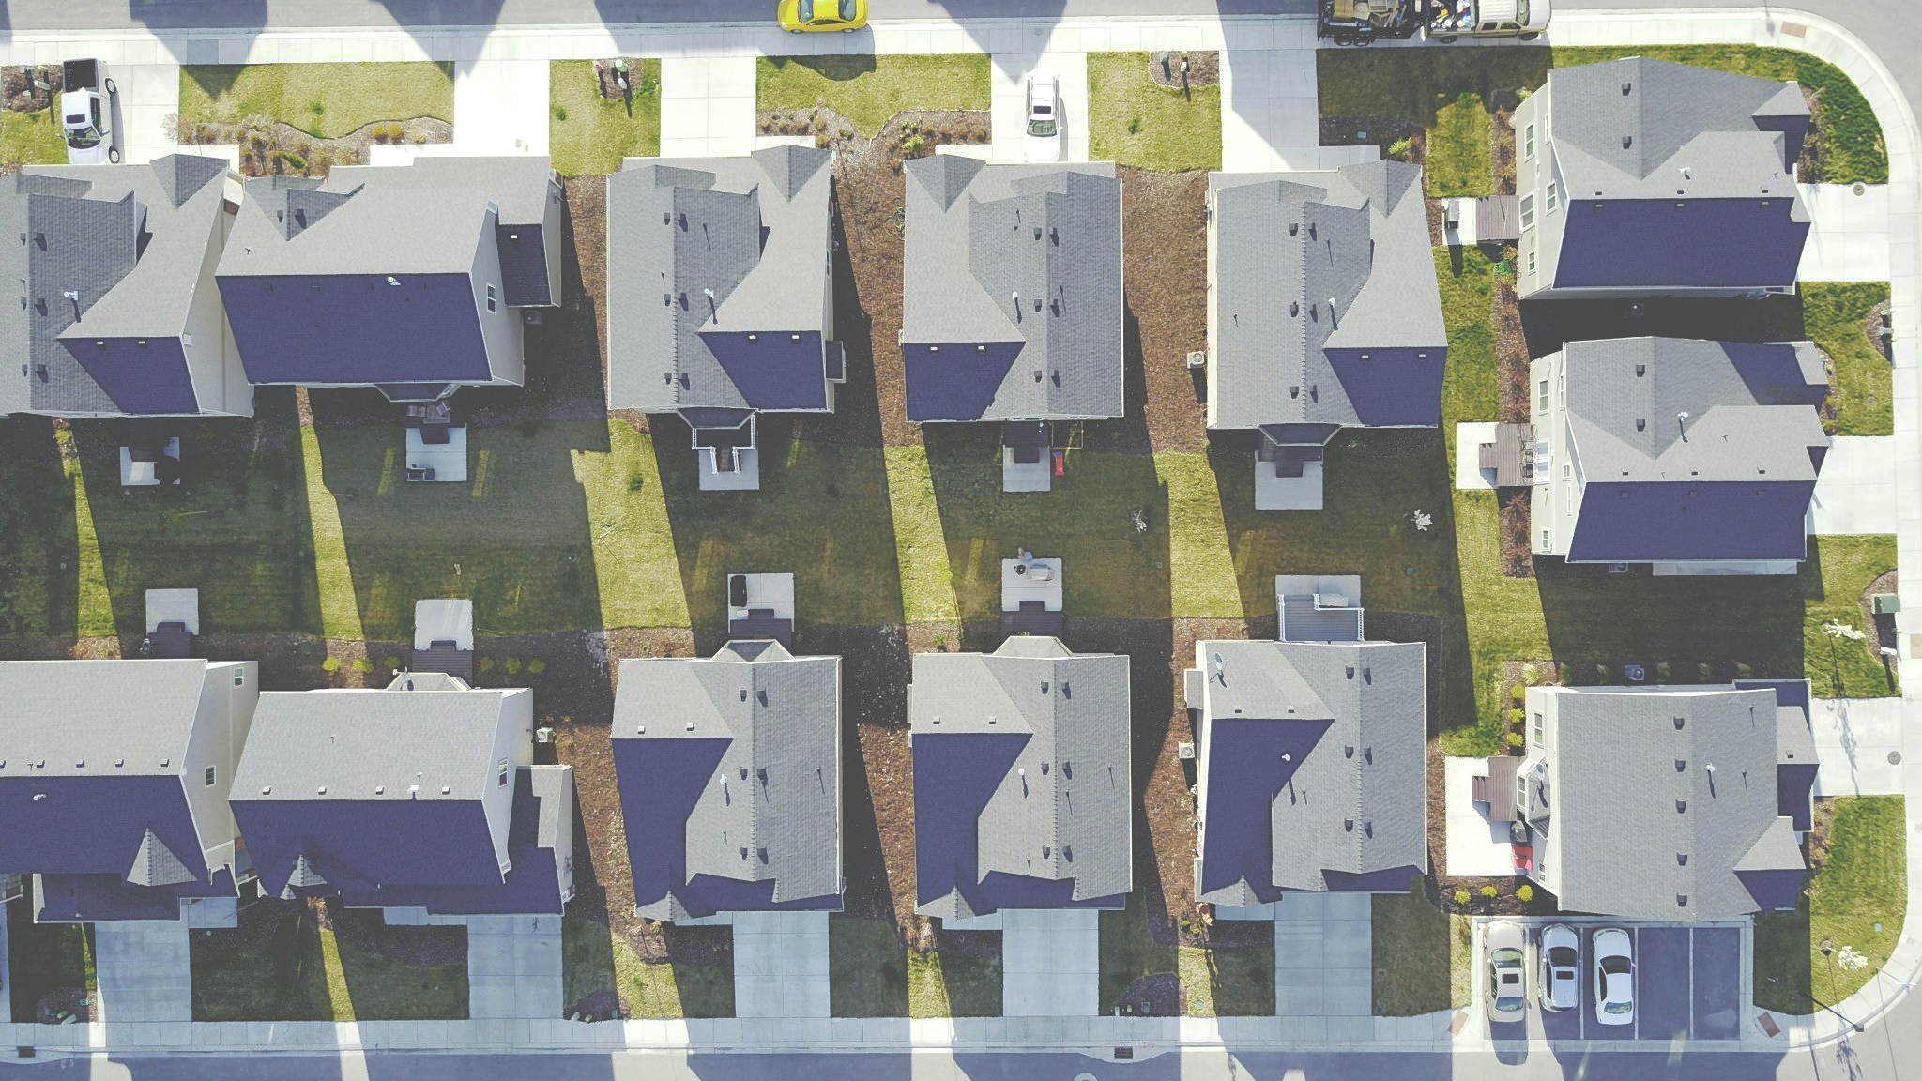
What are we talking about when we talk about displacement?
1
Forms of displacement
Factors that drive displacement

Slide 6

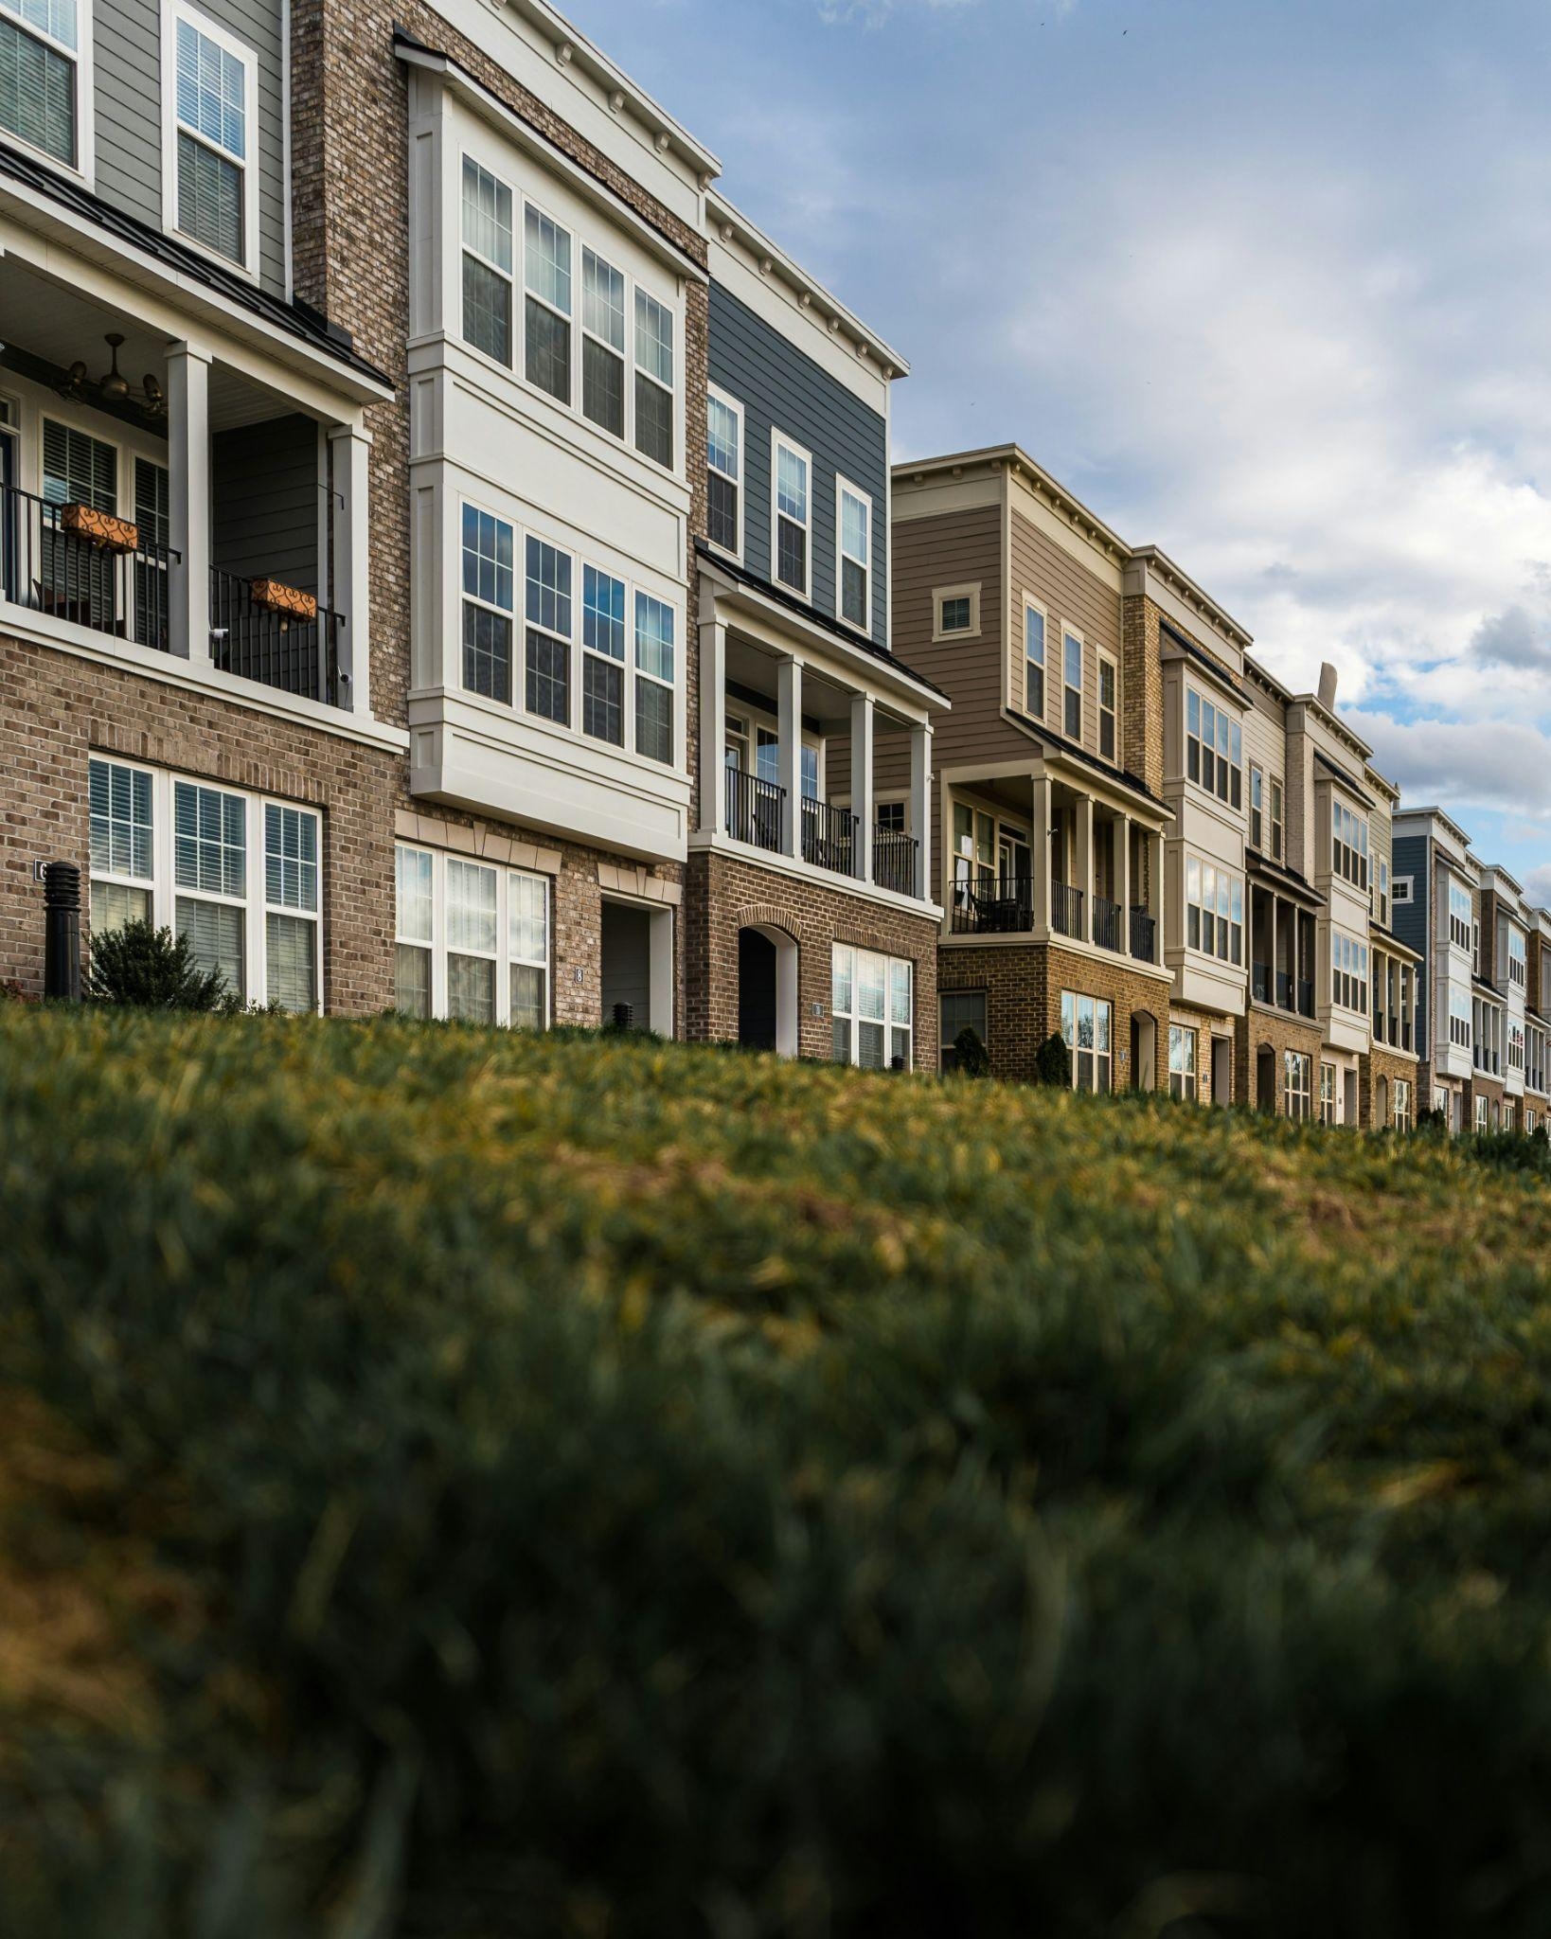




What are we talking about when we talk about displacement?
There are many reasons a person or family might be forced to move, including:
Rising rents that make their home unaffordable
Inability to pay due to a job loss or medical emergency
Lease termination or non-renewal
Hazardous building conditions that make their home uninhabitable
Demolition to make way for a new development
DISPLACEMENT is when residents have to relocate from their homes or neighborhoods due to factors beyond their control.

Slide 7
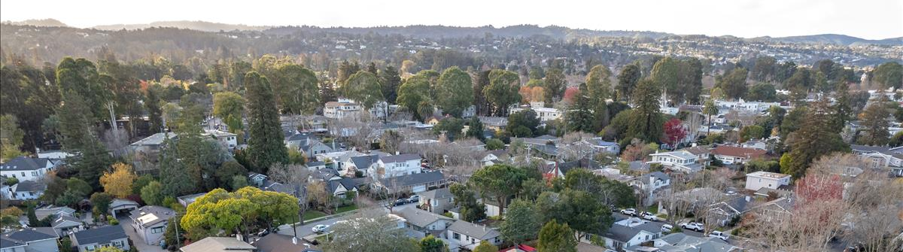
Forms of Displacement
Direct Displacement
Indirect Displacement
Cultural Displacement

Slide 8
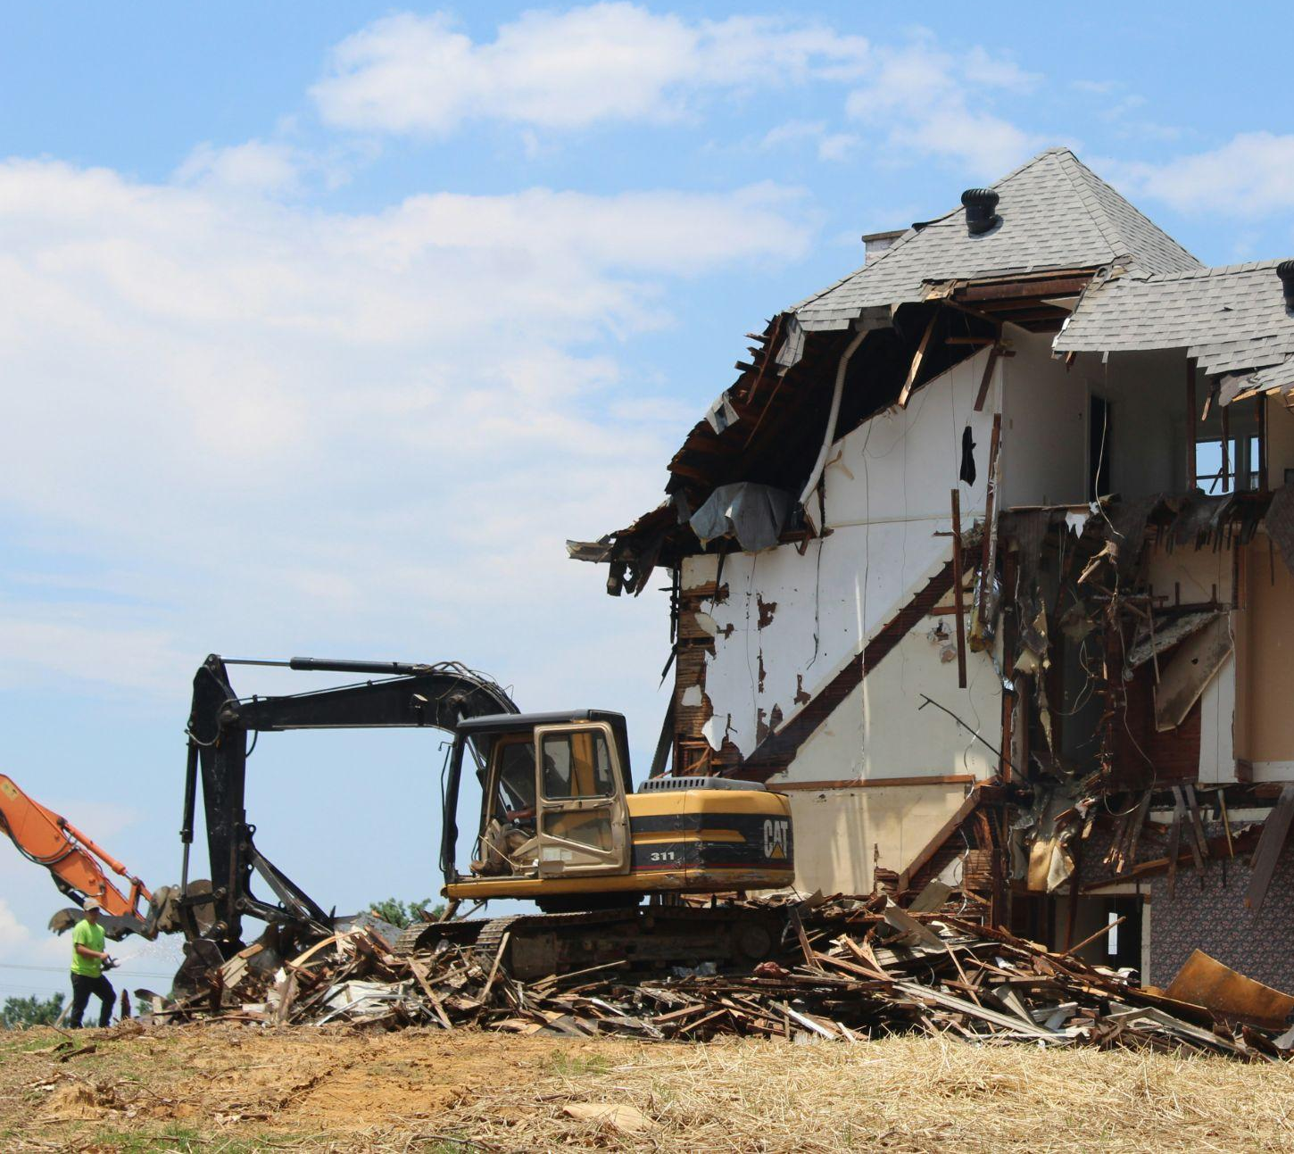
FORMS OF DISPLACEMENT
Direct Displacement
Direct Displacement is when a person or family is forced to move because they are evicted or because their building was torn down. They have to move and live somewhere else, sometimes to a different neighborhood or community.
Direct Displacement is the most visible and immediate form of displacement. It can be extremely disruptive to people’s lives.

Slide 9

FORMS OF DISPLACEMENT
Indirect Displacement
Indirect Displacement is when a person or family can no longer afford to stay in their homes because of increasing rents. When rents get too high, they feel pressure to move away, to a place they can afford.
Indirect displacement is harder to see and happens more slowly over time. But it still takes people away from social networks, jobs, schools and places of worship.

Slide 10

FORMS OF DISPLACEMENT
Cultural Displacement
Cultural Displacement is when new development and new residents change the character of the area. It can create a feeling of loss for those who have been in the area a longer time, even if they can afford to stay. This is sometimes called gentrification.
Cultural displacement happens over time as older businesses close or move away, community institutions lose their membership, and public spaces are reoriented to new users and activities.

Slide 11
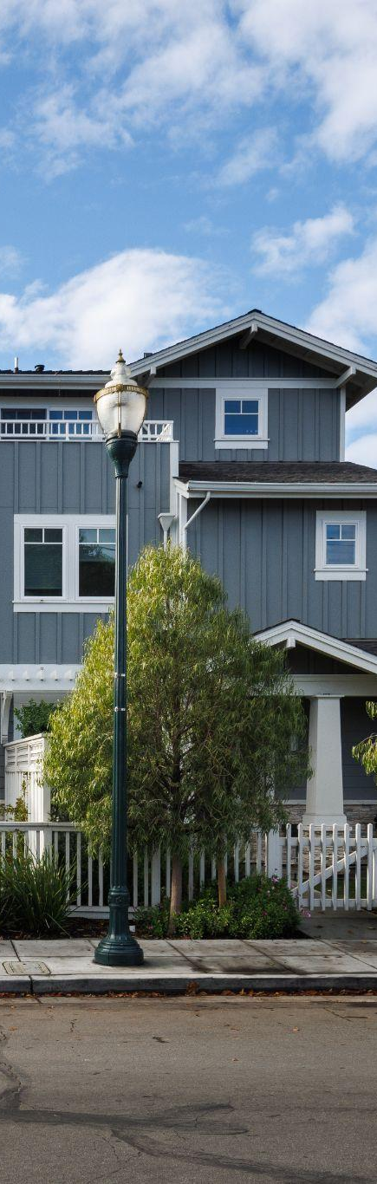
Factors that Drive Displacement
The dynamics of displacement are complex and can differ across communities and over time. Key drivers include:
Incomes not keeping up with the rising cost of housing
Regional population and job growth
Loss of existing affordable housing
Lack of tenant protections
Public investments that attract redevelopment
Segregation, redlining and income inequality

Slide 12
What are the impacts of displacement?
2
On families and individuals
On neighborhoods
On our economy

Slide 13
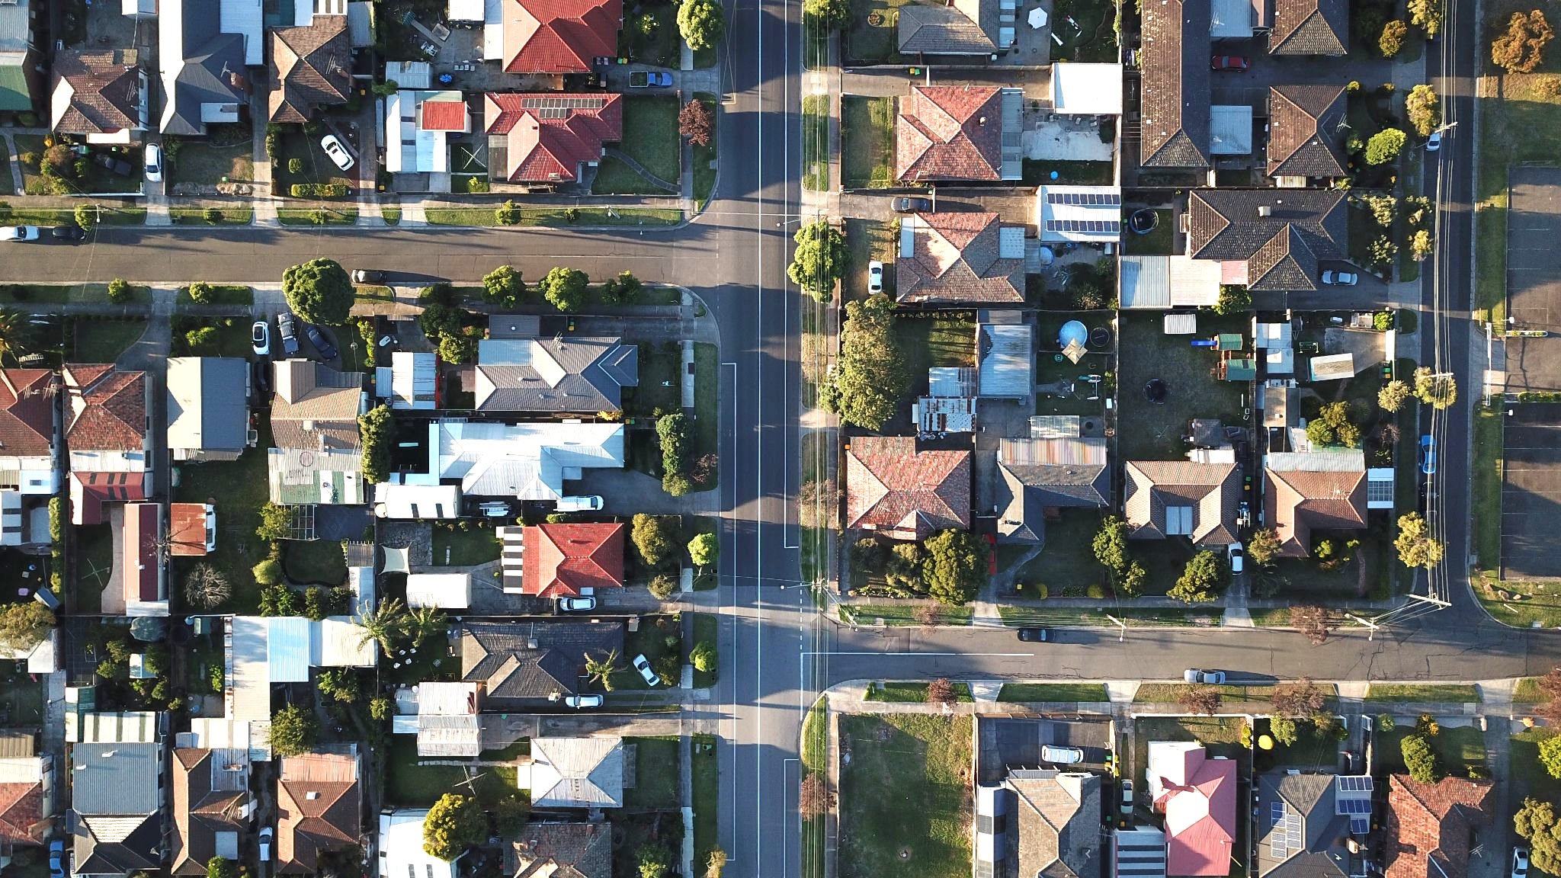
Displacement affects all of us.
For those who are displaced…
Extreme disruption to jobs, schooling, social support networks, and more
Cost of finding another place & moving
In many cases, longer commutes (with cost of time and money)
In some cases, starting over in a new community or loss of housing all together (shifting to sleeping on couches, in vehicles or on the street)

Slide 14
Displacement affects all of us.
For friends and neighbors of people who are displaced…
Impact to social networks
Stress of helping displaced friends find new accommodations
Anxiety about being the next to go
Sense of loss, sadness

Slide 15
Displacement affects all of us.
For those living in areas experiencing displacement…
Loss of affordable shopping, food and services
Sense of loss: community I was part of is now gone
Sense of guilt: community is gone but I’m still here

Slide 16
Displacement affects all of us.
For local businesses in areas experiencing displacement…
Impact to employees & their productivity
Loss of customers
Harder to find and retain employees, especially for lower-paying jobs
For some, pressure to close or relocate

Slide 17
Group Discussion
?
What forms of displacement are we seeing in our community?
?
What factors do you think are contributing the most to the displacement we are seeing?
?
How is displacement affecting you, the people you know and our community overall?

Slide 18
What can we do about displacement?
3
The Three P’s
State Protections
The Role of Local Government
Policies, Programs and Actions

Slide 19
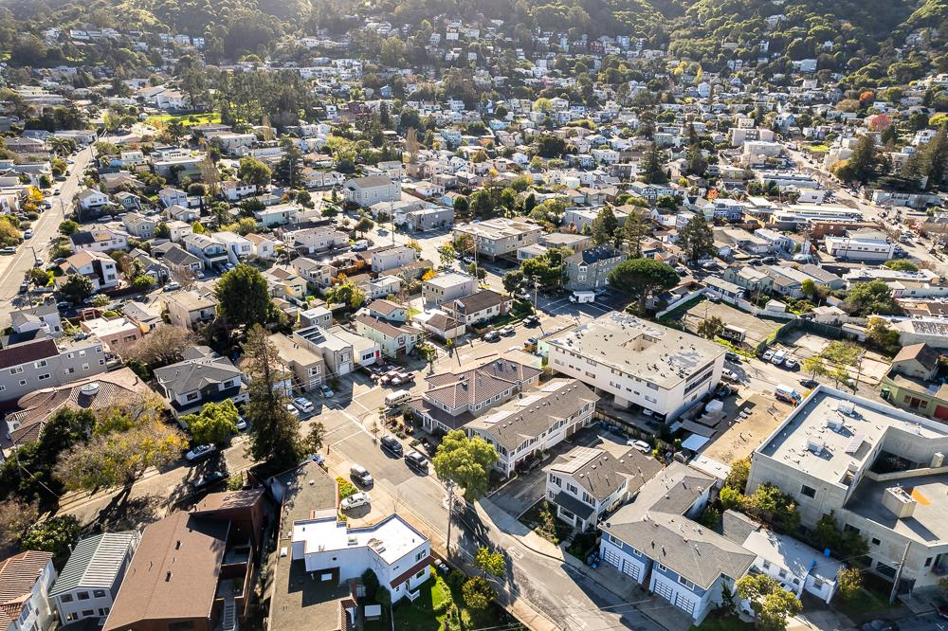



What can we do about displacement?
A comprehensive approach to limit displacement and
its impacts should address The 3 P’s:
Protection
Preservation
Production
and be supported by
Planning and Partnership!

Slide 20
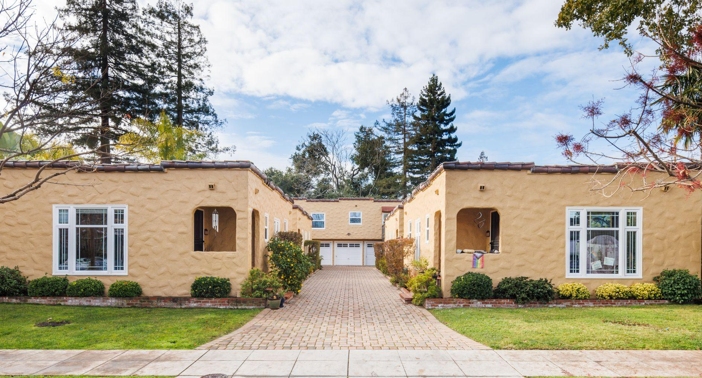
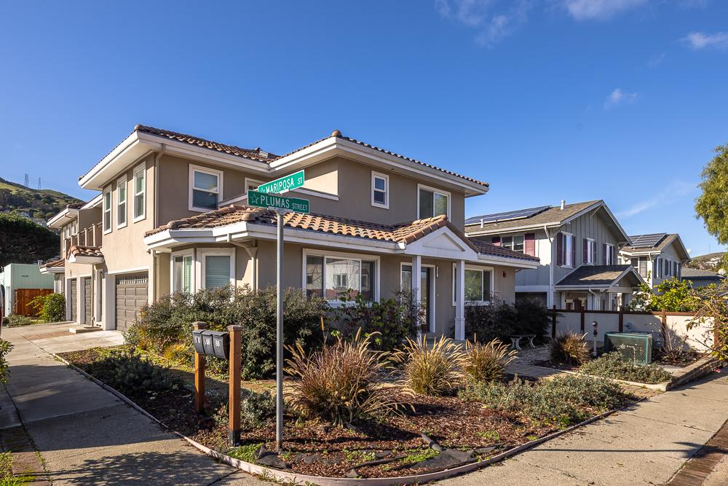
Let’s start with
Protection…
Creating more housing will take time. Many current residents are facing displacement pressures today.
And sometimes they are displaced by the new, higher density housing that’s getting built.

Slide 21
Let’s start with
Protection…
We need to be “pro housing” and “pro tenant” at the same time – helping current residents stay in our community as we work to create more housing opportunities.

Slide 22
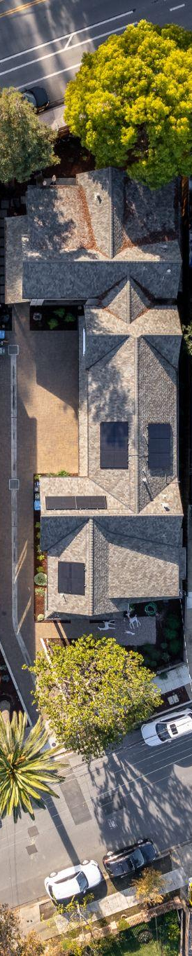

State protections provide a starting point
California’s Tenant Protection Act (AB 1482) became effective in 2020. This law:
Limits rent increases (rent stabilization)
Eliminates “no cause” evictions for covered tenancies
(just cause eviction)
Requires relocation assistance to tenants who are evicted for reasons beyond their control

Slide 23
But stronger protections are often needed
Aspects of state law are vague or provide only minimal protections. For example:
Rents can still be increased 8 to 10 percent each year, which is more than people can afford.
It exempts many types of buildings, which can be a big part of the housing supply in some places.
Relocation assistance is often not high enough to cover the actual costs.
There are no enforcement mechanisms other than tenant complaint.

Slide 24
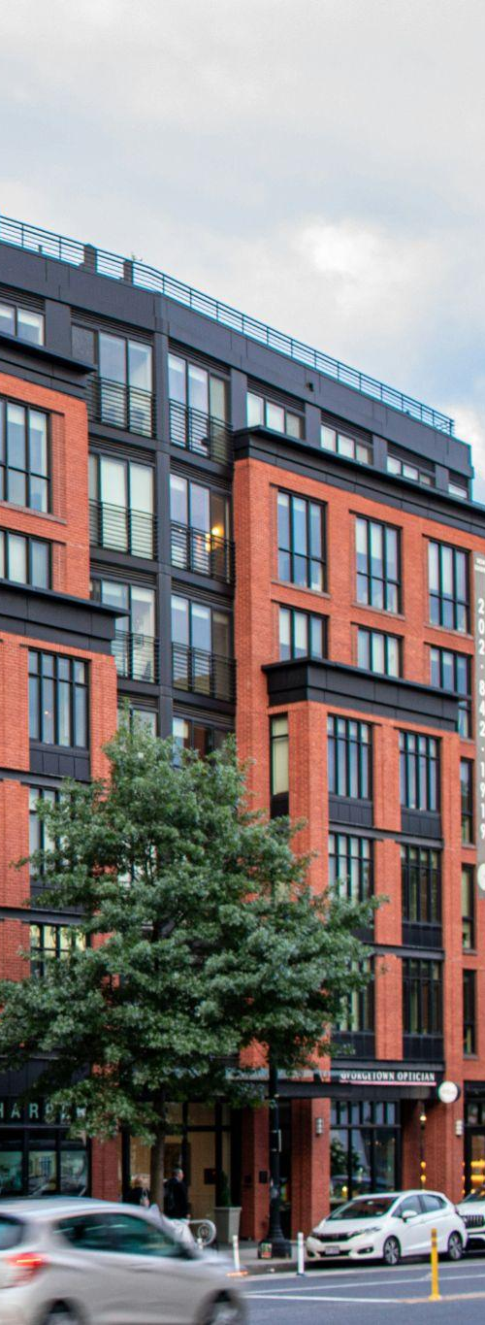
Local governments can strengthen tenant protections and support
Adopt local policies that build on and expand state law
Create and support programs to implement the laws that help tenants facing eviction
or who have been displaced
Partner with community organizations to support enforcement and deliver support services
and more!

Slide 25
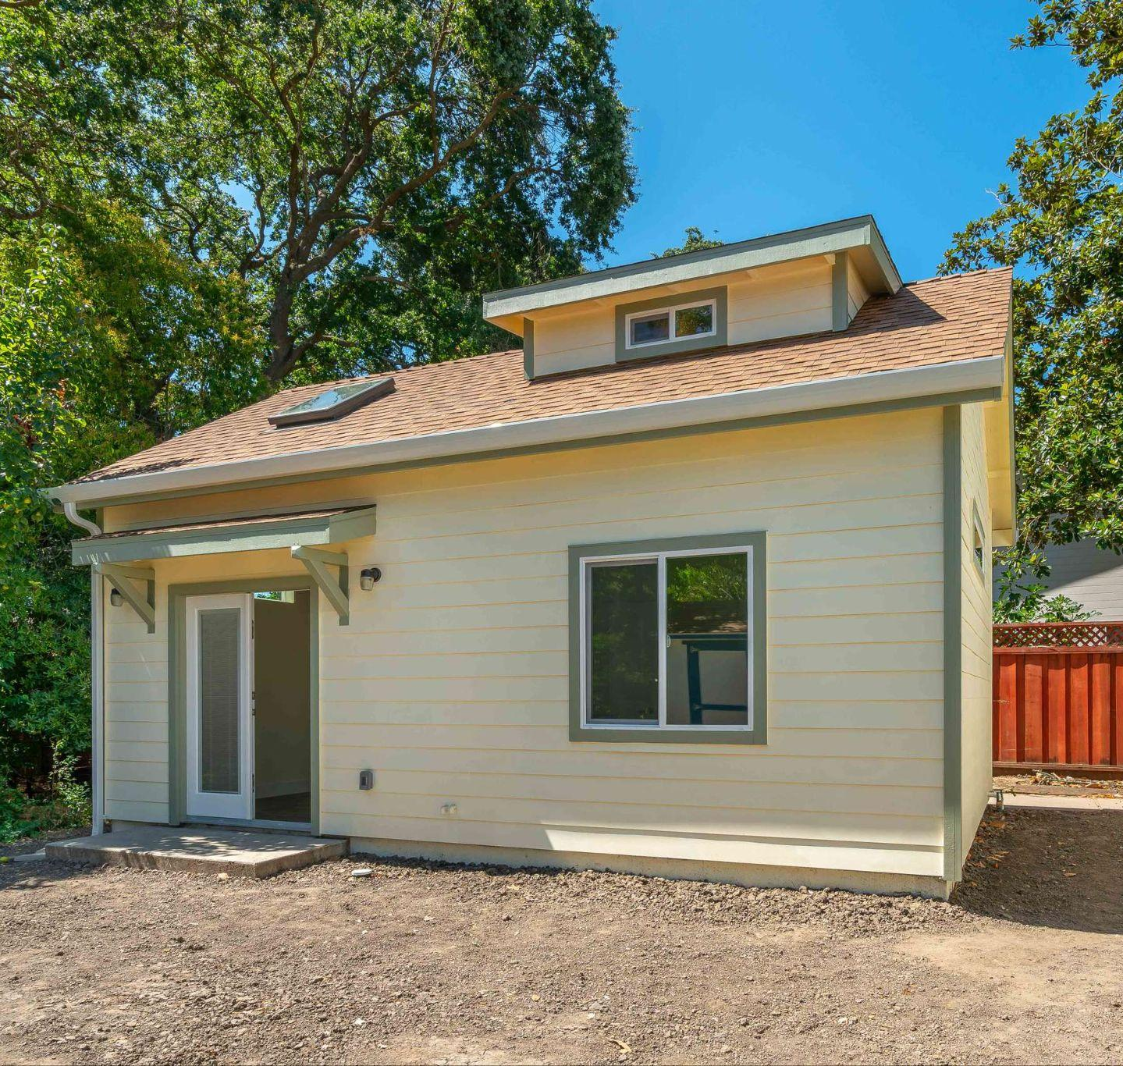
Preservation of existing affordable housing is critical, too
“Affordable Housing” includes
Homes that are “deed restricted” to ensure that they remain affordable to lower income households
Market-rate housing that is not subsidized but has lower rents due to age, location & other factors
Buying and preserving existing affordable housing can help people stay in place and preserve long-term affordability.
It is often less expensive to preserve existing housing and keep it affordable than to build new affordable housing.

Slide 26
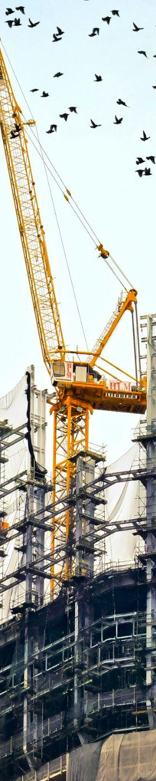


State law provides important tools
Notification: Requires up to three years advance notice when affordable (subsidized) housing is at risk of losing its rent restrictions.
Unit replacement: Requires new housing to replace existing units that are demolished with new units that are similarly affordable and of equivalent size.
Right of Return: When affordable housing is redeveloped, requires that existing tenants be given priority for the new units.

Slide 27
Local governments can help preserve affordable housing, too
Invest in efforts to purchase, rehabilitate and preserve existing affordable housing
Adopt local policies like mobile home preservation and “opportunity to purchase” acts
Partner with local groups to preserve affordable housing, through community land trusts and other mechanisms

Slide 28
And don’t forget
Production!
The largest driver of displacement is
rising rents, which is caused in large part by not having enough housing to meet our needs.

Slide 29
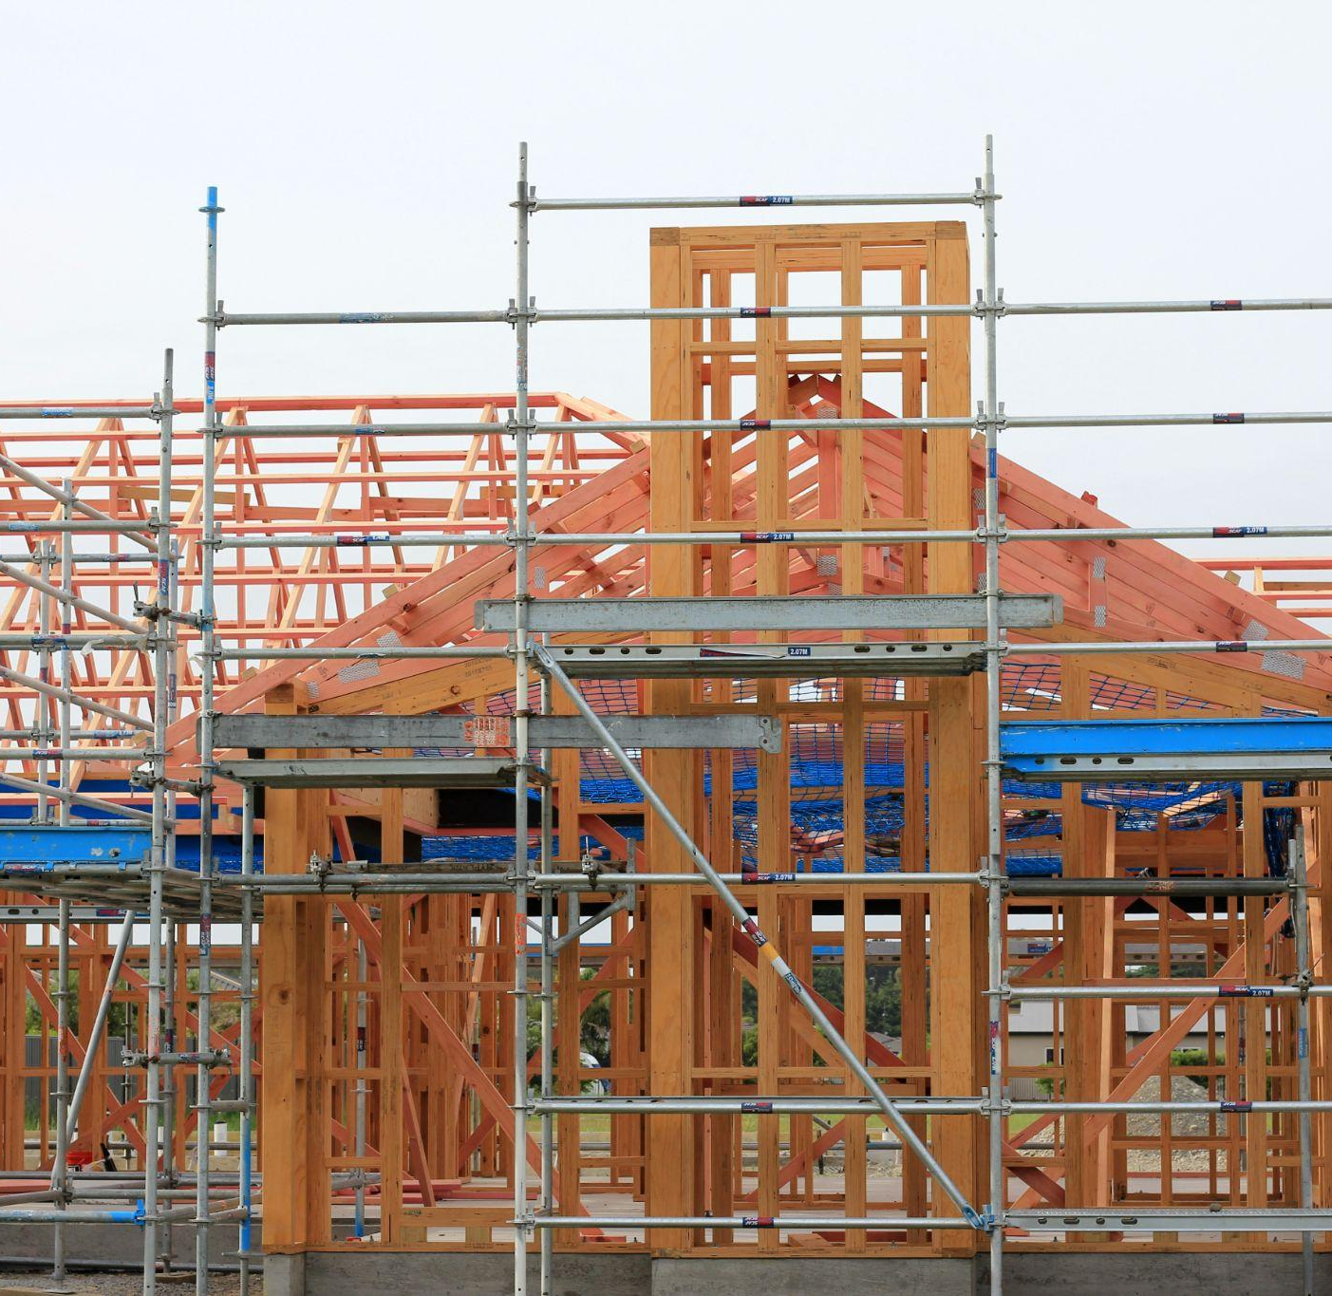
And don’t forget
Production…
Producing more housing is critical to meet the challenge of displacement.
As we plan for and create new housing, we need to consider:
What type of new
housing, and where?
Who will it serve?
How will it be
owned and managed?
How are the people impacted
by new development
being supported?

Slide 30
But:
Building more housing won’t end displacement.
Protection and Preservation are critical.
Local policies and programs are needed to:
Avoid evictions whenever possible
Help those who are displaced
Keep and expand the number of affordable homes

Slide 31

Notes:
Here's link to the video: https://youtu.be/dsWAfFNVPTY

Slide 32
Building more housing—and better systems—to keep people in place
4

Slide 33
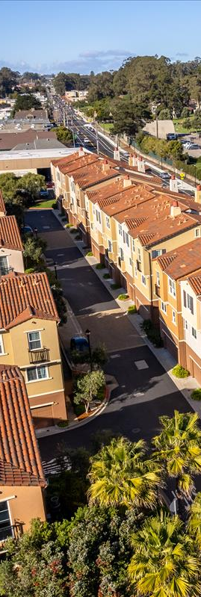
We need to create more and better housing choices while helping existing residents stay in place
We can work together to:
Understand the realities of displacement in our community
Ensure that people most impacted by displacement risks are part of developing the solution
Create and preserve the housing we need for people here today as well as to welcome new neighbors and support future generations
Develop and deliver workable solutions that help people of all incomes stay and thrive in our community

Slide 34
It’s more than having policies and programs — we need a systems approach!
Outreach and Education help everyone understand their rights and the available services
Data and Monitoring help us know what is happening and whether programs are working
Partnerships with Community Groups reach people where they’re at and deliver fast, effective support
Investment makes things happen, to ensure that rules are followed and housing remains affordable

Slide 35
More Resources
Learn more about displacement
through maps, research papers and videos at
UC Berkeley’s Urban Displacement Project www.urbandisplacement.org

