Slide 1
Planning Collaborative
4/28/2020

Slide 2
Agenda
Welcome and Introductions
Overview of Planning Collaborative
New State Laws
General (2019)
Housing Element Related
RHNA 6
Next Steps

Slide 3
Contract
$50,000, 6 months
Tasks undefined
Meeting 1 Priorities / New State Laws
Meeting 2 Guest Speaker / Products / Future
Meeting 3 Products / Future

Slide 4
Requests
Keep expectations modest
Be tolerant if some products are not relevant to you
Focus on staff needs
Build relationships

Slide 5
Survey Priorities
RHNA – What to expect
Housing Elements
New State Laws
ADUs

Slide 6
Survey Goals
Process and collaboration
Develop relationships
Increase sharing of information
Regular schedule/ good systems
Best practice information generally

Slide 7
Interview Themes
Long-Range Local Planning
Housing Elements
New Housing Laws
Sites Inventory
RHNA Methodology
Post-COVID Housing & Economic Impacts
Grant opportunity information
Public Outreach/Support

Slide 8
Comments/Questions

Slide 9
New State Laws

Slide 10
Standard Disclaimers
We are not a legal expert. This is not legal advice. Many aspects are still not clear. The material is subject to change. There is no guidance out yet and there won’t be until after you need to take action. The laws are poorly written. It’s every planner for themselves. Moses, Robert that is, help us.
Notes:
It’s actually not that bad and

Slide 11
Context
High priority for governor
“Our state’s affordability crisis is undermining the California Dream and the foundations of our economic well-being. Families should be able to live near where they work. They shouldn’t live in constant fear of eviction or spend their whole paycheck to keep a roof overhead. That’s increasingly the case throughout California.”
Legislature wants action and distrusts cities
“The Legislature’s intent (is) curbing the capability of local governments to deny, reduce the density of, or render infeasible housing development projects…”
Broad public concern about housing
Notes:
It is helpful to start the legal overview with a little context. The new governor is much more interested in housing than Governor Brown was. Governor Newson has repeatedly identified housing as a top priority for him and has indicated that he will be supportive of many different policies from tenant protections to automatic approvals.
The legislature is equally interested in housing. It’s a little hard to read the tea leaves this early, but generally in past cycles they have viewed cities as an obstacle and that is likely not to change. Also, in past legislative sessions, the legislature was somewhat restrained by the fact that the governor was not supportive of big housing changes. They held their fire in a lot of cases knowing it would not be approved.
Finally, there is broad concern for housing. It ranks as one of voters top issues and surveys consistently report the public wants something done.

Slide 12
What you need to do
Update ADU ordinance
Update rules re: navigation centers
Post many things online
Review/update density bonus ordinance
Prepare/train for new development approval procedures
Be able to answer questions about other topics
Apply for planning money by July
Notes:
Resources uploaded.

Slide 13
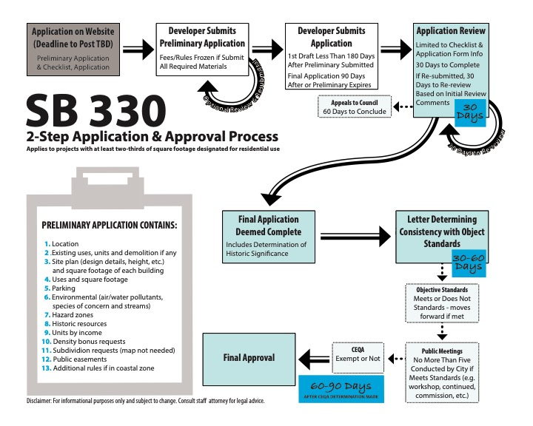
Resources on Website

Slide 14
Comments/Questions/ Poll
Notes:
Survey where people are at
ADU ordinance updated – yes or no
SB 330 ready – yes, no, which bill was that again?
LEAP Money -
And if we should do a separate webinar

Slide 15
Housing Element New Laws

Slide 16
Rules/Realities of RHNA 6
Rule 1a Strict Definition of Non-Vacant
Rule 1b. Non-Vacant Sites Face Significant Scrutiny Applies if you depend on non-vacant sites for lower income inventory
Rule 2 Small and Large Sites Face Moderate Scrutiny Under .5 or over 10 acres
Rule 3 New Rules for Reusing Sites
Rule 4 Many Sites Already Used
Rule 5 Buffer Is Needed
Notes:
50% of

Slide 17
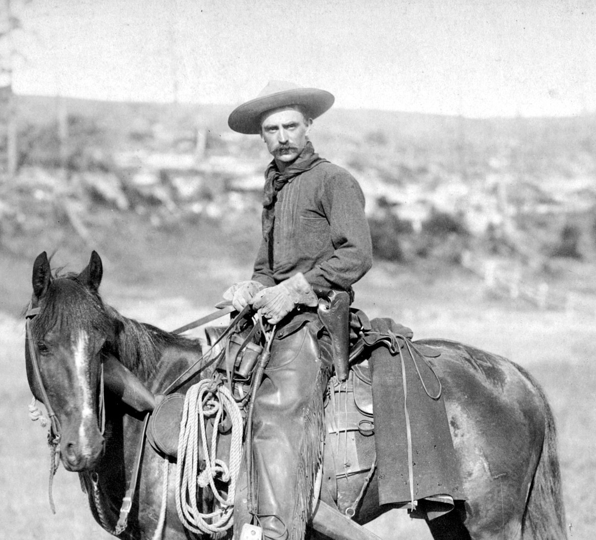
Definition of Vacant
Olden times
If it was vacant, it was vacant
Modern times
Almost nothing is vacant
Parking lots
Partially vacant but not subdivided
Contain power lines
Contain an abandoned house
Used for agriculture.

Slide 18
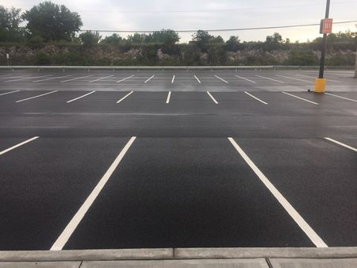
Not Vacant

Slide 19
Scrutiny
Olden times
Light scrutiny
Modern times
Lower income, non vacant sites – Presumed ineligible
Small and large sites – Not clear
Leases need to be considered

Slide 20
Reusing Sites
Olden times
If a site was not developer, use it again.
Modern times
Can reuse once if nonvacant, and twice if vacant
If not
Default density
By right if 20% affordable

Slide 21
Buffer
Olden times
Must have adequate inventory when Housing Element is certified
Modern times
Must maintain income specific inventory throughout 8 years

Slide 22
Questions
Questions / Quiz / Breakout
Notes:
Quiz
Maybe break out room for 10 minutes?
Groups of 3, no report backs,
Group rules: What you discuss in the meeting stays in the meeting. Part therapy, part confessional, part strategizing. Be honest.
Introduce yourself – Name, city, hobby, professional path,
Did you have any questions about the material so far? Are there parts that are still fuzzy in your head?
How ready to do you feel form 1-10? Explain your number.

Slide 23
RHNA 6 Timeline
Summer 2020 HCD releases number for the region
July 2020 Draft Blueprint (which may affect RHNA allocations)
Fall 2020 Draft methodology / hints at allocations
Dec 2020 Final Blueprint
Spring 2021 Final methodology / draft allocations
Winter 2021 Final allocations
Jan 2023 Housing Elements due

Slide 24
RHNA Methodology

Slide 25
Objectives
Increase supply/type in all cities in an equitable manner
Promote infill
Jobs/housing balance
Balance income levels
AFFH

Slide 26
Weighting Factors
Notes:
The RHNA Methodology committee takes the number from the state and decides how to distribute it to cities. There are lots of ways.

Slide 27
Weighting Factors
Notes:
The RHNA Methodology committee takes the number from the state and decides how to distribute it to cities. There are lots of ways.

Slide 28
14 Factors
Future households - Based on Plan Bay Area (and market factors)
Future jobs -
Transit accessibility
Access to high resource areas
Existing need (cost burden)
Existing need (overcrowding)
Existing jobs
Job accessibility
Jobs-housing balance (commute shed)
Jobs-housing fit (commute shed)
Transit connectivity - TPAs
Transit accessibility (current)
Natural hazards
Past RHNA performance
Notes:
Which would you vote for:
Cities with jobs
Cities near jobs
High opportunity areas
Places with good transit
Places with good highways
Where it is more feasible to build
Cities where it would reduce GHG emissions

Slide 29
Visualization Tool
https://rhna-factors.mtcanalytics.org/

Slide 30
The Pie and Our Slice - Speculation
150,000 +
130,000
59,000
RHNA 5
Based on Other Regions
Based on Jobs
Notes:
Trends in other regions are 2 -3 times larger.
RHNA 5 – 59000

Slide 31
Notes:
Potential products
Staff report
Meeting for decision makers
Sample powerpoint
Follow up reports from each methodology committee
Regional feasibility analysis

Slide 32
Next Call

