Slide 1
Santa Clara County Planning Collaborative RHNA Methodology Debrief
20 May 2020

Slide 2
Agenda
Announcements
Governor’s Budget
RHNA 6 Plan
AFFH
Website - https://citiesassociation.org/planning/
2019 New Laws
Webinar
SB 330 – (Procedures and Affordability percentages for demolition)
Super Density Bonus handout
Methodology Committee Debrief

Slide 3
RHNA Methodology

Slide 4
Miscellaneous
April meeting – Canceled
ABAG letter to HCD
Raising concern about deadlines and funding

Slide 5
Review of Deadlines
Summer 2020 HCD releases number for the region
July 2020 Draft Blueprint (which may affect RHNA allocations)
Fall 2020 Draft methodology / hints at allocations
Dec 2020 Final Blueprint
Spring 2021 Final methodology / draft allocations
Winter 2021 Final allocations
Jan 2023 Housing Elements due

Slide 6
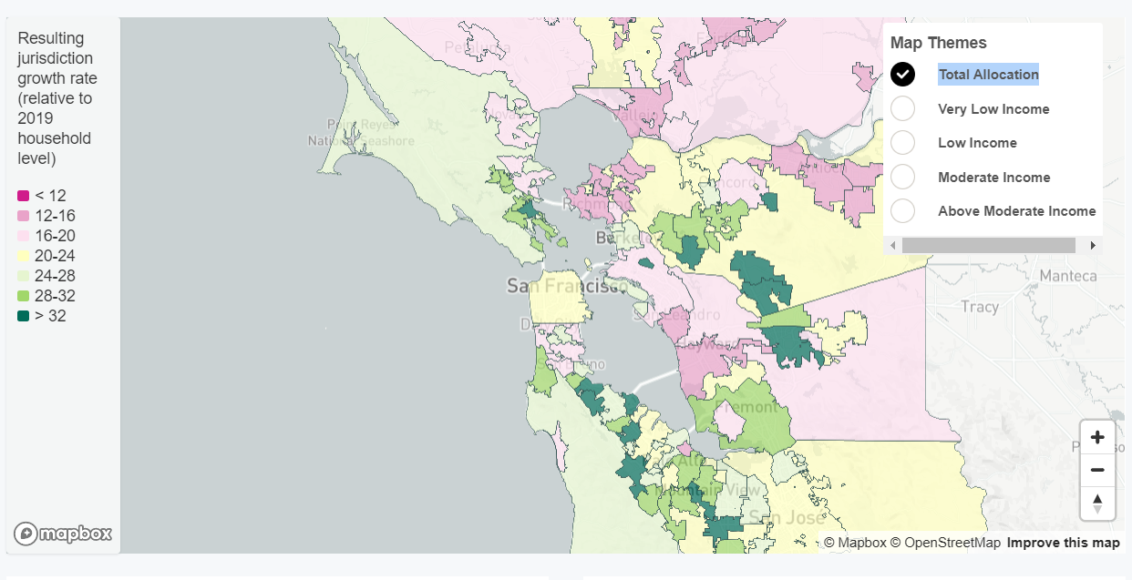
Previous Recap
Teams, factors and maps
Voting

Slide 7
Most Popular Factors
Equity (30-50%)
Jobs (20-60%)

Slide 8
Total Allocation
Bars 1-3 = Popular maps (teams with most votes)
Bar 4 (yellow) = RHNA 5
Bar 5 = Plan Bay Area (2040)

Slide 9
Total Allocation

Slide 10
RHNA Income Distribution
Income shift -
Ground up -

Slide 11
RHNA Categories
Reality
Simplicity
Very Low Income
Low Income
Moderate Income
Above Moderate Income
Low/Mod
Above Moderate

Slide 12
Income Shift
A)
Region Average
60% Low Mod
40% Above Mod
Higher Income City
60% Low Mod
40% Above Mod
Lower Income City
60% Low Mod
40% Above Mod
High income city
Percent high income
Low income city

Slide 13
Income Shift
B)
Region Average
60% Low Mod
40% Above Mod
Higher Income City
80% Low Mod
20% Above Mod
Lower Income City
40% Low Mod
60% Above Mod
High income city
Percent high income
Low income city

Slide 14
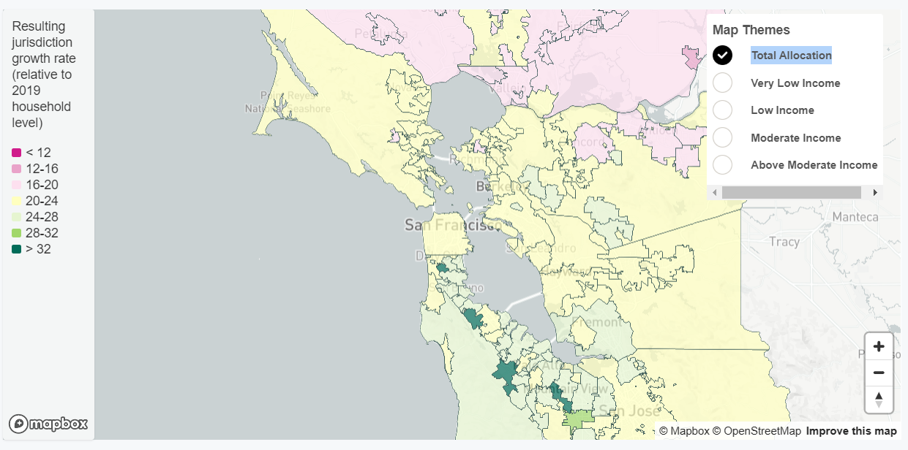
Ground Up
Above Mod
Low/Mod

