Slide 1
See Notes Below
This PowerPoint is minimally formatted so you can use it with your whatever template your jurisdiction uses.

Slide 2
Housing Elements and Plan Bay Area
Notes:
My name is ____. I am going to talk about two inter-related planning activities going on right now. The first is the assigning the housing target for each city, RHNA numbers, and the second is called Plan Bay Area, which is a 30-year vision exercise led by the Association of Bay Area Governments, or ABAG, and Metropolitan Transportation Commission, or MTC.

Slide 3
Housing Element Overview
Deadline for Update: January 2023
Must be certified by State
Sections
Housing needs, including special housing needs
Constraints analysis
Policies and programs
Sites Inventory
Notes:
It is good to start with a review of what a housing element is. It’s a chapter, or element, of our general plan, and helps guide how we will grow. Unlike most other elements, there is more state scrutiny of the Housing Element. Specifically, housing elements must be updated every eight years and must be certified by the California Department of Housing and Community Development. The deadline for the upcoming round of housing elements in the Bay Area is January 2023, but this certification process can take several months so it is good to think of the deadline as several months earlier.
There are various parts of the housing element. Looking at housing needs and trends. Looking at constraints, including governmental constraints from regulations but also market and other constraints. Evaluating the current element and considering new housing policies and programs. And importantly, making sure there is enough land zoned for housing to accommodate the projected demand. This is called the Inventory of Available Sites or Sites Inventory for short.
I’ll note now that most cities are anticipating having to rezone to have enough land in their sites inventory. Because rezoning can take a long time, it is good to get started early.

Slide 4
Sites Inventory
Increased scrutiny
Higher RHNA
Notes:
We anticipate that it will be harder to find enough sites to meet the site inventory. This is because there are new criteria for determining which sites can be used in the sites inventory. Specifically, there will be increased scrutiny for large sites (over 10 acres), small sites (under .5 acres) and--most importantly--redevelopment sites, which represent the majority of sites in most cities.
But for most of this presentation, I want to focus on what our housing target will be. The housing target is called the Regional Housing Needs Allocation or RHNA. We will have to show that we have enough land zoned for housing to meet our RHNA. And it is likely that our RHNA will be substantially higher than in past housing element update cycles

Slide 5
RHNA
Income Category | Housing Unit Need | Percent
Very Low Income (0-50% AMI*) | 114,442 | 26%
Low Income (50-80% AMI) | 65,892 | 15%
Moderate Income (80-120% AMI) | 72,712 | 17%
Above Moderate Income (120%+ AMI) | 188,130 | 43%
TOTAL | 441,176 | 100%
Notes:
You can think of RHNA as having two parts. The first is the big, overall number for the region. Then the next question is our share of the regional number.
The number for the region is about 2.3 time higher than last time. The percent assigned to each income category has not changed much.
The more important number is our share of the regional number, our slice of the pie if you will. If our share stays the same and the pie is 2.3 times larger, our share will increase accordingly.
If the housing need is distributed equally across all cities in the region, then the average city in the Bay Area will be expected to grow by almost 20% from 2023 to 2031. However, it’s unlikely that the allocation will be distributed like that. There will likely be factors that get weighted, resulting in some cities taking a higher share—or a larger slice of the pie—than others.

Slide 6
Methodology Factors
Access to High Opportunity Areas – More housing units allocated to jurisdictions with the most access to opportunity (e.g. good schools, low poverty, etc.).
Divergence Index – More housing allocated to jurisdictions that are more segregated compared to the rest of the region.
Job Proximity – More housing allocated to jurisdictions with easy access to region’s job centers.
Vehicle Miles Travelled (VMT) - More housing allocated to jurisdictions with a high number of vehicle miles travelled per worker.
Jobs-Housing Balance - More housing allocated to jurisdictions with a high number of jobs relative to the amount of housing.
Jobs-Housing Fit - More housing allocated to jurisdictions with a high number of low-wage jobs relative to the number of low-cost rental units.
Future Jobs - More housing allocated to jurisdictions with a higher share of projected jobs.
Transit Connectivity - More housing allocated to jurisdictions with existing and planned transit infrastructure.
Natural Hazards - More housing is allocated to areas with low natural hazard risk.
Notes:
There is a committee that ABAG has put together called the Housing Methodology Committee that will decide how the Bay Area’s total RHNA is distributed to each jurisdiction. Santa Clara County has 3 representatives.
Most likely they will adjust the allocations based on various factors. Currently, they are looking at 9 potential factors, but this is likely to change—i.e., they won’t use all the factors or they may add others. The factors are shown here, but for the sake of time, I am not going to go over all of them. I’ll give you a minute to read them.
One other thing to keep in mind, there are state rules about the methodology and whatever method the committee recommends will have to be consistent with these requirements.

Slide 7
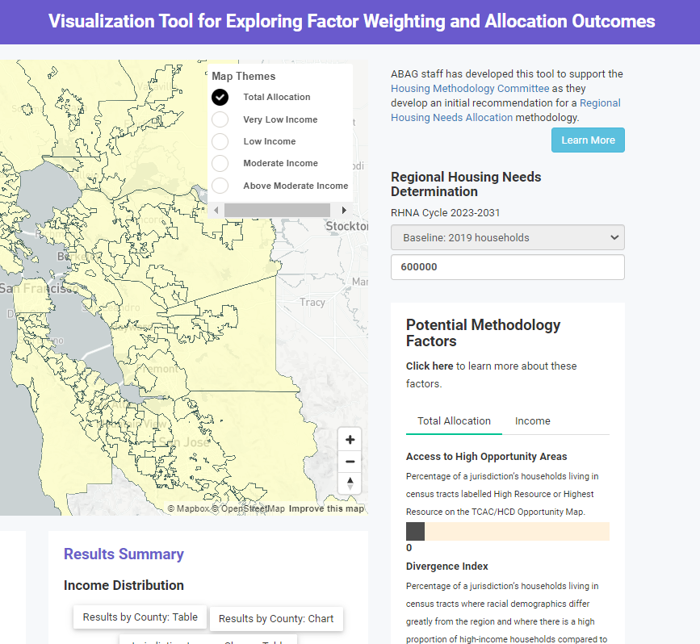
Visualization Tool
Explore factors at https://rhna-factors.mtcanalytics.org/
Notes:
For Illustrative purposes only at this point. Not final.

Slide 8
Plan Bay Area/ Blueprint
Draft available now
Final in December 2020
Can affect RHNA
Sets the maximum RHNA for each jurisdiction.
Potentially determining the RHNA for each jurisdiction
Potentially changing the regional number
Notes:
I should talk a little about Plan Bay Area, the regional visioning I referenced at the start of my talk. It is also sometimes called the Blueprint. In conjunction with assigning the RHNA, ABAG/MTC is required to develop a regional plan. It is a 30-year vision that imagines what the Bay Area would be like if various policy decisions were made. Importantly, it is just a vision and does not obligate cities to make any policy decisions.
The draft report was just released. It
Plan Bay Area might affect the RHNA in 3 ways.
The numbers envisioned in Plan Bay Area set the maximum RHNA for a jurisdiction. In other words, we won’t be given a number for the next 8 years of expected growth that is higher than what the plan envisions for the next 30 years.
Also, the Housing Methodology Committee may adopt the Plan Bay Area numbers as the framework for assigning RHNA, but at their July meeting they did not seem inclined to do so.

Slide 9
Implications for Santa Clara County
Job rich cities – Cities may be expected to close some or all of their jobs/housing imbalance as part of the RHNA process. Many members of the RHNA methodology committee have said that they want employment to be the primary driver of RHNA. The current visualization tool does not reflect this desire, but this may change.
Small towns near job rich cities – In Southern California, the methodology greatly increased RHNA numbers for small, residential towns near job centers. For example, West Hollywood’s RHNA increased from 77 to 3,460. Currently, the visualization tool does not predict this, but it is a possibility.
Cities with good public transportation networks – ABAG may choose to put more RHNA near cities with access to public transportation to reduce greenhouse gasses.
Cities with opportunity areas – Housing methodology committee members have also expressed a strong interest in having more housing in areas of high opportunity (low poverty, good schools, etc.).

Slide 10
Implications for X Jurisdiction
Notes:
Add the implications specific to your jurisdiction here

Slide 11
Next Steps
Feedback
Explore factors at https://rhna-factors.mtcanalytics.org/
Give feedback through designated representatives
Send a letter to ABAG
Rezoning
Consider where new growth will go if needed
Notes:
There is no formal process for jurisdictions to offer feedback on RHNA or PBA at this point. One initial option is to explore a tool that ABAG has developed to demonstrate how the factors will work and offer comments to our designated representatives on the committee. Or we can write a letter offering input to ABAG staff.
It may also be helpful to start considering which areas make the most sense for more housing. Regardless of what our RHNA number is, there’s no doubt that as a region we have a shortage of housing options to meet demand, and it’s highly likely that the RHNA numbers will require rezoning. With processes like this, it is good to be inclusive and deliberative, and with a January 2023 deadline, it will be helpful to start early.

