Slide 1
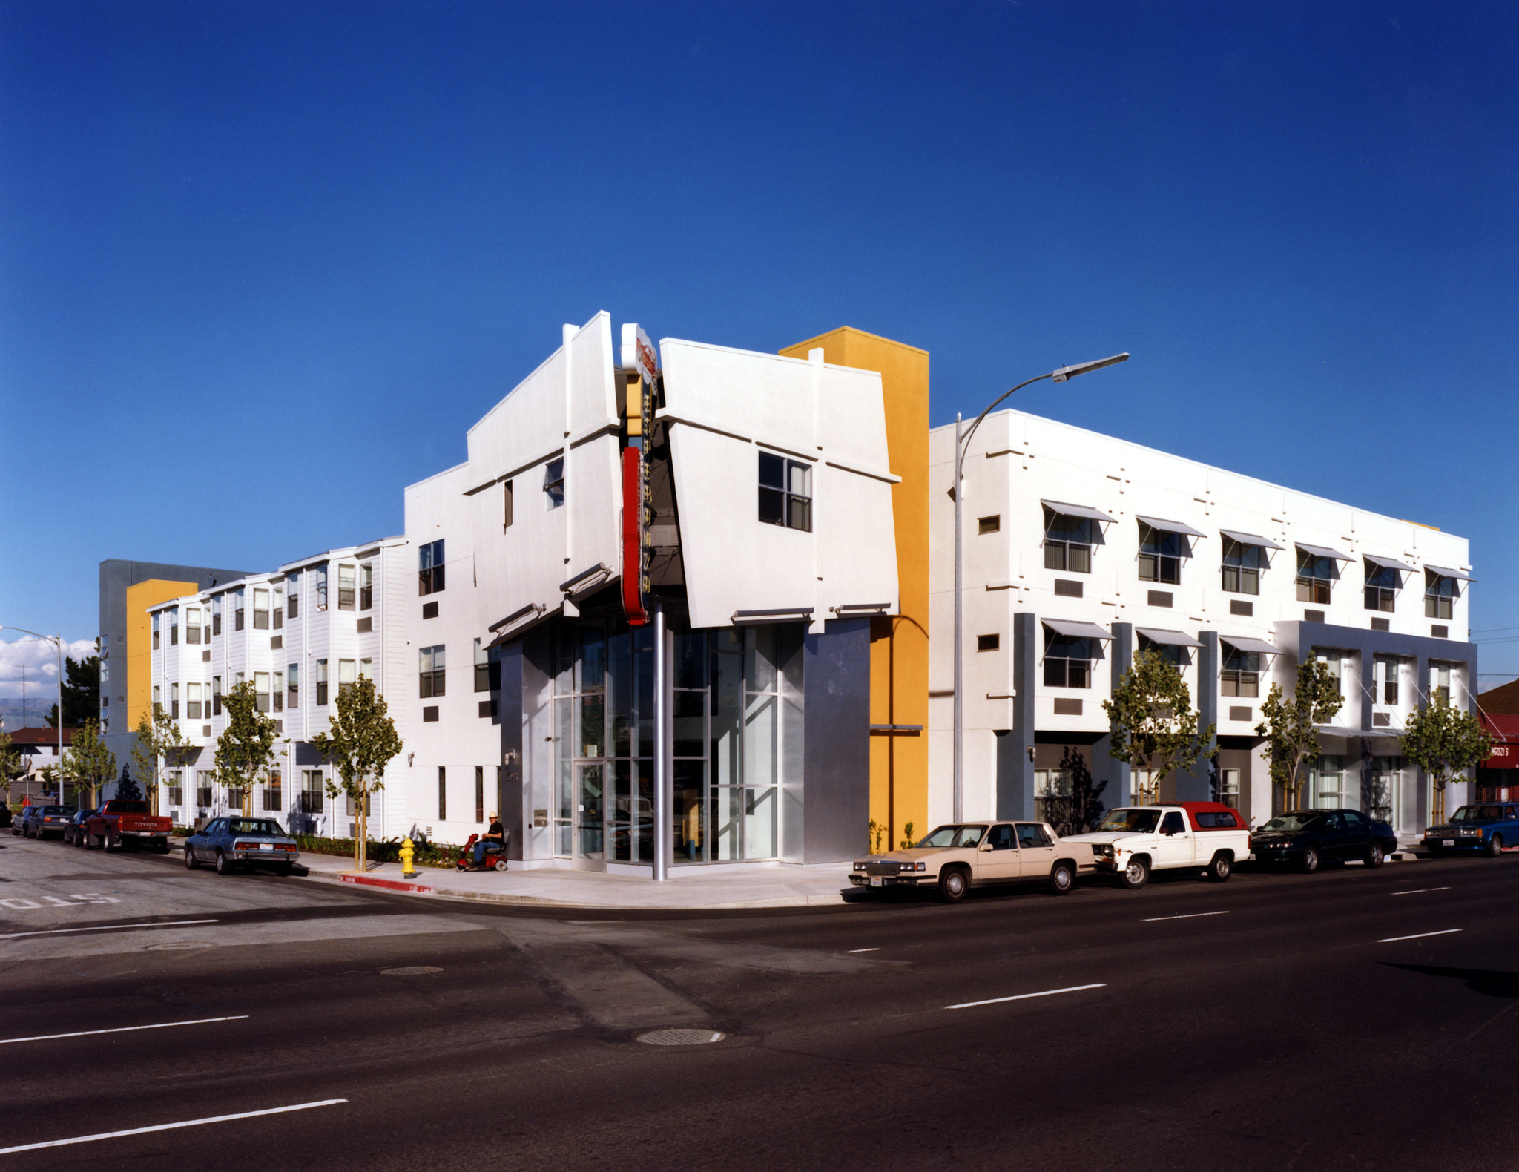
Santa Clara County
Planning Collaborative
January 21, 2021

Slide 2
Agenda
1. Announcements
2. Follow Up on Requested TA Products
- AB 1851
- What is Affordable Housing Handout
3. Environmental Justice Element
4. Survey of Local Jurisdictions’ Inclusionary & In-Lieu Fee
5. REAP Funding & Dreaming Big in 2021
6. Upcoming Meeting Schedule & Topics
7. Close

Slide 3
AB 1851 – Yes in God’s Back Yard
Reduced parking standards.
20% Lower-Income units or 100% moderate.
No more than 1 space per unit allowed.
Lower standards if within ½ mile of transit or shared car resource.
Can double count parking.

Slide 4
AB 1851: Example 1
Site: 100 Existing surface parking spaces
Proposes Project: 70 Affordable Units
Not Within ½ Mile of Transit
Parking Requirements: 1.25 spaces/unit
Max per AB1851: 70*1.25 = 88 Spaces
70 new spots + 18 shared spots

Slide 5
AB 1851: Example 2
Site: 100 Existing surface parking spaces
Proposes Project: 70 Affordable Units
Within ½ Mile of Transit
Max Parking: 1 spaces/units
Max Parking per AB 1851: 70 total/20 New

Slide 6
Products: Affordable Housing 101
Resources:
Nonprofit Housing Association of NorCal
https://nonprofithousing.org/events-and-programs/shift-the-narrative/
East Bay Housing Organizations
https://ebho.org/resources/what-is-affordable-housing/
SV@Home
https://siliconvalleyathome.org/resources/#housing-affordability

Slide 7
DRAFT: Who Needs Affordable Housing
Occupation | Mean Annual Wage | % of AMI for 1 person HH | % of Monthly income needed to afford fair market rent
Dishwashers | $30,160 | 30% | 98%
Retail Salespersons | $39,987 | 40% | 74%
Security Guards | $41,512 | 42% | 71%
Preschool Teachers, Except Special Education | $41,563 | 42% | 71%
Medical Assistants | $47,846 | 48% | 62%
Receptionists and Information Clerks | $39,239 | 40% | 75%
Notes:
(Based on fair market rent for a one bedroom in Santa Clara County (huduser.gov). Wage information from the California Employment Development Department)

Slide 8
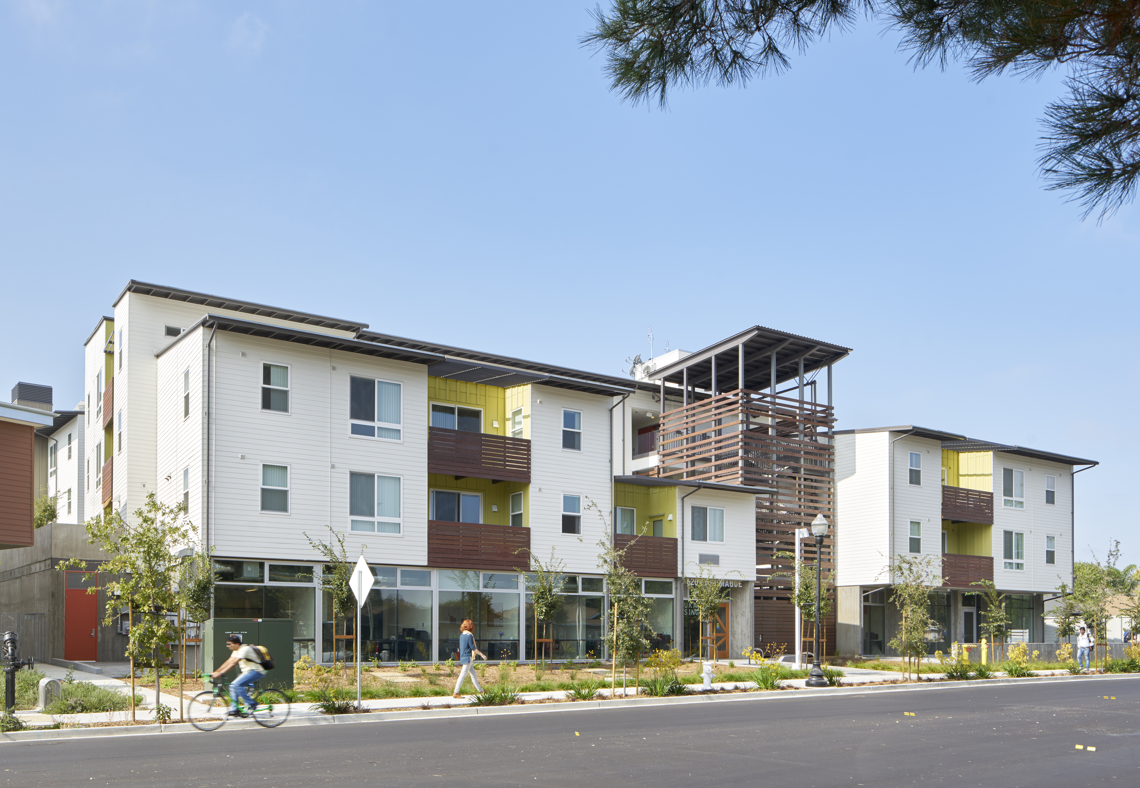
DRAFT: What does Affordable Housing Look Like

Slide 9
Environmental Justice
Thresholds
Updating two Elements
Have a Disadvantaged Community
Disadvantaged Communities (Legal)
‘Disadvantaged communities’ means an area identified by the California Environmental Protection Agency Pursuant to Section 39711 of the Health and Safety Code or an area that is a low-income area that is disproportionately affected by environmental pollution and other hazards that can lead to negative health effects, exposure, or environmental degradation.”
Disadvantaged Communities (Practical)
It’s technical and an art
75%+ on CalEnvironScreen
Low income (census tract level) + burdened
San Jose, Gilroy, Morgan Hill, Santa Clara, Alviso (Unincorprated Santa Clara County).
Notes:
Can be separate or can be integrated
Disadvantaged community is defined as: “‘Disadvantaged communities’ means an area identified by the California Environmental Protection Agency Pursuant to Section 39711 of the Health and Safety Code or an area that is a low-income area that is disproportionately affected by environmental pollution and other hazards that can lead to negative health effects, exposure, or environmental degradation.” (Gov. Code, § 65302, subd. (h)(4)(A)).”
OPR recommends the following methods for the disadvantaged community screening analysis 1. Use CalEnviroScreen to examine whether the planning area for the general plan contains census tracts that have a combined score of 75% or higher. 6 2. Map the household median incomes by census tract in the planning area at or below statewide median income and examine for disproportionate pollution burden. 3. Map the household median incomes by census tract in the planning area at or below the Department

Slide 10
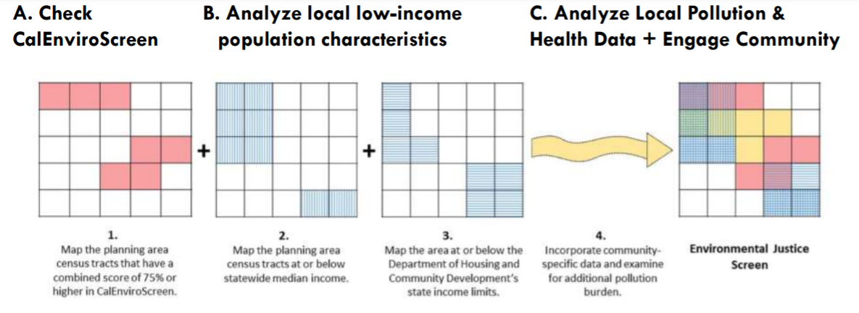

Slide 11
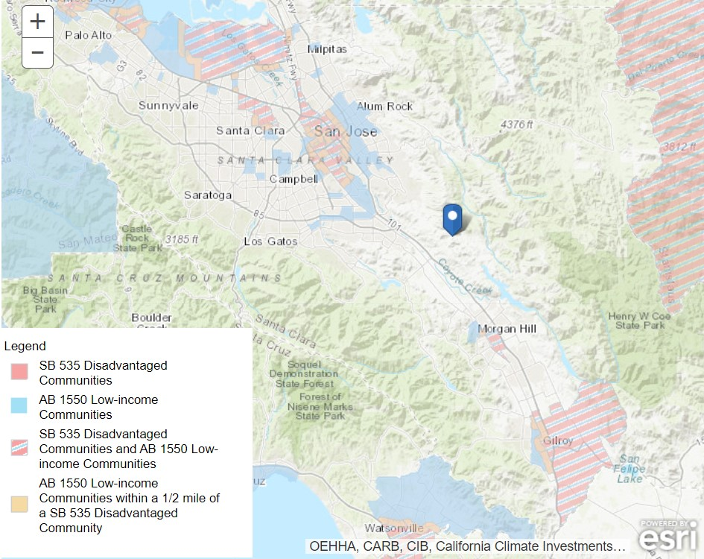
Notes:
https://ww3.arb.ca.gov/cc/capandtrade/auctionproceeds/communityinvestments.htm

Slide 12
Environmental Justice
Review Existing Policies and Programs:
What is happening now
New Policies
Reduce pollution exposure
Promote public facilities
Promote food access
Promote safe and sanitary homes
Promote physical activity
Reduce unique or compounded health risks
Promote civic engagement
Prioritize the needs of disadvantaged communities

Slide 13
Survey of Local Jurisdictions’ Inclusionary & In-Lieu Fees
Thanks Milpitas!
https://drive.google.com/file/d/1LwIy0XBQOxsfyXuvBTNhMkE93aBFspTq/view?usp=sharing

Slide 14
Ideas
Housing Element
Other Projects
Sites Inventory and Analysis
Outreach
Collaborative CEQA
Safety Element
Enviro Justice Element
ADU Promotion
Affordable Housing Resources
BMR best practices
Local preferences
Local Housing Trust Fund prioritizing and spending
Countywide Analysis to identify 9% TC opportunities
Objective Design Standards
Countywide CLT

Slide 15
Dreaming Big
Estimated REAP Funding for Santa Clara County
2021 $240,000
2022 $240,000
2023 $135,000
Total $615,000

Slide 16
Ideas
Housing Element
Other Projects
Sites Inventory and Analysis
Outreach
Collaborative CEQA
Safety Element
Enviro Justice Element
ADU Promotion
Affordable Housing Resources
BMR best practices
Local preferences
Local Housing Trust Fund prioritizing and spending
Countywide Analysis to identify 9% TC opportunities
Objective Design Standards
Countywide CLT

Slide 17
Small Group Discussion
Are there any ideas that are missing?
Which ideas are most promising?

Slide 18
Ideas
Housing Element
Other Projects
Sites Inventory and Analysis
Outreach
Collaborative CEQA
Safety Element
Enviro Justice Element
ADU Promotion
Affordable Housing Resources
BMR best practices
Local preferences
Local Housing Trust Fund prioritizing and spending
Countywide Analysis to identify 9% TC opportunities
Objective Design Standards
Countywide CLT

Slide 19
Ideas
www.menti.com and use code 67 51 35 6

Slide 20
Upcoming Meeting Schedule & Topics
Next Meeting: 2/11/2021
Affirmatively Furthering Fair Housing
Monthly meetings on the second Thursday of each month through 2021.

