Slide 1
RHNA Methodology

Slide 2
RHNA Methodology
Status / Timing
Appeals

Slide 3
RHNA Methodology
Draft methodology (now)
State review
Final methodology (Spring 2021)
Draft allocations
Appeals (Summer 2021)
Final allocations (Dec 2021)

Slide 4
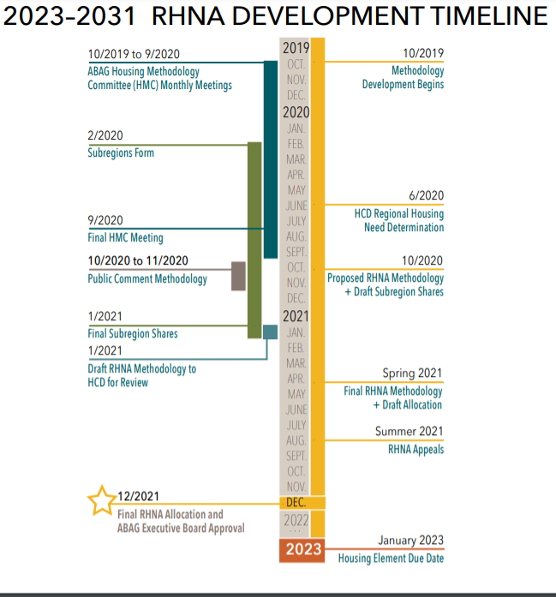

Slide 5
RHNA Allocations
Dec 2020 Revise for GHG/VMT
Jan 2020 Revise for Equity
Now Draft methodology / illustrative allocations

Slide 6
Santa Clara County Allocations
29% of RHNA
23% of region’s households (2020)
27% of regions jobs (2018)

Slide 7
State Review - Objectives
Increase the housing supply and the mix of housing types in an equitable manner
Promote infill development, efficient development, and GHG reduction
Promote better relationship between jobs and housing, particularly jobs housing fit
Balance existing disproportionate concentrations of income categories
Affirmatively furthering fair housing

Slide 8
HCD Review / Metrics
HCD reviews for compliance with objectives
ABAG self-evaluated based on S CA experience
METRIC 5c: Do jurisdictions with the largest percentage of high−income residents receive a share of the region's housing need that is at least proportional to their share of the region's households?
No formal comment period

Slide 9
Appeals – Big Picture
Opens in summer
Limited criteria
Low rates of changes in RHNA

Slide 10
Appeals – Legal Mumbo Jumbo
65584.05(b)(1): The council of governments failed to adequately consider the information regarding the factors listed in subdivision (e) of section 65584.04.
65584.05(b)(2): The council of governments failed to determine the share of the regional housing need in a manner that furthers the intent of the objectives listed in subdivision (d) of section 65584.
65584.05(b)(3): A significant unforeseen change in circumstances occurred in the local jurisdiction that merits a revision of the information submitted pursuant to subdivision (e) of Section 65584.04.

Slide 11
Appeals - Practical
3 out of 14 upheld (RHNA 5)
52 appeals, 2 partially upheld (SCAG)
Technical corrections most likely to result in a change
Remember scales (PBA/Housing Elements)

Slide 12
Appeals – HCD’s take
Several (jurisdictions) cite the lack of land suitable for development as a basis for the appeal…(however) even communities that view themselves as built out must plan for housing through means such as rezoning commercial areas as mixed-use areas and upzoning non-vacant land… Several appeals (argue) that the COVID-19 pandemic represents a significant and unforeseen change in circumstances that will affect future population and job growth. Ensuring everyone has a home is critical to public health. Reducing and preventing overcrowding and homelessness are essential concerns for every community. The COVID-19 pandemic has only increased the importance that each community is planning for sufficient affordable housing

Slide 13
Appeals – Big Picture
Opens in summer
Limited criteria
Low rates of changes to RHNA

