Slide 1
Santa Clara County Planning Collaborative
October 14, 2021
Notes:
https://www.dbarchitect.com/images/dynamic/slideshow_images/image//paseosenter1589bweb.jpg

Slide 2
Agenda
Announcements and Resources
Fees and Processing Times Survey
New Laws/SB 9
Objective Design Standards
Affirmatively Furthering Fair Housing
Let’s Talk Housing Round 2 and EAG

Slide 3
Collaborative Priorities 2021-2022
Intensive sites inventory and analysis
Outreach and community engagement/Let’s Talk Housing
Affirmatively furthering fair housing technical assistance and training
Local preferences ordinances best practices and templates
Assisting jurisdictions in interpreting and applying new laws and regulations (e.g. SB 9).

Slide 4
Announcements/Resources
Zoom Interpretation Training, October 28th, 11:00-11:30 AM
Upcoming ABAG Trainings:
HESS Tool 1.0 Tutorial Webinar, Tuesday, October 19, 9 – 11 am
https://bayareametro.zoom.us/webinar/register/WN_QqItqMCBTjOc0yIIZ0HrKA
Surplus Public Land: What Local Agencies Need to Know, Tuesday, October 26, 9 – 11 am
https://bayareametro.zoom.us/webinar/register/WN_xarcaBMWQYSQBuI2Odspsw

Slide 5
Announcements/Resources
HCD Office Hours November 1, 11 AM- 1 PM
https://calendly.com/daisy-bd/hcd-office-hours-2?month=2021-11&date=2021-11-01
HCD Staff for Santa Clara County
Irvin Saldana
Irvin.saldana@hcd.ca.gov
Divya Ram
Divya.ram@hcd.ca.gov
HCD Staff
Balancing Act
Other?

Slide 6
Announcements/Resources
Social Media Toolkit (updated 10/12/21)
https://abag.ca.gov/technical-assistance/rhta-social-media-toolkit
Balancing Act
Discount available to cities not selected for free license. Contact (chris@abalancingact.com) for more information.
Other Announcements?
Balancing Act
Other?
Notes:
ABAG’s Regional Housing Technical Assistance Program is offering up to 25 free, one-year licenses to Bay Area jurisdictions to pilot an online public engagement tool called Balancing Act. The tool allows community members to offer comments and suggestions on location and type of housing they think should be included to meet the jurisdiction’s RHNA requirements. There are some options to provide parts of the tool’s text in languages besides English, including Spanish, simplified Chinese and Vietnamese. Any user-specific content can be translated by the jurisdiction and embedded into the tool.
ABAG will hold the contract with Balancing Act for these licenses and provide log-in credentials to participants, who will then work with Balancing Act to customize the tool for use on city or county websites. You can learn more about the tool and how several cities used this online platform to broaden the conversation on housing in this brief video here.
It’s easy to apply to be considered for a free Balancing Act license, just complete this short online questionnaire. Applications will be evaluated based on a short narrative about how the Local Jurisdiction proposes to use the Balancing Act tool to enhance public engagement and affirmatively further fair housing. If we are oversubscribed, preference will be given to local jurisdictions with funding gaps for public outreach on their housing elements.

Slide 7
Fees and Processing Times Survey
Hypothetical Development Types:
Single Family (2,600 & 5,000 SF)
Multifamily (100 units &10 Units)
Other?

Slide 8
Fees and Processing Times Survey
Question: for the Following Prototypes what is the average percent of total
development costs added by fees?
 | Planning and Permit Fees as % of Dev. Costs | Impact Fees as % of Dev. Costs | Total Fees as % of Dev. Costs
Single Family Homes |  |  | 0.0%
Townhomes |  |  | 0.0%
Multi-Family |  |  | 0.0%
Accessory Dwelling Units |  |  | 0.0%

Slide 9
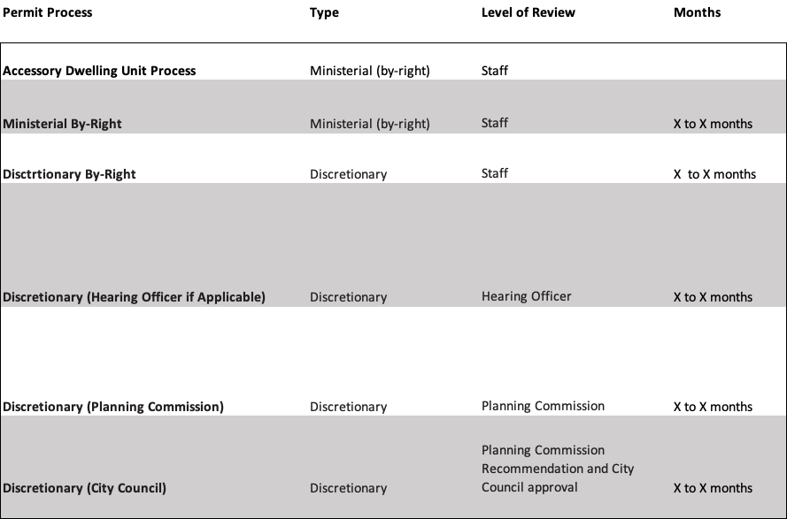
Fees and Processing Times Survey

Slide 10
New Laws
SB 9 – Ministerial approval of qualifying “duplex” units and urban lot splits
AB 215 – Adds a 30-day public comment period w/ 10-day response time for the draft Element prior to submission to HCD + 30 more days for HCD to review
Summary of new laws from Terner Center:
https://ternercenter.berkeley.edu/research-and-policy/single-family-zoning-reform-highlights-a-breakthrough-in-california-housing-policy/

Slide 11
SB 9 Resources
Webinar for jurisdiction staff to provide an overview of SB 9
https://abag.ca.gov/technical-assistance/context-sb-9-and-potential-impacts-webinar
Terner Center Report
https://ternercenter.berkeley.edu/research-and-policy/duplexes-lot-split-sb-9/
Notes:
Describe here materials to be provided by ABAG and Collaborative through both Goldfard and Lipman engagement and other Resources under development.
In the interim, HCD is generally looking at the Terner Report as the most definitive data source available to date. Given the low yield predicted by Terner, and the unique parcel characteristics in different jurisdictions, I am not optimistic about the likelihood of a safe harbor. Our best bet might be to identify jurisdictions with a significant number of large flat lots with small houses and large enough side setbacks to accommodate driveways (or lots of corner lots) and try to negotiate with HCD as a group

Slide 12
SB 9 TA Products
FAQs (next week)
Infographic to help community members understand the implications of SB 9 in simple terms
Presentation slides with talking notes that jurisdictions can use to make their own presentations
Template Staff Report for Santa Clara County jurisdictions
Other?
Notes:
Describe here materials to be provided by ABAG and Collaborative through both Goldfard and Lipman engagement and other Resources under development.
In the interim, HCD is generally looking at the Terner Report as the most definitive data source available to date. Given the low yield predicted by Terner, and the unique parcel characteristics in different jurisdictions, I am not optimistic about the likelihood of a safe harbor. Our best bet might be to identify jurisdictions with a significant number of large flat lots with small houses and large enough side setbacks to accommodate driveways (or lots of corner lots) and try to negotiate with HCD as a group

Slide 13
Objective Design Standards
Discussion: Coordinated Countywide Effort?
Survey:
https://www.surveymonkey.com/r/KB39P9S
Notes:
https://www.surveymonkey.com/r/KB39P9S

Slide 14
AFFH Resources
Staff report
https://abag.ca.gov/tools-resources/digital-library/affhtemplatestaffreport81621docx
Slide deck
https://abag.ca.gov/tools-resources/digital-library/affhtemplatestaffslidedeck81121pptx
Data Guidance Checklist
https://abag.ca.gov/tools-resources/digital-library/draftaffhdataguidancechecklist81621xlsx

Slide 15
AFFH Resources
Crosswalk of ABAG Data checklist with AFH Data provided by Lawyer’s Committee.
Discussion: what would be most useful for SCC jurisdictions for the AFFH analysis at this point. Detailed tables and narrative? Other?
Notes:
From Thomas at Lawyers’ Committee (9/22)
Hi Diana, the list below captures what the current AFHs do not have from the attached ABAG check list.
Row 10 – Discuss levels of segregation and integration for race and ethnicity, income, familial status, persons with disabilities - Segregation is analyzed but not by income level
Row 16 - Map concentrations of low- and moderate-income households within the community – Not included, possible that this is in the Con Plan
Row 18 - Comparison between regional and local racially concentrated areas of affluence – Discussed thematically in many places but not explicitly mapped and terminology not used
Row 19 - Patterns and changes over time in racially concentrated areas of poverty and affluence – Change over time assessed for R/ECAPs but RCAAs
Row 38 - Assess any disproportionate transportation needs for members of protected classes – Access is analyzed but not need
Row 42 - Evaluate consistency with the environmental justice element – Not included (does EJ Element exist yet for Mountain View?)
Row 50 - Disability by Race/Ethnicity/National Origin – Not included
Row 59 - Assessment of accessibility of homelessness programs and coordinated entry system – Not framed this way but contributing factors analysis generally gets at this
Rows 61-63 – Various data points re stock of accessible housing – There is data in the report, but it is pretty spotty
Row 70 - Cost burden and severe cost burden for both owners and renters. Identifying the protected groups (e.g., race/ethnicity, familial status, persons with disabilities and income) that experience higher rates of housing cost burden. – Not included for income but it is included for protected classes
Row 71 - Overcrowding and severe overcrowding for both owners and renters. Identifying the protected groups (e.g., race/ethnicity, familial status, persons with disabilities and income) that experience higher rates of overcrowding. – Not included for income but it is included for protected classes
Row 72 - Prevalence of substandard housing problems. Identifying the protected groups (e.g., race/ethnicity, familial status, persons with disabilities and income) that experience higher rates of housing substandard housing. – Good data on substandard housing conditions was lacking
Row 78 - "n assessment of displacement addressing three processes: movement of people, public policies and investments, such as capital improvements and planned transit stops, and flows of private capital. – Not included
Row 79 - Address the potential displacement from local environmental hazard, referencing the Local Hazard Mitigation Plan, Safety Element, Environmental Justice Element, and any recent locally available hazard data in detailing the types of environmental hazards present in the community, the location of high hazard risk areas in the community, and what type of populations live in those areas of heightened hazard risk. – Narrower scope of analysis and not framed as displacement issue (instead, access to opportunity)
Row 80 - Note the potential impacts of disasters on protected classes and low-income residents, particularly low-income renter populations. – Not included
Row 81 - Analysis of government investments in physical infrastructure, such as rail transit, schools, parks, and highways, all of which can be associated with increasing home values and subsequent displacing forces – Not included
Row 88 - Restrictive covenants and other discriminatory practices – Restrictive covenants not analyzed
Row 97 – Construction – Not included

Slide 16
Let’s Talk Housing Next Steps
Notes:
Paul introduce, hand off to daisy

Slide 17
Let’s Talk Housing Next Steps
Posting session recording on website
Meeting summaries and registration lists
Equity Advisory Group Outreach and Listening Sessions with Jurisdictions
Countywide webinar and workshop series
Notes:
Daisy working on meeting summaries
Individual breakout room recordings saved by City notetakers
Recording of main session content available on web site

Slide 18
EAG Next Steps
Strategic EAG activities
Story-telling (videos, audio, written)
Happy Hour meet & greet
1-1 jurisdiction/community-based org meetings
Other possibilities
Notes:
Vu Bang

Slide 19
Webinar Series Proposal
Phase 2 of countywide outreach
Creating a countywide four-part series
Potential Topics:
Why Affordability Matters
Housing and Racial Equity
The Future of Housing and Climate Change
Balancing New Laws and Community Priorities
Other?

Slide 20
Webinar Series Proposal
1 hour
~30 min presentation/panel with Q&A
~20 min small group interaction
~10 min report out
Countywide audience
Language interpretation
Tools to continue the conversation
Recording, slide deck and support materials

Slide 21
Webinar Series Proposal
Small Group Discussion
Does this approach work?
Do the topics and sequence make sense and respond to priority needs/issues?
How can we make it most useful as a tool that supports your core housing element engagement?

Slide 22
Looking Ahead
Next Collaborative Meetings
November 18th, 2021
December 9th, 2021

