Slide 1
Santa Clara County Planning Collaborative Meeting
December 9, 2021

Slide 2
Agenda
Announcements
SB 9 Products – Paul Peninger/Kristy Wang
General
Objective Design Standards
AFFH Technical Assistance
Government Constraints Analysis
Housing Element Update Timeline
Local Preferences
Product Requests
Letter for property owners
Other?

Slide 3
Announcements
Planning Collaborative + Equity Advisory Group Happy Hour next Tuesday: We encourage jurisdiction staff to join and meet EAG members over drinks and food! Next Tuesday, December 14, from 5:00 – 6:30pm at the River Rock Taproom (155 S Murphy Ave, Sunnyvale, CA 94086, USA)
ADU Calculator for Santa Clara County
ABAG Resources and Training Materials – Somaya

Slide 4
ABAG Announcements
12/9/2021

Slide 5
Regional Housing Needs Allocation
On December 16, 2021, the ABAG Executive Board will conduct a public hearing to consider adoption of the Final RHNA Plan.
Housing Element Law allows an unincorporated county and one or more jurisdictions in the county to voluntarily agree on a transfer of units from the County to the city or town after adoption. Contact Gillian Adams (gadams@bayareametro.gov) with questions.

Slide 6
SB9 Technical Assistance
MTC-ABAG is working to produce a suite of SB9 technical assistance materials. Stay tuned for release after internal legal review
Infographic
Legal summary
Template staff reports/presentations
Model ordinance

Slide 7
HESS 1.0 and 2.0 Modules
HESS 1.0 available now to local planning staff and Housing Element consultants. Register at: https://hess.abag.ca.gov/new/user/account
Filter sites
View and edit site details
Identify action items for inclusion in Sites Inventory
Auto-Populate HCD’s Site Inventory Form with selected sites
Request Office Hours at housingTA@bayareametro.gov
HESS 2.0 Modules coming soon
AFFH Data Layers to be added by end of this year
AFFH Dashboard with summary analyses in Jan or Feb 2022
Capacity Calculations pre-reviewed by HCD in Jan or Feb 2022

Slide 8
Symbium Plancheck Licenses
ABAG is offering 10 free licenses to Symbium Plancheck, a software program designed to streamline jurisdictions’ plan review of residential projects
Jurisdictions may apply for a free license through ABAG by December 22 at 5pm: https://abag.ca.gov/our-work/housing/regional-housing-technical-assistance/resources-translation-services

Slide 9
AFFH
Existing suite of AFFH products can be found here: https://abag.ca.gov/our-work/housing/regional-housing-technical-assistance/affirmatively-furthering-fair-housing
AFFH Template Staff Report.
AFFH Template Staff Slide Deck.
Draft AFFH Data Guidance Checklist
AFFH Products coming soon:
Individually tailored reports on segregation patterns for all 109 jurisdictions, similar to the previously released Data Packets.
Final AFFH Data Checklist that summarizes data points required by HCD’s AFFH Guidance Memo.
Guidance materials about developing policies and programs that address AFFH.

Slide 10
Leading with Equity Workgroup
Work group focused on bringing together planners from across the region striving to embed equity in their housing policy and planning work
4 three-hour sessions in the first half of 2022
Find out more and apply by December 15: https://www.surveymonkey.com/r/F6F8JBM

Slide 11
Transforming Malls and Office Parks into Neighborhoods
MTC-ABAG is offering a three-module work group series starting in early 2022 to support communities exploring or pursuing the reuse of large commercial sites
Housing Element integration
Planning for redevelopment
Implementation and financing
Please contact Bobby Lu (blu@bayareametro.gov) with questions

Slide 12
Public Lands Re-use Initiative
MTC/ABAG launched a Public Lands Reuse Initiative to implement one of Plan Bay Area 2050’s key housing strategies focused on accelerating the reuse of public lands for affordable housing and essential services
Complete the survey by December 23, 2022: https://www.surveymonkey.com/r/P79YHHH
Please direct any questions or concerns to Corinne Tsai (ctsai@bayareametro.gov) or Mark Shorett (mshorett@bayareametro.gov)

Slide 13
AFFH Technical Assistance
Lawyers Committee will Provide Direct TA to local jurisidicitons.
Data tables and maps to supplment AFH analyeses.
Coordinated with ABAG and HCD.
Questions? Requests?

Slide 14
Government Constraints Survey
Survey of jurisdictions on fee and permit processing times.
Collabirative will collect data, analyze results and prepare a memo suitable for insertion in Housing Element Government Constraints section.
Designate a key staff person or persons to fill out by Mid-January.

Slide 15
Housing Element Status and Timing
Where are you at?
https://docs.google.com/spreadsheets/d/18rrkfYHPesZaMHdLWJCx0J6yTJ_ZmjxIQNgUdGXfNcg/edit?usp=sharing

Slide 16
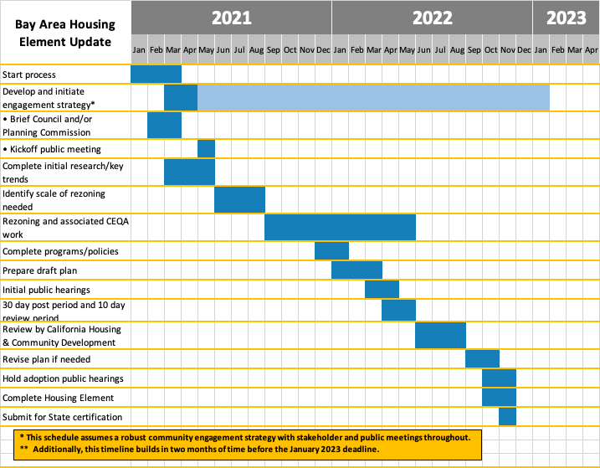
Housing Element Status and Timing
* This schedule assumes a robust community engagement strategy with stakeholder and public meetings throughout. ** Additionally, this timeline builds in two months of time before the January 2023 deadline.

Slide 17
Establishing a Local Preference Policy Step by Step
Define types of preferences desired (live, work, live/work, other)
Prepare a displacement study to show the need for a local preference policy
Prepare a disparate impact analysis to ensure that the implementation of the proposed policy will not adversely impact protected classes
Refine the preferences policy consistent with the study findings
Adopt and implement the policy

Slide 18
Case Study: Redwood City
Policy Rationale: prevent Displacement and reduce greenhouse gas emissions.
Policy and Disparate Impact Study Prepared July 2021
Preference for 100% of eligible units
People displace by city activities
Local residents
Local workers
Notes:
Redwood City is considering adopting a local live/work policy that would require developers to provide a local preference
for affordable rental and ownership housing units that are required to be produced under the City's Affordable Housing Ordinance to
income-eligible households who are (i) displaced by activity by the City, (ii) current and former city residents, and/or (iii) persons
currently employed in the City or that have been offered employment in the City. This report presents data and analysis that
demonstrates the need for the City’s proposed live/work policy and analyzes whether this policy would result in a disparate impact to
protected classes.
The City has articulated two primary purposes in support of the
local live/work policy: (1) to reduce the impacts of the City’s
jobs/housing imbalance and (2) to reduce the displacement of
lower income households by providing affordable housing
opportunities for lower income households. In addition, the
City has a secondary purpose for the local preference, which
is to reduce greenhouse gas emissions (GHG) by providing
affordable housing that is located near to where the City's
lower wage employees work.

Slide 19
Local Preferences
Discussion:
Prepare sub-regional displacememnt and disprate impact studies?
What are some other opportinities for collaboration?
Questions? Requests?

Slide 20
Product Requests? Questions?

