Slide 1
[Jurisdiction Name] SB 9 Presentation Template

Slide 2
SB 9: The California HOME Act (Atkins)
Requires ministerial approval of a/an:
Two-unit housing development – Two homes on a single-family residential parcel
Urban lot split - A one-time subdivision of an existing single-family residential parcel into two parcels
Notes:
Signed into law on September 16, 2021
Goes into effect January 1, 2022
Two primary components
(Also Subdivision Map Act amendment, not controversial)

Slide 3
SB 9: The California HOME Act (Atkins)
Approvals must be based only on objective standards (and cannot preclude construction of 2 units of < 800 sf)
Denials only permitted if projects do not meet objective standards or if there are “specific, adverse impacts” on public health and safety
Limitations on how jurisdictions regulate SB 9 projects, including setback and parking requirements and requirement that attached buildings must be allowed

Slide 4
Which parcels are affected by SB 9: Qualifying Criteria
All single-family residential zoned properties within urbanized areas, EXCEPT:
Environmentally sensitive areas and environmental hazard areas (if specific mitigations are not possible)
Historic properties and districts
Properties where the Ellis Act was used to evict tenants in the last 15 years
Additionally, demolition is generally not permitted for rental units or deed-restricted rental units
Notes:
What parcels are affected by SB 9

Slide 5
What Can Be Built: Current Law
Under current state law, single-family zoned property allows 3 units:
1 primary dwelling unit
1 accessory dwelling unit (ADU)
1 junior accessory dwelling unit (JADU)
3 Total Housing Units

Slide 6
What Can Be Built: Lots Not Being Subdivided (Two-Unit Devts)
Vacant lot: Build two primary dwelling units
Lot with a single family home: add an additional primary dwelling unit
But SB 9 could be interpreted to allow 2 new units beyond an existing unit
It is still unclear how many ADUs and JADUs may be allowed

Slide 7
What Can Be Built: Lots Not Being Subdivided (Two-Unit Devts)
1 Existing Primary Dwelling Unit
1 New Primary Dwelling Unit
1 New Accessory Dwelling Unit
1 Junior Accessory Dwelling Unit
4 Total Housing Units (Subject to verification by legal counsel / HCD)
OR
2 New Primary Units (attached or detached)
1 New Accessory Dwelling Unit
1 Junior Accessory Dwelling Unit
4 Total Housing Units (Subject to verification by legal counsel / HCD)

Slide 8
What Can Be Built: Lots Being Subdivided (Urban Lot Splits)
Homeowners can build 2 homes on each of the 2 new lots, allowing for a total of 4 units
If there are existing units, new homes can be added to result in a maximum of 4 potential units
However, a jurisdiction may choose to allow more units (ADUs and JADUs)
Homes are subject to objective rules, as long as the rules do not preclude two 800 sf units on each property

Slide 9
What Can Be Built: Lots Being Subdivided
Empty lot = Split to two lots with 2 new homes on each
= 4 Total Housing Units
OR
Single family home = Split to two lots.
Lot 1 = 1 existing + 1 new Lot 2 = 2 new
= 4 Total Housing Units

Slide 10
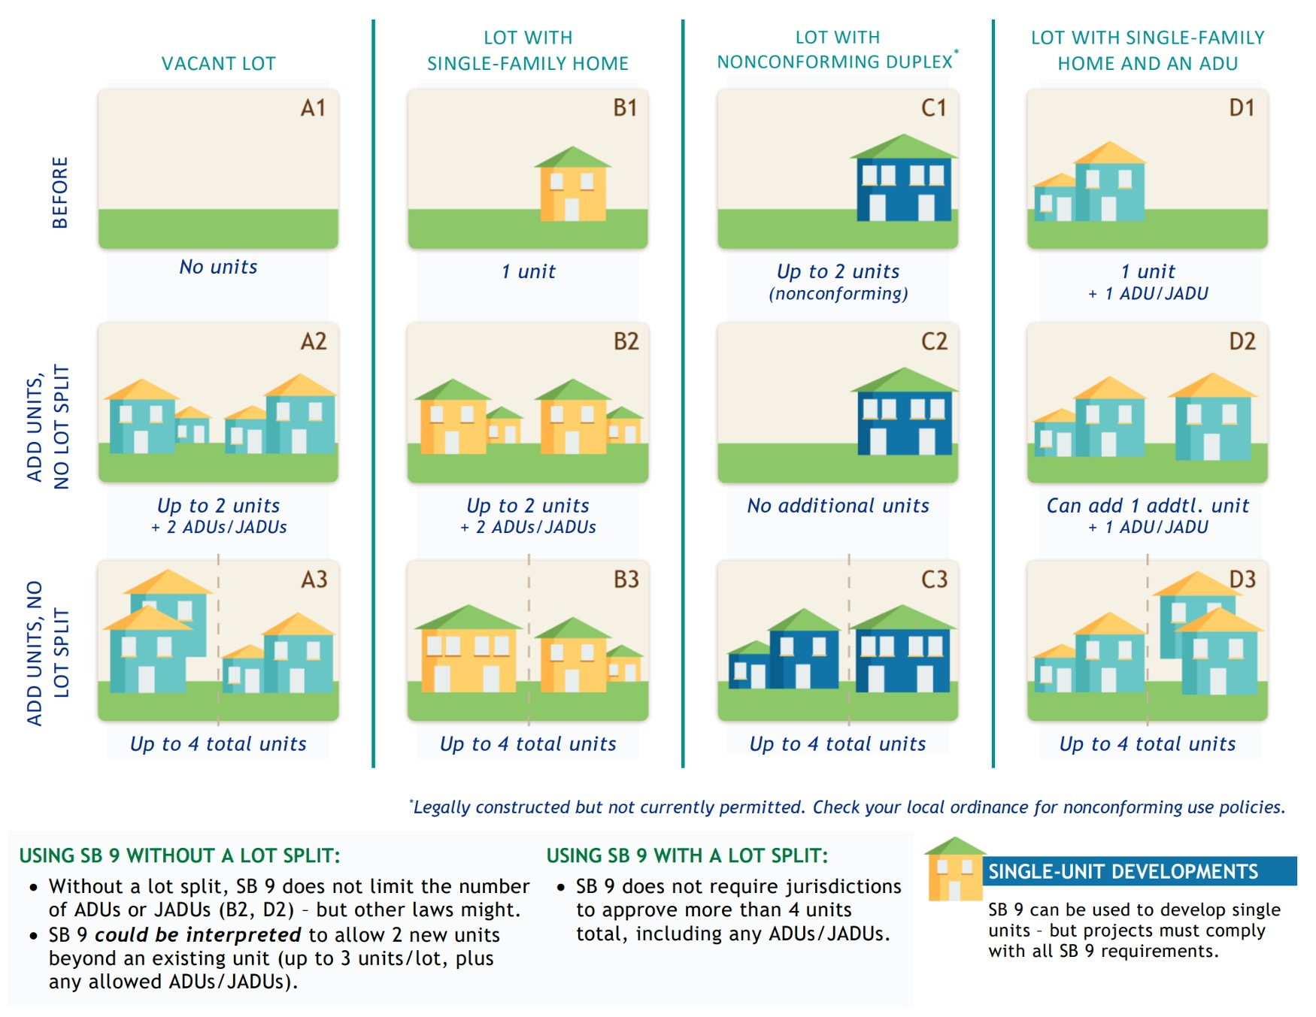
Potential Development Scenarios

Slide 11
Potential New Home Creation
[Jurisdiction Name] has approximately [#] single-family residential lots that would be subject to SB 9
Past experience with Accessory Dwelling Unit laws suggests that only a small percentage of owners will use SB 9. In [YEAR] a total of [#] permits for ADUs were filed in [Jurisdiction Name], and all/almost all were for 1 ADU per lot

Slide 12
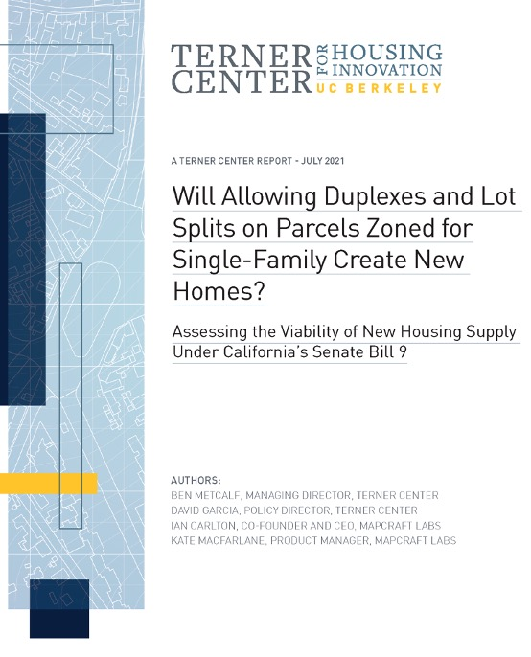
Potential New Home Creation
Impacts likely to be modest and gradual in most communities
According to an analysis by UC Berkeley’s Terner Center:
SB 9’s primary impact will be to unlock incrementally more units on parcels that are already financially feasible under existing law, typically through the simple subdivision of an existing structure. Relatively few new single-family parcels are expected to become financially feasible for added units as a direct consequence of this bill.
Notes:
https://ternercenter.berkeley.edu/research-and-policy/duplexes-lot-split-sb-9/

Slide 13
Potential New Home Creation
[FOR JURISDICTIONS WITH MORE THAN 5,000 SINGLE-FAMILY PARCELS]:
UC Berkeley's Terner Center estimates that [#] of [Jurisdiction Name]'s single-family parcels would be economically viable to allow new unit construction under SB 9, representing the potential creation of [#] new units
Notes:
Jurisdiction-level analysis results (places with more than 5,000 single-family parcels) are linked at this page (after the link to the full report):
https://ternercenter.berkeley.edu/research-and-policy/duplexes-lot-split-sb-9/

Slide 14
Regional Housing Needs Allocation (RHNA)
SB 9 units may count for purposes of Housing Elements and RHNA, but methodology is currently unclear
In the future it will be based on actual trends (like ADUs), but there is no time to establish a pattern for this housing element
Guidance from HCD is expected in the coming months

Slide 15
Missing Middle Housing
House-scale buildings with multiple units in walkable neighborhoods
Notes:
How might SB 9 be an opportunity
What is missing middle housing? - House-scale buildings with multiple units in walkable neighborhoods
Recent interest from lots of jurisdictions as a way to increase housing in a neighborhood-friendly way

Slide 16
Missing Middle Housing

Slide 17
Missing Middle Housing

Slide 18
Missing Middle Housing

Slide 19
KEY ACTIONS & DECISIONS
KEY QUESTION - What does the council like about missing middle housing and what aspects do they have concerns about?
This will help guide implementation of SB 9 in [Jurisdiction Name]

Slide 20
KEY ACTIONS & DECISIONS
ADDITIONAL QUESTIONS
Parking - Should parking be set to the state limits or lowered?
Owner occupancy - Should there be owner occupancy requirements for 2-unit developments?
ADUs – To the extent SB 9 permits [Jurisdiction Name] to decide, should we allow ADUs with SB 9 properties?
Larger units – Does [Jurisdiction Name] want to encourage units larger than 800 sf?
Lot split versus small multifamily on one lot – Does [Jurisdiction Name] prefer to incentivize owners to choose 2+ units on single lot or urban lot splits, or do we have no preference?
Objective standards – Should [Jurisdiction Name] apply regular objective standards to the extent they don’t preclude objective standards, or should we adopt a new set of objective standards?

Slide 21
KEY ACTIONS & DECISIONS: NEXT STEPS
Implementing Ordinance
Objective Zoning/Subdivision/Design Standards
Application forms and checklist

