Slide 1
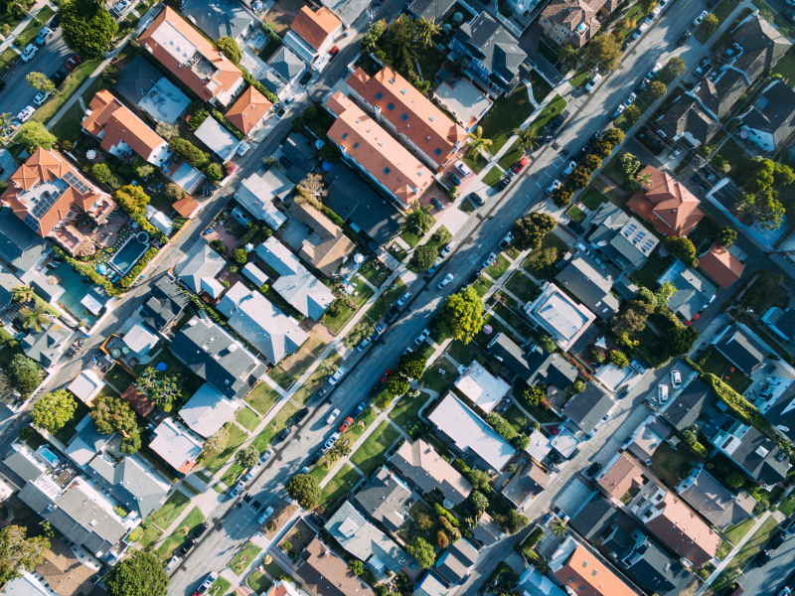
SB9 Residential Analysis
^{SB 9 Residential}
^{Analysis}
^{Prepared by}
^{Dreiling Terrones Architecture}
^{for}
Association of Bay Area Governments
(Basis of Design: current City of Burlingame
^{Zoning Ordinances)}
^{December 2, 2021}

Slide 2
Prototypical Duplex Streetscape
Two – Duplex A: Lot Split
Duplex: Standard Lot
Two – Duplex B: Lot Split
Prototypical Duplex Streetscape
/Residential Study
SB 9 – Duplexes and Lot Splits
Notes:
These drawings will show some possible developments that could exist as a result of the recently passed SB 9 legislation that would fit in to existing single-family residential neighborhoods. We made certain assumptions, regarding prototypical lots and setbacks (based on the Zoning Ordinances of the city that we are located in, Burlingame), and drew what made sense for neighborhoods as well as the goals that SB 9 aims to make possible.

Slide 3
Prototypical Duplex Streetscape with focus on Duplex on a Standard Lot
Duplex: Standard Lot
Prototypical Duplex Streetscape
/Residential Study
SB 9 – Duplexes and Lot Splits
Notes:
Duplex: Standard Lot

Slide 4
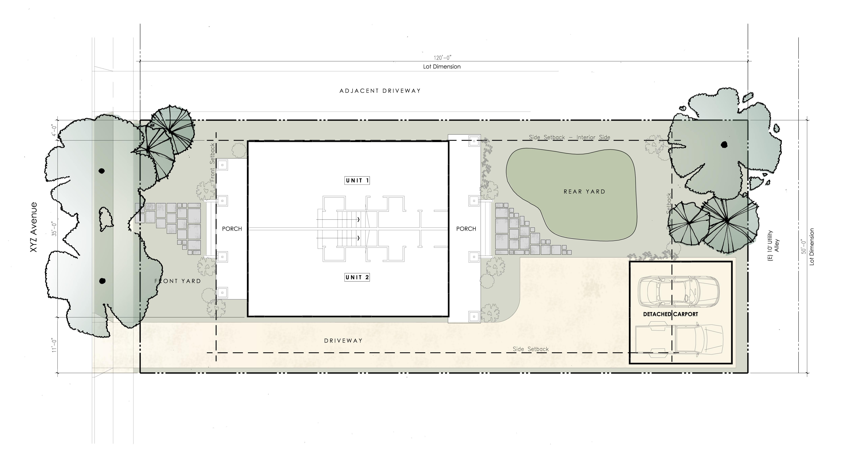
Duplex Standard Interior Lot in Plan View
Duplex: Standard Interior Lot
1” = 10’-0”
/Residential Study
Duplex: Standard Lot
Notes:
Takes a standard 6,000 square feet lot (in some localities 5,000 or 5,500 square feet).
This prototype maintains characteristics of typical single-family-zoned lots in R-1 districts:
Front porch
Driveway (with parking)
Rear yard
Residential-scale landscaping

Slide 5
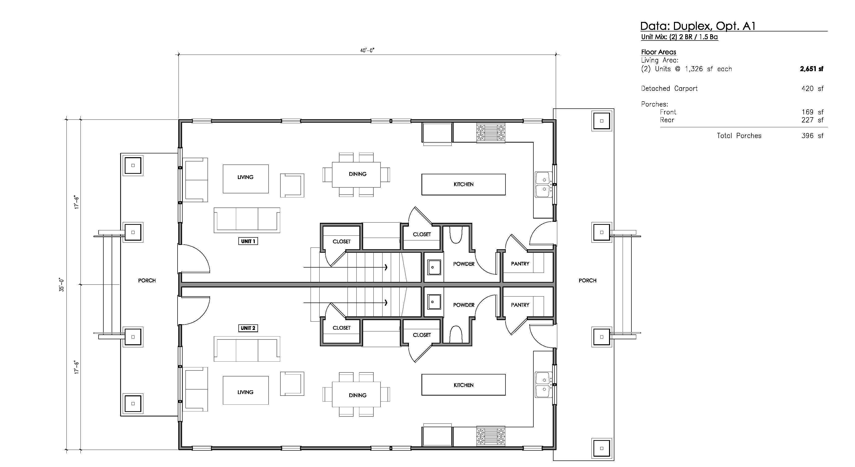
Duplex First Floor Plan View
Duplex: First Floor Plan
3/16” = 1’-0”
/Residential Study
Duplex: Standard Lot
Notes:
(2) two Bedroom and 1.5 Bath units, along a shared wall
Living Area:
(2) Units @ 1,326 square feet each – 2,651 square feet total
Has elements of contemporary / current living accommodations in a more traditional form:
Open plan
In-unit laundry
Shared porches

Slide 6
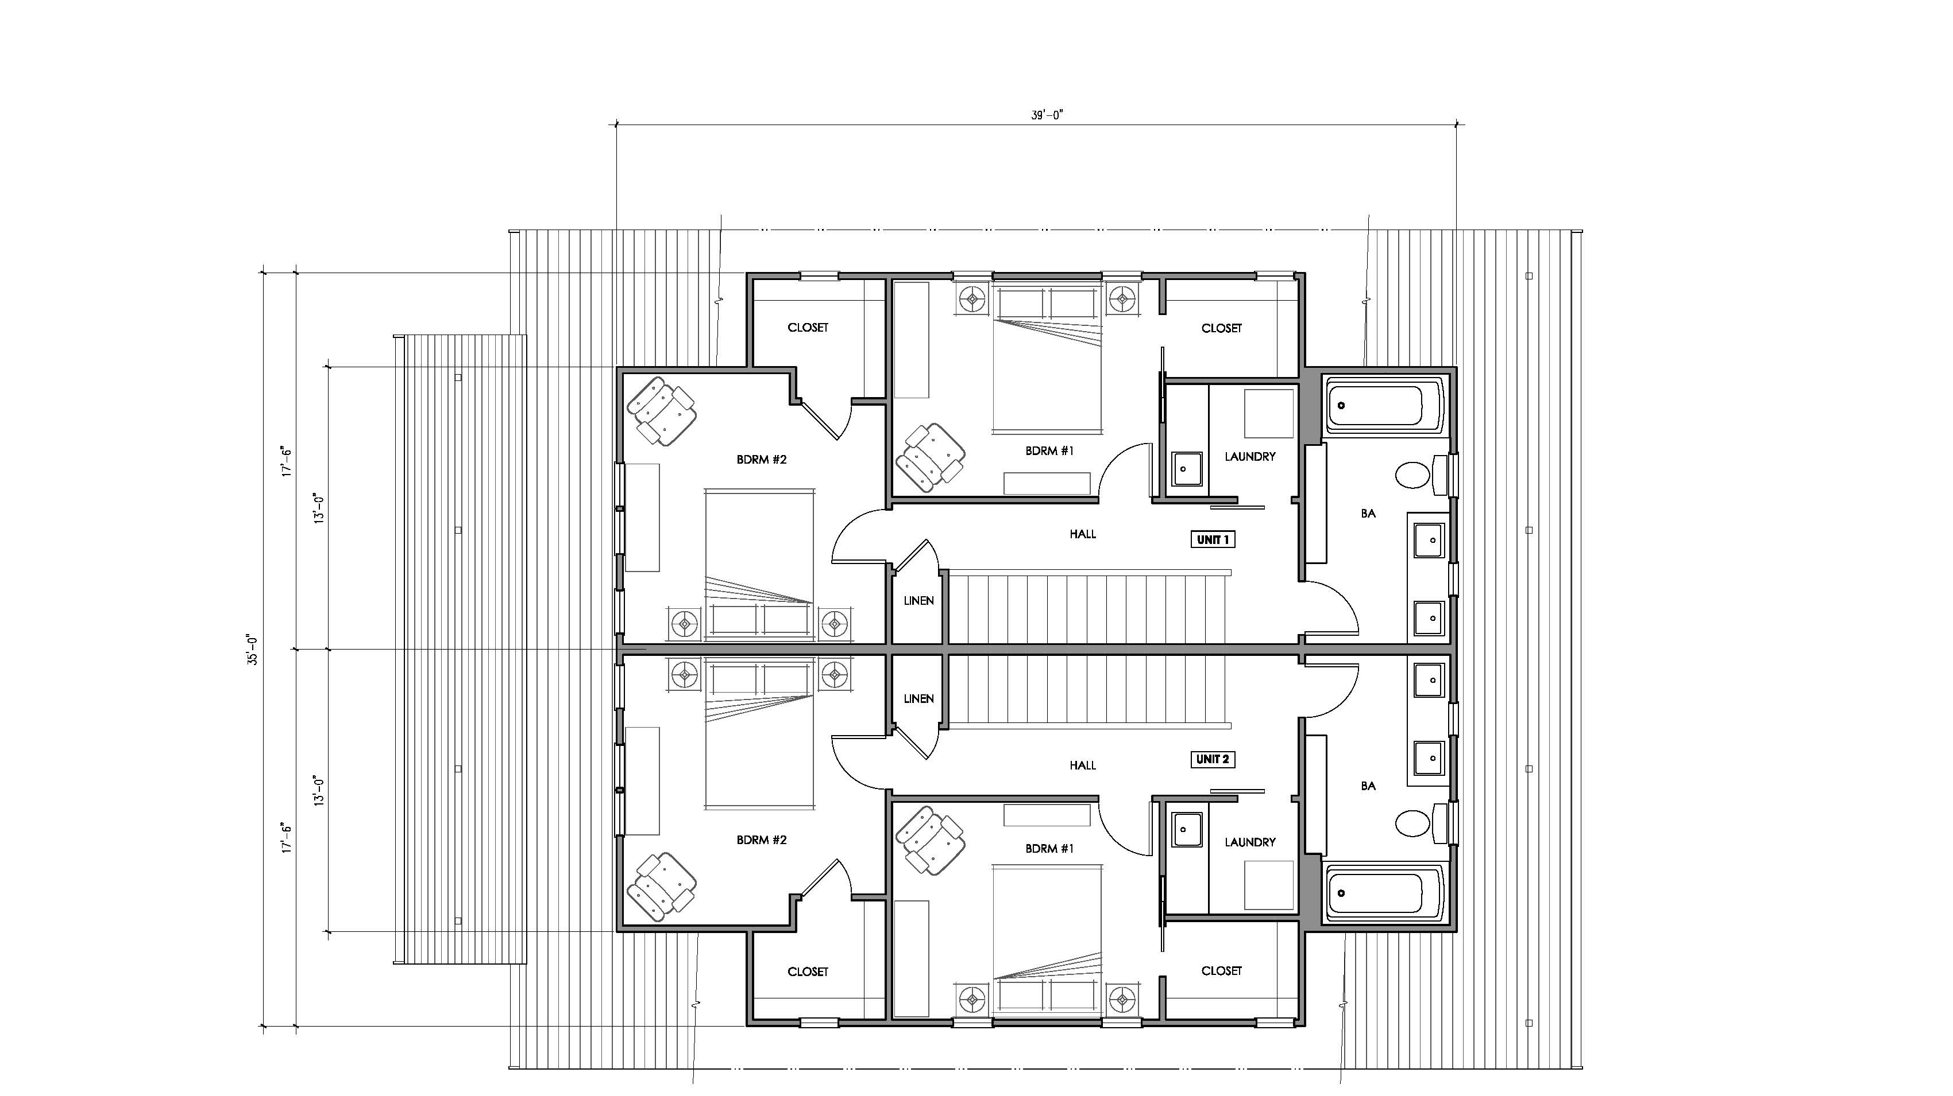
Duplex Second Floor Plan View
Duplex: Second Floor Plan
3/16” = 1’-0”
/Residential Study
Duplex: Standard Lot
Notes:
(2) Two bedroom and 1.5 Bath units, along a shared wall
Living Area:
(2) Units at 1,326 square feet each – 2,651 square feet total
Has elements of contemporary / current living accommodations in a more traditional form:
Open plan
In-unit laundry
Shared porches

Slide 7
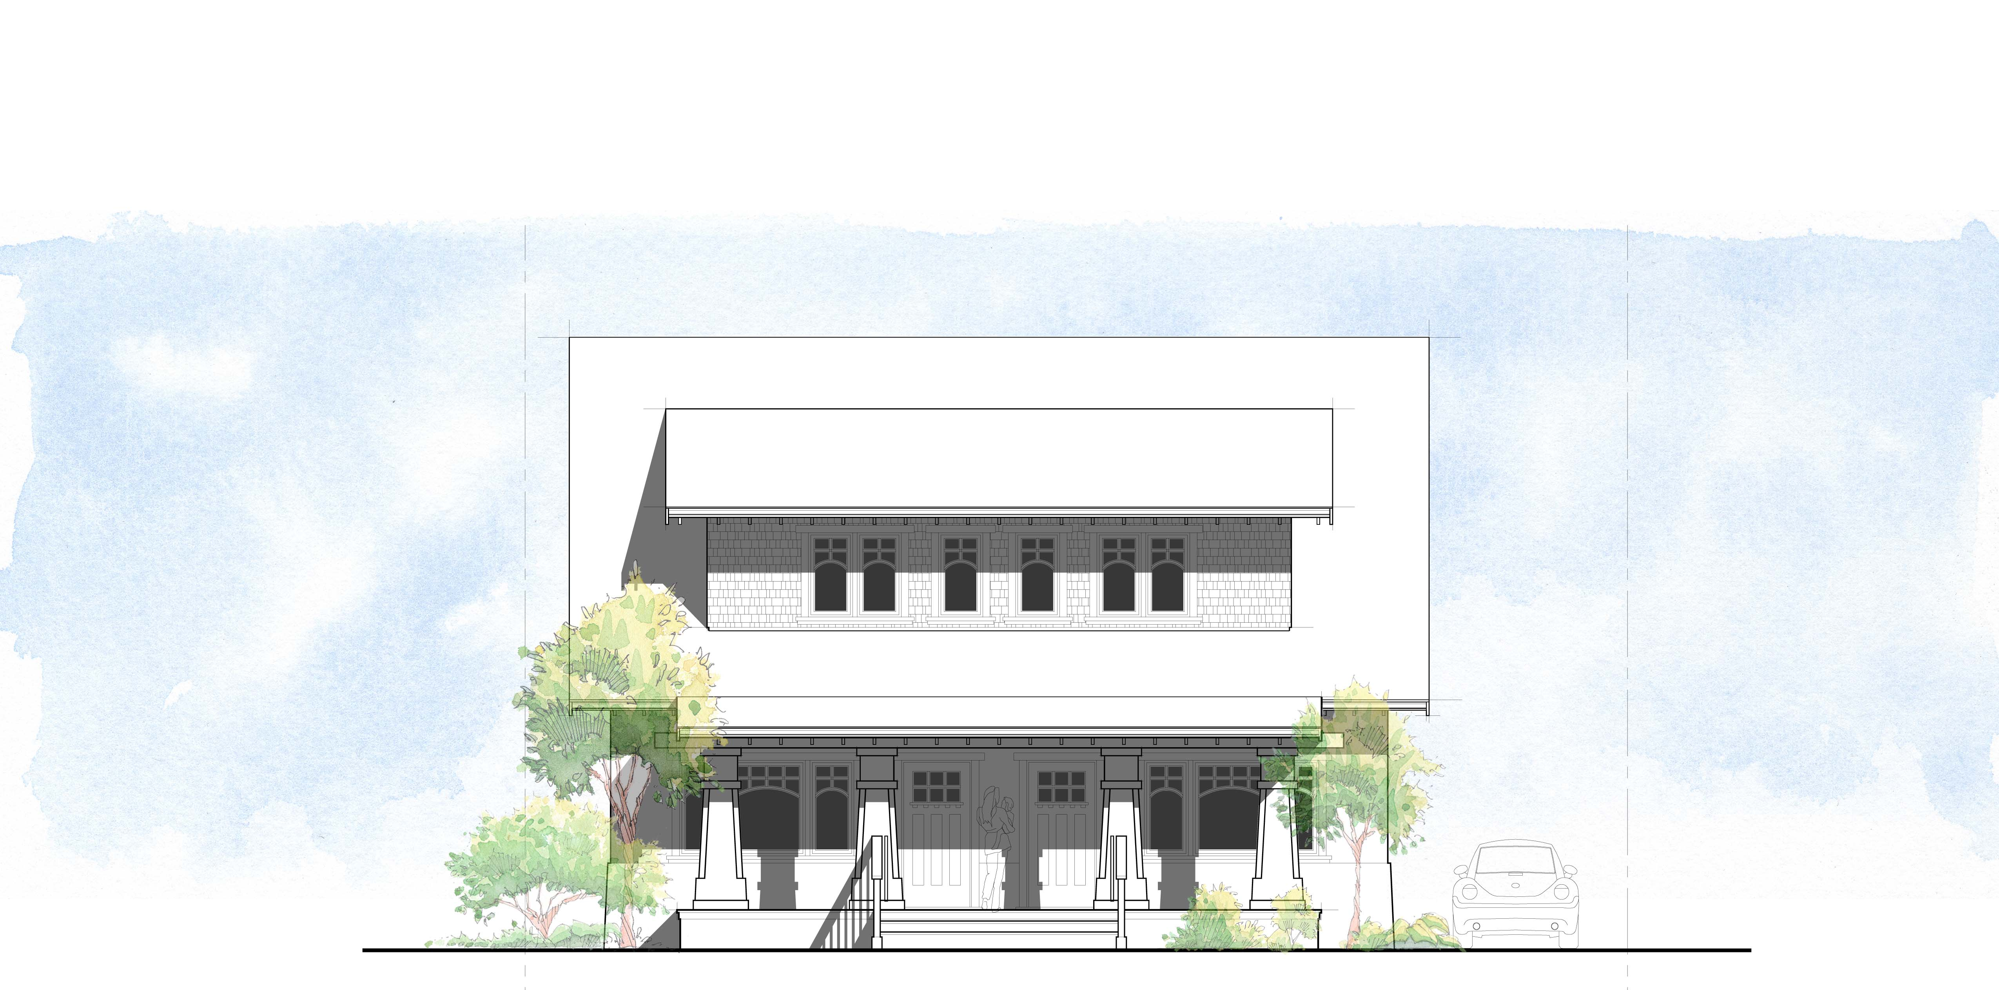
Duplex Standard Lot Front Elevation
Duplex: Standard Lot Front Elevation
3/16” = 1’-0”
/Residential Study
Duplex: Standard Lot
Notes:
Gracious front porch w/ entry to each unit
Side Driveway to rear parking
Traditional gabled structure with “attic-type” second floor bedrooms

Slide 8
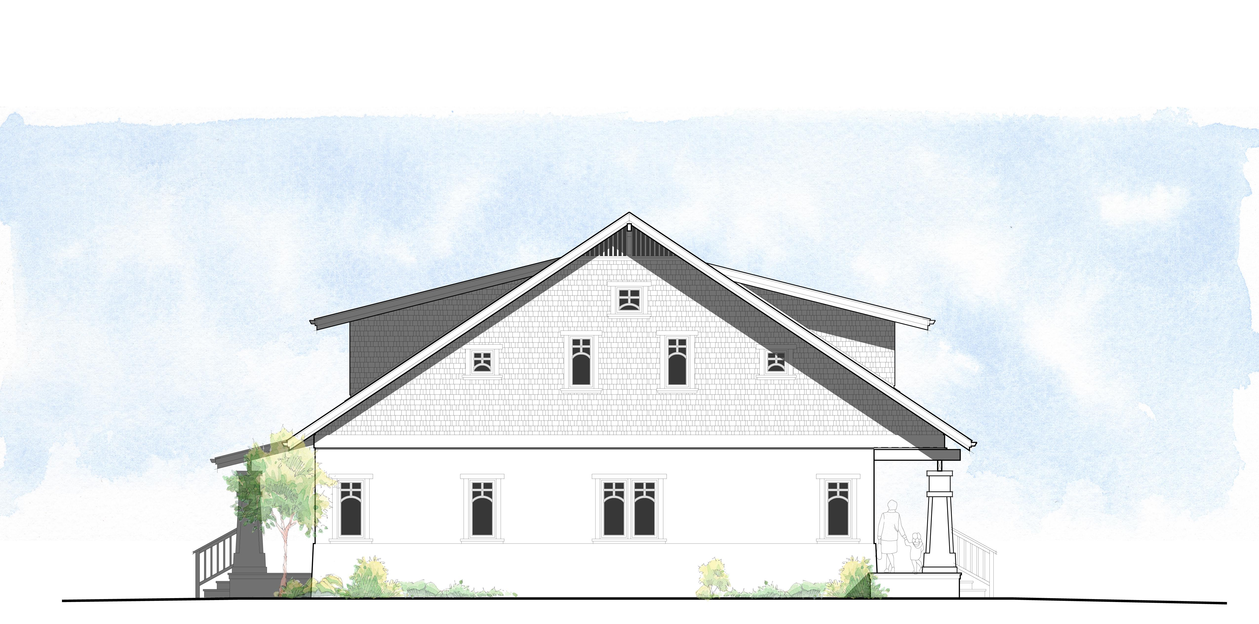
Duplex Standard Lot Side Elevation
Duplex: Standard Lot Side Elevation
3/16” = 1’-0”
/Residential Study
Duplex: Standard Lot
Notes:
Traditional materials palette:
Stucco & shingles with painted wood trims
Simulated true divided light windows
Shared back porch looking over back yard

Slide 9
Prototypical Duplex Streetscape with focus on a Duplex with Lot Split
Two – Duplex A: Lot Split
Prototypical Duplex Streetscape
/Residential Study
SB 9 – Duplexes and Lot Splits
Notes:
Two - Duplex: Lot Split

Slide 10
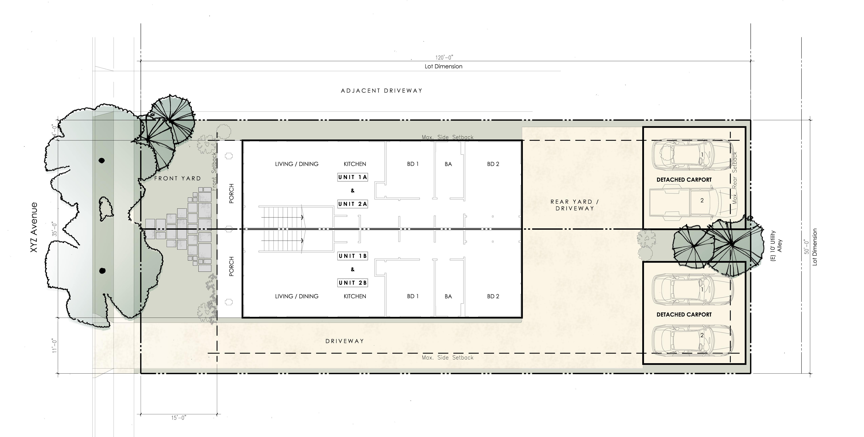
Duplex with Lot Split in Plan View
Two – Duplex A: Lot Split
1” = 10’-0”
/Residential Study
Two – Duplex A: Lot Split
Notes:
(E) Parcel: 6,000 square feet
(N) Parcel 1: 2,580 square feet (43%)
(N) Parcel 2: 3,420 square feet (57%)
This prototype maintains characteristics of typical single-family-zoned lots in R-1 districts:
Front porch
Shared Driveway (with parking)
Rear yard (semi-pervious or impervious finish)
Residential-scale landscaping

Slide 11
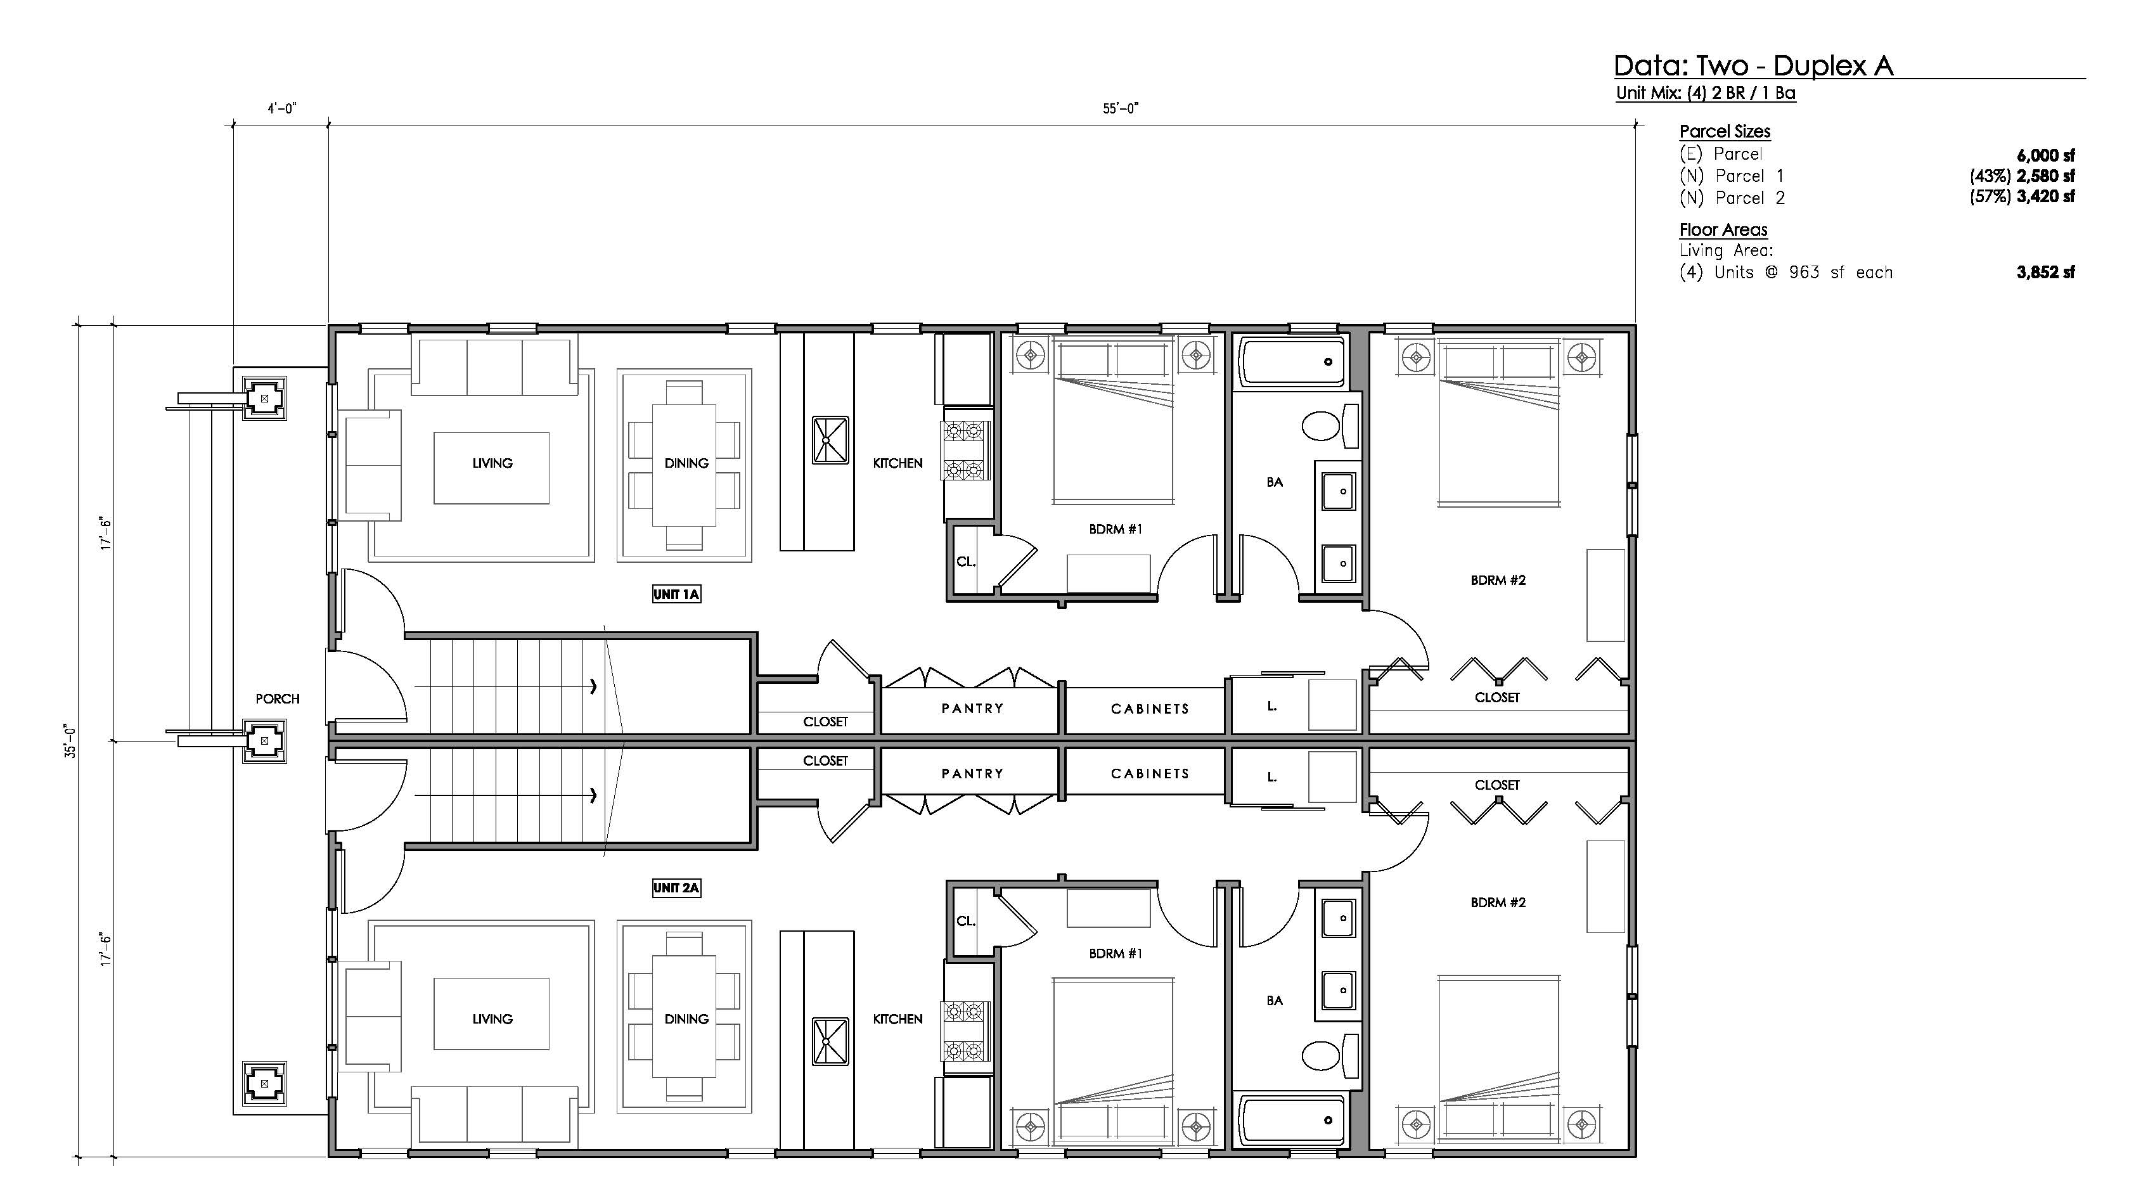
Duplex with Lot Split First Floor Plan
Two – Duplex A: First Floor Plan
3/16” = 1’-0”
/Residential Study
Two – Duplex A: Lot Split
Notes:
Shared wall Duplexes
Split lower units & upper units (Units 1A / 1B & Units 2A / 2B)
(4) Units at 963 square feet – 3,852 square feet total
(E) Parcel: 6,000 square feet
(N) Parcel 1: 2,580 square feet (43%)
(N) Parcel 2: 3,420 square feet (57%)
Has elements of contemporary / current living accommodations in a more traditional form:
Open plan
In-unit laundry
Shared porches

Slide 12
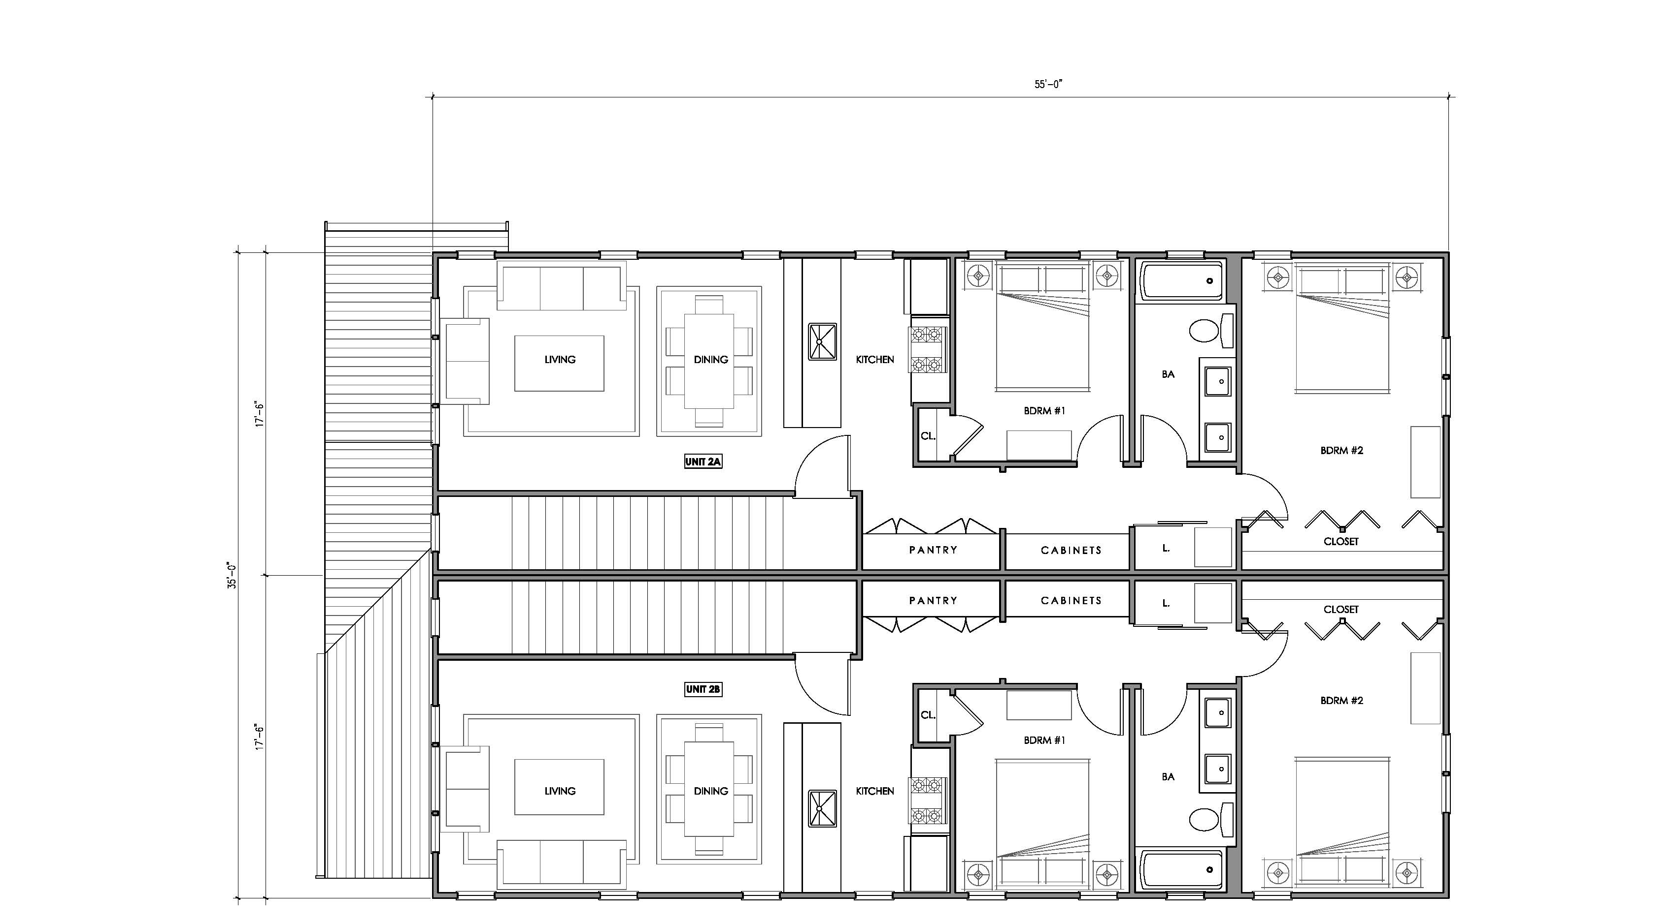
Duplex with Lot Split Second Floor Plan
Two – Duplex A: Second Floor Plan
3/16” = 1’-0”
/Residential Study
Two – Duplex A: Lot Split
Notes:
Shared wall Duplexes
Split lower units & upper units (Units 1A / 1B & Units 2A / 2B)
(4) Units at 963 square feet each– 3,852 square feet total
(E) Parcel: 6,000 square feet
(N) Parcel 1: 2,580 square feet (43%)
(N) Parcel 2: 3,420 square feet (57%)
Has elements of contemporary / current living accommodations in a more traditional form:
Open plan
In-unit laundry
Shared porches

Slide 13
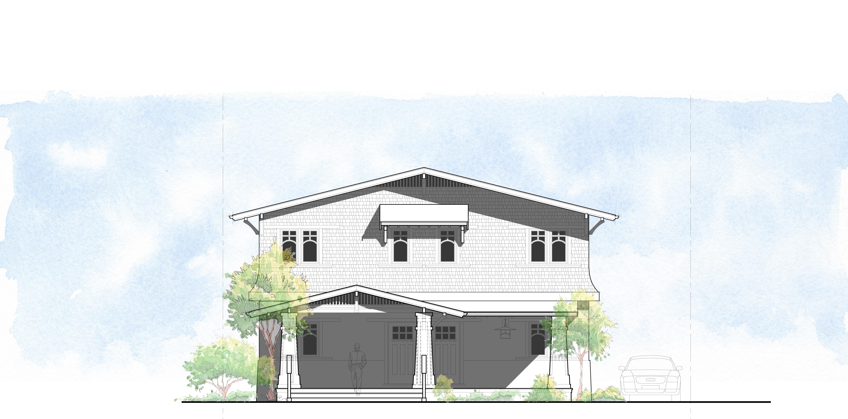
Duplex with Lot Split Front Elevation
Two – Duplex A: Front Elevation
3/16” = 1’-0”
/Residential Study
Two – Duplex A: Lot Split
Notes:
Gracious front porch w/ entry to each unit
Side Driveway to rear parking
Traditional gabled structure with additional window awnings

Slide 14
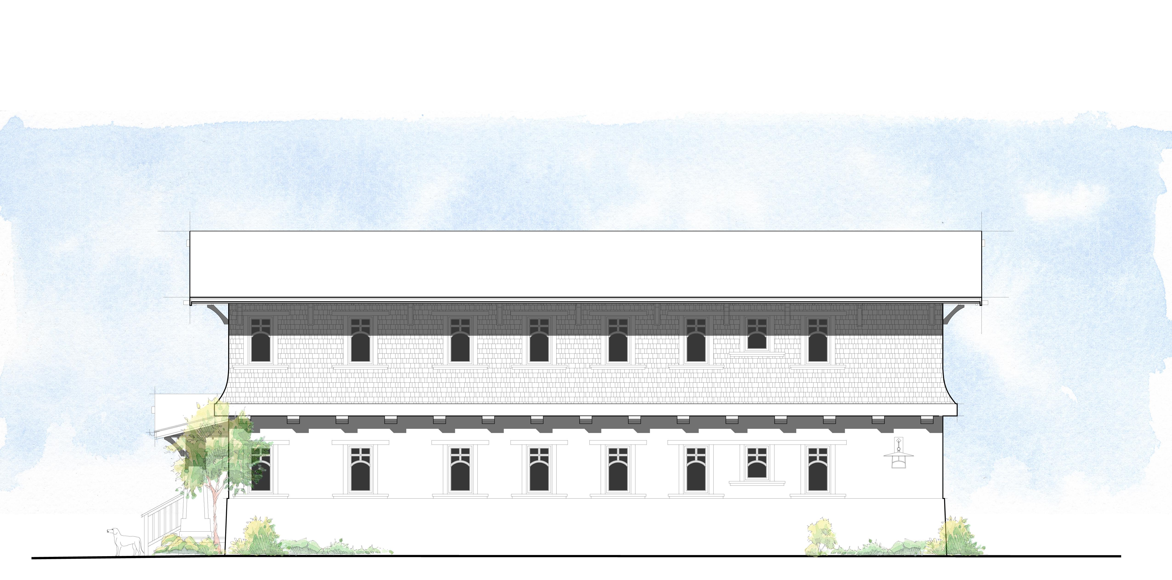
Duplex with Lot Split Side Elevation
Two – Duplex A: Side Elevation
3/16” = 1’-0”
/Residential Study
Two – Duplex A: Lot Split
Notes:
Traditional materials palette:
Stucco & shingles with painted wood trims
Simulated true divided light windows

Slide 15
Prototypical Duplex Streetscape with focus on duplex on Each Lot Split
Two – Duplex B: Lot Split
Prototypical Duplex Streetscape
/Residential Study
SB 9 – Duplexes and Lot Splits
Notes:
Two - Duplex: Lot Split

Slide 16
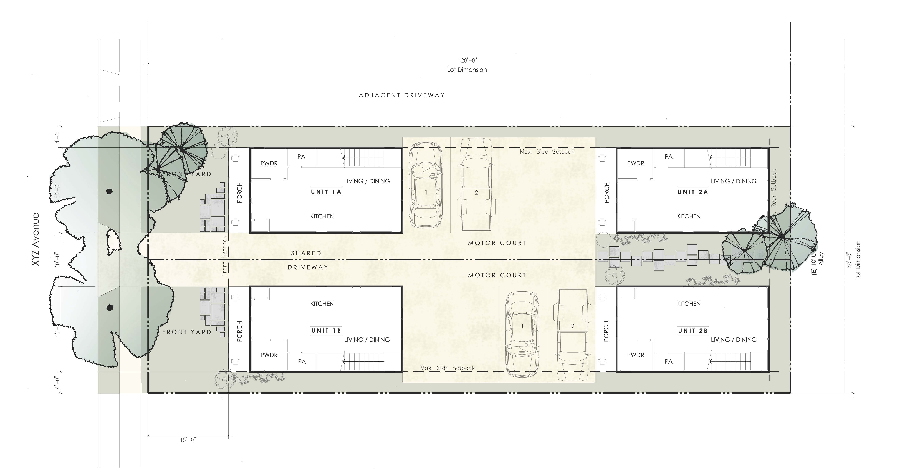
Duplex on Each Lot Split Plan View of the Two Lots
Two – Duplex B: Lot Split
1” = 10’-0”
/Residential Study
Two – Duplex B: Lot Split
Notes:
(E) Parcel: 6,000 square feet
(N) Parcel 1: 3,000 square feet (50%)
(N) Parcel 2: 3,000 square feet (50%)
This prototype provides some characteristics typical of single-family-zoned lots in R-1 districts:
Front porches
Shared Driveway (with surface parking in common Motor Court)
Residential-scale landscaping
Distinct space for each unit (“Bungalow Style”) without shared walls

Slide 17
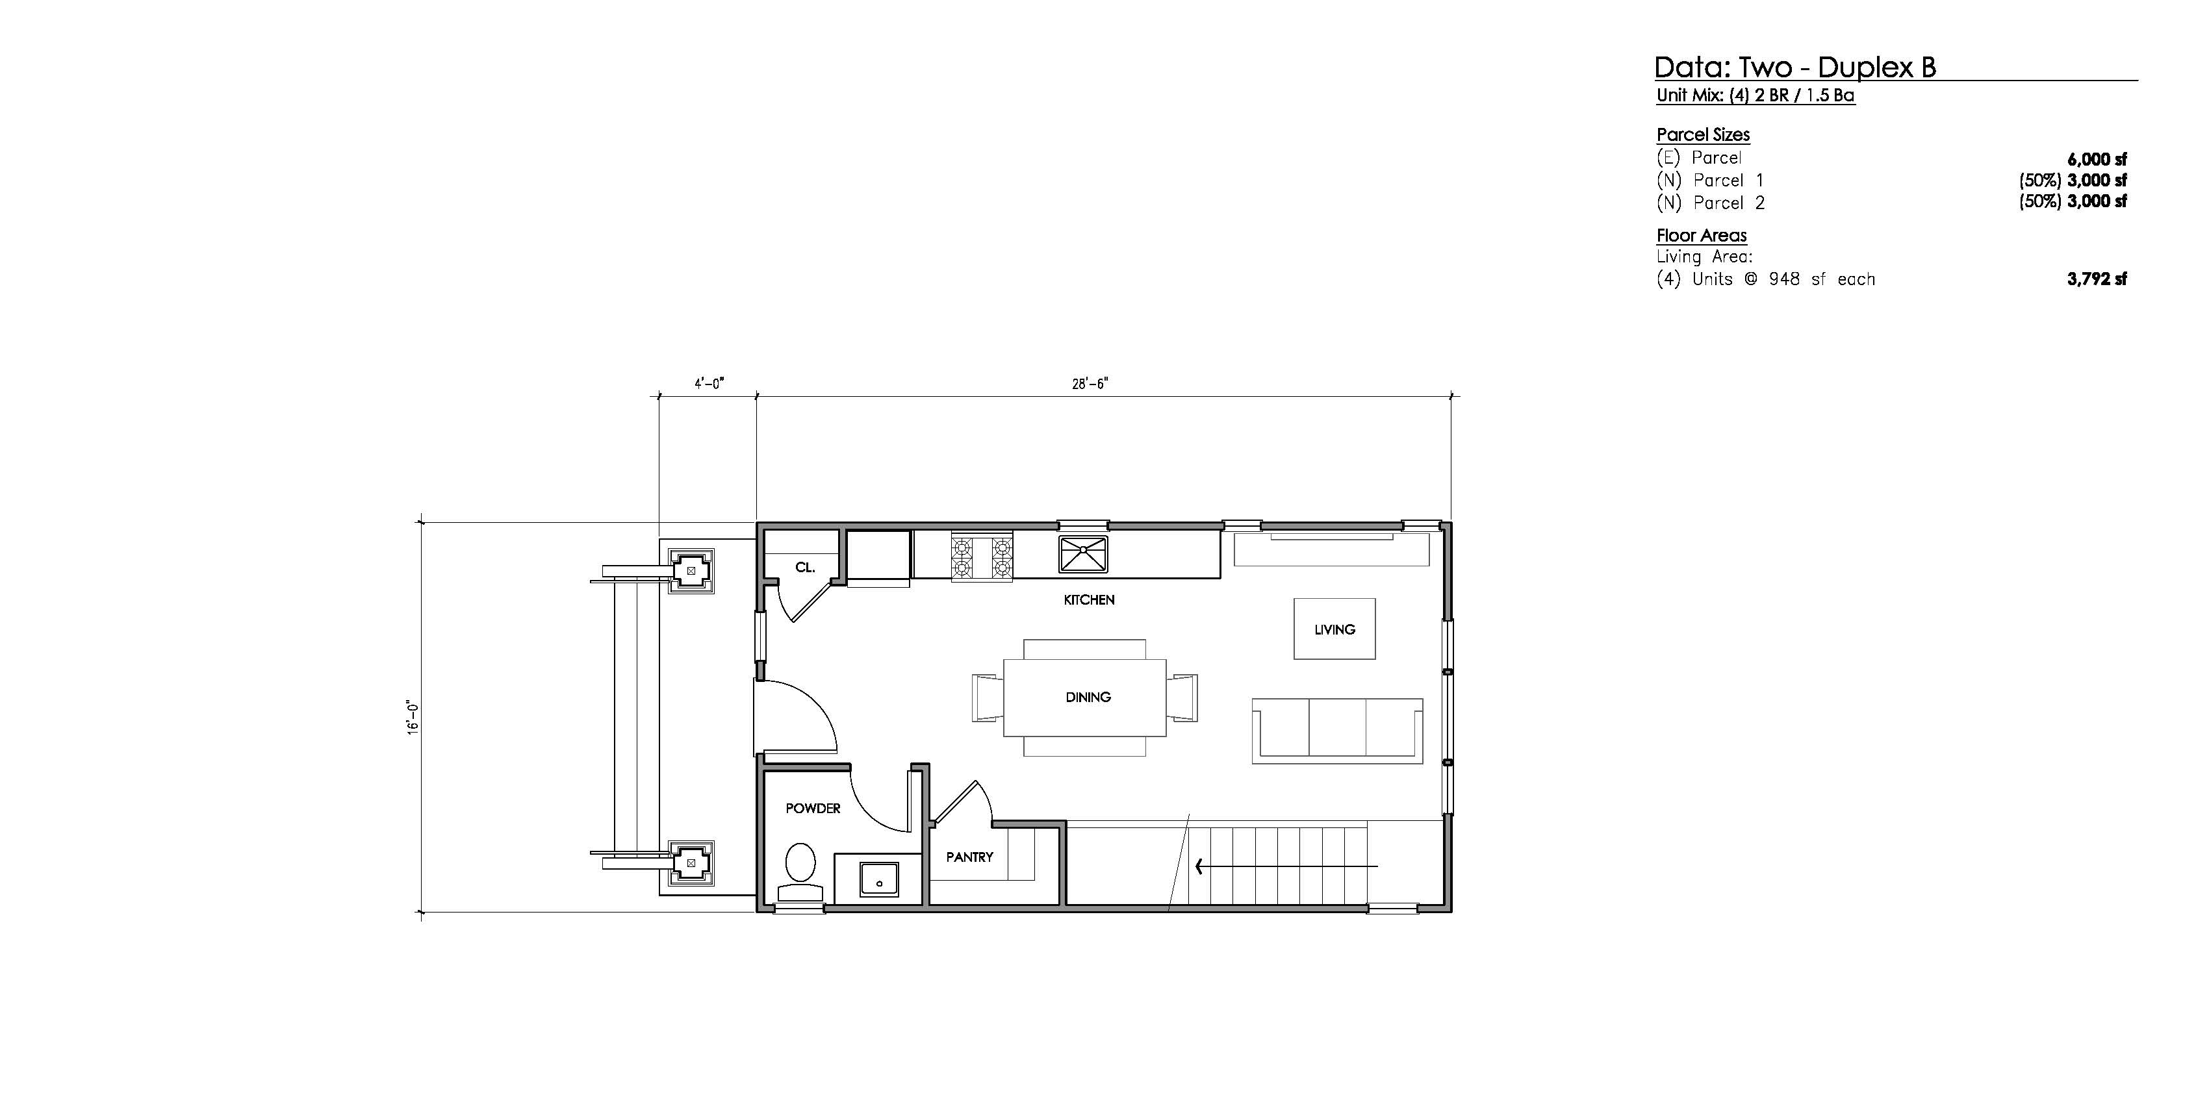
Duplex on Each Lot Split First Floor Plan
Two – Duplex B: First Floor Plan
3/16” = 1’-0”
/Residential Study
Two – Duplex B: Lot Split
Notes:
“Bungalow Style” Units
Individual, 2-story bungalows (Units 1A, 1B & Units 2A, 2B)
(4) Units at 948 square feet each – 3,792 square feet total
(E) Parcel: 6,000 square feet
(N) Parcel 1: 3,000 square feet (50%)
(N) Parcel 2: 3,000 square feet (50%)
Has elements of contemporary / current living accommodations in a more traditional form:
Open plan
In-unit laundry

Slide 18
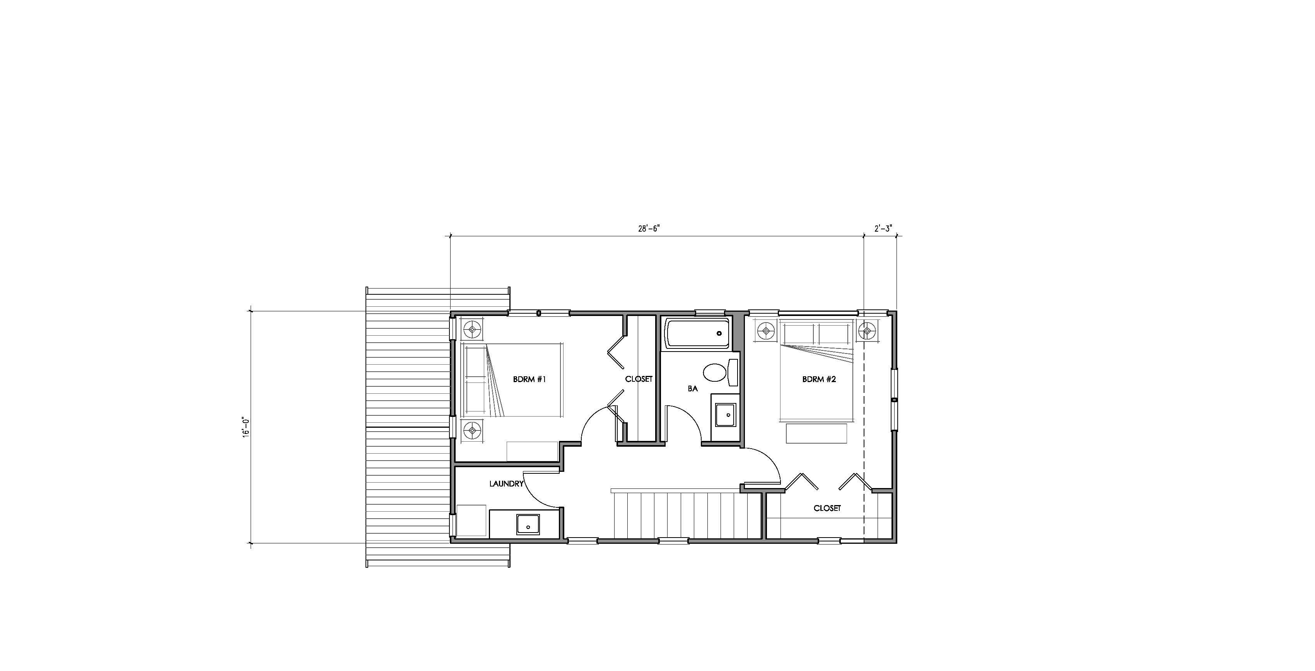
Duplex on Each Lot Split Second Floor Plan
Two – Duplex B: Second Floor Plan
3/16” = 1’-0”
/Residential Study
Two – Duplex B: Lot Split
Notes:
“Bungalow Style” Units
Individual, 2-story bungalows (Units 1A, 1B, 2A, & 2B)
(4) Units at 948 square feet each– 3,792 square feet total
(E) Parcel: 6,000 square feet
(N) Parcel 1: 3,000 square feet (50%)
(N) Parcel 2: 3,000 square feet (50%)
Has elements of contemporary / current living accommodations in a more traditional form:
Open plan
In-unit laundry

Slide 19
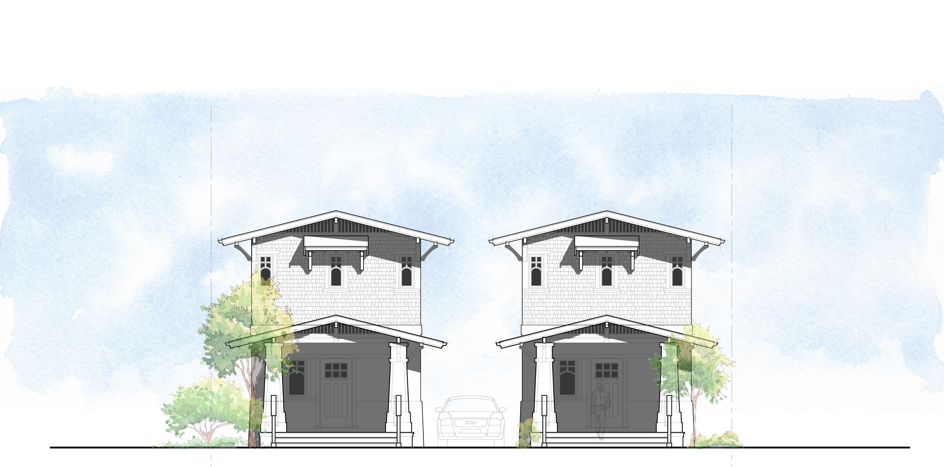
Duplex on Each Lot Split Front Elevation
Two – Duplex B: Front Elevation
1/8” = 1’-0”
/Residential Study
Two – Duplex B: Lot Split
Notes:
Gracious front porch w/ entry to each unit
Shared center Driveway to rear parking in Motor Court
Traditional gabled structure with additional window awnings

Slide 20
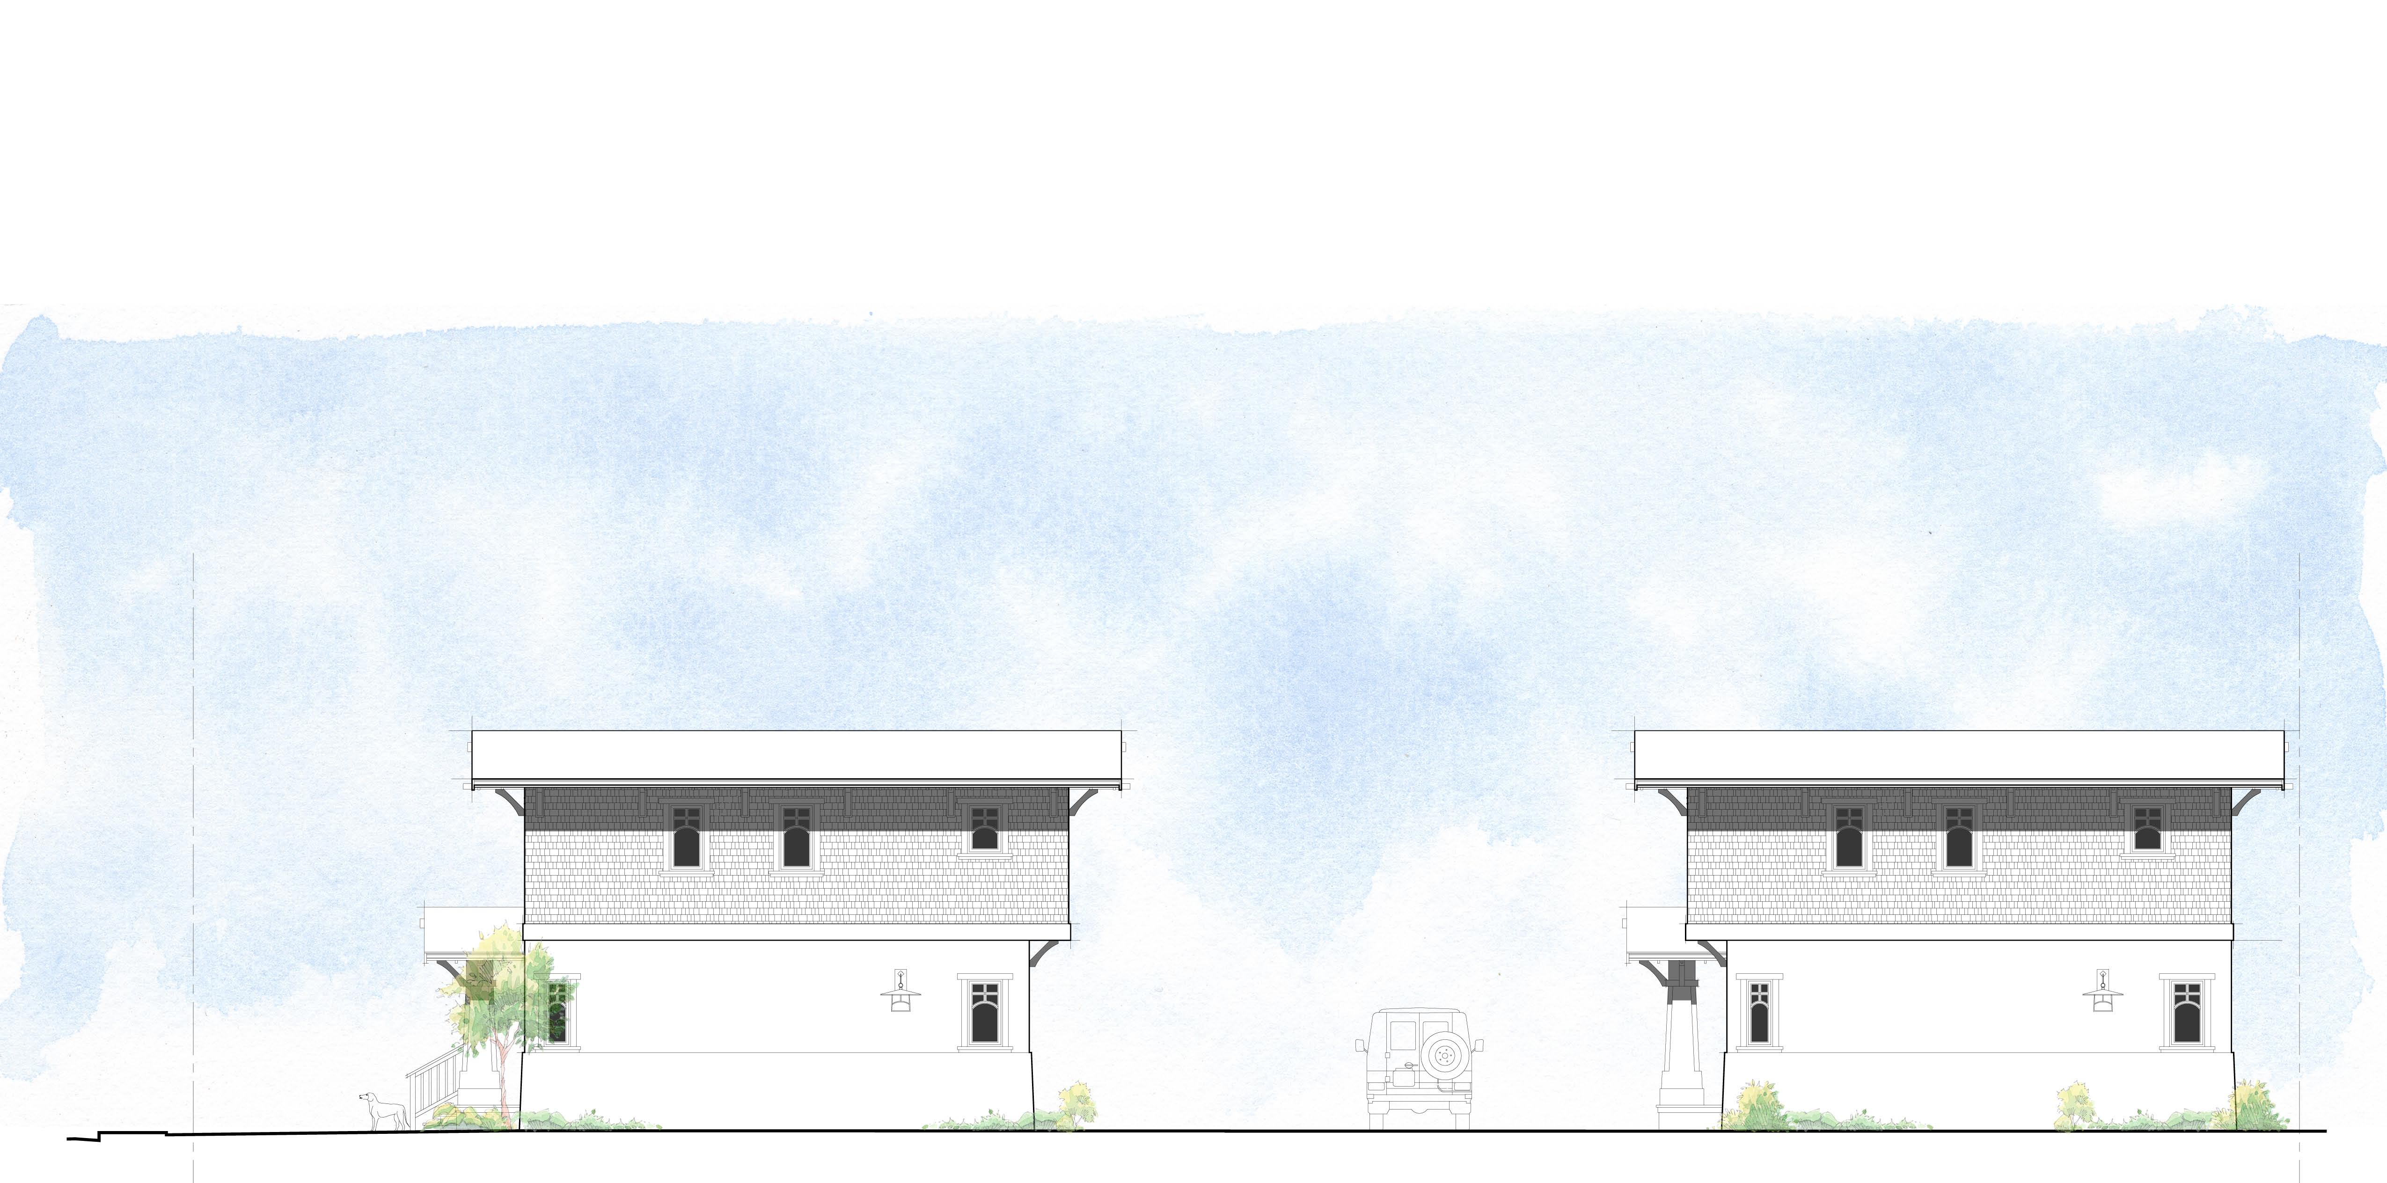
Duplex on Each Lot Split Side Elevation
Two – Duplex B: Side Elevation
1/8” = 1’-0”
/Residential Study
Two – Duplex B: Lot Split
Notes:
Traditional materials palette:
Stucco & shingles with painted wood trims
Simulated true divided light windows
Motor Court between bungalows, accessed by shared Driveway

Slide 21
Last Slide with Name of Architecture Firm
^{SB 9 Residential}
^{Analysis}
^{Prepared by}
^{Dreiling Terrones Architecture}
^{for}
Association of Bay Area Governments
^{December 2, 2021}
^{www.dtbarch.com}
^{Burlingame}
^{650.696.1200}
^{1103 Juanita Ave.}
^{Burlingame, CA 94010}
^{Healdsburg}
^{707.431.1305}
^{314 Center St. #220}
^{Healdsburg, CA 95448}

