Slide 1
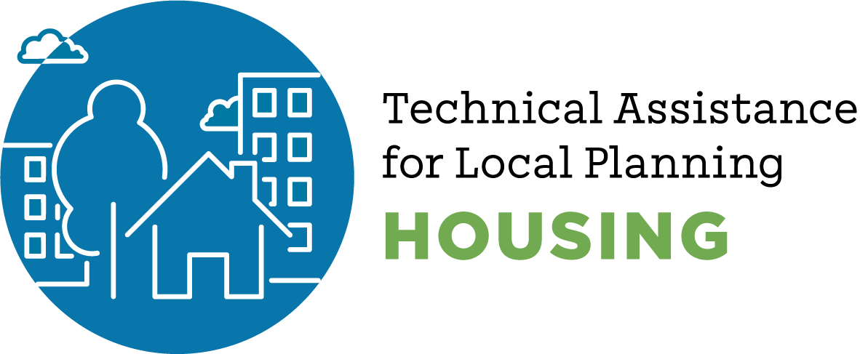
TOOLKIT Farmworker Housing
Abag Housing Element Resource
Draft – January 2022
For further information, contact:
Ada Chan, ABAG
(415) 820-7958; achan@bayareametro.gov

Slide 2
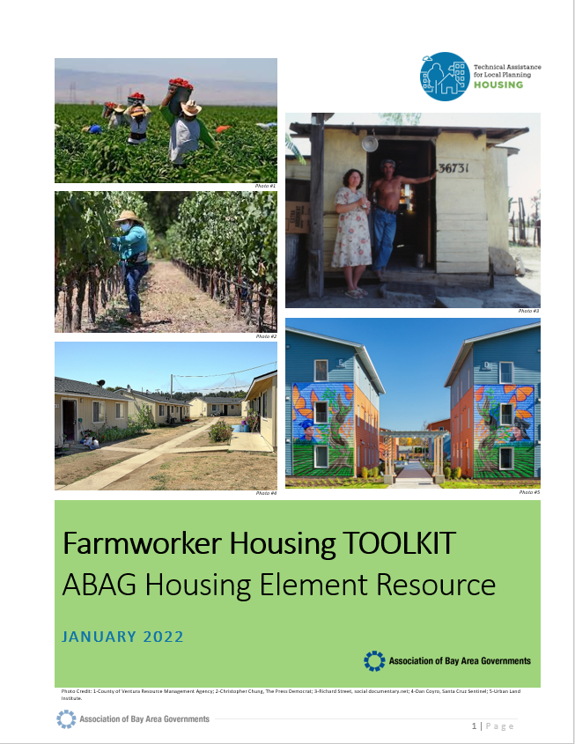
TOOLKIT
Overview
Farmworkers -- Why & What is Required?
Farmworker Profile
Data
Program Matrix – Resources for Housing Element
Appendix
#1 - HCD Information & Guidance
#2 - State Laws Regarding Farmworker Housing
#3 - Bay Area Regional Agricultural Plan
#4 - Recent Farmworker and Agricultural Worker Studies
#5 - Additional Data & Information

Slide 3
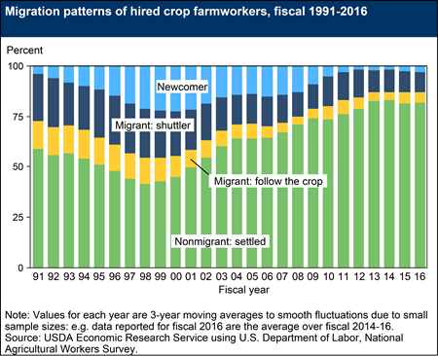
Changing Demographics
SETTLED/PERMANENT -- Today’s farmworkers are more settled and typically live in one location.
COMMUTE UP TO 75 MILES -- Per the USDA, today’s farmworkers can commute up to 75 miles to the workplace. Based on this, the need for housing for agricultural workers is not just the responsibility of Bay Area counties with a robust agricultural economy.
FAMILIES – Farmworkers today are more likely to have families and are looking for schools, employment for a spouse/partner and a location to live in the provides a community.

Slide 4
FARMWORKING HOUSING – PROCESS REVIEW
STEP #1 – ROBUST ANALYSIS
ANALYSIS -- Prepare a robust analysis regarding your community’s farmworker population -- numbers of farmworkers, school age children, and the impact of agriculture on the local economy.
STEP #2 – DETERMINE LEVEL OF DATA SIGNIFICANCE
Data on farmworkers determines the additional level of programmatic support that is required.
STEP #3 – PROGRAM & POLICIES
Incorporate programs and policies into the HE.
OUTREACH – Must do outreach to Farmworkers as part of your AFFH review.
HCD has been requiring additional farmworker analysis especially in the special needs section and inclusion of farmworkers in programs.
Programs and policies must have: (1) metrics, (2) implementation timeline, and (3) be responsive to AFFH issues.
DATA MINIMAL / MINOR
DATA SIGNIFICANT
Analysis may show limited number of farmworkers.
Add targeted programs and policies in Housing Element for farmworkers.
Requires numerical metrics and timelines for programs.
EXAMPLE: Duarte, Santa Monica
EXAMPLE - Ventura County, Wildomar, Coachella
Integrate into general AH plan throughout HE by including FW in list of special need populations to be accommodated.
Partner with County & Planning Collaborative for outreach.
Partner with County & Planning Collaborative for outreach.
(Farmworkers are a special needs housing population that must be addressed in your Housing Element.)

Slide 5
Program Matrix - Categories
FUNDING -- Funding Strategies for Farmworker Housing
PROMOTING -- Convene, Facilitate, Coordinate & Share
PLANNING / ZONING -- Land Use & Permitting Strategies
PRESERVATION – Building Solutions to Preserve Farmworker Housing
GENERAL AH – Program and Policy Strategies that Benefit Affordable Housing in General

Slide 6
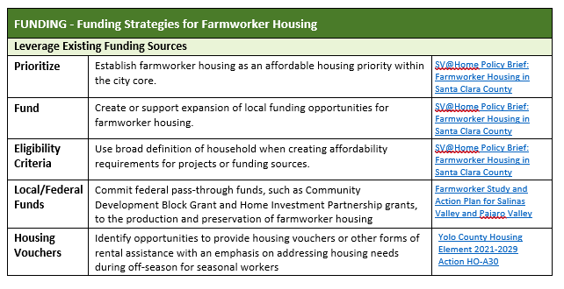
PROGRAM MATRIX – 7 pages of ideas

Slide 7
Questions / Discussion
For further information, contact:
Ada Chan, ABAG
(415) 820-7958; achan@bayareametro.gov

