Slide 1
WORKING EFFECTIVELY
With Fellow Elected Officials, the Manager and Staff
Santa Clara County Cities Association
August 11, 2022

Slide 2
Why This Topic?
Without A Strong/Effective Governance Team:
The Organization Will Not be Effective
The Community Will Not Be Well Served
Citizens Will Not Want to Serve
You Will Not Be Able to Attract/Retain High Quality Staff
It Will Not be an Enjoyable Experience

Slide 3
It’s All About Teams and Effective Relationships:
Elected Official/Manager/Staff Team—You Are All Part of the SAME Team
Teams Succeed or Fail Together
Can’t Have Effective Teams Without Effective Relationships
Effective Relationships Require Time & Attention—They Don’t Just Happen

Slide 4
Key to Effective Relationships:
Ability to Understand & Respect Different Perspectives/Styles:
Life Experiences
Different Philosophies/Perspectives
Different Communication Styles
Different Work Styles
Different Personalities
It Usually Isn’t a Matter of “Right vs. Wrong”—Don’t Act As If It Is

Slide 5
DIVERGENT VIEWS/OPINIONS
Develop an Appreciation and Understanding Regarding Why It’s OK to Have Different Opinions
Differences Are Not Usually a Result of:
Dishonesty
Lacking Values
Intelligence
Differences of Opinion are Normal and Should be Expected

Slide 6
DIVERGENT VIEWS/OPINIONS
The Key Issue Is: How Does a Team Deal With Differences of Opinion?
Can You Overcome Your Differences or Is It a Constant Source of Conflict and Distraction?

Slide 7
Why Being a Council/Board Member Isn’t Easy
Challenging Issues
Varied Opinions/Perspectives
Group Decision Making
Not a Group of Your Choosing
It’s Done in Public/Anyone Can
Participate
Media and Public Scrutiny (Social Media)

Slide 8
Why the Job Has Been/Is Particularly Tough Now
Nature of Civic Discourse/Political Tribalism
Pandemic:
Frustration/Anger
Impatience
Fear
Social Isolation
Focal Points for Contention
Intolerance for Other Perspectives

Slide 9
Why the Job Has Been/Is Particularly Tough Now
Lack of Political Compromise/Effective Governance on the
National Level (Setting a Poor Example)
Demonizing/Intolerance of Those With Different Views
Social Reckoning/Views of Policing
More Challenging to Have Direct “In-Person” Contact With Colleagues, Staff & Public

Slide 10
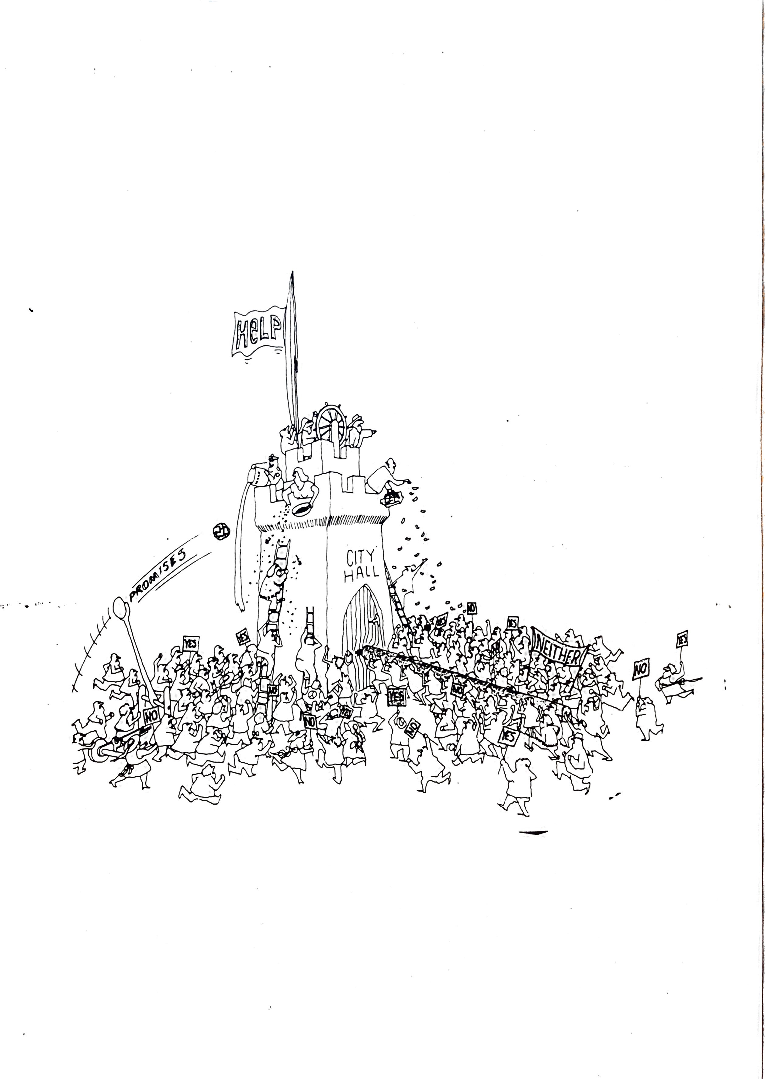

Slide 11
Why Being a City Manager Isn’t Easy
Multiple Bosses
Conflicting Expectations
Needing to “Translate” Between the Council & Staff
Attempts to Get Them to “Take Sides”
Ease of Communication Can Create 24/7 Expectations
Councilmember Conflict

Slide 12
Why Being a City Manager Isn’t Easy
Pandemic Impacts Have Amplified Challenges:
Fundamental Changes on How Services Are Provided
Financial Uncertainty
Loss of Direct Contact With Councilmembers & Staff
Enforcing Pandemic Related Restrictions
Policing Reforms/Social Justice and Equity
Staffing Challenges
Feelings That the Demands & Workload Are Unrelenting
Frustrated and Stressed Members of the Public/Staff/Council

Slide 13
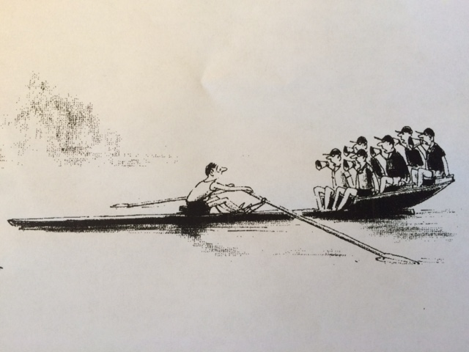

Slide 14
Areas of Greatest Challenge Between Councils & Manager/Staff
Lack of Respect for Different Roles and Responsibilities (Form Of Government)
Finite Resources/Lack of Priority Setting (Keeping Consistent With Established Priorities)
Lack of Tolerance for Mistakes/Imperfection
Technical vs. Community Perspectives

Slide 15
Areas of Greatest Challenge Between Councils & Manager/Staff
Constant Demands/Unrealistic Expectations
Individual vs. Group Expectations
Lack of Clear, Regular, Consistent and “Professional” Feedback
Public Criticism

Slide 16
Areas of Greatest Challenge Between Councils & Manager/Staff
Problematic Interactions Between Council and Staff
Going Around the Manager
Not Separating the “What vs. How”
Staff Not Living Up to High, But Reasonable Expectations
Perceptions of Council & Citizen Support Deficiencies

Slide 17
Areas of Greatest Challenge Between Councils & Manager/Staff
Lack of Appreciation on Staff’s Part That City Councils
Have the Right to Make “Wrong” Decisions
Councilmembers Not Holding Each Other Accountable
Creating Unrealistic Public Expectations
Manager & Staff Perceived as Not Doing Enough to Assist the Council in Dealing With Challenging Issues

Slide 18
PROFESSIONAL CITY MANAGERS
Most Follow a Code of Ethics
Have to Operate Within the Form of Government
Are Committed to Elected Official/Governing Body Success
Don’t Play Favorites/Don’t Take Sides
Must Sometimes Tell You What You Don’t Want to Hear/Can’t Always Do What You Want

Slide 19
PROFESSIONAL CITY MANAGERS
Need Thoughtful and Comprehensive Performance Feedback
Strives to Communicate in a Style That Works for You
Is Obligated to Protect the Staff

Slide 20
Competitive Advantage?
The Competition is Greater than Ever for Top Quality Staff
(Particularly in this Area Due to Housing Costs)
Compensation and Working Conditions Need to be Competitive
The City Council Can Be Either a Competitive Advantage or Disadvantage
If You Have a Good Manager & Staff—Treat Them As If You Want
Them to Stick Around for Awhile—If You Don’t, They Won’t

Slide 21
Where You Might Go From Here
Topics For Potential Discussion:
What Do Councilmembers Need From Each Other
To Be Successful?
What Do Councilmembers Need From the Manager & Staff to be Successful?
What Do the Manager & Staff Need From the Council to be Successful?

Slide 22
Wrapping Up: The Question
As We Established at the Beginning, Both Councilmembers and the
City Manger/Staff Have Challenging Roles
Is Your Elected Official Team and Your Manager/Staff Doing All That Can be Done to Support Each Other in Making These Roles Less Challenging and
Your Organizations More Successful?

Slide 23
Kevin C. Duggan
ICMA/Cal-Cities Senior Advisor
kcduggan@katesbridge.com
650-888-5850

