Slide 1
Santa Clara County Planning Collaborative Meeting
October 13, 2022

Slide 2
Agenda
Welcome & General Announcements, 12:00-12:10
LISC, Faith and Housing – Tia Hicks, 12:10-12:25
HCD Comment Letters – Paul Peninger, 12:25-12:50
Small Group Discussions – Collaborative Successes and Improvements 12:50-1:10
Zoning for Affordability Workgroup Planning – Rick Jacobus 1:10-1:30

Slide 3
General Announcements
EAG Meeting – Call for Presentations
  Email Abbie (tuning@bdplanning.com)
SCCPC Office Hours w. Root Policy – Mountain View/Sunnyvale AFFH Comments
SB9 Survey (See Link in the Chat)
Collecting HE Drafts and Comment Letters – Thumbs Up?
Notes:
SB 9 Survey: https://docs.google.com/spreadsheets/d/1y-KqN7F_yRL3uNAcFKw77iUWWWyDL797ZikO7wShBao/

Slide 4
MTC-ABAG Announcements
  Bay Area Housing Element Status Report
  Analysis of Current HCD Comment Letters on Bay Area Draft Housing Elements
  Transit Oriented Communities (TOC) Policy Adopted
  Priority Development Area (PDA) Grant Program
  Priority Production Area (PPA) Pilot Grant Program
  Sea Level Rise Adaptation Funding and Investment Framework
  SB 743 VMT Policy Adoption Technical Assistance Program
  “How to Address HCD Comments for Certification” Case Studies
  Upcoming Products and Resources
    SB 6 AB 2011 Comparison (out soon!)
    2022 New Laws Webinar (November 15th)

Slide 5
LISC Faith and Housing Program
Tia hicks

Slide 6
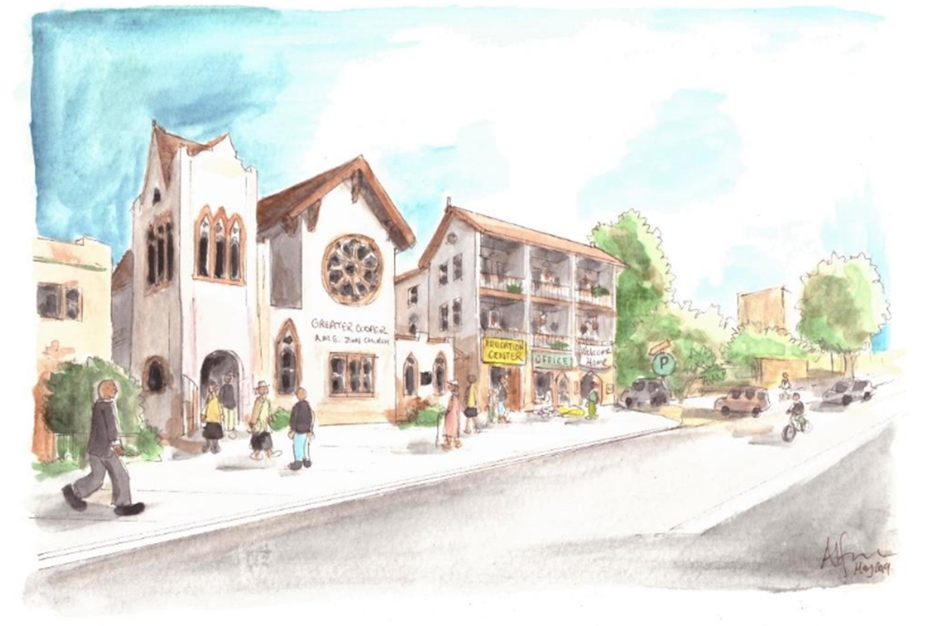

Faith and Housing Program Overview
Santa Clara County Planning Collaborative
October 13, 2022

Slide 7
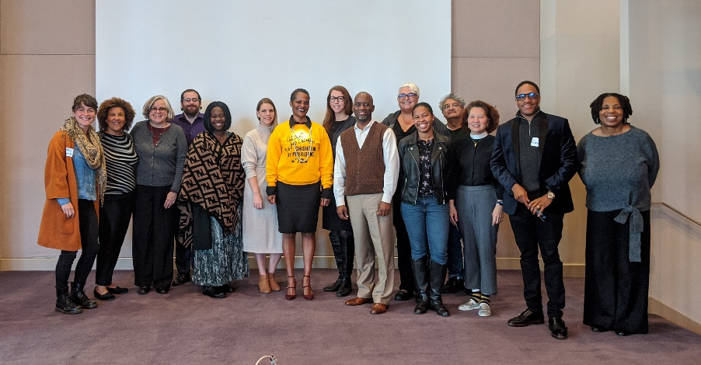
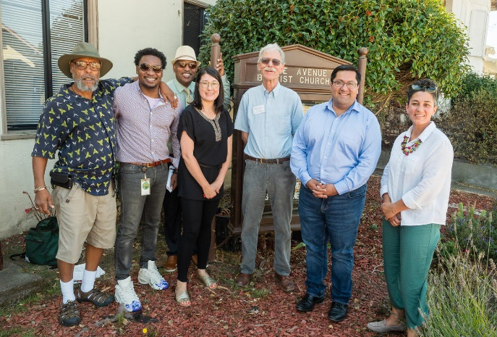
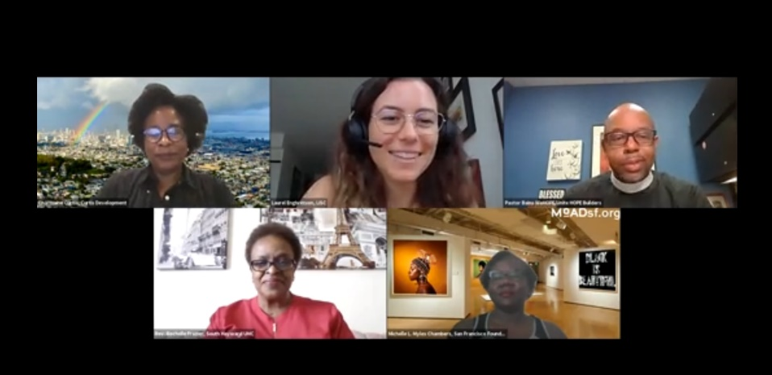
LISC Bay Area is deeply invested in partnering with local faith-based organizations to build housing stability and healthy communities
Inaugural cohort of our Alameda County Housing Development Capacity Building Program for faith-based and community-based organizations
Former LISC Program Officer Quency Phillips at groundbreaking of McGee Avenue Baptist Church’s affordable housing development in partnership with Bay Area Community Land Trust, financed and supported by LISC
LISC Program Officer Laurel Engbretson moderating a panel on Racial Equity in Faith-Based Development with development consultant Charmaine Curtis, Pastor Paul Bains, Pastor Rochelle Frazier, and San Francisco Foundation FAITHS Program Manager Michelle Myles Chambers
Notes:
THIS SLIDE NEEDS WORK

Slide 8
LISC GOAL:
To equip faith-based and community-based organizations to make informed decisions about their property and if they decide to do so, form a partnership with an experienced developer that results in new affordable housing development.
Notes:
The goal of this program – as it exists now and we believe in the next few years – is to equip faith-based and community organizations to make informed choices about their property. If faith organizations decide to move forward with affordable housing development, we seek to equip them to form a partnership with a developer that results in new affordable housing development.
Really seeks to put the faith leaders in the position to understand and drive decision-making about projects on their land.

Slide 9

Faith leaders are rooted and ready to address housing affordability inequities
People of color hit hardest by housing crisis
Since 2015, more than 30% of all low-income people of color were displaced from the Bay Area, at least 53% of all people of color are housing burdened
COVID-19 exacerbating housing insecurity
Since COVID-19 started, a staggering 52% of Latinx renters and 35% of Black renters had no or slight confidence they could pay their coming month’s rent.
Faith leaders are on the front lines providing essential services to communities of color
According to UC Berkeley’s Terner Center, there is approximately 38,800 acres of faith-owned land in California that has the potential to be developed into affordable housing.
“The faith community is paramount in any type of development that you’re doing. The faith community are the largest land bankers in the country right now. It is imperative that we give them the tools and the toolkit to be able to make conscious decisions on whether they want to move into the affordable housing arena. Remember that faith communities are first responders. They are the first place people go to when they are in crisis.”
- Michelle Myles Chambers, FAITHS Program Officer at the San Francisco Foundation
Notes:
Our work with faith leaders really starts with the leadership of faith leaders and communities – as you all know, faith leaders are already on the front lines of providing essential services to communities of color across the region – and are engaged in support for affordable housing and housing justice in many different ways.
With regard to affordable housing development, faith communities also collectively own over 38K acres of land in the Bay Area alone – and some of that land could be used to develop affordable housing on. The resources I’ll talk about today and that LISC offers are really geared to helping organizations with land figure out if and how to proceed on building affordable housing on that land.
Michelle – we love to lift up this quote from you as part of our work!

Slide 10
LISC’s Program Fills a Gap between Faith Leadership and Land and the goal of producing affordable housing
Insufficient Affordable Housing
Faith organization with Real Estate
Coaching, Education & Resources
Affordable Housing Development
Scarce Land for Development
Notes:
This graphic shows the slice of the work that LISC can help support in this space. As you all know, we have far far less affordable housing in the region than we need, and one of the main components needed to develop more affordable housing is land. For faith institutions that want to explore affordable housing development - faith organizations bring their land – and their leadership and congregation capacities – and LISC can bring technical knowledge, training, and resource --> to get us all to the end goal we're seeking.
Also want to acknowledge again - there’s a lot more that goes into affordable housing than just development – advocacy and organizing is another big piece, for example. The resource we have won’t address all of the ways you can get involved in affordable housing, but it is part of this larger picture.

Slide 11
LISC Bay Area – Resources for Faith based-organizations
Intensive TA program
Recorded videos and self-assessments
Self-guided learning
Materials
Four Guidebooks
Web-training – 101 series
Planning for our third cohort right now, hoping to start accepting applications in the summer.

Slide 12
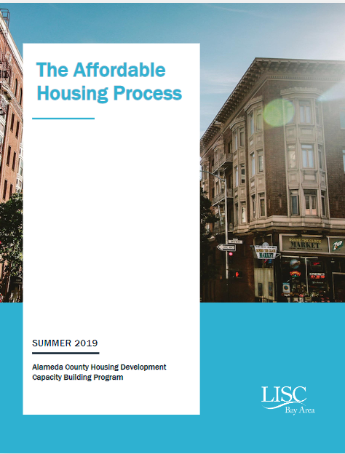
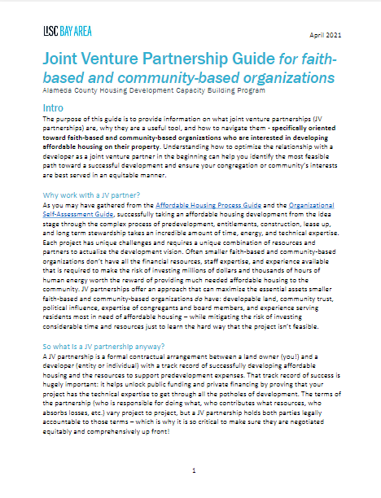
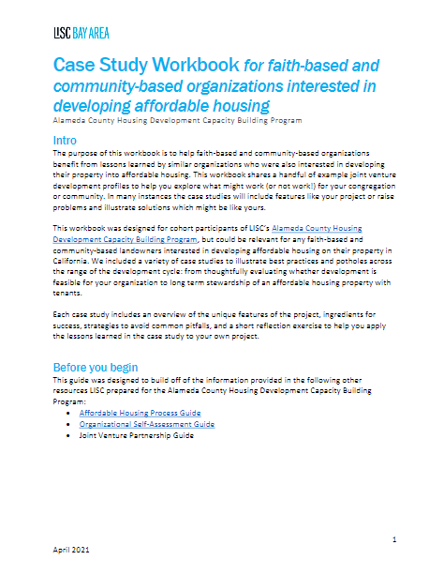
Four Guidebooks – on the Faith and Housing and LISC Bay Area websites

Slide 13
Faith and Housing (web-based training series) - Provides training and education for FBOs that are starting to explore affordable housing
Part 1: What is affordable housing?
Part 3: Joint Venture partnership model
Part 2: Organizational readiness
Part 4: Affordable housing development process overview
Website with over 8 hours of video trainings – interviews, panel discussions, and more.
Visit Bay Area LISC website or register for the webinar to learn more!
Register here: https://bit.ly/faithandhousingREG
Notes:
We also just launched this new web-based training series. This is a website with over 8 hours of video trainings – interviews, panel discussions, and more.
This is free, and anyone can access it and start deepening their knowledge immediately. I'd love if you all would share with your networks – and I can share the outreach toolkit with you all as a follow-up. Includes both social media and sample emails you can use to share this resource with your networks!
We’ve also been thinking about how we can integrate this resource with the TA and support we're providing as part of a comprehensive package, or maybe different options for faith organizations.

Slide 14
How the program works
Cohort trainings on how to prepare for and successfully build affordable housing development in partnership with an experienced developer
1:1 technical assistance with a development coach to translate and navigate through the complicated development process
Modest grant resources fund predevelopment expenses that mitigate the risk of faith-based organizations entering into an infeasible or exploitative deal

Slide 15
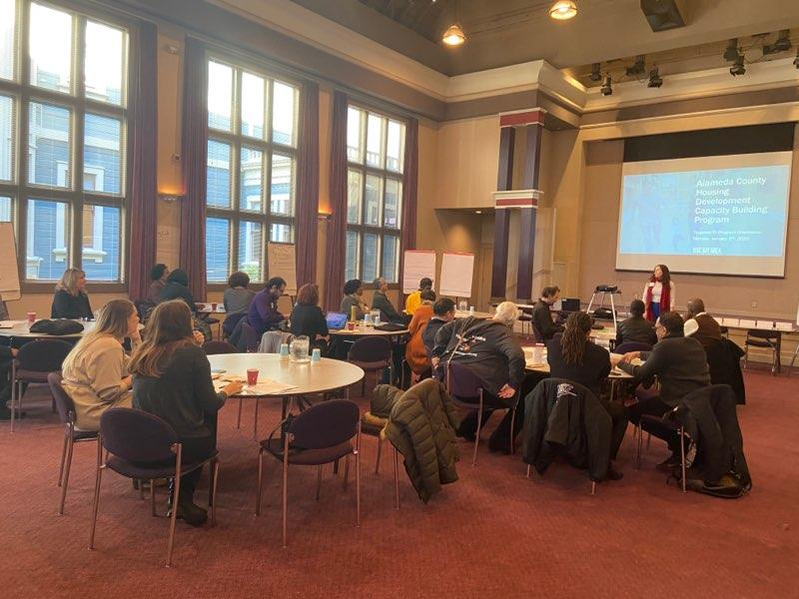
Training curriculum tied to TA program builds on web-training
LISC Bay Area hosts trainings with experts from the field and facilitates exercises that apply the learnings to the participants’ individual projects. The training curriculum includes workshops on:
MOUs
Building Neighborhood Support / Planning for NIMBYism
Predevelopment Budgeting
Development Budgeting
Entitlements
Fair Housing and Public Subsidies
Relationship Management with Joint Venture Partners
Asset Management
Services Management

Slide 16

Development Coach Support over 12 months
Work with Development Coach to identify development milestone and create TA Plan
Work with Development Coach to Implement TA Plan and utilize program resources
Outcomes range: prepare RFP to partner with an experienced developer, OR decide that pursuing development is not best use of church’s resources
Attend monthly cohort meetings + trainings
Notes:
The “targeted” in Targeted Technical Assistance is really important: every site, project, and organization is different. Development advising must be tailored to the specifics.

Slide 17
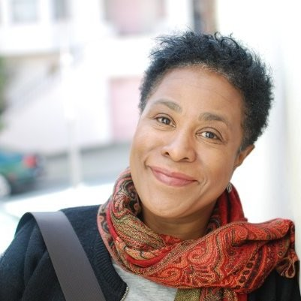

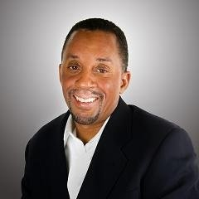
Targeted technical assistance guides through project specificities
Each faith-based organization in the program receives 1:1 coaching from a technically experienced, culturally competent development consultant. A few of our team of development consultants from Cohort 1:
Charmaine Curtis
Principal, Curtis Development
Charmaine has developed over 7,000 units of housing. Before starting her own ventures, Charmaine was President of A.F. Evans Development and Director of Development for Mercy Housing. She has a Master’s Degree in City and Regional Planning from UC Berkeley and a Bachelor’s degree from Dartmouth College.
Landis Graden
CEO, DCG Strategies
Since 1997, Landis has managed multiple real estate investment groups focused on acquiring, rehabilitating, and selling undervalued Bay Area properties. Landis earned a Bachelor of Science Degree in Information Systems Management from the University of San Francisco, and an MBA from Holy Names University.
Kenneth N. Jones
Principal, Landis Development
Kenneth has over 20 years experience in urban real estate development and management consulting. Kenneth graduated from UC Berkeley with a degree in Business Administration with a Finance and Real Estate emphasis. He also has a Master’s Degree in Real Estate and the Built Environment from the University of Denver.

Slide 18
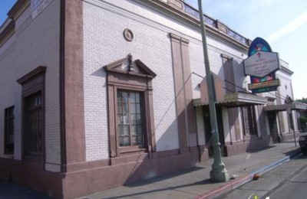
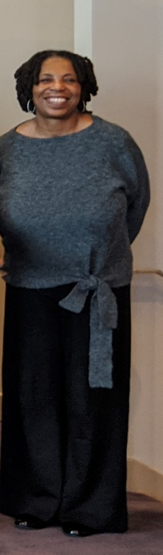
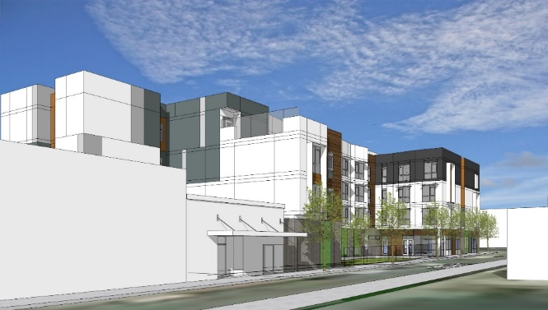
Success Story: Agnes Memorial Church of God in Christ
Value of the program:
“Knowledge is power… I want to understand the language of affordable housing.”
“I have always wanted to have a Development Consultant to look out for the best interest of the church and move the project along.”
- Billie Simmons, President of Agnes Memorial Church
After waiting 12 years, revived
60 unit affordable housing for seniors
20-30% for formerly homeless seniors
12 years in a dormant joint venture partnership with Related companies
Via LISC program, secured entitlements and achieved competitiveness for tax credit financing and other gov’t subsidy programs
And, renegotiated a more equitable and accountable MOU with developer

Slide 19
Faith and Housing (web-based training) Module Components
Module 1: What is affordable housing?
Module 3: Joint Venture partnership model
Module 2: Organizational readiness
Module 4: Affordable housing development process overview
Why Affordable Housing?
What Does Success Look Like?
Introduction to Critical Elements of Affordable Housing Development
Will and relationship readiness
Resources and land size
Critical Organizational Structure and how we solve problems
Potholes and Problem Solving
They Key Members of the Team and Their Roles
Panel Discussion – different perspectives and roles in JVP
The Development Process
The Money & Timing
The Economics for the Community Partner
Notes:
Module 1: What is affordable housing?
Participants will see examples of successful affordable housing developments sponsored by faith-based and community-based organizations
Participants will be introduced to critical elements of affordable housing development, in particular: Site Feasibility, Organization Support and Commitment and Partnerships
Module 2: Organizational readiness
Participants will learn about the basic requirements for their organization to be successful in the development of affordable housing
Participant organizations will be able to evaluate their properties’ fitness for development and their next steps
Participant organizations will be able to identify whether they believe they are ready for third party support in formulating their development plan
Organizational Self-Assessment Tool Exercise walk through (with links)
Participant organizations will be able to practice assessing their readiness to seek and use technical assistance such as an advisor and/or architect
Participant organizations will be able to practice decision making focused on formulating their development plan
Module 3: Affordable housing development process overview
Participants will be able to describe the major steps in the development process (project concept, project feasibility, project deal making, construction and lease up, operations) and identify where in the process their group is today
Module 4: Joint Venture Agreement development model
Participants will be able to identify three key development team members and how they fit into the development process (owner, developer, property/asset manager)
Participants will be able to describe why they need a partner, criteria to consider in selecting a partner, and issues/concerns which they want to pay particular attention in evaluating partner choices

Slide 20
PHASE 1
Apply!
PHASE 2
Org & Site Assessment, Web-Training, Work Planning
PHASE 3
Pair with Development Coach, Work Plan Implementation, Monthly Trainings
Continuing Support
Access to Recoverable Grants and ongoing LISC staff support
Cohort 3 Design

Slide 21
Cohort 3 Timeline
September 2022 | Phase 1: Rolling Applications Open
November 30th, 2022 | Phase 1 Closes: Final Applications Due
December 10th, 2022 | Phase 2 Begins: Org and Site Assessment, Web-training, Work Plan development (10 organizations will be selected to participate)
March 30th, 2023 | Phase 2 is complete (5 organizations invited to Phase 3)
April – May 2023 | Phase 3 begins: Select/Confirm development coach
June 2023 | Phase 3: Monthly Trainings and Work Plan Implementation Begins
March 2024 | Phase 3 complete
Continuing Support | Program Participants with Feasible Projects in Predevelopment are eligible to apply to Recoverable Grant Pool

Slide 22
Faith and Housing Recoverable Grant Fund
Eligibility
Participants of the LISC Faith + Housing Program, including ACHDCB Program Participants and future cohort members
Amount
Up to $100,000
Criteria
Confirmed concept feasibility
Appropriate zoning designation for multi-family development
Development plan and/or plan for moving forward after completion of the program
Demonstrated organizational capacity to move a housing development project forward

Slide 23
Further Information
Tia Hicks, Program Officer, LISC Bay Area, thicks@lisc.org
Access application materials here.

Slide 24
The End

Slide 25
Mountain View and Sunnyvale HCD Comment Letters
AFFH
Disproportionate Housing Needs, Including Displacement Risk
“For example, the element discusses a housing condition survey and observations by City staff but could also discuss neighborhood planning areas with higher and less concentrations of housing rehabilitation needs.”
Site Inventory
“It should provide some quantification by area and evaluate the impacts on the existing patterns of socio-economic characteristics.”
Notes:
SB 9 Survey: https://docs.google.com/spreadsheets/d/1y-KqN7F_yRL3uNAcFKw77iUWWWyDL797ZikO7wShBao/

Slide 26
Mountain View and Sunnyvale HCD Comment Letters
AFFF, Cont.
Goals, Priorities, Metrics, Actions and Milestones
“it does not include sufficient action to overcome patterns of segregation and foster inclusive communities. As a result, programs must be added as appropriate to sufficiently respond to contributing factors to fair housing issues. In addition, all actions related to AFFH must contain specific commitment, timing, geographic targeting and metrics or numerical targets.”
Local Knowledge
Racially Concentrated Areas of Affluence
Notes:
SB 9 Survey: https://docs.google.com/spreadsheets/d/1y-KqN7F_yRL3uNAcFKw77iUWWWyDL797ZikO7wShBao/

Slide 27
Mountain View and Sunnyvale HCD Comment Letters
Sites and Constraints
Progress in Meeting RHNA/Planned Units
Non-Vacant Sites
“However, the element should clearly relate these criteria to the sites identified. For example, it is unclear which properties have underutilized surface parking or which had expressed interest in redevelopment. In addition, to further demonstrate the development potential of these underutilized sites, the element could also include information related to the condition of the structure and where the uses are operating, marginalized, or for shopping centers, current rate of occupancy.”
Fees and Permit Processing Times
Notes:
SB 9 Survey: https://docs.google.com/spreadsheets/d/1y-KqN7F_yRL3uNAcFKw77iUWWWyDL797ZikO7wShBao/

Slide 28
Small Group Reflections:
  How has the Collaborative been successful?
  What has been useful?
    Technical Assistance Products
    Discussion with peers
  What improvements can we make?

Slide 29
Zoning for Affordability Working Group
Rick Jacobus

Slide 30
Zoning for Affordability working group
  Current and Planned Working Groups
  Leading with Equity
  Missing Middle
  Wildfires
  Malls and Office Parks
  Objective Design and Development Standards - Starting soon
  ADUs - Planned for spring
  Inclusionary Housing/Zoning for affordability

Slide 31
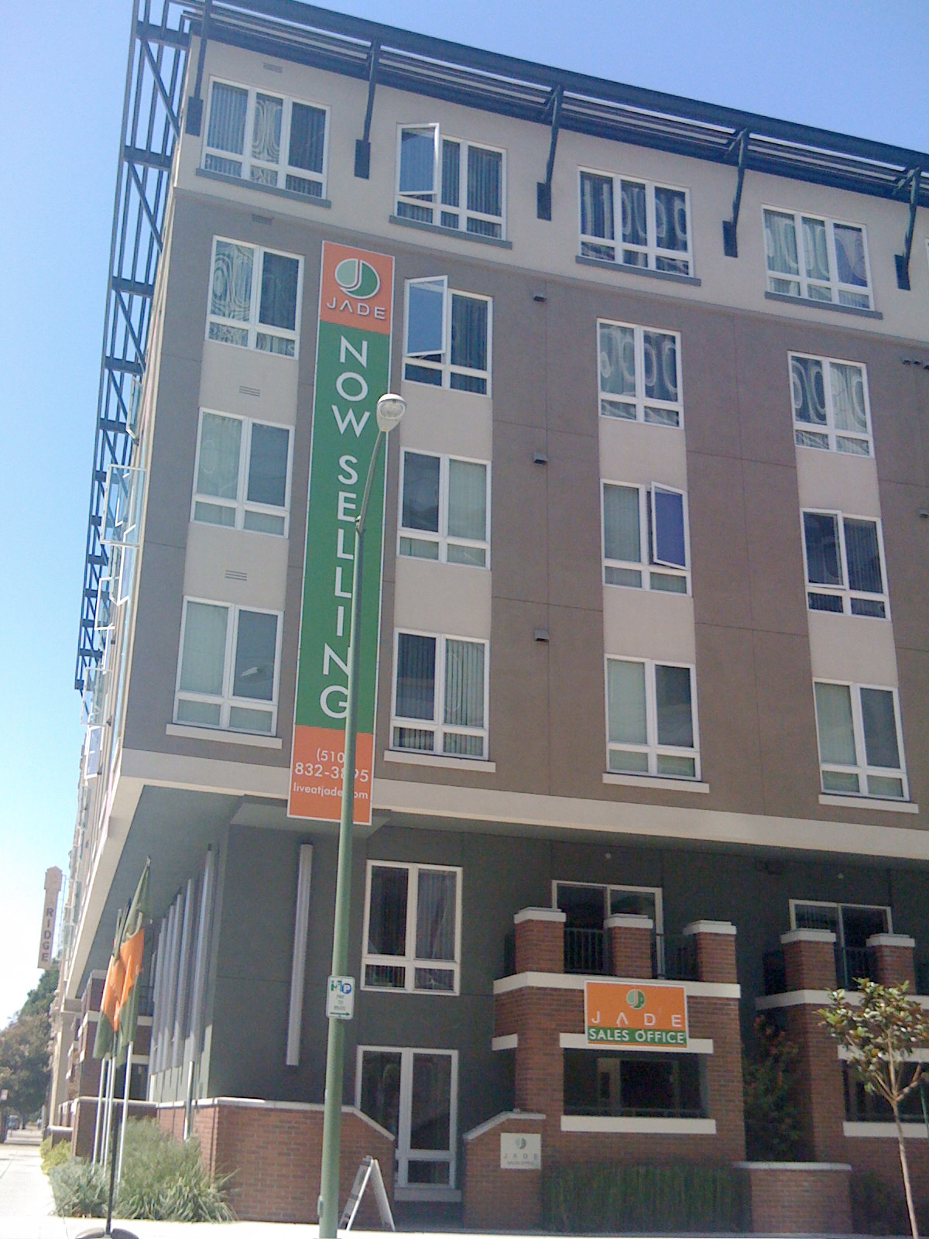
Zoning for Affordability working Group
When we increase zoning to allow more housing, we can often create significant increases in land value.
How can we ensure that everyone can share in the benefits of those changes?

Slide 32
Zoning for Affordability working Group
Local policies can ensure some benefits go to lower income households:
  Inclusionary Housing Ordinances
  Affordable Housing Impact Fees
  Density Bonus Programs
  Affordable Housing Overlay Zones
  Commercial Linkage Fees

Slide 33
Zoning for Affordability
Potential Working Group
Convene a workgroup that meets approximately four or five times to assist interested cities.
Potential Materials: Model Ordinances, Guidebooks, Shared Consultant RFP
Sessions could include:
Inclusionary zoning basics
Units or dollars – What do you want?
Market realities – Using the Inclusionary Calculator to explore what might work
Tradeoffs and flexibility – More units or deeper affordability? How to provide flexibility while protecting jurisdictions interest
Talking about Inclusionary – How to discuss inclusionary with the public and respond to critics

Slide 34
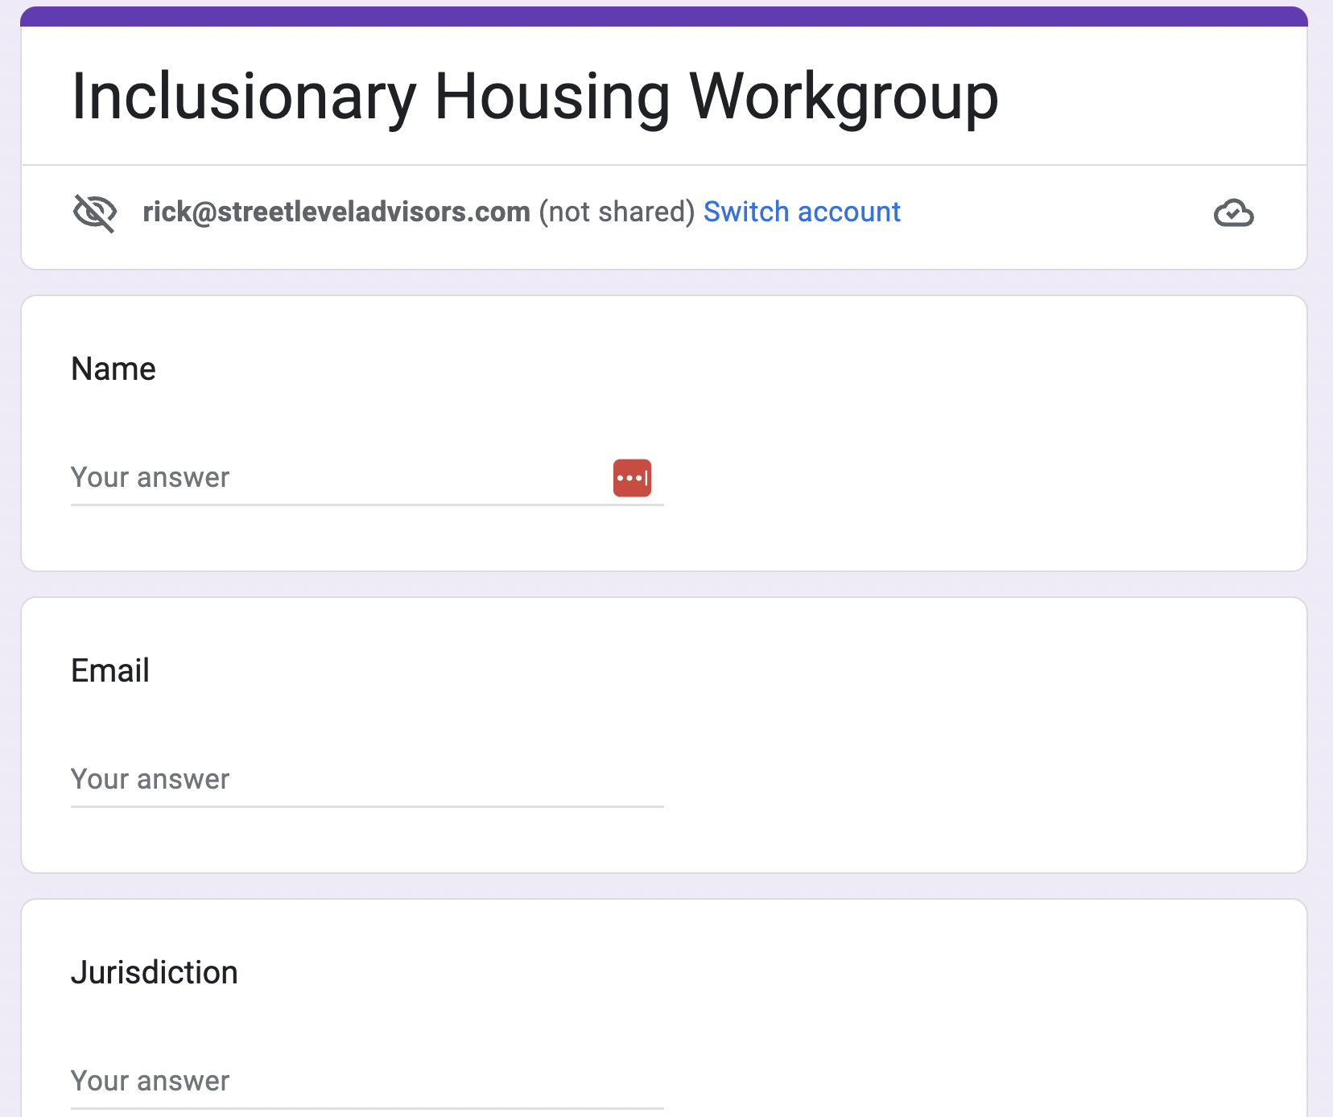
Zoning for Affordability working Group
Two-minute Survey

Slide 35
Next Meeting:
ADU Collaboration Update
November 10, 2022
12:00 – 1:30

