Slide 1
KEY STRATEGIES TO WORK EFFECITIVELY
With Your Elected Colleagues, the Manager and Staff
Santa Clara County Cities Association
November 10, 2022

Slide 3
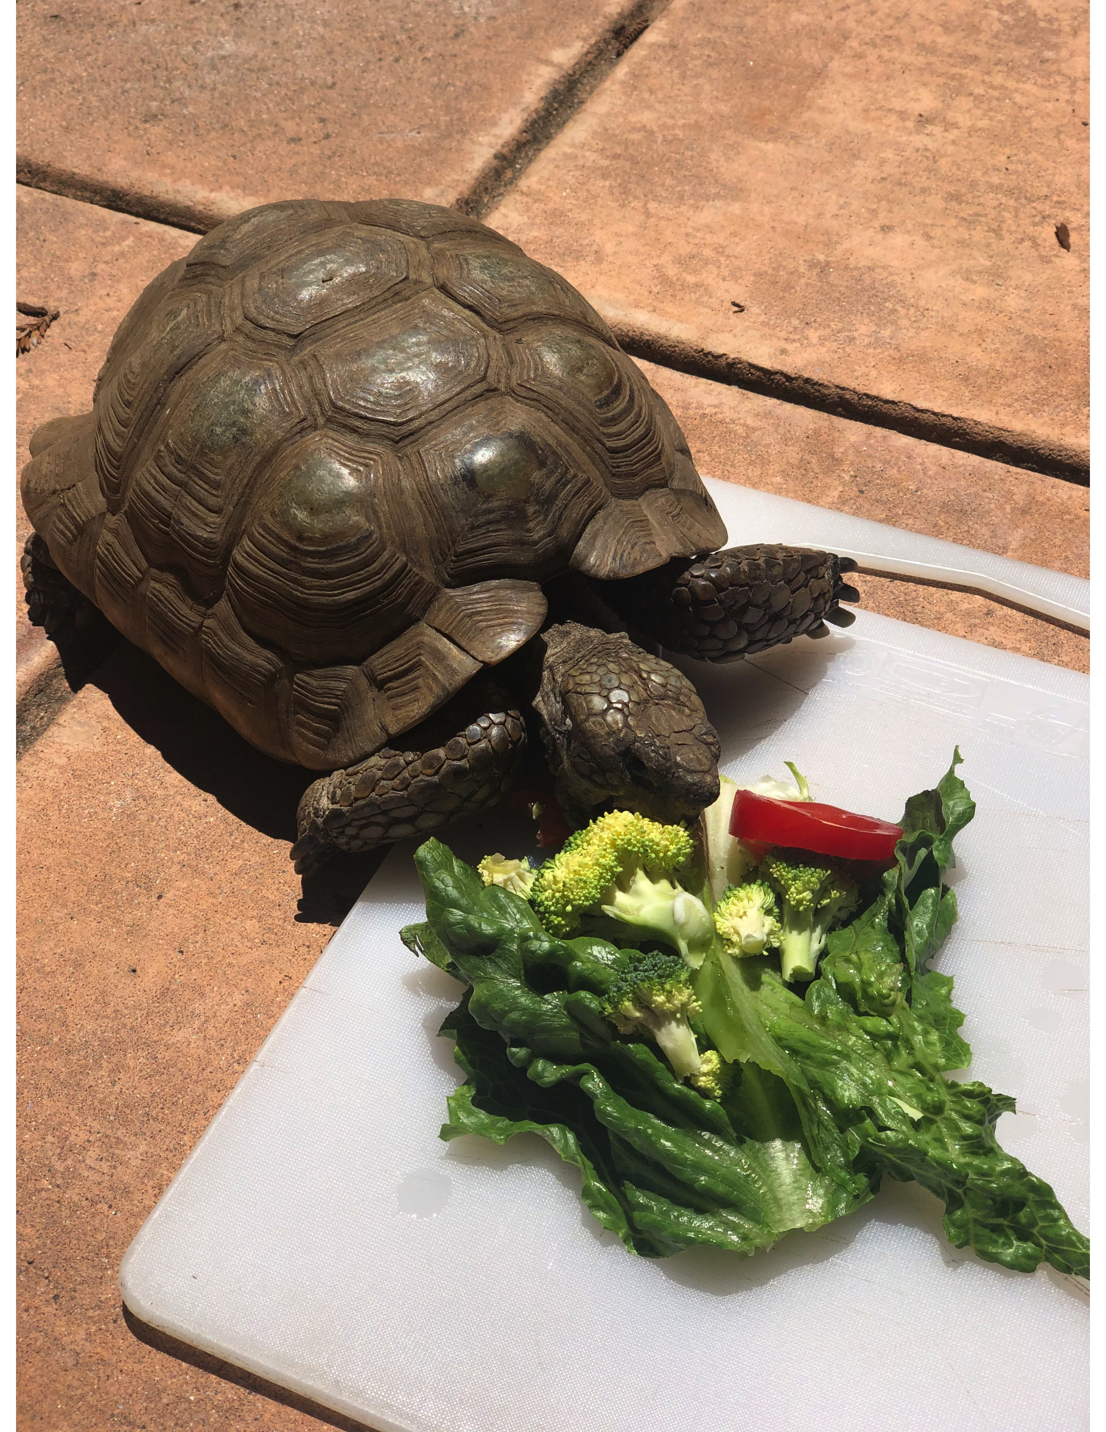
HERMAN
1966
2022

Slide 4
Why This Topic?
Without A Strong/Effective Governance Team:
The Organization Will Not be Effective
The Community Will Not Be Well Served
Citizens Will Not Want to Serve
You Will Not Be Able to Attract/Retain High Quality Staff
It Will Not be an Enjoyable Experience

Slide 5
It’s All About Teams and Effective Relationships:
Elected Official/Manager/Staff Team—You Are All Part of the SAME Team
Teams Succeed or Fail Together
Can’t Have Effective Teams Without Effective Relationships
Effective Relationships Require Time & Attention—They Don’t Just Happen

Slide 6
Key to Effective Relationships:
Ability to Understand & Respect Different Perspectives/Styles:
Life Experiences
Different Philosophies/Perspectives
Different Communication Styles
Different Work Styles
Different Personalities
It Usually Isn’t a Matter of “Right vs. Wrong”—Don’t Act As If It Is

Slide 7
DIVERGENT VIEWS/OPINIONS
Develop an Appreciation and Understanding Regarding Why It’s OK to Have Different Opinions
Differences Are Not Usually a Result of:
Dishonesty
Lacking Values
Intelligence
Differences of Opinion are Normal and Should be Expected

Slide 8
DIVERGENT VIEWS/OPINIONS
The Key Issue Is: How Does a Team Deal With Differences of Opinion?
Can You Overcome Your Differences or Is It a Constant Source of Conflict and Distraction?

Slide 9
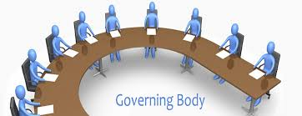
Why Being a Council Member Isn’t Easy
Challenging Issues
Varied Opinions/Perspectives
Group Decision Making
Not a Group of Your Choosing
It’s Done in Public/Anyone Can
Participate
Media and Public Scrutiny (Social Media)

Slide 10
Why the Job Has Been/Is Particularly Tough Now
Nature of Civic Discourse/Political Tribalism
Pandemic:
Frustration/Anger
Impatience
Fear
Social Isolation
Focal Points for Contention
Intolerance for Other Perspectives

Slide 11
Why the Job Has Been/Is Particularly Tough Now
Lack of Political Compromise/Effective Governance on the
National Level (Setting a Poor Example)
Demonizing/Intolerance of Those With Different Views
Social Reckoning/Views of Policing
More Challenging to Have Direct “In-Person” Contact With Colleagues, Staff & Public

Slide 12
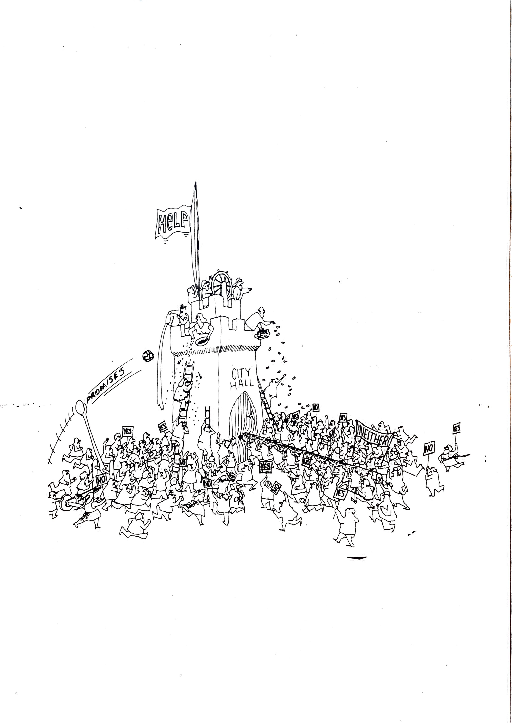

Slide 13
Why Being a City Manager Isn’t Easy
Multiple Bosses
Conflicting Expectations
Needing to “Translate” Between the Council & Staff
Attempts to Get Them to “Take Sides”
Ease of Communication Can Create 24/7 Expectations
Councilmember Conflict

Slide 14
Why Being a City Manager Isn’t Easy
Pandemic Impacts Have Amplified Challenges:
Fundamental Changes on How Services Are Provided
Financial Uncertainty
Loss of Direct Contact With Councilmembers & Staff
Enforcing Pandemic Related Restrictions
Policing Reforms/Social Justice and Equity
Staffing Challenges
Feelings That the Demands & Workload Are Unrelenting
Frustrated and Stressed Members of the Public/Staff/Council

Slide 15
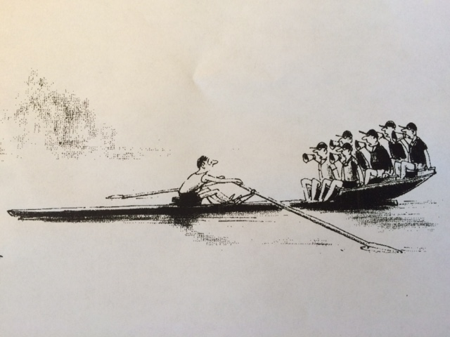

Slide 16
Areas of Greatest Challenge Between Councils & Manager/Staff
Lack of Respect for Different Roles and Responsibilities (Form Of Government)
Finite Resources/Lack of Priority Setting (Keeping Consistent With Established Priorities)
Lack of Tolerance for Mistakes/Imperfection
Technical vs. Community Perspectives

Slide 17
Areas of Greatest Challenge Between Councils & Manager/Staff
Constant Demands/Unrealistic Expectations
Individual vs. Group Expectations
Lack of Clear, Regular, Consistent and “Professional” Feedback
Public Criticism

Slide 18
Areas of Greatest Challenge Between Councils & Manager/Staff
Problematic Interactions Between Council and Staff
Going Around the Manager
Not Separating the “What vs. How”
Staff Not Living Up to High, But Reasonable Expectations
Perceived Lack of Council & Citizen Support

Slide 19
Areas of Greatest Challenge Between Councils & Manager/Staff
Lack of Appreciation on Staff’s Part That City Councils
Have the Right to Make “Wrong” Decisions
Council Members Not Holding Each Other Accountable
Creating Unrealistic Public Expectations
Manager & Staff Perceived as Not Doing Enough to Assist the Council in Dealing With Challenging Issues

Slide 20
Small Group Discussion
What Do You and Your Fellow Elected Officials Need From Each Other to be Successful?
What Does the Council/Council Members Need From the Manager and Staff to be Successful?
What Does the Manager and Staff Need From the Council/Council Members to Be Successful?
Notes:
Report out after discussion.

Slide 22
What Do Council Members Need From Each Other? (Kevin Duggan)
Respect for Different Perspectives and Opinions
Listening Skills
Emotional Maturity
Handling Conflict Respectfully
Coming to Meetings Prepared/Do Homework

Slide 23
What Do Council Members Need From Each Other? (Kevin Duggan)
Treating the Public, the Staff and Other “Audiences” With Respect
Supporting Council/Board Decisions
Dealing With Issues With Honesty
Being Willing to “Move On” From Council/Board Votes
Support for Efficient Meetings

Slide 25
What Do Council Members Need From the Manager and Staff? (City Managers Association)
Clear and Concise Staff Report
Clear, Timely and Accurate Communication
Anticipate Issues/No Surprises
Understand What Issues Will be Politically Sensitive
Follow the Direction of the Entire Council While Attempting to be Helpful to Individual Council Members
Respond in a Timely and Effective Manner to Council Requests/Referrals

Slide 26
What Do Council Members Need From the Manager and Staff? (City Managers Association)
Respond Promptly to Resident Concerns/Close the Loop
Professional Competency
Loyalty
Trustworthiness/Credibility
Commitment of the Manager to Meet With Individual Council Members
Encourage/Be Responsive to Performance Evaluation Feedback

Slide 27
What Do Council Members Need From the Manager and Staff? (City Managers Association)
Anticipate Challenging Issues and Provide Options and Alternatives
Demonstrate Creativity
Take Responsibility/Admit and Correct Mistakes
Help Council Members be Prepared for Meetings
Transparency/Complete Honesty
Effective Community Outreach
Demonstrate Respect for Office

Slide 28
What Do Council Members Need From the Manager and Staff? (Kevin Duggan)
Respect for the Policy Making Role of the Elected Officials
Long Term Planning Perspective
Professional Competency
Selection/Retention of High Quality Staff
Know When to Withdraw From the Discussion

Slide 29
What Do Council Members Need From the Manager and Staff? (Kevin Duggan)
Good Customer Service/Citizen Responsiveness & Follow-Up
Creativity and Innovation
No Surprises
Respect for the Role/Office
Recognition of the Pressures Faced by Elected Officials

Slide 30
What Do Council Members Need From the Manager and Staff? (Kevin Duggan)
Establishing and Maintaining High Standards for Work Performance
Responsiveness to the Council/Board and Community Members
Complete and Professional Staff Work
Avoid Bringing Personal Value Judgments to Recommendations

Slide 32
What Does the Manager and Staff Need From the Council/Council Members? (City Managers Association)
Conduct Thoughtful and Professional Performance Evaluations
Respect the Different Roles of Policy Making vs. Administration/Management
Don’t Underestimate the Power of Positive Feedback to the Manager and Staff
Recognize Your Role in Establishing a Positive Organizational Culture and How That Impacts Recruitment and Retention of Staff

Slide 33
What Does the Manager and Staff Need From the Council/Council Members? (City Managers Association)
Don’t Bash the Staff in Public
Establish Norms of Conduct and Follow Them
Hold Each Other Accountable to Norms (Deal With Outliers)
Don’t Attempt to Individually Direct Staff
Support Council Decisions (and Don’t Blame Staff for Implementing Those Decisions)
Recognize the Challenges Faced by the CM and Staff--Mutual Empathy and Support

Slide 34
What Does the Manager and Staff
Need From the Council/Council Members? (City Managers Association)
Recognize that the City Manager is Not a Council Member
Show Appreciation to CM (and Not Just $)
Be a Good Partner/Recognize the Value of Team Work
The Mayor Needs to Lead Based on Council Consensus
Don’t Micromanage
Don’t Go Around the Manager

Slide 35
What Do the Manager and Staff
Need From Council/Council Members? (Kevin Duggan)
Respect for Form of Government/Different Roles & Responsibilities
Recognize (And Utilize) Professional Knowledge And Experience—And Professional Obligations
Clear Policy Direction
Speaking With a Unified Voice
Support for Hiring Top Quality Staff

Slide 36
What Do the Manager and Staff
Need From Council/Council Members? (Kevin Duggan)
Don’t Attack the Messenger if You Don’t Agree With the Message
Clear Operating Policies/Respect for Those Policies
Willingness to Make Tough Decisions/ Say “No”
Openness to Creativity and Innovation

Slide 37
What Do the Manager and Staff
Need From Council/Council Members? (Kevin Duggan)
Clear Communication and Feedback (Usually Through the Manager)
Honesty/No Hidden Agendas
Tolerance for Mistakes/Imperfection
Service Quality Feedback Focused on the “What”
Vs. the “How”
Appreciation of the Difference Between Professional/Technical Perspective vs. Community
Perspective

Slide 38
What Do the Manager and Staff
Need From Council/Council Members? (Kevin Duggan)
No Surprises/Blindsiding
Avoid Jumping to Conclusions Regarding Citizen Complaints
Respectful Treatment
Willingness to Set Priorities

Slide 39
PROFESSIONAL CITY MANAGERS
Most Follow a Code of Ethics
Have to Operate Within the Form of Government
Are Committed to Elected Official/Governing Body Success
Don’t Play Favorites/Don’t Take Sides
Must Sometimes Tell You What You Don’t Want to Hear/Can’t Always Do What You Want

Slide 40
PROFESSIONAL CITY MANAGERS
Need Thoughtful and Comprehensive Performance Feedback
Strives to Communicate in a Style That Works for You
Is Obligated to Protect the Staff

Slide 41
The Bottom Line
Interpersonal Skills
Listening Skills
Patience
Respecting Roles/Responsibilities
Emotional Maturity
Honesty/Trustworthiness
Tolerance for Differences and Imperfection
Willingness to Establish Priorities
Sense of Humor
Ability to Keep Everything in Perspective
IT’S ALL ABOUT RELATIONSHIPS

Slide 42
Competitive Advantage?
The Competition is Greater than Ever for Top Quality Staff
(Particularly in this Area Due to Housing Costs)
Compensation and Working Conditions Need to be Competitive
The City Council Can Be Either a Competitive Advantage or Disadvantage
If You Have a Good Manager & Staff—Treat Them As If You Want
Them to Stick Around for Awhile—If You Don’t, They Won’t

Slide 43
What Do You Want Your Public Service Legacy to Be?
What Do You Want to Accomplish?
How Do You Want to Accomplish Those Things?
How Would You Like to Feel When You Look Back at Your Service?
How Would You Like Others to Remember You?
It’s as Much (If Not More) About HOW You Accomplish Goals vs. What You Accomplish

Slide 44
Wrapping Up: Key Questions
Recognizing, As We Established at the Beginning, Both Councilmembers and the City Manger/Staff Have Challenging Roles:
Is Your Elected Official Team and Your Manager/Staff Team Doing All That Can be Done to Support Each Other in Making These Roles Less Challenging and Your Organizations More Successful?
What More Can You Do?

Slide 45
Six Attributes of Exceptional City Councils
Develop a “Sense of Team”: Mayor/Council/City Manager
Recognizes/Respects Clear Roles and Responsibilities
Honor the Relationship With Staff and Each Other

Slide 46
Six Attributes of Exceptional City Councils
Routinely Conduct Effective Meetings
Hold Themselves and the City Accountable
Practice Continuous Learning and Development

Slide 47
www.icma.org/en/press

Slide 49
Kevin C. Duggan
ICMA/Cal-Cities Senior Advisor
kcduggan@katesbridge.com
650-888-5850

