Slide 1
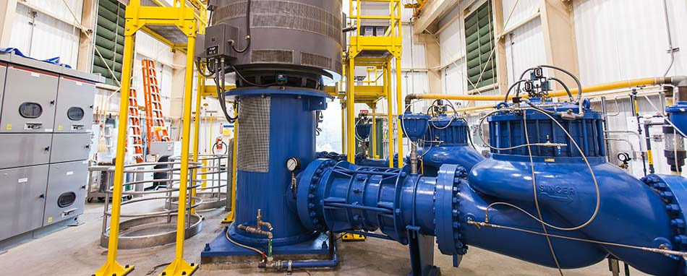
FY 18-19 Proposed Budget and Rates Water Transmission System
Presentation to:
City of Sonoma
March 19, 2018

Slide 2
Proposed Rates for FY 18-19
Charge / Aqueduct | Santa Rosa | Petaluma | Sonoma
Deliveries (Acre-Feet) | 41,768
O&M | $578.85 | $578.85 | $578.85
Water Management Planning | $1.00 | $1.00 | $1.00
Watershed Planning & Restoration | $91.07 | $91.07 | $91.07
Recycled Water and Local Supply | $2.92 | $2.92 | $2.92
Water Conservation | $45.16 | $45.16 | $45.16
Total O&M | $719.00 | $719.00 | $719.00
Storage & Common Bond/Loan Charges | $139.38 | $139.38 | $139.38
Sonoma Aqueduct Bond/Loan Charge |  |  | $142.68
Prime Contractors | $858.38 | $858.38 | $1,001.06
Discretionary Charges
Capital Charges - to build fund balance for future projects | $19.50 | $19.50 | $0.00
Local Recycled Water Tier 2 Program | $0.00 | $0.00 | $0.00
Prime Contractors | $19.50 | $19.50 | $0.00
Total Prime Contractors | $877.88 | $877.88 | $1,001.06
Total Overall Increase: | 3.67% | 3.67% | 5.98%

Slide 3
Rate Setting Calculation (EXAMPLE)
$36,700,000
Cost of Operations and Maintenance
$878/ Acre Foot
Cost of Water (Dollars per acre-foot)
=
Water Sold
41,768 AF
Water Sold = Lesser of:
43,848 AF
Last 12 months of actual water deliveries
41,768 AF
Average of last 3 years annual water deliveries
or

Slide 4
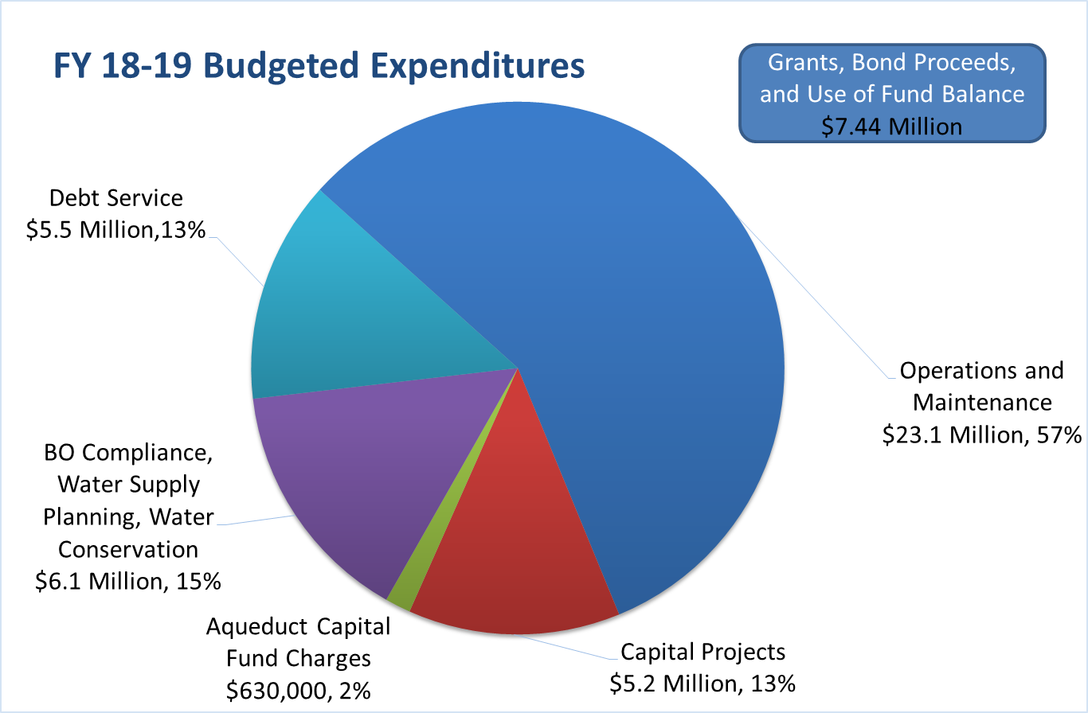

Slide 5
Expenditures Compared to FY 17-18
 | FY17-18 |  | FY18-19
 | Budget |  | Budget |  | Change
Operations and Maintenance | $22.00 | Million | $23.13 | Million | $1,130,000
Capital Projects | $5.59 | Million | $5.21 | Million | ($390,000)
BO Compliance, Water Supply Planning, Water Conservation | $6.68 | Million | $6.05 | Million | ($630,000)
Debt Service | $4.22 | Million | $5.47 | Million | $1,250,000
Aqueduct Capital Contribution | $750,000 |  | $630,000 |  | ($120,000)
Totals | $39.24 | Million | $40.49 | Million | $1,240,000
Grants, Use of Fund Balance, and Bond Proceeds | $8,170,000 |  | $7,440,000 |  | ($730,000)

Slide 6
Historical Water Transmission Deliveries

Slide 7
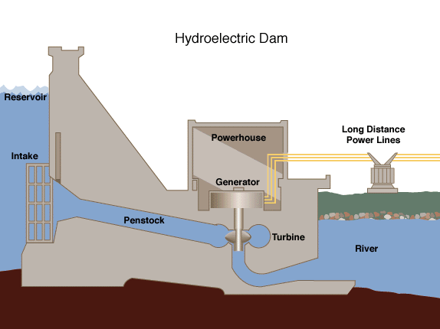
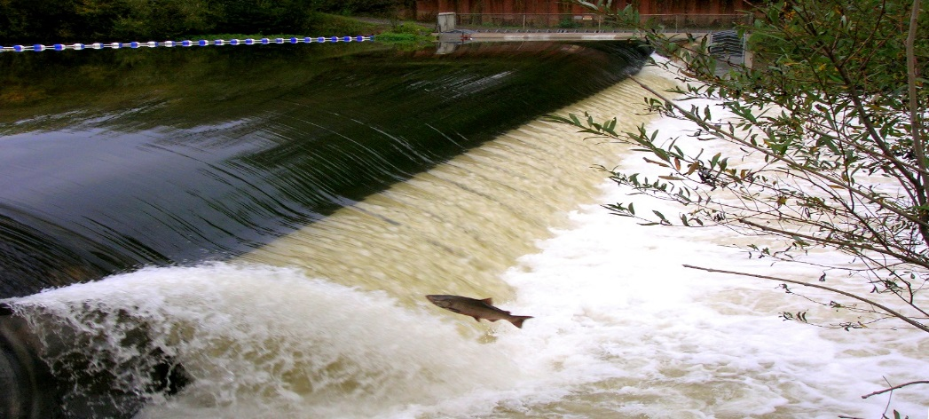
Capital Projects
Warm Springs Dam Hydroturbine Retrofit
Mirabel Dam Bladder Replacement

Slide 8
2018 Wholesale Water Rates Per Acre-Foot

Slide 9
Proposed Rates for FY 18-19
Charge / Aqueduct | Santa Rosa | Petaluma | Sonoma
Deliveries (Acre-Feet) | 41,768
O&M | $578.85 | $578.85 | $578.85
Water Management Planning | $1.00 | $1.00 | $1.00
Watershed Planning & Restoration | $91.07 | $91.07 | $91.07
Recycled Water and Local Supply | $2.92 | $2.92 | $2.92
Water Conservation | $45.16 | $45.16 | $45.16
Total O&M | $719.00 | $719.00 | $719.00
Storage & Common Bond/Loan Charges | $139.38 | $139.38 | $139.38
Sonoma Aqueduct Bond/Loan Charge |  |  | $142.68
Prime Contractors | $858.38 | $858.38 | $1,001.06
Discretionary Charges
Capital Charges - to build fund balance for future projects | $19.50 | $19.50 | $0.00
Local Recycled Water Tier 2 Program | $0.00 | $0.00 | $0.00
Prime Contractors | $19.50 | $19.50 | $0.00
Total Prime Contractors | $877.88 | $877.88 | $1,001.06
Total Overall Increase: | 3.67% | 3.67% | 5.98%

Slide 10
Next Steps
Recommended by Technical Advisory
Committee - March 5
Presentations to City Councils/District Boards as requested during March
Vote by Water Advisory Committee on Monday, April 2
Adoption by Water Agency Board of Directors – by April 30

Slide 11
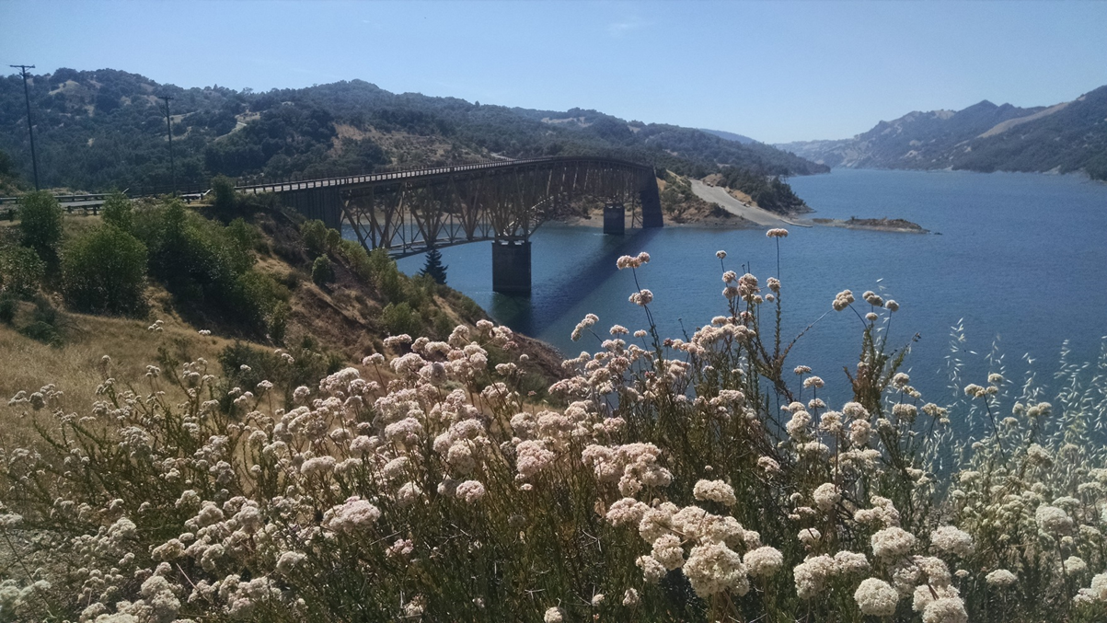
FY 18-19 Proposed Budget and Rates Water Transmission System
Lynne Rosselli
Finance & Accounting Mgr
lynne.rosselli@scwa.ca.gov
707-524-3771
Notes:
Questions?

Slide 12
Sonoma Aqueduct Long Range Financial Plan Projects
Sonoma Aqueduct Projects | Construction Start | Project Cost
Local Hazard Mitigation Program Design - Sonoma AQ | 2018 | 70,000
Sonoma Booster Pump Station Upgrade | 2020 | 4,704,000
Calabasas Creek Crossing - net of possible $2.2M FEMA grant | 2022 | 1,067,000
Sonoma Creek Crossing (Lawndale/Madrone) - net of possible $1.3M FEMA grant | 2022 | 661,000
Bennett Valley Fault Crossing (Sonoma AQ Portion) - net of possible $3.3M FEMA grant | 2023 | 1,589,000
Sonoma Creek Crossing (Verano Ave) - net of possible $2.2M FEMA grant | 2024 | 1,067,000
1. Project costs are from FY2017-2018 forward, and are net of grant funds.
Notes:
The Agency’s LRFP Looks out over the next 30 years and takes into account Water Demand, Capacity Projects, Hazard Mitigation Projects, Large Maintenance Projects and Biological Opinion Projects.
It accounts for financing, rising construction costs escalated 3.2% per year, and operations and maintenance costs.
Spits out rates for future years to support the system
Actually more complex than this, because we have to optimize these rate increases to avoid rate spikes in years with large projects.
The basis for all calculations is the Restructured Agreement for Water Supply between the Water Agency and its contractors.
Total project costs from FY17-18 forward are shown in the table.

Slide 13
Water Delivery Projections in
Acre Feet
Fiscal Year | 2016 | 2017 | 2020 | 2025 | 2030 | 2035 | 2040
Valley of the Moon Water District Deliveries | 1,806 | 1,819 | 2,306 | 2,453 | 2,550 | 2,623 | 2,651
Sonoma AQ Deliveries | 3,441 | 3,551 | 4,502 | 4,788 | 4,976 | 5,120 | 5,174
Total Transmission System Deliveries | 39,905 | 40,356 | 51,160 | 54,409 | 56,554 | 58,185 | 58,798
Growth (per 2015 UWMP) |  | 1.1% | 26.8% | 6.4% | 3.9% | 2.9% | 1.1%
Notes:
Capacity Projects required after 2040 when deliveries exceed 65,000 Acre Feet. Current projection estimate 59,000 Acre Feet in 2040.
Financing $2-$3M each in FY18-19 and FY21-22.
Projected Average Annual Increase in Deliveries:
2020: 8.2%
2025: 1.2%
2030: 0.8%
2035: 0.6%
2040: 0.2%

Slide 14
Example Sonoma Aqueduct Rate Scenario
Notes:
The Agency’s LRFP Looks out over the next 30 years and takes into account Water Demand, Capacity Projects, Hazard Mitigation Projects, Large Maintenance Projects and Biological Projects.
It accounts for financing, rising construction costs, and operations and maintenance costs.
Spits out rates for future years to support the system
Actually more complex than this, because we have to optimize these rate increases to avoid rate spikes in years with large projects.

