Slide 1
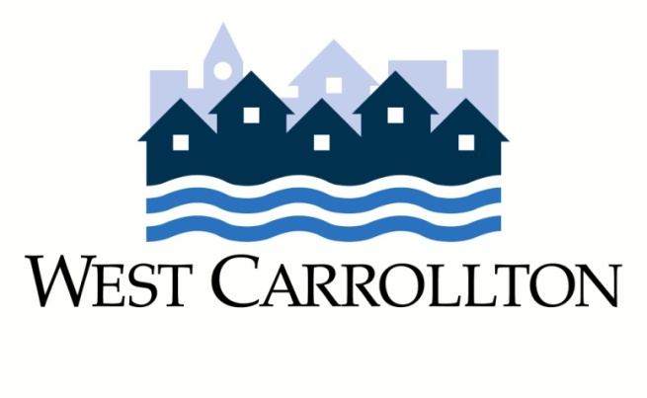
West Central Avenue Strategic Plan
West Carrollton City Council
May 23, 2017

Slide 2
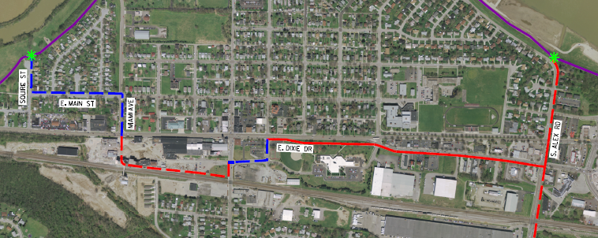
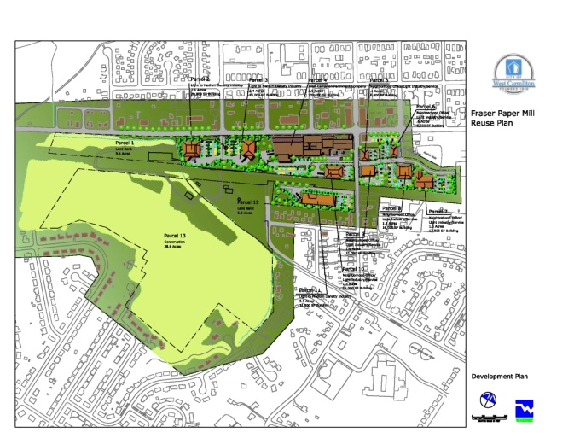
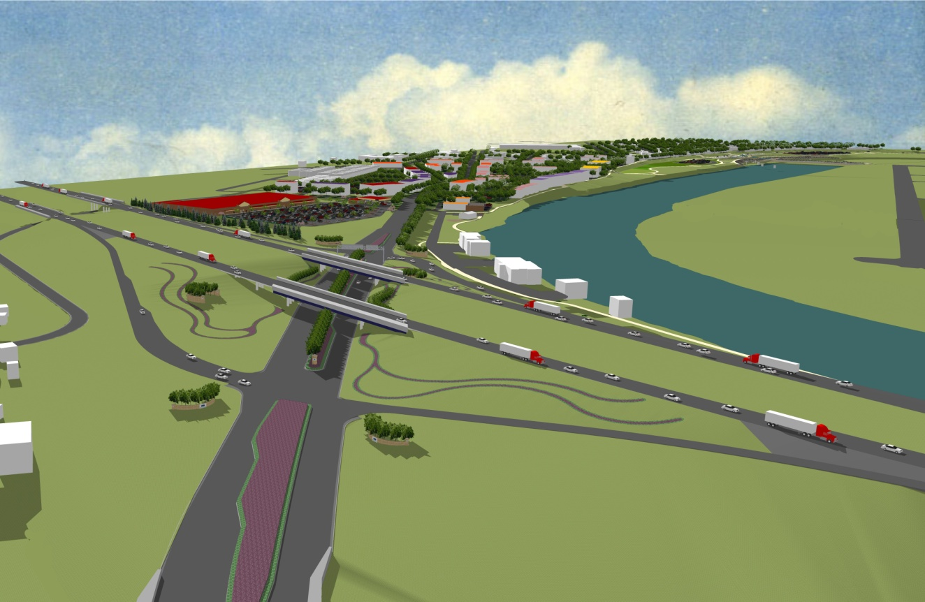
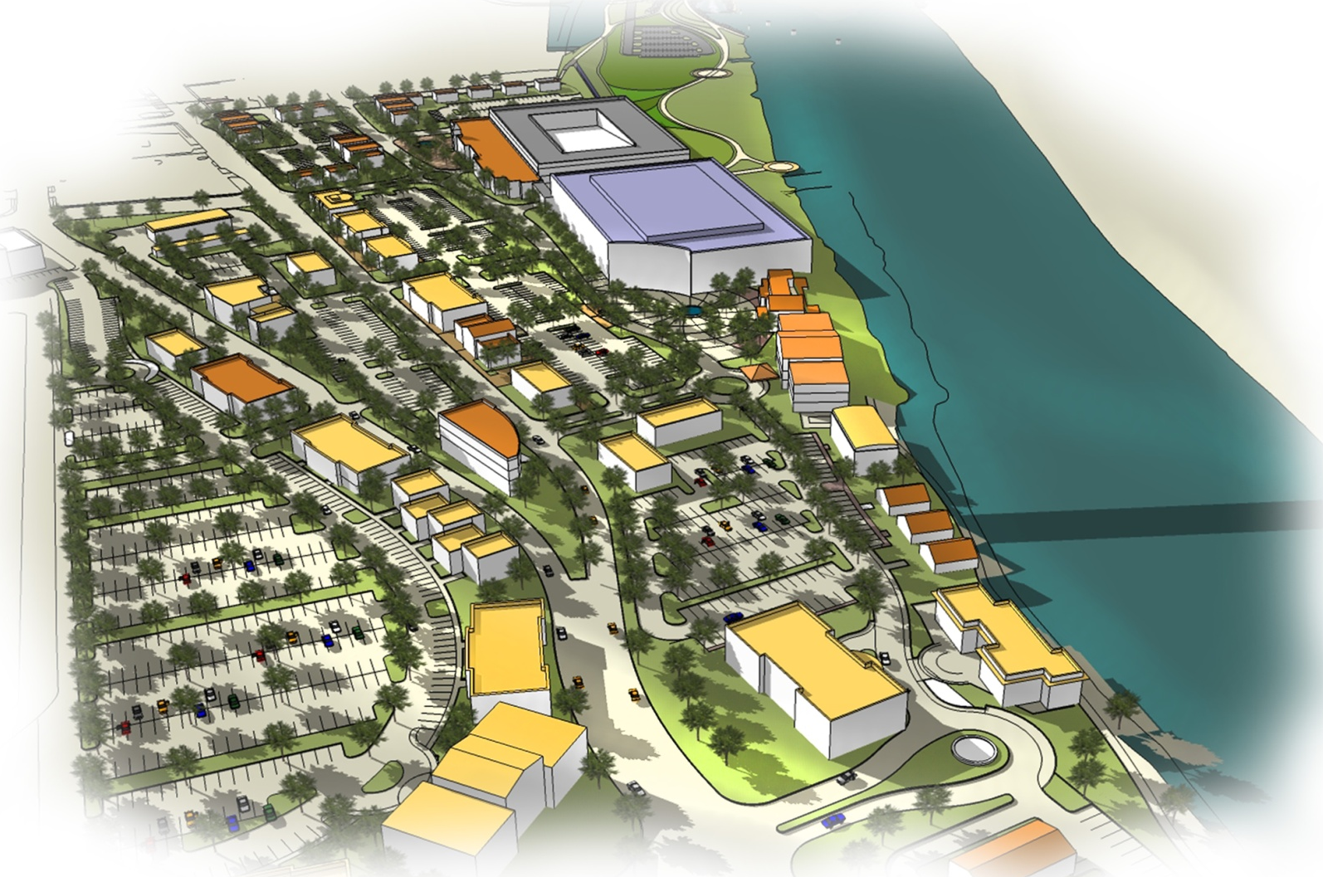
The Big Picture
Western anchor of Downtown Corridor
Key element of Comprehensive Plan and Downtown Corridor Plan

Slide 3
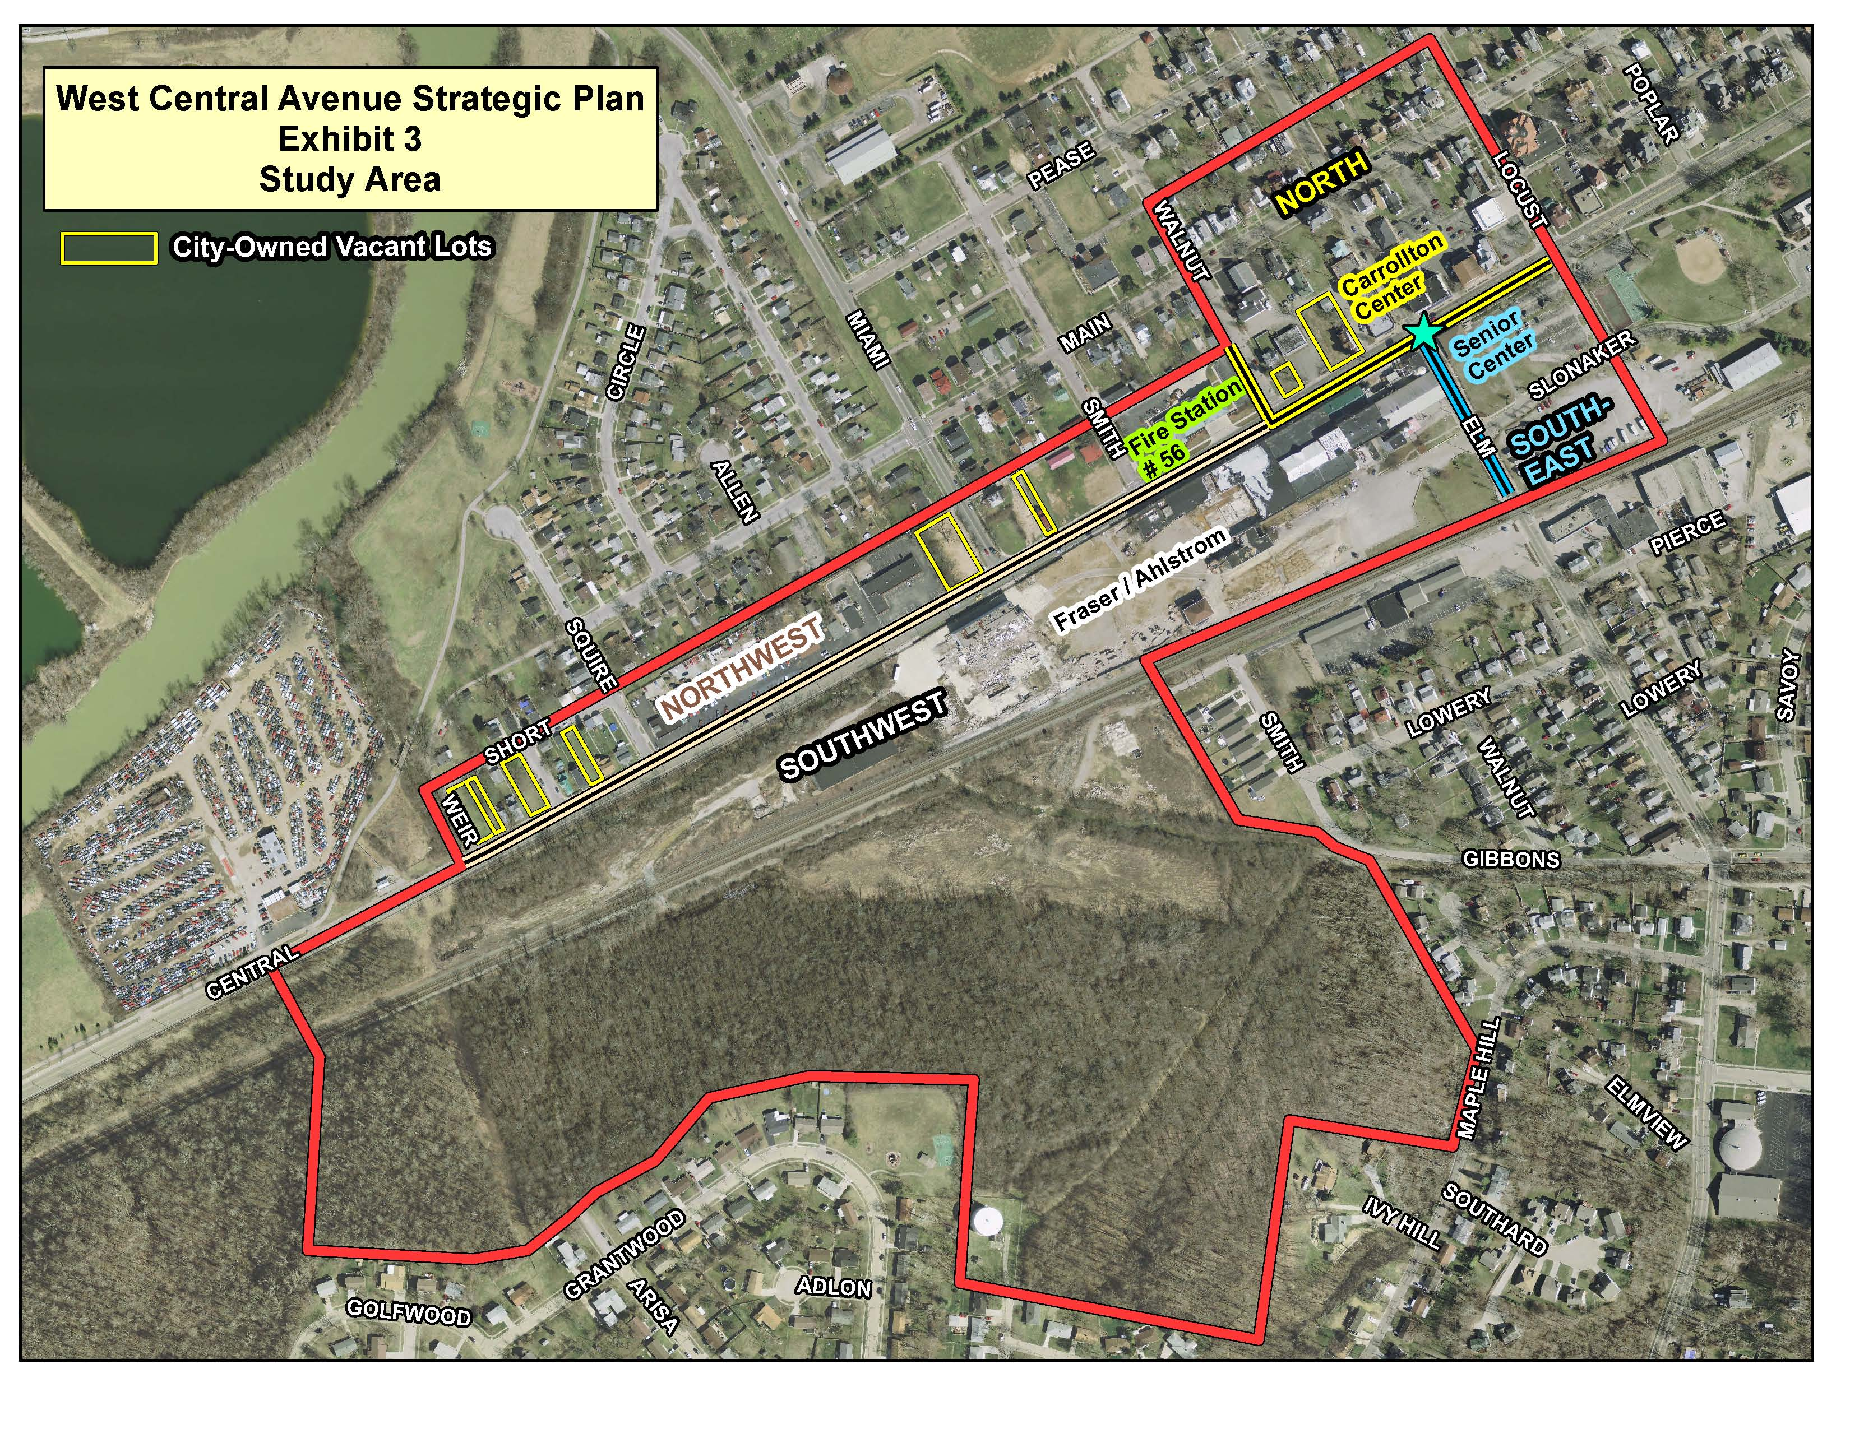

Slide 4
Goals and Objectives
“The goal of preparing a strategic redevelopment plan for this area is to identify its highest and best reuse potential, and to clearly articulate a plan of future action which will promote economically-viable, market-based, and sustainable redevelopment in order to create a stable and vibrant district.”
Objectives:
Determine best re-use of Fraser/Ahlstrom properties
Evaluate expansion of Carrollton Center
Elevate under-performing properties on W. Central Ave.
Expand city tax base and increase property values
Use as marketing tool to attract private developer(s)

Slide 5
Recommendation
OHM Advisors (Columbus, OH)
Creative/unique approach to each situation
Successful track record with similar projects
Strong client recommendations
Focus on “real world” solutions
Strong team / diverse range of expertise
Local
Cost: $62,000

Slide 6
Key Elements
Oversight: PC/Steering Committee/Staff
Four Steering Committee meetings
Public involvement
Online communication tools / project website
Two public workshops
Market study (feasibility/viability)
DiSalvo Development Advisors
Alternative redevelopment plan scenarios
Recommend preferred redevelopment plan with funding strategies
Timeline: 8-9 months

