Slide 1
2018-2019

Slide 2
Class of 2025

Slide 3
Begin with the End in Mind
To provide general information about planning for middle and high school
To begin the planning process for students and their families
To explain some of the changes that will affect students in the future
Notes:
Explain that tonight is not about answering every question that parents may have. Tonight is about understanding the planning process and hearing about additional opportunities that students and their families will have to seek information before making decisions regarding high school. Explain that expectations for high school students are changing beginning with the Freshmen Class of 2007. Reassure parents that while they will receive a large amount of information tonight, they will hear it again and again to help them understand and remember all of it. Remind them that tonight is just one of many opportunities they will have in the future to clarify information introduced tonight.

Slide 4
Schedule
8:25 a.m. – 3:40 p.m.
Lunch is 30 minutes.

Slide 5
CLASS SCHEDULE
EXAMPLE
1ST ENGLISH Pre AP Mrs. Wahl Room A015
2ND SOCIAL STUDIES Mrs. Robertson Room A035
3RD MATH Pre AP Mr. Wilder Room A013
LUNCH (10:50-11:20) Cafeteria
4TH SCIENCE Mr. Lopez Room A122
5TH (1) P.E. Coach Scott Gym
5th (2) Health Coach Walls Room A037
6TH Reading Pre AP Mrs. Cloud Room A016
7TH A.I.M. Mr. Lopez Room A122
8TH Band Mr. Rosas Room B161

Slide 6
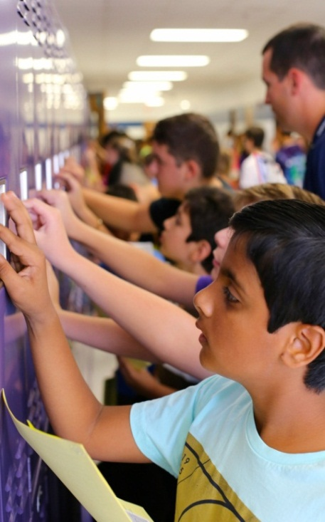
Typical School Day
Before school – bus, parent drop off, walking, riding bike, breakfast, tutoring
Lockers – textbooks, backpacks
Responsibility – traveling to lunch/classes
Organization – agenda, HW, teacher web page
Eight classes – 5 minute passing periods
Lunch – 6th grade lunch is first
PE – dressing out, lockers, etc.
After school – bus, parent pick-up, walking, riding bike, KINS
Notes:
The typical school day:
Students arrive to school by bus, by parent drop off, or by walking or riding bikes. The school day begins at 8:20 a.m.
You will be issued a locker and you will use this for your backpack. You will also be issued a set of textbooks, but these are able to be taken home because your teachers will have a classroom set.
Responsibility is a big word in 6th grade. As you travel through middle school, your teachers will trust you to be responsible as you travel from class to class.
To help you keep organized you will use an agenda each day to track your homework. You can use teacher webpages to identify your homework assignments, projects, and upcoming tests.
You’ll have 8 classes with a 4 minute passing period between them.
6th graders get to eat lunch first followed by 7th graders and then 8th graders.
PE is different from elementary school because in middle school you will be asked to dress out into gym shorts and a t-shirt for exercising and physical activity. You will also be issued a gym basket with a lock to secure your PE clothing.
After school students will travel home by bus, be picked up, walk or even ride their bikes. Tejeda offers the KINS program (Kids Involvement Network) which allows parents to have the option for an extended school day.

Slide 7
Your choices help guide your future

Slide 8
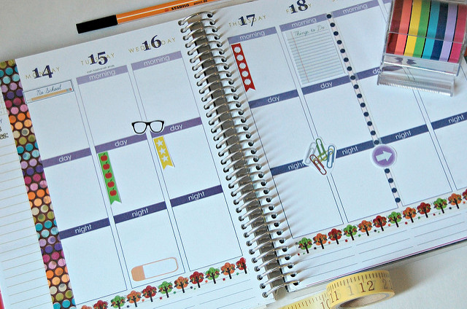
Success In The Future Requires Planning
Preparation for school success requires students to:
take rigorous middle school courses
develop meaningful goals
learn and utilize strong study, organization & time management skills
Notes:
In order to prepare for HS student need to do the following while in MS. (read the bullets) To help you understand why these points are so critical, we need to look at what HS will expect of students.

Slide 9
College & Career Readiness
NEISD has an initiative to ensure that after high school, all students are prepared to enter
A four-year college or university
A junior or community college
A trade or technical school
The military
The workforce
Students wishing to rank in the Top 10% of their high school class need to pursue rigorous academic courses to prepare for high school.
Notes:
Explain that college and career planning will be an integral part of students’ planning throughout high school. In the small group guided sessions, students will think about their career options. In January and February, they will select specific courses each year and their electives should be geared toward exploring and preparing for career options.

Slide 10
Open Access to Rigorous Courses
Pre-Advanced Placement courses in middle school are available to any students willing to take on the academic challenges
6th grade – English, Reading and Math
7th grade – English, Reading and Math
8th grade – English, Reading, Math, Science and History
GT Courses – Math & English require testing in 5th grade
Notes:
The title of this slide reads, “Open Access to Rigorous Courses”. Pre-Advanced Placement courses are available to any student. Pre-AP courses move at a faster pace and introduce students to learning strategies that promote high order thinking and more complex reasoning.
In 6th grade you have a choice to take regular or Pre-AP English, Reading or Math. Pre-AP English is combined with Pre-AP Reading. Students choosing regular English will also take regular Reading. In a Pre-AP class, students work above grade level. To help you decide whether or not to take Pre-AP, we recommend you talk with your parents and your fifth grade teacher. Taking a Pre-AP class is a choice, but it’s not the right choice for everyone. Students do well in Pre-AP if they are intrinsically motivated. This means that you take charge of your learning on your own, you work hard in school, and you like to do your best on assignments. If you have mostly A’s and B’s on your report card and you do well on your state testing for STAAR, then Pre-AP is probably the right choice for you.
The math class chosen in 6th grade is very important. You want to choose your Math class carefully. The reason for this is because Math is sequential. Students who take regular Math in 6th grade, will take Pre-Algebra in 8th grade. Students who take Pre-AP Math or GT Math in 6th grade, will take Algebra in 8th grade. Completing Algebra successfully in middle school will earn high school credit for the course.
Students in the Gifted and Talented program in elementary will be tested before entering 6th grade. Results will be shared with the middle school in order for the schedule to reflect GT courses for English, Math, or for both subjects.

Slide 11
Physical Education / Health
All 6th graders are required to take 1 semester of P.E. and 1 semester of health.
4 semesters of P.E. are required in middle school. 1 semester must be taken each year with the 4th semester flexible over the 3 years of middle school.
P.E. uniforms are required; maroon gym shorts and a Bush T-shirt (cost $20)

Slide 12
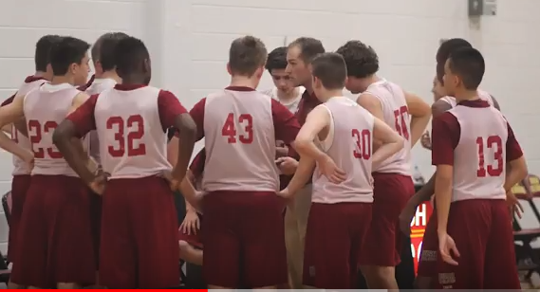
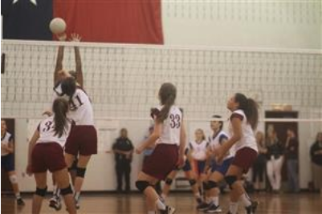
Athletics 7th & 8th Grade
BOYS: football, basketball, track (football is required to be in the athletic period & 1 other sport)
GIRLS: volleyball, basketball, track (must participate in at least 2 sports to enroll in the athletic period)
**The Athletic Course is a one year commitment. An athletic contract must be signed along with athletic participation forms & a physical must be obtain from a physician.***
Teacher recommendation is required.
**The Athletic Course counts as 1 year of P.E.

Slide 13
Fine-Art Electives
NEISD recommends one year or two semesters of a fine art over the 3 years in middle school.
Fine-Art electives include:
Band
Orchestra
Choir
Art
Theatre Arts

Slide 14
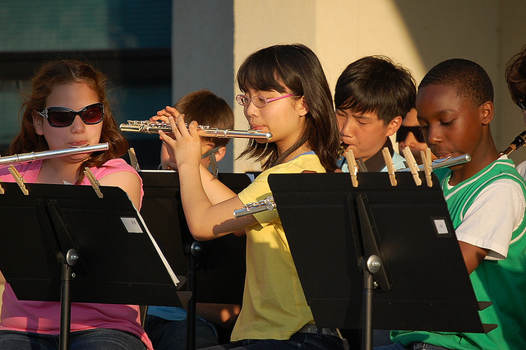
BAND
Students must audition with band directors to determine which instrument the student will play.
Students are required to participate in concerts and contests after school.
A full-year course.

Slide 15
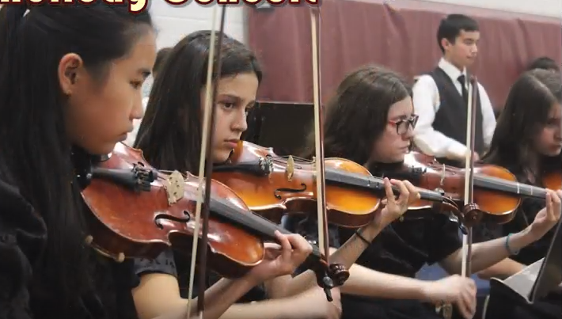
Orchestra
Students will learn to play stringed instruments such as violin, cello, viola and string base.
Students are required to participate in concerts and contests after school.
Orchestra is a full year course.

Slide 16
CHOIR
Students will sing and learn to sight-read along with proper vocal techniques.
Students are required to participate in concerts and contests after school.
Choir is a full year course.

Slide 17
Art
Activities include drawing, painting, and sculpture. Art is a full year course.

Slide 18
Theater Arts
This class emphasizes acting and drama.
Theater Arts is offered as a semester or full-year course.

Slide 19
6th Grade
Course Requirements
Pre AP English and
Pre AP Reading
OR
Regular English and Regular Reading
Pre AP Math
OR
Regular Math
Science
Social Studies
P.E. / Health
A.I.M.
Fine Art Elective

Slide 20
7th Grade
Course Requirements
Science
Texas History
P.E./Athletics
Electives
Pre AP English and
Pre AP Reading
OR
Regular English and Regular Reading
Pre AP Math
OR
Regular Math

Slide 21
8th Grade
Course Requirements
Pre AP English and Pre AP Reading
OR
Regular English and Regular Reading
Pre AP Algebra I
OR
Regular Math
Pre AP Science
OR
Regular Science
Pre AP American History
OR
Regular American History
P.E./Athletics
Electives

Slide 22
Electives
Courses for
High School
Credit

Slide 23
High School Credit Courses for 7th and 8th Grade Students
Principles of Arts, Audio Video Technology, and Communications
(1.0 credit)
Principles of Applied Engineering
(1.0 credit)
Spanish 1A (7th Grade) (must complete 1B in 8th grade to get 1.0 hs credit)

Slide 24
High School Credit Courses for 8th Grade Students Only
High School Health (0.5 credit)
Spanish 1B (1.0 credit for passing both Spanish 1A and 1B)
Spanish I (1.0 credit)
Pre AP Spanish II Native Speakers (2.0 credits)
Algebra I Pre AP (1.0 credit)
GT Algebra I Pre AP (1.0 credit)

Slide 25
PROMOTION POLICY
To be promoted to 7th grade you must:
Pass all core classes with a 70 or higher.
Maintain good attendance (90% attendance)

Slide 26
5th Grade Visit
On January 30, 2018 we will welcome our future bulldogs from Canyon Ridge, Stone Oak, Tuscany Heights, and Las Lomas. Students will tour the school. The students will get a chance to meet the leadership team, hear about the elective programs we offer here at Bush and get information about what clubs and organizations are available to 6th graders!

Slide 27
CAMP
Incoming 6th grade students will:
Meet the sixth grade teachers
Receive an orientation of Bush
School Tours
Lockers
Cafeteria procedures
Opportunity to purchase Bush gear & PE uniforms
Usually held the week before school begins

Slide 28
Disclaimers
Students should receive the course card for the next campus that is listed on SAGR.
The School Choice window is open from January 8-Februay 28. There is no guarantee that students will be granted their school choice.
If you are moving or plan to move, you will need to update your address. If you move before school is out, you will update your info at Tuscany. If you move over the summer, you will have to go to the middle school and provide new proof of residency.
If you are applying to a magnet school, please complete the choice card for your home campus. You will not know if you are accepted to the magnet school until sometime in late February or March.

Slide 29
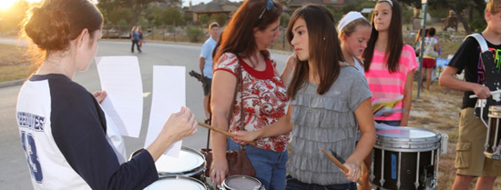
6th Grade Electives Tejeda
AIM
Art (Fine Arts)
Theatre Art (Fine Arts)
Choir (Fine Arts)
Orchestra (Fine Arts)
Band (Fine Arts)
Debate
Dance (Fine Arts)
Notes:
This is a list of electives for 6th grade.
AIM stands for Academic Individual Motivation and is strongly encouraged, but not required.
The purpose of AIM is to provide an opportunity for STAAR support, academic support, character education, leadership development, and additional time to complete student work.
Please note that Debate does not count towards the fine art requirement.

Slide 30
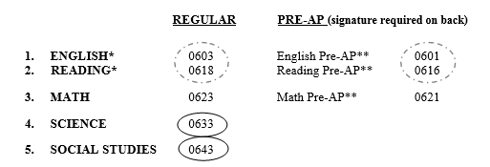
Tejeda Course Card
Notes:
This is a sample of a course card. You will notice on the far left the 5 core classes are listed: English, Reading, Math, Science, and Social Studies. If you take regular English, it will automatically be combined with regular Reading. On the right, if you choose to take Pre-AP English, it is automatically combined with Pre-AP Reading.
Following the core classes you will see PE is listed as number 6. This doesn’t necessarily mean that your PE class will be the 6th period of the day, but just a time slot as part of the school day. 6th graders will have PE for a semester opposite Health.

Slide 31
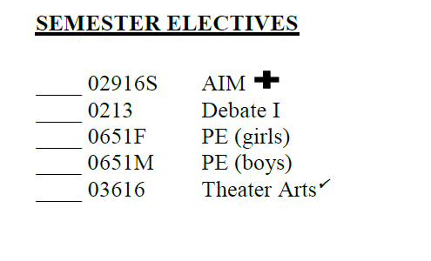
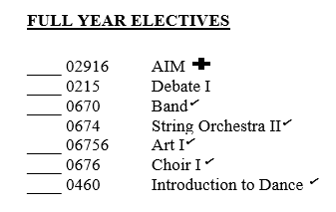
Tejeda Electives
1
7
6
3
2
4
8
5
Remember:
Mark only one #1, one #2, one #3, etc.
Notes:
And now for the bright spot in the day, the elective that many of you are looking forward to. You will number your top priority elective with number 1, your second choice with a number 2, your third choice with a number 3. Continue numbering until you reach number 8. Please make sure that you have one number 1, one number 2, and so on. If your counselor sees two number 1’s, it’s difficult to tell which class you really want the most.

Slide 32
Bush Elective Pathway Options
Option 1
AIM
Band
Health/PE
Option 2
AIM
Orchestra (Beginning)
Health/PE
Option 3
AIM
Orchestra (Advanced)
Health/PE
Option 4
AIM
Choir (M or F)
Health/PE

Slide 33
Options (Continued)
Option 5
AIM
Art
Health/PE
Option 7
AIM
Theater Arts/Health
PE/PE
Option 6
AIM
Theater Arts (Full-year)
Health/PE

Slide 34
Choice cards are due back to Mrs. Staples by February 2, 2018

