Slide 1
Bourj al Shamali camp
a Palestinian refugee camp that houses Palestinians , Lebanese and Syrians too.
-1.35$km^{3}$
-around 22,000 without counting the new Syrian refugees

Slide 2
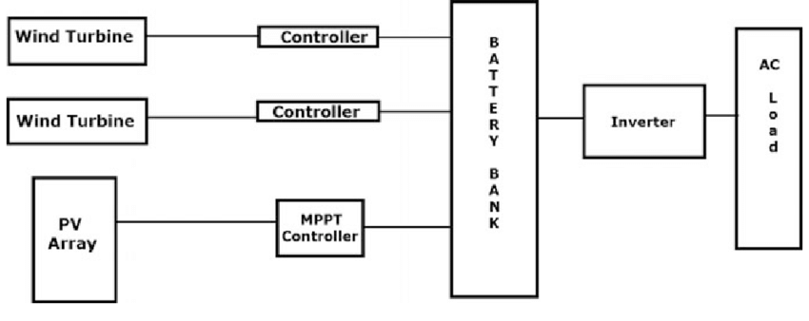
We want to built this
This stored energy that we can extract in a free , clean matter
Will be used to light up those ways in the night using LED’s that
require very low energy to give us what we want

Slide 3
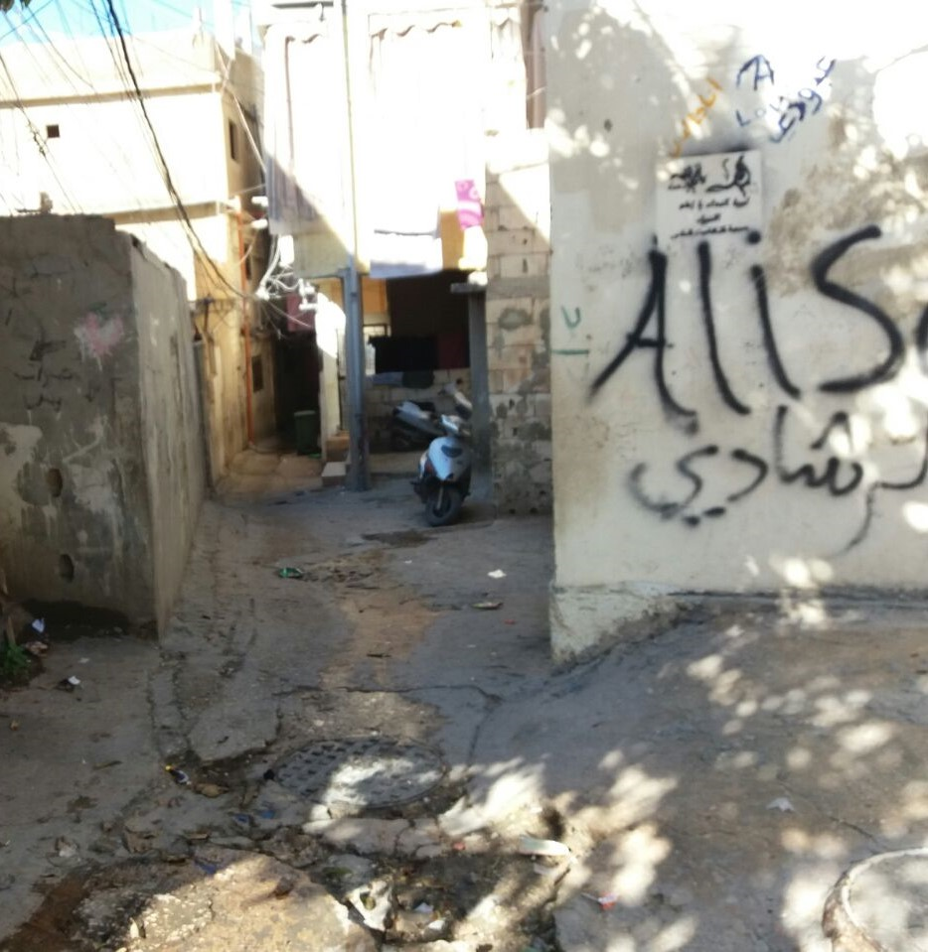
To solve a problem
That is our project that we believe it will help our society, specially refugees camps which is known in its narrow alleys, living thousands of refugees in a very small area.
These narrow alleys as soon as the sun starts setting these alleys turn pitch dark. And make it hard for everyone to move from place to place ,
And not only the alleys have this narrow texture
You can see how the way is very rough , so it’s
normal to hear that an elderly had a fall accident
And fractured his hip or some other trauma injuries

Slide 4
photovoltaic system
A photovoltaic system for residential, commercial, or industrial energy supply consists of the solar array and a number of components often summarized as the balance of system (BOS). This term is synonymous with "Balance of plant" q.v. BOS-components include power-conditioning equipment and structures for mounting, typically one or more DC to AC power converters, also known as inverters, an energy storage device, a racking system that supports the solar array, electrical wiring and interconnections, and mounting for other components.
Optionally, a balance of system may include any or all of the following: renewable energy credit revenue-grade meter, maximum power point tracker (MPPT), battery system and charger, GPS solar tracker, energy management software, solar irradiance sensors, anemometer, or task-specific accessories designed to meet specialized requirements for a system owner. In addition, a CPV system requires optical lenses or mirrors and sometimes a cooling system.

Slide 5
wind turbine
A wind turbine system consists of the wind turbine and a number of components often summarized as the balance of system (BOS). This term is synonymous with "Balance of plant" q.v. BOS-components include power-conditioning e, typically one or more DC to AC power converters, also known as inverters, an energy storage device, electrical wiring and interconnections.
Optionally, a balance of system may include any or all of the following: renewable energy credit revenue-grade meter, maximum power point tracker (MPPT), battery system and charger, GPS solar tracker, energy management software, wind force sensors, anemometer, or task-specific accessories designed to meet specialized requirements for a system owner.

Slide 6
hybrid system
Some example of projects that have been done
A project that have been done:
https://www.youtube.com/watch?v=YY1oCNhD8_0
Hybrid system:
https://www.youtube.com/watch?v=xA-TcVKEuJ8
https://www.youtube.com/watch?v=JXYkjHKakGE
https://www.youtube.com/watch?v=xNpkw9lzBWg

Slide 7
The next slide will show you some photo of the camp and you will surely notice the small alleys
NB: This photo is taken by us greening bourj al shamali team

Slide 8
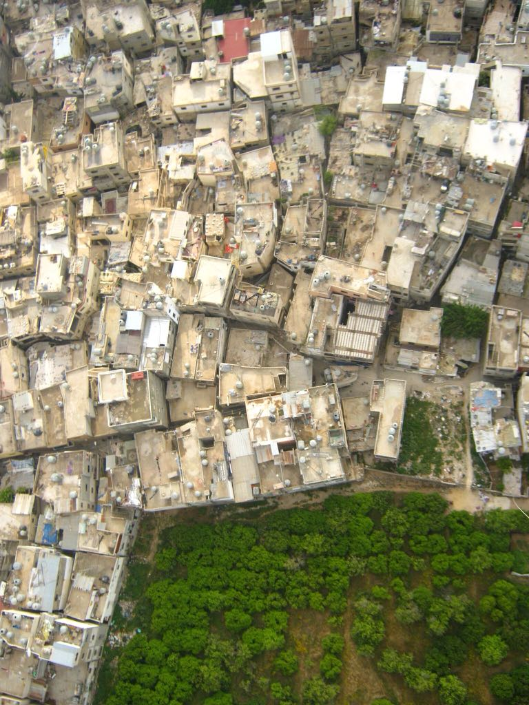

Slide 9
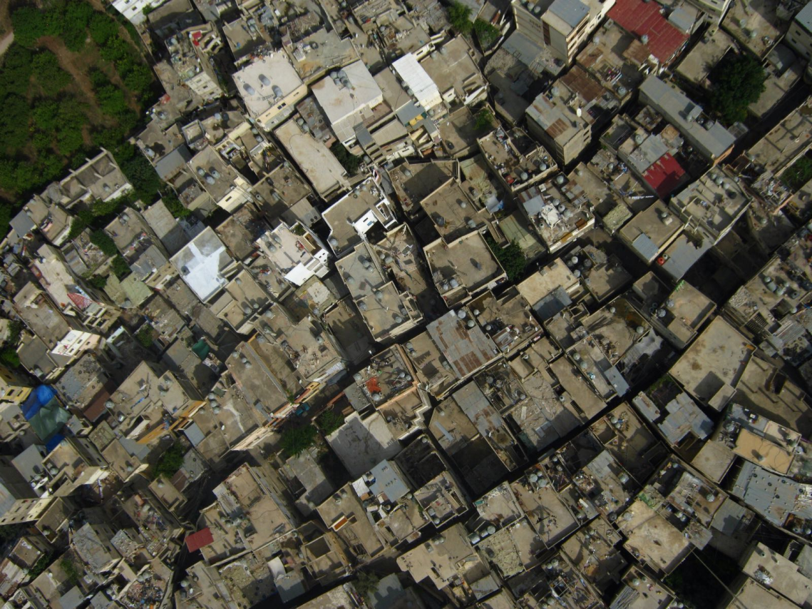

Slide 10
