Slide 1

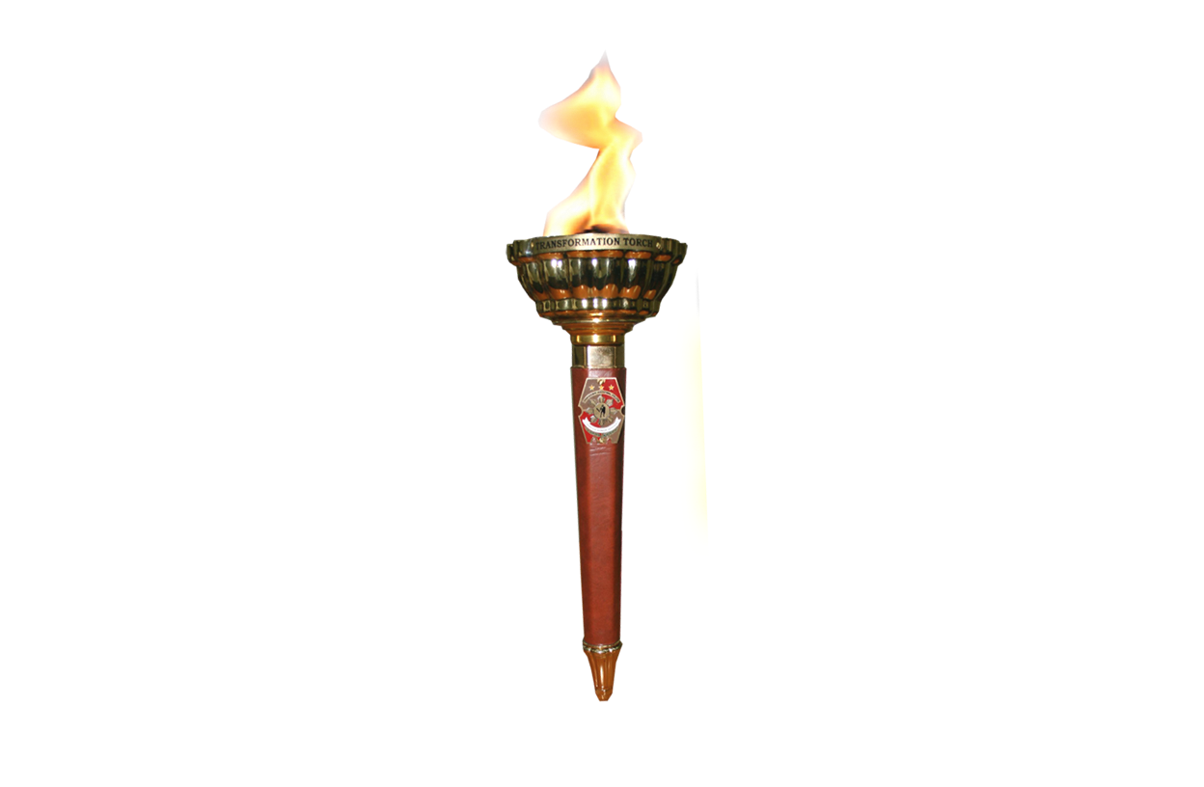


Aurora Hill Police Station (PS6)
Crime Statistic For Barangay East Modernsite covering the period from January to September 2022

Slide 2

EAST MODERN SITE AURORA HILL
Notes:
*there is an increase in Crime Volume from Year 2021 to September2022,
Those additional increase of incident include VTA, in addition to Rape and VAWC

Slide 3
EAST MODERN SITE AURORA HILL

