Slide 1

Notes:
• GLOBAL PEACE INITIATIVE • BST / BSF •
GLOBAL PEACE INITIATIVE
MAHARISHI VEDIC PANDITS FOR WORLD PEACE

Slide 2

Notes:
1. THE TRANSCENDENTAL MEDITATION TECHNIQUE
2. reduces stress and improves brain functioning
3. AMYGDALA
4. PREFRONTAL CORTEX

Slide 3
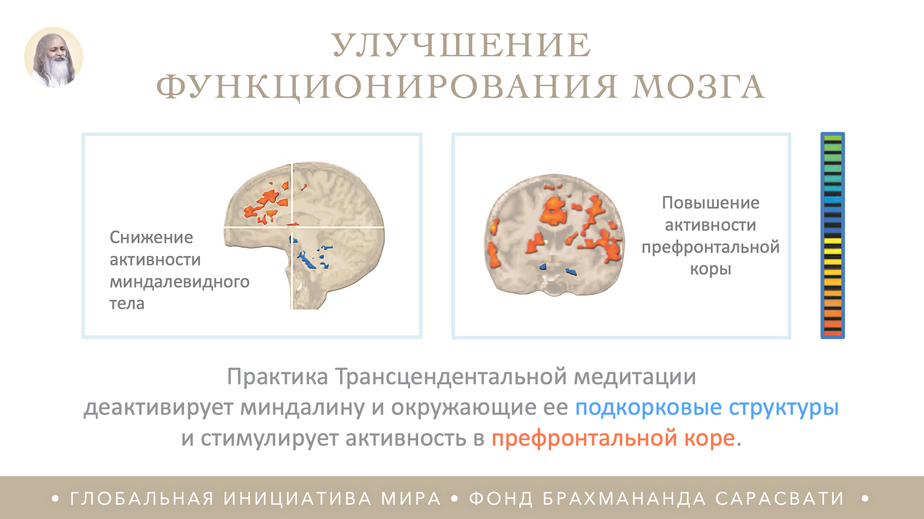
Notes:
1. IMPROVED BRAIN FUNCTIONING
2. Decreased amygdala activity
3. Increased prefrontal cortex activity
4. Transcendental Meditation practice deactivates the amygdala and surrounding sub [cortical structures*] and stimulates activity in the [prefrontal cortex**].
* = blue
** = red

Slide 4
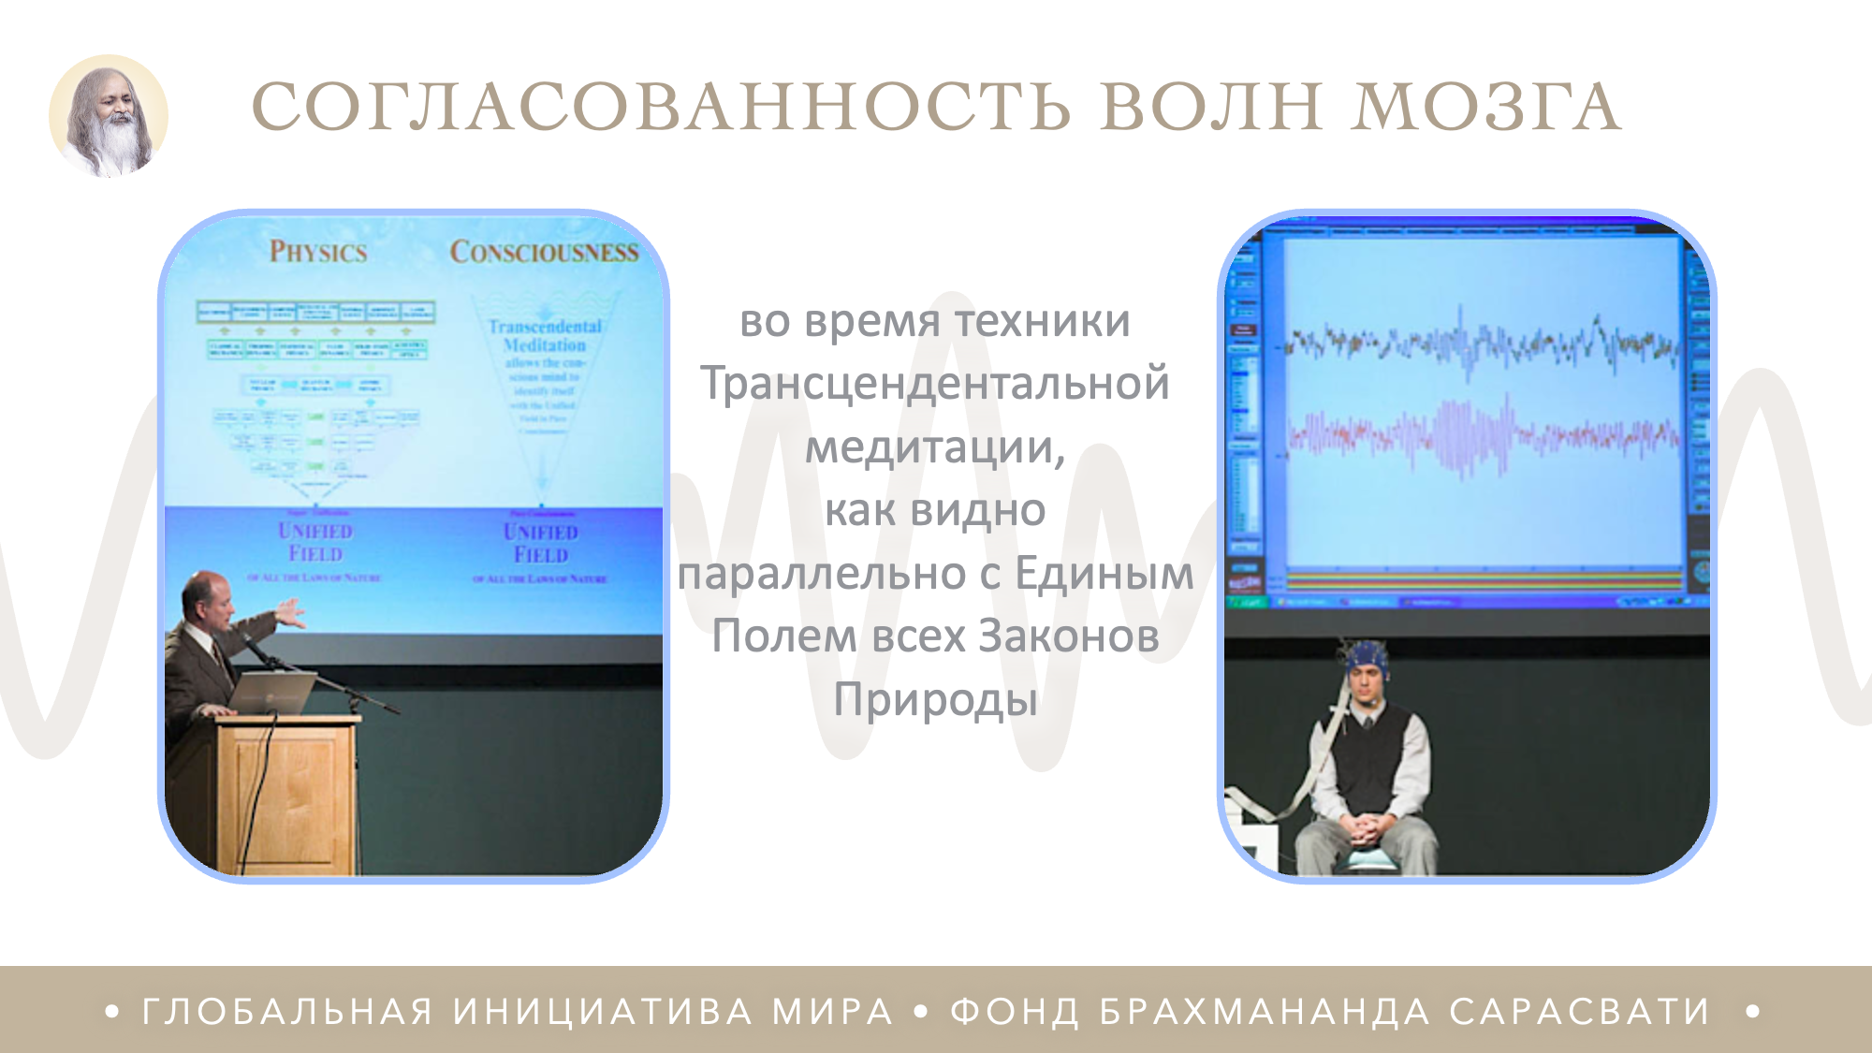
Notes:
1. BRAINWAVE COHERENCE
2. during the Transcendental Meditation technique – as seen in parallel with the Unified Field of all the Laws of Nature

Slide 5
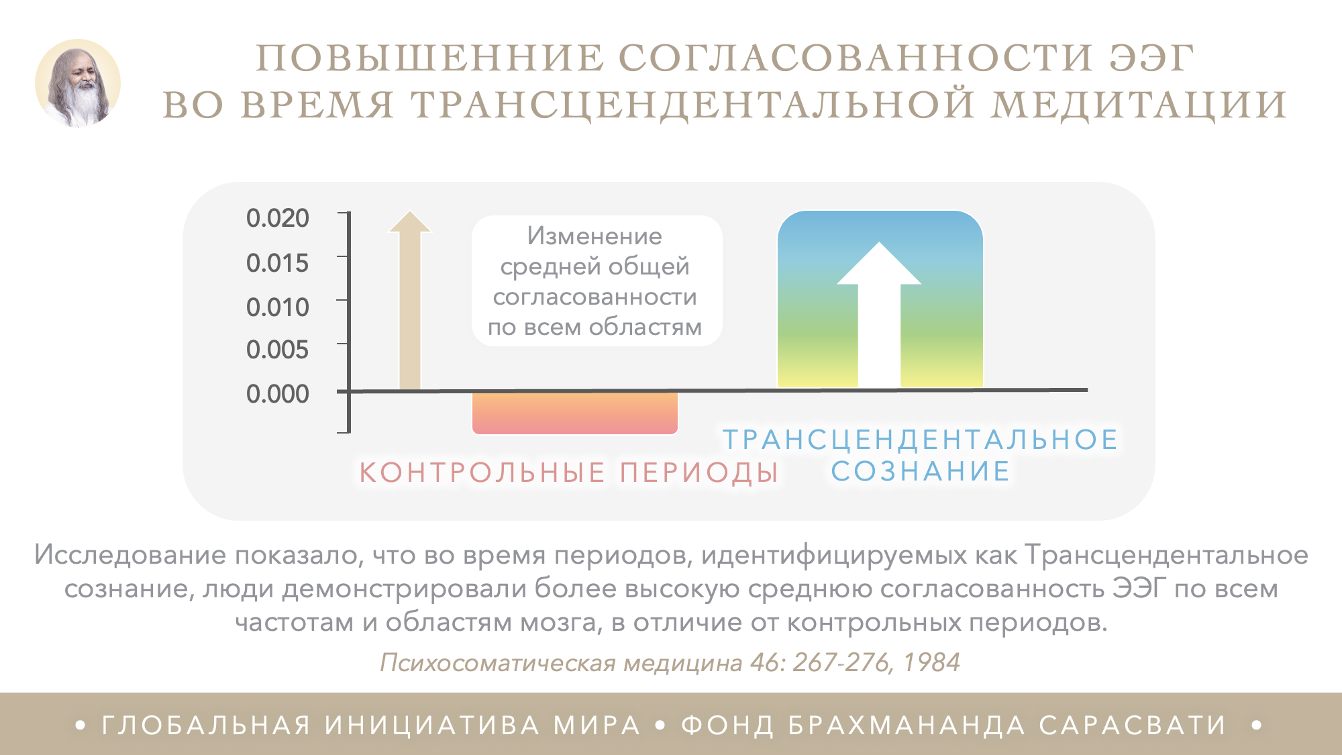
Notes:
INCREASED EEG COHERENCE DURING TM
Change in mean total coherence over all areas
CONTROL PERIODS
TRANSCENDENTAL CONSCIOUSNESS
This study found that during periods identified as Transcendental Consciousness, individuals displayed higher mean EEG coherence over all frequencies and brain areas, in contrast to control periods.
Psychosomatic Medicine 46: 267-276, 1984

Slide 6

Notes:
GROUP TM
FOR REDUCED CRIME
TM practitioners, Washington D.C. 1993

Slide 7
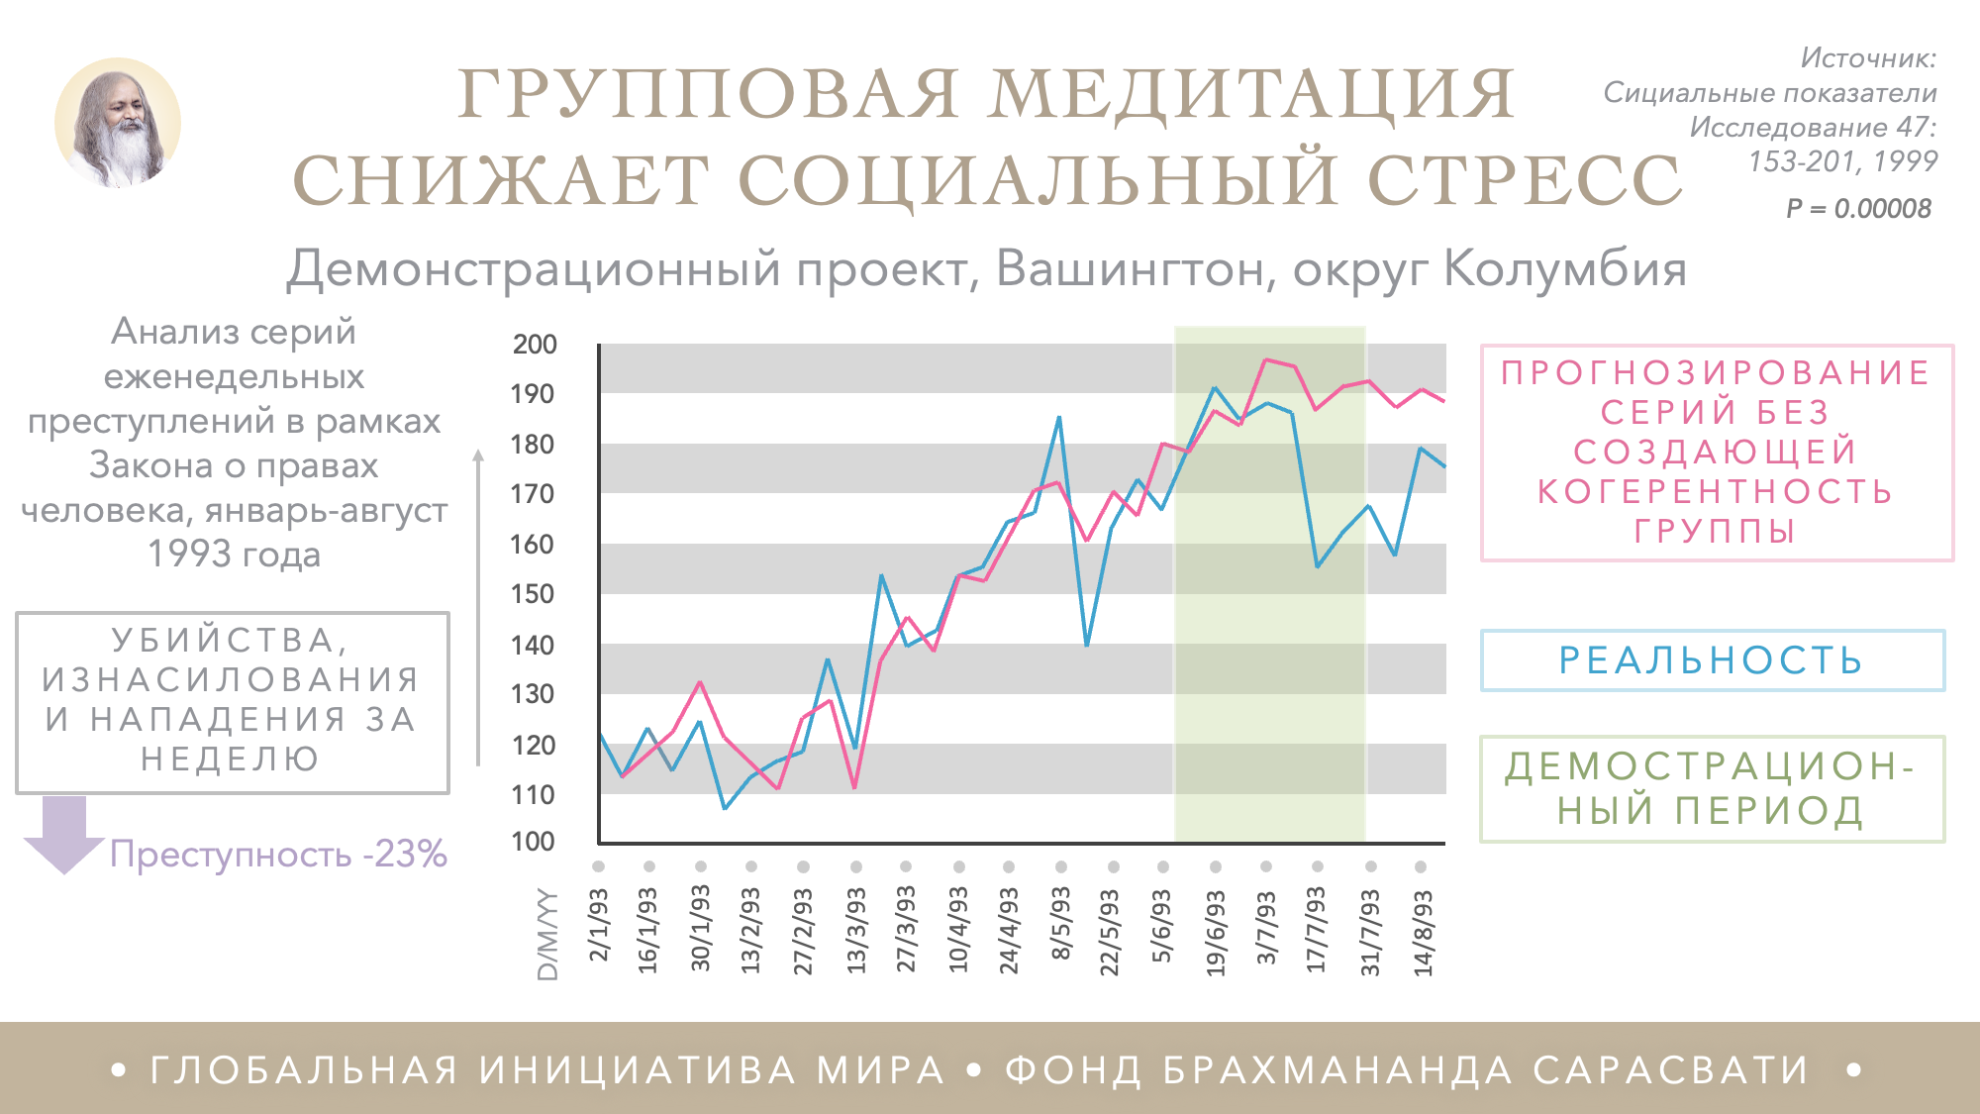
Notes:
Merge/transition
GROUP MEDITATION REDUCES SOCIAL STRESS
Demonstration project, Washington DC
Source: Social Indicators Research 47: 153-201, 1999
P = 0.00008
Time Series Analysis of Weekly HRA Crimes, January through August 1993
HOMICIDES, RAPES, AND ASSAULTS PER WEEK
Crime 23%
TIME SERIES PREDICTION WITHOUT COHERENCE-CREATING GROUP
ACTUAL CRIME
DEMONSTRATION PERIOD
D/M/YY

Slide 8
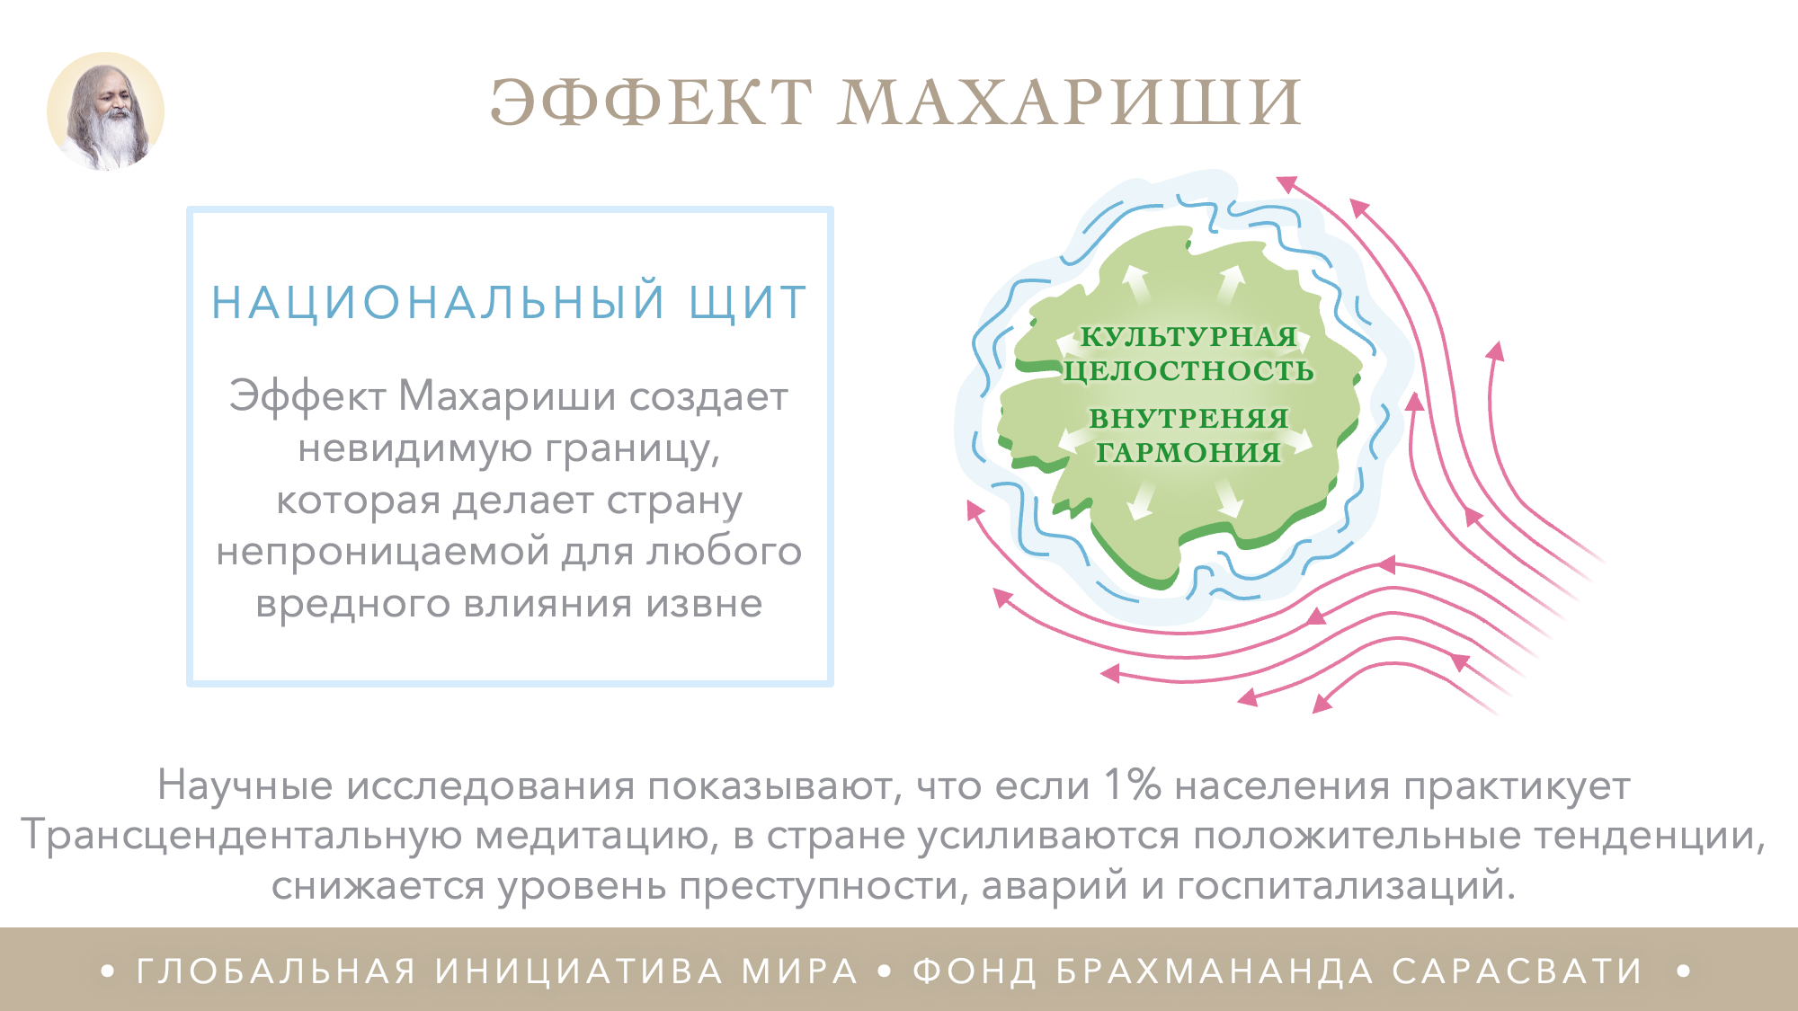
Notes:
1. THE MAHARISHI EFFECT
2. NATIONAL ARMOUR
3. The Maharishi Effect creates an invincible border that makes the nation impenetrable to any harmful influence from the outside
4. CULTURAL INTEGRITY
5. INTERNAL COHERENCE
6. Scientific research shows that 1% of the population practicing Transcendental Meditation increases positive trends and reduces crime rate, accidents, and hospital admissions.

Slide 9
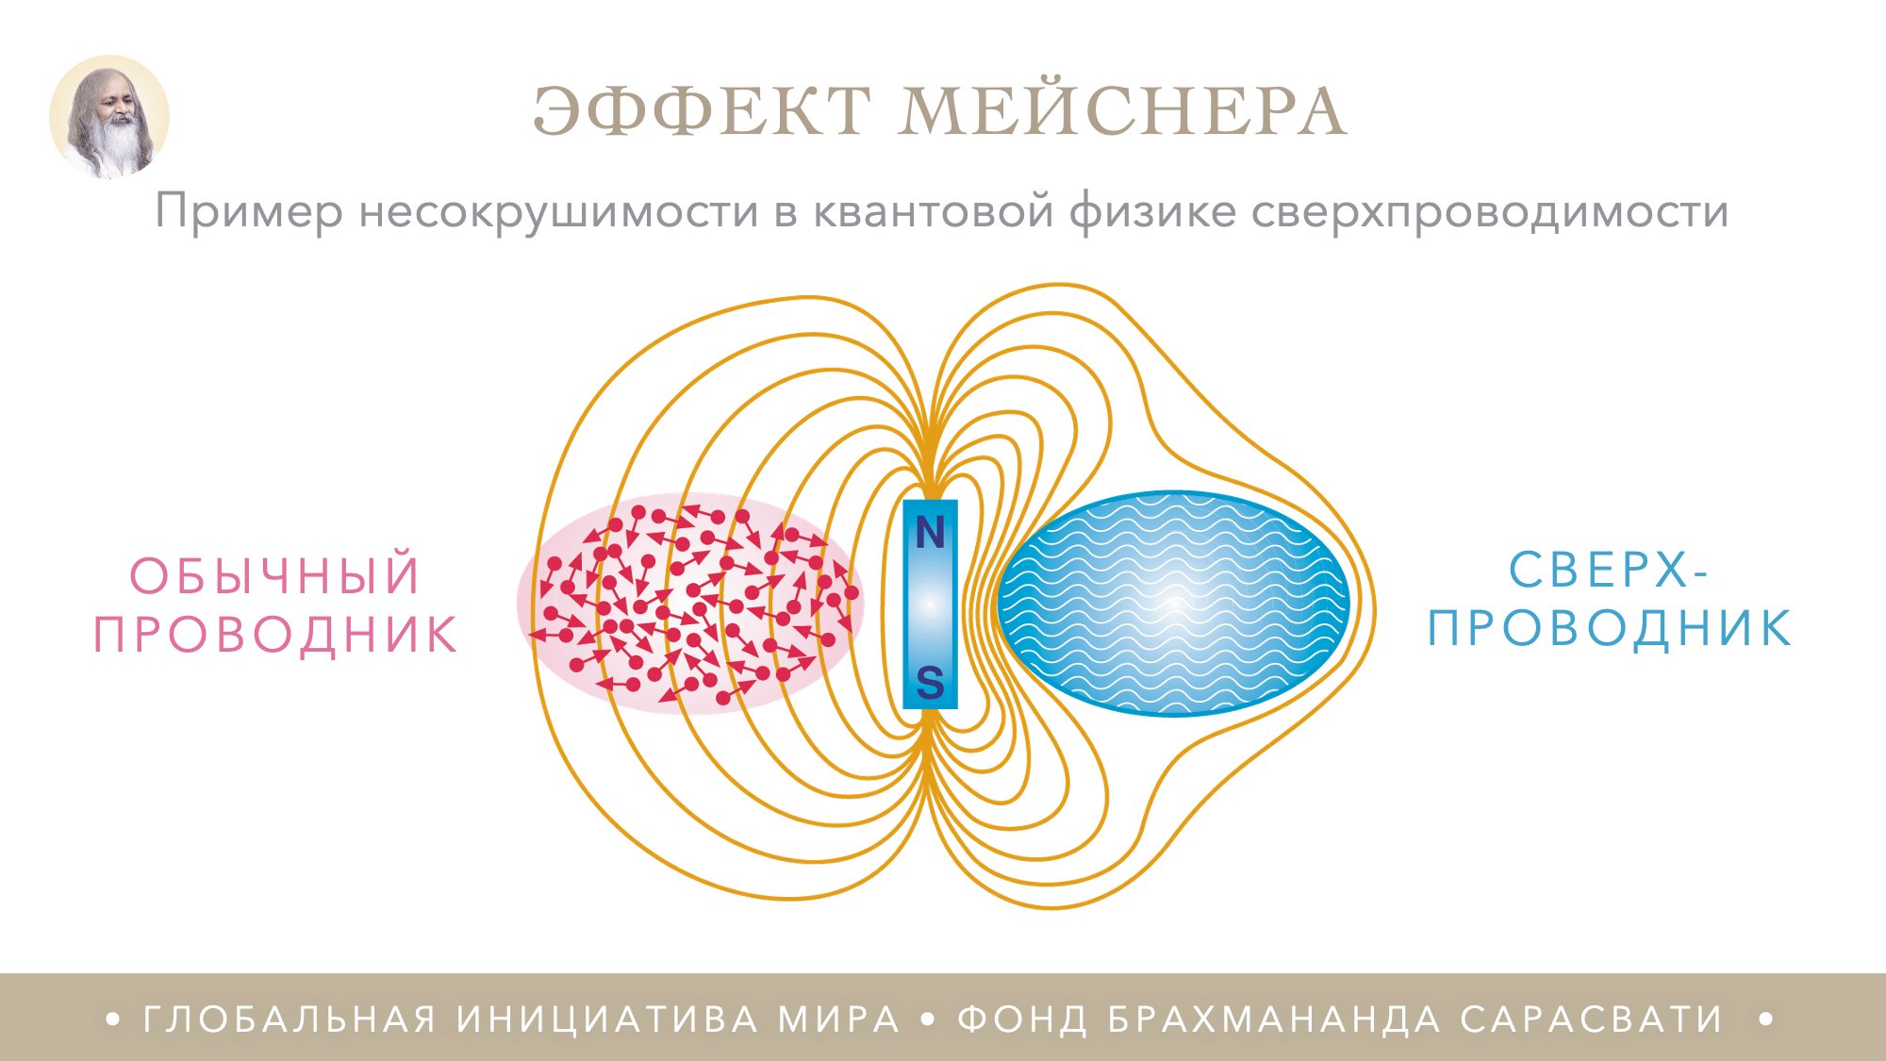
Notes:
THE MEISSNER EFFECT
An example of invincibility in the Quantum Physics of Superconductivity
ORDINARY CONDUCTOR
SUPER-CONDUCTOR

Slide 10
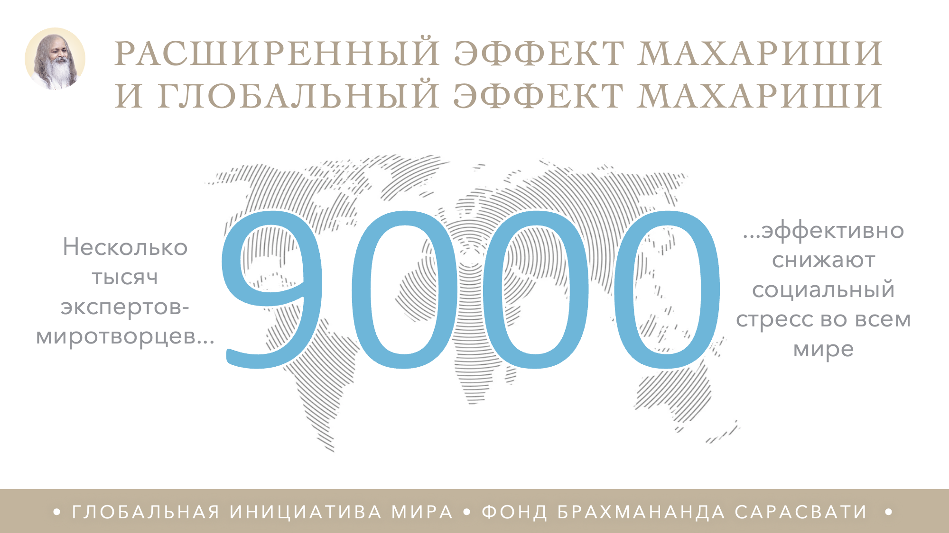
Notes:
CLARIFICATION NEEDED: the title seems redundant
THE EXTENDED MAHARISHI EFFECT AND THE GLOBAL MAHARISHI EFFECT
Several thousand peace-creating experts…
…effectively reduce social stress for the whole world

Slide 11

Notes:
SCIENCE with Dr Hagelin
2. WHAT IS MAHARISHI YAGYA?
3. The full length and a short version of the Hagelin video 'What is Maharishi Yagya’ can be found on our website.
4. Here is the link:
5. https://material.vedicpandits.org/english-material/#PPT_Videos

Slide 12

Notes:
THE FORMULA FOR WORLD PEACE
‘In the vicinity of [Yoga*] hostile tendencies are eliminated.’
YOGA:
UNITY, TRANSCENDENTAL CONSCIOUSNESS
– MAHARISHI PATANJALI

Slide 13

Notes:
1. MAHARISHI VEDIC PANDITS
2. A peace-creating group in the centre point of India

Slide 14

Notes:
1. REVIVING THE ANCIENT
VEDIC PANDIT TRADITION
2. through structured training programmes
3. Young Pandits studying at a local school, aged 10 to 15

Slide 15
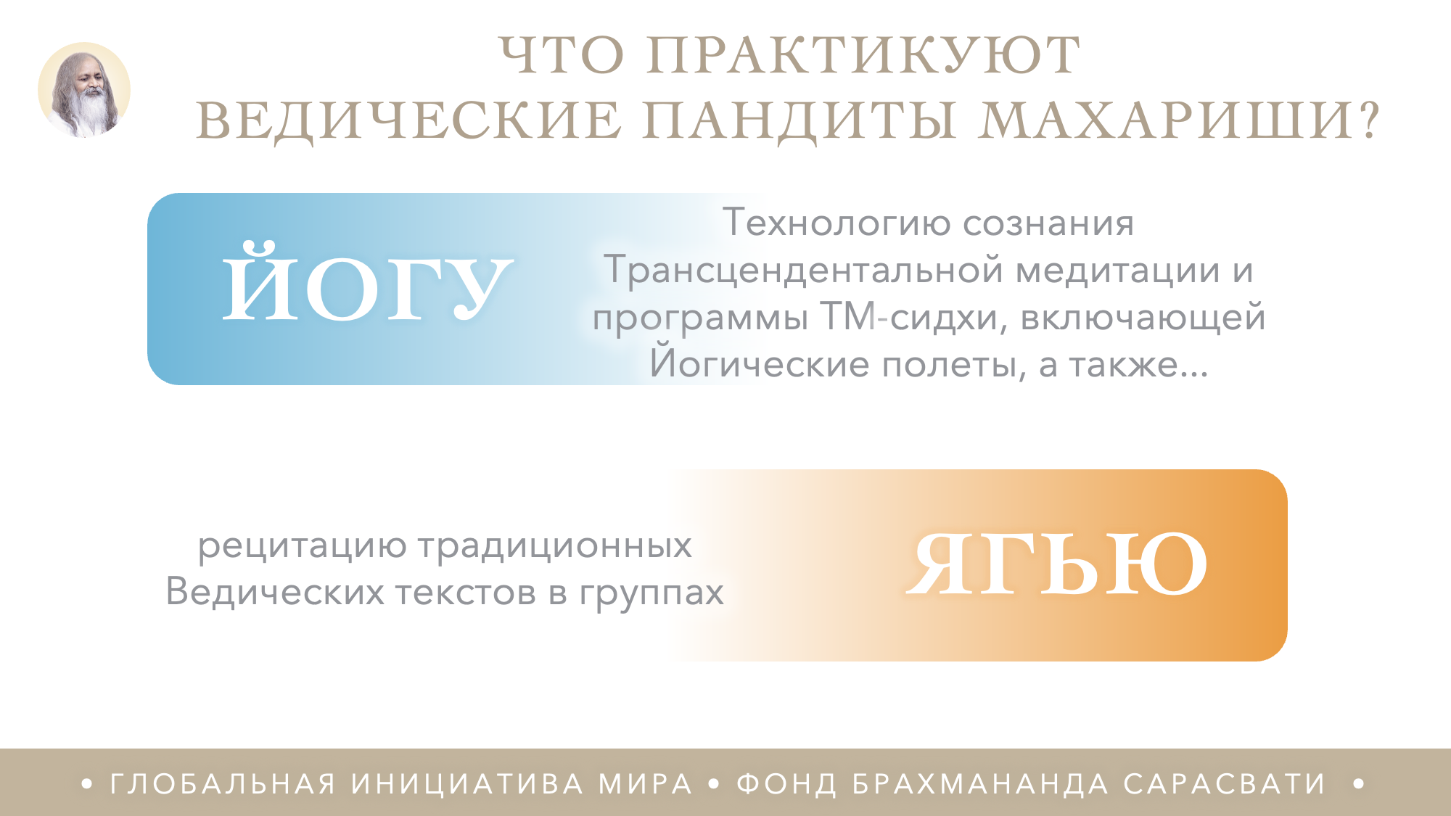
Notes:
WHAT ARE THE VEDIC PANDITS DOING?
YOGA
Technology of Consciousness – Transcendental Meditation and TM-Sidhi Programme including Yogic Flying and…
The recitation of the traditional Vedic verses in groups
YAGYA

Slide 16

Notes:
The Vedic Pandits preserve and implement the ancient Vedic life-supporting technologies.
UNESCO (United Nations Education Scientific and Cultural Organisation) officially described this as an ‘intangible heritage of humanity’.

Slide 17
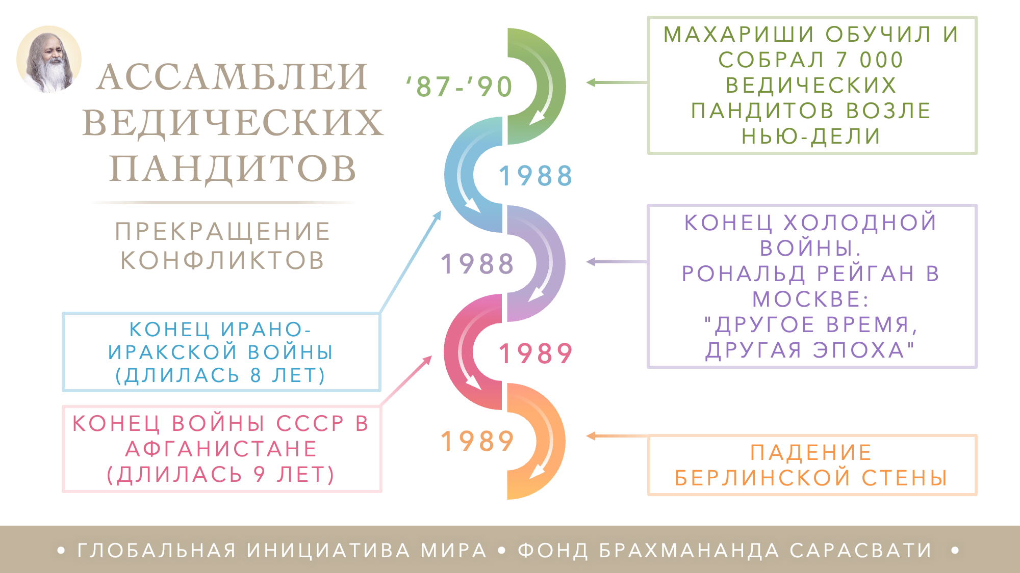
Notes:
What year was the cessation? Is that point in the right place/order?
Also this could be shown as a timeline with the years instead of bullet points
VEDIC PANDITS ASSEMBLIES
CESSATION OF CONFLICTS
Maharishi trained and gathered 7,000 Vedic Pandits near New Delhi
Iran-Iraq war ends (8 yrs)
End of Cold War; Ronald Reagan while in Moscow: ‘Another time, another era’
Soviet War in Afghanistan ends (9 yrs)
The Berlin Wall falls

Slide 18

Notes:
11-DAY NATIONAL YAGYAS FOR COUNTRIES
Increase good fortune and help prevent problems for an entire nation
1-DAY, 2-DAY, 3-DAY SPECIAL YAGYAS FOR INDIVIDUALS

Slide 19
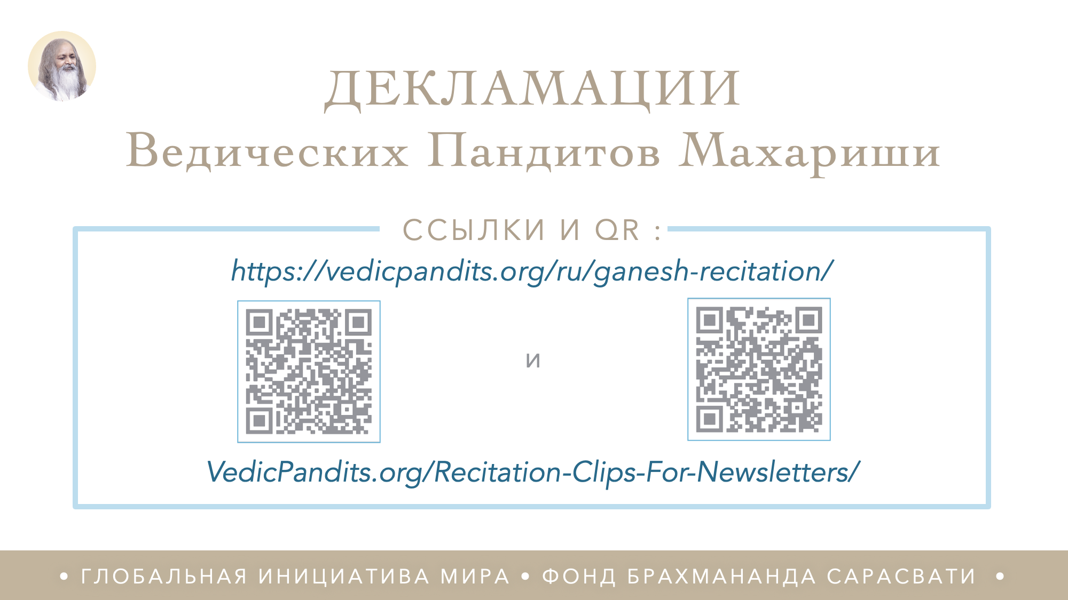
Notes:
1. Maharishi Vedic Pandits
RECITATIONS
2. LINKS HERE
3. https://vedicpandits.org/ganesh-recitation/
4. Or
5. https://vedicpandits.org/recitation-clips-for-newsletters/#ganesh

Slide 20
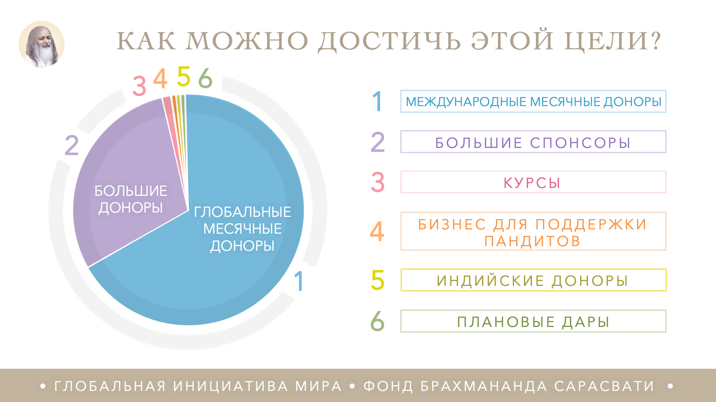
Notes:
HOW CAN THIS GOAL BE ACHIEVED?
MAJOR DONORS
GLOBAL MONTLY DONORS
GLOBAL MONTHLY DONORS
MAJOR DONORS
COURSES
BUSINESS SUPPORTING PANDITS
INDIAN DONORS
PLANNED GIVING

Slide 21

Notes:
THE GLOBAL MONTHLY
DONOR PROGRAMME
An initiative of Brahmananda Saraswati Trust/BST (The Netherlands) and Brahmananda Saraswati Foundation/BSF (USA). Both are non-profit organisations.
It engages all Governors, Sidhas, and Meditators in a united campaign for world peace.
It allows everyone to participate on a regular basis at whatever level is comfortable for them.

Slide 22
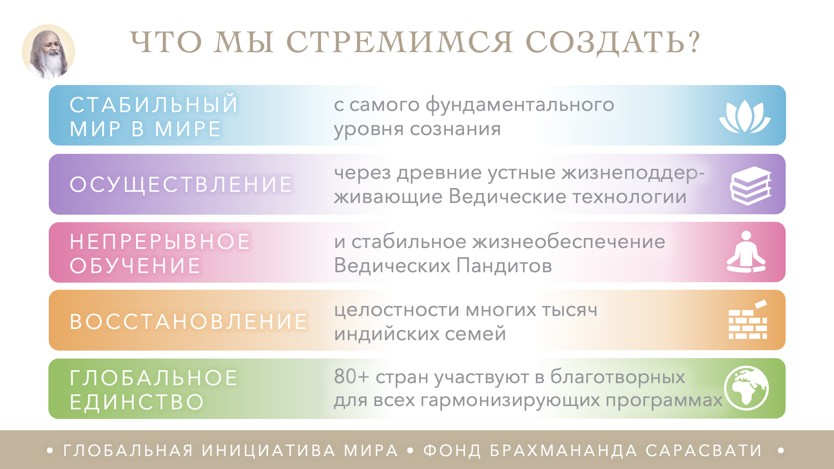
Notes:
WHAT ARE WE CREATING?
PERMANENT WORLD PEACE
from the fundamental level of consciousness
THE IMPLEMENTATION
of the ancient oral Vedic life-supporting technologies
ONGOING TRAINING
and stable livelihood of the Vedic Pandits
RESTORATION
of the cultural integrity of many thousands of Indian families
GLOBAL UNITY
80+ countries in mutually beneficial coherence-creating programmes

Slide 23
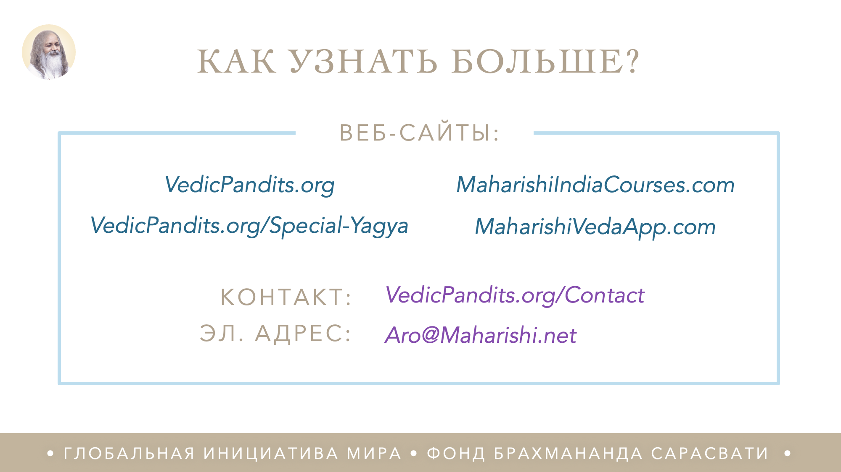
Notes:
Jane feels that maybe the materials site is too much for the public
HOW TO FIND OUT MORE
WEBSITES
VedicPandits.org
VedicPandits.org/Special-Yagya
MaharishiIndiaCourses.com
MaharishiVedaApp.com
CONTACT:
VedicPandits.org/Contact
EMAIL:
Aro@Maharishi.net

Slide 24

Notes:
JAI GURU DEV
‘Yogic Flying and Yagyas are the only thing that will effectively uphold world consciousness on an eternal level of invincibility. I want to engage from now on as large numbers of Vedic Pandits as possible but I have to be careful that once I engage them, the funds will be there
to continue to support them.
The only wise thing to do now, is to establish homes of Vedic knowledge because the Vedic vibrations of the performances of the Vedic Pandits have been established to motivate life according to Natural Law for the whole world and to usher in a new golden destiny of the human race.’

Slide 25

Notes:
The End.

Slide 26
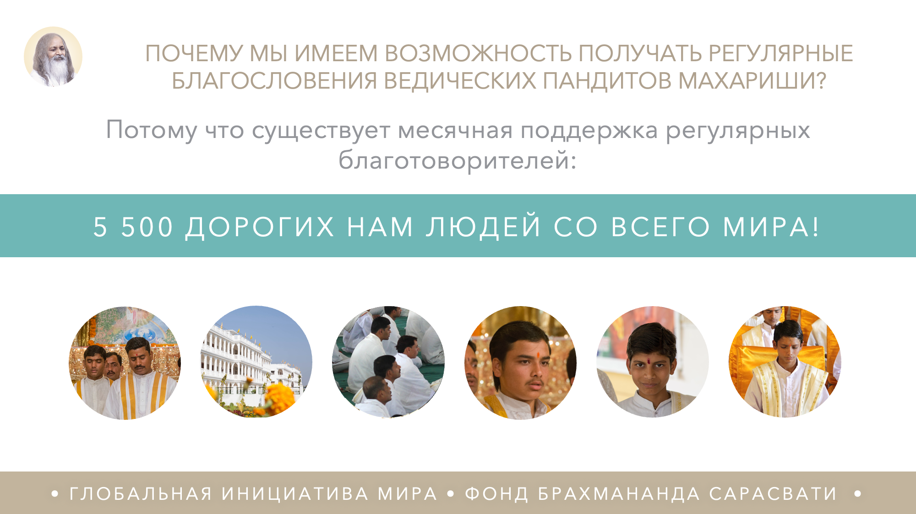
Notes:
WHAT IS THE ONLY REASON WE ARE ABLE TO HAVE MAHARISHI VEDIC PANDITS?
The support of regular monthly donors:
5,500 DEAR PEOPLE FROM ALL OVER THE WORLD!

Slide 27

Notes:
THANKS TO OUR DEDICATED DONORS:
VEDIC EVENTS ON M. CHANNEL
BRAHMASTHAN & OTHER CAMPUSES
GROUP TM & YOGA
NATIONAL, SPECIAL& OTHER YAGYA
GENERATION TO GENERATION
VEDIC PANDITS IN TRAINING

Slide 28

Notes:
A REMARKABLY SUCCESSFUL APPROACH
The greatest support comes from thousands of individuals worldwide participating in the Global Monthly Donor Programme.

Slide 29

Notes:
Add manual bullet point

Slide 30

Notes:
MAHARISHI VEDIC PANDITS AT MERU

Slide 31
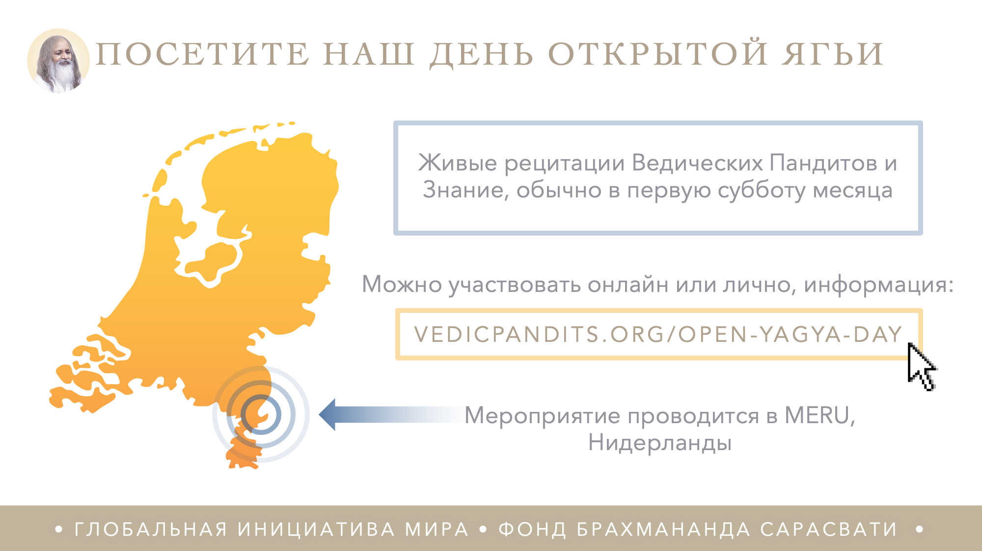
Notes:
ATTEND OPEN YAGYA DAY
Live recitation and knowledge, usually on the first Saturday of the month.
To join online or in-person, visit:
VEDICPANDITS.ORG/OPEN-YAGYA-DAY
In-person events are hosted at MERU, the Netherlands

