Slide 1
什么是天使？神为什么要造天使?
What is Angels? Why God made Angels
08/24/2019 SACC Sunday School

Slide 2
圣安的天使

Slide 3
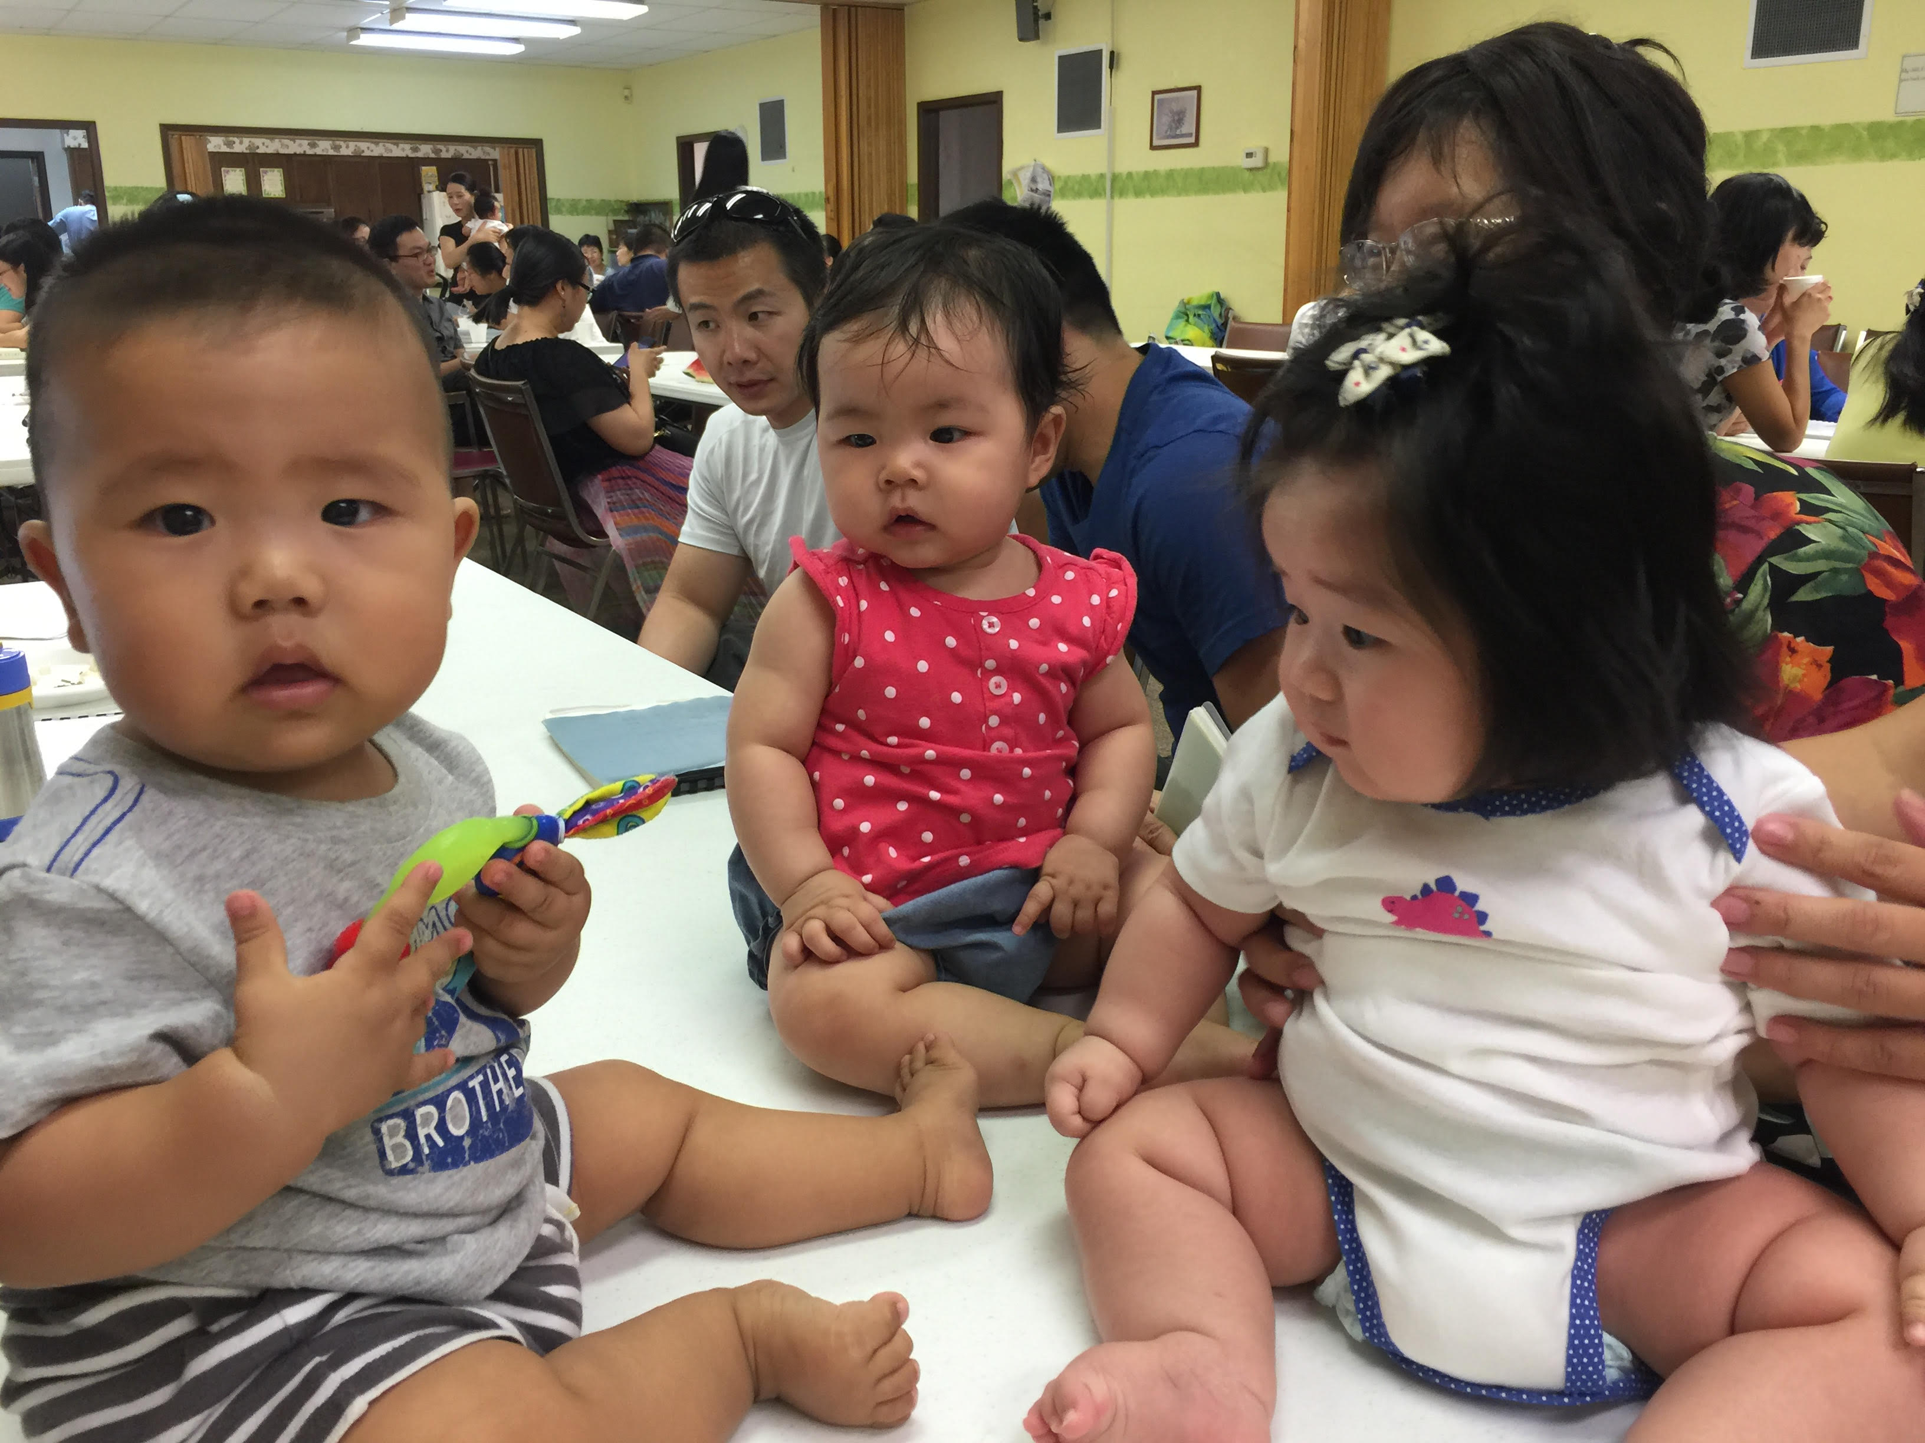
圣安的天使

Slide 4
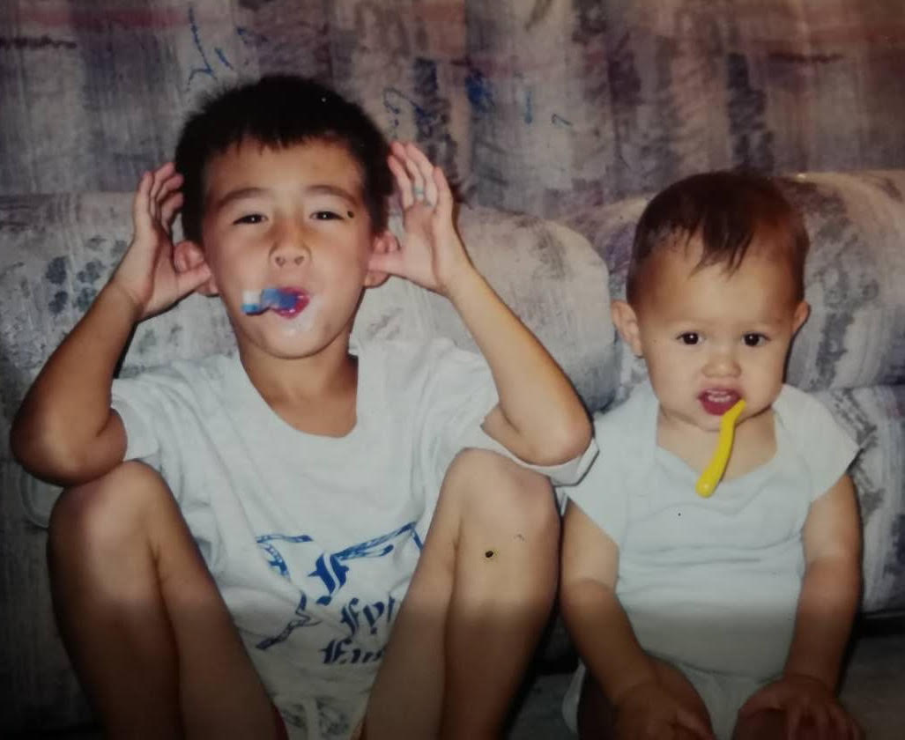
我的天使

Slide 5
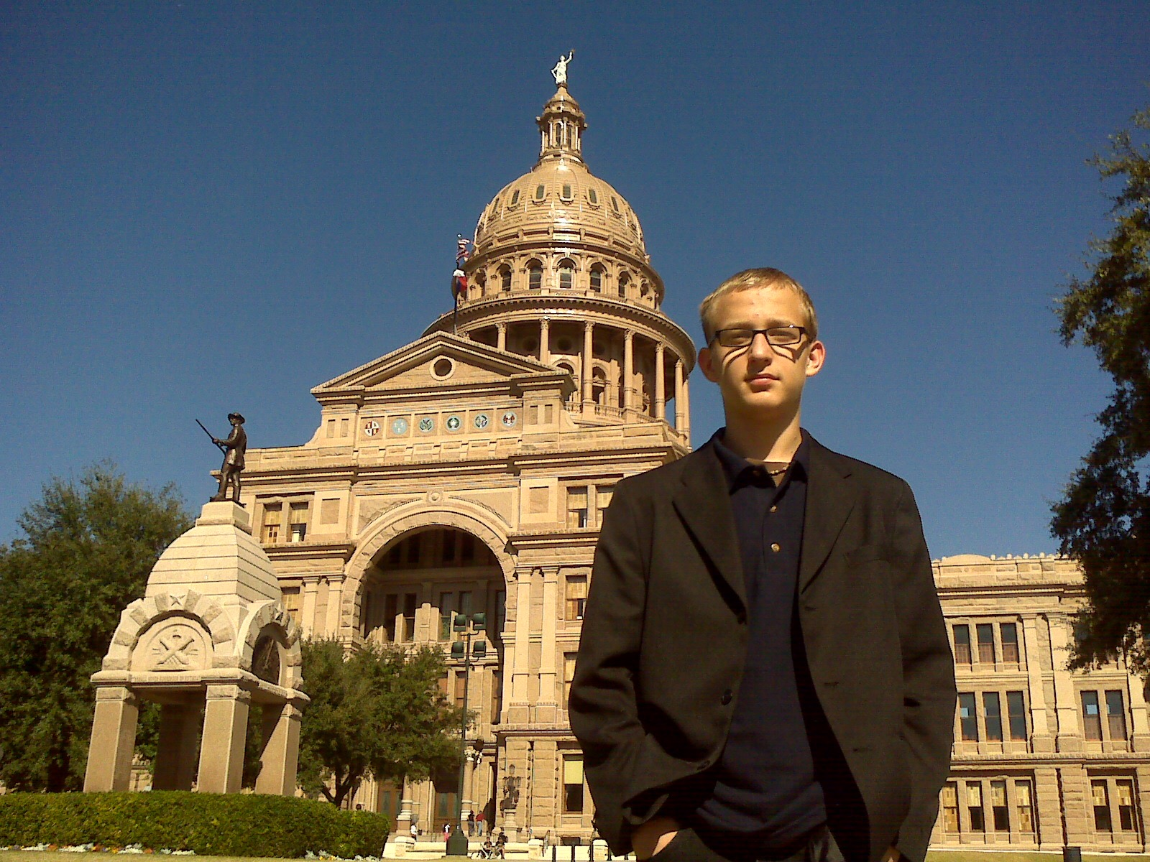
Jim’s Angels 骑宇航 的天使

Slide 6
天使是受造的，属灵的实存
尼9:6 你、惟獨你、是耶和華．你造了天、和天上的天、並天上的萬象、地和地上的萬物 、海和海中所有的、這一切都是你所保存的．天軍也都敬拜你。
Nehemiah 9:6 You alone are the Lord. You made the heavens, even the highest heavens, and all their starry host, the earth and all that is on it, the seas and all that is in them. You give life to everything, and the multitudes of heaven worship you.

Slide 7
天使的受造
詩148:2 他的眾使者都要讚美他．他的諸軍都要讚美他。 詩148:3 日頭月亮、你們要讚美他．放光的星宿、你們都要讚美他。 詩148:4 天上的天、和天上的水、你們都要讚美他。 詩148:5 願這些都讚美耶和華的名．因他一吩咐便都造成。
Psalm 148:2-5
Praise him, all his angels; praise him, all his heavenly hosts. ³ Praise him, sun and moon; praise him, all you shining stars. ⁴ Praise him, you highest heavens and you waters above the skies.
⁵ Let them praise the name of the Lord, for at his command they were created.

Slide 8
路2:13-14 忽然有一大隊天兵、同那天使讚美上帝說、 在至高之處榮耀歸與上帝、在地上平安歸與他所喜悅的人。
Luke 2:13-14
¹³ Suddenly a great company of the heavenly host appeared with the angel, praising God and saying,
¹⁴ “Glory to God in the highest heaven, and on earth peace to those on whom his favor rests.”
天使有道德的判断力和高度的智慧

Slide 9
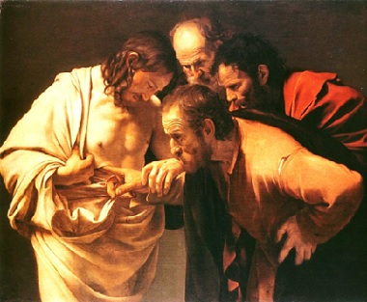
天使没有物质的身体 (路24:39 Luke 24:39)
路24:39 你們看我的手、我的腳、就知道實在是我了．摸我看看．魂無骨無肉、你們看我 是有的。
Luke 24:39 Look at my hands and my feet. It is I myself! Touch me and see; a ghost does not have flesh and bones, as you see I have.”
Notes:
路24:39 你們看我的手、我的腳、就知道實在是我了．摸我看看．魂無骨無肉、你們看我 是有的。
Luke 24:39 Look at my hands and my feet. It is I myself! Touch me and see; a ghost does not have flesh and bones, as you see I have.”

Slide 10
天使其它的名字:
西1:16 因為萬有都是靠他造的、無論是天上的、地上的、能看見的、不能看見的、或是 有位的、主治的、執政的、掌權的、一概都是藉著他造的、又是為他造的．
Colossians 1:16 For in him all things were created: things in heaven and on earth, visible and invisible, whether thrones or powers or rulers or authorities; all things have been created through him and for him.
Notes:
神的众子（伯1:6）圣者（诗89:5，7）灵（来1:14）守望的圣者（但4:13，17，23

Slide 11
天使是在什么时候被造的？
創1:31 上帝看著一切所造的都甚好．有晚上、有早晨、是第六日。 創2:1 天地萬物都造齊了。 出20:11 因為六日之內、耶和華造天、地、海、和其中的萬物、第七日便安息．所以耶和 華賜福與安息日、定為聖日。
伯38:6 地的根基安置在何處．地的角石是誰安放的。 伯38:7 那時晨星一同歌唱、上帝的眾子也都歡呼。

Slide 12
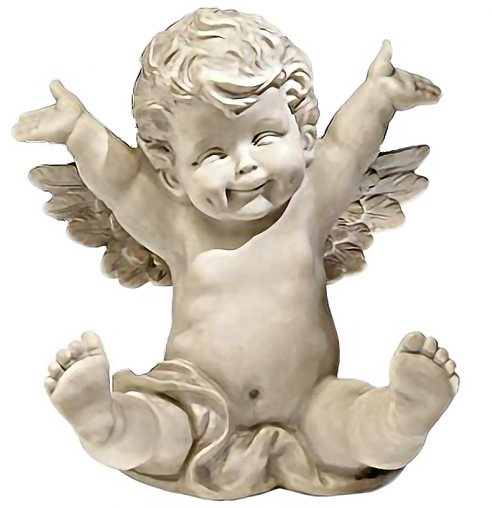
天使的数目
啟5:11 我又看見、且聽見、寶座與活物並長老的周圍、有許多天使的聲音．他們的數目 有千千萬萬． Revelation 5:11
¹¹ Then I looked and heard the voice of many angels, numbering thousands upon thousands, and ten thousand times ten thousand. They encircled the throne and the living creatures and the elders.

Slide 13
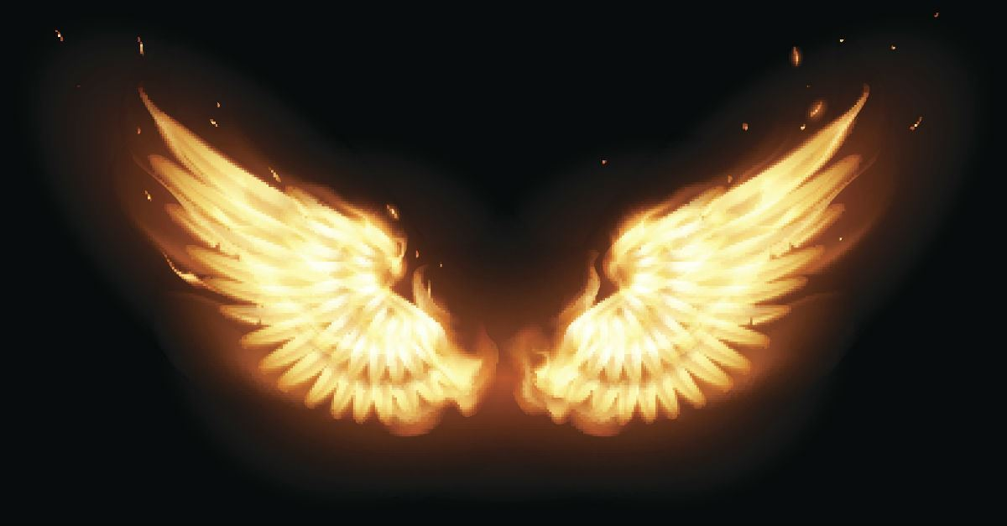
撒拉弗 Seraph ( Seraphim)賽 Isaiah 6:2-7
賽6:2 其上有撒拉弗侍立．各有六個翅膀．用兩個翅膀遮臉、兩個翅膀遮腳、兩個翅膀飛 翔． 賽6:3 彼此呼喊說、聖哉、聖哉、聖哉、萬軍之耶和華．他的榮光充滿全地。
Isaiah 6:2-3 ² Above him were seraphim, each with six wings: With two wings they covered their faces, with two they covered their feet, and with two they were flying. ³ And they were calling to one another:
“Holy, holy, holy is the Lord Almighty; the whole earth is full of his glory.”
Notes:
賽6:2 其上有撒拉弗侍立．各有六個翅膀．用兩個翅膀遮臉、兩個翅膀遮腳、兩個翅膀飛 翔． 賽6:3 彼此呼喊說、聖哉、聖哉、聖哉、萬軍之耶和華．他的榮光充滿全地。
Isaiah 6:2-3 ² Above him were seraphim, each with six wings: With two wings they covered their faces, with two they covered their feet, and with two they were flying. ³ And they were calling to one another:
“Holy, holy, holy is the Lord Almighty; the whole earth is full of his glory.”

Slide 14
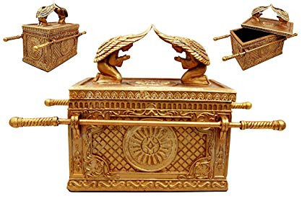
基路伯Cherub (Cherubim) ( Genesis 3:24; Psalm 18:10; Exodus 25:22)
Notes:
Genesis 3:24 New International Version (NIV)
²⁴ After he drove the man out, he placed on the east side^{[a]} of the Garden of Eden cherubim and a flaming sword flashing back and forth to guard the way to the tree of life.
Psalm 18:10 He mounted the cherubim and flew; he soared on the wings of the wind.
Exodus 25:22 New International Version (NIV)
²² There, above the cover between the two cherubim that are over the ark of the covenant law, I will meet with you and give you all my commands for the Israelites.
Ezekiel 10 New International Version (NIV)
God’s Glory Departs From the Temple
10 I looked, and I saw the likeness of a throne of lapis lazuli above the vault that was over the heads of the cherubim. ² The Lord said to the man clothed in linen, “Go in among the wheels beneath the cherubim. Fill your hands with burning coals from among the cherubim and scatter them over the city.”

Slide 15
基路伯Cherub (Cherubim)結 Ezekiel 10:1-20
Notes:
Ezekiel 10 New International Version (NIV)
God’s Glory Departs From the Temple
10 I looked, and I saw the likeness of a throne of lapis lazuli above the vault that was over the heads of the cherubim. ² The Lord said to the man clothed in linen, “Go in among the wheels beneath the cherubim. Fill your hands with burning coals from among the cherubim and scatter them over the city.”
結10:3 那人進去的時候、站在殿的右邊．雲彩充滿了內院。 結10:4 耶和華的榮耀從那裡上升、停在門檻以上．殿內滿了雲彩、院宇也被耶和 華榮耀的光輝充滿。 結10:5 翅膀的響聲聽到外院、好像全能上帝說話的聲音。 結10:6 他吩咐那穿細麻衣的人說、要從旋轉的輪內、中間取火．那人就進去站在 一個輪子旁邊。 結10:7 有一個、從中伸手到中間的火那裡、取些放在那穿細麻衣的 人兩手中、那人就拿出去了。 結10:8 在翅膀之下、顯出有人手的樣式。 結10:9 我又觀看、見旁邊有四個輪子、這旁有一個輪子、那旁有一 個輪子、每都是如此．輪子的顏色、〔原文作形狀〕彷彿水蒼玉。 結10:10 至於四輪的形狀、都是一個樣式、彷彿輪中套輪。 結10:11 輪行走的時候、向四方都能直行、並不掉轉、頭向何方、他們也隨向何方、行走 的時候並不掉轉。 結10:12 他們全身、連背帶手和翅膀、並輪周圍、都滿了眼睛．這四個的輪子、都 是如此。 結10:13 至於這些輪子、我耳中聽見說、是旋轉的。 結10:14 各有四臉．第一是的臉、第二是人的臉、第三是獅子的臉、第四是 鷹的臉。 結10:15 升上去了、這是我在迦巴魯河邊所見的活物。 結10:16 行走、輪也在旁邊行走、展開翅膀、離地上升、輪也不轉離他們旁 邊。 結10:17 那些站住、這些也站住、那些上升、這些也一同上升、因為活物的靈在輪中。 結10:18 耶和華的榮耀從殿的門檻那裡出去、停在以上。 結10:19 出去的時候、就展開翅膀、在我眼前離地上升、輪也在他們的旁邊、都停 在耶和華殿的東門口．在他們以上、有以色列上帝的榮耀。 結10:20 這是我在迦巴魯河邊所見以色列上帝榮耀以下的活物、我就知道他們是 。 結10:21 各有四個臉面、四個翅膀、翅膀以下有人手的樣式。

Slide 16
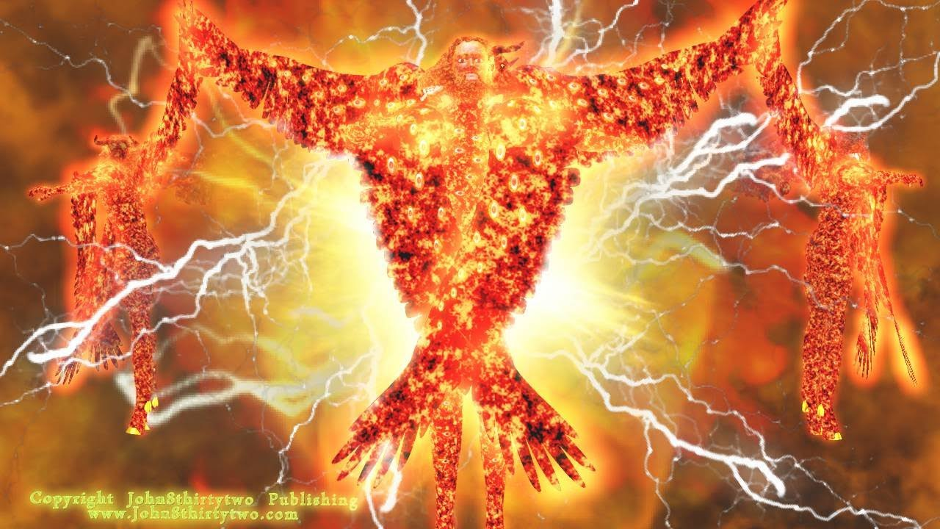
活物 Living Creatures
結1:5-10 又從其中、顯出四個活物的形像來、他們的形狀是這樣、有人的形像。 各有四個臉面、四個翅膀。 他們的腿是直的、腳掌好像牛犢之蹄、都燦爛如光明的銅。 在四面的翅膀以下有人的手．這四個活物的臉和翅膀、乃是這樣． 翅膀彼此相接、行走並不轉身、俱各直往前行。至於臉的形像、前面各有人的臉、右面各有獅子的臉、左面各有牛的臉、後面各 有鷹的臉。
Notes:
結1:5-10 又從其中、顯出四個活物的形像來、他們的形狀是這樣、有人的形像。 各有四個臉面、四個翅膀。 他們的腿是直的、腳掌好像牛犢之蹄、都燦爛如光明的銅。 在四面的翅膀以下有人的手．這四個活物的臉和翅膀、乃是這樣． 翅膀彼此相接、行走並不轉身、俱各直往前行。至於臉的形像、前面各有人的臉、右面各有獅子的臉、左面各有牛的臉、後面各 有鷹的臉。
Ezekiel 1:5-10 ⁵ and in the fire was what looked like four living creatures. In appearance their form was human, ⁶ but each of them had four faces and four wings.⁷ Their legs were straight; their feet were like those of a calf and gleamed like burnished bronze. ⁸ Under their wings on their four sides they had human hands. All four of them had faces and wings, ⁹ and the wings of one touched the wings of another. Each one went straight ahead; they did not turn as they moved. ¹⁰ Their faces looked like this: Each of the four had the face of a human being, and on the right side each had the face of a lion, and on the left the face of an ox; each also had the face of an eagle.

Slide 17
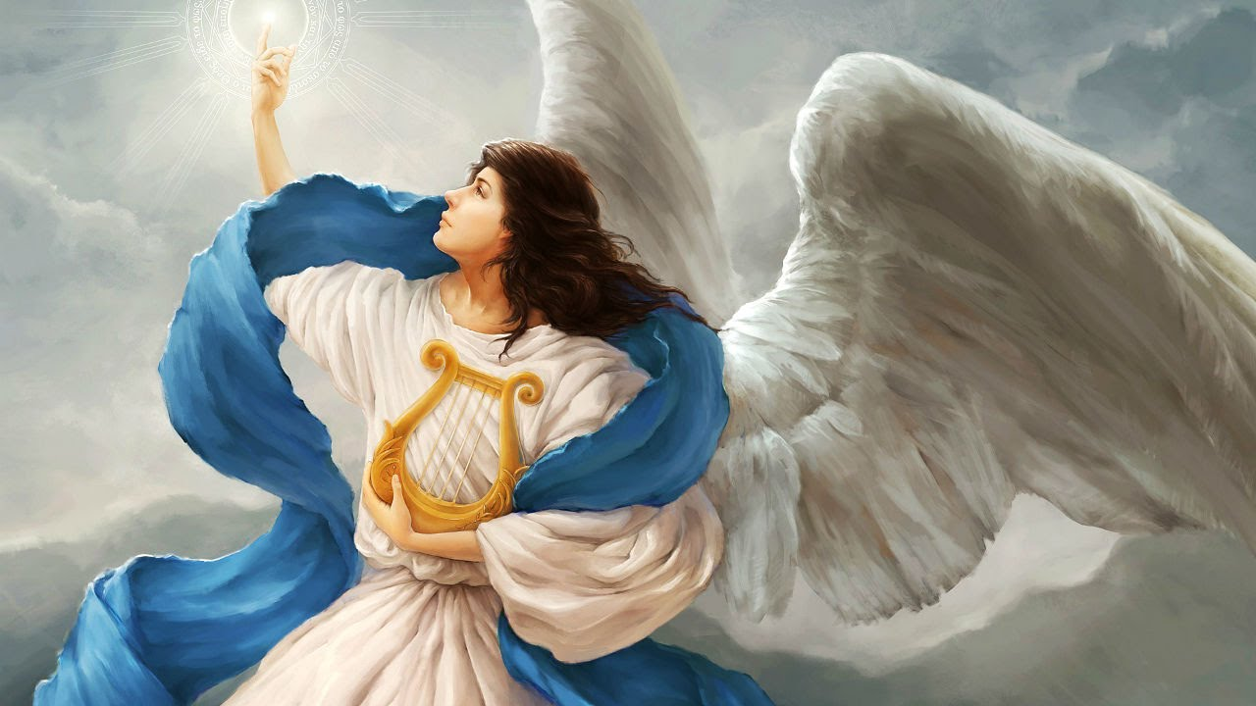
米迦勒 Michale - 天使長 Archangel;天使加百列 Angle Gabriel

Slide 18
米迦勒 Michael - 天使長 Archangel
但10:13 但波斯國的魔君、攔阻我二十一日、忽然有大君〔就是天使長二十一節同〕中的 一位米迦勒來幫助我、我就停留在波斯諸王那裡。
Daniel 10:13 But the prince of the Persian kingdom resisted me twenty-one days. Then Michael, one of the chief princes, came to help me, because I was detained there with the king of Persia.
猶9 天使長米迦勒、為摩西的屍首與魔鬼爭辯的時候、尚且不敢用毀謗的話罪責他、只 說、主責備你罷。
Jude 9 But even the archangel Michael, when he was disputing with the devil about the body of Moses, did not himself dare to condemn him for slander but said, “The Lord rebuke you!”^{[a]}
Notes:
天使中的阶段和次序
两位特别天使的名字
天使一个时间只能在一处
天使不娶也不嫁

Slide 19
米迦勒 Michale - 天使長 Archangel
帖前4:16 因為主必親自從天降臨、有呼叫的聲音、和天使長的聲音、又有上帝的號吹響 ．那在基督裡死了的人必先復活。
1 Thessalonians 4¹⁶ For the Lord himself will come down from heaven, with a loud command, with the voice of the archangel and with the trumpet call of God, and the dead in Christ will rise first.
啟12:7 在天上就有了爭戰．米迦勒同他的使者與龍爭戰．龍也同他的使者去爭戰．
Revelation 12:7 Then war broke out in heaven. Michael and his angels fought against the dragon, and the dragon and his angels fought back.

Slide 20
天使加百列 Angle Gabriel
但8:16 我又聽見烏萊河兩岸中有人聲呼叫說、加百列阿、要使此人明白這異象。
Daniel 8:16 ¹⁶ And I heard a man’s voice from the Ulai calling, “Gabriel, tell this man the meaning of the vision.”
但9:21 我正禱告的時候、先前在異象中所見的那位加百列、奉命迅速飛來、約在獻晚祭 的時候、按手在我身上。
Daniel 9:21 ²¹ while I was still in prayer, Gabriel, the man I had seen in the earlier vision, came to me in swift flight about the time of the evening sacrifice.

Slide 21
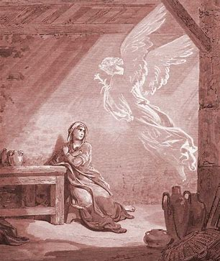
天使加百列Angel Gabirel 路Luke 1:26-27 ²⁶
路1:26 到了第六個月、天使加百列奉上帝的差遣、往加利利的一座城去、這城名叫拿撒 勒．
路1:27 到一個童女那裡、是已經許配大衛家的一個人、名叫約瑟、童女的名字叫馬利亞 。
Luke 1:26-27 ²⁶ In the sixth month of Elizabeth’s pregnancy, God sent the angel Gabriel to Nazareth, a town in Galilee, ²⁷ to a virgin pledged to be married to a man named Joseph, a descendant of David. The virgin’s name was Mary.

Slide 22
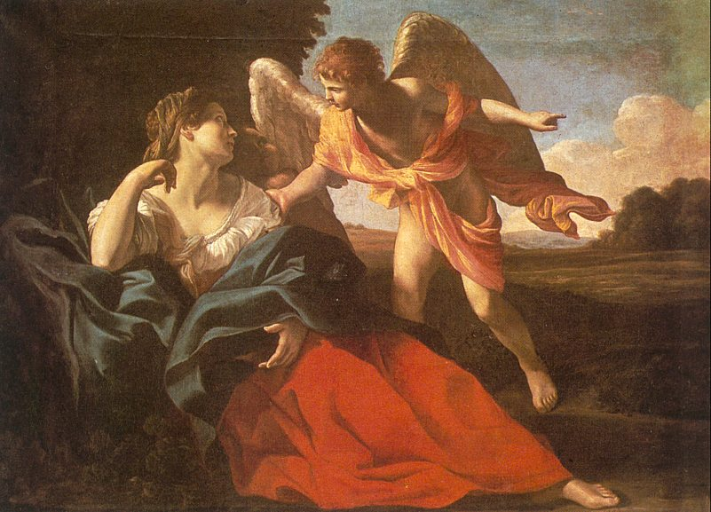
耶和華的使者
創16:9 耶和華的使者對他說、你回到你主母那裡、服在他手下。 創16:10 又說、我必使你的後裔極其繁多、甚至不可勝數。 創16:11 並說、你如今懷孕要生一個兒子、可以給他起名叫以實瑪利、因為耶和華聽見了 你的苦情。〔以實瑪利就是上帝聽見的意思〕 創16:12 他為人必像野驢．他的手要攻打人、人的手也要攻打他、他必住在眾弟兄的東邊 。 創16:13 夏甲就稱那對他說話的耶和華為看顧人的上帝．因而說、在這裡我也看見那看顧 我的麼。

Slide 23
Angel of the Lord
Genesis 16:9-13 ⁹ Then the angel of the Lord told her, “Go back to your mistress and submit to her.” ¹⁰ The angel added, “I will increase your descendants so much that they will be too numerous to count.”
¹¹ The angel of the Lord also said to her:
“You are now pregnant and you will give birth to a son. You shall name him Ishmael,^{[a]} for the Lord has heard of your misery. ¹² He will be a wild donkey of a man; his hand will be against everyone and everyone’s hand against him, and he will live in hostility toward^{[b]} all his brothers.”
¹³ She gave this name to the Lord who spoke to her: “You are the God who sees me,” for she said, “I have now seen^{[c]} the One who sees me.”

Slide 24
耶和華的使者 Angel of the Lord

Slide 25
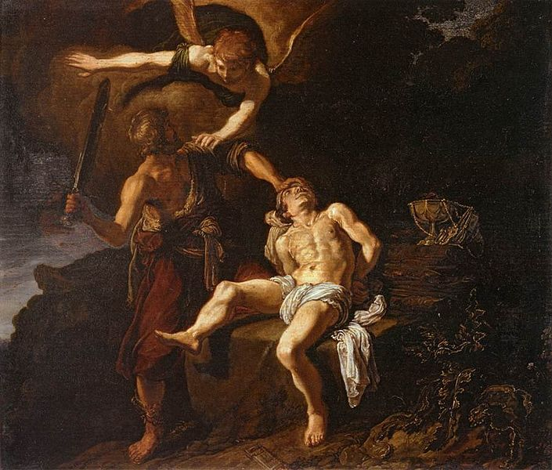
耶和華的使者
創22:11 耶和華的使者從天上呼叫他說、亞伯拉罕、亞伯拉罕、他說、我在這裡。 創22:12 天使說、你不可在這童子身上下手、一點不可害他．現在我知道你是敬畏上帝的 了、因為你沒有將你的兒子、就是你獨生的兒子、留下不給我。
創22:14 亞伯拉罕給那地方起名叫耶和華以勒、〔意思就是耶和華必豫備〕直到今日人還 說、在耶和華的山上必有豫備。 創22:15 耶和華的使者第二次從天上呼叫亞伯拉罕說、 創22:16 耶和華說你既行了這事、不留下你的兒子、就是你獨生的兒子、我便指著自己起 誓說、

Slide 26
Angel of the Lord
Genesis 22:11-16 ¹¹ But the angel of the Lord called out to him from heaven, “Abraham! Abraham!”
“Here I am,” he replied.
¹² “Do not lay a hand on the boy,” he said. “Do not do anything to him. Now I know that you fear God, because you have not withheld from me your son, your only son.”
¹³ Abraham looked up and there in a thicket he saw a ram^{[a]} caught by its horns. He went over and took the ram and sacrificed it as a burnt offering instead of his son. ¹⁴ So Abraham called that place The Lord Will Provide. And to this day it is said, “On the mountain of the Lord it will be provided.”
¹⁵ The angel of the Lord called to Abraham from heaven a second time¹⁶ and said, “I swear by myself, declares the Lord, that because you have done this and have not withheld your son, your only son,

Slide 27
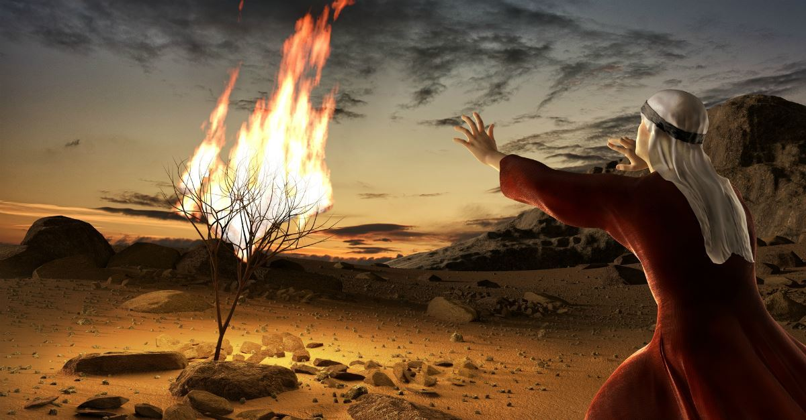
耶和華的使者 Angel of the Lord
出3:2 耶和華的使者從荊棘裡火焰中向摩西顯現．摩西觀看、不料、荊棘被火燒著、卻沒 有燒燬。 出3:3 摩西說、我要過去看這大異象、這荊棘為何沒有燒壞呢。 出3:4 耶和華上帝見他過去要看、就從荊棘裡呼叫說、摩西、摩西．他說、我在這裡。 出3:5 上帝說、不要近前來、當把你腳上的鞋脫下來、因為你所站之地是聖地． 出3:6 又說、我是你父親的上帝、是亞伯拉罕的上帝、以撒的上帝、雅各的上帝。摩西蒙 上臉、因為怕看上帝。
Notes:
出3:2 耶和華的使者從荊棘裡火焰中向摩西顯現．摩西觀看、不料、荊棘被火燒著、卻沒 有燒燬。 出3:3 摩西說、我要過去看這大異象、這荊棘為何沒有燒壞呢。 出3:4 耶和華上帝見他過去要看、就從荊棘裡呼叫說、摩西、摩西．他說、我在這裡。 出3:5 上帝說、不要近前來、當把你腳上的鞋脫下來、因為你所站之地是聖地． 出3:6 又說、我是你父親的上帝、是亞伯拉罕的上帝、以撒的上帝、雅各的上帝。摩西蒙 上臉、因為怕看上帝。
出3:2 耶和華的使者從荊棘裡火焰中向摩西顯現．摩西觀看、不料、荊棘被火燒著、卻沒 有燒燬。 出3:3 摩西說、我要過去看這大異象、這荊棘為何沒有燒壞呢。 出3:4 耶和華上帝見他過去要看、就從荊棘裡呼叫說、摩西、摩西．他說、我在這裡。 出3:5 上帝說、不要近前來、當把你腳上的鞋脫下來、因為你所站之地是聖地． 出3:6 又說、我是你父親的上帝、是亞伯拉罕的上帝、以撒的上帝、雅各的上帝。摩西蒙 上臉、因為怕看上帝。

Slide 28
Angel of the Lord
Exodus 3:2-6 ² There the angel of the Lord appeared to him in flames of fire from within a bush. Moses saw that though the bush was on fire it did not burn up. ³ So Moses thought, “I will go over and see this strange sight—why the bush does not burn up.”
⁴ When the Lord saw that he had gone over to look, God called to him from within the bush, “Moses! Moses!”
And Moses said, “Here I am.”
⁵ “Do not come any closer,” God said. “Take off your sandals, for the place where you are standing is holy ground.” ⁶ Then he said, “I am the God of your father,^{[a]} the God of Abraham, the God of Isaac and the God of Jacob.” At this, Moses hid his face, because he was afraid to look at God.

Slide 29
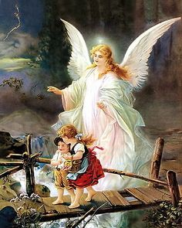
个人的守护天使?
太18:10 你們要小心、不可輕看這小子裡的一個．我告訴你們、他們的使者在天上、常見 我天父的面。
Matthew 18:10 ¹⁰ ¹⁰ “See that you do not despise one of these little ones. For I tell you that their angels in heaven always see the face of my Father in heaven.

Slide 30
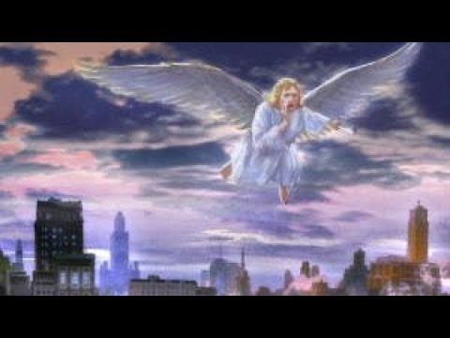
区域性的天使?
詩91:11 因他要為你吩咐他的使者、在你行的一切道路上保護你。 詩91:12 他們要用手托著你、免得你的腳碰在石頭上。
Psalm 91:11-12
¹¹ For he will command his angels concerning you to guard you in all your ways; ¹² they will lift you up in their hands, so that you will not strike your foot against a stone.

Slide 31
犯了罪的天使

Slide 32
犯罪的天使 Fallen Angels
啟12:4 他的尾巴拖拉著天上星辰的三分之一、摔在地上．龍就站在那將要生產的婦人面 前、等他生產之後、要吞喫他的孩子。
Revelation 12:4 Its tail swept a third of the stars out of the sky and flung them to the earth. The dragon stood in front of the woman who was about to give birth, so that it might devour her child the moment he was born.
啟12:9 大龍就是那古蛇、名叫魔鬼、又叫撒但、是迷惑普天下的．他被摔在地上、他的 使者也一同被摔下去。
Revelation 12:9 The great dragon was hurled down—that ancient serpent called the devil, or Satan, who leads the whole world astray. He was hurled to the earth, and his angels with him.

Slide 33
犯罪的天使 Fallen Angels
猶6 又有不守本位、離開自己住處的天使、主用鎖鍊把他們永遠拘留在黑暗裡、等候大 日的審判。
Jude 6 And the angels who did not keep their positions of authority but abandoned their proper dwelling—these he has kept in darkness, bound with everlasting chains for judgment on the great Day.
彼後2:4 就是天使犯了罪、上帝也沒有寬容、曾把他們丟在地獄、交在黑暗坑中、等候審 判．
2 Peter 2:4 For if God did not spare angels when they sinned, but sent them to hell,^{[a]} putting them in chains of darkness^{[b]} to be held for judgment;

Slide 34
天使在神旨意中的地位

Slide 35
天使显示出神对我们的爱和计划之伟大
創1:26 上帝說、我們要照著我們的形像、按著我們的樣式造人、使他們管理海裡的魚、 空中的鳥、地上的牲畜、和全地、並地上所爬的一切昆蟲。 創1:27 上帝就照著自己的形像造人、乃是照著他的形像造男造女
創9:6 凡流人血的、他的血也必被人所流、因為上帝造人、是照自己的形像造的。
林前6:3 豈不知我們要審判天使麼、何況今生的事呢。
來2:7 你叫他比天使微小一點、〔或作你叫他暫時比天使小〕賜他榮耀尊貴為冠冕、並將 你手所造的都派他管理．

Slide 36
天使显示出神对我们的爱和计划之伟大
創1:26-27 上帝說、我們要照著我們的形像、按著我們的樣式造人、使他們管理海裡的魚、 空中的鳥、地上的牲畜、和全地、並地上所爬的一切昆蟲。上帝就照著自己的形像造人、乃是照著他的形像造男造女
創9:6 凡流人血的、他的血也必被人所流、因為上帝造人、是照自己的形像造的。
林前6:3 豈不知我們要審判天使麼、何況今生的事呢。
來2:7 你叫他比天使微小一點、〔或作你叫他暫時比天使小〕賜他榮耀尊貴為冠冕、並將 你手所造的都派他管理．

Slide 37
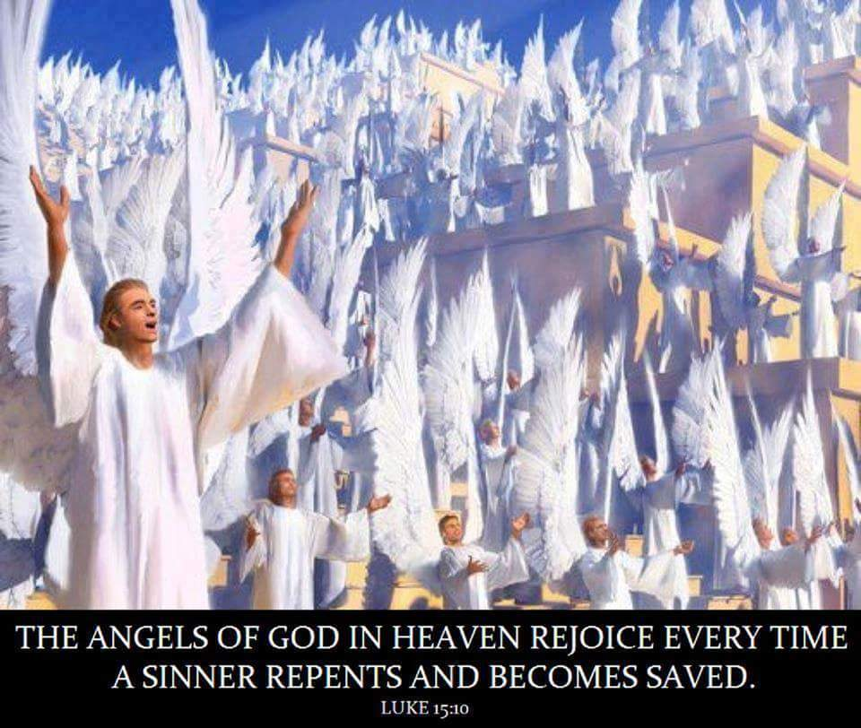
天使显示出神对我们的爱和计划之伟大
來1:14 天使豈不都是服役的靈、奉差遣為那將要承受救恩的人效力麼。
路15:10 我告訴你們、一個罪人悔改、在上帝的使者面前、也是這樣為他歡喜。

Slide 38
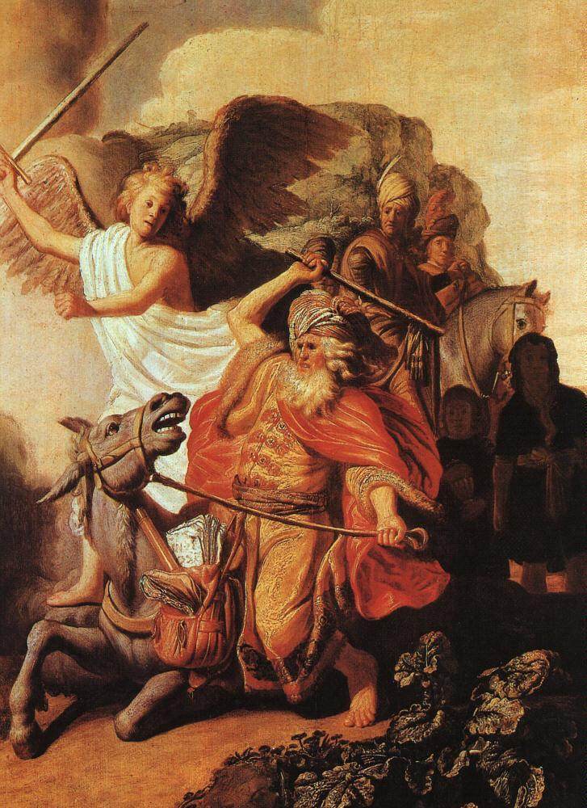
天使提醒我们看不见之世界的真实性
民22:31 當時、耶和華使巴蘭的眼目明亮、他就看見耶和華的使者站在路上、手裡有拔出 來的刀．巴蘭便低頭俯伏在地。
Numbers 22:31 Then the Lord opened Balaam’s eyes, and he saw the angel of the Lord standing in the road with his sword drawn. So he bowed low and fell facedown.

Slide 39
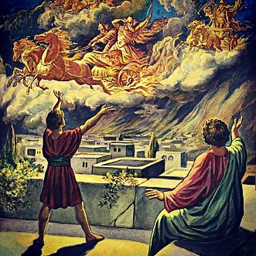
天使提醒我们看不见之世界的真实性
王下6:17 以利沙禱告說、耶和華阿、求你開這少年人的眼目、使他能看見。耶和華開他 的眼目、他就看見滿山有火車火馬圍繞以利沙。
2 Kings 6:17 And Elisha prayed, “Open his eyes, Lord, so that he may see.” Then the Lord opened the servant’s eyes, and he looked and saw the hills full of horses and chariots of fire all around Elisha.

Slide 40
天使是我们的榜样
太6:10 願你的國降臨。願你的旨意行在地上、如同行在天上。
賽6:2 其上有撒拉弗侍立．各有六個翅膀．用兩個翅膀遮臉、兩個翅膀遮腳、兩個翅膀飛 翔． 賽6:3 彼此呼喊說、聖哉、聖哉、聖哉、萬軍之耶和華．他的榮光充滿全地。
啟5:11 我又看見、且聽見、寶座與活物並長老的周圍、有許多天使的聲音．他們的數目 有千千萬萬． 啟5:12 大聲說、曾被殺的羔羊、是配得權柄、豐富、智慧、能力、尊貴、榮耀、頌讚的 。 啟5:13 我又聽見、在天上、地上、地底下、滄海裡、和天地間一切所有被造之物、都說 、但願頌讚、尊貴、榮耀、權勢、都歸給坐寶座的和羔羊、直到永永遠遠。

Slide 41
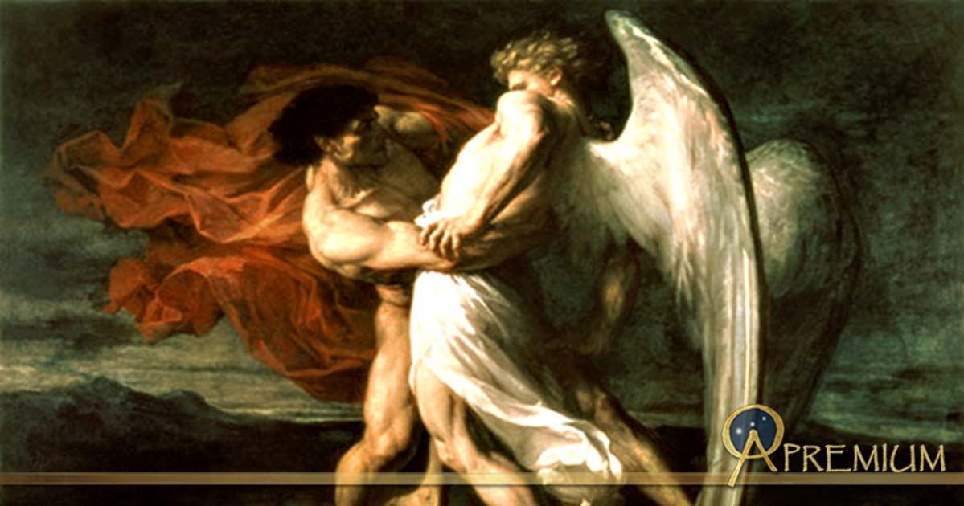
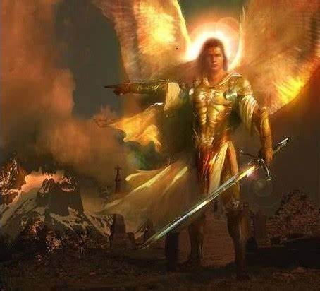
天使执行神的计划 Daniel 10:13; 2 Samuel 24:16-17

Slide 42
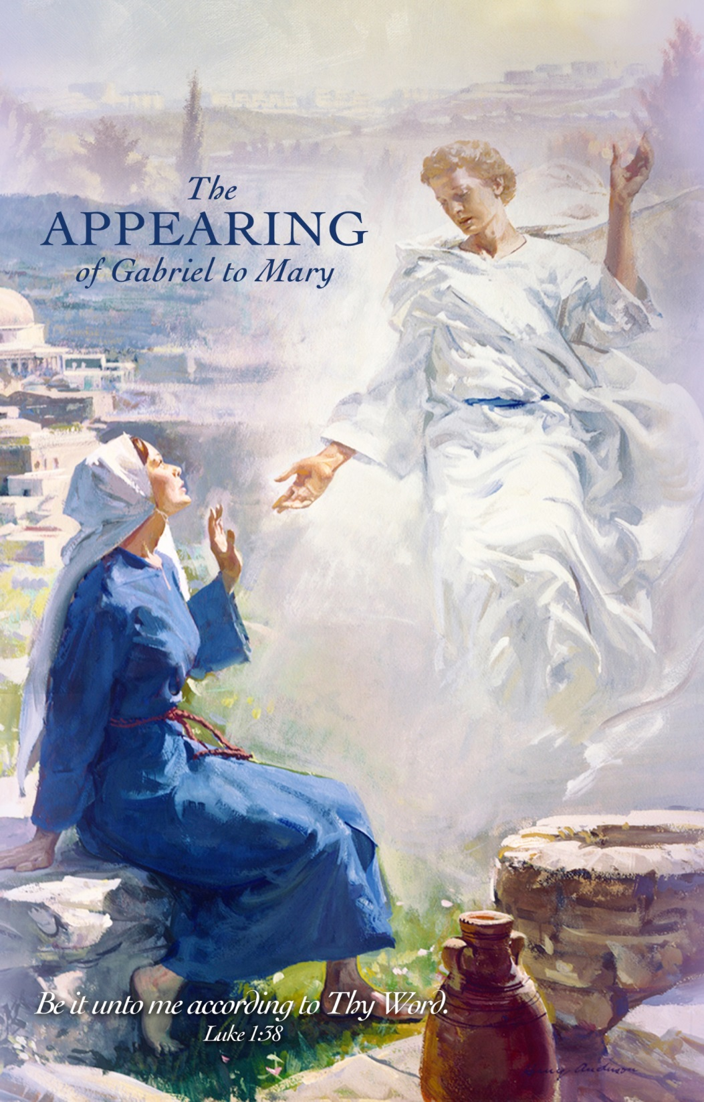
天使的能力: 执行神的计划

Slide 43
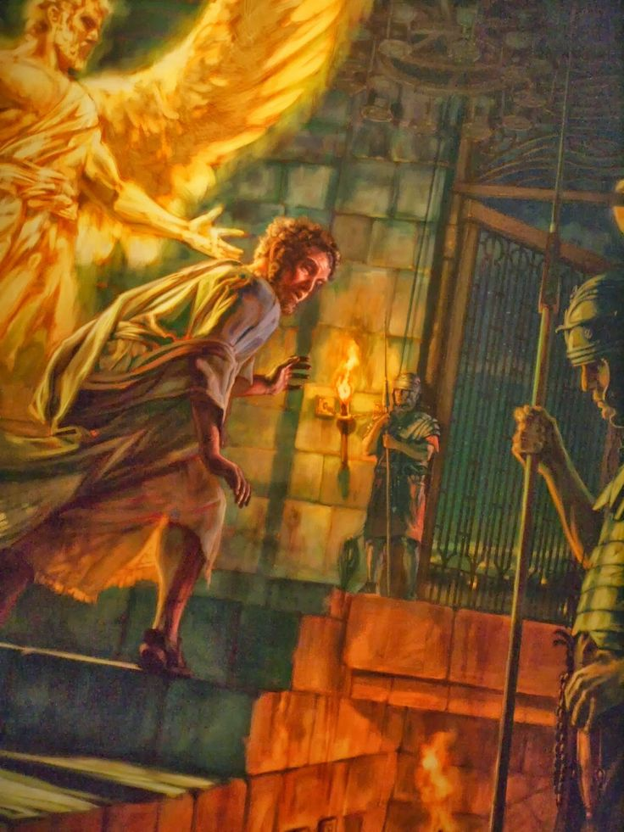
天使执行神的计划 Act 12:23; 12:6-11

Slide 44
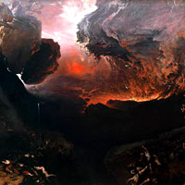
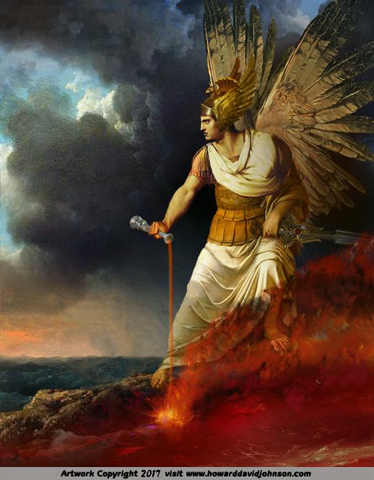
天使执行神的计划 Revelation 18:21 ;16:1

Slide 45
我们与天使的关系
在生活中留意天使的存在
小心与天使的关系
今天天使会向人显现吗？

