Slide 1


AMAZON SWOT ANALYSIS
S
W
O
T
Presentation

Slide 2



Amazon SWOT Analysis
S
W
O
T
Strengths
Weaknesses
Opportunities
Threats
What do we do well?
What can we improve?
What emerging trends can we take advantage of?
What is our competition doing?
What have our customers or partners told us they like about us?
What are our customers or partners dissatisfied with?
Which of our strengths might be valuable to potential partners?
How could our weaknesses leave us vulnerable?
In what areas do we outpace our competitors?
Where do we fall behind our competitors?
What adjacent markets might we tap into?
What market trends are we unprepared for?

Slide 3






Amazon SWOT Analysis
Strengths
Weaknesses
  Strong brand recognition and reputation.
  Problems with working conditions.
  Variety of products.
  Dependence on third parties.
  A well-developed distribution network.
  Regulatory control.
  Advanced technologies.
S
W
  Problems with delivery.
O
T
Opportunities
Threats
  Development of new technologies.
  Increase in the number of counterfeit goods.
  Expansion of the range of services.
  Intense competition.
  Partnerships and acquisitions.
  Supply chain issues.
  Expansion into new markets.
  Rising labor costs.

Slide 4





Amazon SWOT Analysis
Strengths
Weaknesses
  Strong brand recognition and reputation.
  Problems with working conditions.
  Variety of products.
  Dependence on third parties.
  A well-developed distribution network.
  Regulatory control.
  Advanced technologies.
  Problems with delivery.
Opportunities
Threats
  Development of new technologies.
  Increase in the number of counterfeit goods.
  Expansion of the range of services.
  Intense competition.
  Partnerships and acquisitions.
  Supply chain issues.
  Expansion into new markets.
  Rising labor costs.

Slide 5






Amazon SWOT Analysis
Strengths
Weaknesses
S
W
Strong brand recognition and reputation.
Problems with working conditions.
Variety of products.
Dependence on third parties.
A well-developed distribution network.
Regulatory control.
Advanced technologies.
Problems with delivery.
Opportunities
Threats
Development of new technologies.
Increase in the number of counterfeit goods.
Expansion of the range of services.
Intense competition.
Partnerships and acquisitions.
O
T
Supply chain issues.
Expansion into new markets.
Rising labor costs.

Slide 6


Amazon SWOT Analysis
Strengths
Weaknesses
What do we do well?
What can we improve?
What have our customers or partners told us they like about us?
S
W
What are our customers or partners dissatisfied with?
In what areas do we outpace our competitors?
Where do we fall behind our competitors?
Opportunities
O
T
Threats
What emerging trends can we take advantage of?
What is our competition doing?
Which of our strengths might be valuable to potential partners?
How could our weaknesses leave us vulnerable?
What adjacent markets might we tap into?
What market trends are we unprepared for?

Slide 7

Amazon SWOT Analysis
S
W
O
T
Strengths
Weaknesses
Opportunities
Threats
  Variety of products.
  Problems with working conditions.
  Development of new technologies.
  Increase in the number of counterfeit goods.
  Strong brand recognition and reputation.
  Dependence on third parties.
  Expansion of the range of services.
  Intense competition.
  Advanced technologies.
  Regulatory control.
  Partnerships and acquisitions.
  Supply chain issues.
  A well-developed distribution network.
  Problems with delivery.
  Expansion into new markets.
  Rising labor costs.

Slide 8


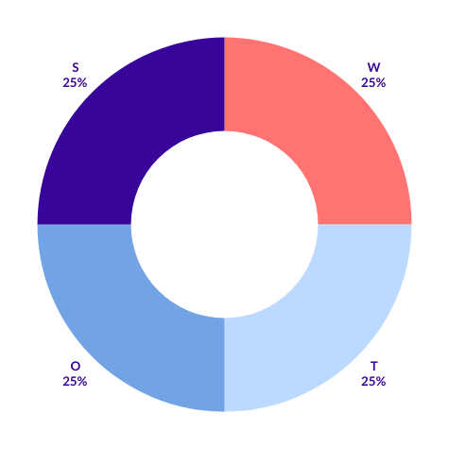
Amazon SWOT Analysis
S
W
  Strong brand recognition and reputation.
  Problems with working conditions.
  Dependence on third parties.
  Variety of products.
  A well-developed distribution network.
  Regulatory control.
  Advanced technologies.
  Problems with delivery.
  Development of new technologies.
  Increase in the number of counterfeit goods.
  Expansion of the range of services.
  Intense competition.
  Partnerships and acquisitions.
  Supply chain issues.
  Expansion into new markets.
  Rising labor costs.
O
T

Slide 9







Strengths
What do you do well? What unique resources can you draw on?
Weaknesses
SWOT
What could you improve? Where do you have fewer resources that others?
Opportunities
What opportunities are open to you? What trends could you take advantage of?
Threats
What threats could harm you? What is your competition doing?

Slide 10






Amazon SWOT Analysis
Strengths
S
W
Weaknesses
What do you do well? What unique resources can you draw on?
What could you improve? Where do you have fewer resources that others?
Opportunities
O
T
Threats
What opportunities are open to you? What trends could you take advantage of?
What threats could harm you? What is your competition doing?

Slide 11


Amazon SWOT Analysis
Strengths
Weaknesses
Strong brand recognition and reputation.
Problems with working conditions.
Variety of products.
Dependence on third parties.
A well-developed distribution network.
S
W
Regulatory control.
Advanced technologies.
Problems with delivery.
Opportunities
Threats
O
T
Development of new technologies.
Increase in the number of counterfeit goods.
Expansion of the range of services.
Intense competition.
Partnerships and acquisitions.
Supply chain issues.
Expansion into new markets.
Rising labor costs.

Slide 12






Contact Us
123 Anywhere St., Any City,ST 12345
123-456-7890
hello@reallygreatsite.com
@reallygreatsite
reallygreatsite.com

Slide 13

Resource Page
Use these design resources in your Canva Presentation.
You can find these fonts online too. Happy designing!
Don't forget to delete this page before presenting.
This presentation template uses the following free fonts:
  Titles: Fira Sans
  Headers: Fira Sans
  Body Copy: Lato

Slide 14



Credits
This presentation template is free for everyone to use thanks to the following:
SlidesCarnival for the presentation template
Pexels for the photos
Happy designing!

