Slide 1



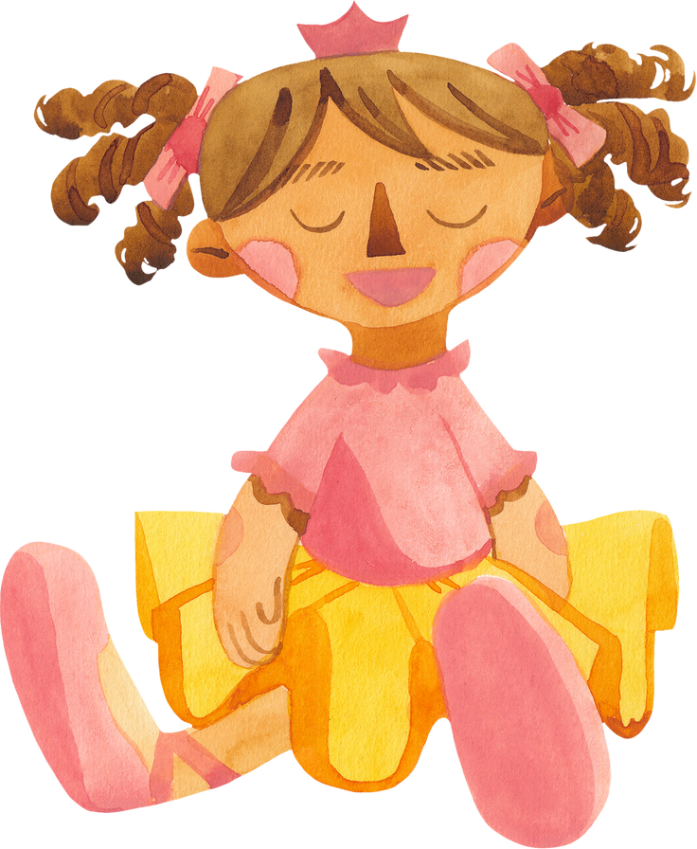

Sasha's
First 18 Months
A year and a half in review

Slide 2
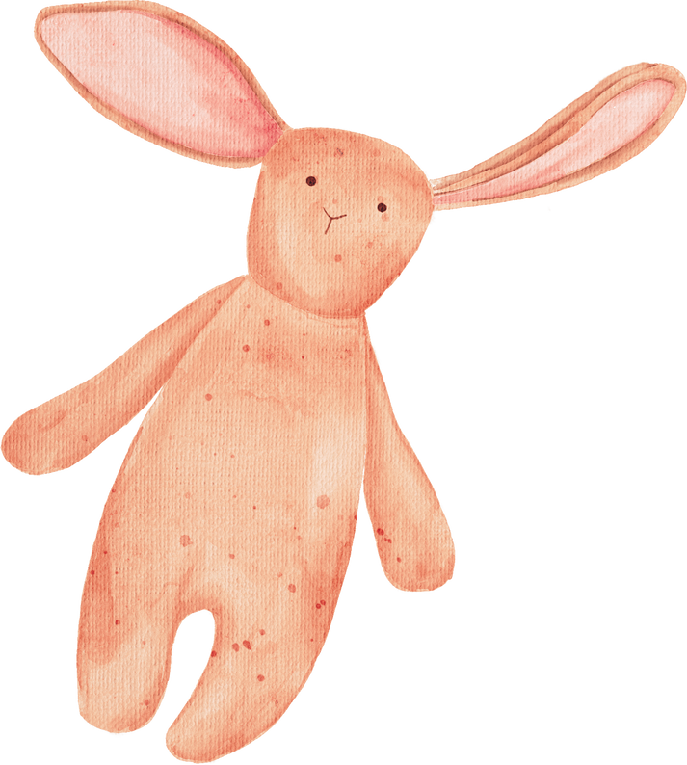


Sasha
OUR BUNDLE OF JOY
Presentations are communication tools that can be used as lectures.

Slide 3


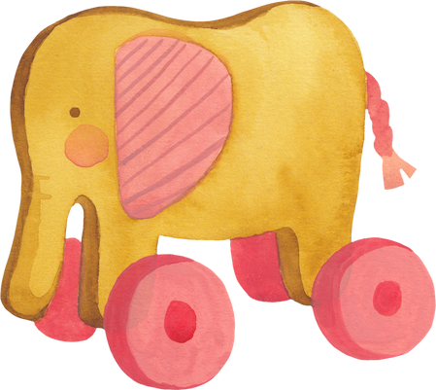

Milestones
TIMELINE OF SIGNIFICANT EVENTS
6 MONTHS
9 MONTHS
12 MONTHS
Presentations are communication tools.
Presentations are communication tools.
Presentations are communication tools.

Slide 4


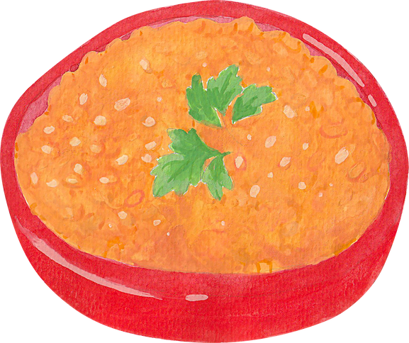
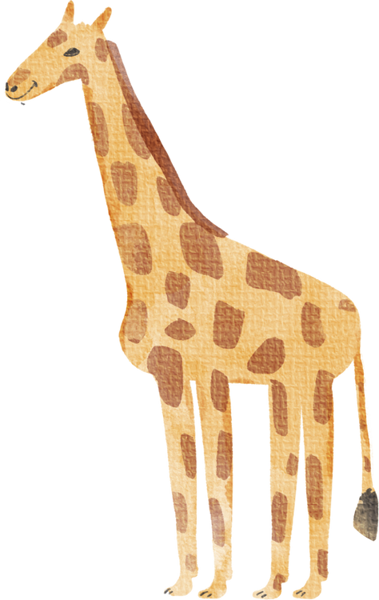

EATING SOLIDS
SPEAKING
Presentations are communication tools.
Presentations are communication tools.
WALKING
STEADY GROWTH
Presentations are communication tools.
Presentations are communication tools.

Slide 5






Food Preferences
WE HAVE A NEW FOODIE IN THE FAMILY
LIKES
DISLIKES
Presentations are communication tools that can be used as lectures.
Presentations are communication tools that can be used as lectures.

Slide 6


Sasha
Speaking for
the First Time
Presentations are communication tools that can be used as lectures.

Slide 7



First Few Words
"PLAY"
Presentations are communication tools that can be used as lectures.
"MAMA" AND "PAPA"
"MILK"
Presentations are communication tools that can be used as lectures.
Presentations are communication tools that can be used as lectures.

Slide 8




Progression to Walking
CRAWLING
USING THE WALKER
FIRST STEPS WITHOUT ANY HELP
Presentations are communication tools that can be used as lectures.
Presentations are communication tools that can be used as lectures.
Presentations are communication tools that can be used as lectures.

Slide 9


Presentations are communication tools that can be used as lectures.

Slide 10


Sasha's Growth
FROM DAY 1 TO PRESENT
Presentations are communication tools that can be used as lectures.

Slide 11

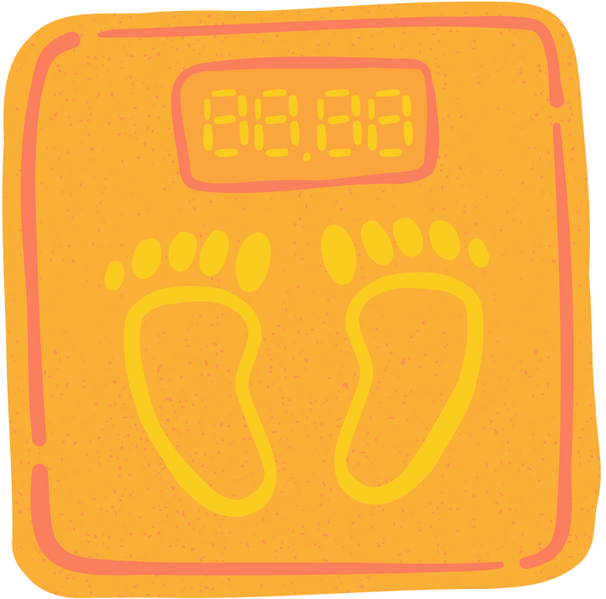
24 lbs.
SASHA'S WEIGHT AS OF TODAY
6.8 lbs.
WEIGHT AS A NEWBORN

Slide 12


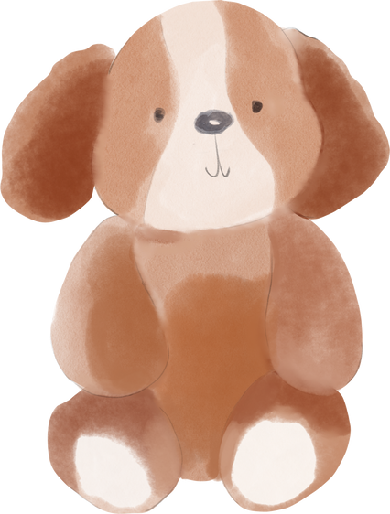
20 inch
LENGTH AS A NEWBORN
32 inch
SASHA'S HEIGHT AS OF TODAY

Slide 13
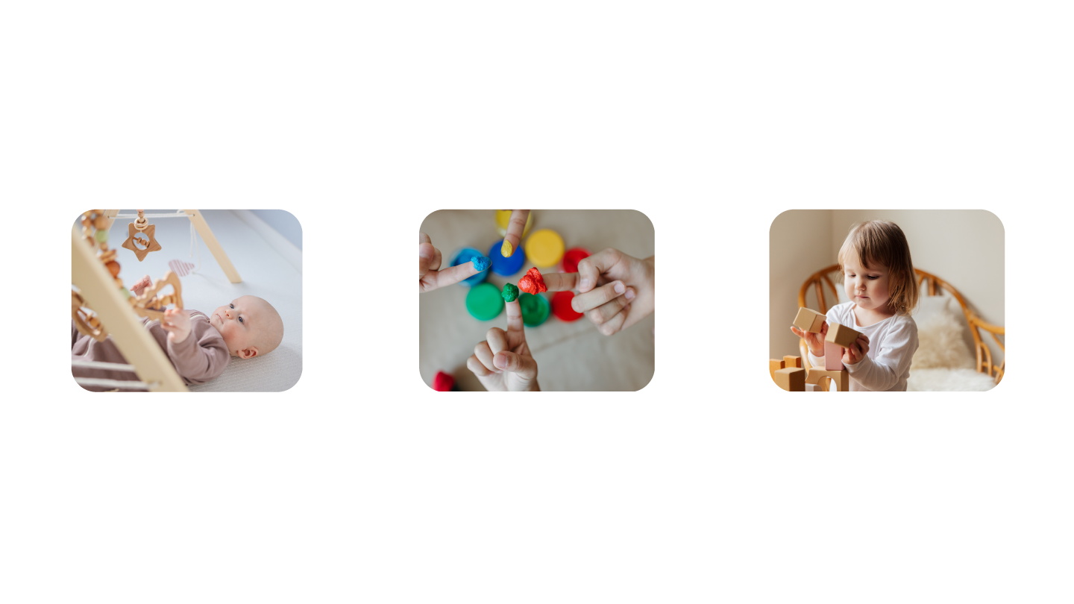
Motor Skills
PLAY WITH BUILDING BLOCKS
HOLDS RATTLE
FINGERPAINTING
Presentations are communication tools that can be used as lectures.
Presentations are communication tools that can be used as lectures.
Presentations are communication tools that can be used as lectures.

Slide 14

Sasha’s Interests
DRAWING
COOKING
READING
Presentations are communication tools that can be used as lectures.
Presentations are communication tools that can be used as lectures.
Presentations are communication tools that can be used as lectures.

Slide 15
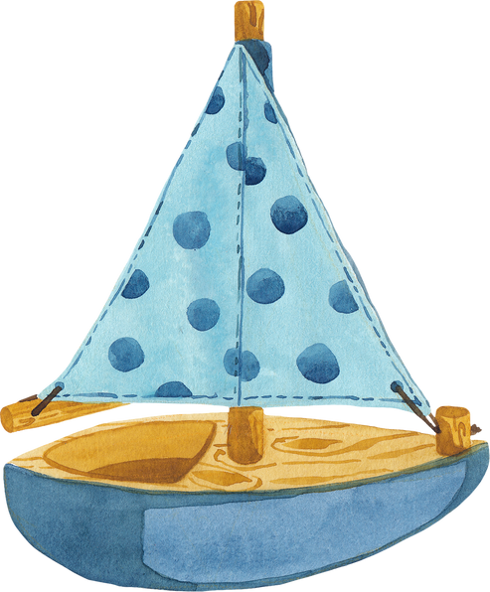

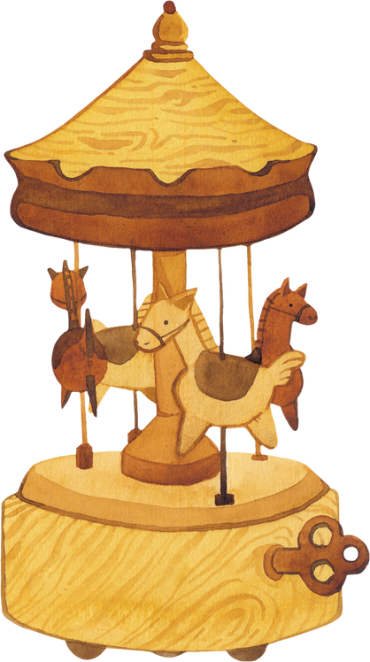

COMING HOME FROM THE HOSPITAL
Presentations are communication tools that can be used as lectures.
OUR SWEETHEART TODAY
Presentations are communication tools that can be used as lectures.

Slide 16

Sasha's Wonderful Progress
Presentations are communication tools that can be used as lectures.

Slide 17
Resource Page
  Use these design resources in your Canva Presentation.
Fonts
Design Elements
This presentation template
uses the following free fonts:
TITLES:
CABIN SKETCH
HEADERS:
COMING SOON
BODY COPY:
COMING SOON
You can find these fonts online too.
Colors
#DCD5D3
#F7DE53
#F48482
  DON'T FORGET TO DELETE THIS PAGE BEFORE PRESENTING.

Slide 18

Credits
  This presentation template is free for everyone to use thanks to the following:
  for the presentation template
Pexels, Pixabay
  for the photos
Happy designing!

