Slide 1













Happy 10th
Anniversary

Slide 2




Agenda Page
Write an agenda here.
Write an agenda here.
Write an agenda here.
Write an agenda here.
Write an agenda here.
Write an agenda here.
Write an agenda here.

Slide 3





Love Story Beginnings
  In the beginning, it was just a spark, a glance exchanged, a shy smile that spoke volumes.
  Let's reminisce about those early days, when every moment together felt like a fairytale waiting to unfold.

Slide 4





Milestones of Love
2014
2016
2015
  Elaborate on what
  you want to discuss.
  Elaborate on what
  you want to discuss.
  Elaborate on what
  you want to discuss.
2018
2019
2021
2024
  Elaborate on what
  you want to discuss.
  Elaborate on what
  you want to discuss.
  Elaborate on what
  you want to discuss.
  Elaborate on what
  you want to discuss.

Slide 5

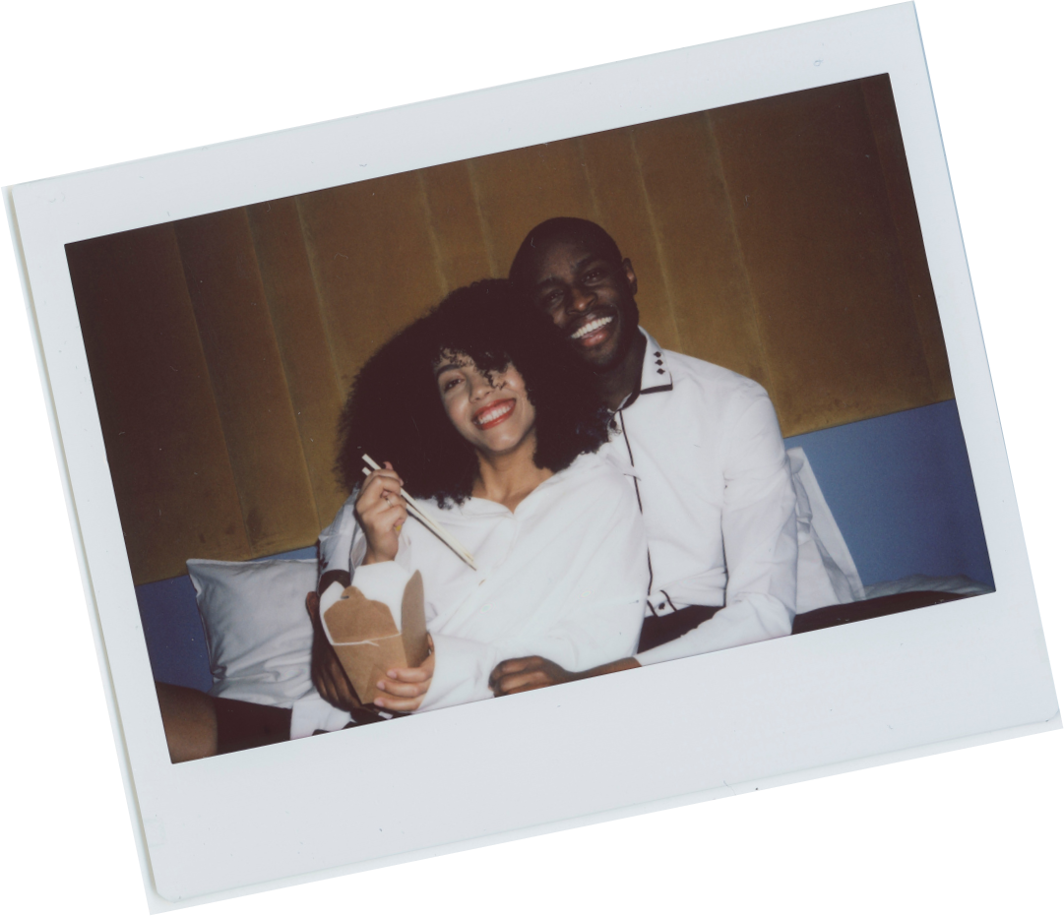


A Decade of
Adventures
  Together, you've explored the world, creating a tapestry of memories woven with threads of joy, discovery, and shared experiences. From romantic getaways to spontaneous adventures, each moment has been a testament to your adventurous spirits and the joy you find in each other's company.
Love is like a friendship caught
on fire.

Slide 6





Reflections on Togetherness

Slide 7



Promises Renewed
Promise One
Promise Two
Promise Three
Elaborate on what
  you want to discuss.
Elaborate on what
  you want to discuss.
Elaborate on what
  you want to discuss.

Slide 8



The Heart
of Home
Home is not just a place; it's the warmth of your embrace, the comfort of your presence, and the love that fills every corner. Here's to the sanctuary you've built together, where love resides and memories are made.

Slide 9




A Love Letter
Dear [Partner's Name],
  In the pages of our shared story, I find countless reasons to smile, to cherish, and to be grateful. With every passing year, my love for you grows deeper, like roots anchoring us against the storms of life. Here's to ten years of laughter, love, and endless adventures. I love you more than words can express.
With all
my heart,
Name

Slide 10



Looking Ahead
As you turn the page to a new chapter, may it be filled with endless possibilities, dreams yet to be realized, and a love that continues to flourish with each passing day. Here's to the next ten years and beyond, hand in hand, heart in heart.

Slide 11




A Symphony of Memories
  Let the sweet melodies of your shared memories serenade your hearts as you celebrate a decade of love. From the first notes of your love story to the harmonious blend of laughter and joy, may your journey continue to resonate with the beautiful music of your togetherness.

Slide 12


Write a
header here.

Slide 13






Laughter and Love
Memory One
Memory Two
Memory Three
Elaborate on what
  you want to discuss.
Elaborate on what
  you want to discuss.
Elaborate on what
  you want to discuss.

Slide 14


Love is
being
stupid
together.
Paul Valery

Slide 15



Gratitude
Amidst the hustle and bustle of life, take a moment to pause and express gratitude for the gift of each other's presence. For the love that sustains, the friendship that endures, and the countless blessings that make life's journey richer and more meaningful.

Slide 16



Cheers to Love
  Raise a glass to ten years of love, laughter, and unforgettable moments. Here's to the couple who has weathered every storm, celebrated every victory, and grown more in love with each passing day. Cheers to a love that knows no bounds and a future filled with endless love stories.

Slide 17

Forever Starts Today
Today marks not only a milestone in your journey but also the beginning of a new chapter filled with endless possibilities. May your love continue to grow deeper, your bond stronger, and your hearts intertwined
for eternity.
29.9.2024

Slide 18


Resource Page
  Use these design resources in your Canva Presentation.
Fonts
Design Elements
This presentation template
uses the following free fonts:
TITLES:
LAILA
HEADERS:
GAEGAU
BODY COPY:
HI MELODY
You can find these fonts online too.
Colors
#E84715
#FECE41
#FF9CB6
#F7F5E0
  DON'T FORGET TO DELETE THIS PAGE BEFORE PRESENTING.

Slide 19

Resource Page
  Use these design resources in your Canva Presentation.
Fonts
Design Elements
This presentation template
uses the following free fonts:
TITLES:
LAILA
HEADERS:
GAEGAU
BODY COPY:
HI MELODY
You can find these fonts online too.
Colors
#E84715
#FECE41
#FF9CB6
#F7F5E0
  DON'T FORGET TO DELETE THIS PAGE BEFORE PRESENTING.

Slide 20

Credits
  This presentation template is free for everyone to use thanks to the following:
  for the presentation template
Pexels, Pixabay
  for the photos
Happy designing!

