Slide 1








INTRODUCTION TO LINE, SHAPE AND PATTERN
Understanding the Basics: Line, Shape, and Pattern

Slide 2

HOW TO USE THIS PRESENTATION
Google Slides
PowerPoint
Canva
Click on the "Google Slides" button below this presentation preview. Make sure to sign in to your Google account. Click on "Make a copy." Start editing your presentation.
Alternative: Click on the "Share" button on the top right corner in Canva and click on "More" at the bottom of the menu. Enter "Google Drive" in the search bar and click on the GDrive icon to add this design as a Google slide in your GDrive.
Click on the "PowerPoint" button below this presentation preview. Start editing your presentation.
Alternative: From Canva template file, Click on the "Share" button on the top right corner in Canva and click on "More" at the bottom of the menu. Enter "PowerPoint" in the search bar and click on the PowerPoint icon to download.
Click on the "Canva" button under this presentation preview. Start editing your presentation. You need to sign in to your Canva account.

Slide 3




LESSON OUTLINE
Lines in Art
Playing with line & shape
Shapes in Art
Patterns in Art

Slide 4


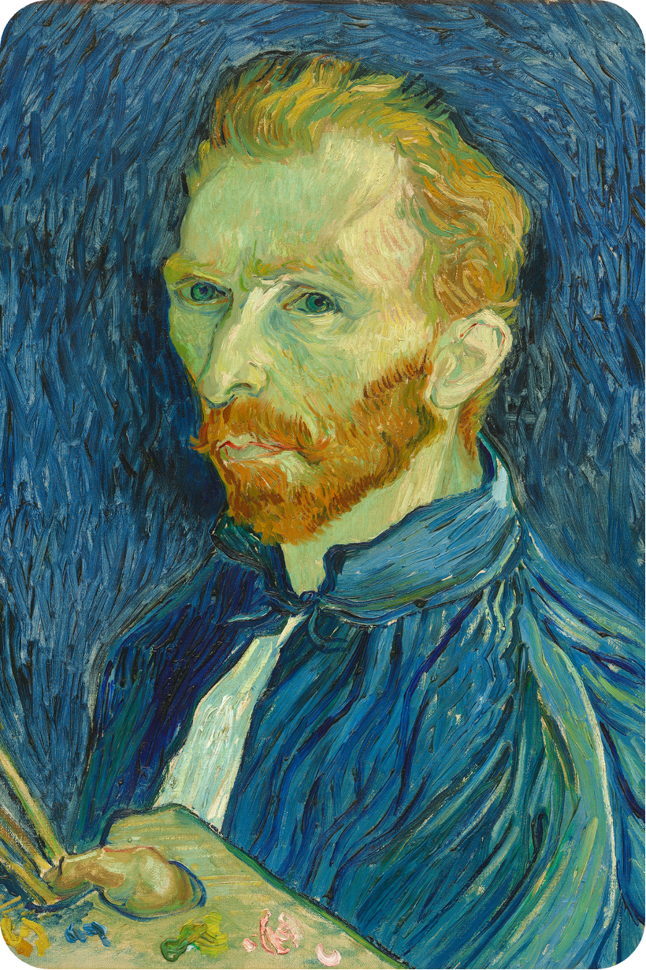


“Self-portrait”,
Vincent van Gogh, 1889
WHAT ARE THE
ELEMENTS OF ART?
These are the tools that artists use to communicate their ideas. Viewers like us use them to understand what we are looking at.
The elements are:
LINE
SHAPE
COLOR
TONE
FORM
TEXTURE
This painting has mainly wavy lines. What might we guess the artist is feeling?

Slide 5


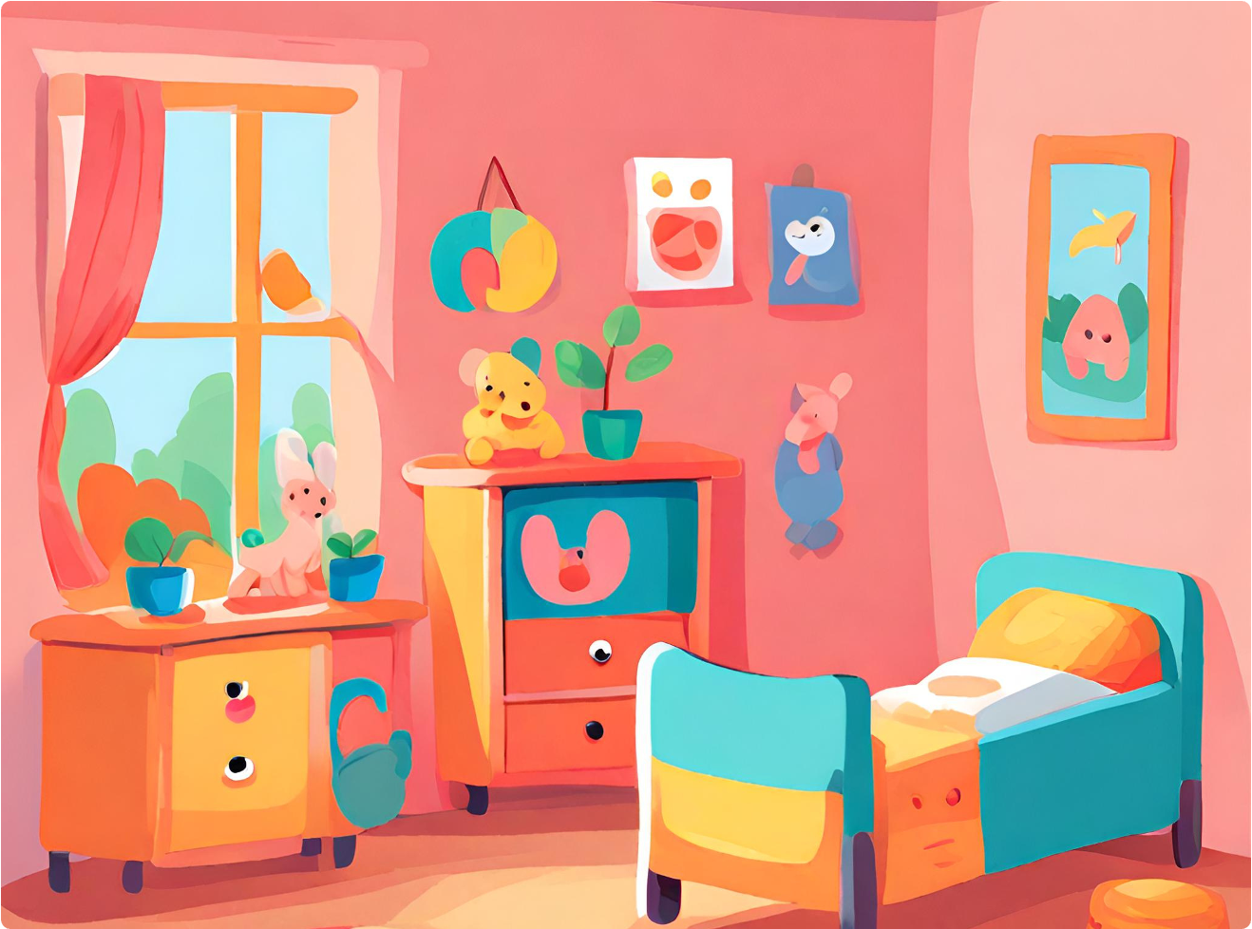

LOOK AROUND THE ROOM YOU’RE IN. CAN YOU SPY THE FOLLOWING?
LINES AND SHAPES ARE
ALL AROUND US
Today, we will investigate how artists use lines and shapes in their art.
1 CURVED LINE
2 RECTANGLES
1 PAIR OF PARALLEL LINES
1 CIRCLE

Slide 6

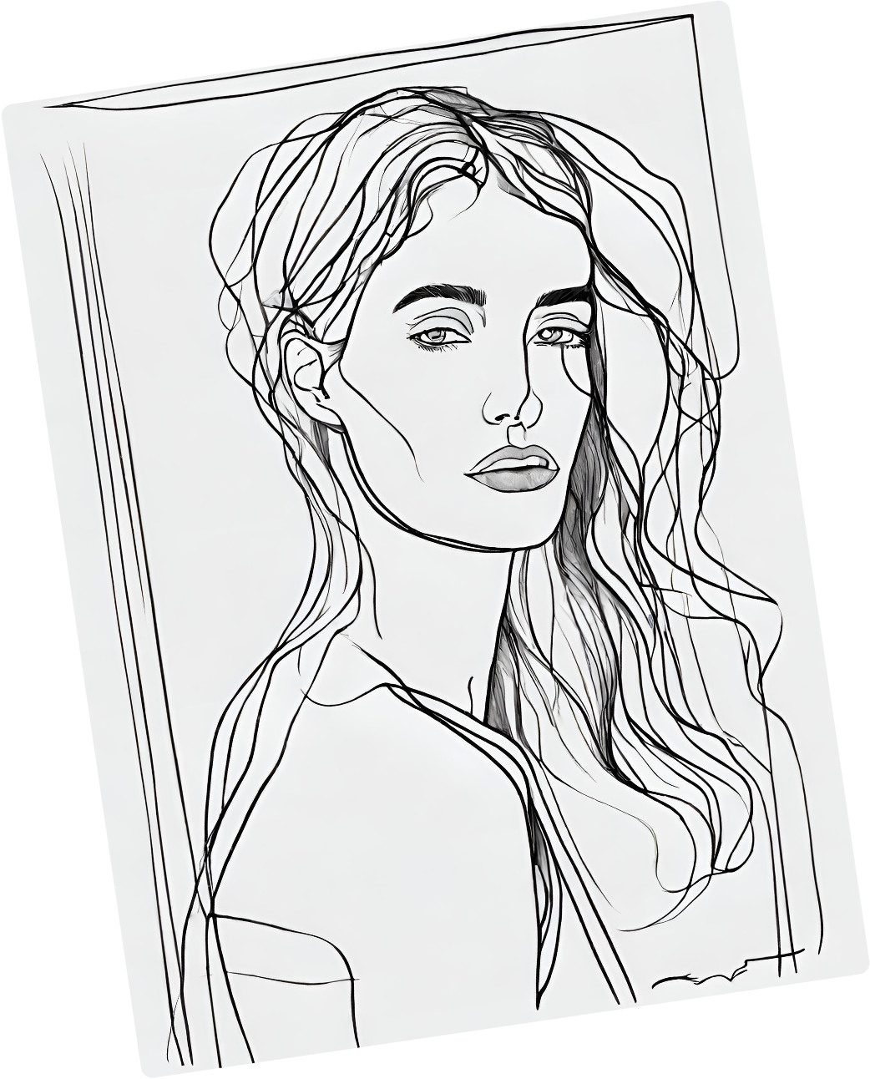
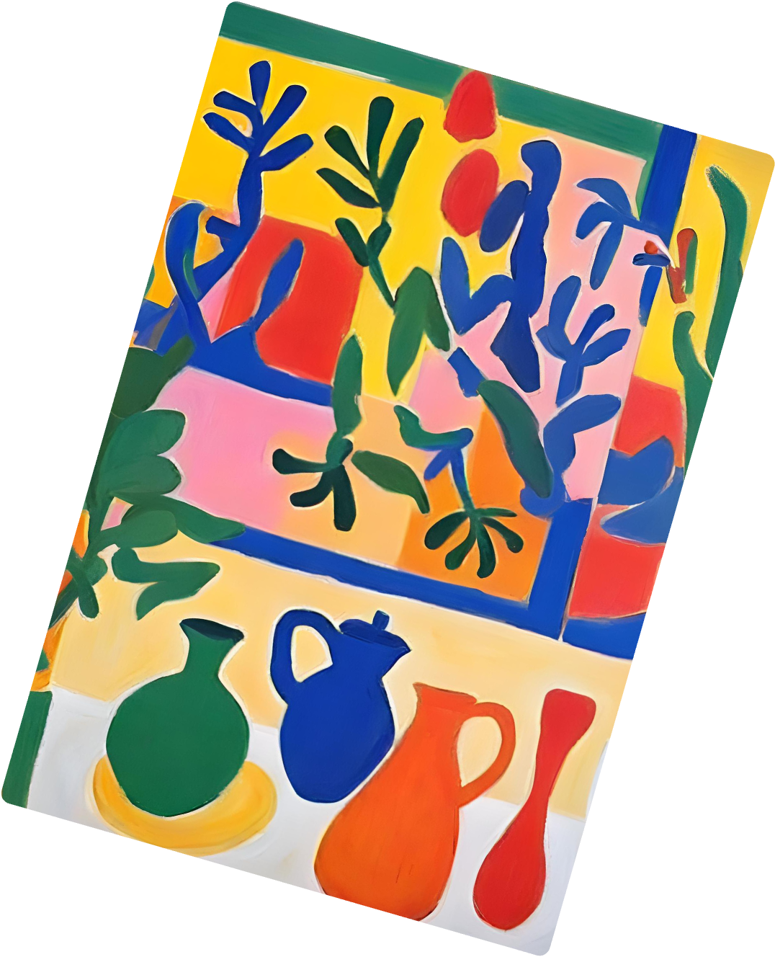

TODAY WE ARE LEARNING TO:
01
Identify different types of lines
02
Recognize that line and shape can be used to create emotion
03
Identify and create basic shapes and patterns in art

Slide 7


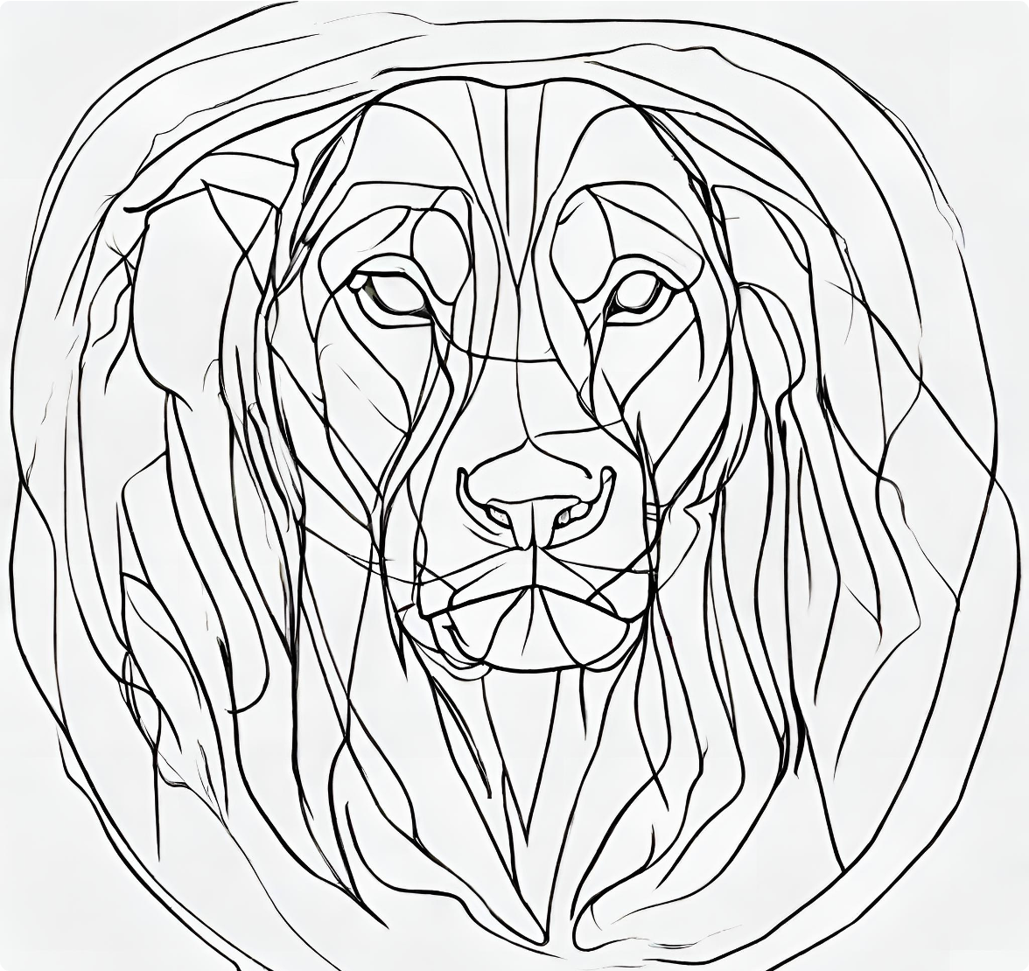



LINES IN ART
A LINE IS A PATH OR MARK ON A PAGE.
Lines can help move our eyes around an artwork. The color, shape, and texture of a line can give us information.

Slide 8
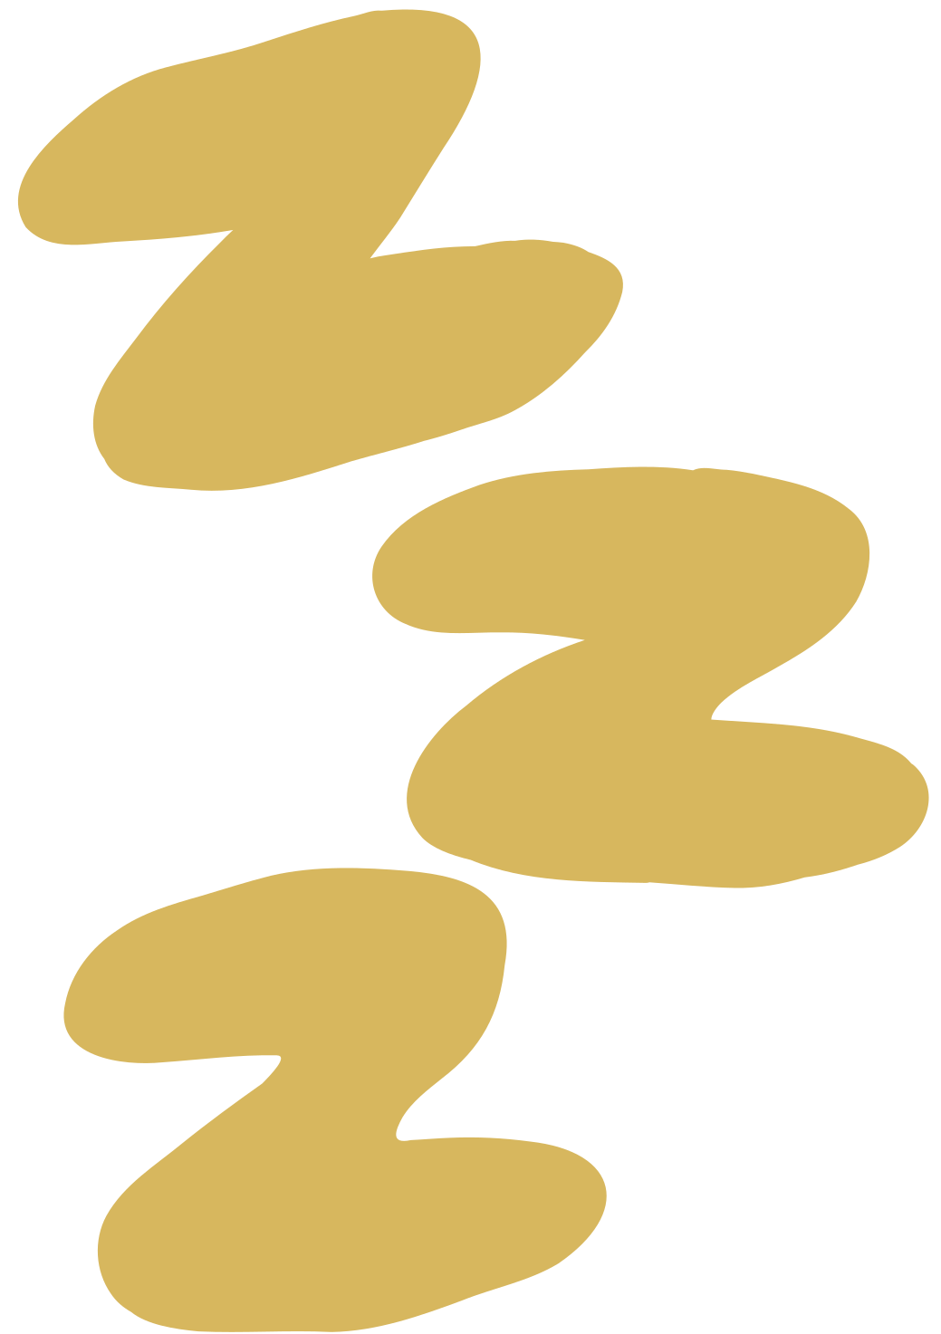



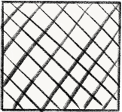



DIFFERENT TYPES OF LINES
straight
dotted
bold
fine
curved
wavy
Look carefully at these lines. What emotions can you associate with them?
cross hatched
spiral
zigzag
painterly

Slide 9
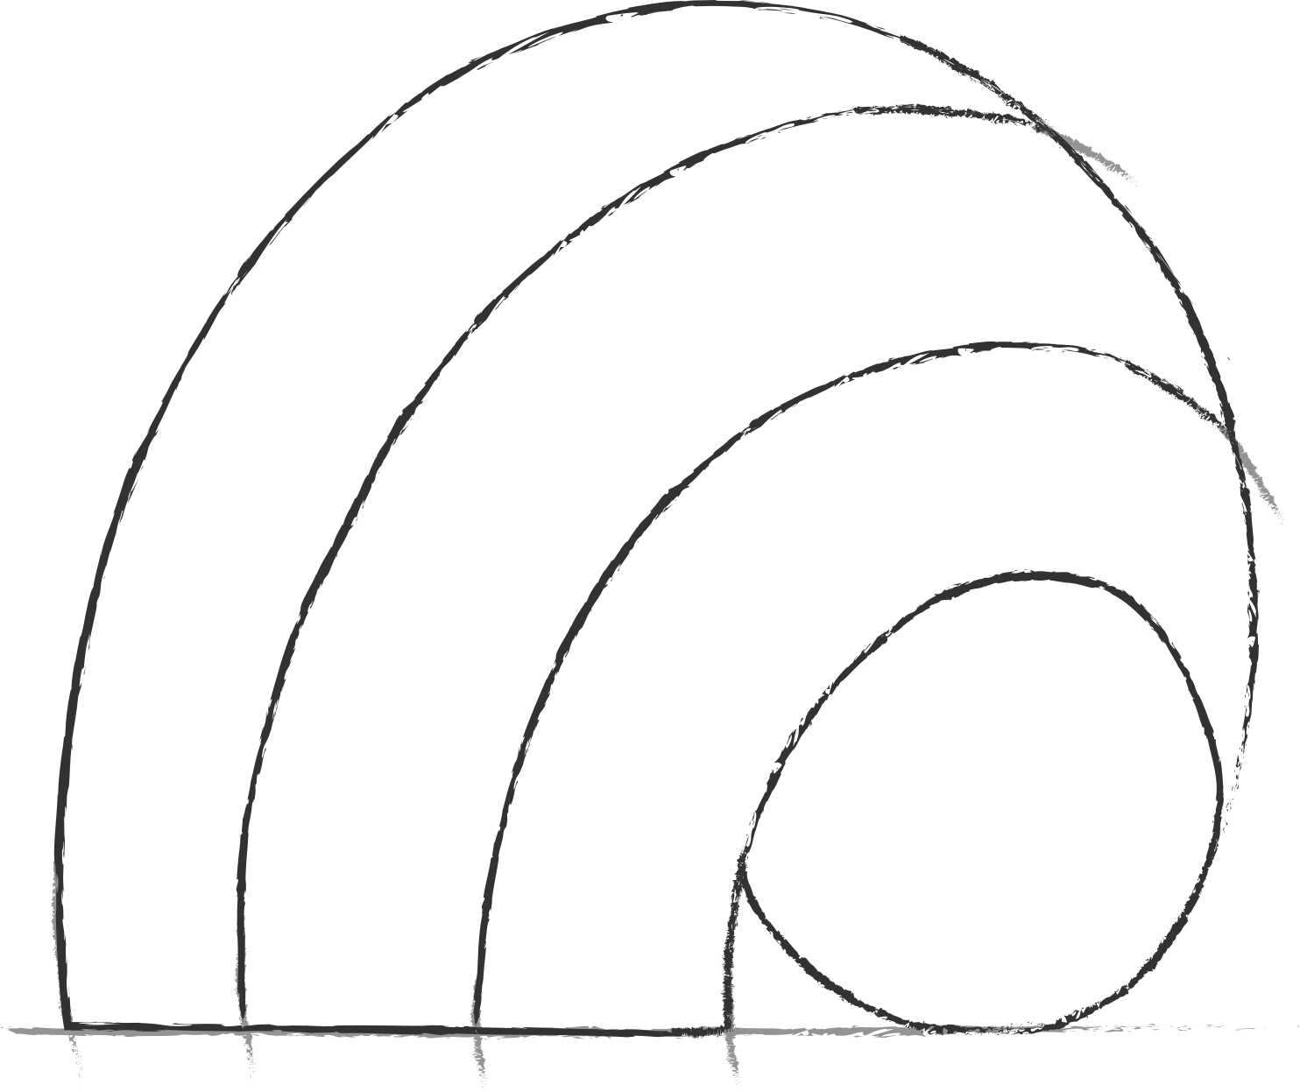




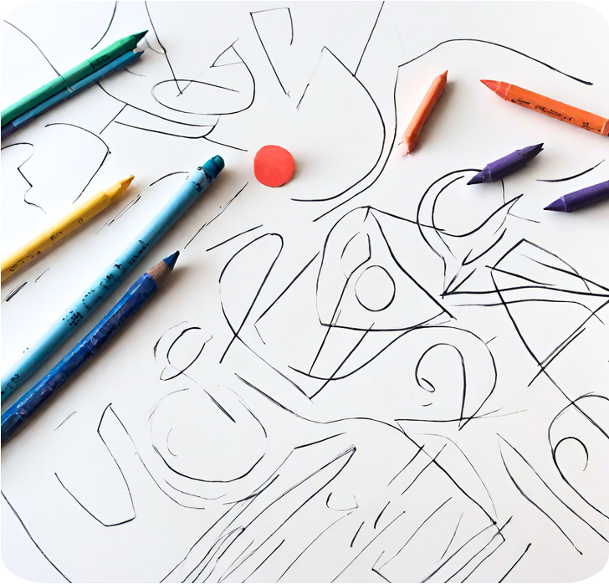
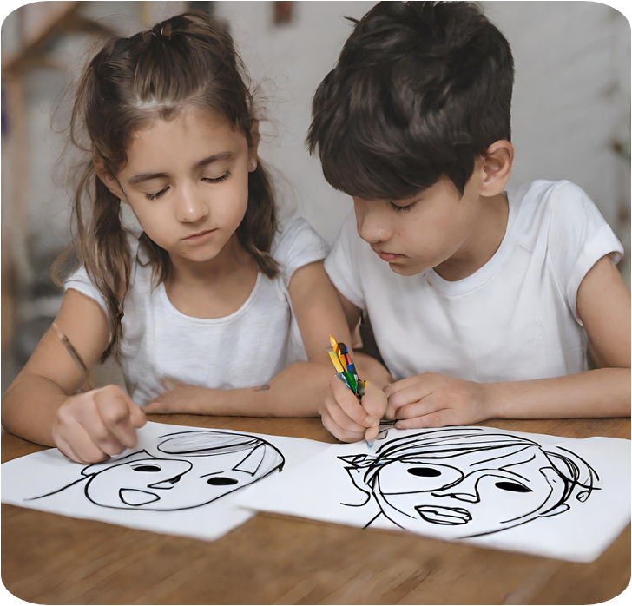
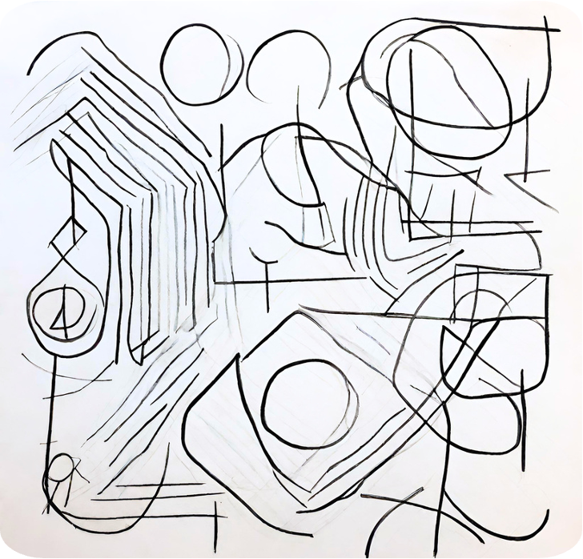
PLAYING WITH LINE AND SHAPE
1
2
3
With a pencil and a piece of paper, use a line to create shapes and meaning, just like an artist.
Look at your classmate. Now, without lifting your pencil off the paper, draw your friend’s face!
Remember: Try not to look at your paper and do not lift your pencil while drawing.

Slide 10


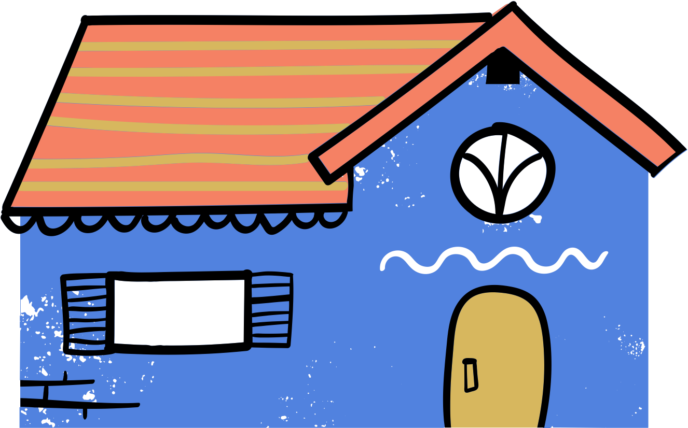

How many regular shapes make up this image?
SHAPES IN ART:
REGULAR SHAPES
LINES CAN CREATE THE OUTLINE OF SHAPES.
We often see regular shapes like triangles, rectangles, ovals, and squares.

Slide 11







How would you describe these shapes?
SHAPES IN ART:
IRREGULAR SHAPES
SHAPES THAT ARE LESS FAMILIAR ARE CALLED IRREGULAR SHAPES.
They can be:
CURVY
POINTED
SYMMETRICAL
ASYMMETRICAL
WAVY
ROUNDED

Slide 12


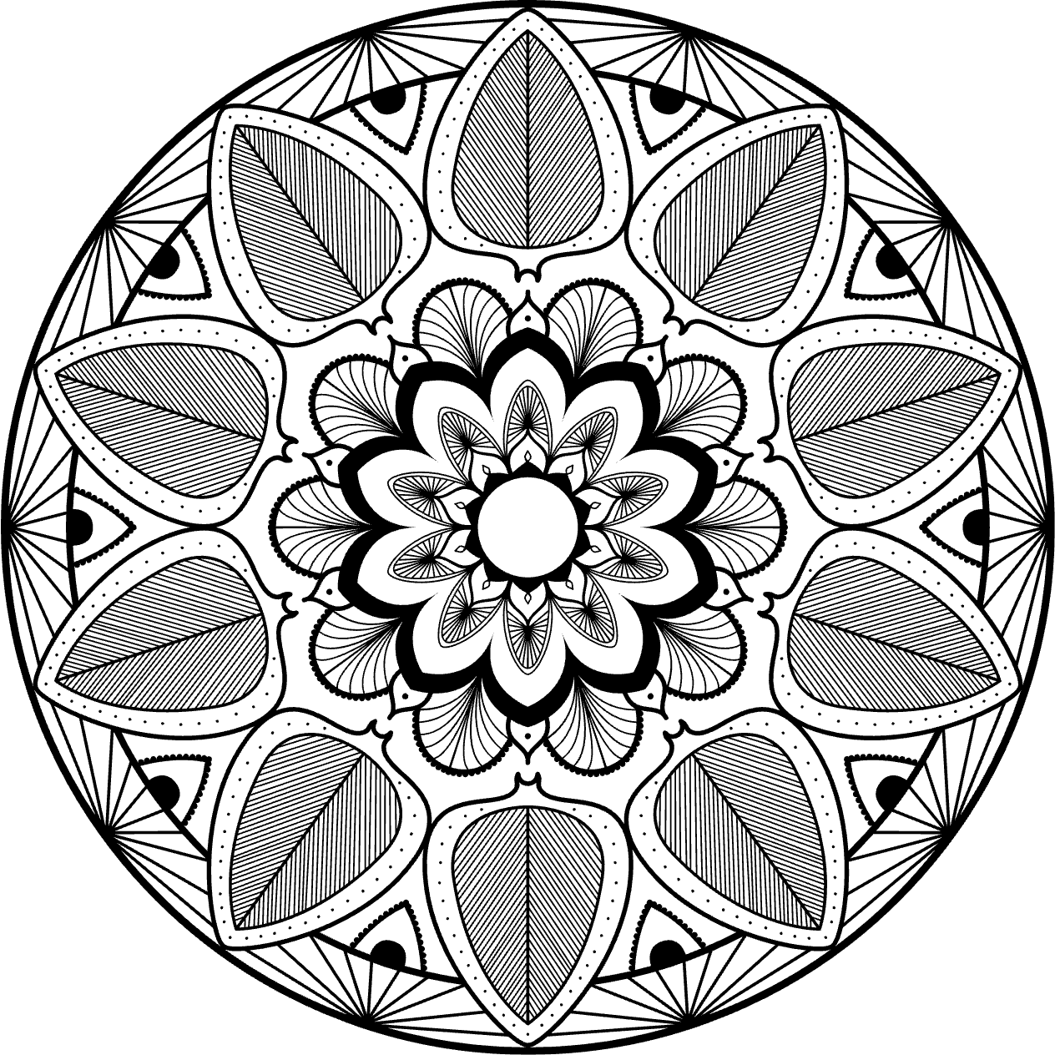


In this mandala artwork you can see lots of repeated shapes and lines.
PATTERNS IN ART
PATTERNS ARE MADE WITH
REPEATED LINES AND SHAPES.

Slide 13
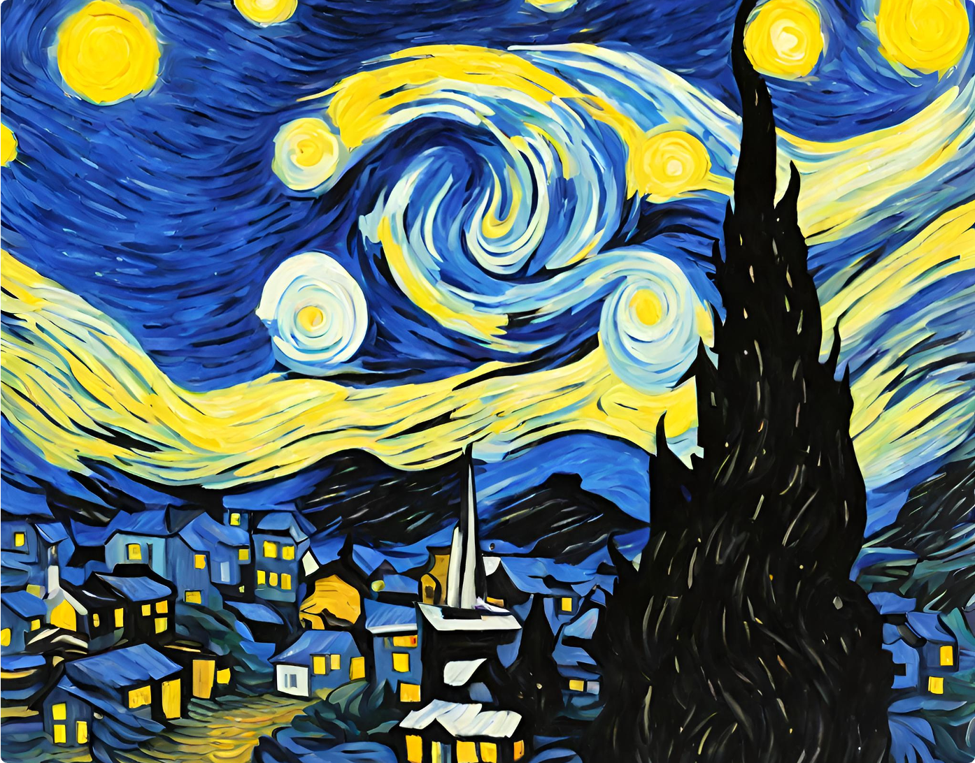

How does this artwork make you feel? What about the artwork makes you feel this way?
LINES, SHAPES AND EMOTION
Vincent Van Gogh was a famous Dutch painter. This painting, "The Starry Night," was created over 150 years ago.
He used:
LINE
SHAPE
PATTERN
“THE STARRY NIGHT”,
VINCENT VAN GOGH, 1889

Slide 14

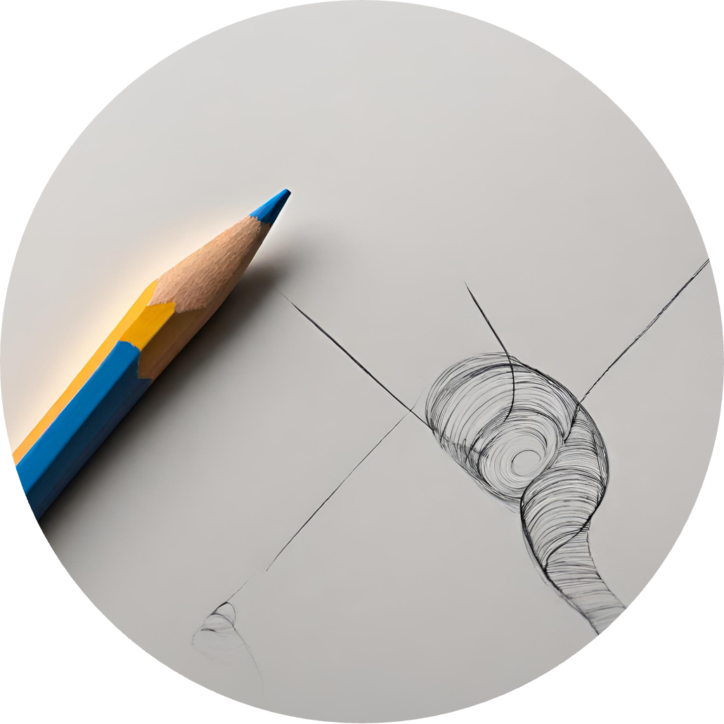
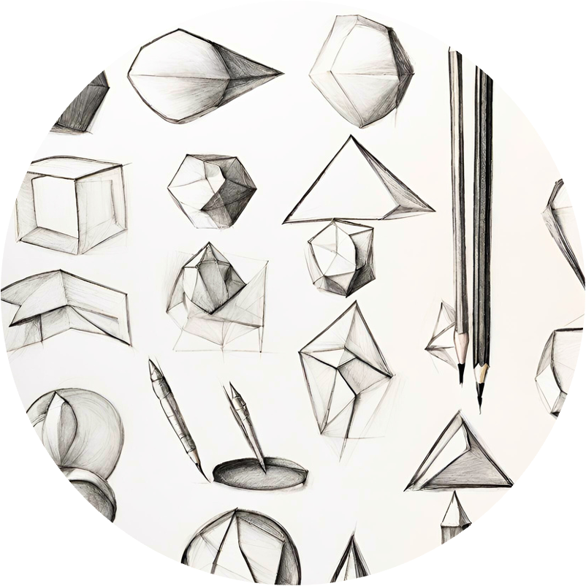

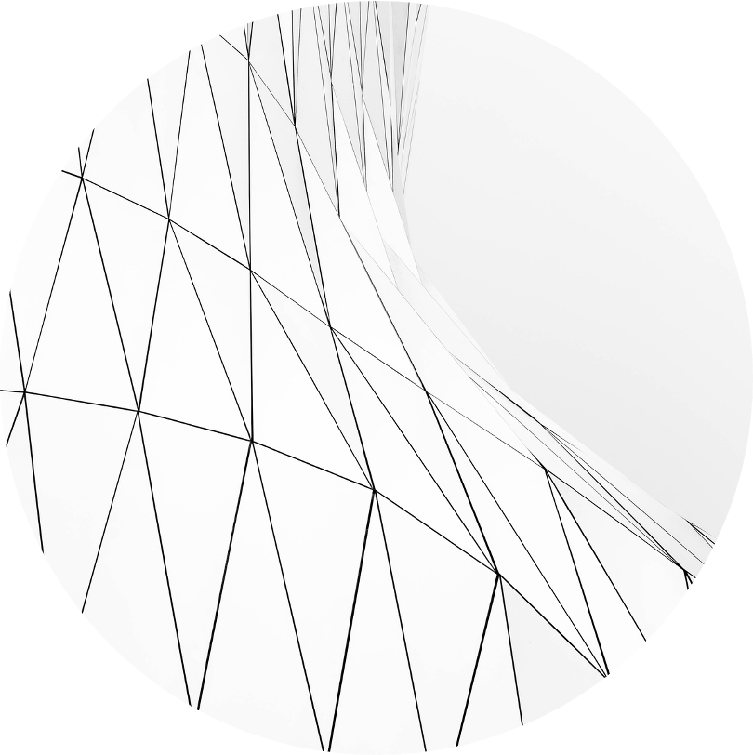

There are many different types of lines. These can be used to create different emotions.
LET’S RECAP!
Line and shape are two of the elements of art.
Repeated lines and shapes make patterns.

Slide 15
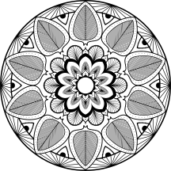




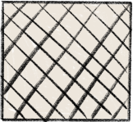
RESOURCE
PAGE
  Use these design resources
  in your Canva Presentation.
This presentation template
uses the following free fonts:
Titles: Londrina Solid
Headers: Nunito Sans
Body Copy: Nunito Sans
You can find these fonts
online too. Happy designing!
Don't forget to delete this
page before presenting.

Slide 16


CREDITS
  This presentation template is free for
  everyone to use thanks to the following:
SLIDESCARNIVAL
  for the presentation template
PEXELS
  for the photos

