Slide 1



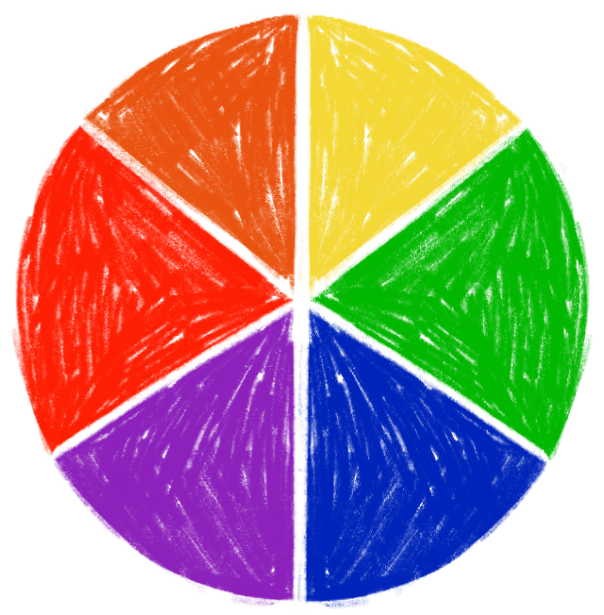

INTRODUCTION
TO COLOR THEORY
Color is one of the Elements of Art

Slide 2

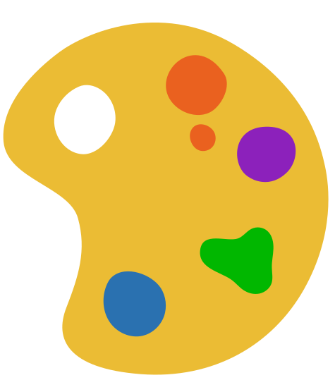
01
The Color Wheel
02
Primary, Secondary
and Tertiary Colors
LESSON
OUTLINE
03
Warm and Cool Colors
04
Hue, value and saturation
05
Color Wheel, Who Am I?

Slide 3




TODAY, WE ARE LEARNING TO:
01
02
03
Organize and develop artistic ideas and work
Learn how the color wheel works
Identify and name different color groups

Slide 4
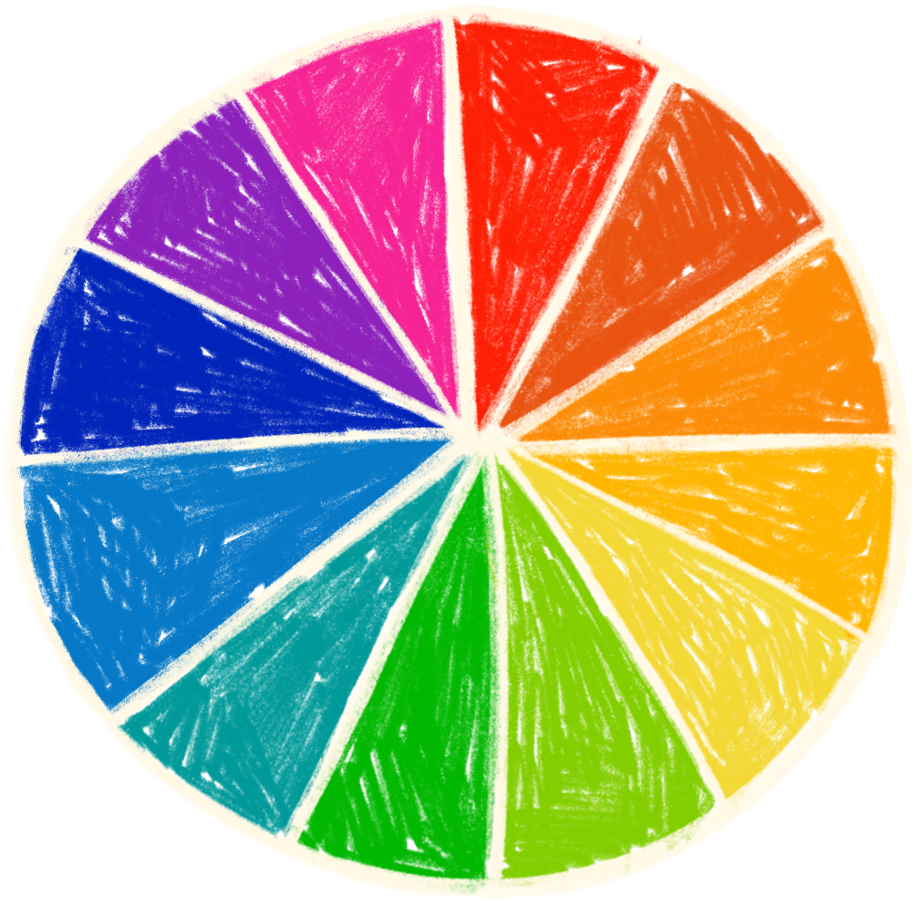
THE COLOR WHEEL
  It shows the connection between colors and organizes these colors into groups.
  Did you know? Another word for color is ‘hue.’ So in this color wheel, we can see many different hues!

Slide 5
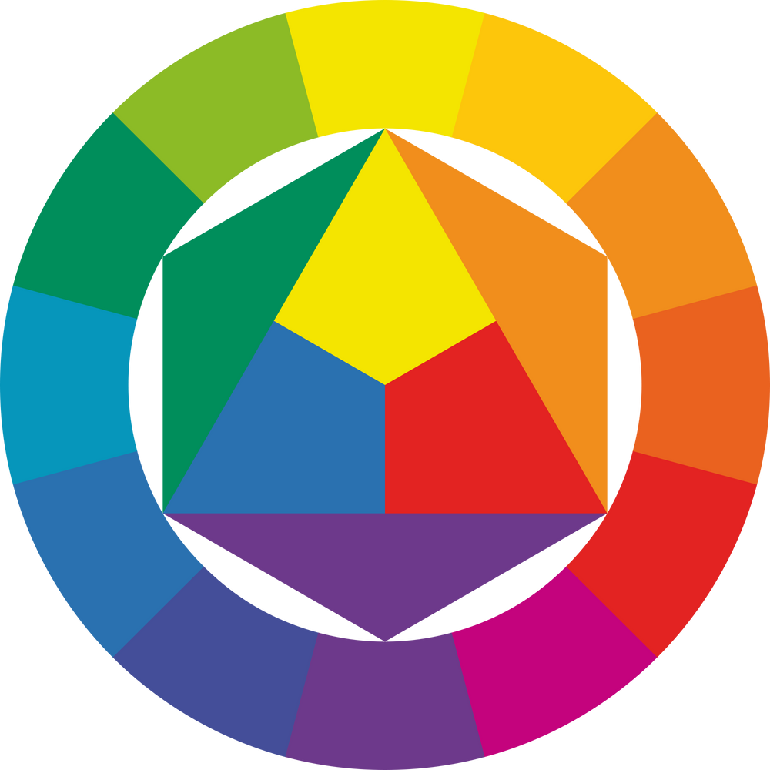



WE CAN SEE PRIMARY COLORS ON THE COLOR WHEEL.
YELLOW
BLUE
RED
RED
BLUE
YELLOW
You use these colors to make all other colors.

Slide 6




PRIMARY COLORS
BLUE
YELLOW
RED

Slide 7









WE CAN SEE SECONDARY COLORS ON THE COLOR WHEEL.
YELLOW
BLUE
RED
PURPLE
GREEN
ORANGE
The color wheel shows us which primary colors
mix to make a secondary color. For example,
  Can you see which colors make purple and orange?
BLUE
YELLOW
GREEN

Slide 8
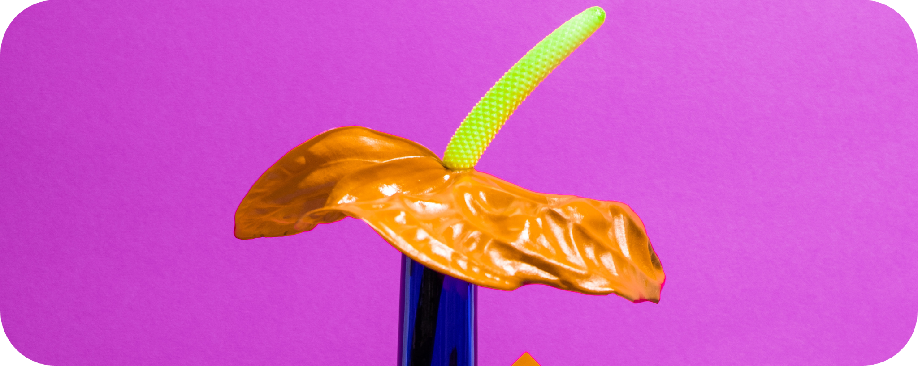
SECONDARY COLORS
GREEN
ORANGE
PURPLE

Slide 9









WE CAN SEE TERTIARY COLORS ON THE COLOR WHEEL.
green-yellow
yellow-orange
GREEN
-
YELLOW
YELLOW
-
ORANGE
RED
-
ORANGE
RED
-
PURPLE
PURPLE
-
BLUE
BLUE
-
GREEN
blue-green
red-orange
Tertiary colors are made by mixing
a primary color
and
a secondary color
purple-blue
red-purple
For example,
Yellow
Orange
Yellow-Orange

Slide 10
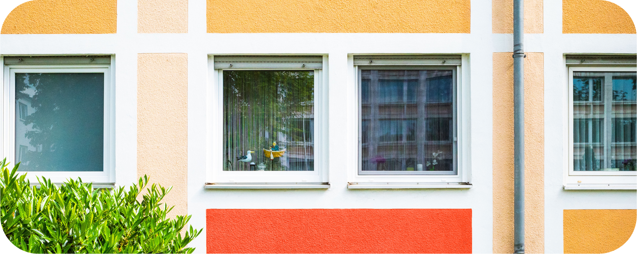
TERTIARY COLORS
YELLOW-ORANGE
RED-ORANGE

Slide 11















WARM & COOL COLORS
WARM COLORS
  Warm colors are red, yellow, and orange, and colors they are connected to in the color wheel.
Cool colors are blue, green and purple and
  colors they are connected to in the color wheel.
COOL COLORS

Slide 12


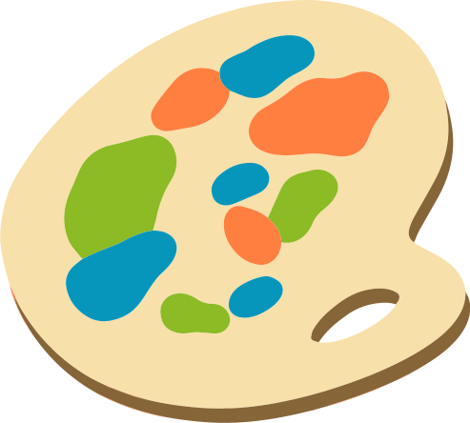



LET’S GET MIXING!

Slide 13
HUE, VALUE & SATURATION
These are the three components of color.
HUE
VALUE
SATURATION
  What is the color?
  How light or dark is the color?
  How strong or faded is the color?

Slide 14



COLOR WHEEL
WHO AM I?
green-yellow
yellow-orange
Choose a color from the wheel and create sentences
that hint at your color using the guiding sentences
below. Then, make your friend guess the color you chose!
green
yellow
orange
blue-green
red-orange
blue
red
  I am a warm / cool color.
Purple
  You make me by mixing .
purple-blue
red-purple
  I am used to create .
  I am a primary / secondary / tertiary color.

Slide 15






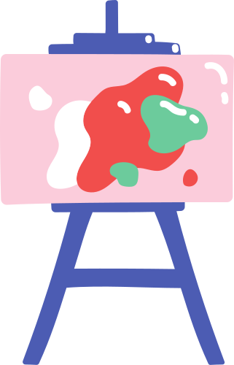


THANK YOU

Slide 16
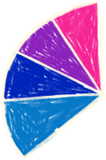
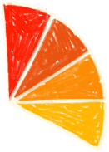
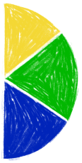
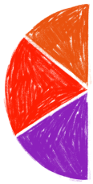
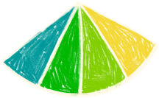

RESOURCE
PAGE
  Use these design resources
  in your Canva Presentation.
This presentation template
uses the following free fonts:
Titles: Lilita One
Headers: Lato
Body Copy: Lato
You can find these fonts
online too. Happy designing!
Don't forget to delete this
page before presenting.

Slide 17
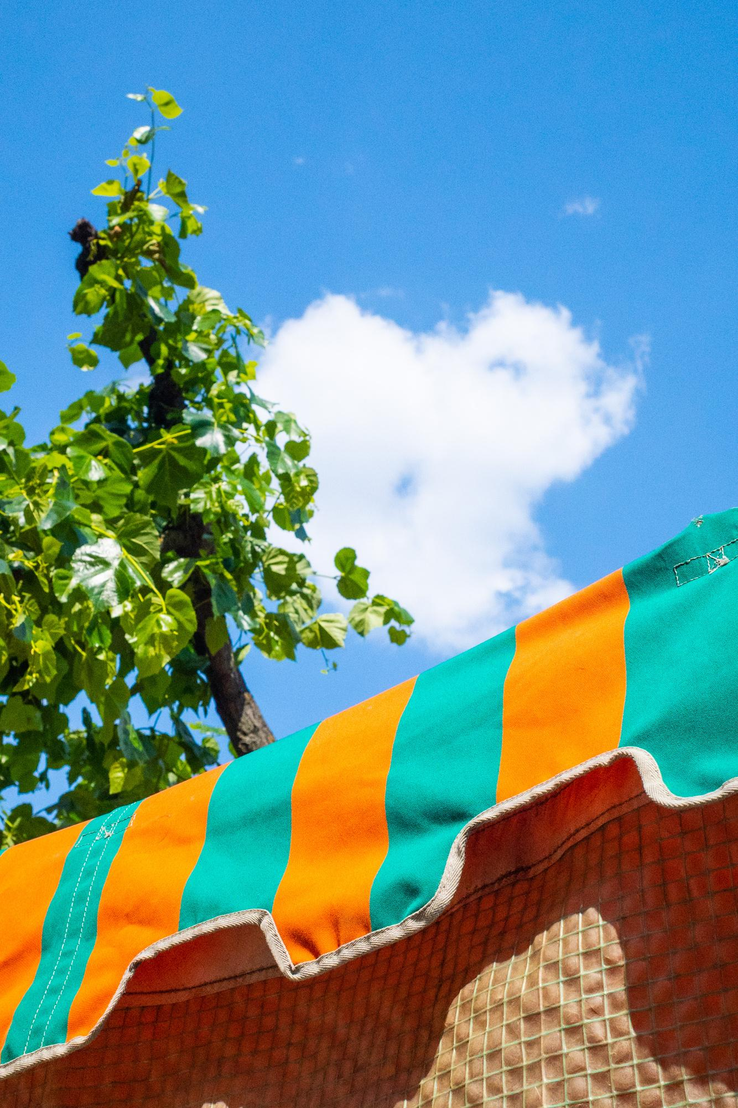

CREDITS
  This presentation template is free for everyone to use thanks to the following:
  SlidesCarnival
  for the presentation template
  Pexels
  for the photos

