Slide 1
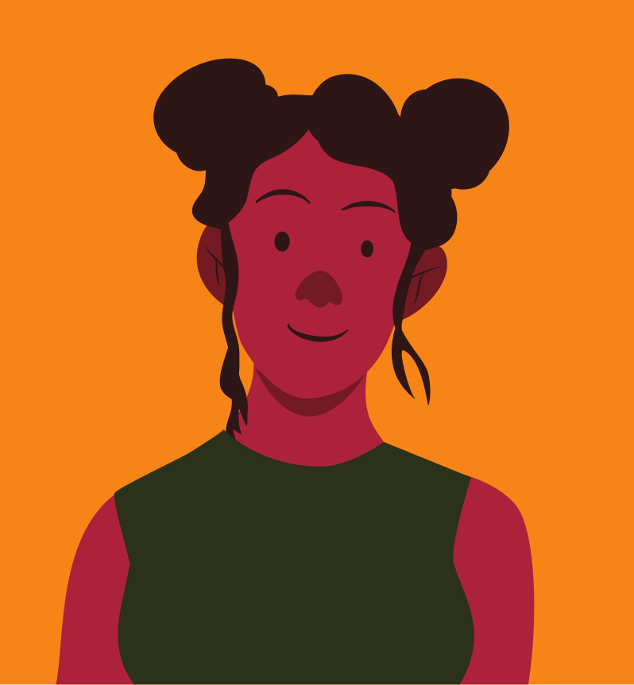
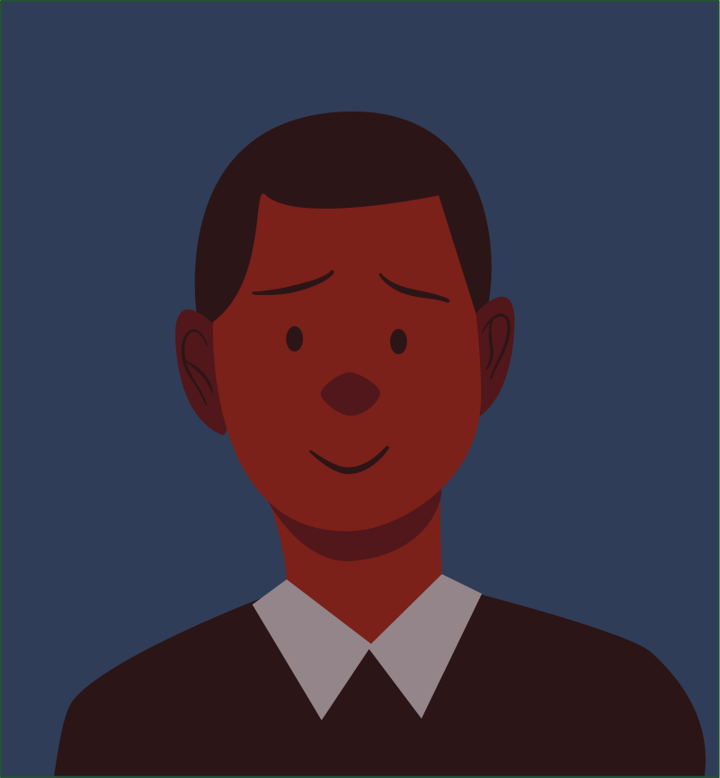
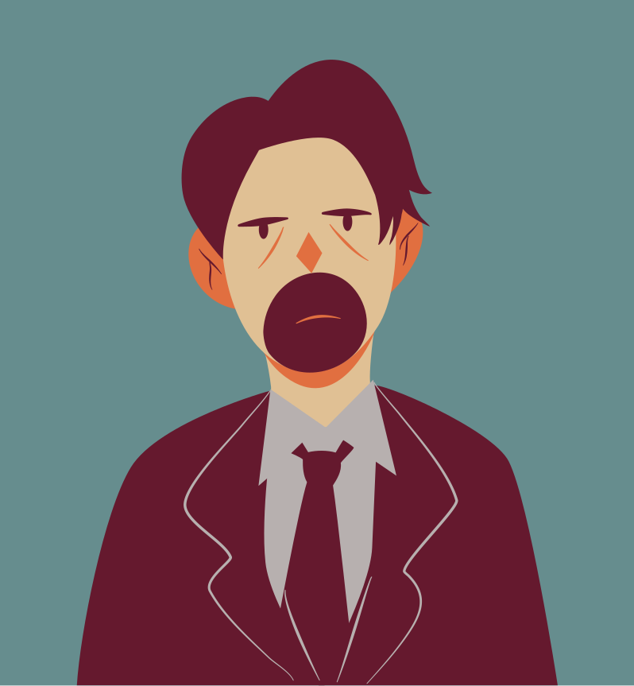

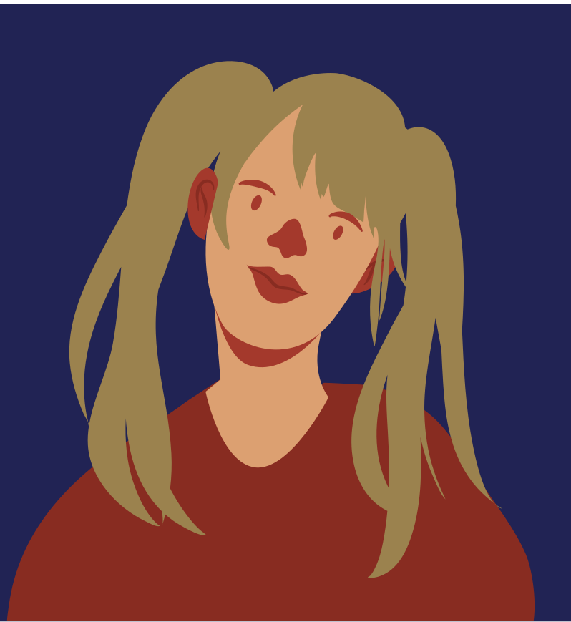
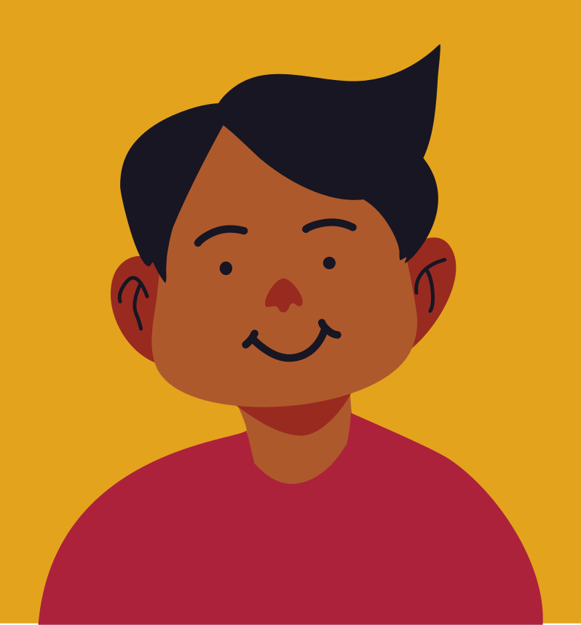
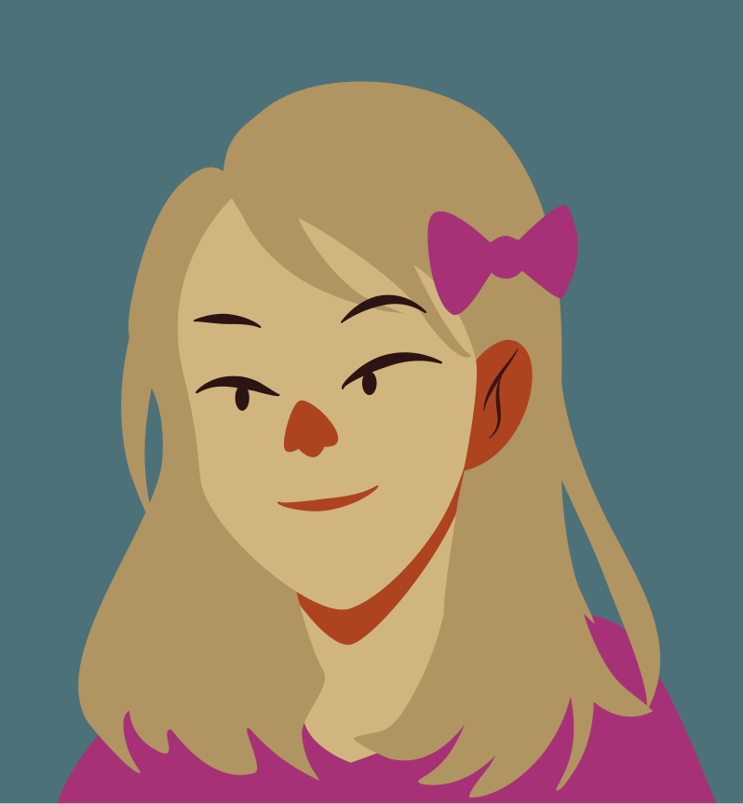
Self-Portraits:
IDENTITY AND SELF-EXPRESSION
How do artists use art to express themselves?

Slide 2


How to Use This Presentation
Google Slides
PowerPoint
Canva
Click on the "Google Slides" button below this presentation preview. Make sure to sign in to your Google account. Click on "Make a copy." Start editing your presentation.
Alternative: Click on the "Share" button on the top right corner in Canva and click on "More" at the bottom of the menu. Enter "Google Drive" in the search bar and click on the GDrive icon to add this design as a Google slide in your GDrive.
Click on the "PowerPoint" button below this presentation preview. Start editing your presentation.
Alternative: From Canva template file, Click on the "Share" button on the top right corner in Canva and click on "More" at the bottom of the menu. Enter "PowerPoint" in the search bar and click on the PowerPoint icon to download.
Click on the "Canva" button under this presentation preview. Start editing your presentation. You need to sign in to your Canva account.

Slide 3

Lesson Outline
Identity & Self-Expression
Reflect
Self-Portraits
Recap
Frida Kahlo
Your Turn!

Slide 4

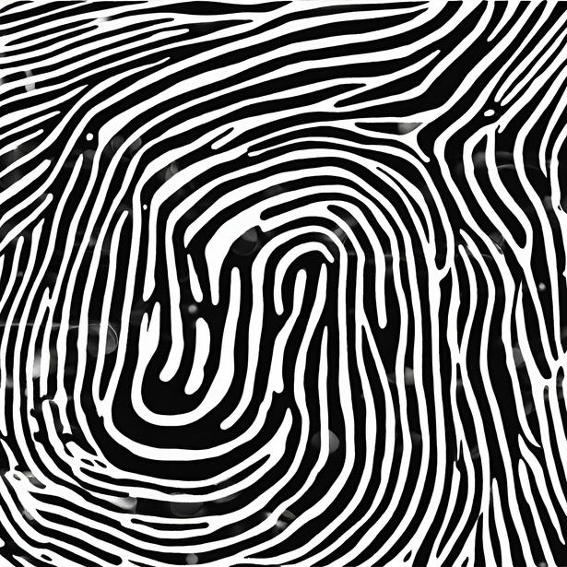

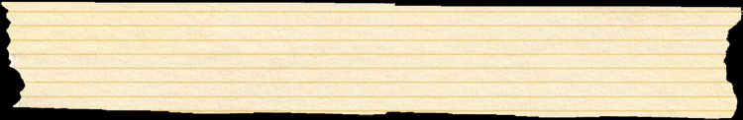
You and your identity
Your identity are the qualities that make up you!
What do you look like?
What do you like to do in your spare time?
What don't you like to do?
What is your cultural background?
What religious beliefs do you follow?
Fun fact
What is something that is unique about you?
Your fingerprint is a unique form of identity. No two people have the same fingerprint.

Slide 5
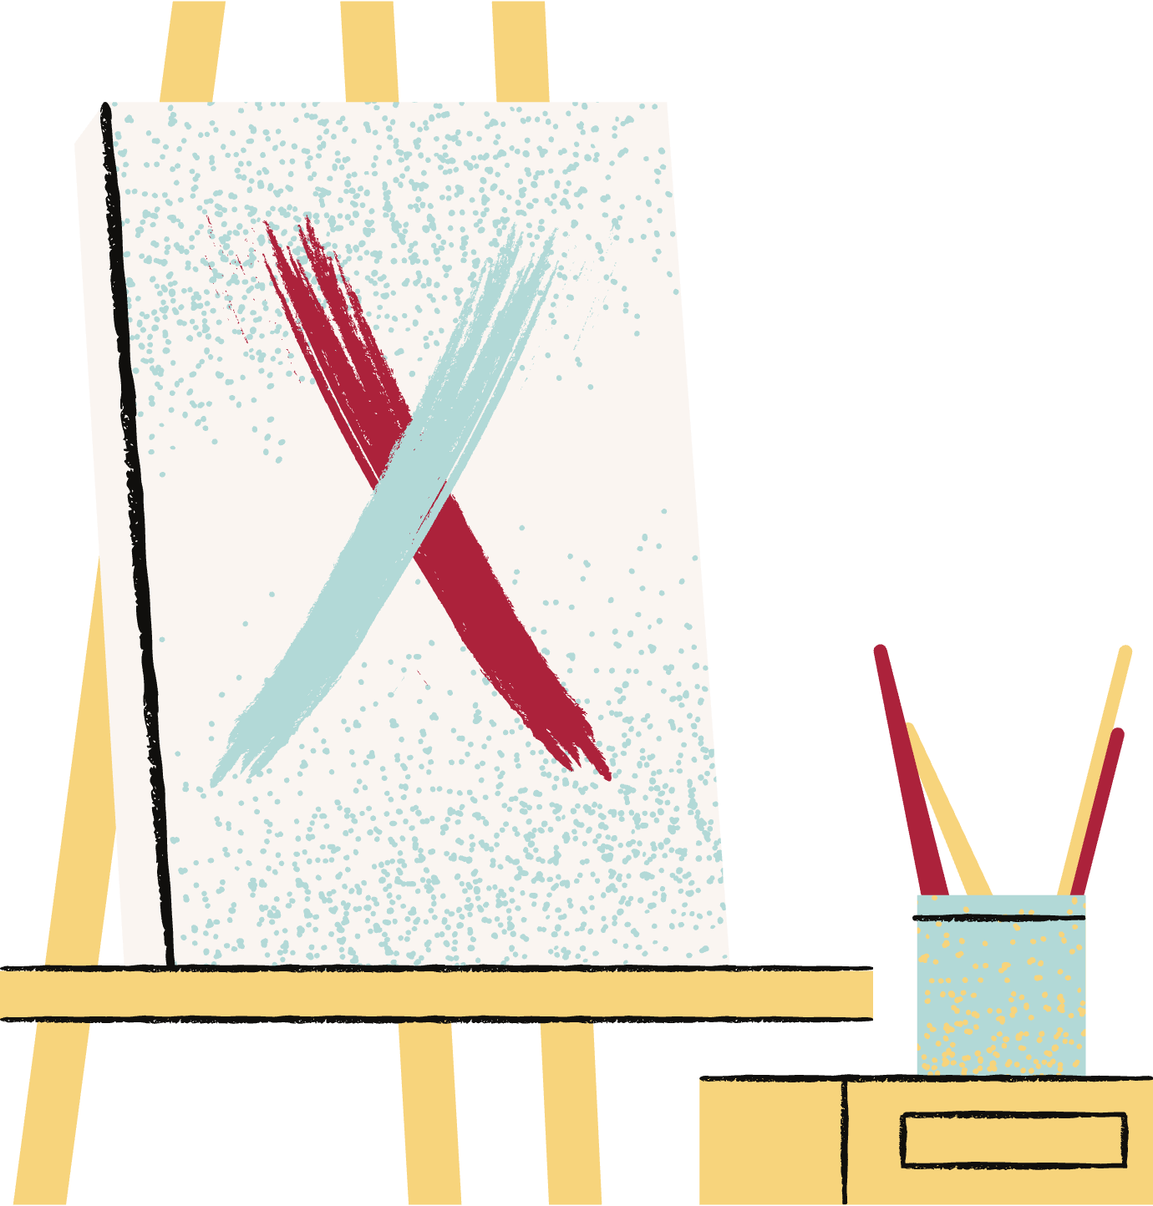
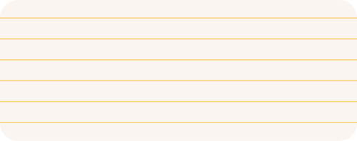
Learning Outcomes
By the end of this lesson, you should be able to:
01
Recognize the meaning of identity and self-expression
02
Analyze the use of identity and self expression in self-portraits

Slide 6

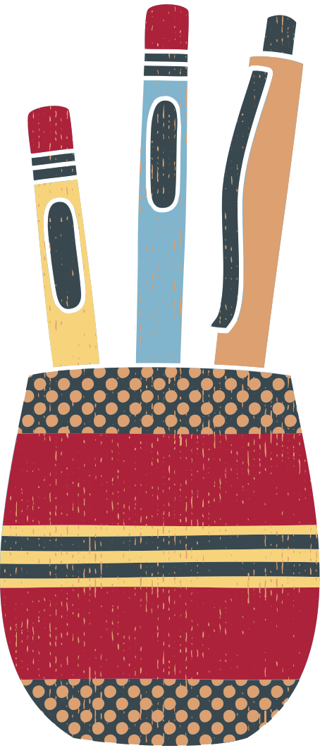
Identity &
Self-Expression
Artists use self-expression as a way to explore their personal thoughts and experiences.
These thoughts and experiences are what make up part of an artist's identity.

Slide 7

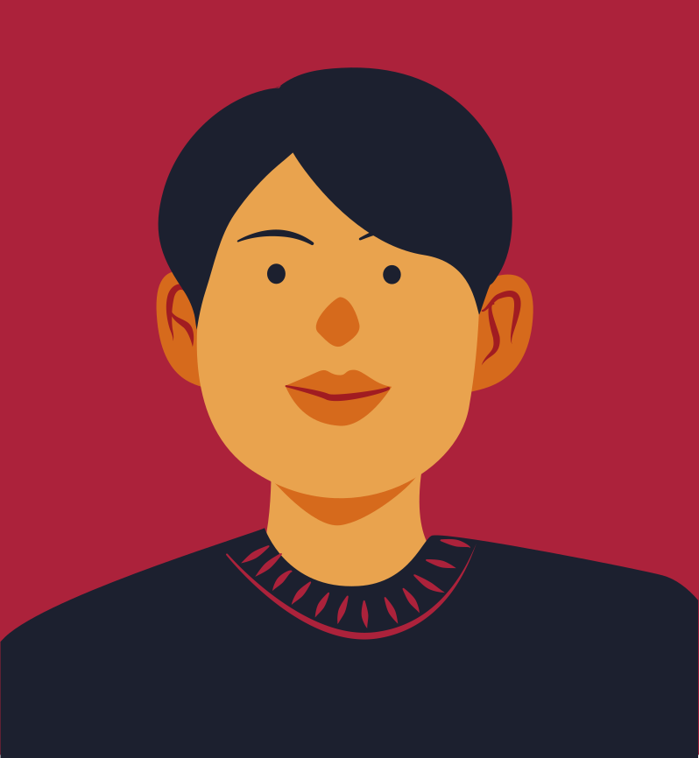
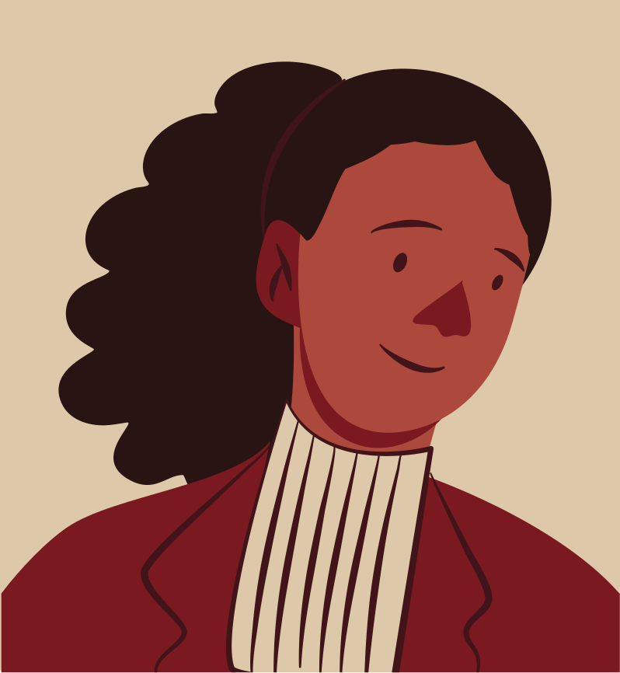
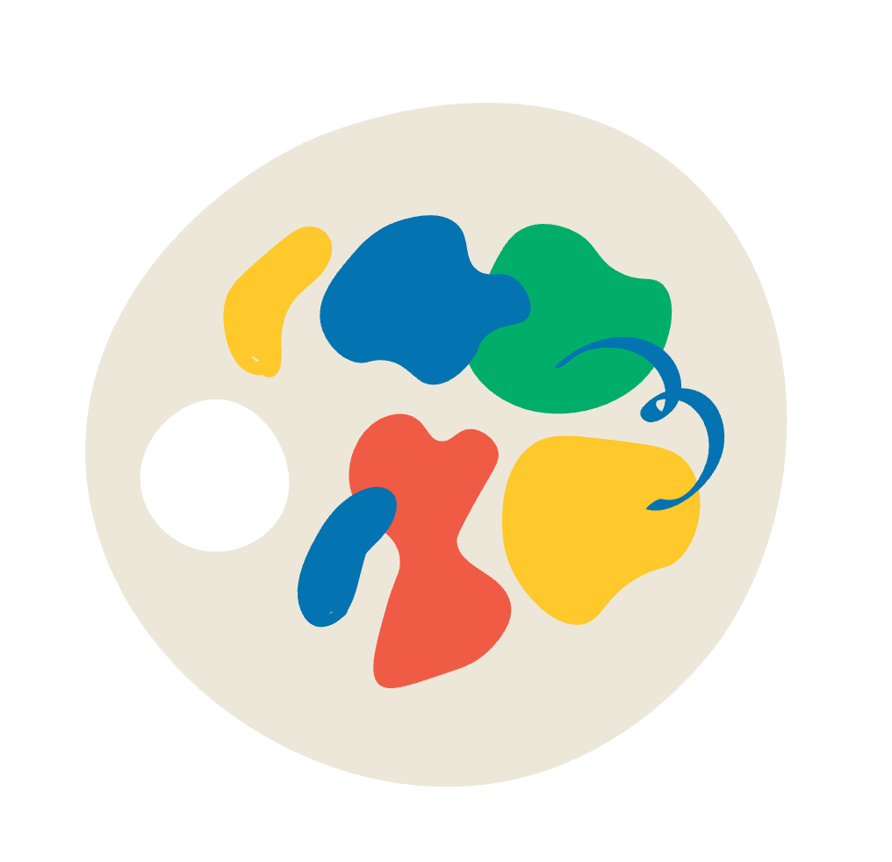
Self-Portraits
Artists who create art about their identity often do so in self-portraits. Self-portraits are paintings made by and about the artist.
Self-portraits may involve aspects of the artist's identity in the artwork. This may be an object or event from their life, cultural background or personal interests.

Slide 8

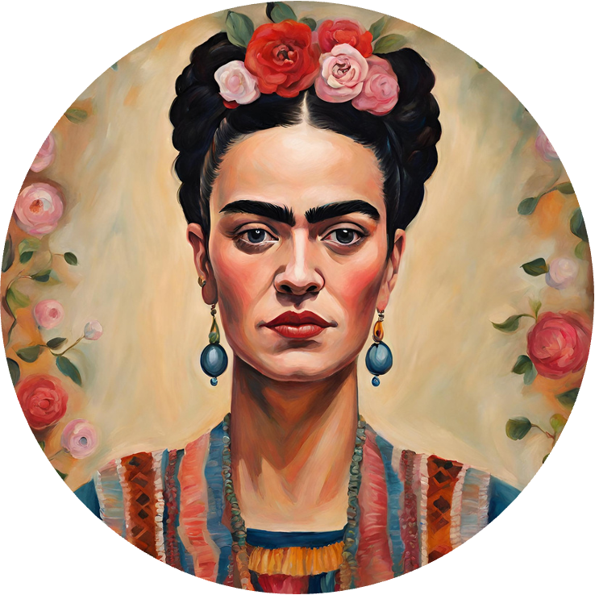

Where would the key events in
Frida Kahlo's life sit on the timeline?
Frida Kahlo
Meet Mexican artist Frida Kahlo. Spend some time researching and reading about her life online. How do the following details fit in her life's timeline?
Bus accident
Marriage to Diego Rivera
1925
1938
1954
Divorce from Diego Rivera
Birth
1907
1929
1939
First solo art exhibition
Death

Slide 9

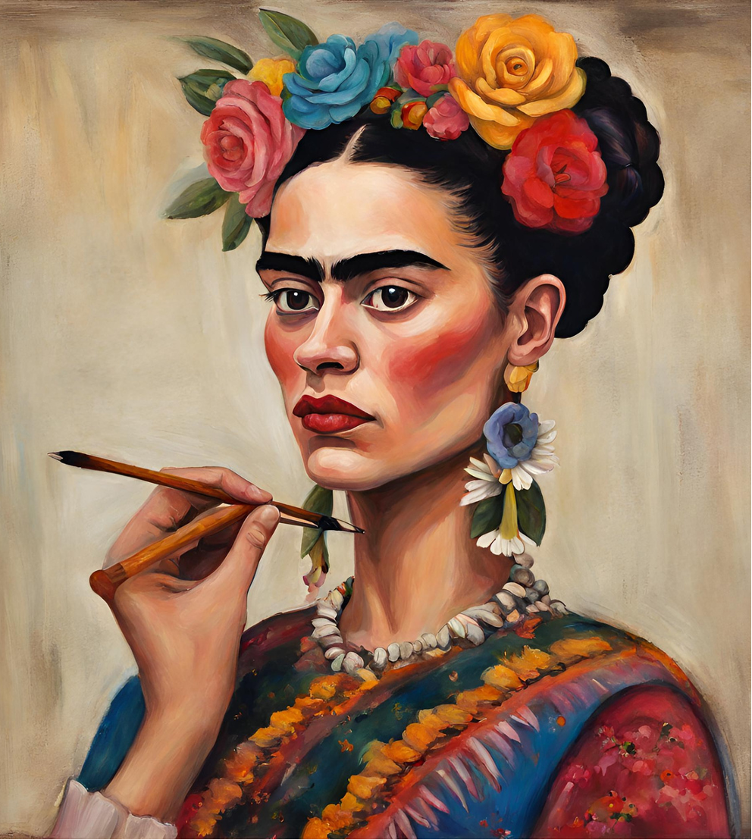

TEACHER TO ADD IMAGE OF FRIDA KAHLO'S 'THE TWO FRIDAS' IN THIS SPACE.
The Two Fridas
Aspects of Kahlo's life that influence her art:
  Her Mexican heritage
  The bus accident that left her with health struggles
  Her marriage and divorce to Diego Rivera
  - a famous artist
How does Kahlo express her identity in this artwork?
The Two Fridas, Frida Kahlo, 1939

Slide 10

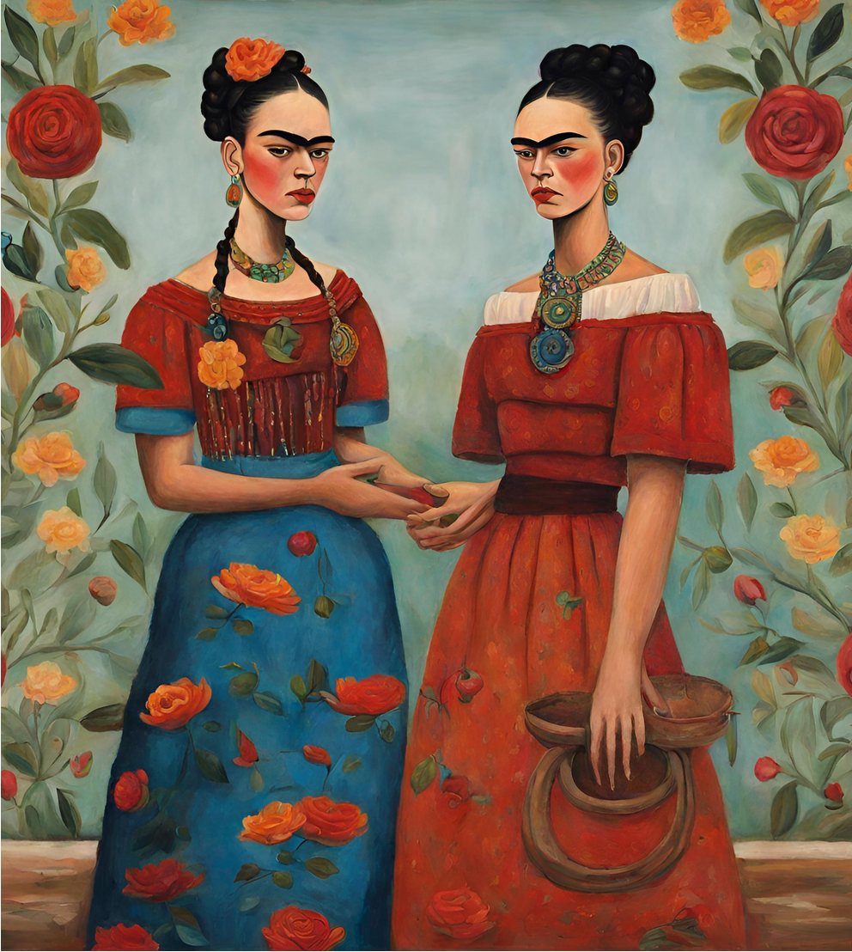
  TEACHING NOTE: ADD IMAGE OF THE ARTWORK HERE.
The Two Fridas
Kahlo expresses her identity through symbolism.
We see symbolism of her Mexican heritage in the Tehuana dress she is wearing.
We also visualize the pain she is feeling with the broken artery and heart. This could symbolize her health struggles or her marriage and then her divorce from Diego Rivera.
The Two Fridas, Frida Kahlo, 1939

Slide 11


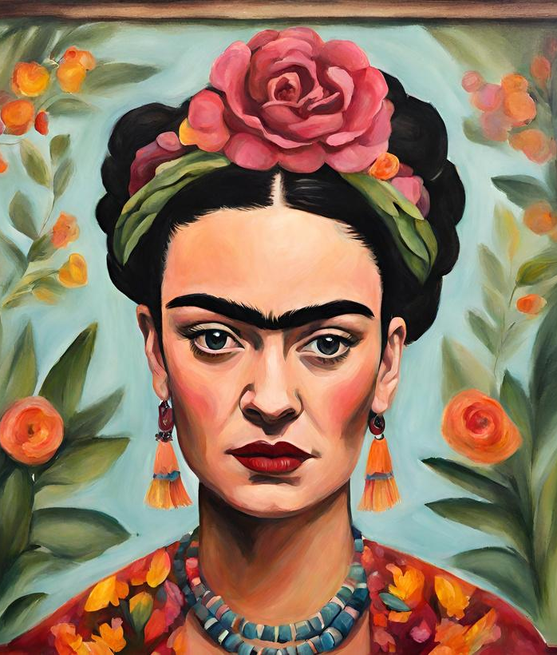
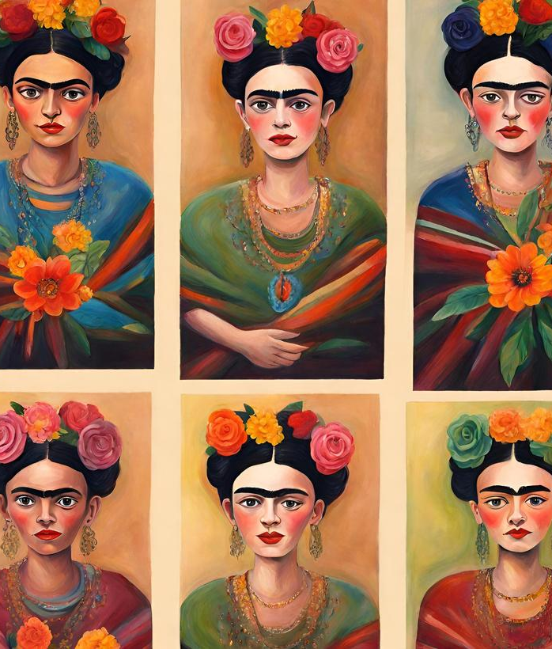
Other works by Kahlo
How is Kahlo's identity symbolized in these artworks?
TEACHING NOTE
  ADD IMAGE OF THE ARTWORK HERE.
TEACHING NOTE
  ADD IMAGE OF THE ARTWORK HERE.
"Self Portrait with Cropped Hair,"
Frida Kahlo, 1940
"Self Portrait with Cropped Hair,"
Frida Kahlo, 1940

Slide 12
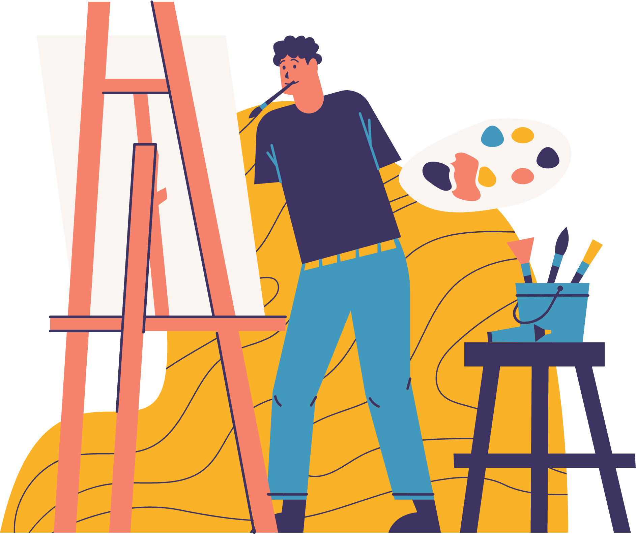
Reflect
  If you were to make a self-portrait, what would you add to it to reflect your identity?

Slide 13

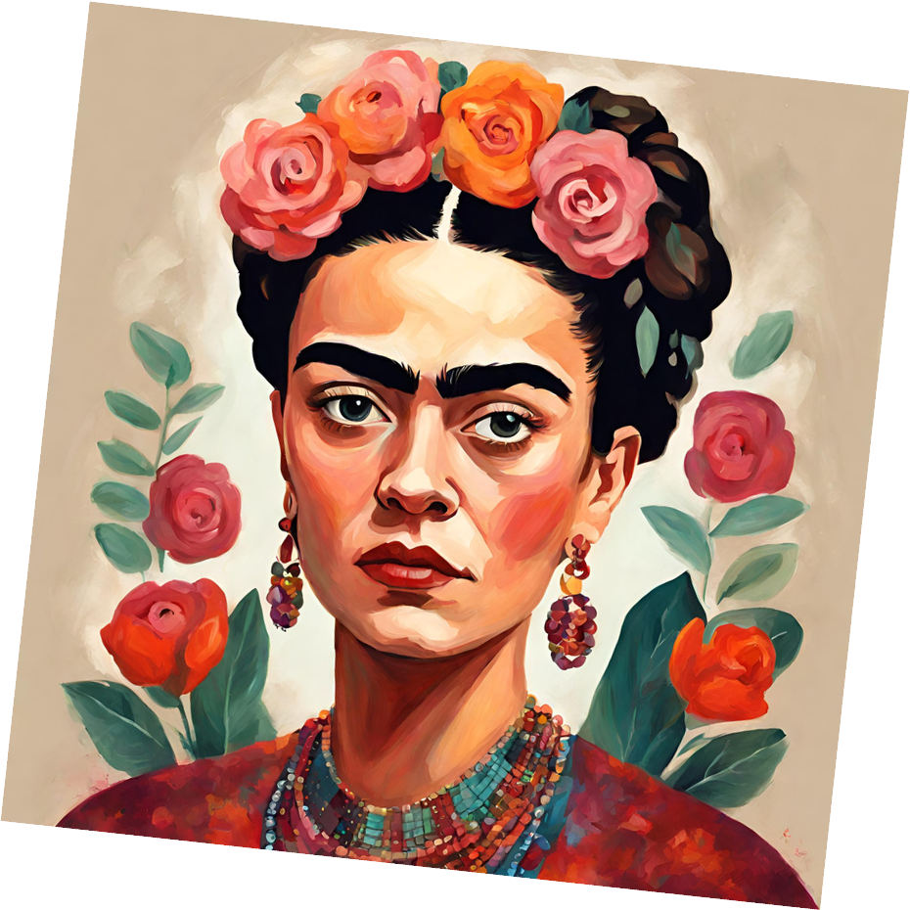


Recap
Self-Portraits
  Self-portraits are artworks that are artists' depictions of themselves.
Identity &
Self-Expression
  Self-expression is a way to explore personal thoughts and experiences in art.
  These thoughts and experiences are what make up your identity.
Frida Kahlo
  Kahlo was a Mexican artist who used symbolism to reflect aspects of her identity in her self-portraits.

Slide 14
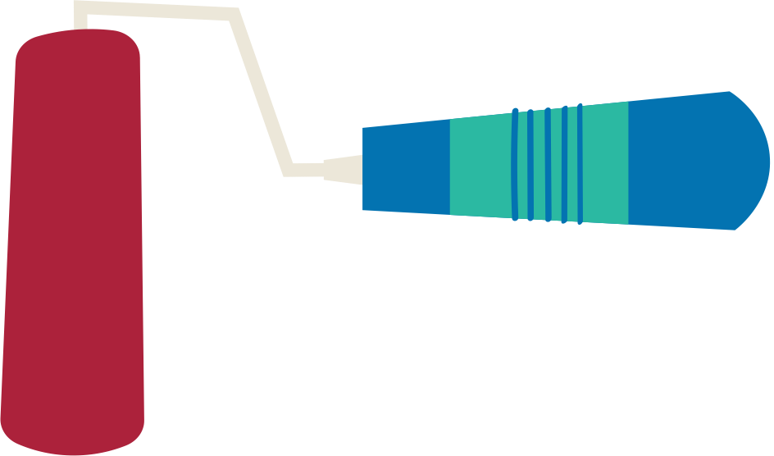

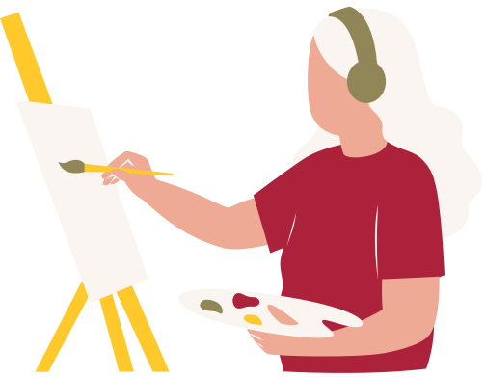

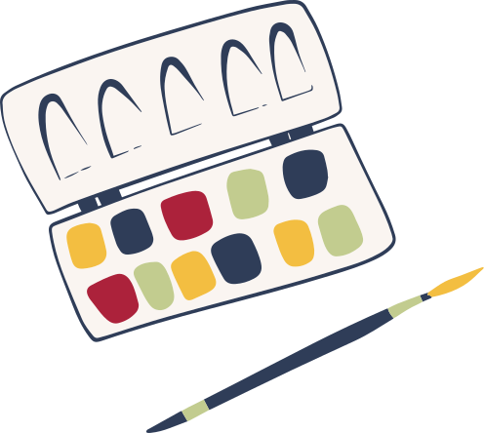
Your Turn!
  Express yourself! Try these activities to learn more about expressing your identity in art.
  Plan and create your own self-portrait to reflect your own identity.
  Create a group collage portrait to represent your group's identity and self-expression.

Slide 15
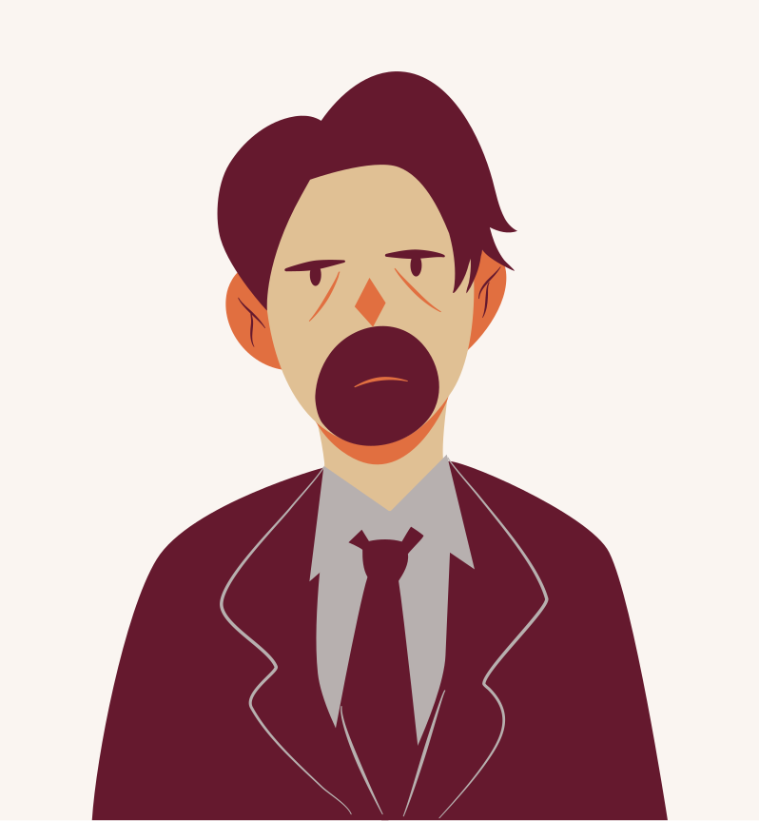







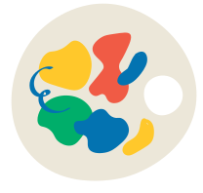

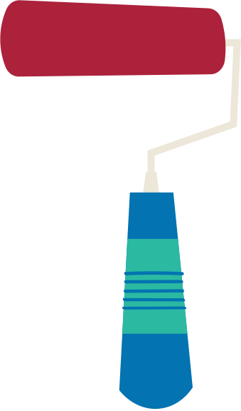









Resource
Page
  Use these design resources
  in your Canva Presentation.
This presentation template
uses the following free fonts:
Titles: Pacifico
Headers: Poppins
Body Copy: Poppins
You can find these fonts
online too. Happy designing!
Don't forget to delete this
page before presenting.

Slide 16
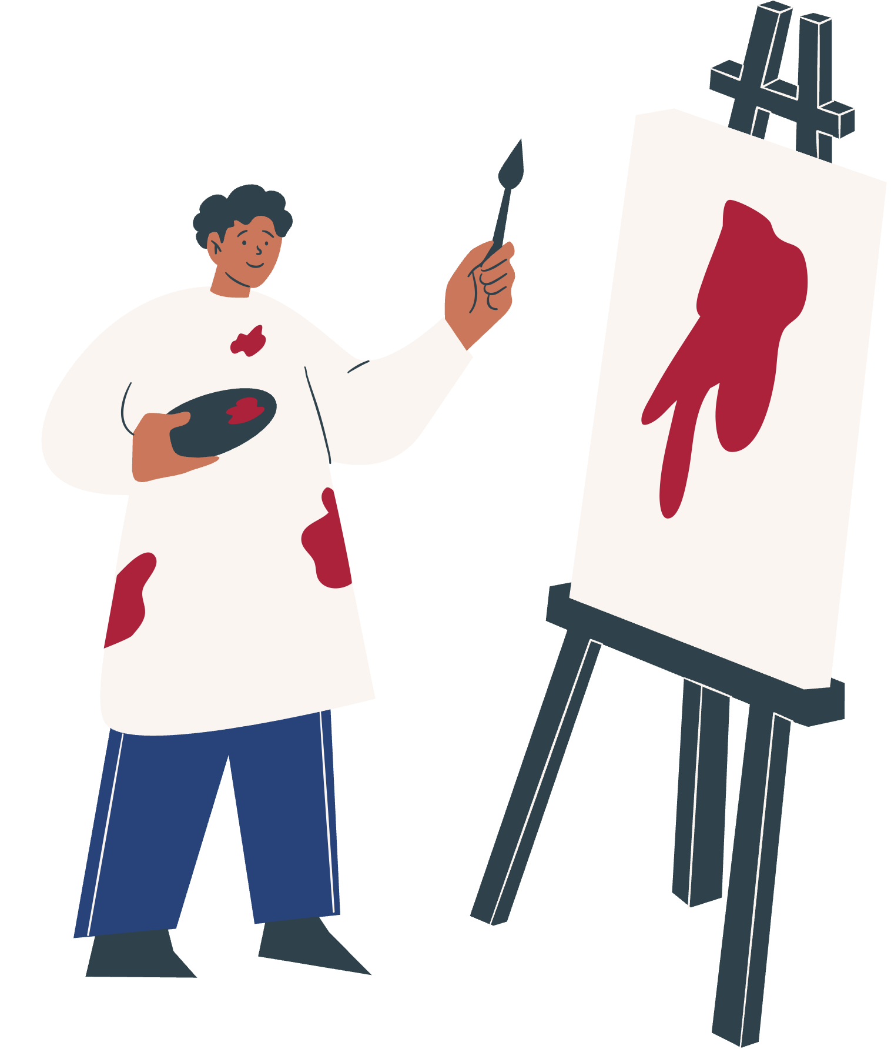

Credits
  This presentation template is free for everyone to use thanks to the following:
SlidesCarnival
  for the presentation template
Pexels
  for the photos

