Slide 1





BACK TO SCHOOL
ORIENTATION
WEEK
SEPT 9-11 2024

Slide 2


WELCOME
STUDENTS!
This week is designed to help you transition smoothly into the new school year.
Whether you're a returning student or new to our school, we're excited to have you join our community.

Slide 3



MEET YOUR LEADERS

Slide 4


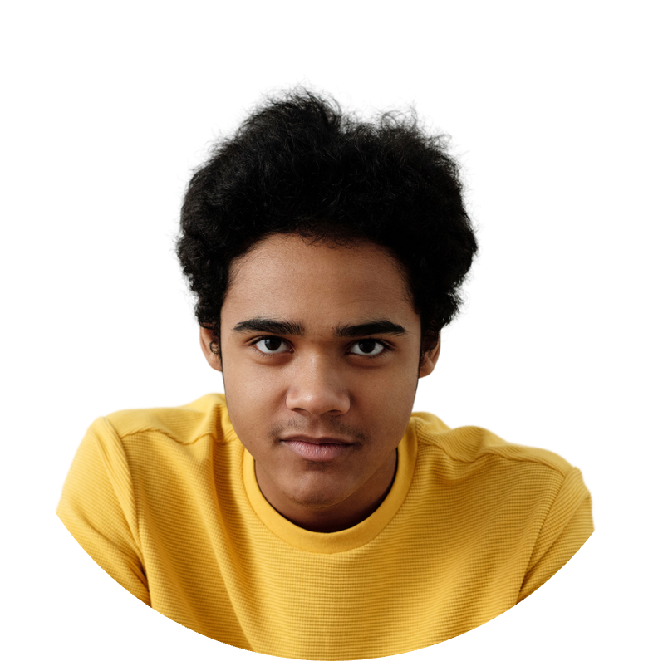
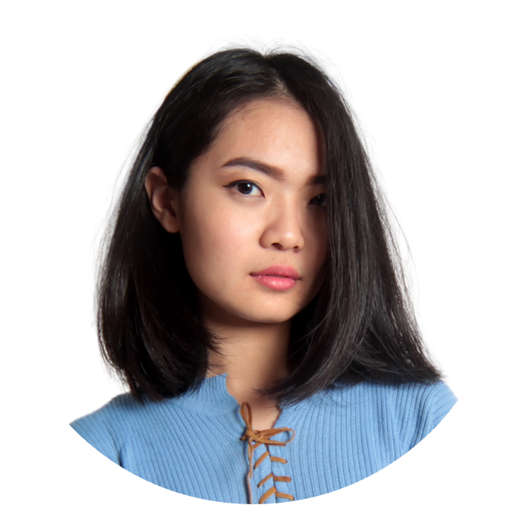



YOUR LEADERS
JOHN DOE
Title/Position
JANE DOE
Title/Position
JANE DOE
Title/Position

Slide 5


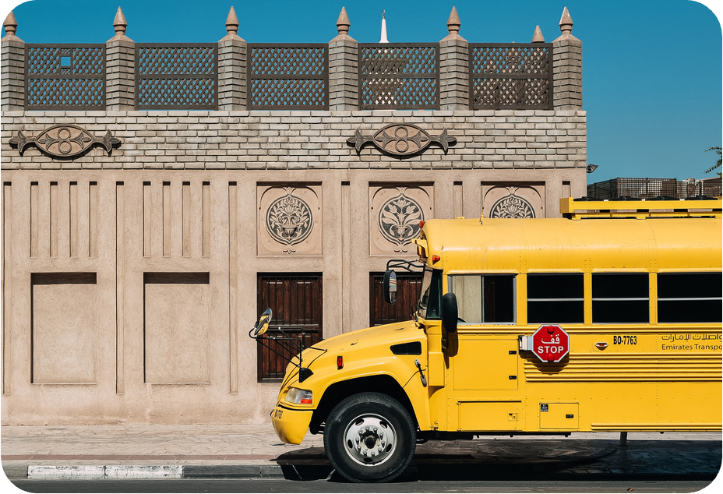



SCHOOL TOURS
Get to know the ins and outs of Maplewood High School with our guided campus tours. Explore classrooms, facilities, and meet some of our staff members along the way.

Slide 6


Monday, August 26
9:00 AM - 10:30 AM | Orientation Assembly
11:00 AM - 1:00 PM | Campus Tours
SCHEDULE
OF EVENTS
Tuesday, August 27
9:00 AM - 10:30 AM | Meet Your Teachers Sessions
11:00 AM - 1:00 PM | Club Fair in the Gym
Wednesday, August 28
10:00 AM - 12:00 PM | Student Support Services Fair
1:00 PM - 2:30 PM | Icebreaker Games

Slide 7



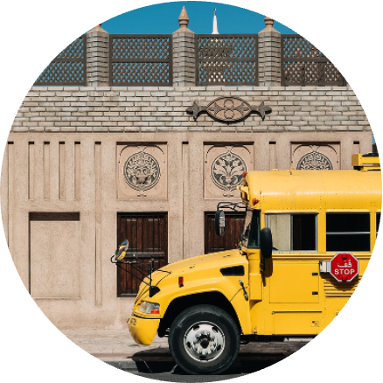



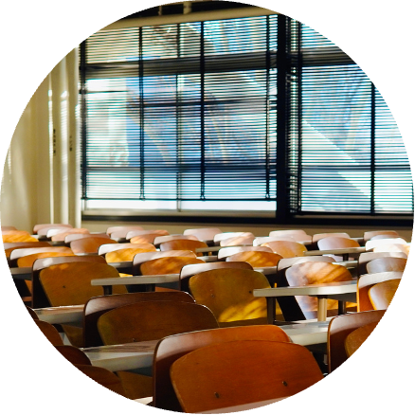
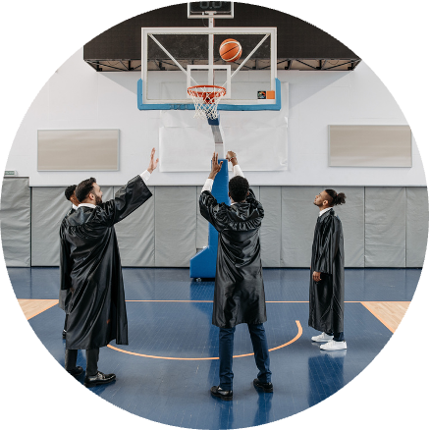

MAP & FACILITIES

Slide 8



TIPS FOR STUDENTS
GET PLENTY OF REST
GET INVOLVED
Use a planner or digital calendar to keep track of assignments, deadlines, and extracurricular activities.
Make sure to get enough sleep each night to stay focused and energized during the school day.
STAY ORGANIZED
Take advantage of clubs, sports teams, and other opportunities to get involved in our school community.

Slide 9


DAY ONE
We're excited to start a week-long event introducing you to our school community and preparing you for the upcoming academic year. Participate in activities, meet students and staff, and learn about available resources for your success.

Slide 10

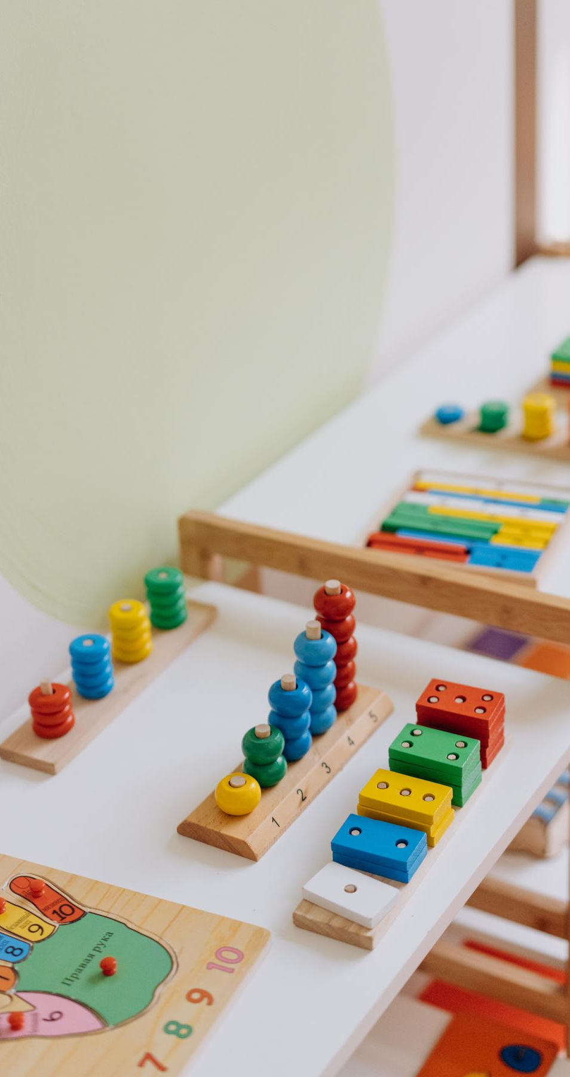
DAY TWO
We're excited to start a week-long event introducing you to our school community and preparing you for the upcoming academic year. Participate in activities, meet students and staff, and learn about available resources for your success.

Slide 11


DAY THREE
We're excited to start a week-long event introducing you to our school community and preparing you for the upcoming academic year. Participate in activities, meet students and staff, and learn about available resources for your success.

Slide 12


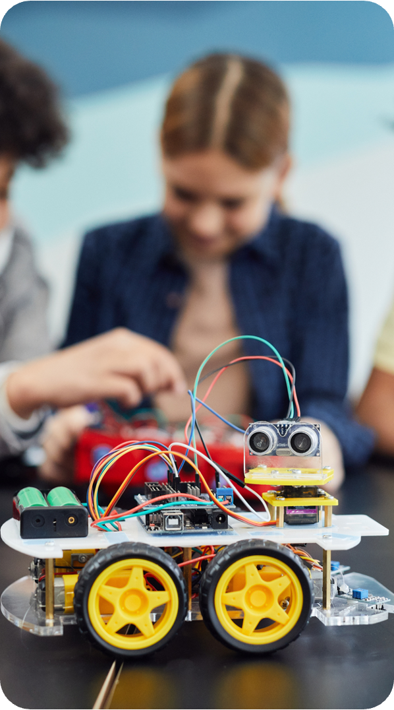
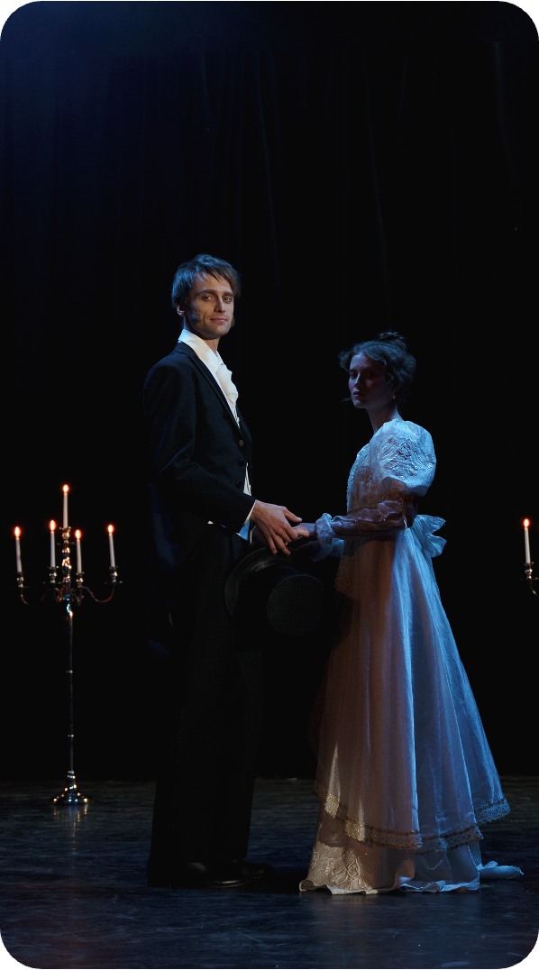


CLUBS & ORGANIZATIONS
Chess Club
Robotics Team
Drama Club
Debate Team

Slide 13


ANY QUESTIONS?

Slide 14




STUDENT SUPPORT SERVICES
Academic Advising
Counseling Services
Need help planning your course schedule or setting academic goals? Our academic advisors are here to assist you.
Our counseling team provides confidential support for students facing personal, academic, or social challenges.

Slide 15




THANK
YOU
If you have any questions or need further assistance, please don't hesitate to contact us.

Slide 16








RESOURCE PAGE
Use these design resources in your Canva Presentation.
  FONTS
This presentation template
uses the following free fonts:
Titles
Headers
Body Copy
Concert One
Montserrat
Montserrat
You can find these fonts online too.
  Colors
#F2B1DF
#F54C2E
#59BBD6
#F47760
#F5F5F5
#226F43

Slide 17











RESOURCE PAGE
Use these design resources in your Canva Presentation.

Slide 18


CREDITS
This presentation template is free for
everyone to use thanks to the following:
for the presentation template
Pexels & Pixabay
for the photos

