Slide 1


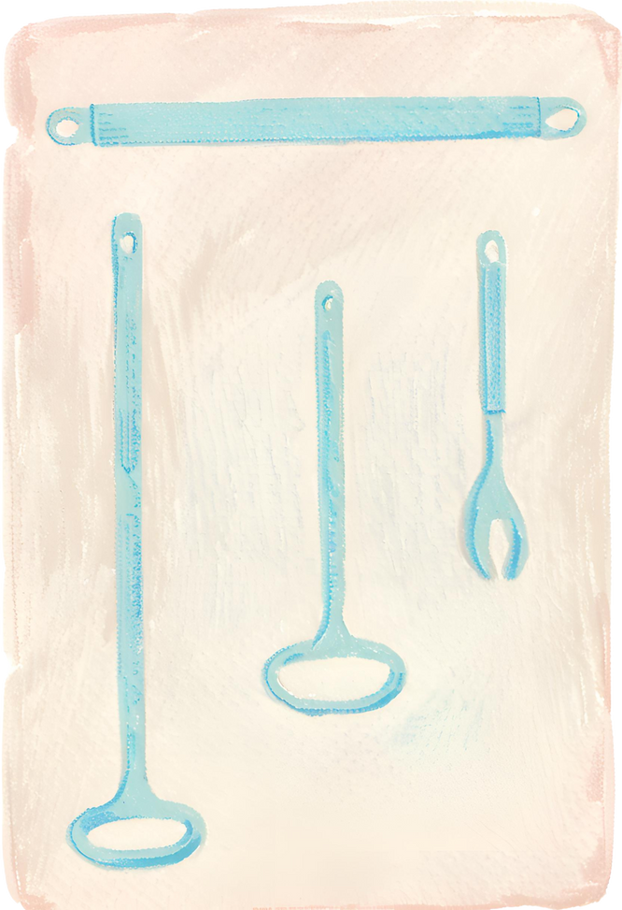

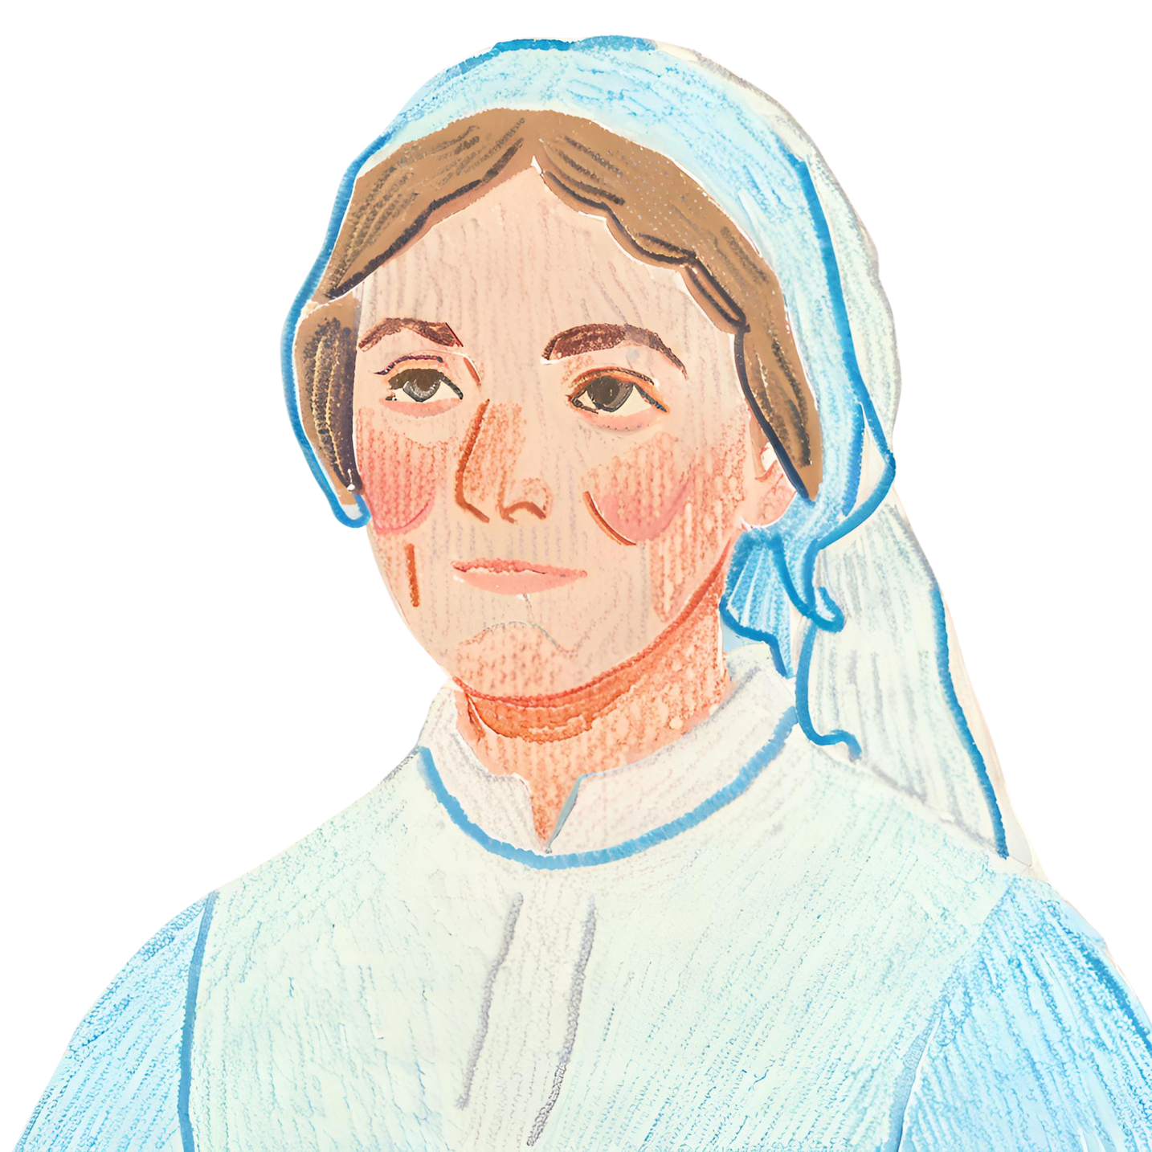
Florence
Nightingale
A Pioneer in Nursing
and Healthcare Reform

Slide 2
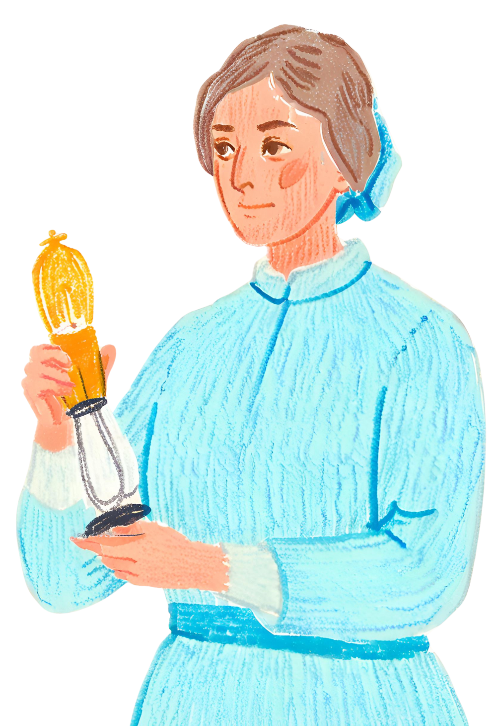
Introduction
Florence Nightingale, known as "The Lady with the Lamp," revolutionized the field of nursing and established the foundations of modern healthcare. Born into a wealthy family, she chose a path of service and dedication to the sick and wounded, transforming nursing into a respected profession. This presentation will explore her life, achievements, and lasting legacy.

Slide 3


Nightingale's childhood home
Florence Nightingale was born on May 12, 1820, in Florence, Italy. She was the second of two daughters in a wealthy and well-connected British family. From a young age, Nightingale displayed a keen interest in caring for others, often tending to the sick and injured animals on the family estate. Her upbringing was marked by a strong emphasis on education, and she excelled in subjects such as mathematics, science, and languages.
Florence, Italy

Slide 4
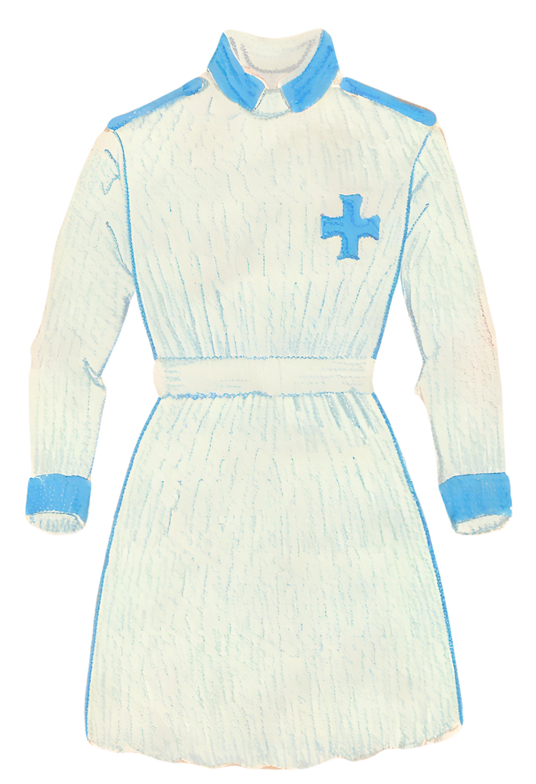
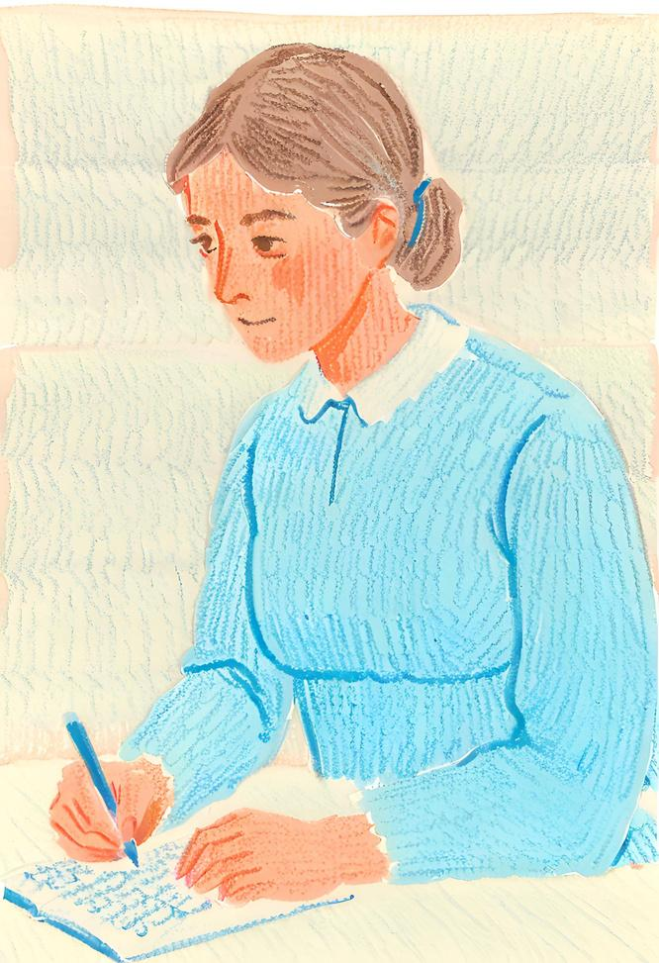
Calling to Nursing
Despite societal expectations for women of her status, Florence felt a divine calling to pursue nursing. In 1844, she defied her family’s wishes and enrolled in a nursing program in Kaiserswerth, Germany. This decision marked the beginning of her lifelong commitment to healthcare. Her experiences there, including exposure to the rigors of patient care and hospital administration, solidified her resolve to reform the healthcare system.

Slide 5
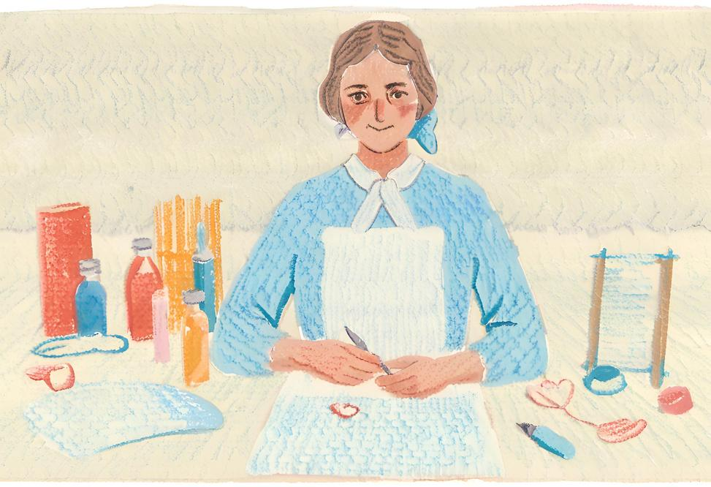
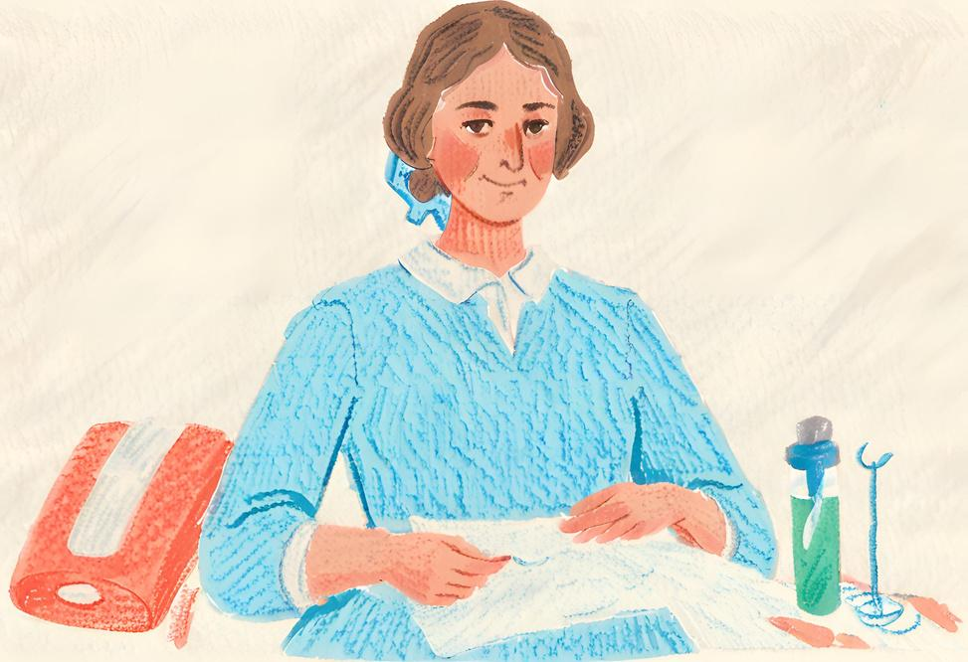
Early Career
Upon returning to England, Nightingale worked as a superintendent at the Institute for the Care of Sick Gentlewomen in London. Her innovative approaches to patient care and hospital management began to draw attention.
She introduced sanitation practices that significantly reduced infection rates and advocated for improved conditions for both patients and staff. Her early career laid the groundwork for the pivotal role she would play during the Crimean War.

Slide 6
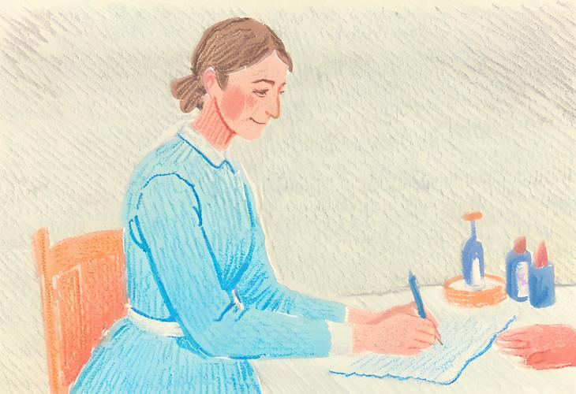
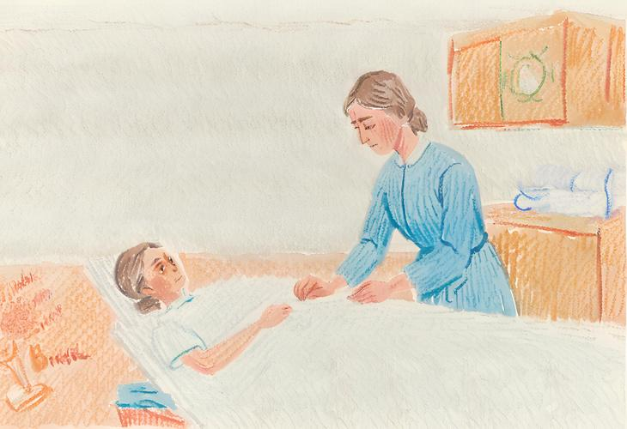
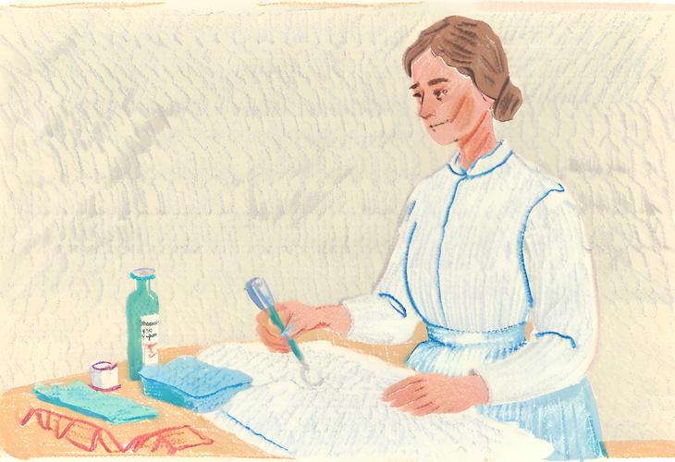
Institute for the Care of Sick Gentlewomen
Innovative Approaches to Patient Care
Introduction of Sanitation Practices
Briefly elaborate on
what you want to discuss.
Briefly elaborate on
what you want to discuss.
Briefly elaborate on
what you want to discuss.

Slide 7
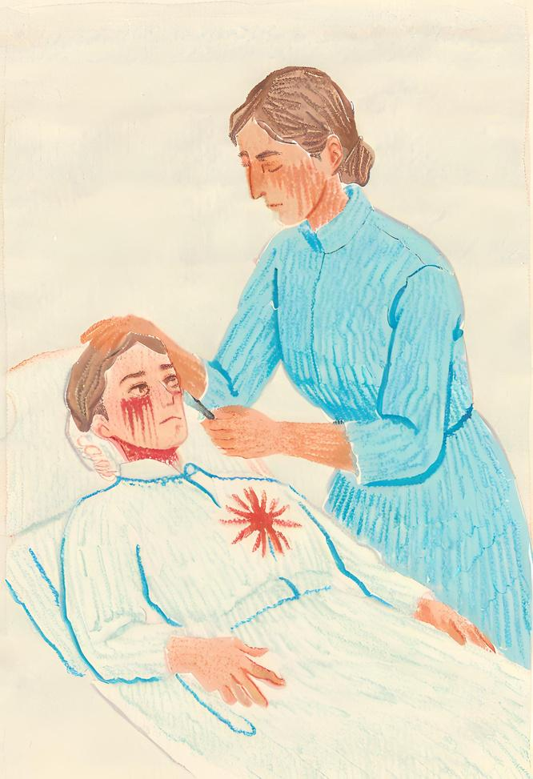
Call to Serve in the Crimean War
Nightingale's most famous contribution came during the Crimean War, where she and a team of nurses were called to assist in British military hospitals.
Impact on Military Healthcare
Her efforts revolutionized military healthcare, drastically reducing mortality rates through improved sanitation and nursing practices
Legacy of Service and Compassion
Nightingale's dedication and compassion towards wounded soldiers earned her the nickname "The Lady with the Lamp" and cemented her status as a pioneer in nursing.
Crimean War

Slide 8
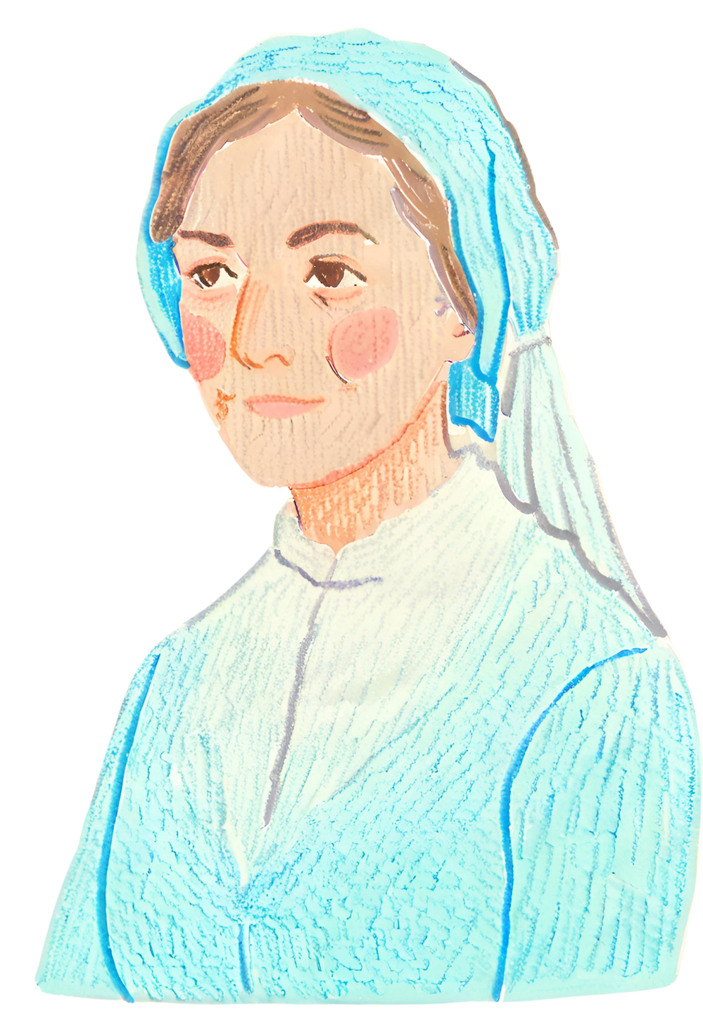
Post-War Advocacy
Continued Advocacy for
Healthcare Reform
Following the Crimean War, Nightingale continued her advocacy for healthcare reform, focusing on improving sanitation and hospital conditions. Her tireless efforts were instrumental in raising awareness about the importance of hygiene and implementing reforms to enhance patient care standards across the healthcare system.

Slide 9
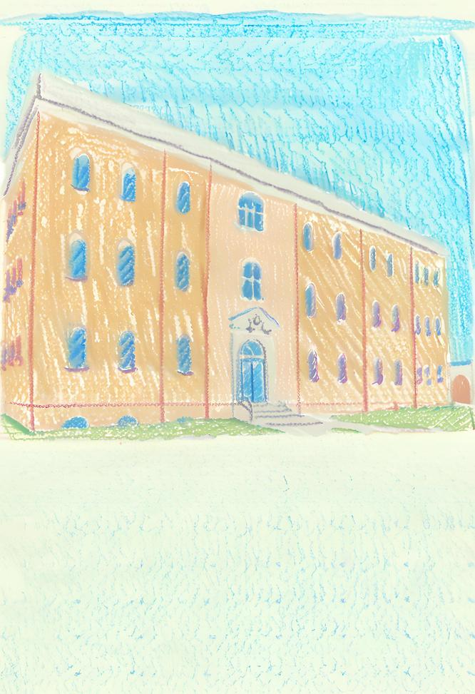
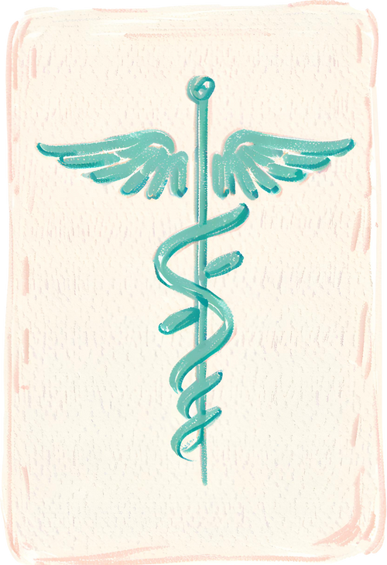
Nightingale
Training School
In a significant milestone for nursing education, Nightingale founded the Nightingale Training School for Nurses at St. Thomas' Hospital in London. This pioneering institution set new standards for nursing education and professional development, emphasizing rigorous training and compassionate care. The establishment of the school marked a pivotal moment in the history of nursing, shaping the future of the profession and ensuring a legacy of excellence in patient care.
St. Thomas'
Hospital in London

Slide 10
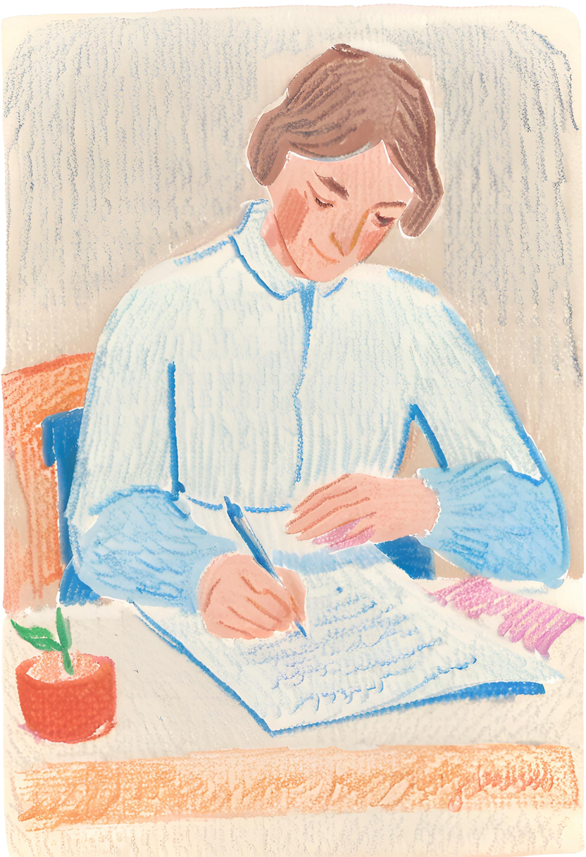
Writing & Publications
Authorship of "Notes on Nursing"
Nightingale authored "Notes on Nursing," a seminal work that laid out principles of nursing practice and healthcare management.
Use of Statistical Analysis in Healthcare
She utilized statistical analysis to support her arguments for healthcare reform, pioneering the use of data-driven decision-making in the field.
Legacy as a Writer and Theorist
Nightingale's writings and theories continue to be studied and revered in nursing education and healthcare management worldwide.

Slide 11
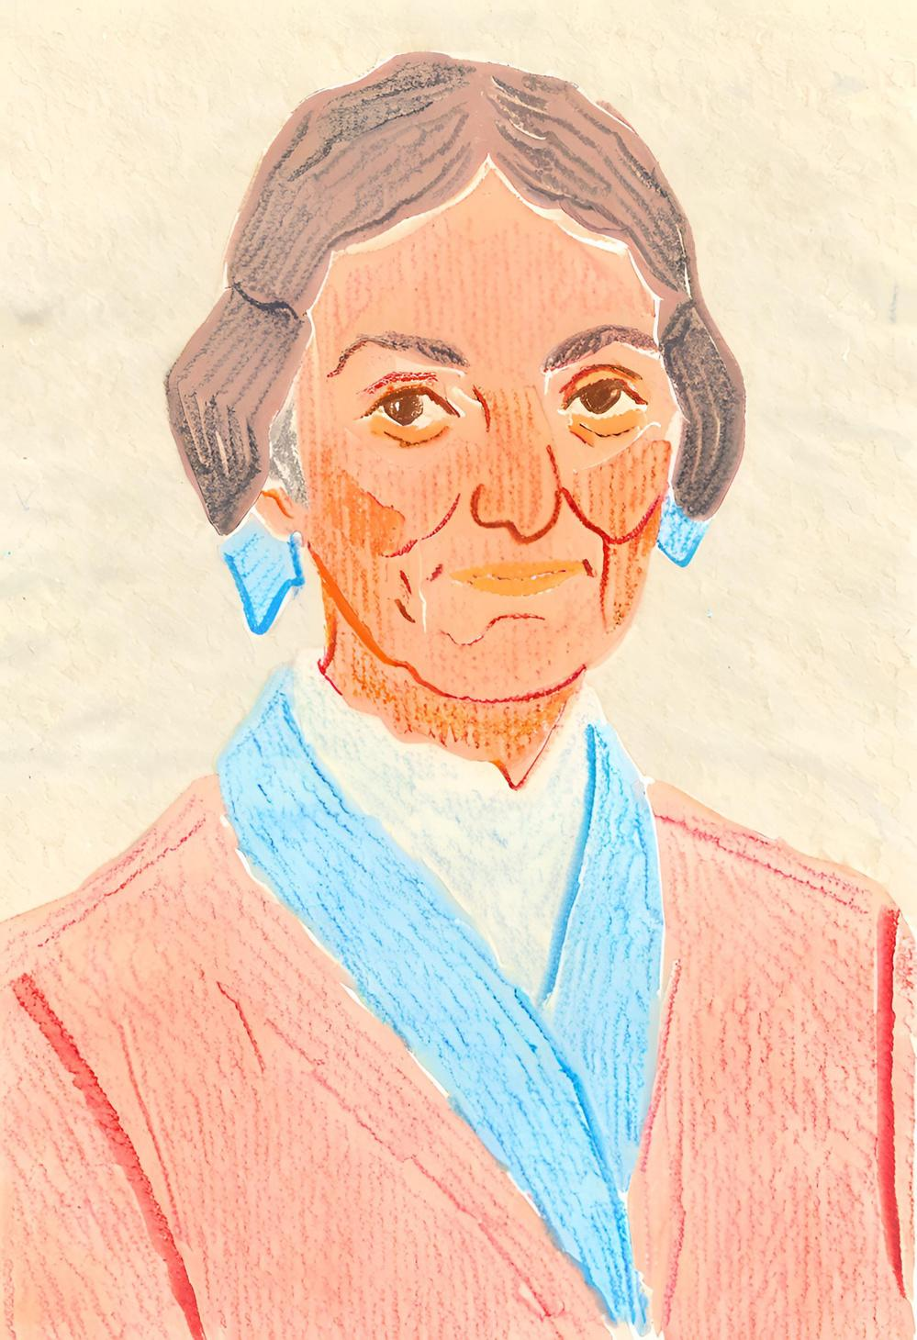
Retreat from Public Life
In her later years, Florence Nightingale gradually retreated from public life due to health issues. Despite her physical limitations, she remained a powerful advocate for healthcare reform through extensive correspondence and writing. From her home, she continued to influence public health policies and hospital practices by sharing her insights and recommendations with policymakers, healthcare professionals, and fellow reformers. Nightingale's dedication to improving healthcare never wavered, and her written works during this period provided invaluable guidance that continued to shape the field of nursing and public health long after her active years had ended.

Slide 12
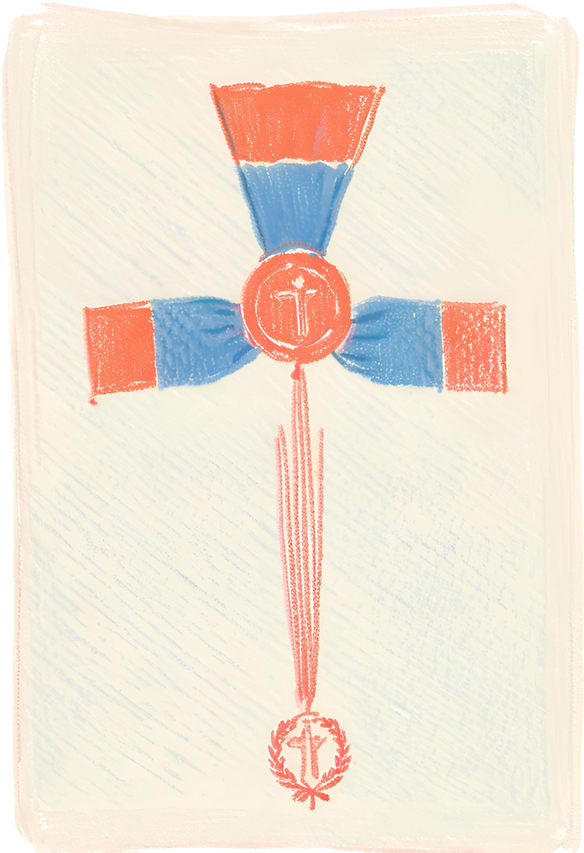
Recognition &
Honors
Florence Nightingale received numerous honors and accolades for her groundbreaking contributions to nursing and public health. Among the most prestigious was the Order of Merit, awarded to her by King Edward VII in 1907, making her the first woman to receive this distinction. Throughout her life, Nightingale's relentless dedication and innovative work were recognized by various institutions and governments, solidifying her legacy as a pioneering figure in healthcare. Her achievements not only transformed the nursing profession but also earned her lasting respect and admiration worldwide.
Order of Merit
from King Edward VII

Slide 13

Legacy of Compassion
Florence Nightingale's legacy is one of profound compassion and unwavering dedication to the well-being of others. Her innovative approaches to nursing and patient care set new standards for the medical profession, emphasizing the importance of hygiene, compassion, and meticulous attention to detail. Nightingale's work during the Crimean War, where she dramatically reduced mortality rates through improved sanitary practices, exemplifies her commitment to saving lives and alleviating suffering.

Slide 14
Continued Relevance
in Modern Healthcare
Her principles of nursing practice and healthcare management remain relevant in today's healthcare landscape, serving as a guiding light for nurses and healthcare professionals worldwide.

Slide 15
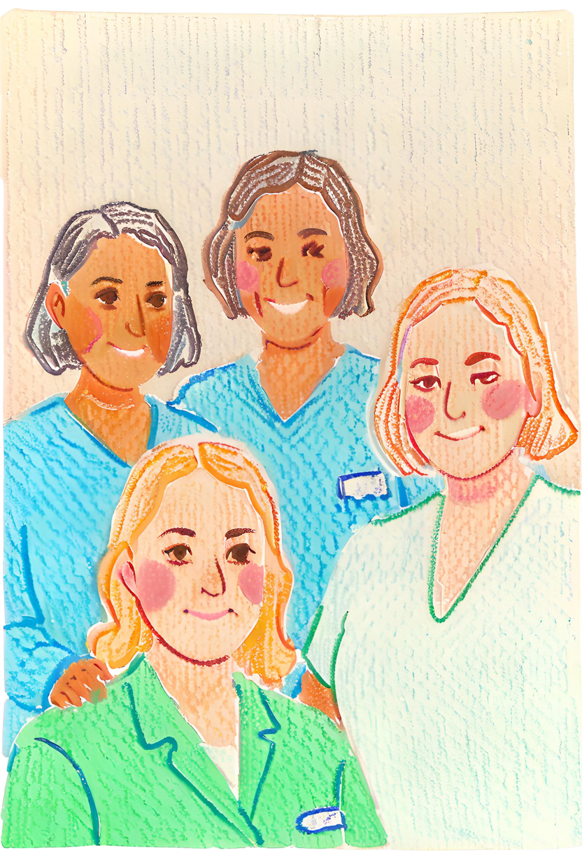
Inspiration for Future Generations
Florence Nightingale's life and work continue to inspire future generations to pursue careers in nursing and to advocate for equitable and compassionate healthcare for all. Her pioneering spirit, dedication to patient care, and innovative contributions to medical practices serve as a powerful example for nurses and healthcare professionals worldwide. Nightingale's legacy encourages a commitment to excellence, empathy, and the ongoing pursuit of healthcare reforms that benefit society as a whole.

Slide 16
Resource Page
  Use these design resources in your Canva Presentation.
Fonts
Design Elements
This presentation template
uses the following free fonts:
TITLES:
KURALE
HEADERS:
ARCHITECTS DAUGHTER
BODY COPY:
ARCHITECTS DAUGHTER
You can find these fonts online too.
Colors
#FAE5D1
#AB7E49
#5FC1D9
#6D4026
  DON'T FORGET TO DELETE THIS PAGE BEFORE PRESENTING.

Slide 17
Resource Page
  Use these design resources in your Canva Presentation.
Fonts
Design Elements
This presentation template
uses the following free fonts:
TITLES:
KURALE
HEADERS:
ARCHITECTS DAUGHTER
BODY COPY:
ARCHITECTS DAUGHTER
You can find these fonts online too.
Colors
#FAE5D1
#AB7E49
#5FC1D9
#6D4026
  DON'T FORGET TO DELETE THIS PAGE BEFORE PRESENTING.

Slide 18

Credits
  This presentation template is free for everyone to use thanks to the following:
  for the presentation template
Pexels, Pixabay
  for the photos
Happy designing!

