Slide 1



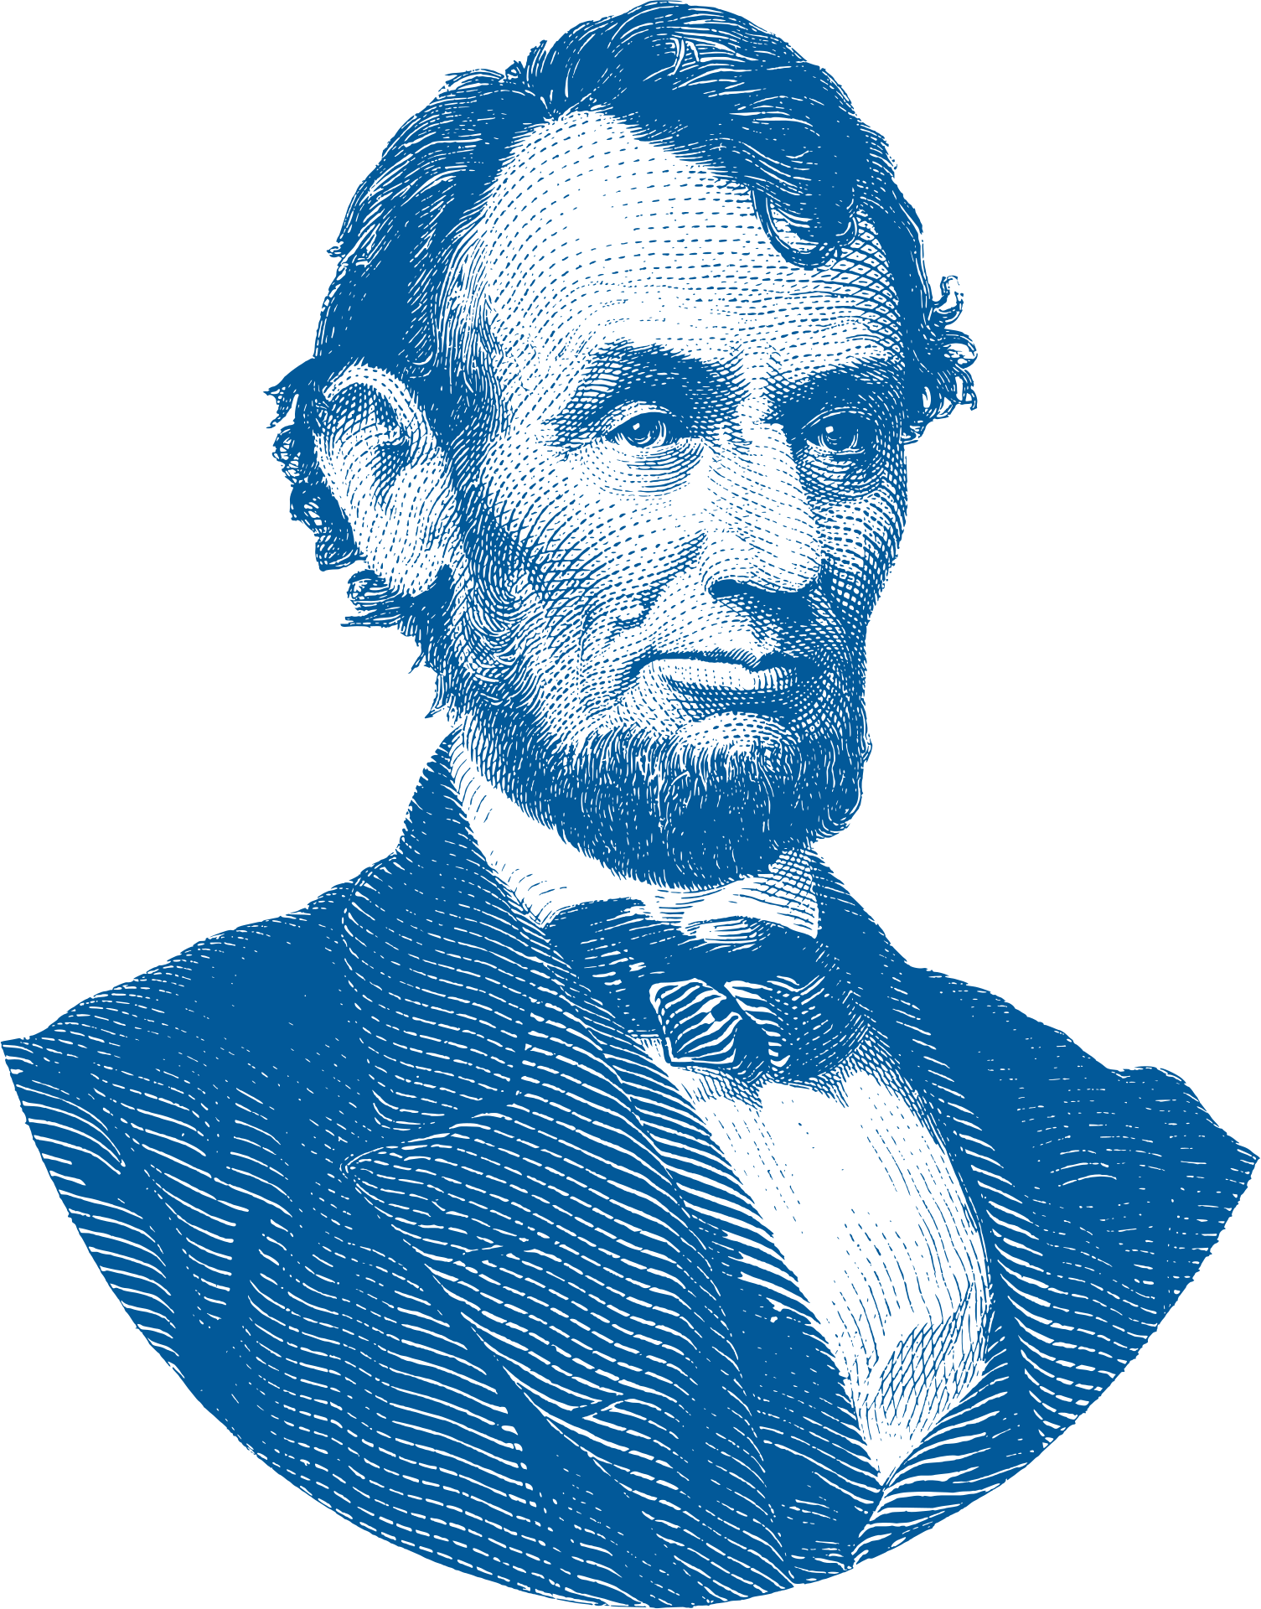



The Life of
Abraham
Lincoln
From Log Cabin
to the White House

Slide 2

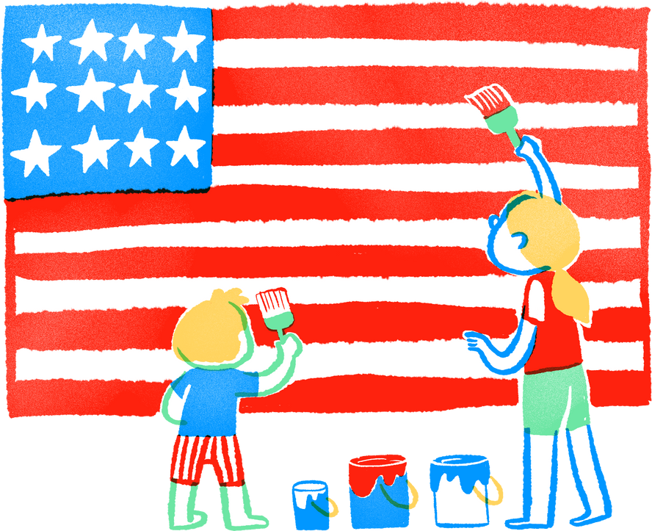
Government of the people, by the people, for the people, shall not perish from the earth.
Abraham Lincoln
(November 19, 1863)

Slide 3

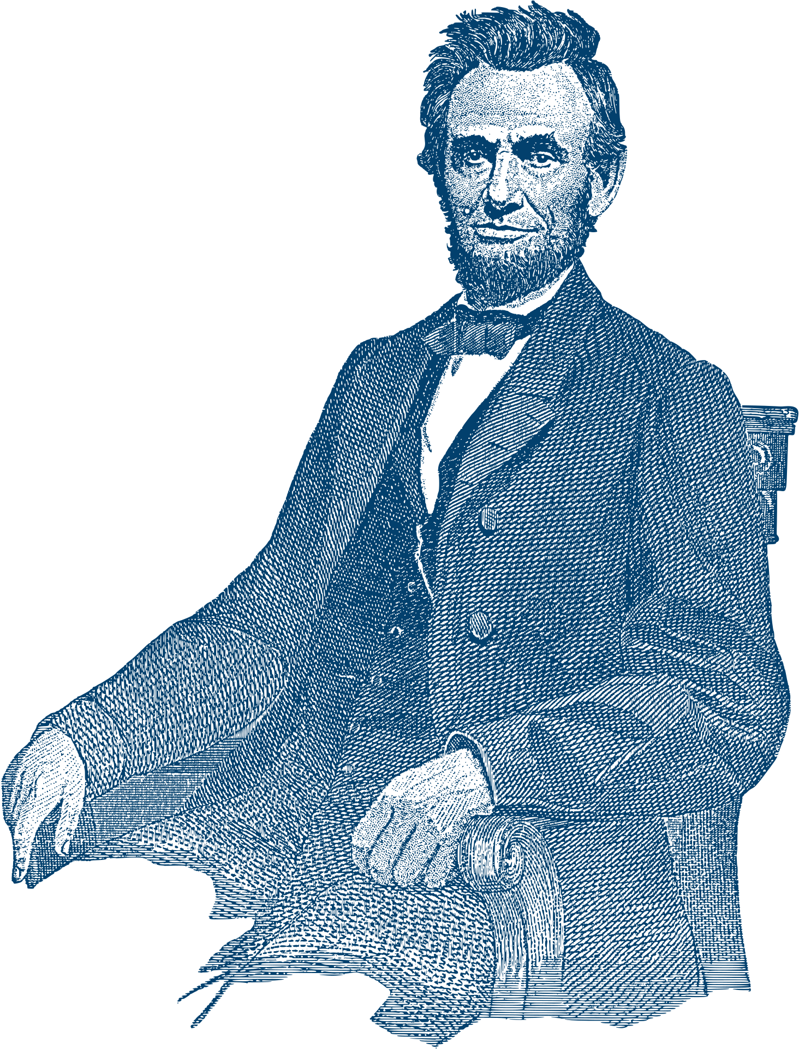


Introduction to
Abraham
Lincoln
Abraham Lincoln, often regarded as one of America's greatest presidents, rose from humble beginnings to become a towering figure in history. Born on February 12, 1809, in a one room log cabin in Hardin County, Kentucky, Lincoln's early life was marked by poverty and hardship. Despite his humble upbringing, Lincoln's intelligence, integrity, and determination would propel him to the highest office in the land.

Slide 4


Early Years
Lincoln's
Childhood and Youth
Lincoln's formative years were spent in the wilderness of Kentucky and later Indiana, where he developed a strong work ethic and a thirst for knowledge. His love for reading and learning led him to pursue a career in law, despite limited formal education.
During this time, Lincoln's experiences with frontier life and his interactions with diverse communities laid the groundwork for his deep empathy and understanding of the American people, shaping his future leadership style as a compassionate and inclusive statesman.

Slide 5
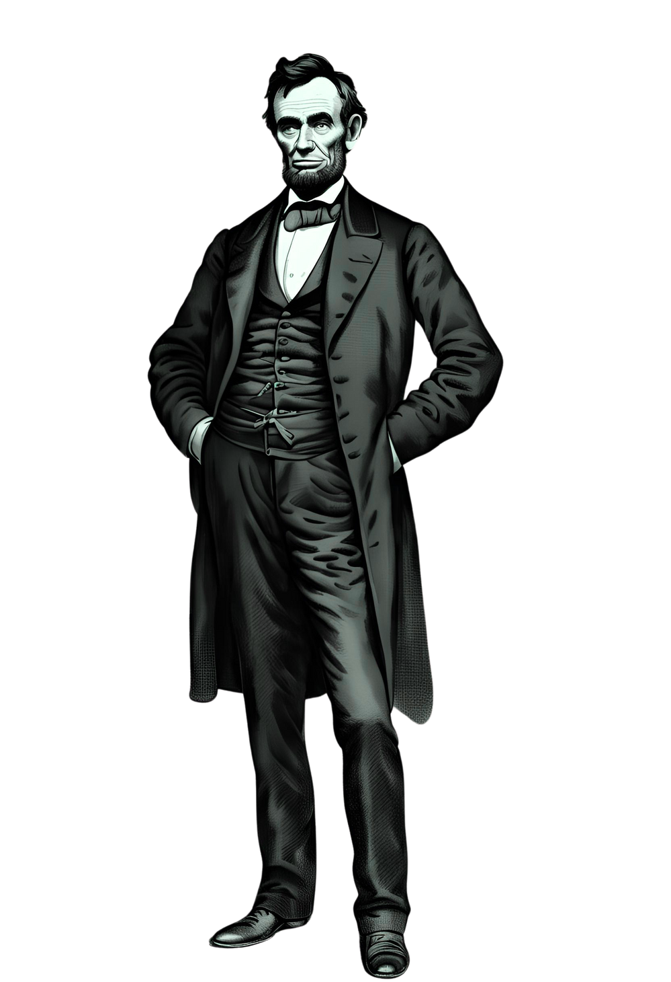

Birth of a
Legend
Despite his premature death, Lincoln's legacy as the Great Emancipator, the savior of the Union, and the embodiment of American ideals continued to grow in the hearts and minds of the American people. His enduring impact on the nation and the world serves as a testament to the enduring power of leadership, courage, and compassion in times of adversity. Lincoln's memory lives on as a beacon of hope and inspiration for generations to come.

Slide 6

Folks are usually about as happy as they make their minds up to be.
Abraham Lincoln

Slide 7

Timeline Page
1809
1837
1860
1861-1865
Abraham Lincoln is born on February 12, 1809, in a one-room log cabin in Hardin County, Kentucky, to Thomas and Nancy Lincoln.
In 1837, Lincoln relocates to Springfield, Illinois, where he begins his legal and political career, establishing himself as a respected lawyer and entering the world of Illinois politics.
Abraham Lincoln is elected as the 16th President of the United States on November 6, 1860, becoming the first Republican president in American history.
Lincoln's presidency is defined by the Civil War (1861-1865), during which he navigates the nation through its most tumultuous period and ultimately abolish slavery.

Slide 8
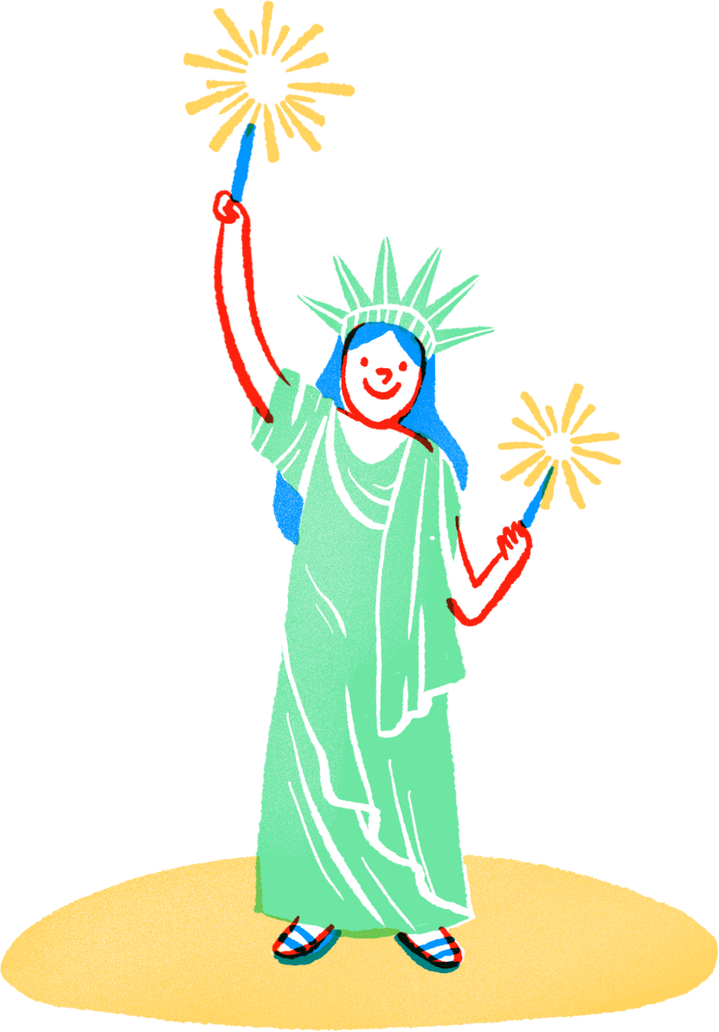

Political Rise
Lincoln's entry into politics was marked by his election to the Illinois State Legislature in 1834, where he served four consecutive terms. As a member of the Whig Party, Lincoln advocated for economic development and internal improvements. In 1846, he was elected to the U.S. House of Representatives, where he opposed the expansion of slavery into new territories.
Although his term in Congress was brief, Lincoln's opposition to the Kansas-Nebraska Act and the repeal of the Missouri Compromise foreshadowed his future role as a leader in the fight against slavery.

Slide 9




Lincoln's Views
on Slavery
01.
Evolution of Opposition
Lincoln's opposition to slavery evolved over time, from initially seeking to contain its spread to eventually advocating for its abolition.
02.
Moral Abhorrence
While Lincoln personally abhorred slavery, he initially prioritized preserving the Union over immediate emancipation, fearing the potential for civil unrest.
03.
Commitment to Abolition
As the Civil War progressed, Lincoln's commitment to ending slavery grew stronger, leading to the Emancipation Proclamation and eventual support for the 13th Amendment.

Slide 10

Whatever
you are,
be a
good one.
Abraham Lincoln

Slide 11
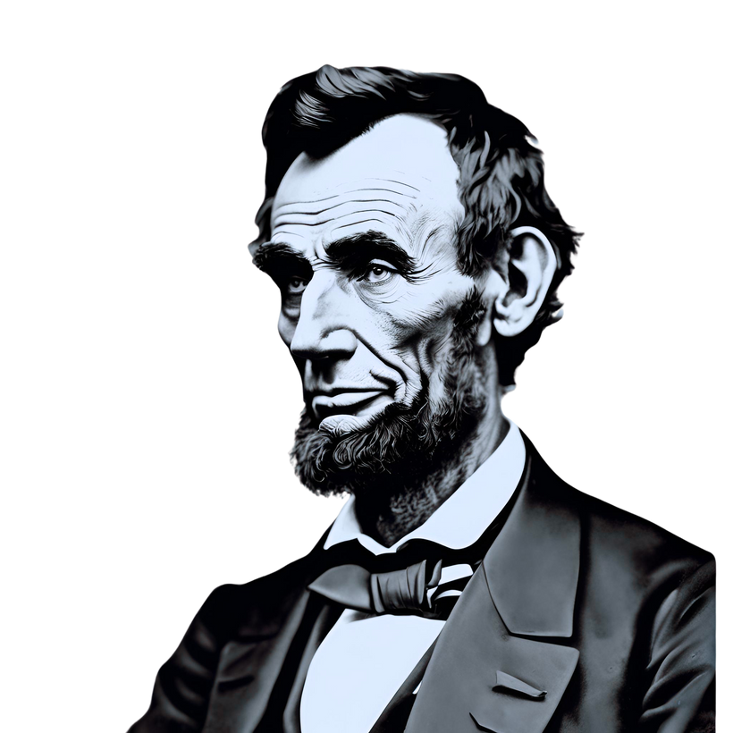

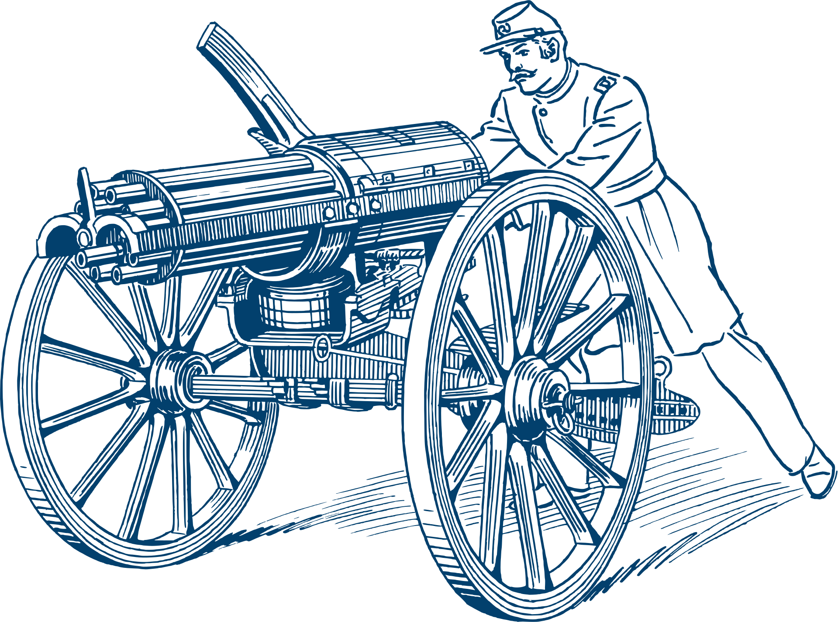
Civil War
Presidency
Leading the Nation Through Turmoil
Abraham Lincoln's presidency was defined by the Civil War, the deadliest conflict in American history. From 1861 to 1865, Lincoln faced the monumental task of preserving the Union and navigating the nation through its most tumultuous period. Despite the immense challenges, Lincoln's leadership and resolve were instrumental in guiding the country towards eventual victory and the abolition of slavery.

Slide 12


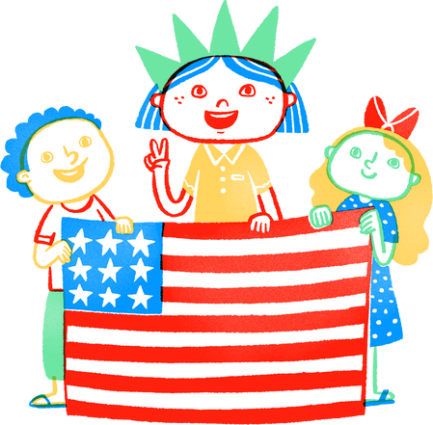

Emancipation Proclamation
A Turning Point in History
Main point
Main point
Main point
Main point
Briefly elaborate on what you want to discuss.
Briefly elaborate on what you want to discuss.
Briefly elaborate on what you want to discuss.
Briefly elaborate on what you want to discuss.

Slide 13


Gettysburg Address
On November 19, 1863, Abraham Lincoln delivered the Gettysburg Address at the dedication of the Soldiers' National Cemetery in Gettysburg, Pennsylvania. In just over two minutes, Lincoln eloquently captured the essence of the Civil War and the principles for which the Union fought. His call for "a new birth of freedom" and his solemn dedication to preserving the ideals of democracy continue to resonate with audiences around the world, cementing the Gettysburg Address as one of the most revered speeches in American history.
In his address, Lincoln honored the sacrifice of those who had fought and died on the battlefield, emphasizing the importance of preserving the Union and the principles of liberty and equality for which it stoodThe Gettysburg Address serves as a timeless reminder of the enduring values that bind Americans together and the sacrifices made to uphold them.
Honoring
the Fallen,
Inspiring
the Nation

Slide 14



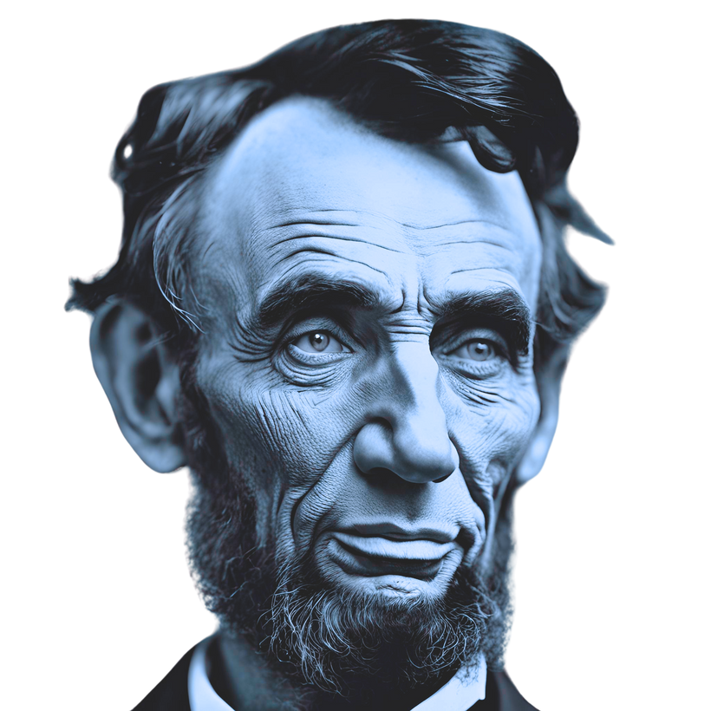



Tragic End
Assassination
Tragically, Abraham Lincoln's life was cut short by an assassin's bullet on April 14, 1865, just days after the Confederate surrender at Appomattox Court House. His untimely death marked the end of an era and sent shockwaves across the nation.

Slide 15



My Best Friend is a person who will give me a book I have not read.
Abraham Lincoln

Slide 16
Abraham Lincoln
A Legacy of Leadership and Liberty
In conclusion, the life of Abraham Lincoln is a testament to the power of leadership, resilience, and moral conviction. From his humble beginnings in a log cabin to his tenure as the 16th President of the United States, Lincoln's unwavering commitment to preserving the Union and abolishing slavery has left an indelible mark on history. His legacy as the Great Emancipator and the embodiment of American ideals continues to inspire people around the world. As we reflect on Lincoln's life and legacy, may we be reminded of the enduring power of courage, compassion, and the pursuit of justice in shaping a better future for all.

Slide 17

Thank You
for Watching
Your time and attention
are greatly appreciated.

Slide 18
Resource Page
Use these design resources in your Canva Presentation.
Fonts
Design Elements
This presentation template
uses the following free fonts:
TITLES:
CALISTOGA
HEADERS:
JUA
BODY COPY:
JUA
You can find these fonts online too.
Colors
#025999
#70C5F2
#F04B16
#FFF4CC
  DON'T FORGET TO DELETE THIS PAGE BEFORE PRESENTING.

Slide 19

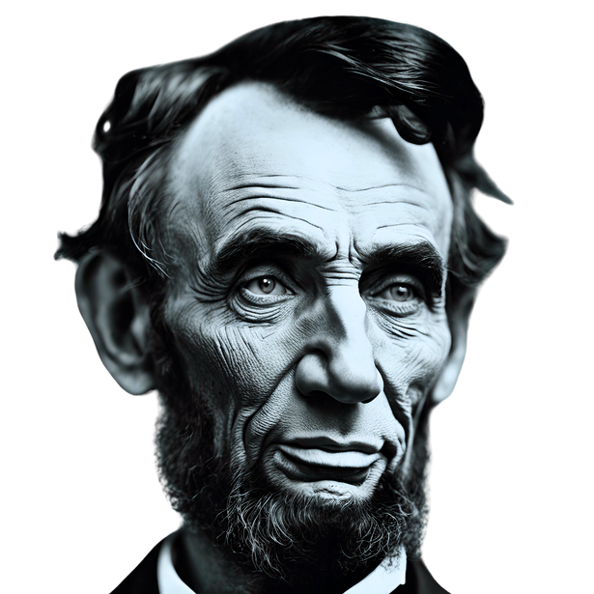
Resource Page
Use these design resources in your Canva Presentation.
Fonts
Design Elements
This presentation template
uses the following free fonts:
TITLES:
CALISTOGA
HEADERS:
JUA
BODY COPY:
JUA
You can find these fonts online too.
Colors
#025999
#70C5F2
#F04B16
#FFF4CC
  DON'T FORGET TO DELETE THIS PAGE BEFORE PRESENTING.

Slide 20

Credits
This presentation template is free for everyone to use thanks to the following:
  for the presentation template
Pexels, Pixabay
  for the photos
Happy designing!

