Slide 1


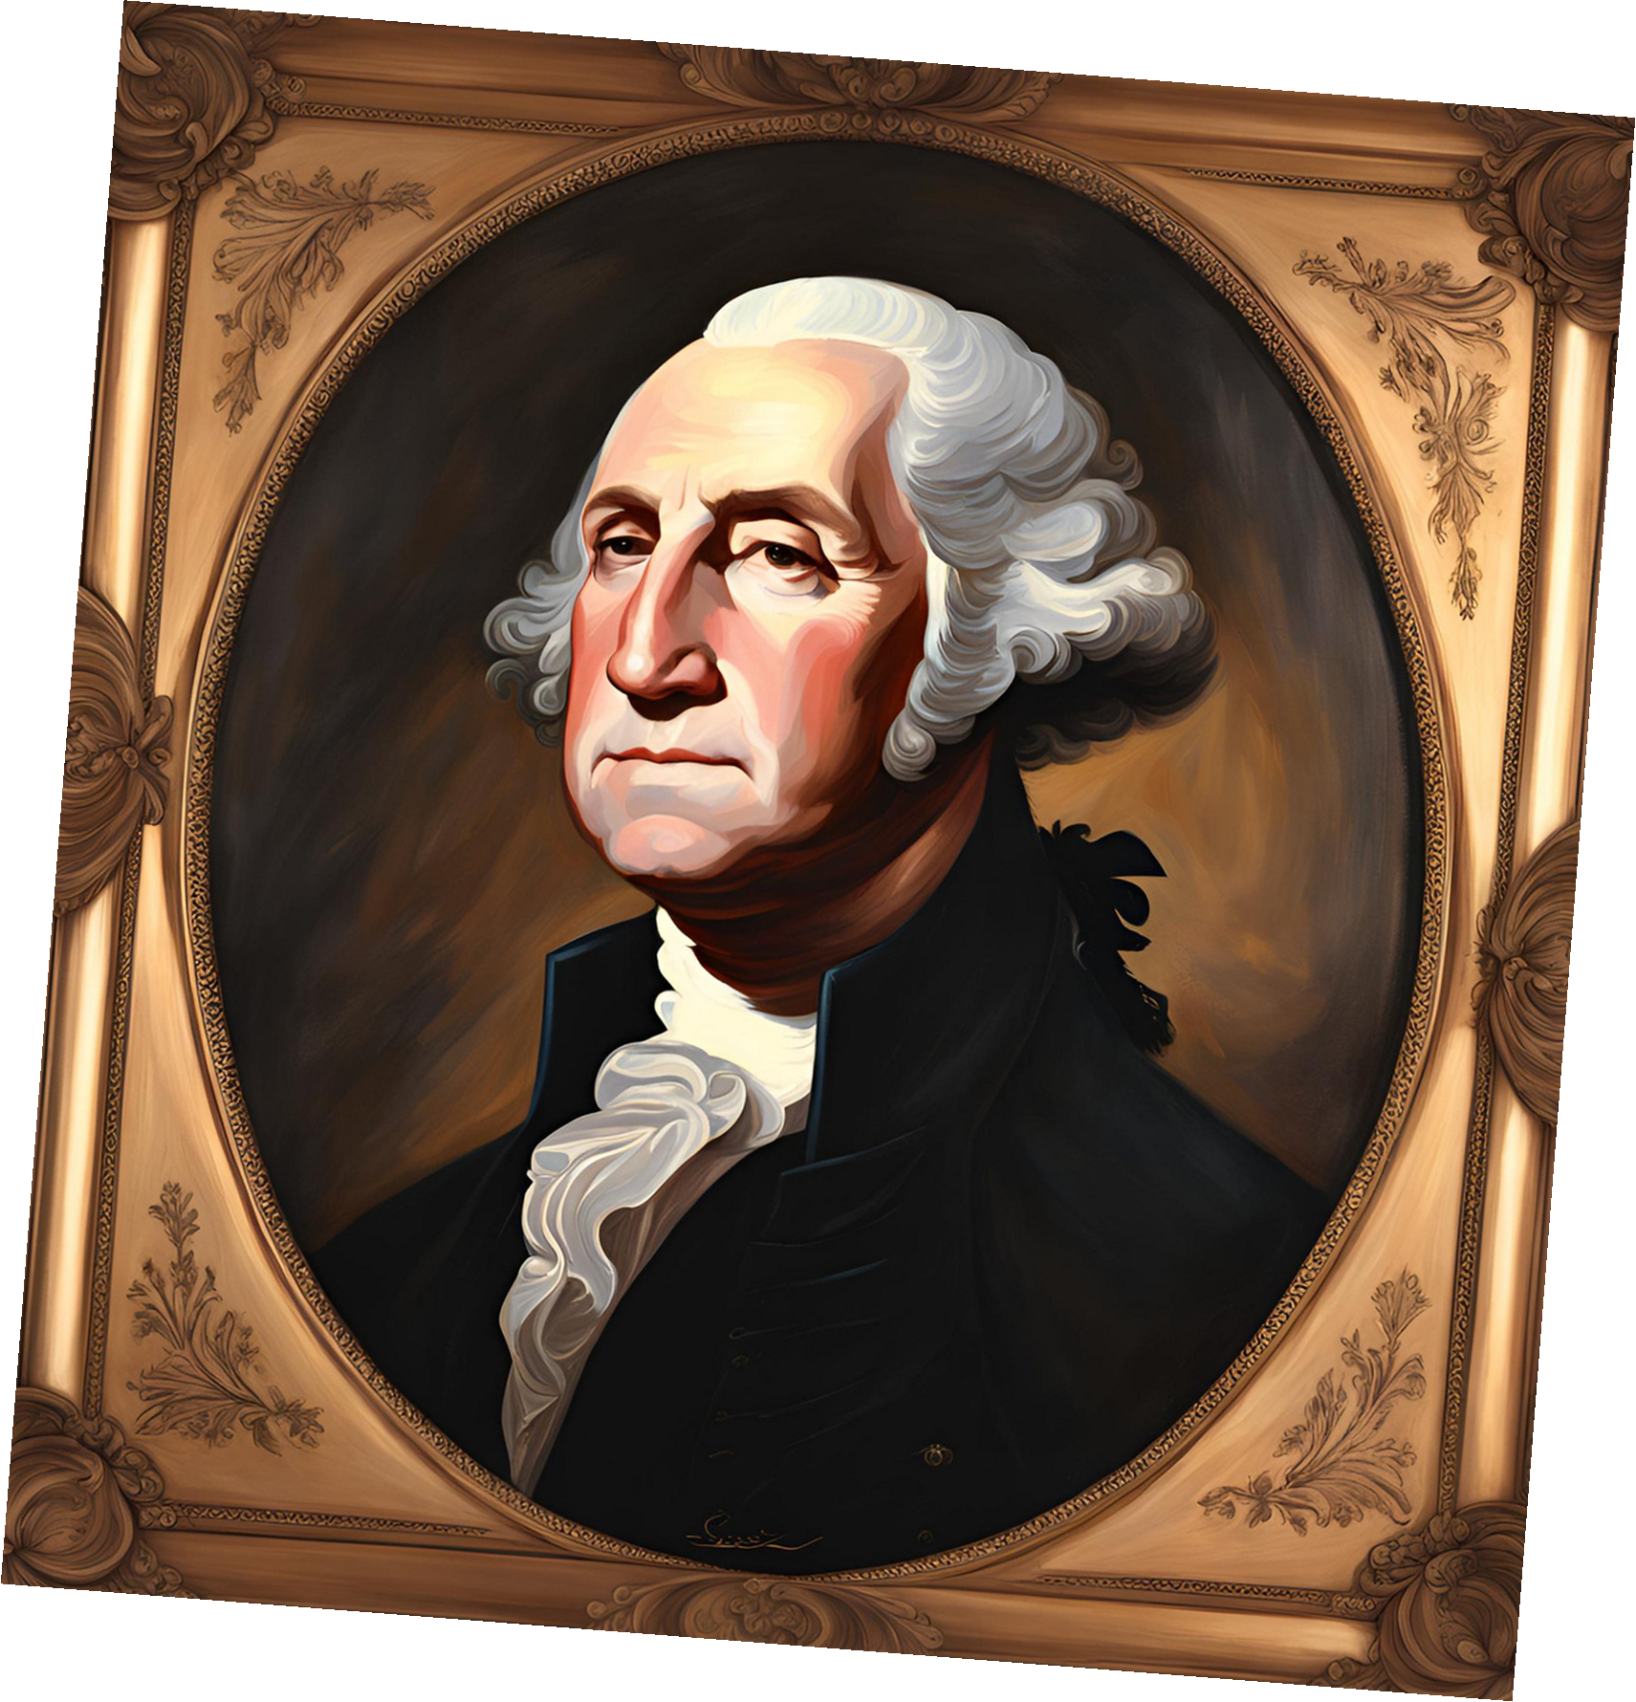

Presidency Of
George
Washington

Slide 2


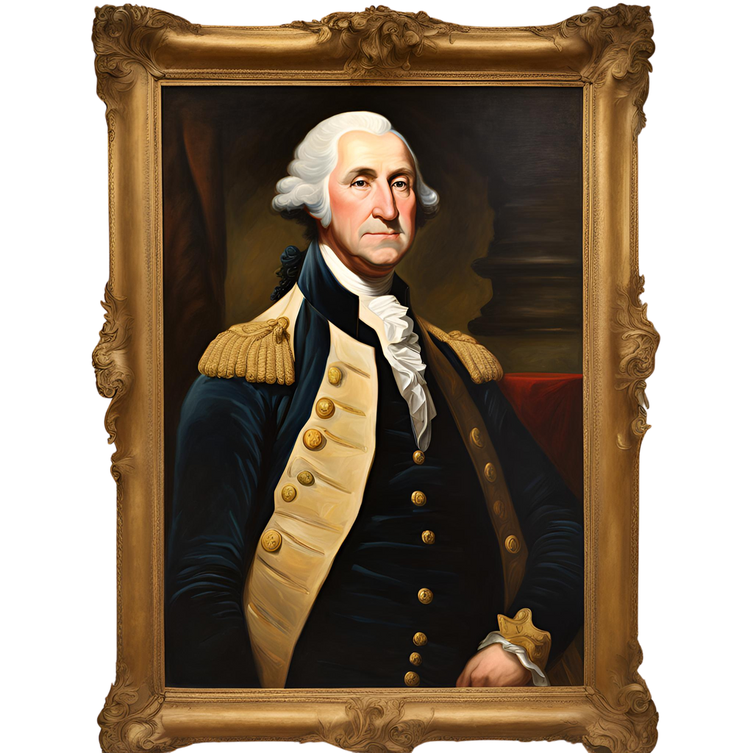

01.
Introduction
Elaborate on what you want to discuss.

Slide 3
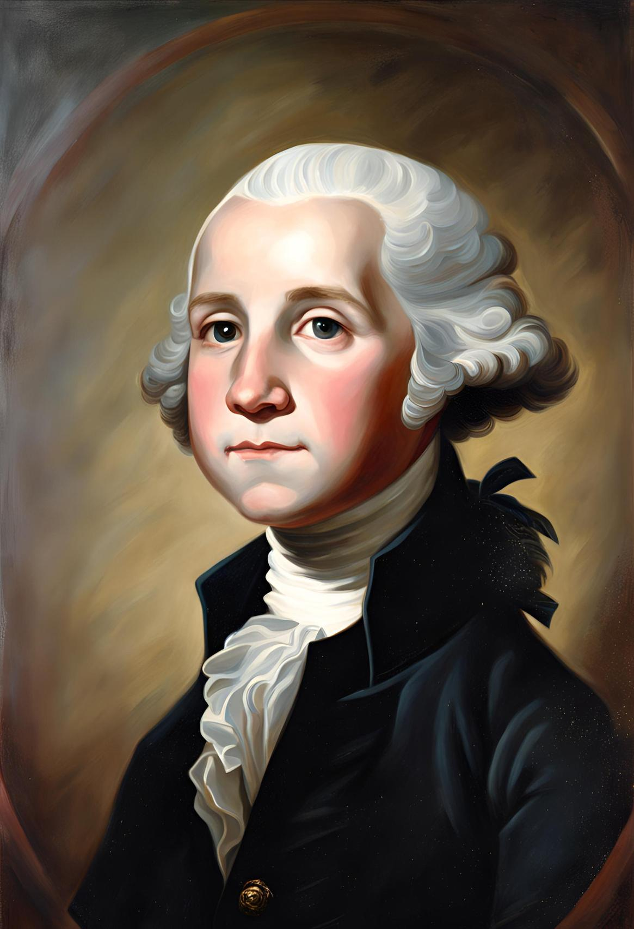
Early Life
George Washington, born on February 22, 1732, in Westmoreland County, Virginia, is revered as the first president of the United States, an iconic figure whose leadership laid the groundwork for the nation's future. His early life on the Virginia frontier shaped his character, instilling in him values of resilience, determination, and a deep commitment to public service. Washington's upbringing in the heart of colonial America provided him with a unique perspective on the challenges and opportunities facing the fledgling nation, setting the stage for his pivotal role in shaping American history.

Slide 4
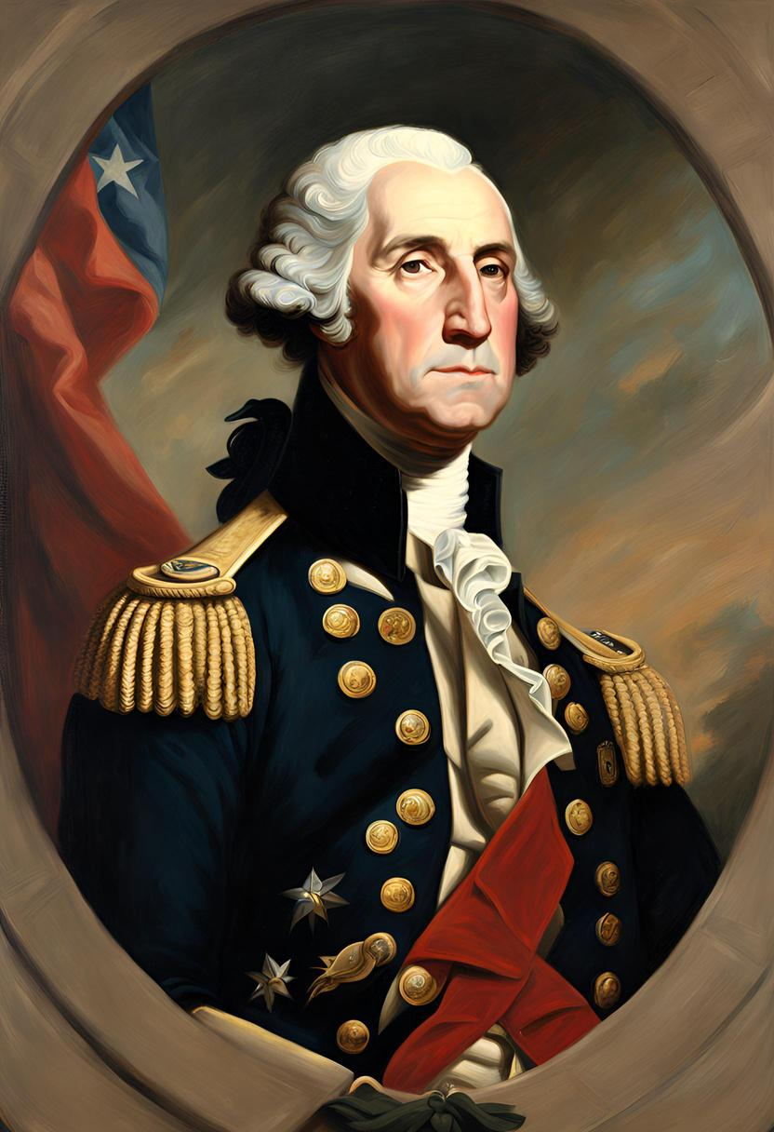
Military
Leadership
Washington's military leadership during the American Revolutionary War stands as a cornerstone of his legacy, garnering widespread admiration and respect both during his time and in the annals of history. His strategic acumen, unwavering resolve, and ability to inspire troops were instrumental in turning the tide of the conflict against British forces. Washington's leadership on the battlefield not only led to crucial victories but also galvanized the spirit of the American people, uniting them in the pursuit of independence. His pivotal role in securing American freedom from British rule laid the foundation for his future leadership, establishing him as a figure of national significance and setting the stage for his presidency.

Slide 5
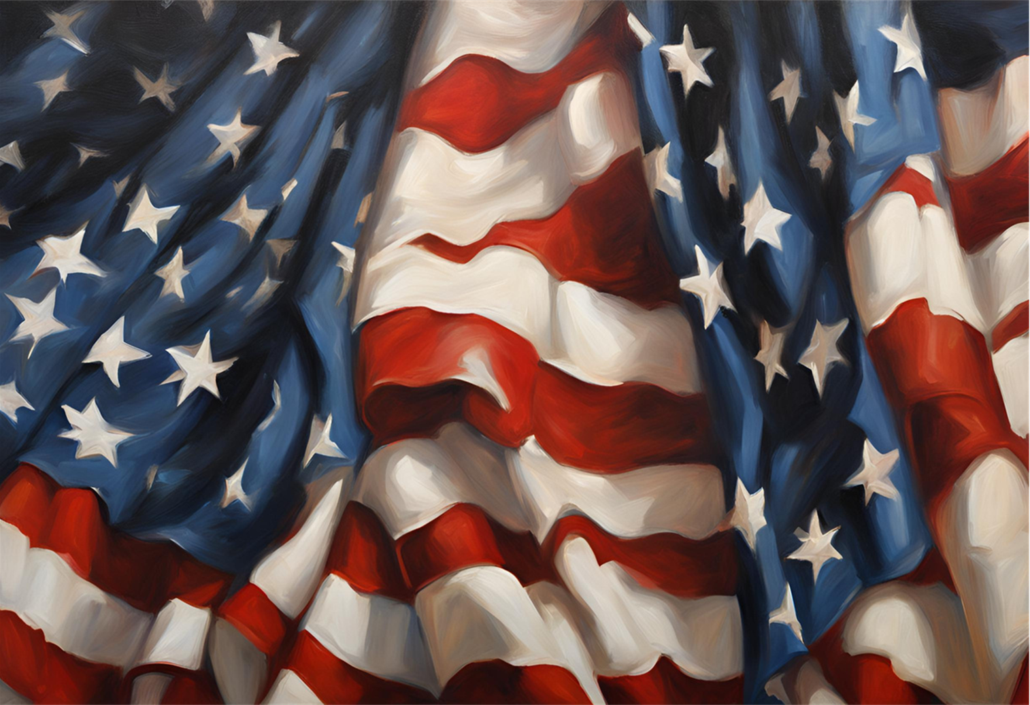
Statesmanship
Known for his integrity, wisdom, and commitment to the ideals of the American Revolution, Washington emerged as a unifying figure and a symbol of national unity during a critical period in American history.

Slide 6
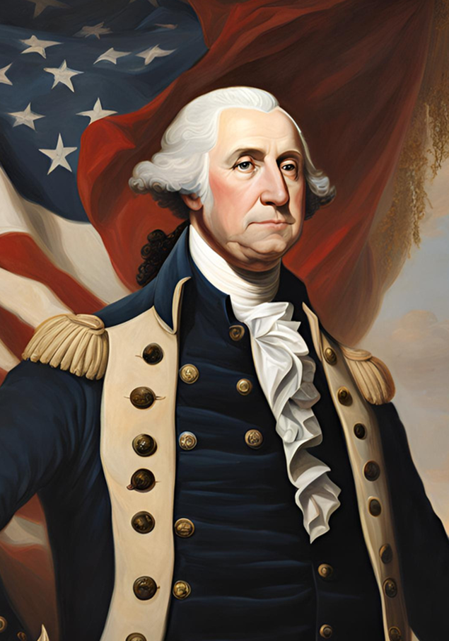
02.
Election as President
Elaborate on what you want to discuss.

Slide 7
Unanimous Election
In 1789, George Washington made history by becoming the unanimous choice of the Electoral College as the inaugural President of the United States. This remarkable feat underscored the immense trust and confidence bestowed upon him by both the American people and the nation's founders. Washington's unanimous election reflected not only his esteemed reputation as a military leader and statesman but also the widespread belief in his ability to lead the fledgling nation with wisdom, integrity, and foresight.
His election as president marked a pivotal moment in American history, symbolizing the unity and collective vision of the newly formed republic. Washington's leadership was seen as essential in guiding the nation through its formative years and establishing the foundations of a stable and prosperous government. With his unparalleled reputation and unwavering commitment to the principles of liberty and democracy, George Washington embarked on his presidency with the weight of history on his shoulders, poised to shape the destiny of a young and ambitious nation.

Slide 8
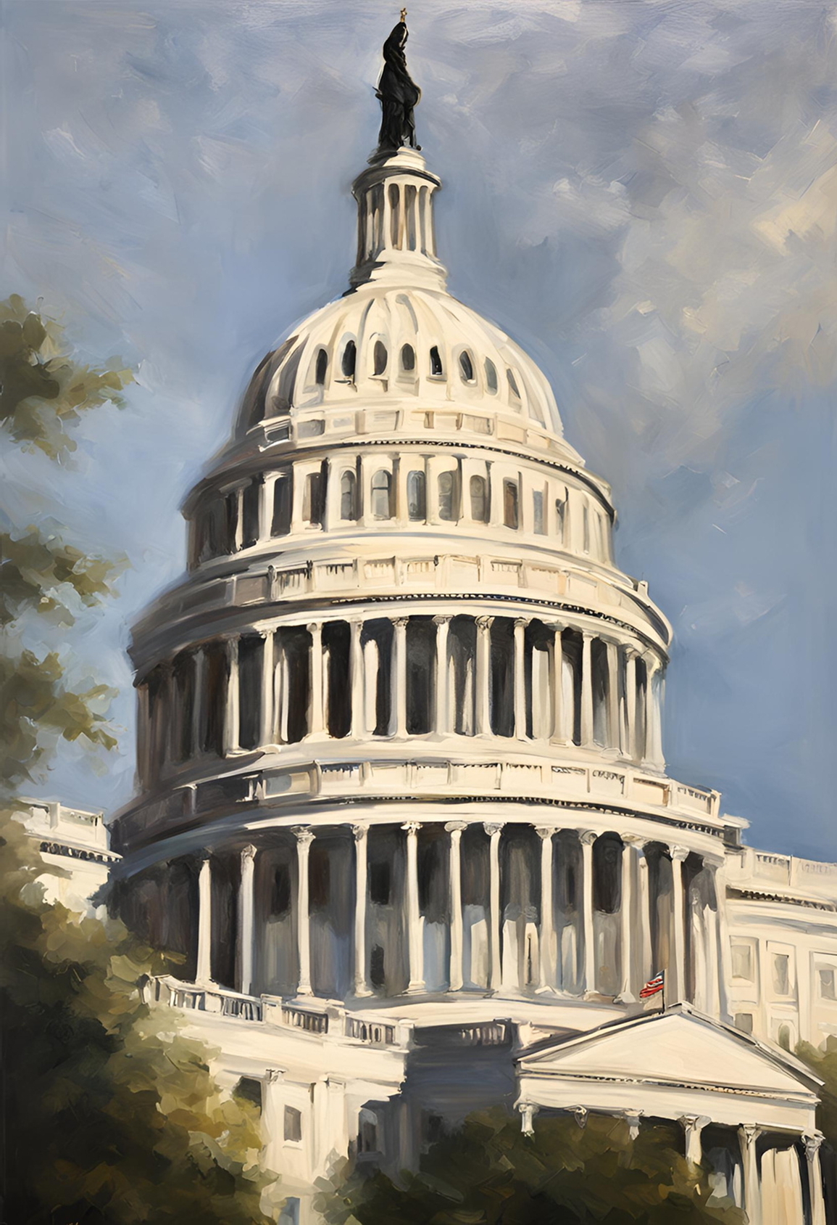
Inauguration
Marking a Historic Milestone
On April 30, 1789, Washington was inaugurated as president in New York City, the temporary capital of the United States at that time. His inauguration marked the beginning of a new era in American governance.

Slide 9
Building a New Government
01.
02.
03.
Constitutional
Framework
Formation of the
Cabinet
Ratification of the
Bill of Rights
Washington worked closely with the framers of the Constitution to implement the principles of the new government. He set precedents that would shape the office of the presidency for generations to come.
Washington established the first presidential cabinet, appointing prominent figures such as Thomas Jefferson as Secretary of State and Alexander Hamilton as Secretary of the Treasury. This cabinet system provided advice and expertise to the president and helped to centralize executive authority.
Washington played a crucial role in securing the ratification of the Bill of Rights, the first ten amendments to the Constitution, which protected individual liberties and helped to cement the principles of the new republic.

Slide 10

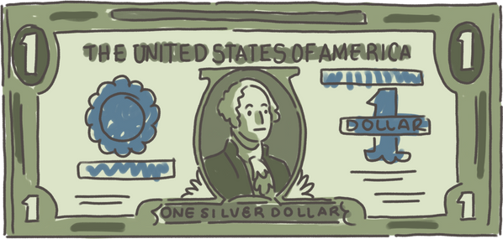
Domestic Policy
Whiskey Rebellion
Financial Stability
In 1794, Washington faced the Whiskey Rebellion, a protest against the federal excise tax on whiskey. He demonstrated the federal government's ability to enforce its laws by personally leading a militia force to suppress the rebellion, asserting federal authority.
Washington's administration prioritized economic stability and growth. He supported Alexander Hamilton's financial policies, including the establishment of a national bank and the assumption of state debts, to strengthen the nation's credit and promote economic development.

Slide 11
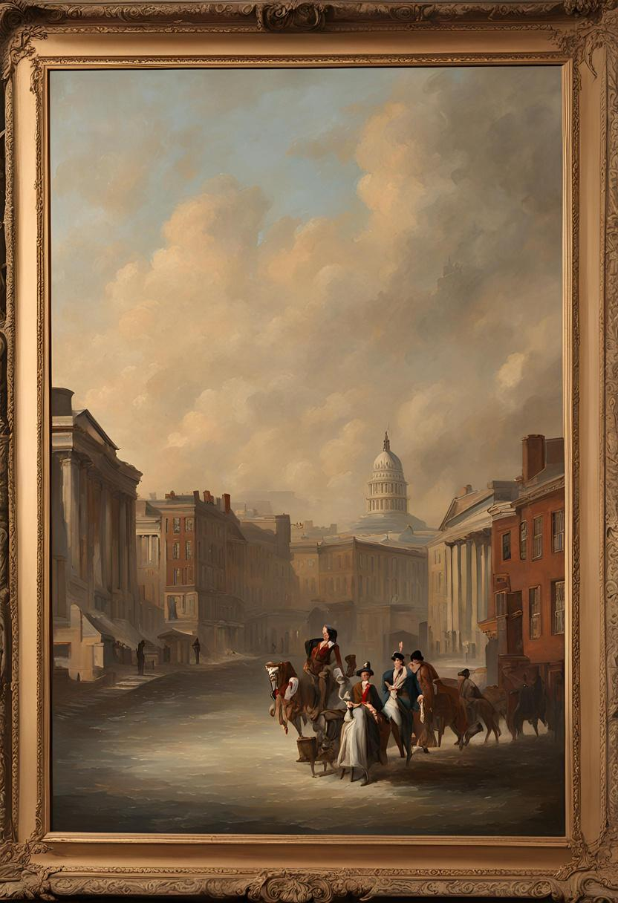
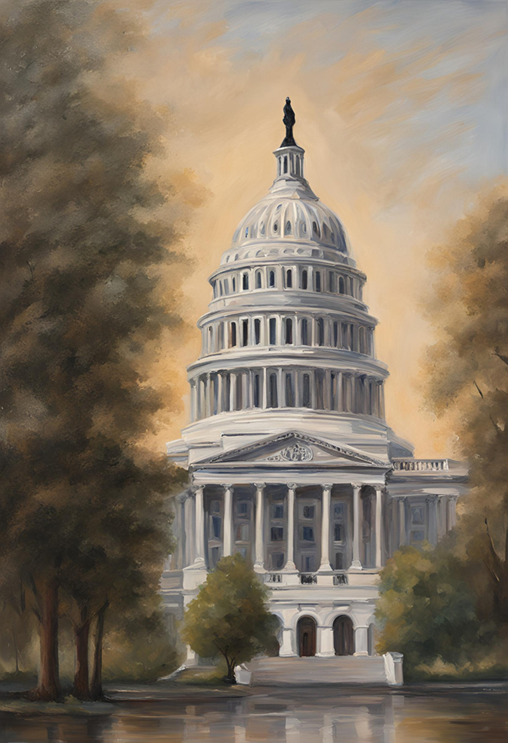
Foreign Policy
Neutrality Proclamation
Washington issued the Neutrality Proclamation in 1793, declaring America's neutrality in the conflict between France and Britain. This proclamation reflected Washington's commitment to preserving American independence and avoiding entanglement in foreign conflicts.
Jay Treaty
In 1795, Washington's administration negotiated the Jay Treaty with Great Britain, resolving outstanding issues between the two nations and preventing war. While controversial, the treaty helped to maintain peace and secure American interests.
Farewell
Address
In his Farewell Address in 1796, Washington emphasized the importance of unity, political moderation, and avoiding foreign entanglements. His farewell address set a precedent for peaceful transitions of power and remains a cornerstone of American political tradition.

Slide 12

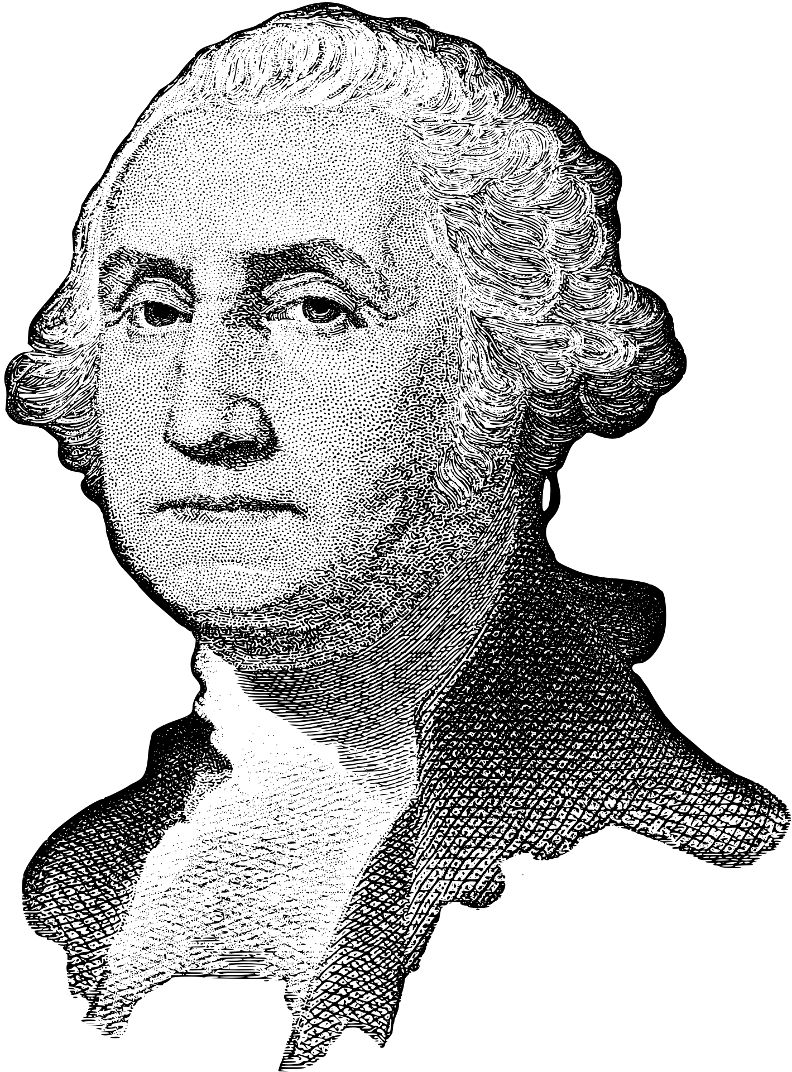
03.
Later Life and Legacy
Elaborate on what you want to discuss.

Slide 13
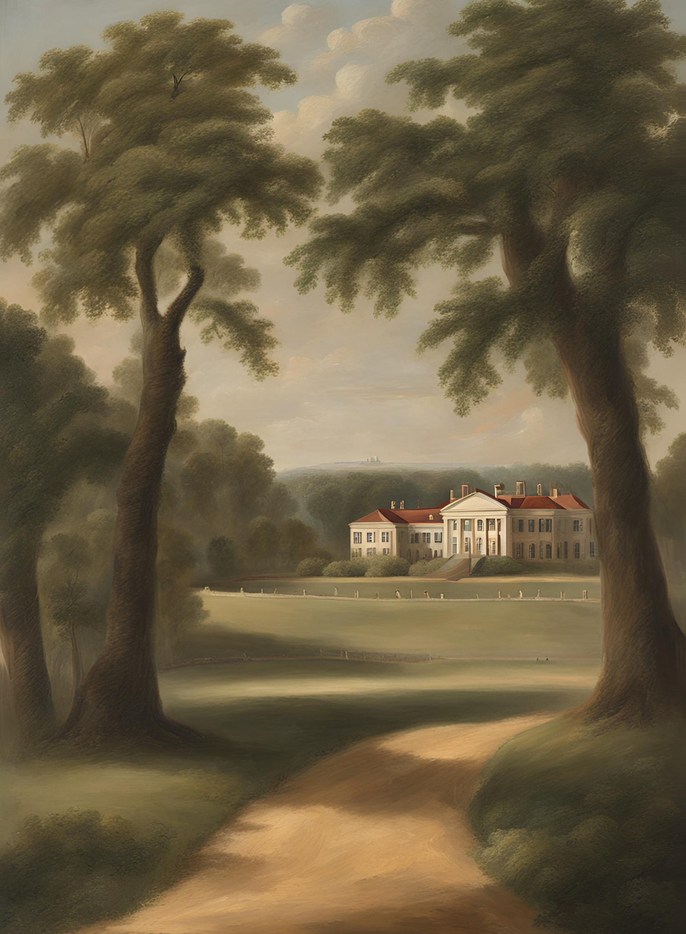
Retirement at
Mount
Vernon
  After serving two terms as president, George Washington retired to his beloved Mount Vernon estate in Virginia. He sought solace and tranquility in the life of a gentleman farmer, but his retirement was marked by continued involvement in public affairs and a deep concern for the nation's future.

Slide 14

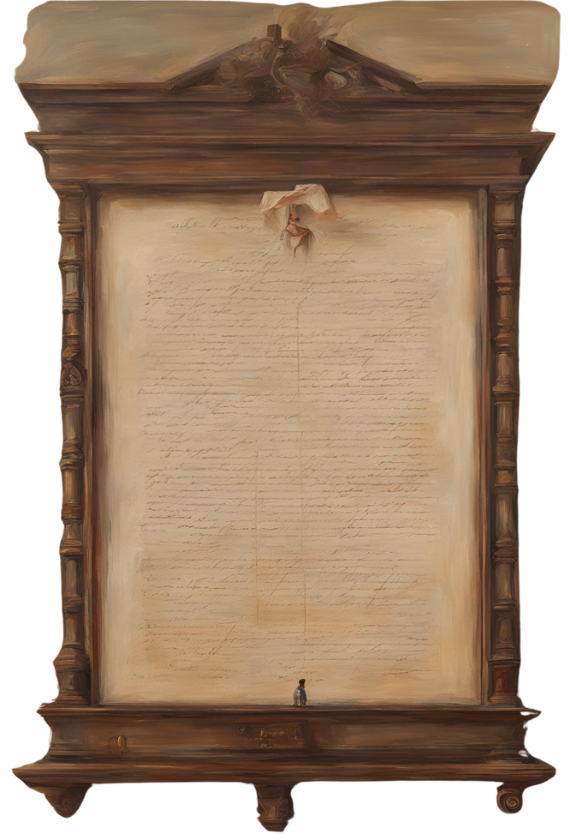
Farewell Address
  In 1796, Washington delivered his Farewell Address, a seminal document in American history. In it, he warned against the dangers of political factionalism, foreign entanglements, and the erosion of national unity. His words continue to resonate as a timeless guide for future generations.

Slide 15
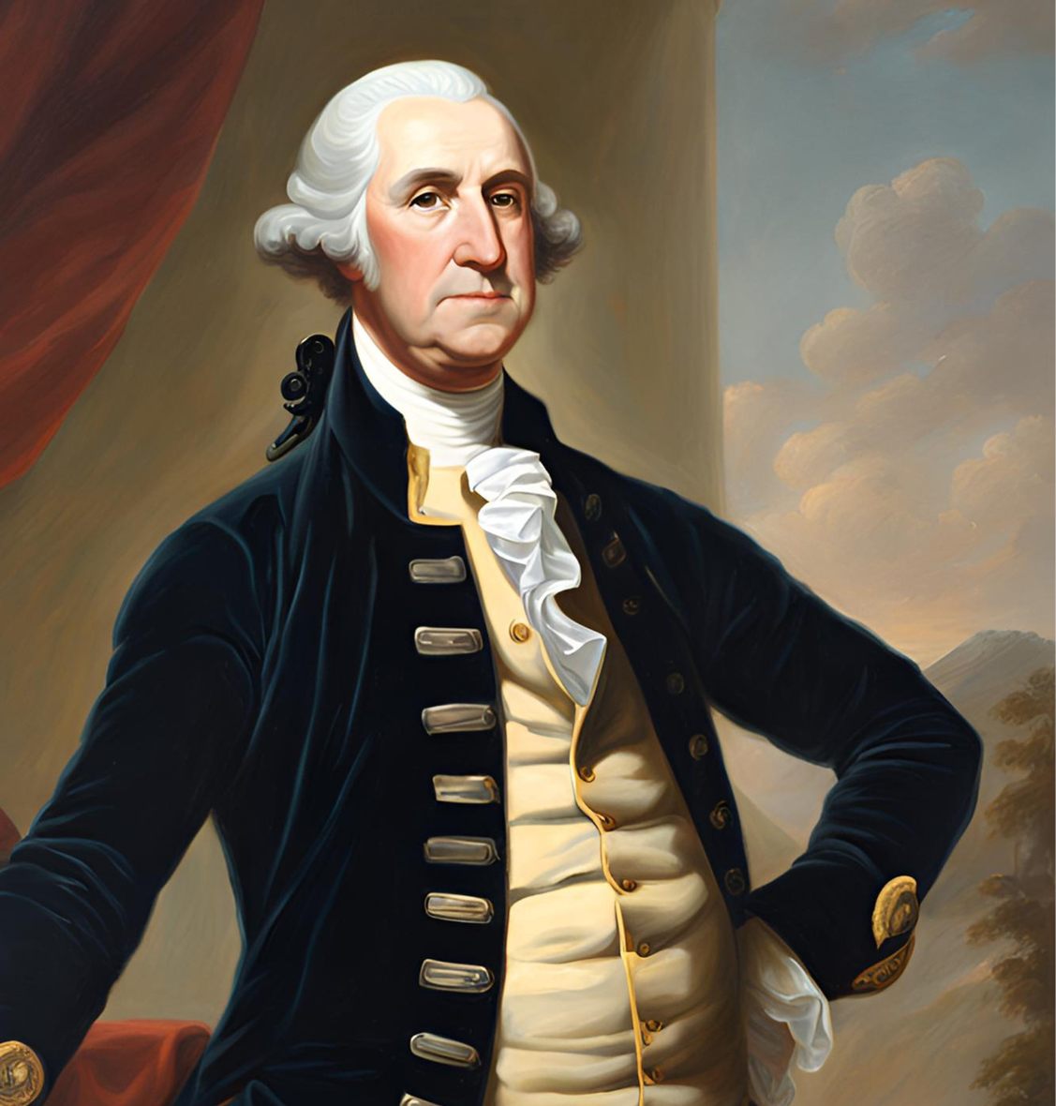
Death and
Legacy
  George Washington passed away on December 14, 1799, at the age of 67. His death prompted an outpouring of grief across the nation, as Americans mourned the loss of their revered leader and father of the country. Washington's legacy endures as a symbol of integrity, leadership, and national unity, leaving an indelible mark on American history and shaping the presidency for centuries to come.

Slide 16
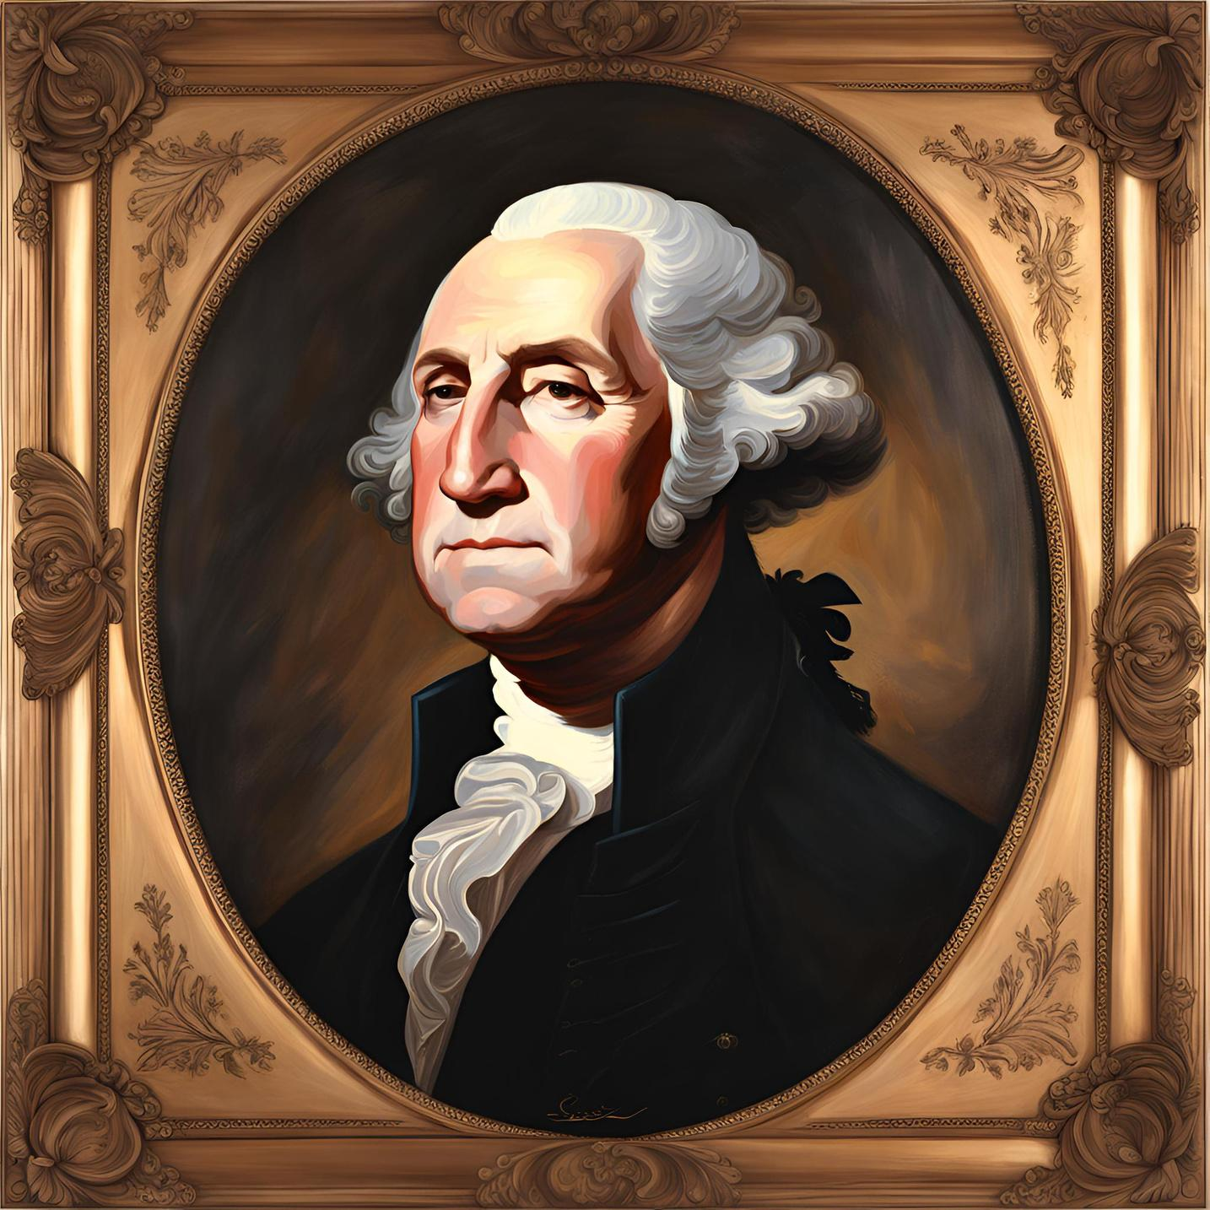
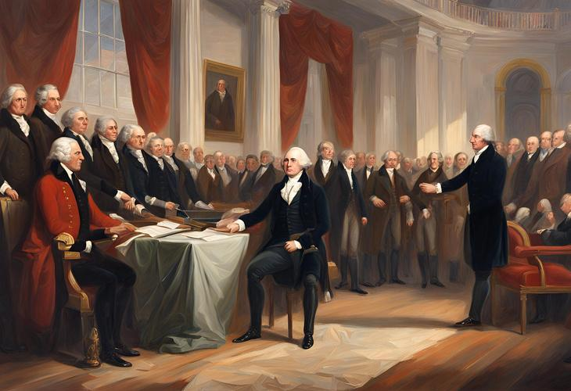
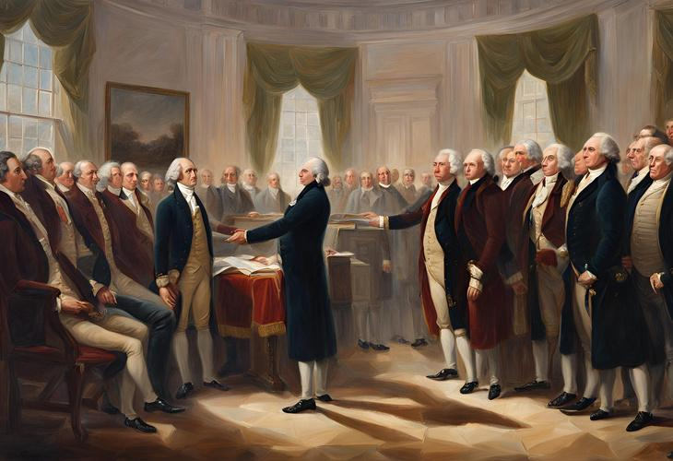
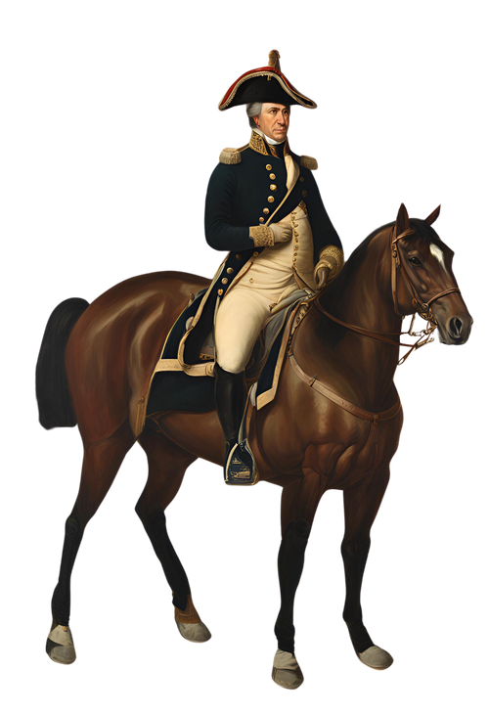
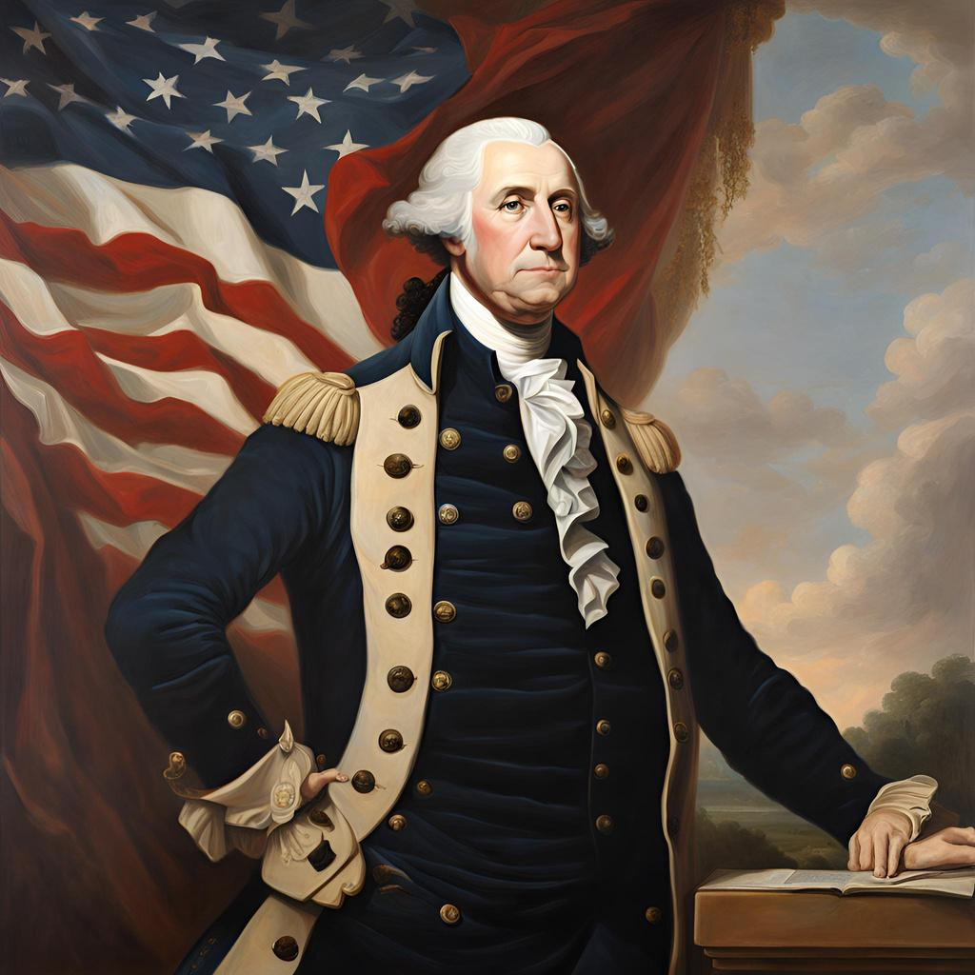
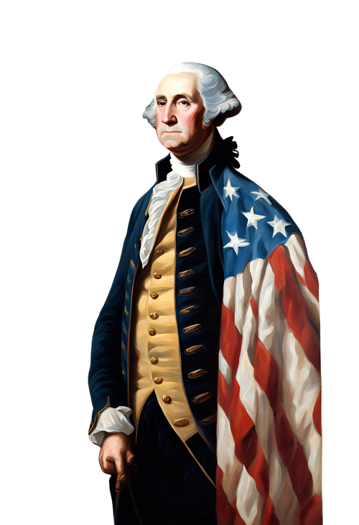

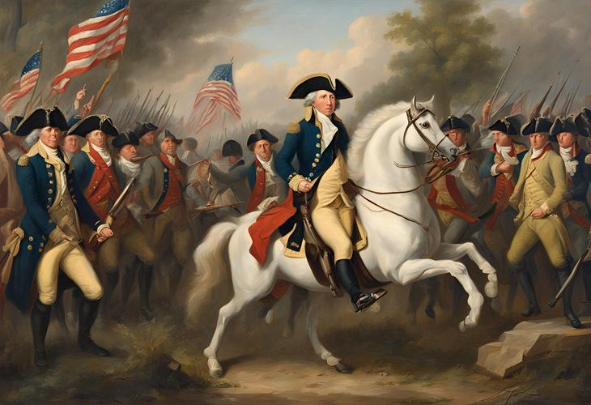
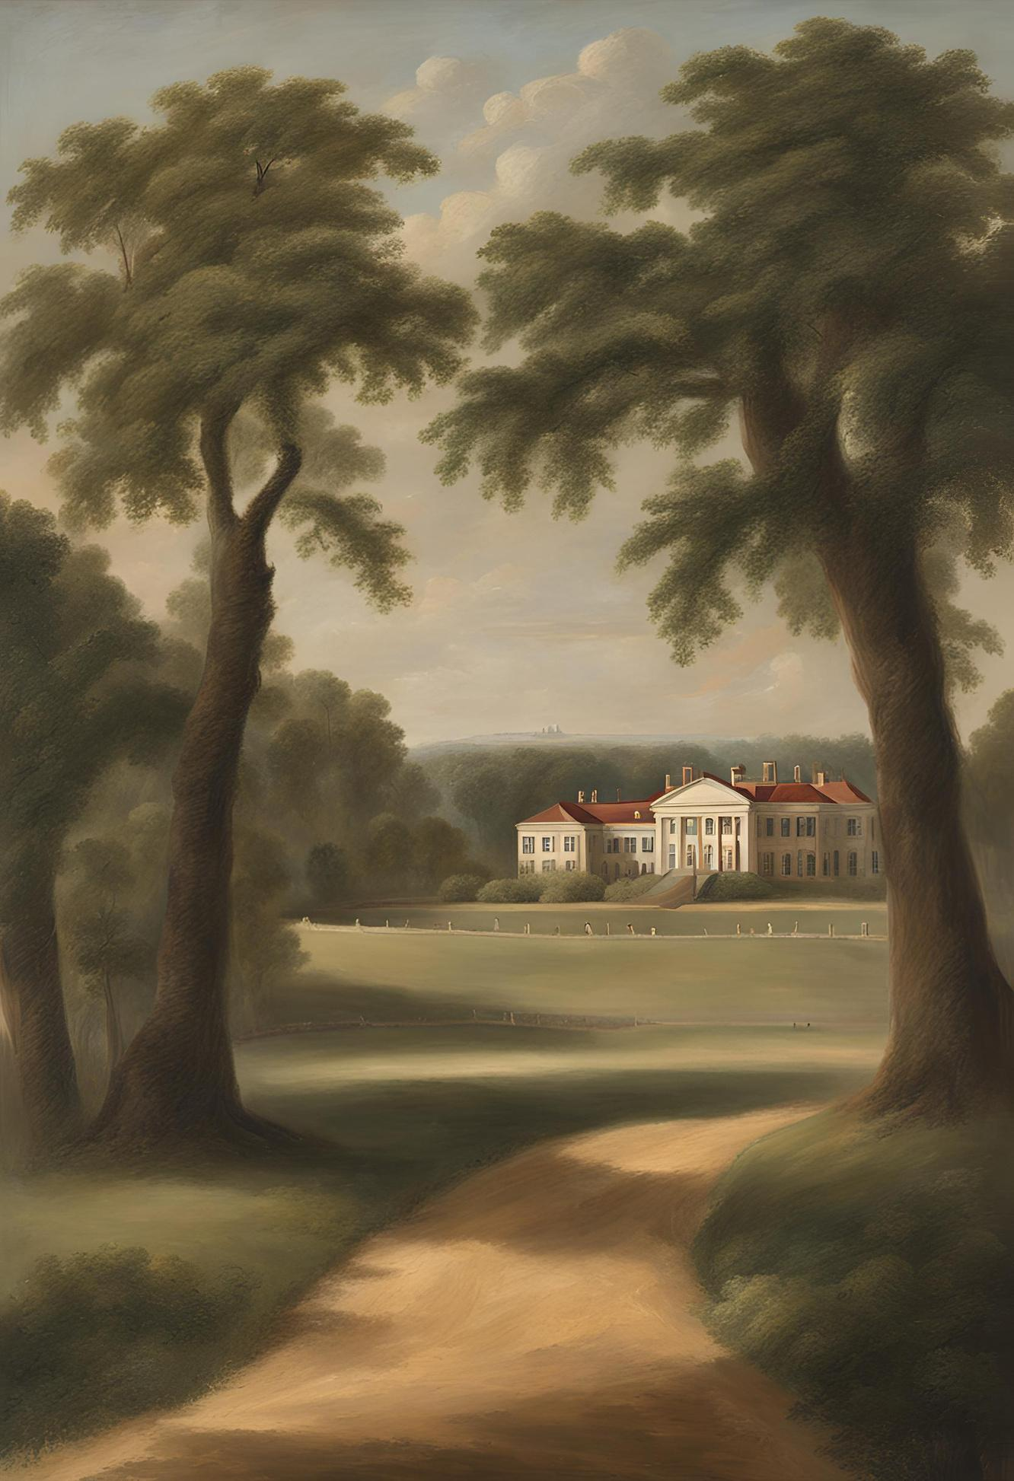
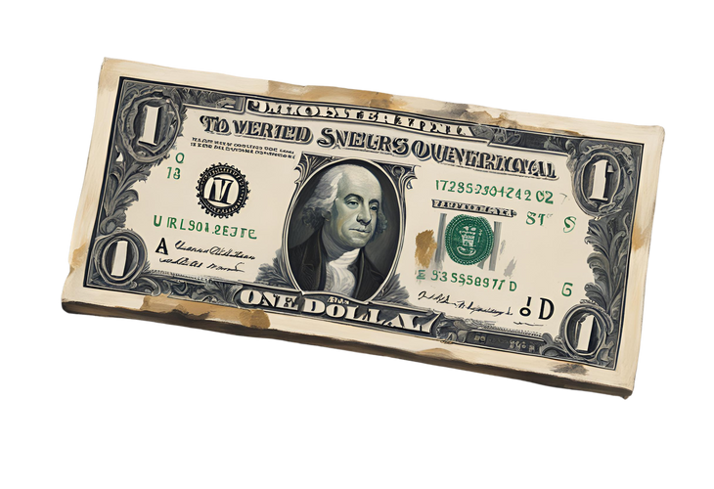
Resource Page
  Use these design resources in your Canva Presentation.
Fonts
Design Elements
This presentation template
uses the following free fonts:
TITLES:
ECZAR
HEADERS:
NICONNE
BODY COPY:
ECZAR
You can find these fonts online too.
Colors
#573825
#072B5B
#CD9667
  DON'T FORGET TO DELETE THIS PAGE BEFORE PRESENTING.

Slide 17

Credits
  This presentation template is free for everyone to use thanks to the following:
  for the presentation template
Pexels, Pixabay
  for the photos
Happy designing!

