Slide 1





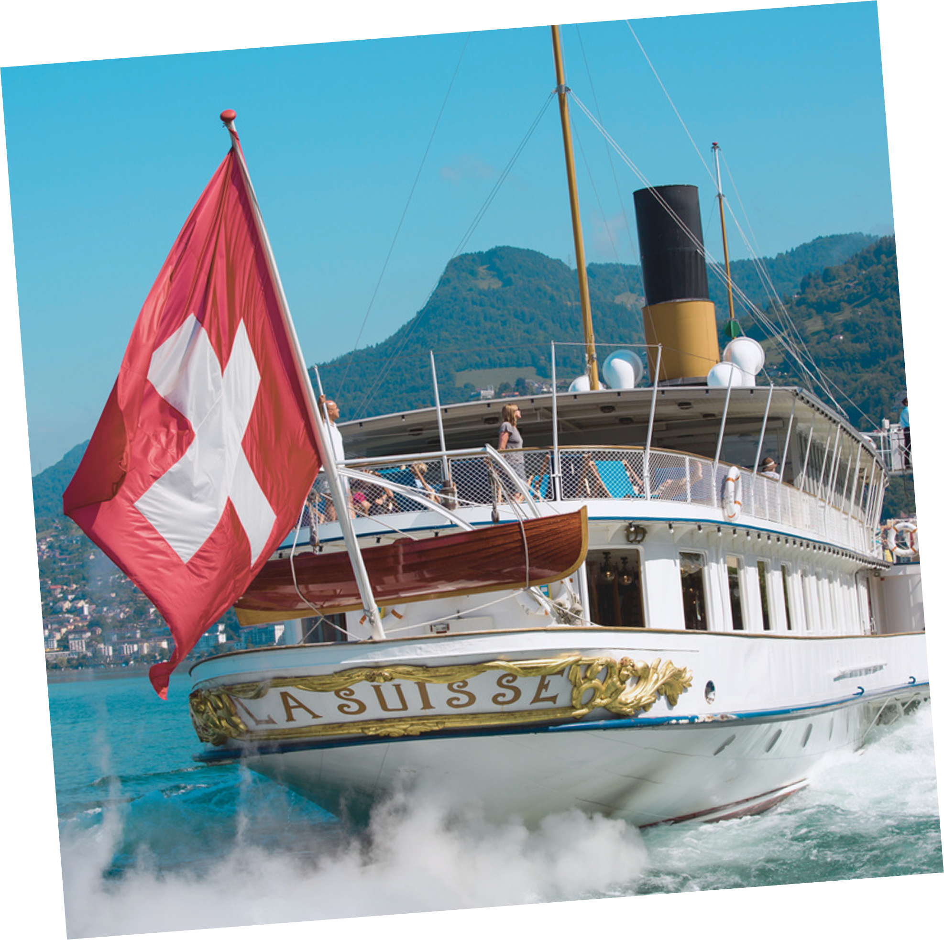
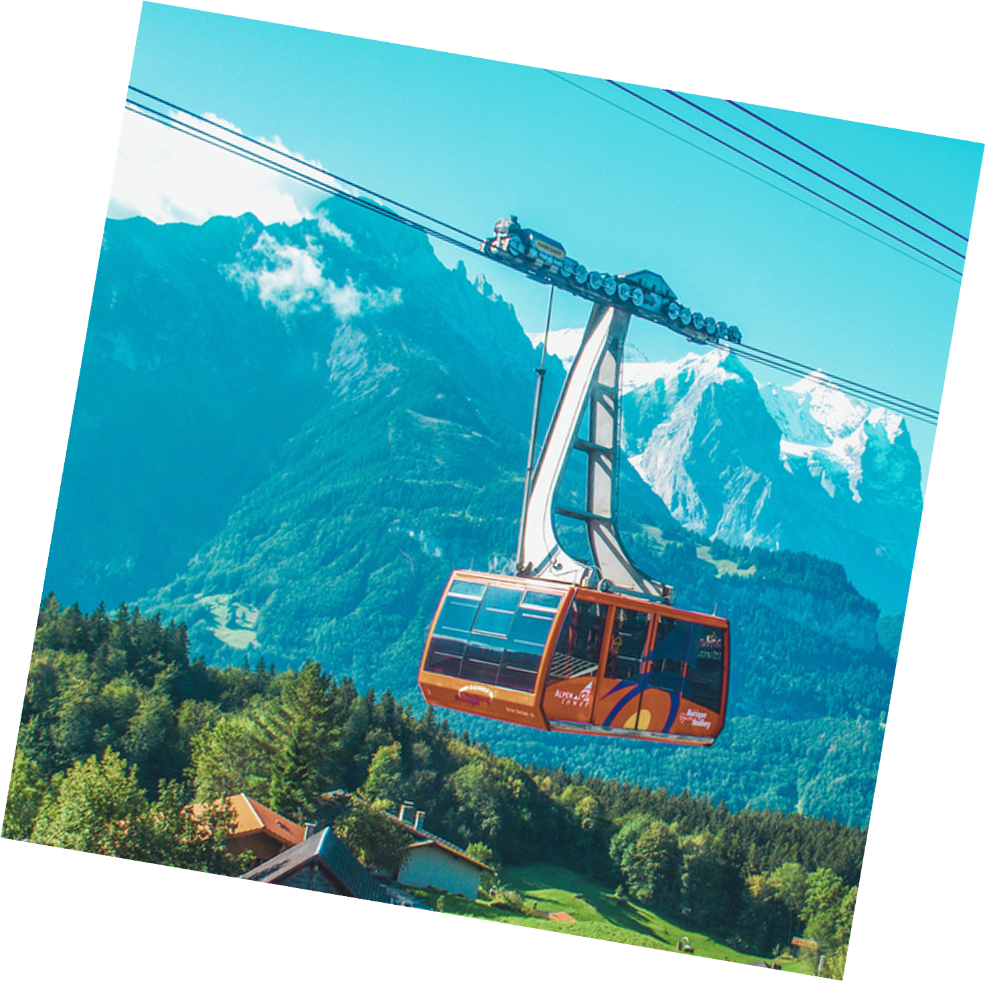

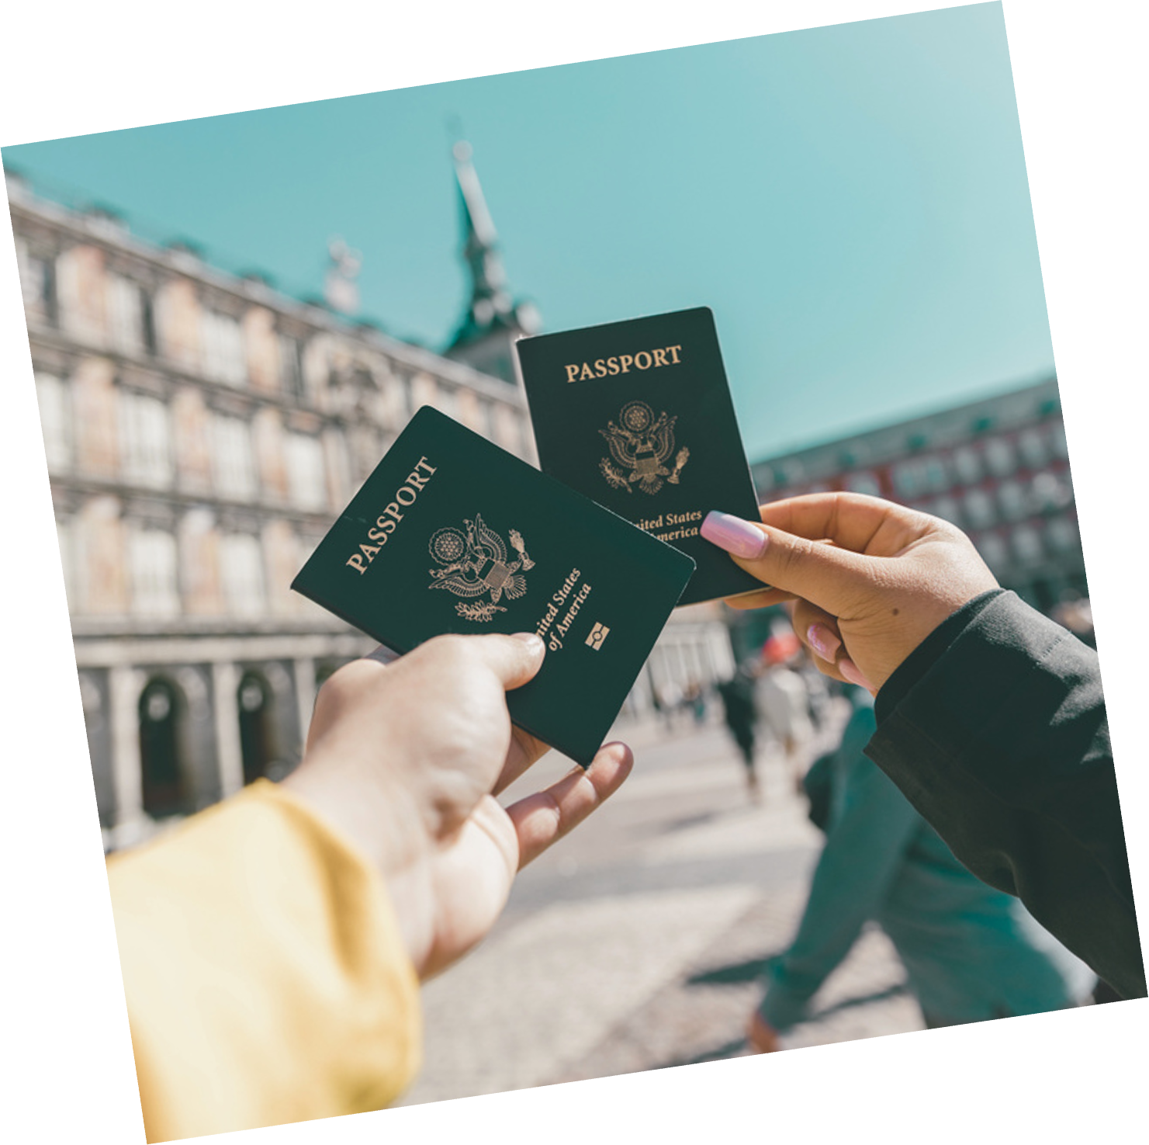








Trip Travel Tours
Holiday Travel
Deals and Getaways
ENJOY
30% OFF
FLY WITH US
123-4567-8910
hello@triptraveltours.com
triptraveltours.com

Slide 2

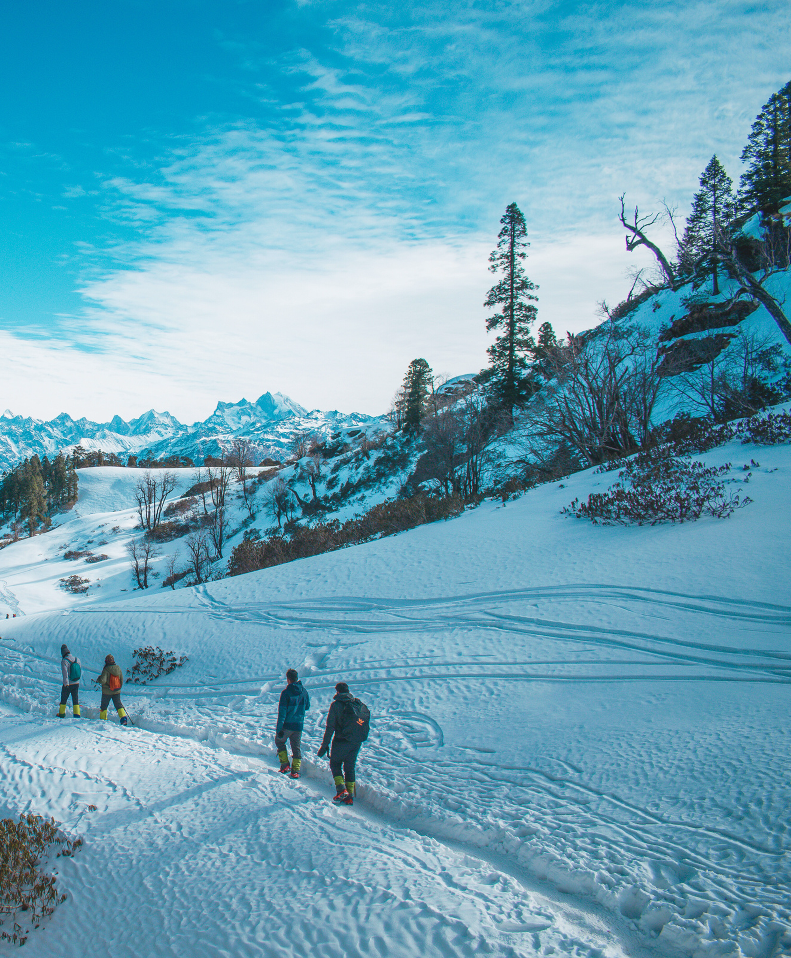

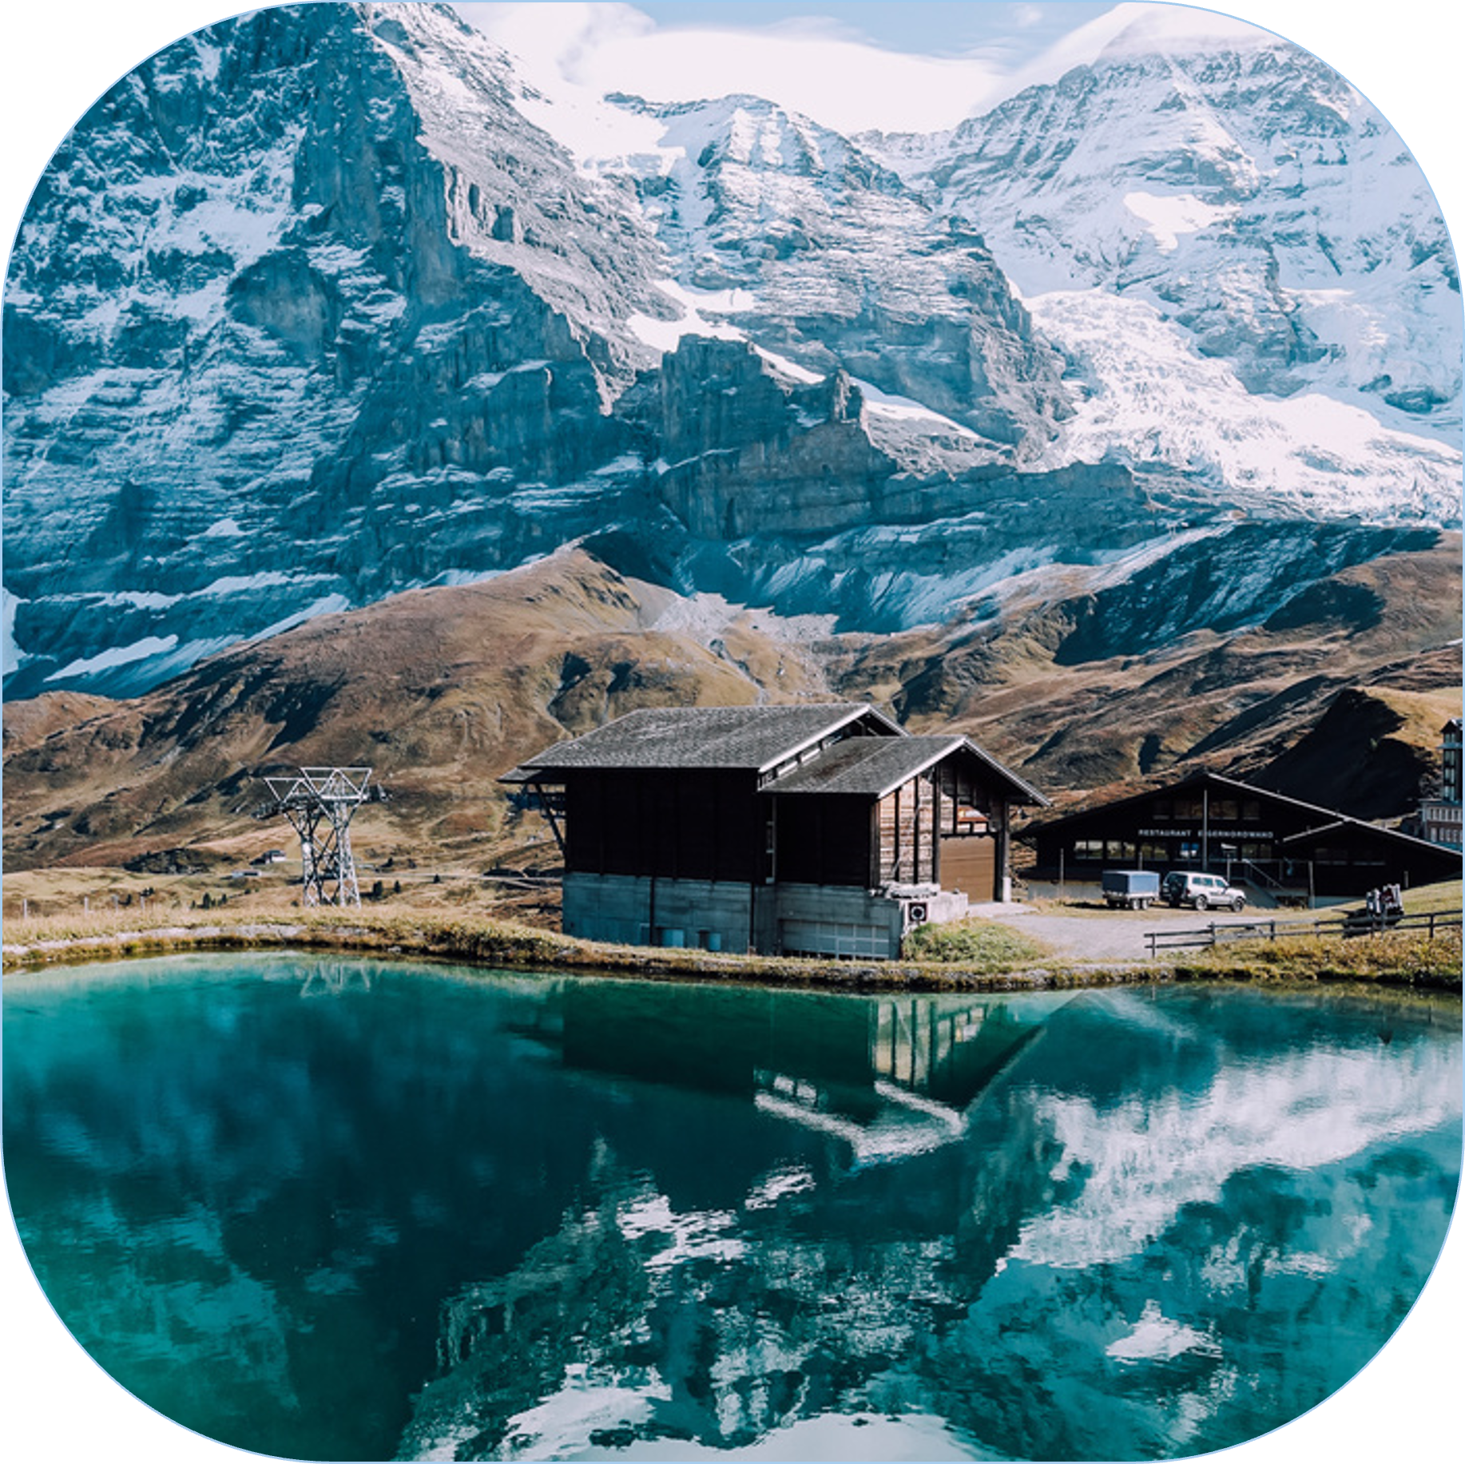


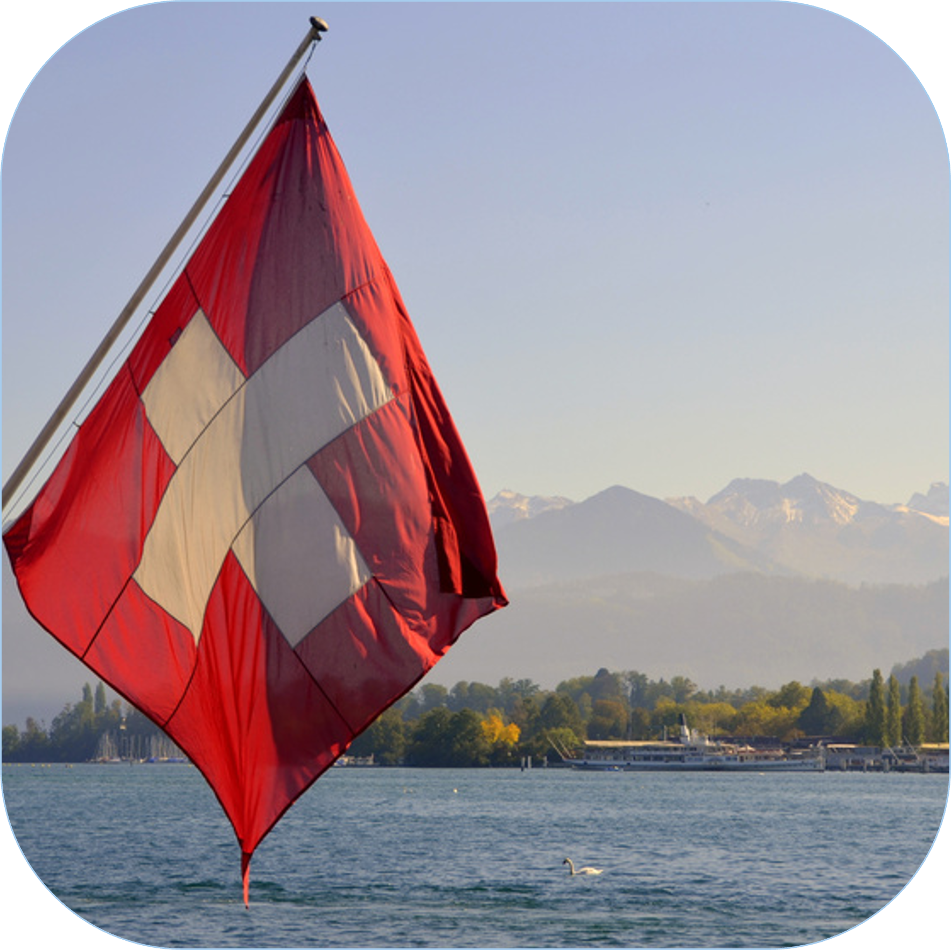

Trip Travel Tours Agency
Holiday Travel
Deals and Getaways
Up to 30% off!
7-DAY
Swiss Adventure
TRAVEL DATES:
December 1, 2025 - January 30, 2026
Guided tours of Zurich, Lucerne, and Interlaken and the Swiss Alps.
CALL US NOW!

Slide 3
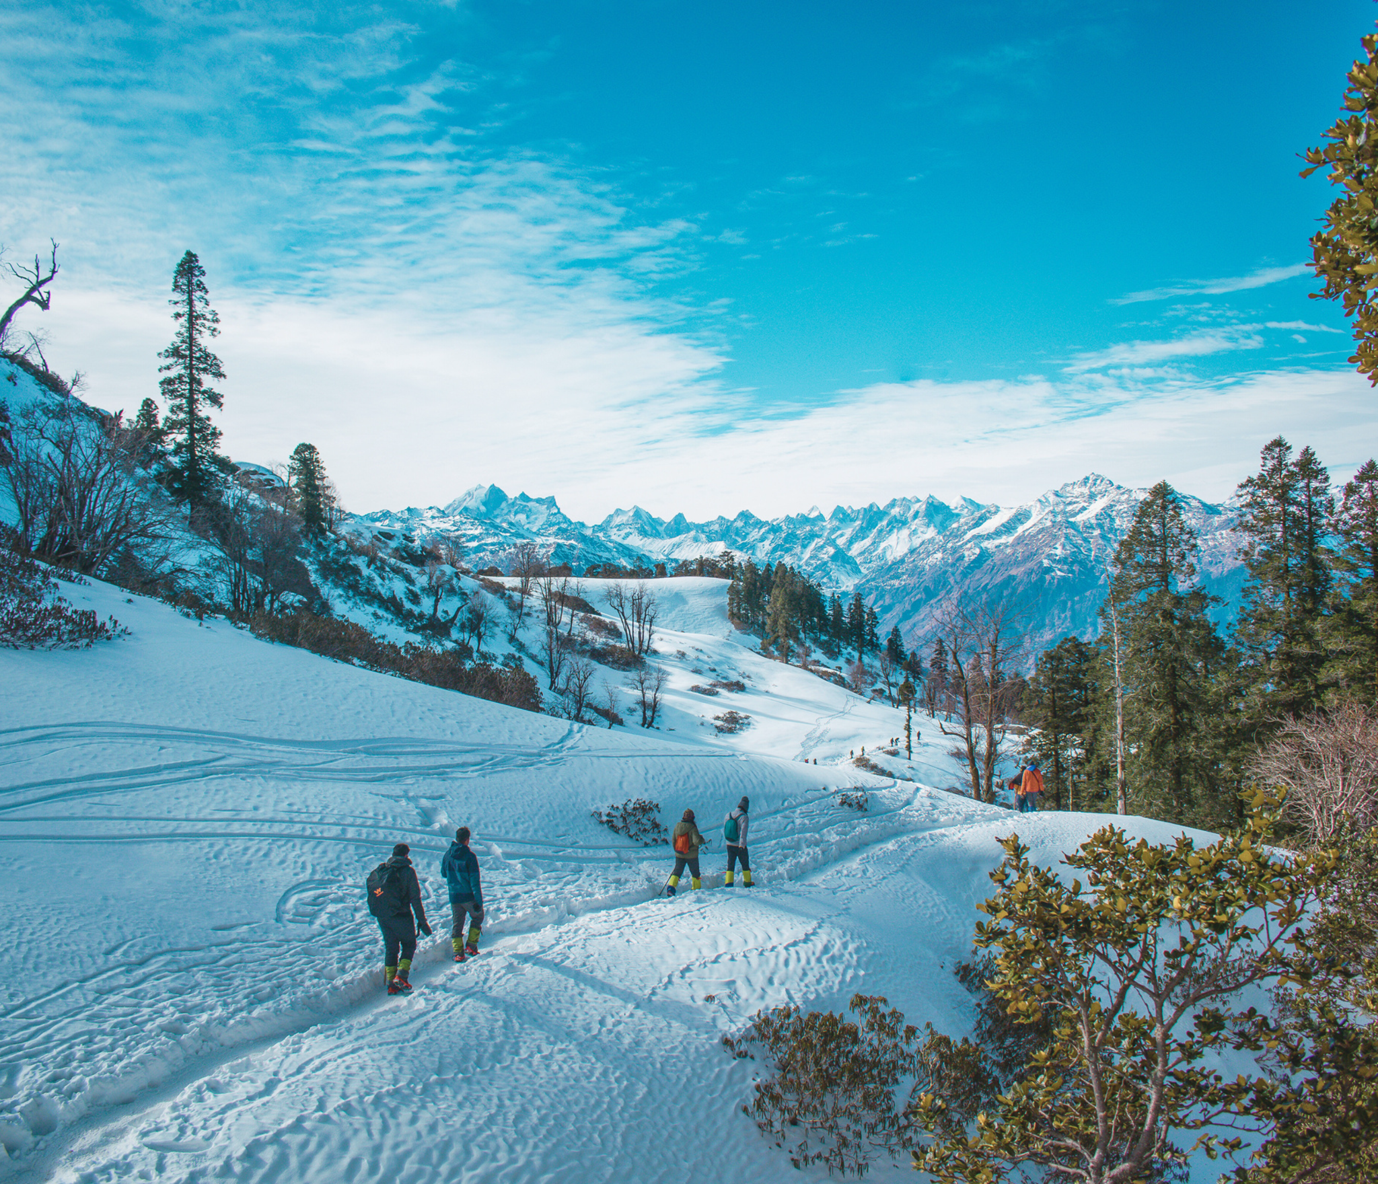

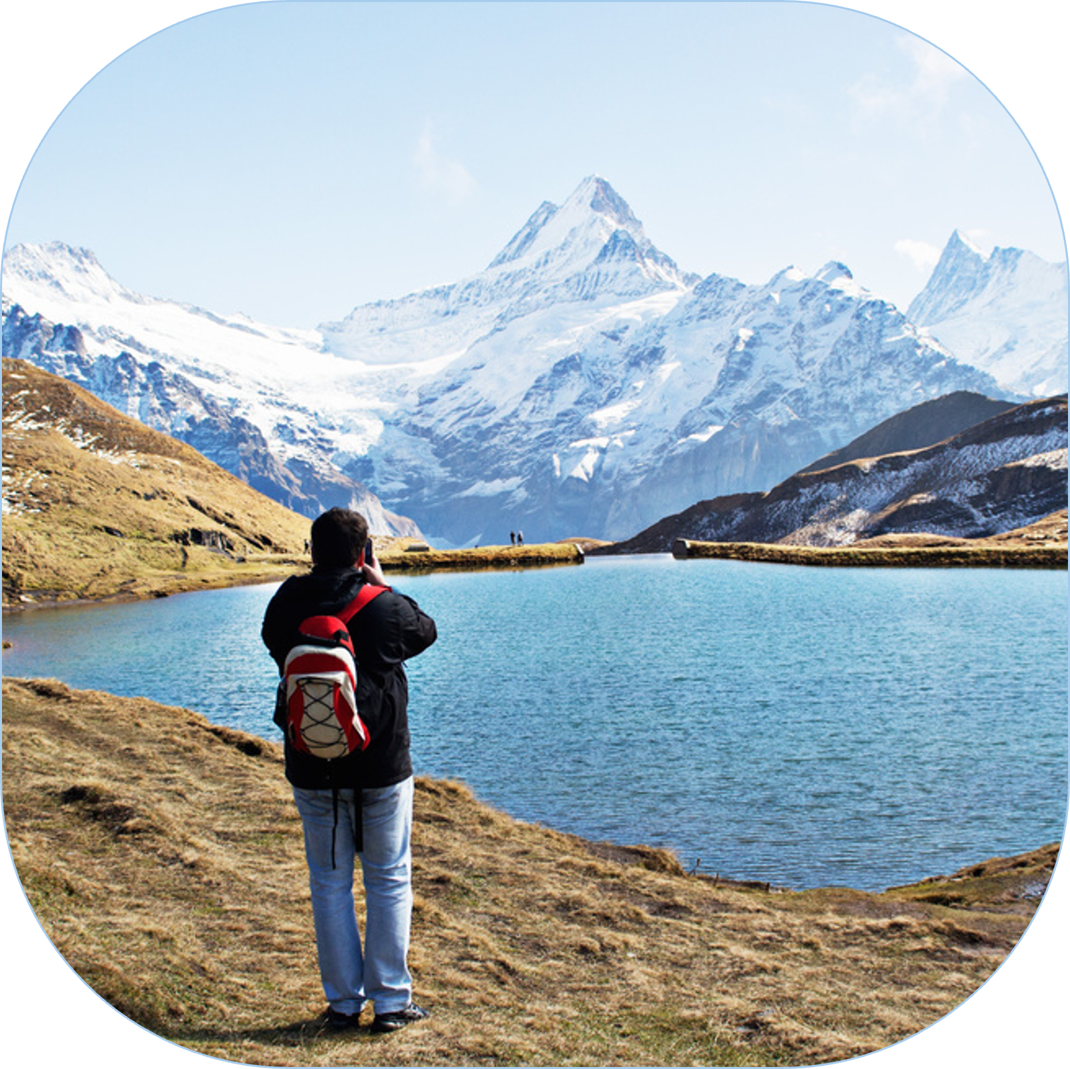
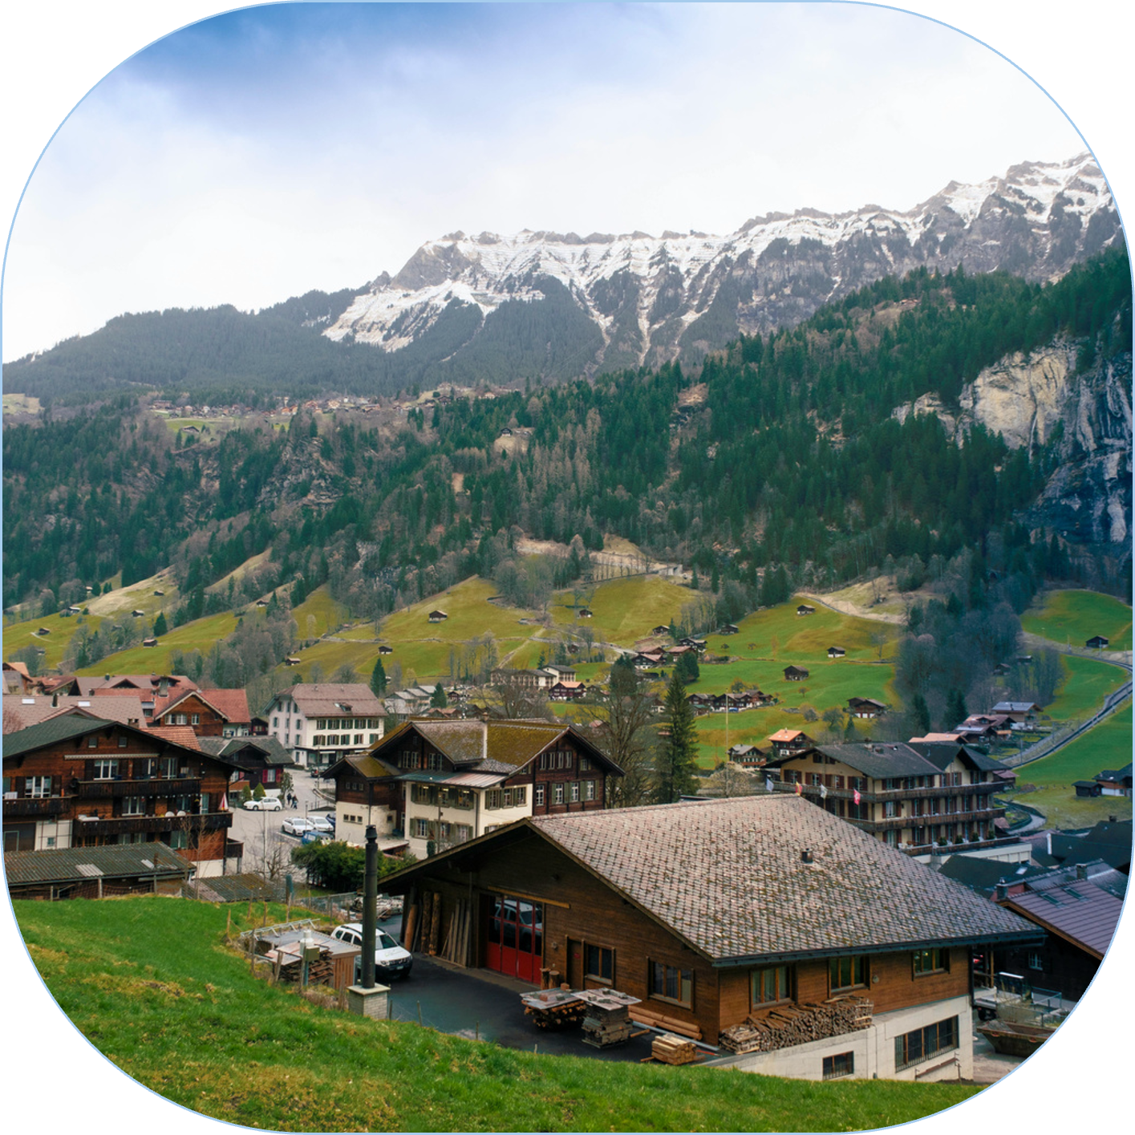


Trip Travel Tours
Holiday Travel
Holiday Travel
Deals and Getaways
7-Day Swiss Adventure
Starting from $1,299!
Includes:
Travel Dates:
  Round-trip airfare from major cities
December 1, 2025 - January 30, 2026
  6 nights in charming hotels
Limited Spots Available! Don’t miss your chance to experience the magic of Switzerland!
  Daily breakfast & authentic Swiss dinner
  Guided tours of Zurich, Lucerne, and Interlaken
BOOK US NOW!
  Scenic train rides through the breathtaking Swiss Alps
123-4567-8910
hello@triptraveltours.com
triptraveltours.com

Slide 4




Trip Travel Tours
7-DAY
Swiss Adventure
Starting from $1,299!
Includes:
Travel Dates:
  Round-trip airfare from major cities
December 1, 2025 - January 30, 2026
  6 nights in charming hotels
Limited Spots Available! Don’t miss your chance to experience the magic of Switzerland!
  Daily breakfast & Swiss dinner
  Guided tours of Zurich, Lucerne, and Interlaken
  Scenic train rides through the breathtaking Swiss Alps
FLY WITH US
123-4567-8910
hello@triptraveltours.com
triptraveltours.com

Slide 5
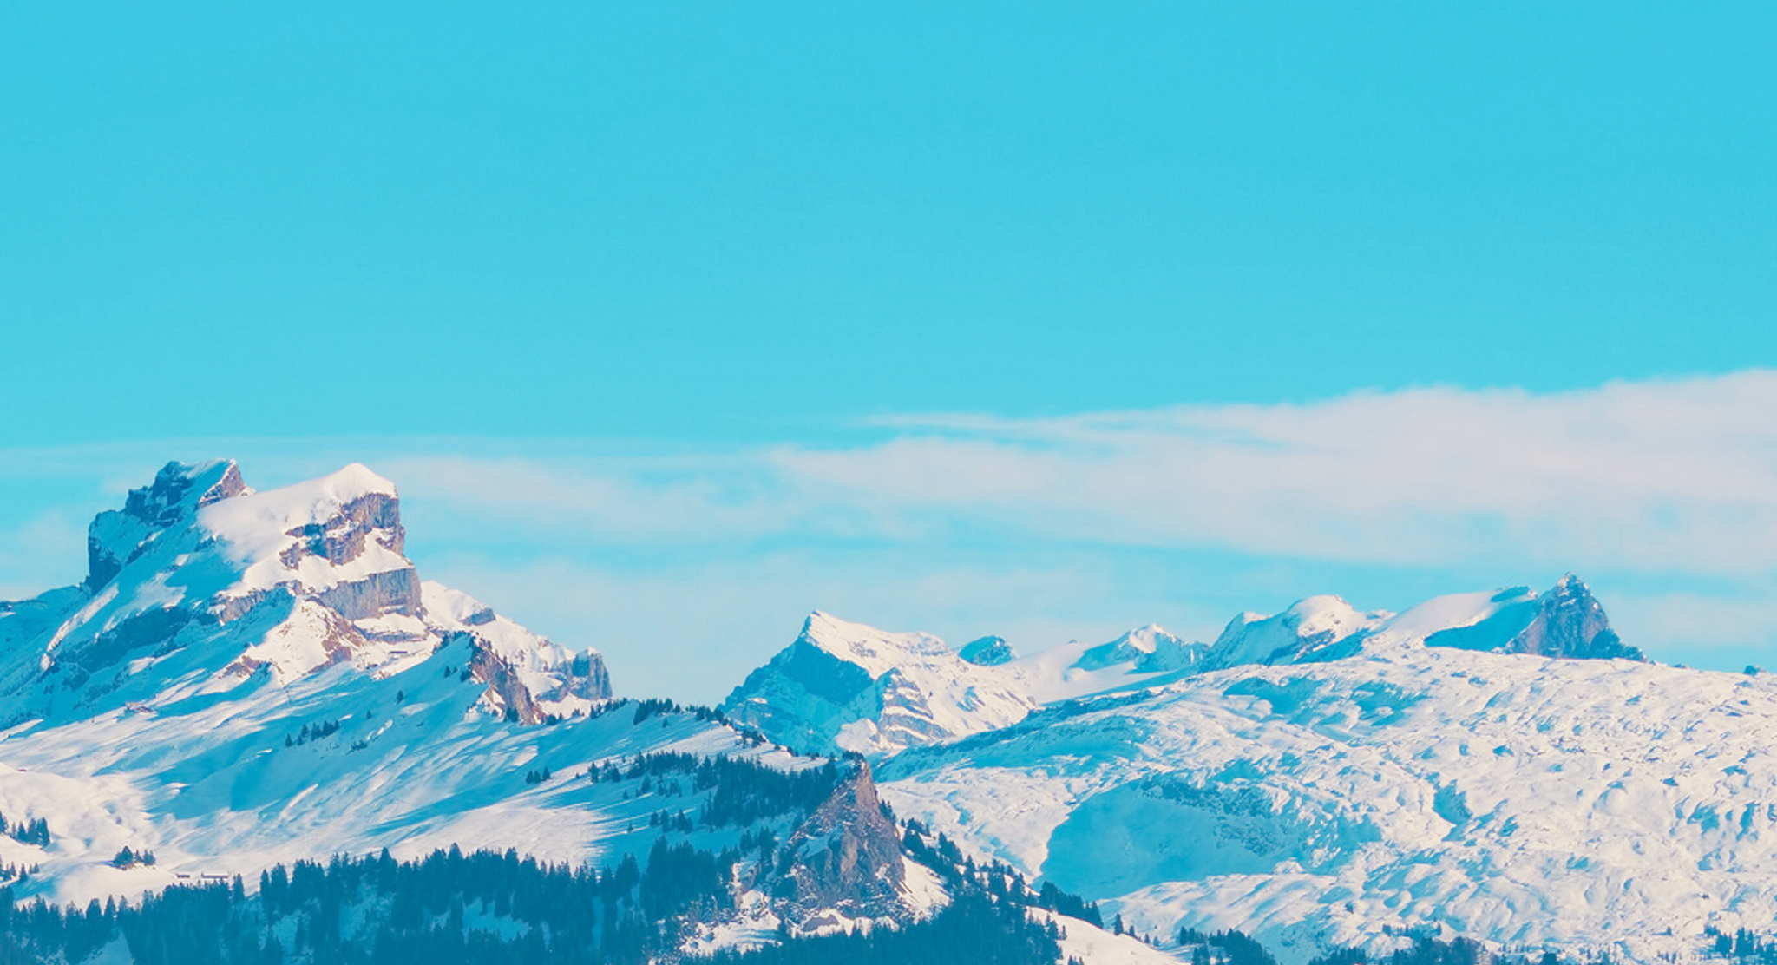


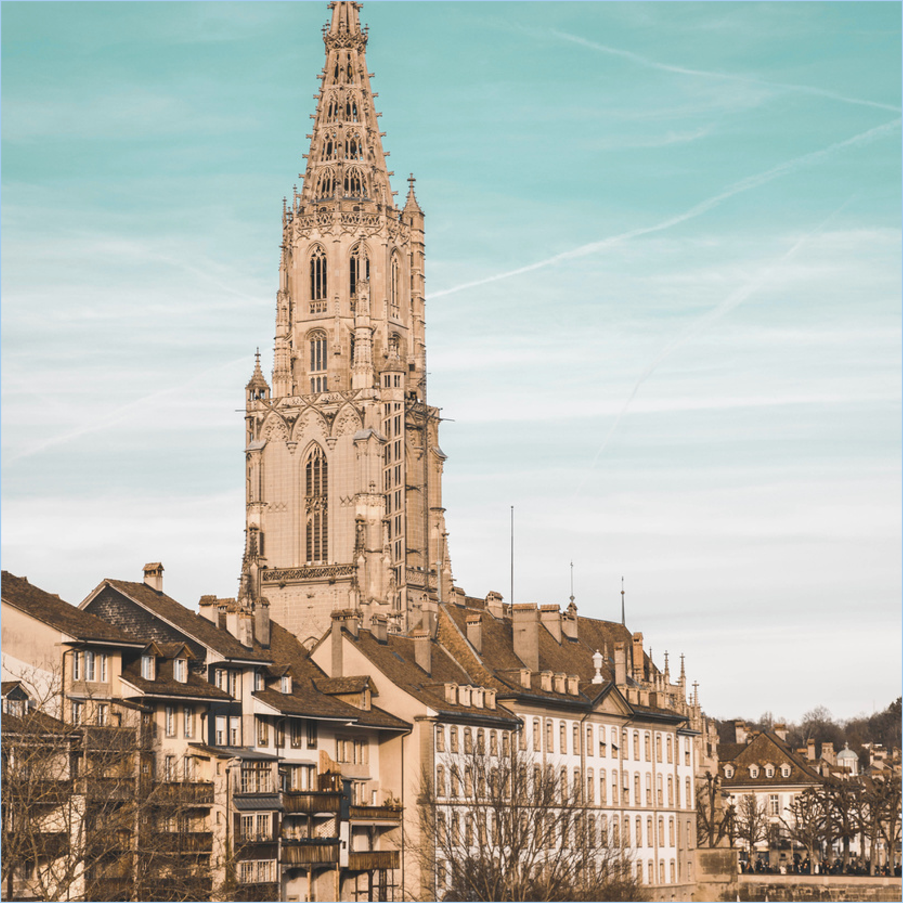






Trip Travel Tours
Holiday Travel
Deals and Getaways
EXPLORE THE LAND OF
ALPINE WONDERS
Starting from $1,299!
Includes:
BOOK US NOW!
  Round-trip airfare from major cities
  6 nights in charming hotels
Travel Dates:
  Daily breakfast & authentic Swiss dinner
  Guided tours of Zurich, Lucerne, and Interlaken
December 1, 2025 - January 30, 2026
  Scenic train rides through the breathtaking Swiss Alps
Limited Spots Available! Don’t miss your chance to experience the magic of Switzerland!
123-4567-8910
hello@triptraveltours.com
triptraveltours.com

Slide 6









RESOURCE PAGE
  Use these design resources in your Canva Presentation.
Fonts
Colors
This presentation template
uses the following free fonts:
TITLES AND HEADER:
Kalam
#E7EEF4
#AB2B2C
BODY COPY:
Koho
You can find these fonts online too.
#A6CCED
#353970
#2EBDDB
  Design Elements

Slide 7
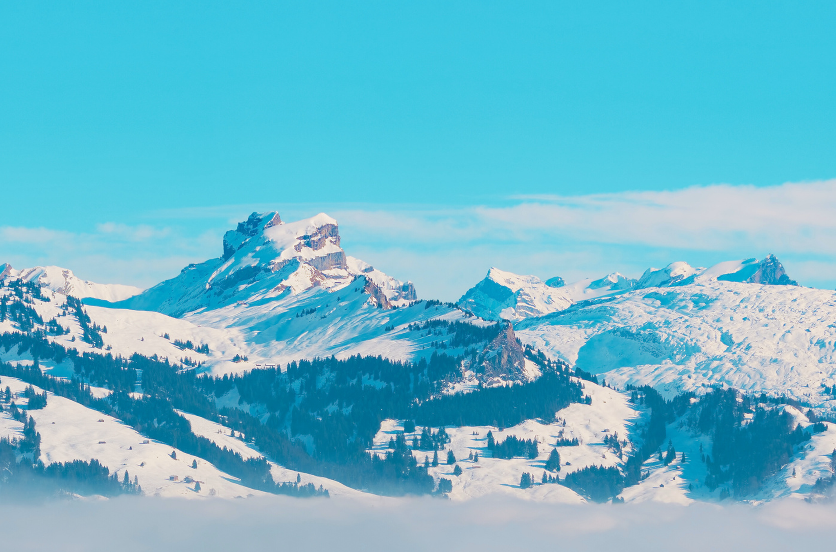

CREDITS
This design template is free for
  everyone to use thanks to the following:
  for the presentation template
Pexels, Pixabay
  for the photos
Happy designing!

