Slide 1

BIG BRAIN
MEME SLIDES

Slide 2
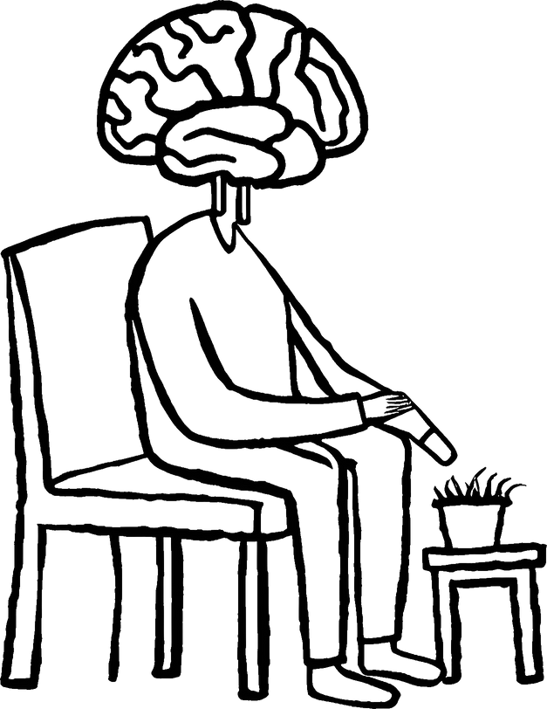
WHEN THE PUZZLE SAYS 6+ YEARS
BUT YOU SOLVE IT IN 1 YEAR

Slide 3

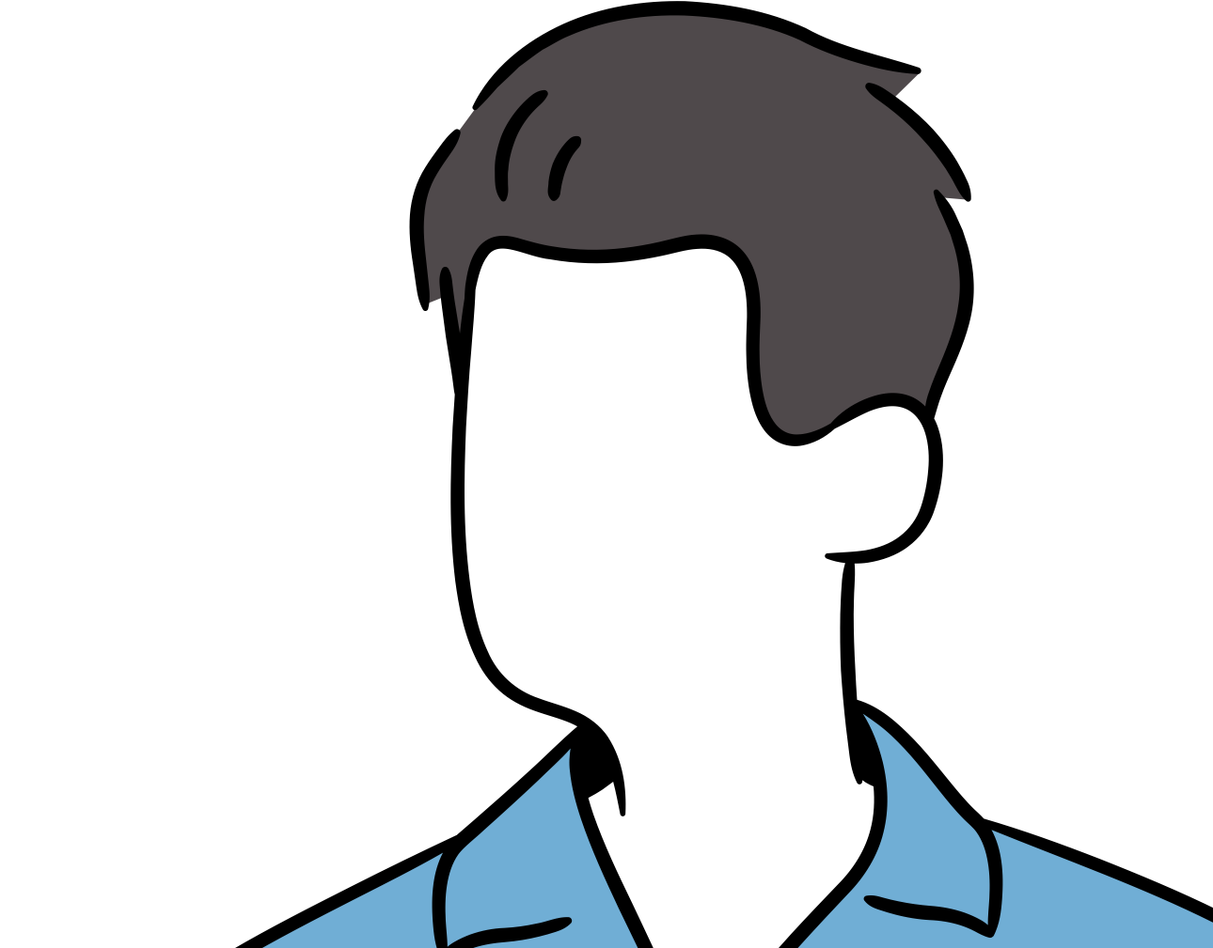




THIS IS WHY
I DON’T ARGUE BACK

Slide 4
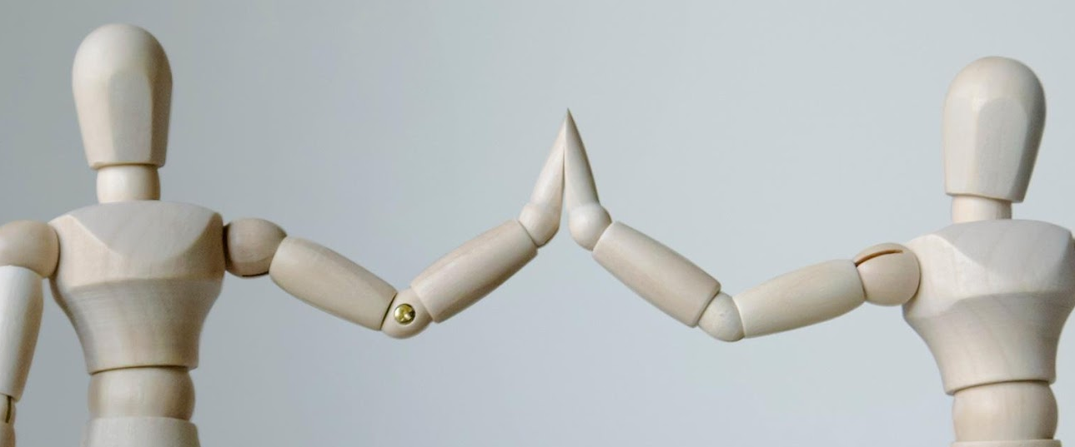
YOU
ME

Slide 5
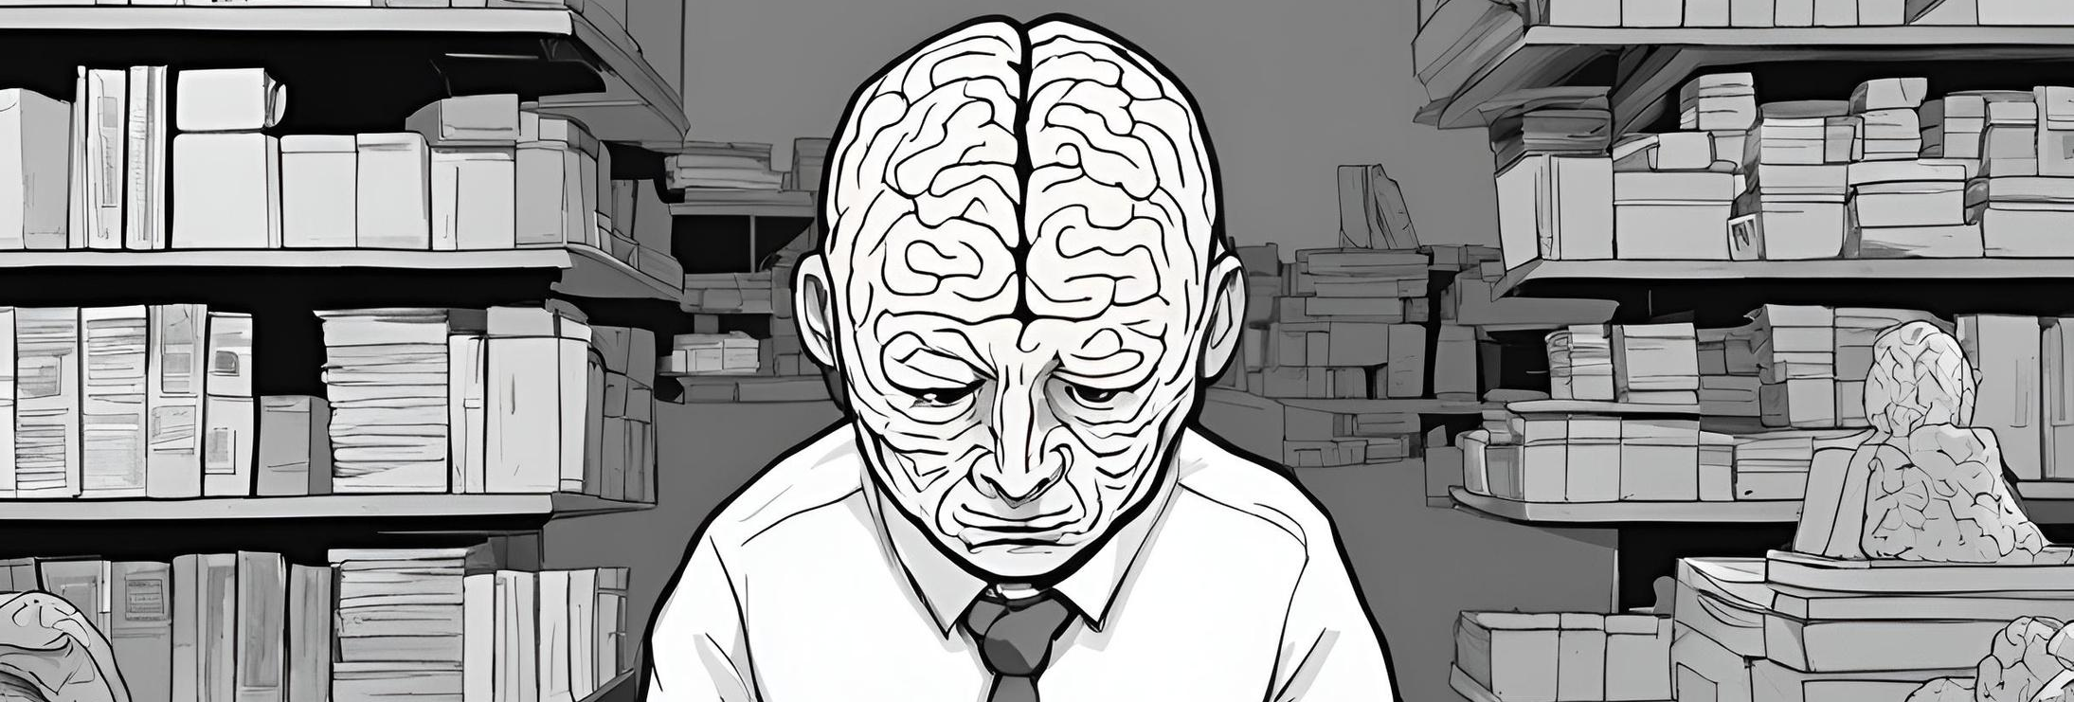
WHEN I FIND THE ANSWER TO A PROBLEM
WITHOUT GOOGLING IT

Slide 6

100% OF THE BRAIN

Slide 7

IT’S
TIME!

Slide 8

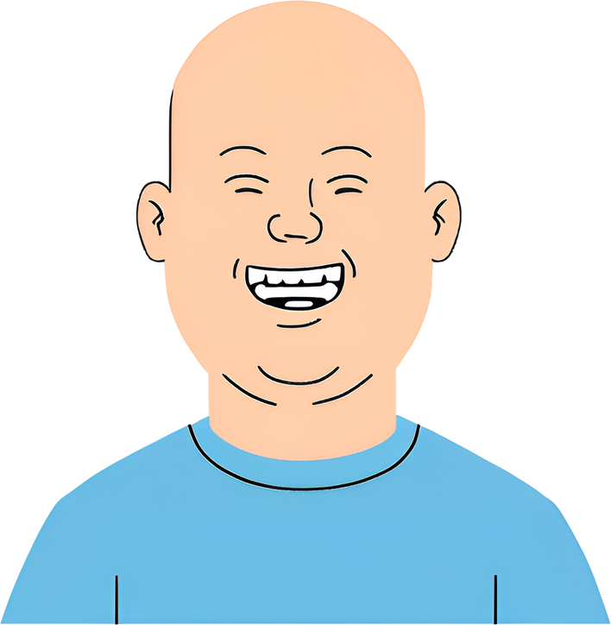
WHEN I REMEMBER SOMEONE’S BIRTHDAY
WITHOUT A FACEBOOK REMINDER

Slide 9
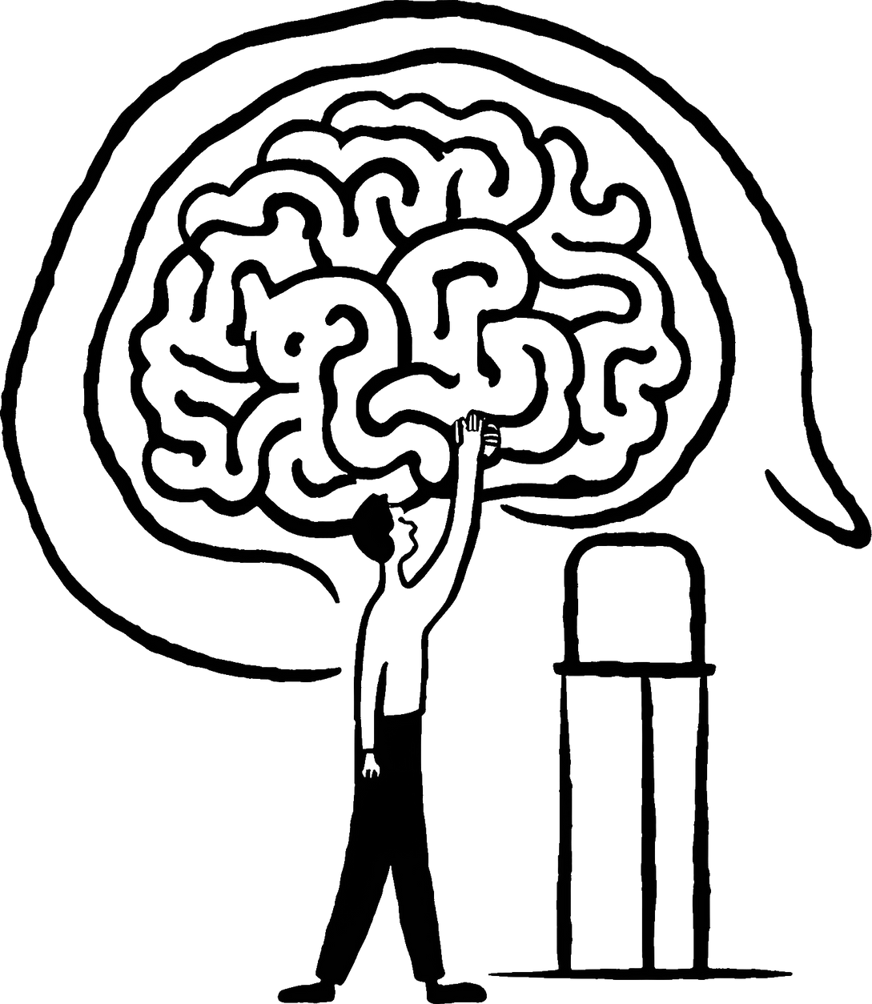
BIG BRAIN MOMENT

Slide 10
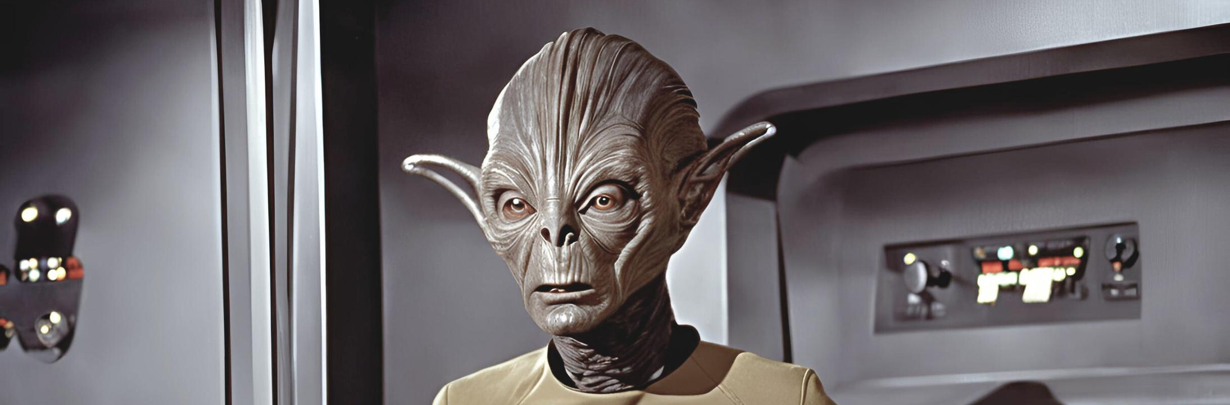
WHEN THE PUZZLE SAYS 4-8 YEARS,
BUT YOU SOLVE IT IN 3 MONTHS

Slide 11


Medium
Small
Mega
BRAIN SIZE

Slide 12

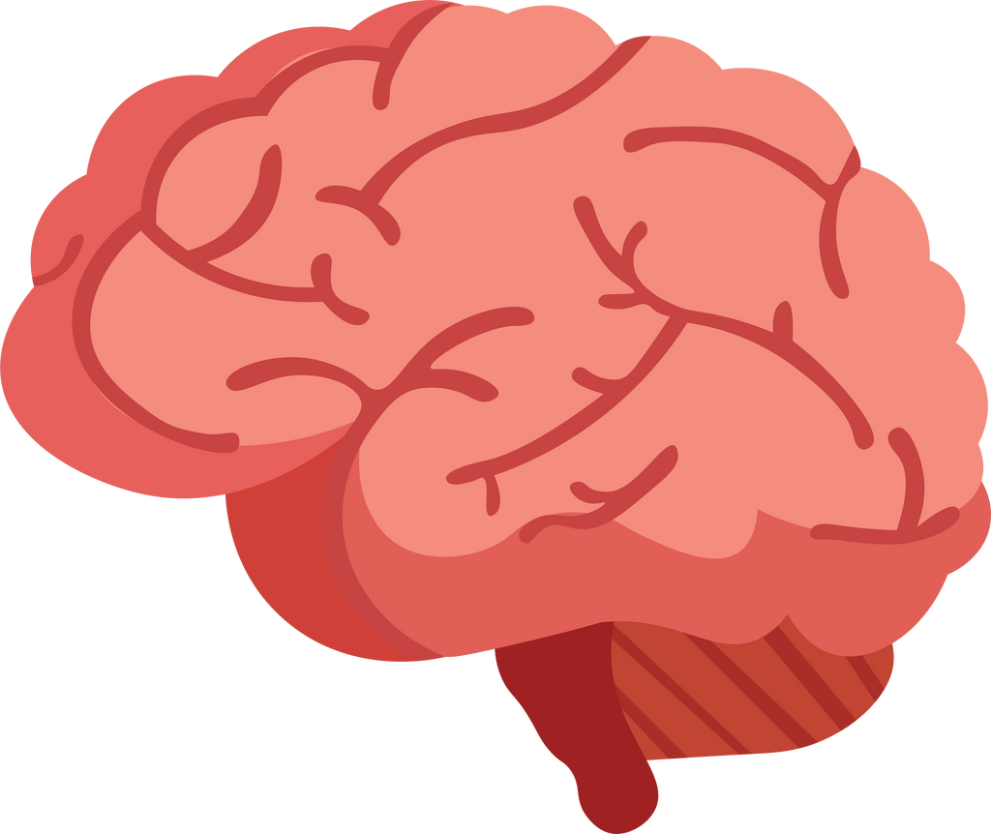
HEY YOU
DROPPED
THIS

Slide 13
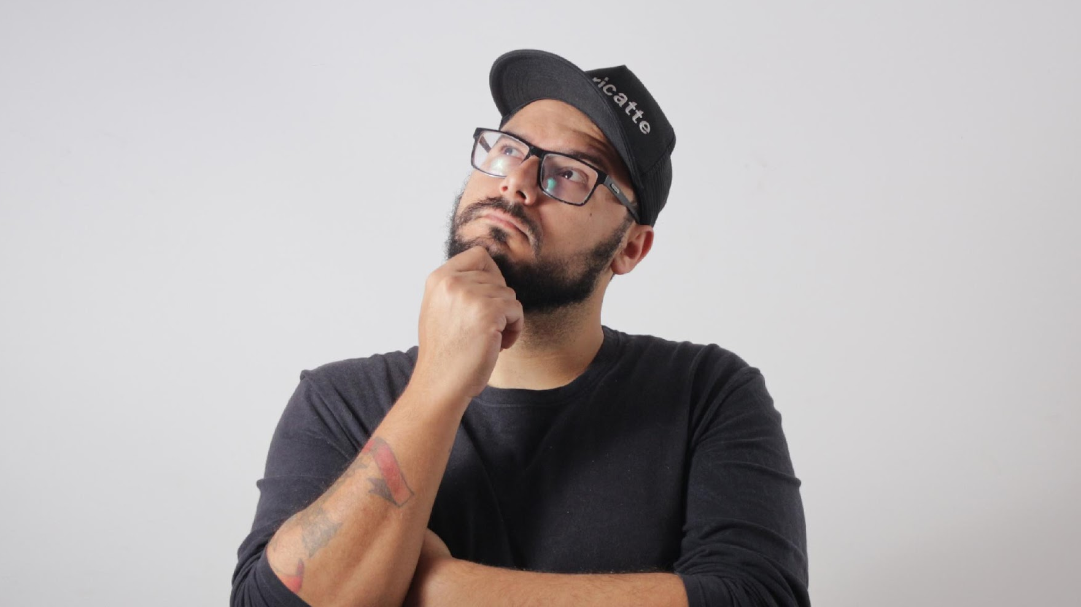


YEAH, THIS IS BIG BRAIN TIME.

Slide 14
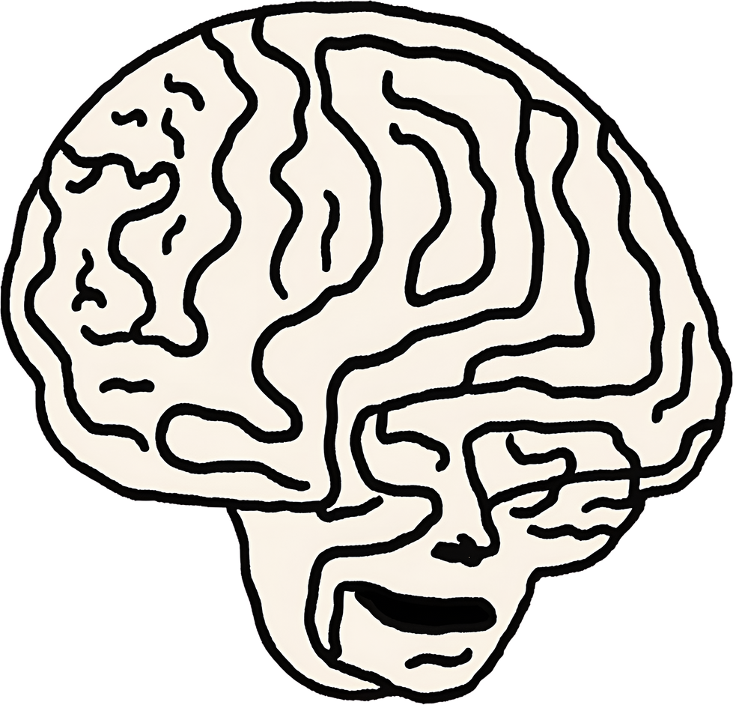
WHEN I REMEMBER MY WORK
PASSWORD ON MONDAY MORNING

Slide 15
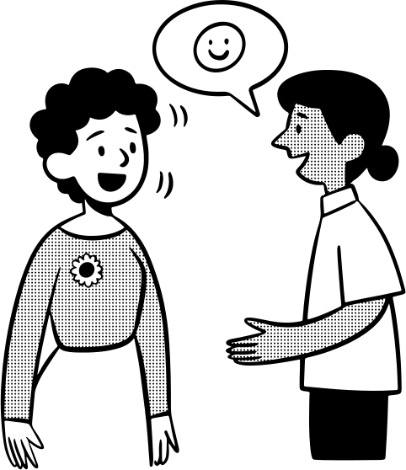

I’VE TRAINED MY MEMORY TO REMEMBER
EVERYTHING WITHOUT REMINDERS

Slide 16
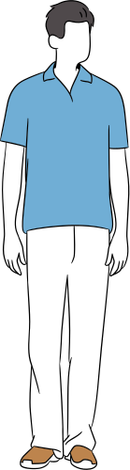




RESOURCE PAGE
  Use these design resources in your Canva Presentation.
FONTS
This presentation template uses the following free fonts:
Titles :
  Oswald
  Headers :
  Oswald
  Body Copy :
  Oswald
You can find these fonts online too.
COLORS
  #E7E8E9
  #70AED5
  #FBB8FF

Slide 17

CREDITS
  This presentation template is free for everyone to use thanks to the following:
  for the presentation template
PEXELS & PIXABAY
  for the photos

