Slide 1


KILI’S COFFEE HOUSE
SIMPLY GREAT COFFEE
COFFEE SHOP
BUSINESS PLAN 2030
Prepared by:
123 Anywhere Street
Andres Schafer
123-456-7890
Edith Fernsby
reallygreatsite.com

Slide 2

CONTENTS
  Executive Summary
  Company Overview
  Market Analysis
  Menu and Pricing Strategy
  Marketing Strategy
  Operations Plan
  Financial Plan
  Growth and Exit Strategy
  Appendix

Slide 3



EXECUTIVE SUMMARY
Capture the essence of your coffee business in this one-page summary. Keep it clear, engaging, and inspiring.
Our mission
At Kili’s Coffee House, we create a welcoming community space where quality coffee meets exceptional service.
Business concept
We will establish a specialty coffee shop located in Any City targeting young professionals and remote workers. Our unique value proposition is ethically sourced beans and local art partnerships.
Success factors
Our competitive advantages include
Direct trade relationships with local farmers
Trained and certified baristas
Locally sourced ingredients
Financial highlights
Initial investment: $150,000
Covering equipment, renovations, initial inventory, marketing, and 3 months of operating expenses
Projected break-even: Month 14
Based on average monthly revenue of $25,000–$30,000 and steady growth
Year 3 revenue projection: $420,000
Assuming 15–20% annual revenue growth and customer retention strategies

Slide 4
COMPANY OVERVIEW
Introduce your business with a quick snapshot of who you are, where you're based, and what you offer.
Legal Structure
Limited Liability Company (LLC)
We chose an LLC for its flexibility and personal liability protection, ideal for our size and growth plans.
Location
123 Anywhere St., Any City, ST 12345
We chose this location for its high foot traffic, close proximity to office buildings and homes, and great visibility on a busy commuter street.
Operating Hours
Monday-Friday 6:30 AM - 7:00 PM; Saturday-Sunday 7:00 AM - 8:00 PM
We chose this location for its high foot traffic, close proximity to office buildings and homes, and great visibility on a busy commuter street.
Business Stage
Pre-launch
We’re in the final stages of buildout, with hiring and marketing already underway. We’re planning a soft opening in June 2030.

Slide 5
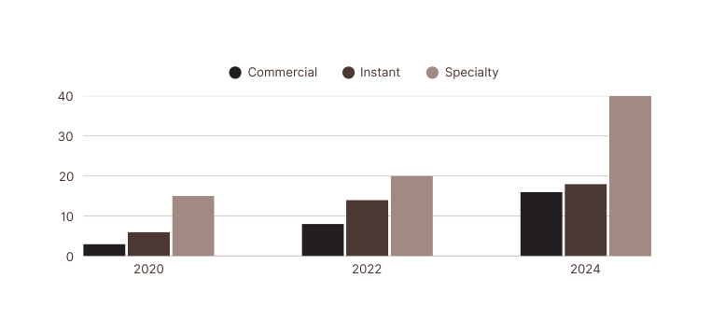


MARKET ANALYSIS
Take a closer look at coffee industry trends, define your ideal customers, and understand your competitors.
Industry Overview
Figure 1. Coffee market share by type
1
2
3
Specialty coffee now accounts for 40% of total coffee consumption.
Interpret the trends in the chart.
Interpret the trends in the chart.
Target Market
Primary Market
Secondary Market
Urban professionals aged 25–40 who value ethically sourced, premium coffee and efficient service
Remote workers and college students seeking a comfortable, reliable space to work and connect

Slide 6

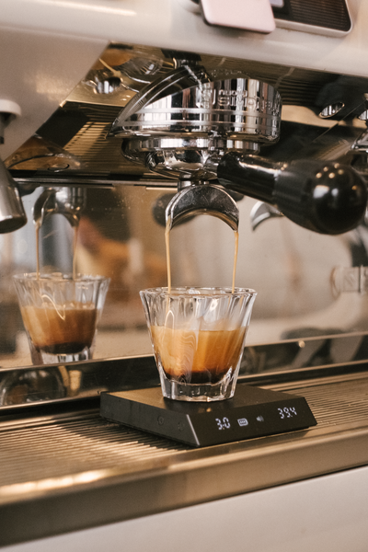
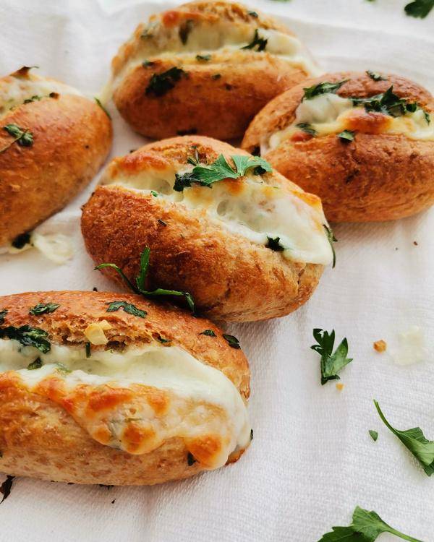
MENU & PRICING STRATEGY
Show what’s on your menu and how you plan to price it.
Core Offerings
Kili’s Coffee House will offer a thoughtfully curated menu that highlights quality, simplicity, and consistency.
House blend
$3.00-$4.50
Espresso drinks
$3.75-$6.50
Baked goods
$3.00-$9.00
Pricing Strategy
We offer tiered pricing to give customers more options, from affordable daily brews to premium drinks for special moments.
Seasonal and Specialty Offerings
To keep our menu fresh and aligned with seasonal trends, we’ll introduce limited-time drinks and treats throughout the year.
Fall
Pumpkin Spice Latte
Winter
Peppermint Mocha
Spring
Lavender Latte
Summer
Iced Matcha

Slide 7

MARKETING STRATEGY
Share how you'll attract and keep customers while building your brand presence.
Brand Identity
Kili’s Coffee House is a warm, community-driven space that brings together simplicity, sustainability, and great coffee.
Brand Identity
Channel | Description
Social media | Focus on Brand A and Brand B, posting 3-5x per week
Partnerships | Collaborate with local yoga studios, bookstores, and artisans to co-host events
Add another channel here. | Describe how you’ll use this to connect with your audience.

Slide 8
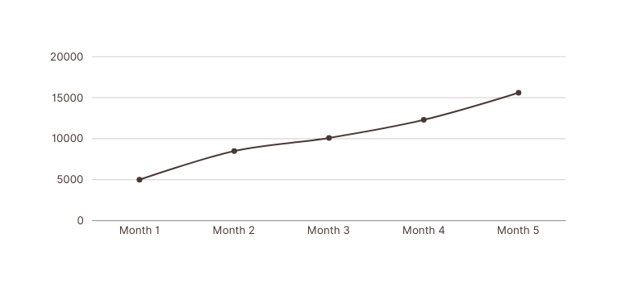
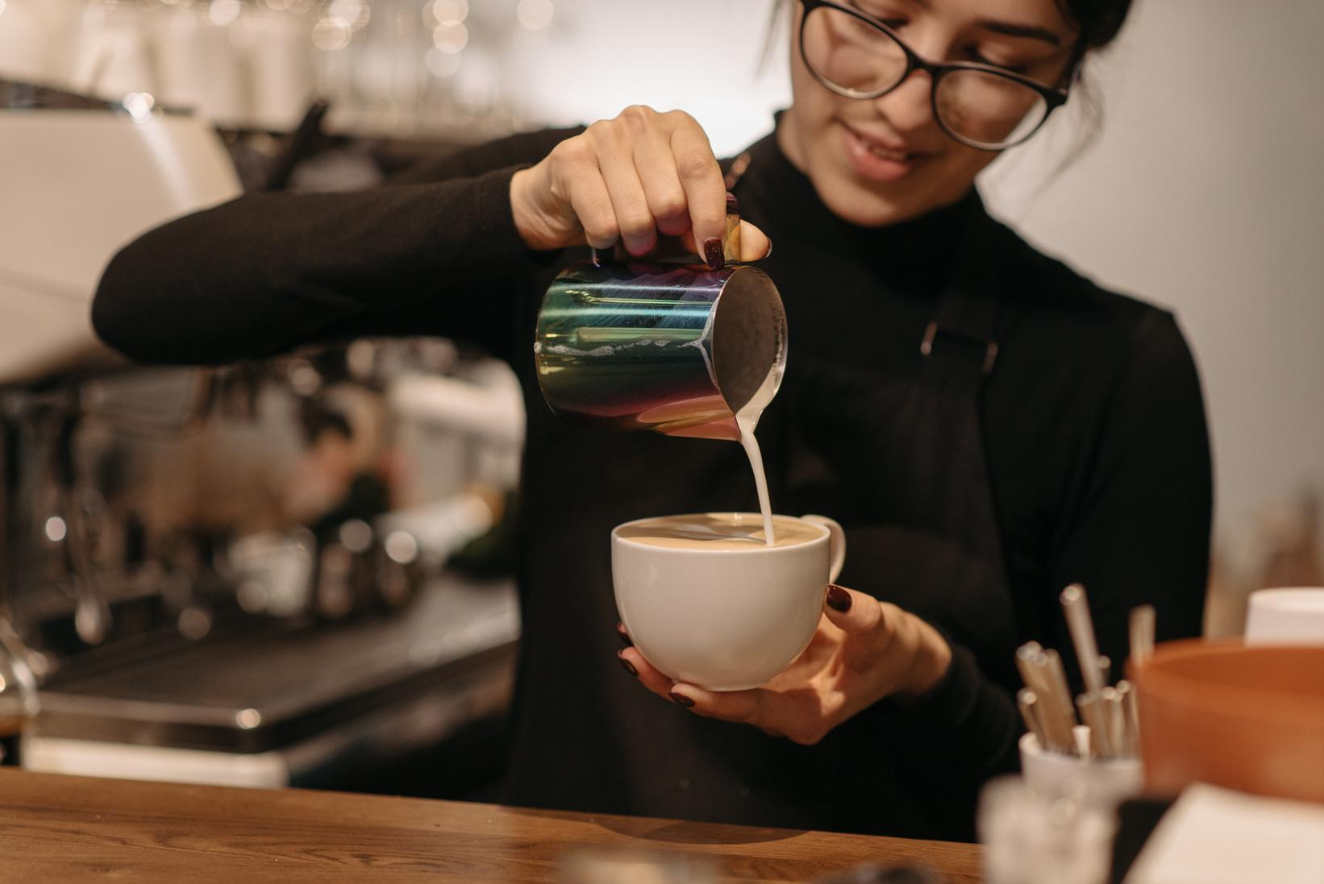

MARKETING STRATEGY
Share how you'll attract and keep customers while building your brand presence.
Sales Projection
Figure 2. Sample monthly sales projection
Customer Retention
Host monthly latte art workshops and coffee tastings to engage regulars.
Use a mobile app to deliver personalized rewards and limited-time offers.

Slide 9

OPERATIONS PLAN
Detail how your coffee shop will run day to day.
Industry Overview
Channel | Description | Estimated Cost
Coffee equipment | Espresso machine, grinders, drip brewers | $35,000
Food prep | Oven, refrigeration, display case | $12,000
Add item here. | Add details here. | $XXX
Staffing Plan
Manager
1 full-time
Baristas
3 full-time
4 part-time
Kitchen support
1 part-time
Staffing Plan
Our success depends on smooth, consistent operations daily.
Equipment checks
Review customer
service standards
Track daily usage
and waste

Slide 10
FINANCIAL PLAN
Share the key numbers that show how your coffee shop will stay sustainable and grow over time.
Monthly Operating Expenses
Category | Monthly Cost
Rent | $1,000
Payroll | $2,500
Inventory | $4,500
Add item here | $X,XXX
Total | $8,000
3-Year Profit and Loss Projection
Category | Year 1 | Year 2 | Year 3
Revenue | $285,000 | $340,000 | $420,000
Cost of goods sold (COGS) | $97,000 | $100,000 | $120,000
Gross profit | $188,000 | $240,000 | $300,000
Operating expenses | $196,000 | $205,000 | $215,000
Net profit | -$8,000 | $35,000 | $85,000
Profit margin | -3.8% | 10.3% | 20.2%

Slide 11

GROWTH & EXIT STRATEGY
Outline your long-term vision, including how the business will grow, evolve, or eventually transition.
Milestones
Month 3
Month 6
Year 2
Year 3
Reach an average of 75 daily customers
Launch Kili’s Coffee Rewards App
Explore opening a second location
Introduce a subscription model for monthly coffee bean deliveries
Expansion Options
Open additional locations in similar high-foot-traffic neighborhoods
1
2
3
Open additional locations in similar high-foot-traffic neighborhoods
Sell branded beans, mugs, and merch online and through boutique retailers
Host barista workshops and community brewing classes to build local engagement
Exit Strategy
  Sell to a regional chain or private equity firm aligned with the brand’s values
  Transition to a franchise model after refining operations and branding
  Owner exits after training internal management to continue operations seamlessly

Slide 12

APPENDIX
Add supporting documents that strengthen your business plan, show your research
Resumes of owners and key management
Relevant experiences of the owners and partners
Full financial statements
Includes a 12-month cash flow projection
Sample menu
Includes pricing and product categories
Interior layout sketches
Preliminary renderings of the coffee shop design
Customer survey insights
Local demographic data and insights gathered during market research

Slide 13
























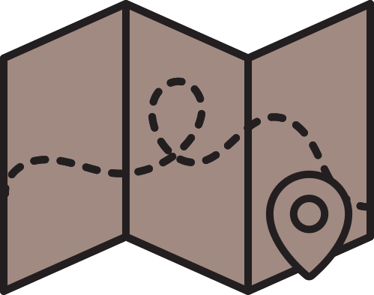














RESOURCE PAGE
  Use these in your template, then delete or hide this page afterward.
Fonts
Colors
This presentation template
uses the following free fonts:
TITLES:
Barlow Semi Condensed
#F8F5F2
#A18A82
BODY TEXT:
Inter Regular, Bold
You can find these fonts online too.
#4B3832
#231F20
Design Elements / Icons

Slide 14

CREDITS
This template is free for everyone to use,
  thanks to the following:
  for this template
PEXELS, PIXABAY, SKETCHIFY
  for the photos, graphics, and elements
HAPPY DESIGNING!

