Slide 1
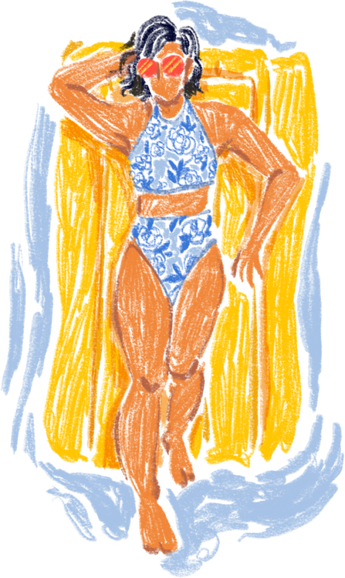
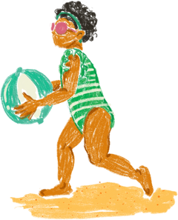
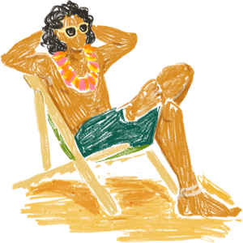
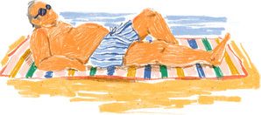
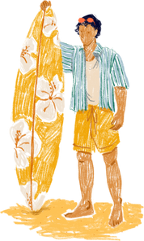
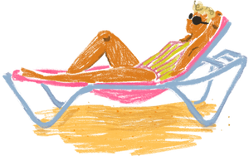
SUN
MON
TUE
WED
THU
FRI
SAT
01
02
03
04
05
06
07
Beach Hopping
08
09
10
11
12
13
14
Tanning Day
Maldives Trip
15
16
17
18
19
20
21
SURFING WEEK!
22
23
24
25
26
27
28
Boracay Trip
29
30
JUNE 2025

Slide 2

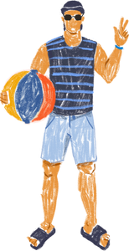
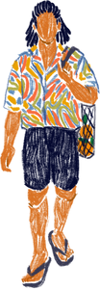
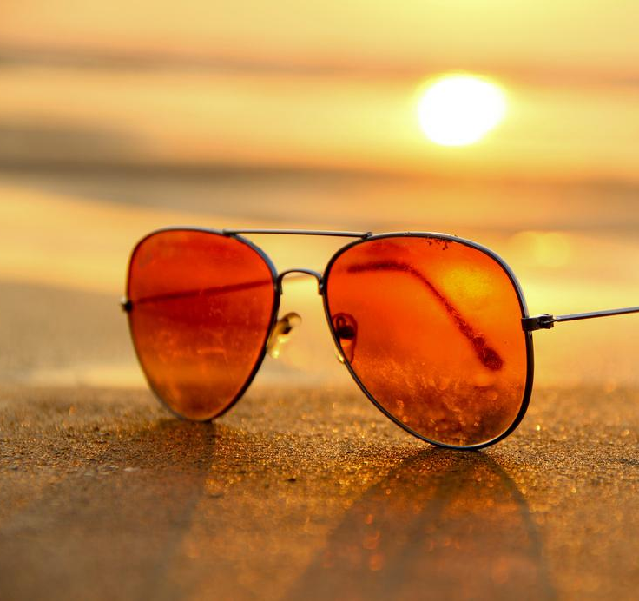
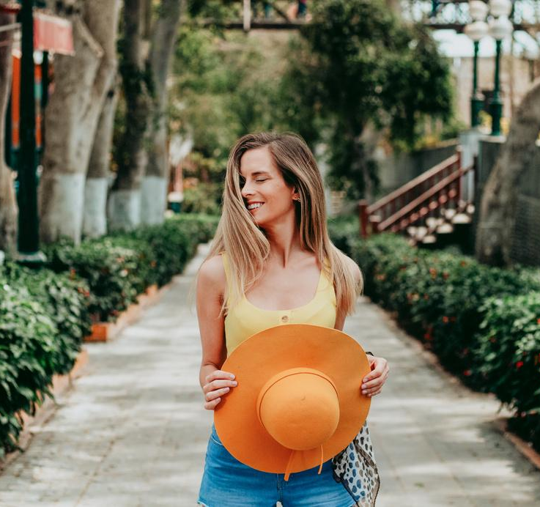
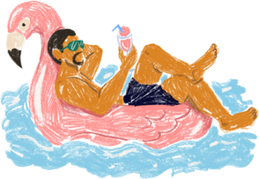
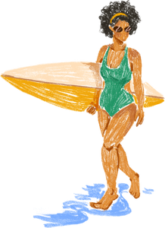
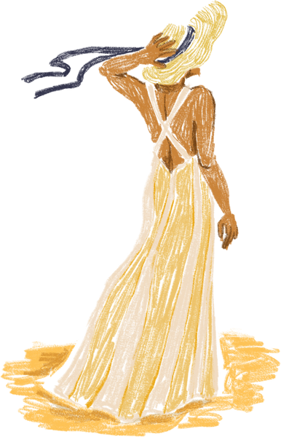
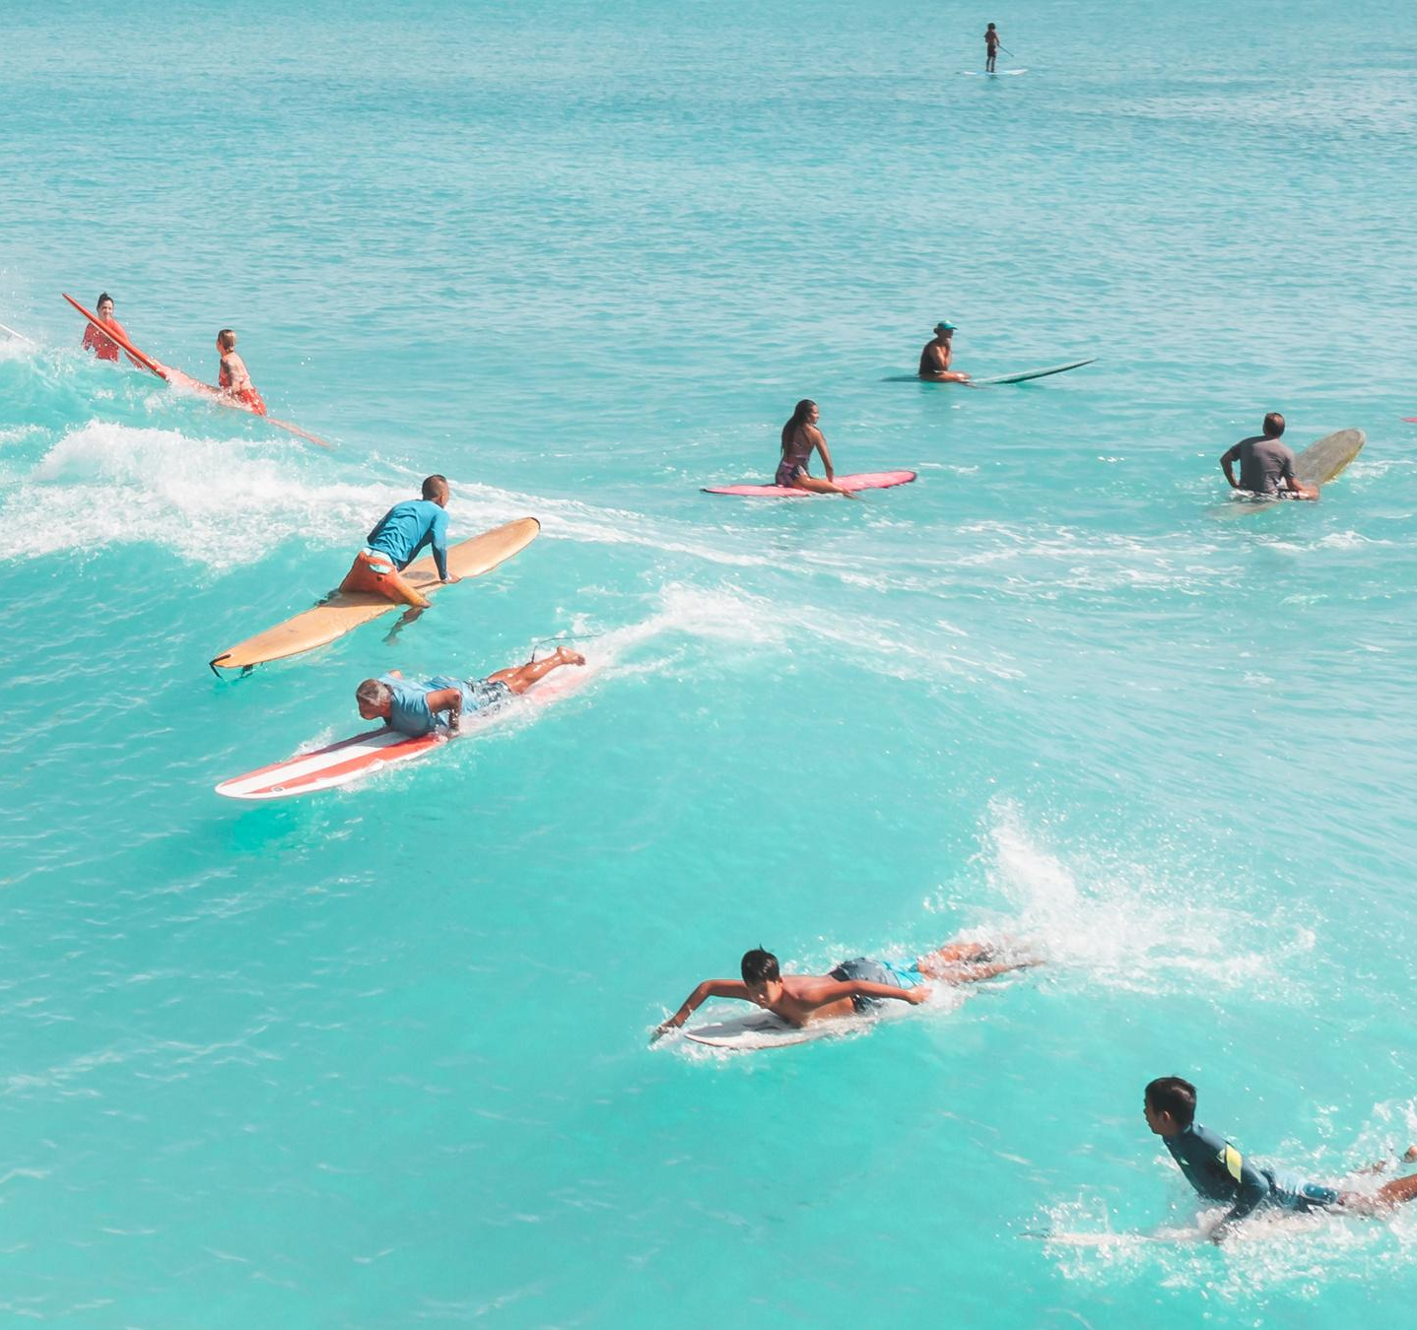
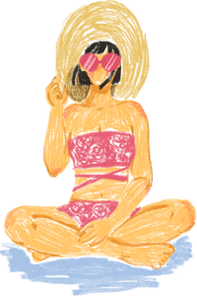
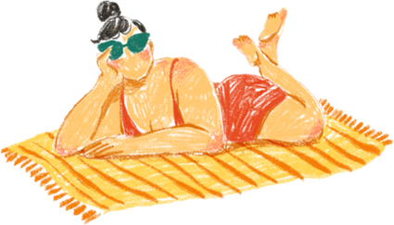
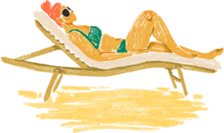
JUNE 2025
WEEK #1 PLANS
HIGHLIGHTS
01
Sun
02
Mon
  Plan a weekend getaway to the beach
  Organize a picnic with friends
  Start a summer reading challenge
  Take a day trip to explore a nearby city or attraction
03
Tue
04
Wed
  Try out new recipes for summer dishes
  Visit a local farmer's market
  Attend outdoor concerts or festivals
BORACAY TRIP
BEST SHOT OF THE TRIP
PLANNING MODE
05
Thu
06
Fri
  Go hiking or camping in a nearby national park
  Set up a home garden or care for indoor plants
REST DAY
07
Sat
REMINDERS
BAY VIEW @ STATION 03
STRESS LESS THIS WEEK!
BORACAY TRIP!

Slide 3
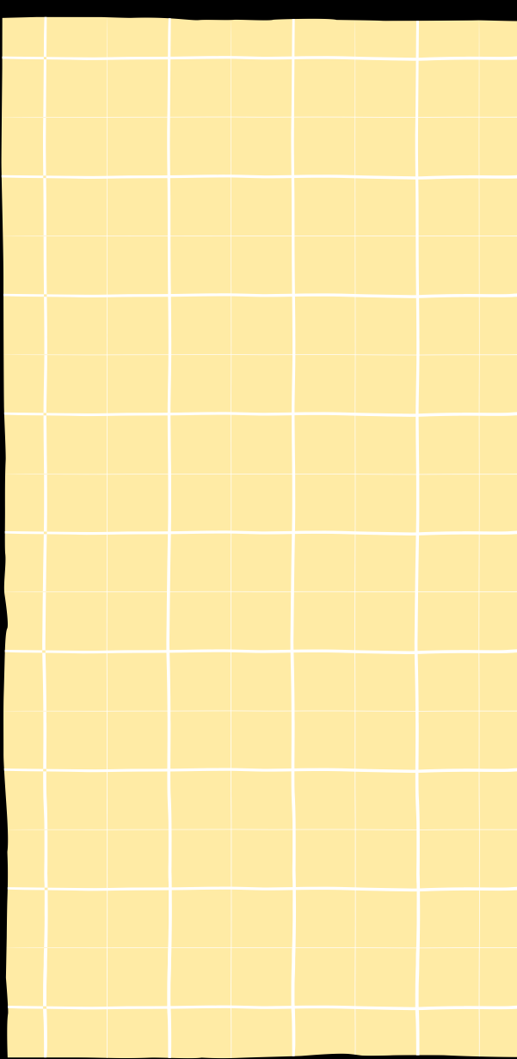
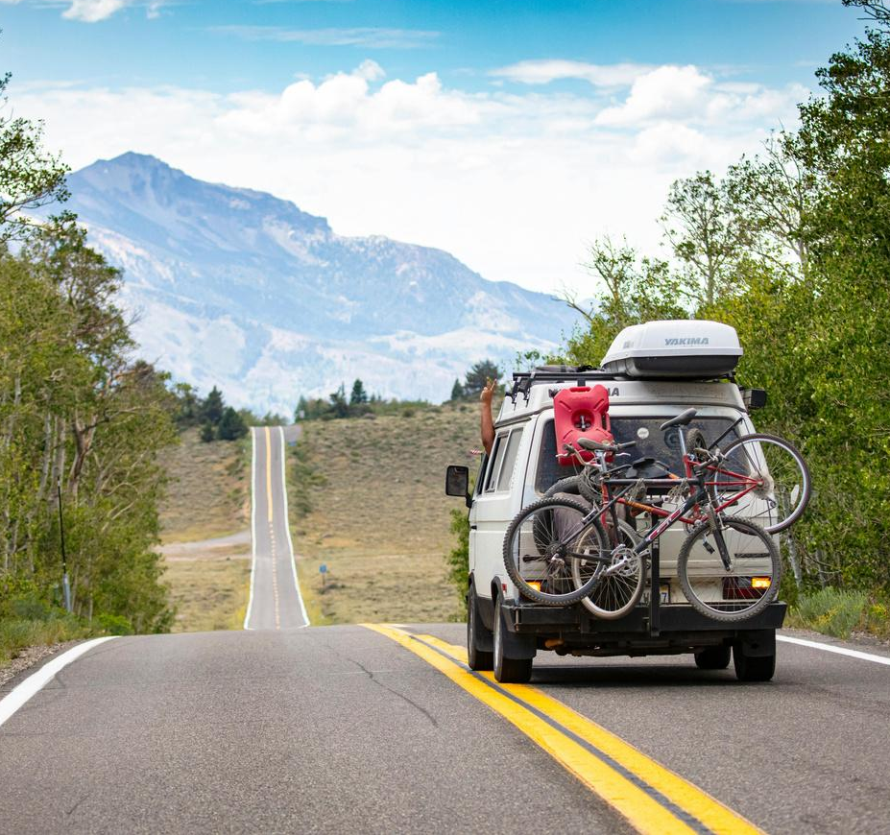
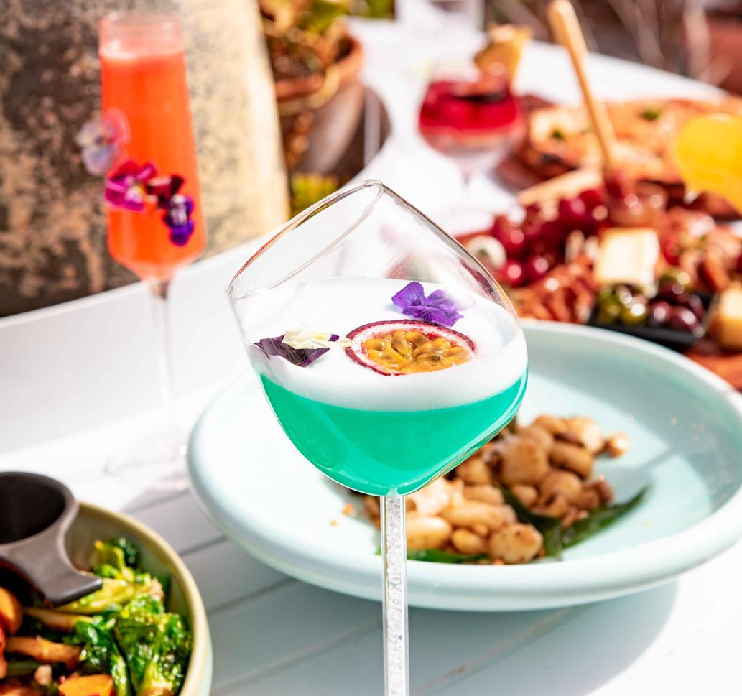
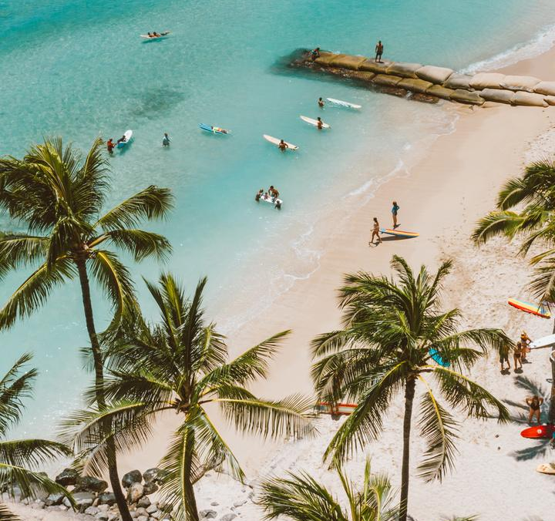
SUN
MON
TUE
WED
THU
FRI
SAT
01
02
03
04
05
06
07
Take a day trip to explore a nearby city or attraction
Beach Hopping
HIGHLIGHT 01
08
09
10
11
12
13
14
Tanning Day
Maldives Trip
15
16
17
18
19
20
21
SURFING WEEK!
Try out new recipes for summer dishes
22
23
24
25
26
27
28
HIGHLIGHT 02
Boracay Trip
29
30
JUNE 2025
Plan a weekend getaway to the beach
HIGHLIGHT 03

Slide 4

RESOURCE PAGE
  Use these design resources in your Canva Presentation.
Fonts
Design Elements
This presentation template
uses the following free fonts:
TITLES:
Monoton
HEADERS:
Montserrat
BODY COPY:
Montserrat
You can find these fonts online too.
Colors
#3C71B7
#FFEBA5
#A0AFC3
#C6D3E5
  DON'T FORGET TO DELETE THIS PAGE BEFORE PRESENTING.

Slide 5

CREDITS
  This presentation template is free for everyone to use thanks to the following:
  for the presentation template
Pexels, Pixabay
  for the photos
  Happy designing!

