Slide 1



Cervical Cancer
Understanding prevention, risk factors,
and early detection

Slide 2

About cervical cancer
Causes
What you’ll learn today
Risk factors
Signs and Symptoms
Prevention
Treatment

Slide 3


About cervical cancer
Define cervical cancer in simple terms. Emphasize that it’s preventable and treatable when detected early.

Slide 4
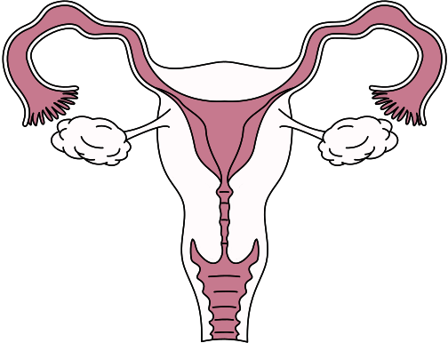

Fallopian tube
About
cervical cancer
Briefly explain the cervix’s role and location in the body. Describe how cervical cancer forms and develops over time.
Uterus
Ovary
Cervix
Vagina
The female reproductive system

Slide 5

4th
Most common cancer in women globally
Cervical cancer in numbers
660,000
Description of the featured statistic
350,000
Description of the featured statistic

Slide 6

Main cause: HPV
Explain what HPV is and how it’s connected to
cervical cancer.
Highlight that most infections are cleared by the immune system, but persistent high-risk types can cause abnormal cell changes that may lead to cancer.

Slide 7



Types
of HPV
Explain that HPV has many types.
Low-risk HPV
High-risk HPV
Describe what these types generally cause and why they’re not cancer-related.
List examples (e.g., HPV 16, 18) and note their strong link to cervical and other cancers.

Slide 8


Myth or fact?
Add two common statements and let the learners decide if they’re true or false.
Statement 1
Statement 2
Insert a widely believed myth here.
Insert a proven fact here.

Slide 9

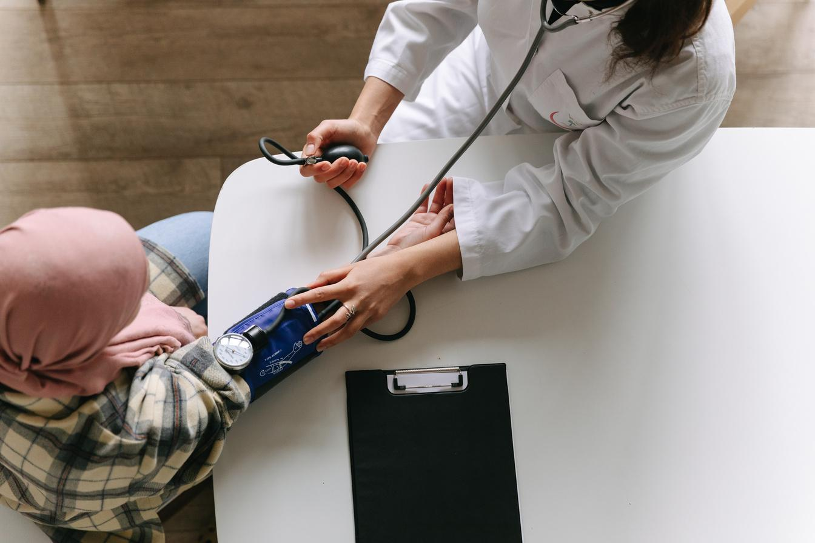

Risk factors
Certain factors can increase the risk of developing cervical cancer
Risk factor 1
Risk factor 2
Risk factor 3
Explain why this increases risk.
Highlight the connection here.
Describe how this factor affects cervical cells.

Slide 10

Signs and symptoms
Symptom 1
1
Add a brief description.
Early cervical cancer often has no symptoms. As it advances, symptoms
may include:
Symptom 2
2
Explain what to look for.
Symptom 3
3
Describe when it might appear and why it’s important.

Slide 11

Prevention
Cervical cancer is one of the most preventable cancers.
Key prevention strategies include:
HPV vaccination
Recommend age groups and importance of early immunization.
Regular screening
Suggest testing intervals based on age.
Safe practices
Encourage healthy behaviors to reduce HPV transmission.

Slide 12

Treatment
Treatment depends on the stage and type of cervical cancer. Some of the most common approaches are:
Surgery
Radiation therapy
Chemotherapy
Describe when it’s
typically used.
Explain how it works and what
it targets.
Mention when it’s
recommended.

Slide 13

A recap
About cervical cancer
Cause
Briefly define what it is and why early detection matters.
State the main cause of cervical cancer and why it’s important to understand.
Prevention
Treatment
List the top prevention methods discussed, like vaccination or screening.
Note the common treatment options and when they’re typically used.

Slide 14








Resource Page
  Use these in your presentation. Delete or hide this page before presenting.
Fonts
Design Elements / Icons
This presentation template
uses the following free fonts:
TITLES:
Fraunces Light
BODY TEXT:
Inter
You can find these fonts online too.
Colors
#FFFBFC
#F4DBE3
#DDADBB
#C6798E
#000000

Slide 15

Credits
  This presentation template is free for everyone to use, thanks to the following:
  for this presentation template
Pexels, Pixabay, Sketchify
  for the photos, graphics, and elements
  Happy designing!

