Slide 1

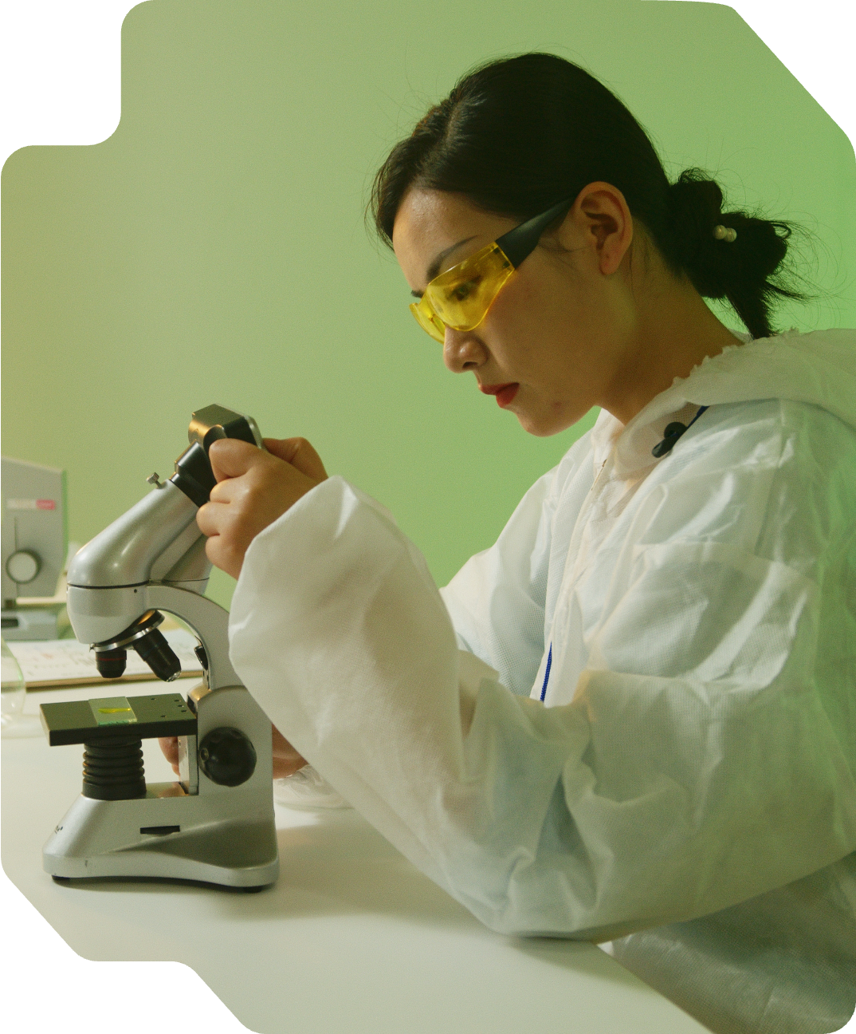

GENTLE CARE
WELLNESS CENTER
Hallmarks of Cancer
A guide to the traits that define tumor development
REALLYGREATSITE.COM

Slide 2

Sustaining proliferative signaling
Evading growth suppressors
What is it?
Tumor-promoting inflammation
Resisting cell death
The 10 Key Traits of Cancer
Genome instability and mutation
Enabling replicative immortality
Over decades of research, scientists have identified 10 key traits that most cancers share. They help explain how cancer begins, grows, survives, and spreads.
Understanding these traits gives insight into how cancer works and how treatments can target it.
Avoiding immune destruction
Inducing angiogenesis
Reprogramming energy metabolism
Activating invasion and metastasis

Slide 3


Sustaining proliferative signaling
GENTLE CARE
WELLNESS CENTER
Normal cells
Cancer cells
Only divide when they receive external signals (like growth factors) from the body.
Don’t wait for external signals. They make their own or keep growth signals permanently “switched on.”

Slide 4
Evading growth suppressors
GENTLE CARE
WELLNESS CENTER
Normal cells
Cancer cells
Use proteins like p53 or Rb as brakes that stop division when it’s unsafe or unnecessary.
Ignore or disable these growth-stopping mechanisms, allowing uncontrolled cell division.

Slide 5


Resisting cell death
GENTLE CARE
WELLNESS CENTER
Normal cells
Cancer cells
Undergo apoptosis (programmed cell death) if damaged or no longer needed.
Ignore death signals and keep dividing, even when damaged. They may also switch off the genes that trigger apoptosis.

Slide 6
Enabling replicative immortality
GENTLE CARE
WELLNESS CENTER
Normal cells
Cancer cells
Can only divide a limited number of times.
Their telomeres (chromosome ends) shorten with each division.
Activate telomerase, an enzyme that rebuilds telomeres, allowing endless cell division.

Slide 7
Inducing angiogenesis
GENTLE CARE
WELLNESS CENTER
Normal cells
Cancer cells
Only signal for new blood vessels when needed, like during wound healing.
Release signals that force the body to grow new blood vessels to feed the tumor.

Slide 8
Activating invasion and metastasis
GENTLE CARE
WELLNESS CENTER
Normal cells
Cancer cells
Stay in their original tissue. Strong cell-to-cell connections keep them in place.
Break away, invade nearby tissue, and travel through the body to form new tumors.

Slide 9
Reprogramming energy metabolism
GENTLE CARE
WELLNESS CENTER
Normal cells
Cancer cells
Use aerobic respiration in the mitochondria to make energy efficiently (ATP).
Prefer glycolysis — a less efficient process that helps them grow quickly by creating building blocks for new cells.

Slide 10
Avoiding immune destruction
GENTLE CARE
WELLNESS CENTER
Normal cells
Cancer cells
Abnormal or infected cells are detected and destroyed by the immune system.
Develop ways to hide from the immune system by suppressing danger signals or disabling immune cells.

Slide 11
Genome instability and mutation
GENTLE CARE
WELLNESS CENTER
Normal cells
Cancer cells
Have strict systems that check and repair DNA to keep the genome stable.
Lose these repair systems, leading to mutations that help them evolve and survive.

Slide 12
Tumor-promoting inflammation
GENTLE CARE
WELLNESS CENTER
Normal cells
Cancer cells
Inflammation is a temporary response to injury or infection and stops once healing is complete.
Use chronic (long-term) inflammation to access growth signals and attract blood vessels, supporting tumor growth.

Slide 13

Sustaining proliferative signaling
GENTLE CARE
WELLNESS CENTER
Read about the newer hallmarks proposed in 2022.
Choose two to highlight:
  List their names
  Briefly explain one in your own words
  Describe how it helps cancer grow or spread

Slide 14































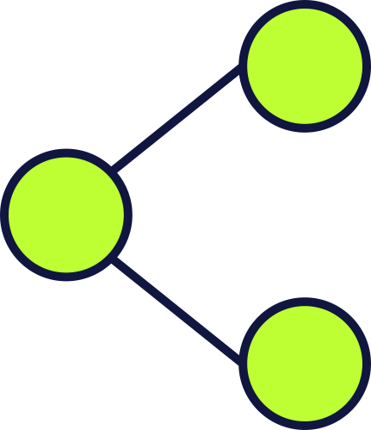







Resource Page
  Use these in your presentation. Delete or hide this page before presenting.
Fonts
Design Elements / Icons
This presentation template
uses the following free fonts:
TITLES:
DM Sans Bold
BODY TEXT:
Public Sans Regular
You can find these fonts online too.
Colors
#F1F1F2
#BDFF32
#B0C5F0
#10163F
#0530ED

Slide 15

Credits
  This presentation template is free for everyone to use, thanks to the following:
Pexels, Pixabay, & Sketchify
  for this presentation template
  for the photos, graphics, and elements
  Happy designing!

