Slide 1


Vital Point Health Center
Prostate
Cancer
A closer look at one of the most common cancers among men
REALLYGREATSITE.COM

Slide 2

Contents
01
What is prostate cancer?
02
Risk factors
03
Early warning signs
04
Screening and early detection
05
Treatment options
06
Life after treatment

Slide 3


What is
Prostate Cancer?
The Male Reproductive System
Start with a simple, clear definition of prostate cancer. Include the location and function of the prostate gland.
Vas deferens
Prostate
Penis
Urethra
Testes

Slide 4
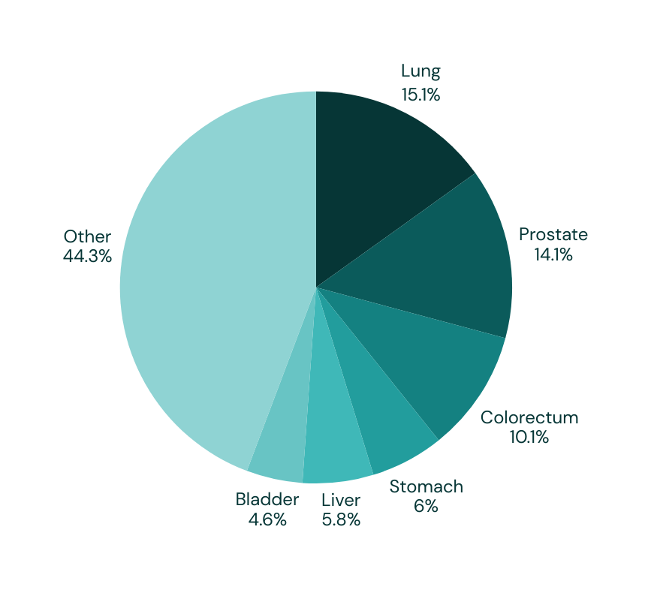

How common is Prostate Cancer?
Most common Cancers for men
Use this slide to explain how common prostate cancer is globally. Add recent, credible statistics to show its scope.

Slide 5
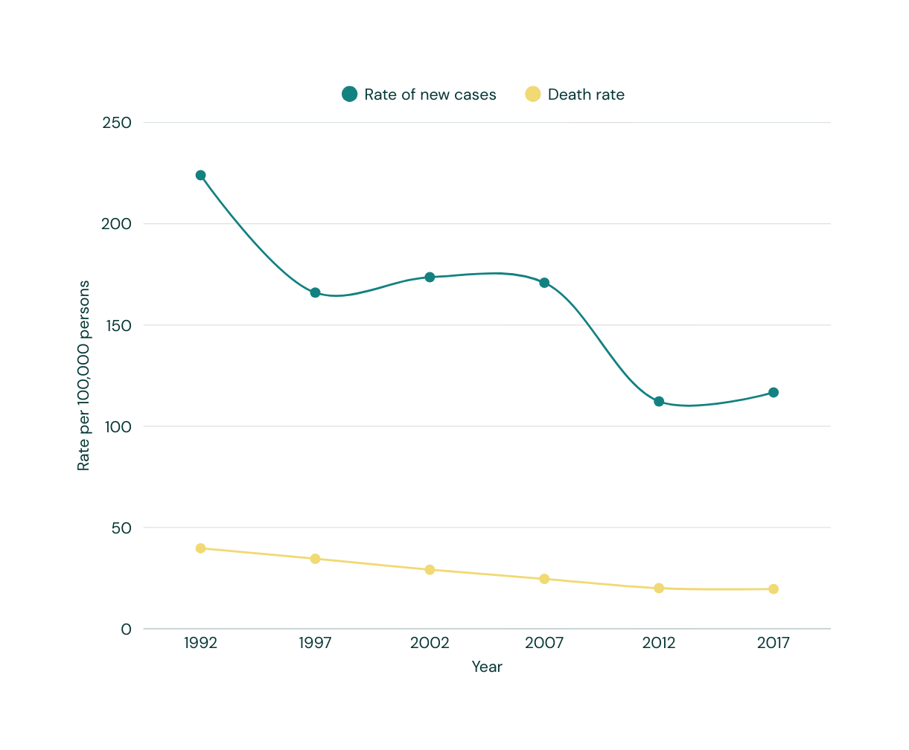
Prostate cancer cases over time
Insert a chart showing prostate cancer incidence and mortality rates over the years. Explain the difference between the two, and highlight any notable trends or changes. Add facts that may explain shifts in the data.

Slide 6

Risk factors
List the factors that can increase someone’s risk of developing prostate cancer.
Age
Another risk factor
Briefly describe why risk increases with age.
Describe its connection with prostate cancer.
Family history of prostate cancer
Another risk factor
Explain how genetics may increase risk.
Describe its connection with prostate cancer.

Slide 7
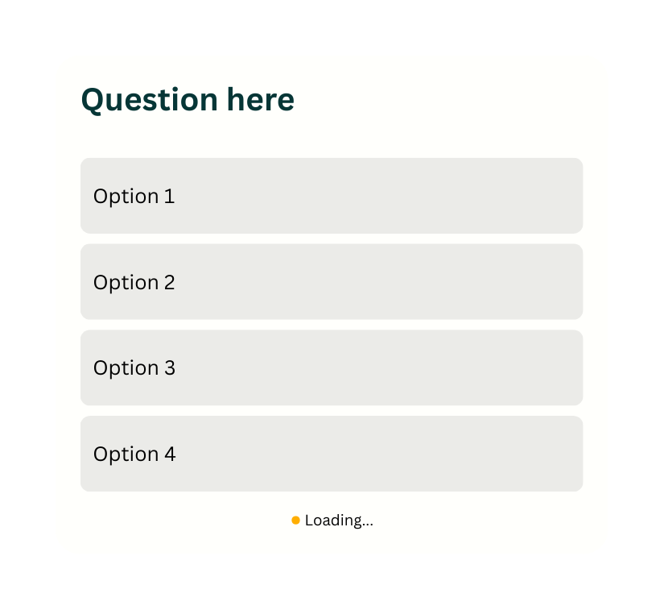
Check your knowledge
Add a poll or quiz to check learner understanding.

Slide 8




Early warning signs
Mention that early prostate cancer often has no symptoms. List possible symptoms below, and encourage learners to speak with a healthcare professional about any concerns.
Symptom 1
Symptom 2
Symptom 3
Add a short description.
Add a short description.
Add a short description.

Slide 9
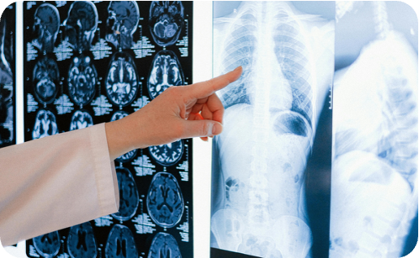
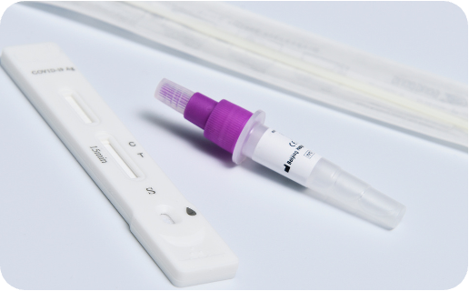

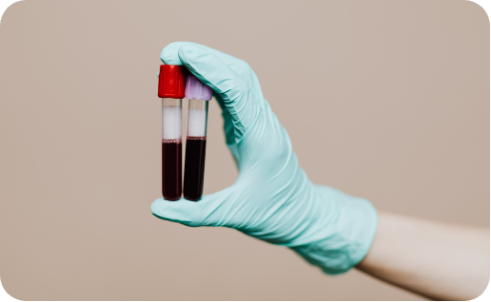
Screening and early detection
Digital rectal exam
Add a short description.
Explain the main methods used to screen for prostate cancer
Prostate-specific antigen test
Add a short description.
PCA3 RNA test
Add a short description.

Slide 10


Treatment options
List the common approaches to treating prostate cancer. Include both treatment options and active surveillance.
Active surveillance
Surgery
Radiation therapy
Explain how this works.
Explain how this works.
Explain how this works.
Chemotherapy
Hormone therapy
Immunotherapy
Explain how this works.
Explain how this works.
Explain how this works.

Slide 11

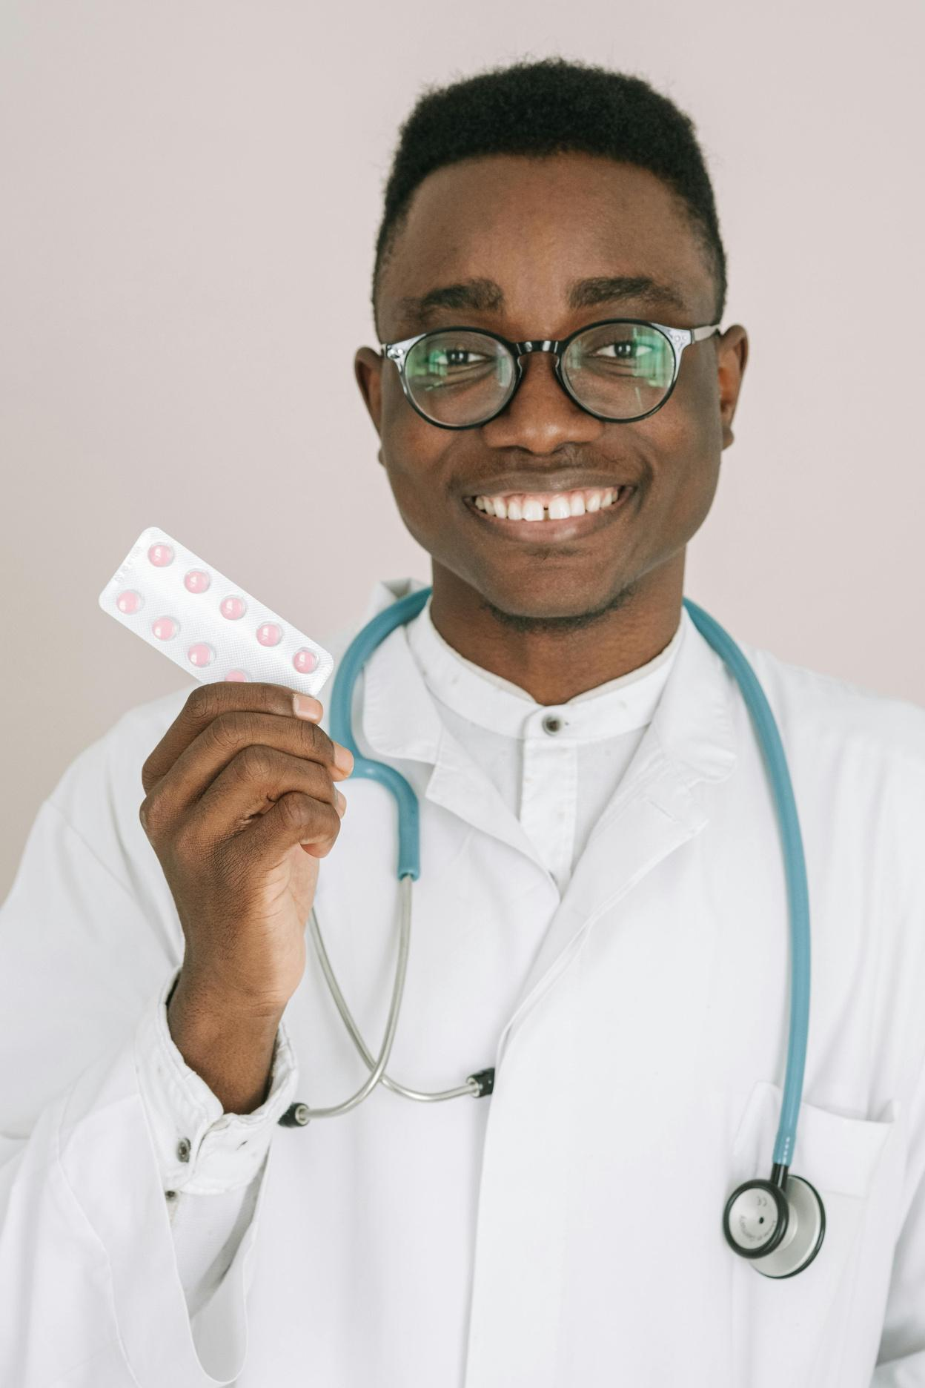
Describe one physical or emotional effect someone may experience after treatment.
Life after treatment
Help learners understand what life may look like after prostate cancer treatment.
Add tips, strategies, or considerations that can help improve the quality of life.

Slide 12

Review
Prostate cancer
Explain what prostate cancer is.
Risk factors
Highlight who is most at risk and why.
Signs and screening options
Mention potential symptoms and how cancer is detected.
Treatment pathways
List common treatment options and when they’re used.

Slide 13






Resource Page
  Use these in your presentation. Delete or hide this page before presenting.
Fonts
Design Elements / Icons
This presentation template
uses the following free fonts:
TITLES:
Cormorant Garamond
BODY TEXT:
DM Sans Regular
You can find these fonts online too.
Colors
#063636
#063636
#063636
#063636
#063636

Slide 14

Credits
  This presentation template is free for everyone to use, thanks to the following:
Pexels, Pixabay, & Sketchify
  for this presentation template
  for the photos, graphics, and elements
Happy designing!

