Slide 1

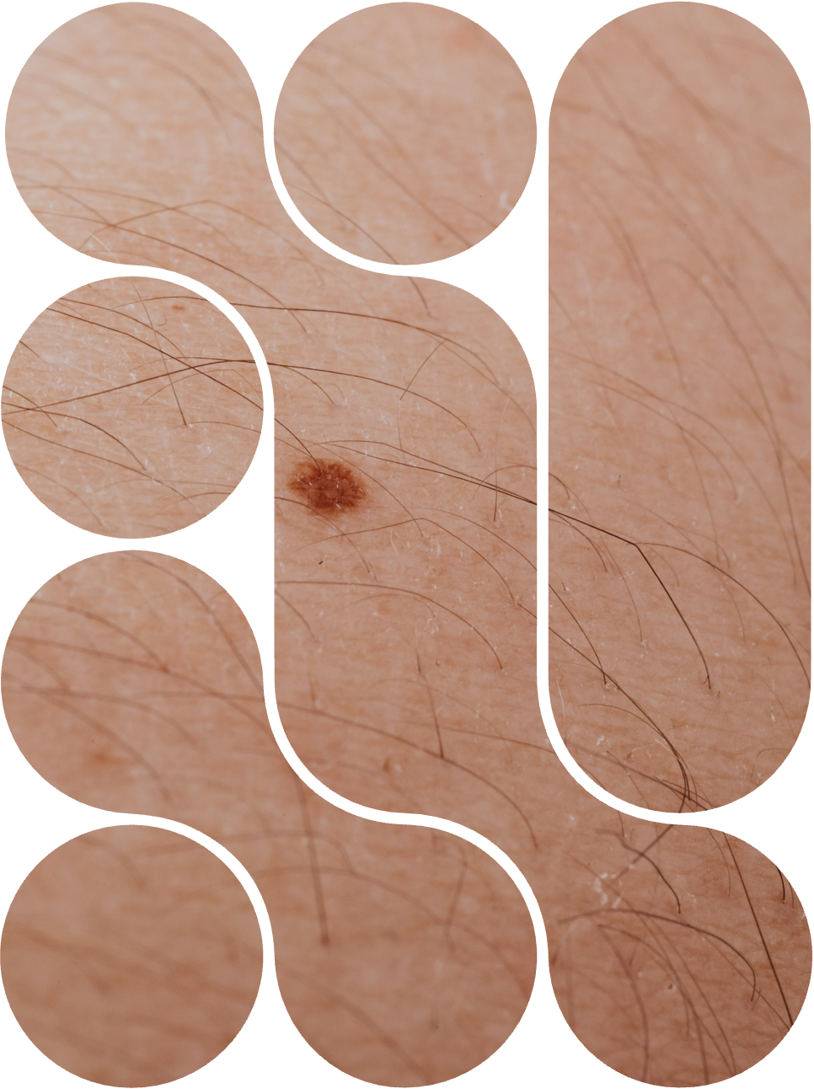


CRIMSWEST
INSTITUTE
Skin Cancer
An overview of causes, risks, and prevention

Slide 2

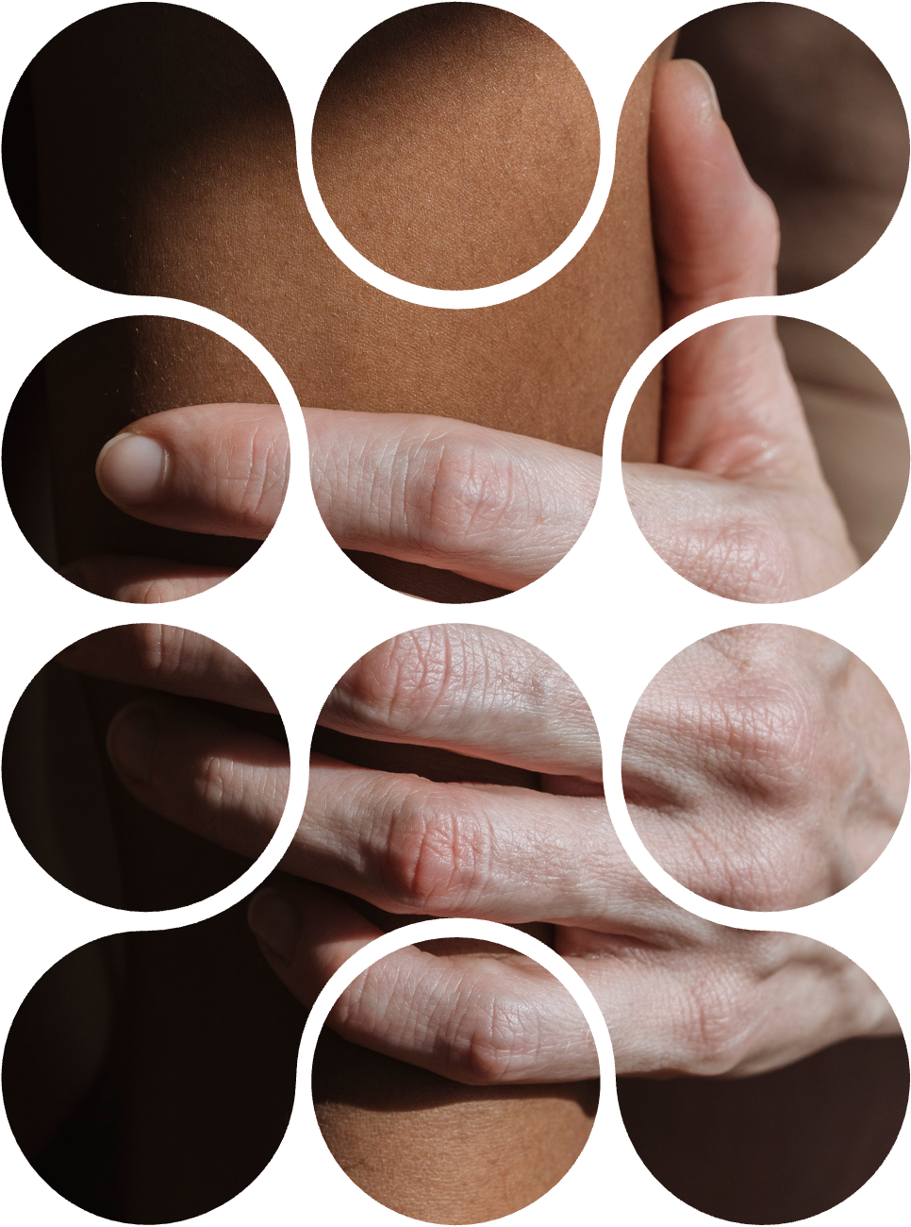

Overview
1
About the skin
2
Types of skin cancer
3
Causes of skin cancer
4
Risk factors
5
How to reduce your risk

Slide 3

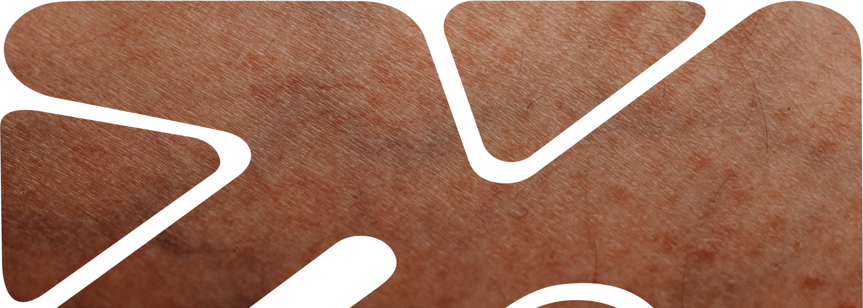
Introduction
Define skin cancer in 1-2 simple sentences. Explain that it occurs when skin cells grow abnormally due to DNA damage.

Slide 4
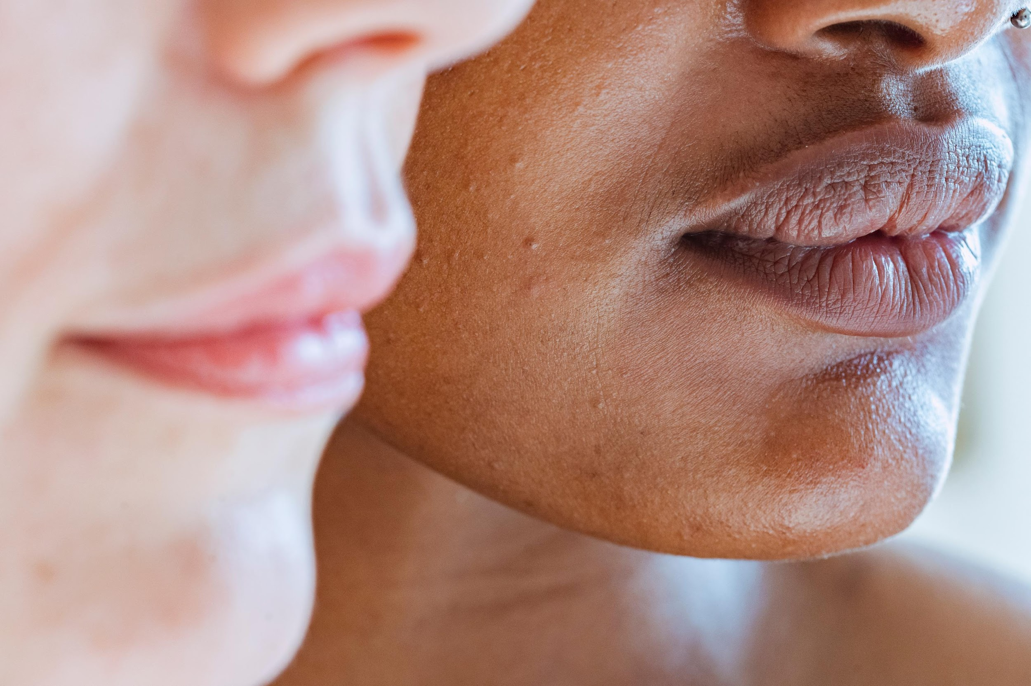
1 in 3
A key statistic about skin cancer

Slide 5

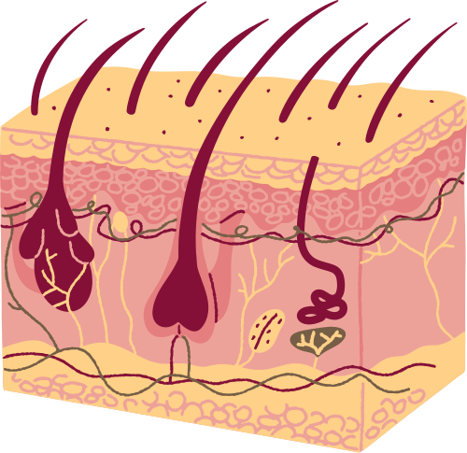
About the skin
Introduce the skin as the body’s largest organ. Explain its role and basic structure.
Epidermis
Describe its role here.
Dermis
Describe its role here.
Hypodermis
(subcutaneous tissue)
Describe its role here.

Slide 6

Check your
knowledge
Add a question related to the main topic here.
a
Option 1
b
Option 2
c
Option 3
d
Option 4
Use this slide to pause and assess understanding of the skin’s structure before moving into how and where skin cancer forms.

Slide 7

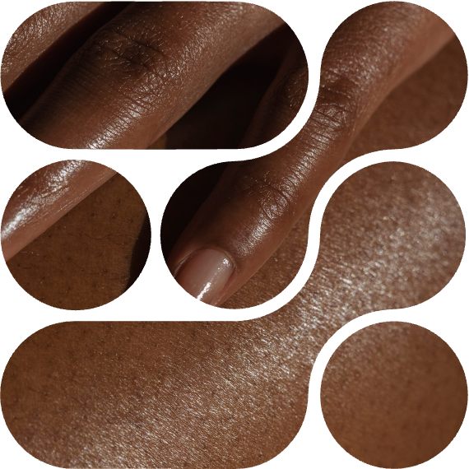
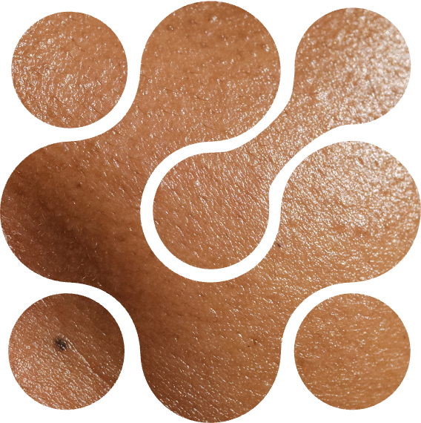
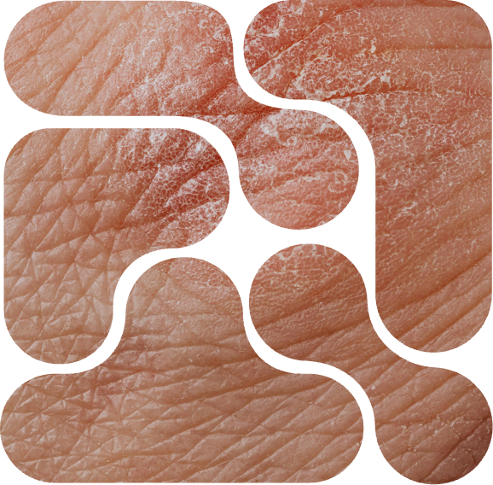
Types of skin cancer
BASAL CELL CARCINOMA
SQUAMOUS CELL CARCINOMA
MELANOMA
Explain where it begins and why it’s the most common.
Describe how it forms and its potential to spread if untreated.
Highlight why this is the most serious type and the importance of early detection.

Slide 8
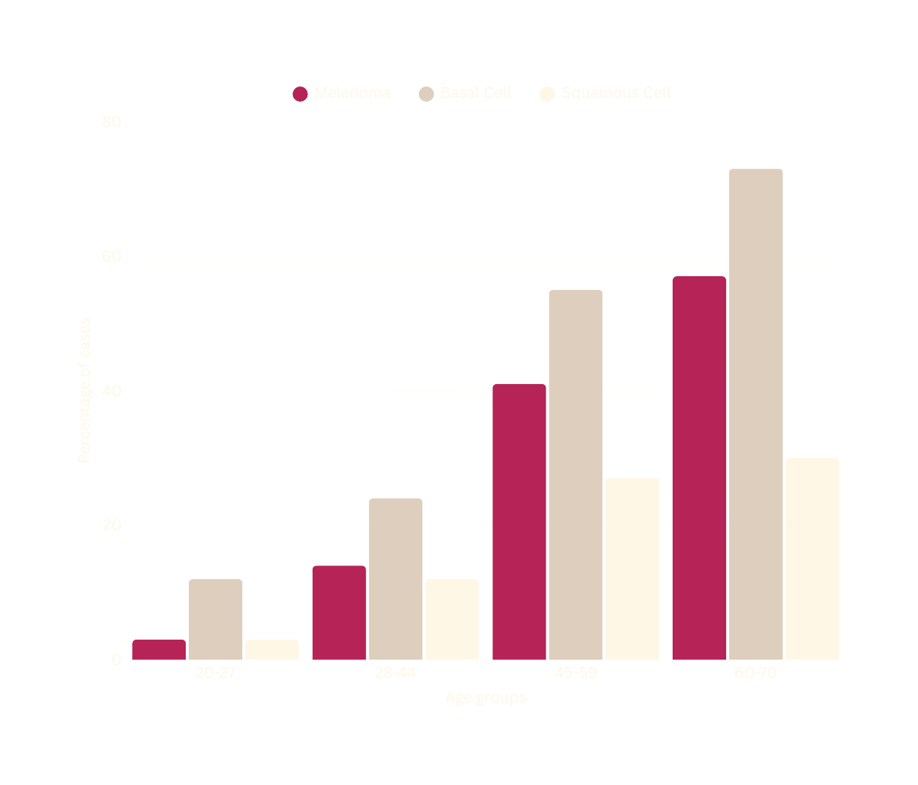

Skin cancer cases in different age groups
Add a short paragraph that explains the trend shown in the graph. Mention which age group has the highest number of skin cancer cases and highlight any surprising patterns.

Slide 9
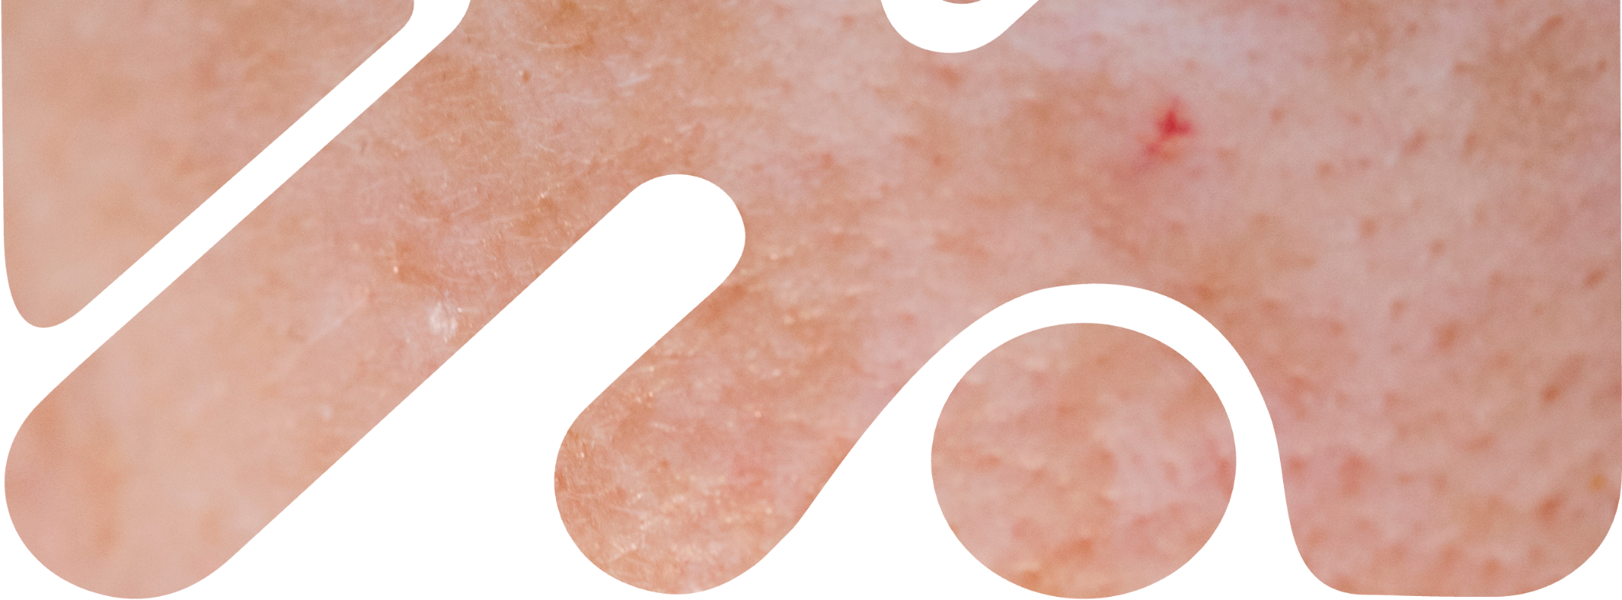
Causes of skin cancer
Explain the primary cause of skin cancer (UV radiation) and its long-term effects on skin health.

Slide 10



UVA vs UVB
UVA
Introduce the main types of UV rays that penetrate and damage the skin.
Mention that UVC rays are fully absorbed by the atmosphere and don’t reach the ground.
UVB
UVC
OZONE LAYER
EPIDERMIS
DERMIS

Slide 11

Risk factors
Introduce the idea that certain factors increase a person’s risk of developing cancer.
Risks you can control
Risks you can’t control
  Add behaviors here
  Or environmental exposures
  Add behaviors here
  Or environmental exposures
  Add inherited factors here.
  Or other natural factors
  Add inherited factors here.
  Or other natural factors

Slide 12
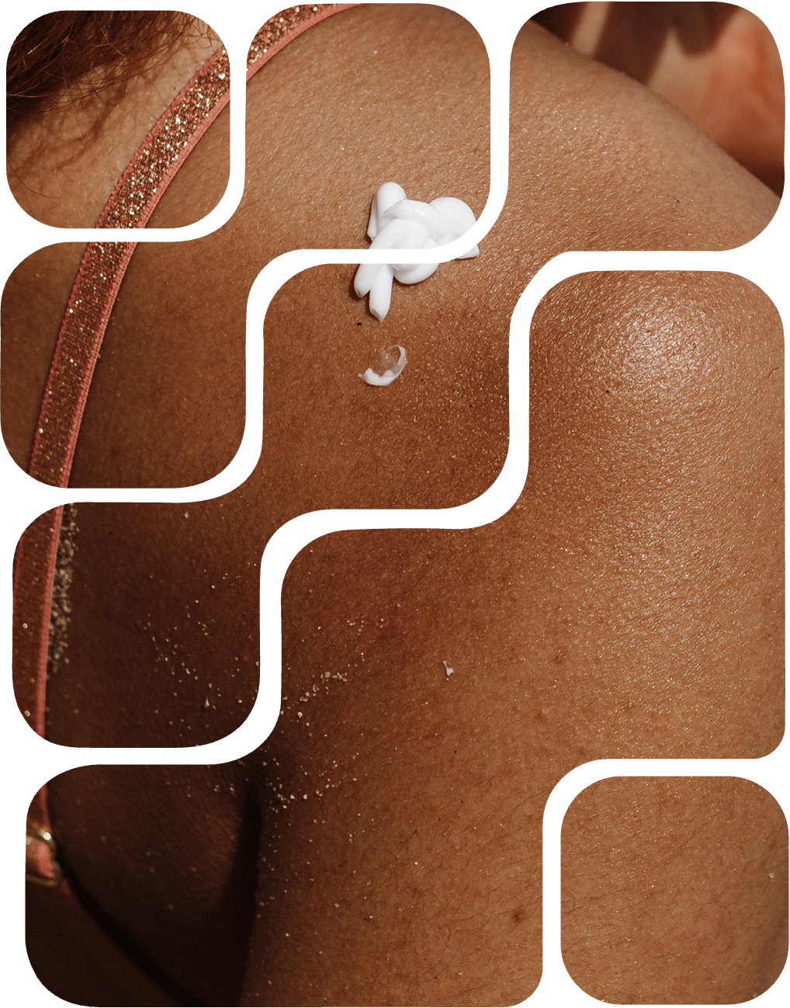
How to reduce your risk
PRACTICE SUN SAFETY
Add tips like wearing sunscreen, hats, etc.
SKIP TANNING BEDS
Explain the risk of artificial UV exposure.
CHECK YOUR SKIN REGULARY
Encourage professional screening for early detection.

Slide 13
Review
ABOUT THE SKIN
Summarize the skin’s role and name its three main layers.
TYPES OF SKIN CANCER
Name the three main types and note one key trait for each.
RISK FACTORS
Mention key modifiable and non-modifiable factors that increase skin cancer risk.

Slide 14





Resource Page
  Use these in your presentation. Delete or hide this page before presenting.
Fonts
Design Elements / Icons
This presentation template
uses the following free fonts:
TITLES:
Gilda Display
BODY TEXT:
Inter Regular
You can find these fonts online too.
Colors
#841038
#B62356
#FFF7E6
#AB9279
#DECEBE

Slide 15

Credits
  This presentation template is free for everyone to use, thanks to the following:
  for this presentation template
Pexels, Pixabay, Sketchify
  for the photos, graphics, and elements
  Happy designing!

