Slide 1



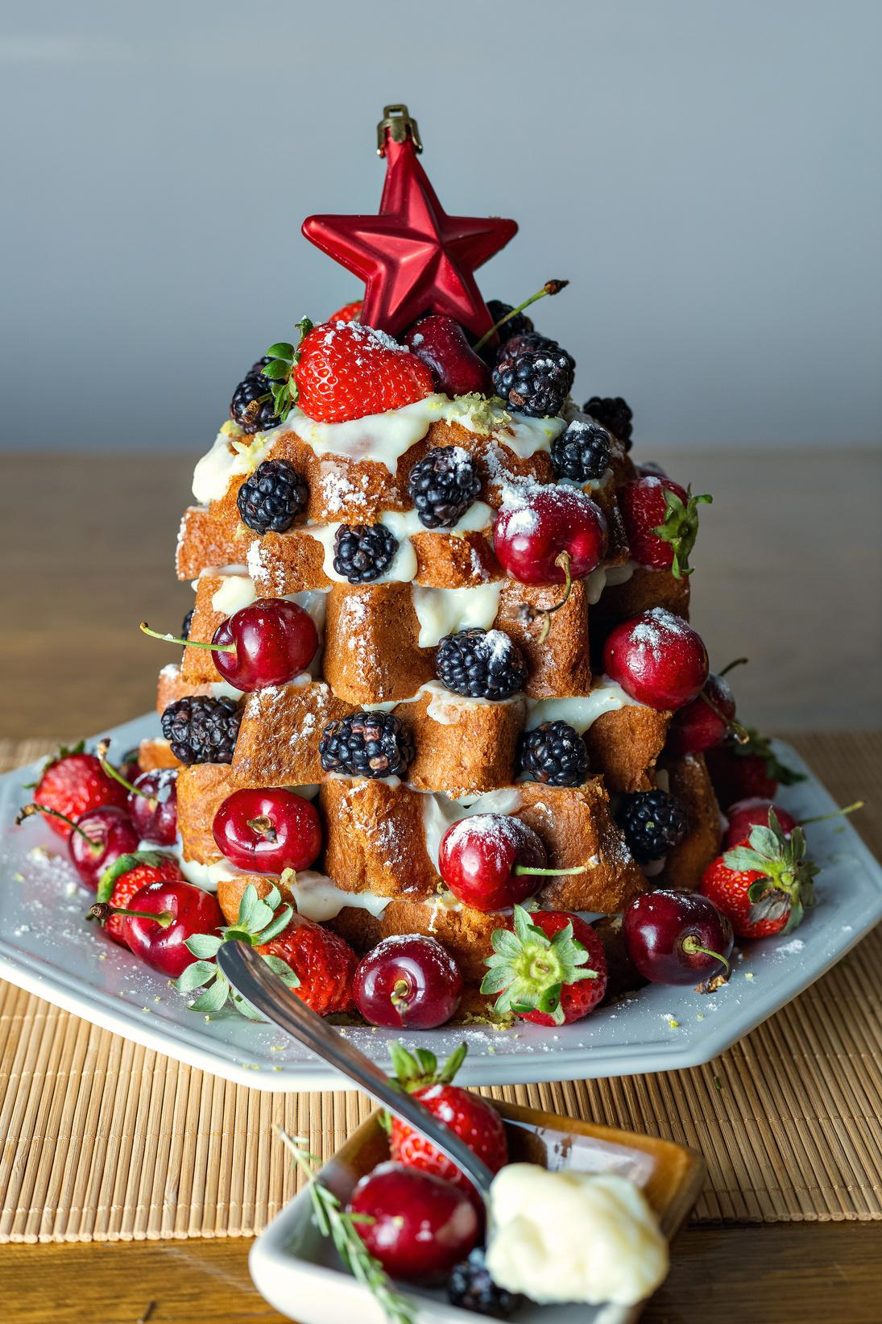
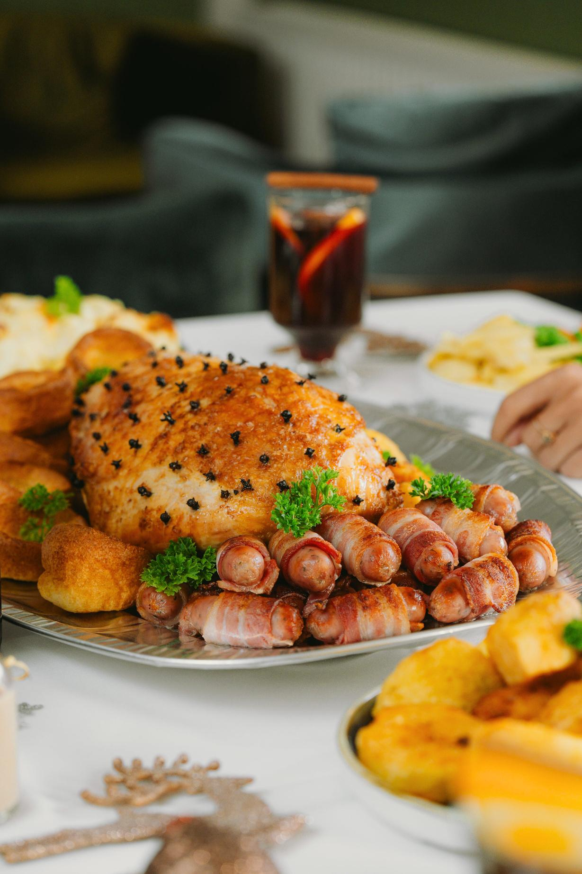
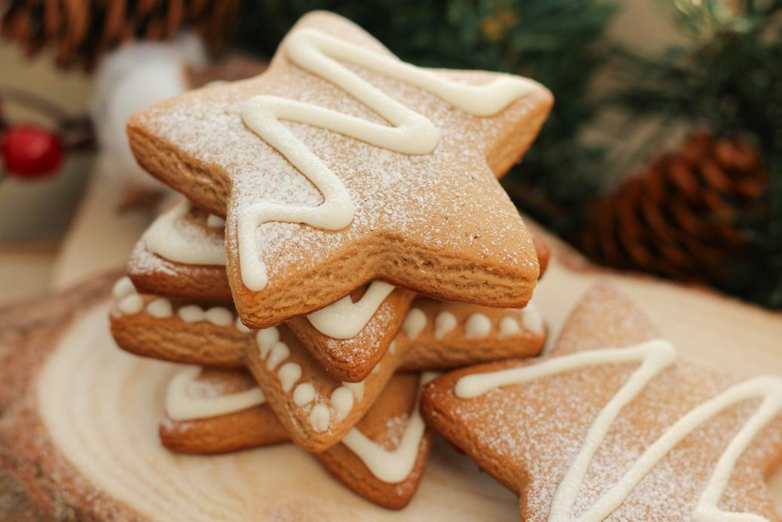
Munchie’s Kitchen
@SlidesCarnival
Christmas
Best Recipes
Delightful Festive Recipes to Brighten Your Holidays!
LEARN MORE

Slide 2
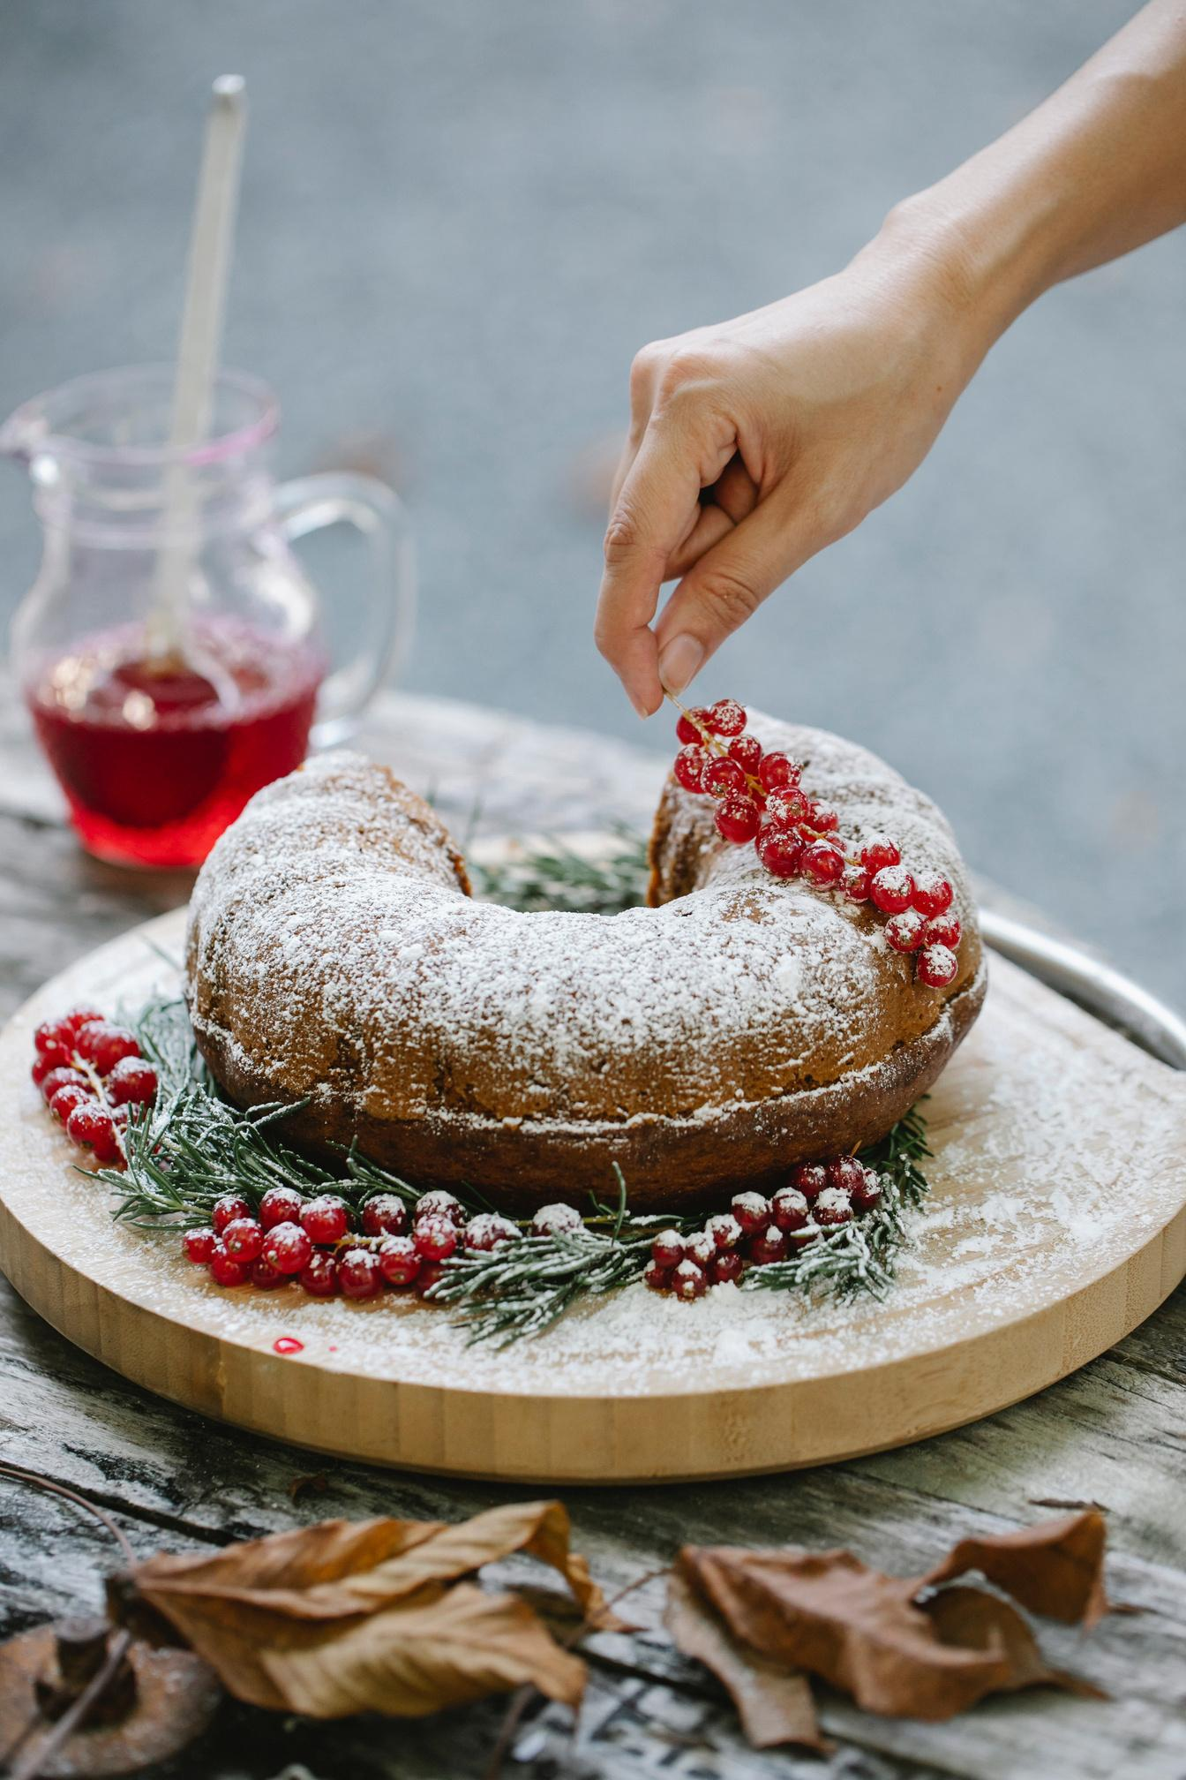

A TRADITIONAL HOLIDAY TREAT THAT IS RICH, MOIST, AND PACKED WITH A VARIETY OF DRIED FRUITS AND NUTS. IT'S PERFECT FOR CELEBRATING THE FESTIVE SEASON.
christmas fruit cake
Ingredients
Instructions
  2 cups mixed dried fruits (such as raisins, currants, and chopped dates)
  1 cup chopped nuts (walnuts, pecans, or almonds)
  1 cup diced candied fruit (such as cherries or pineapple)
  1 cup unsweetened applesauce
  1/2 cup unsalted butter, softened
  1 cup brown sugar
  4 large eggs
  2 cups all-purpose flour
  1 teaspoon baking powder
  1 teaspoon ground cinnamon
  1/2 teaspoon ground nutmeg
  1/4 teaspoon ground cloves
  1/4 teaspoon salt
  1/2 cup orange juice
  1/4 cup dark rum (optional)
  Zest of 1 orange
1.Preheat oven to 325°F (165°C) and prepare a 9-inch round or loaf pan.
2. Cream softened butter and brown sugar until fluffy.
3. Add eggs one at a time, then mix in applesauce and orange zest.
4.Combine flour, baking powder, spices, and salt in a separate bowl. Gradually mix with wet ingredients, alternating with orange juice and rum.
5. Fold in dried fruits, nuts, and candied fruit.
6. Pour batter into the pan and smooth the top.
7. Bake for 60-75 minutes until a toothpick comes out clean. Cool in the pan for 10 minutes, then transfer to a wire rack.
8. Wrap in rum-soaked cheesecloth for deeper flavor before storing.

Slide 3
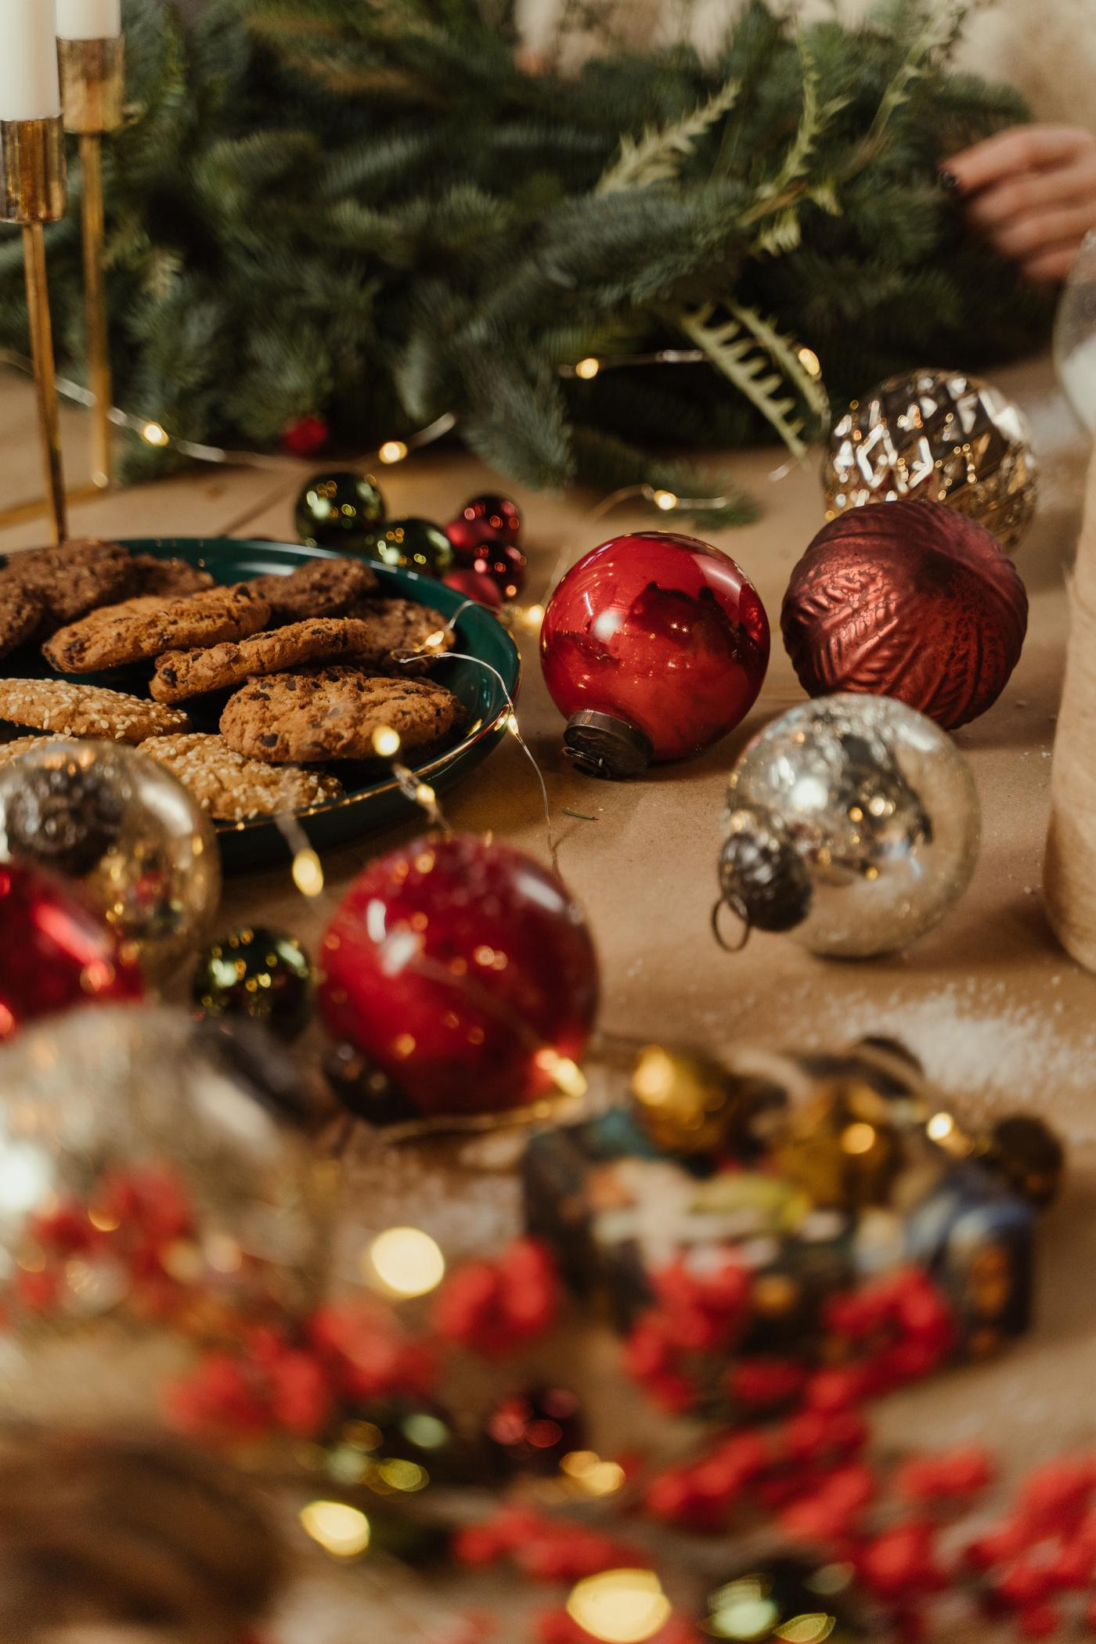


Munchie’s Kitchen
Christmas
Best Recipes
Delightful Festive Recipes to Brighten Your Holidays!
For your daily dose of recipes, visit www.munchieskitchen.com

Slide 4

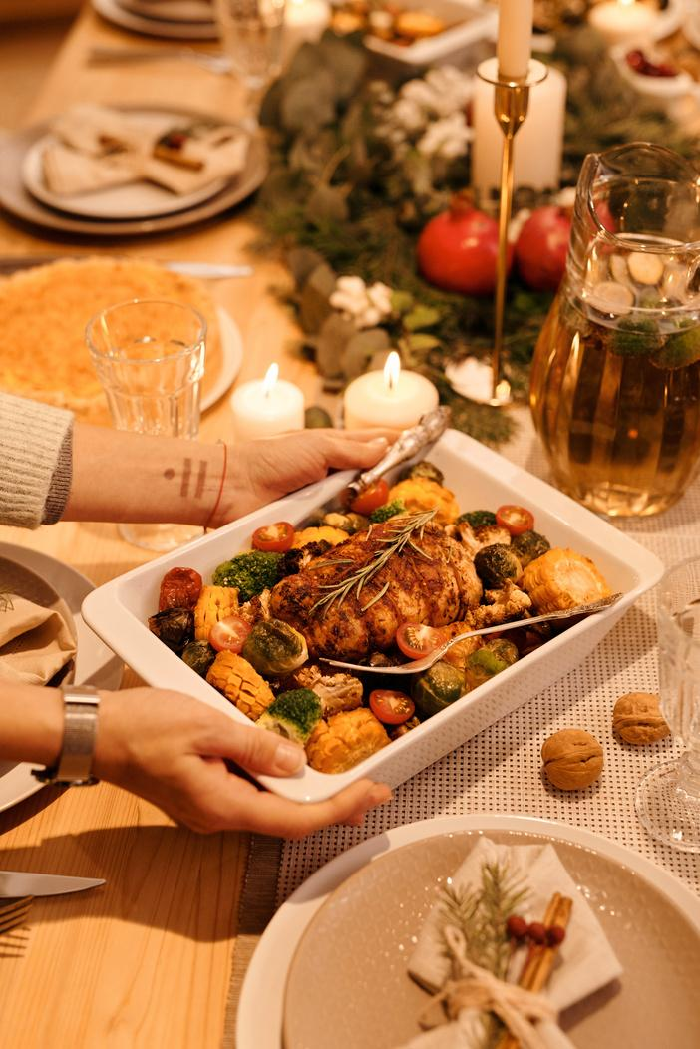

honey glazed ham
by Munchie’s Kitchen
Ingredients
  1 fully cooked bone-in ham (about 8-10 pounds)
  1 cup honey
  1 cup brown sugar
  1/4 cup Dijon mustard
  1/4 cup apple cider vinegar
  1 teaspoon ground cloves
  1 teaspoon ground cinnamon
  1/2 teaspoon ground ginger
  Whole cloves (for studding the ham)
Instructions
1. Preheat your oven to 325°F (163°C).
2. Remove packaging, place in a roasting pan with the cut side down, and score the surface in a diamond pattern. Optionally, add whole cloves at the diamond intersections.
3. Heat honey, brown sugar, Dijon mustard, apple cider vinegar, ground cloves, cinnamon, and ginger in a saucepan until well combined and slightly thickened.
4. Brush with glaze, reserving some for later basting. Cover with foil and bake for 1.5 to 2 hours, basting every 30 minutes. Remove foil for the last 30 minutes to caramelize the glaze.
5. Ensure internal temperature reaches 140°F (60°C). Let rest for 15-20 minutes before slicing.

Slide 5
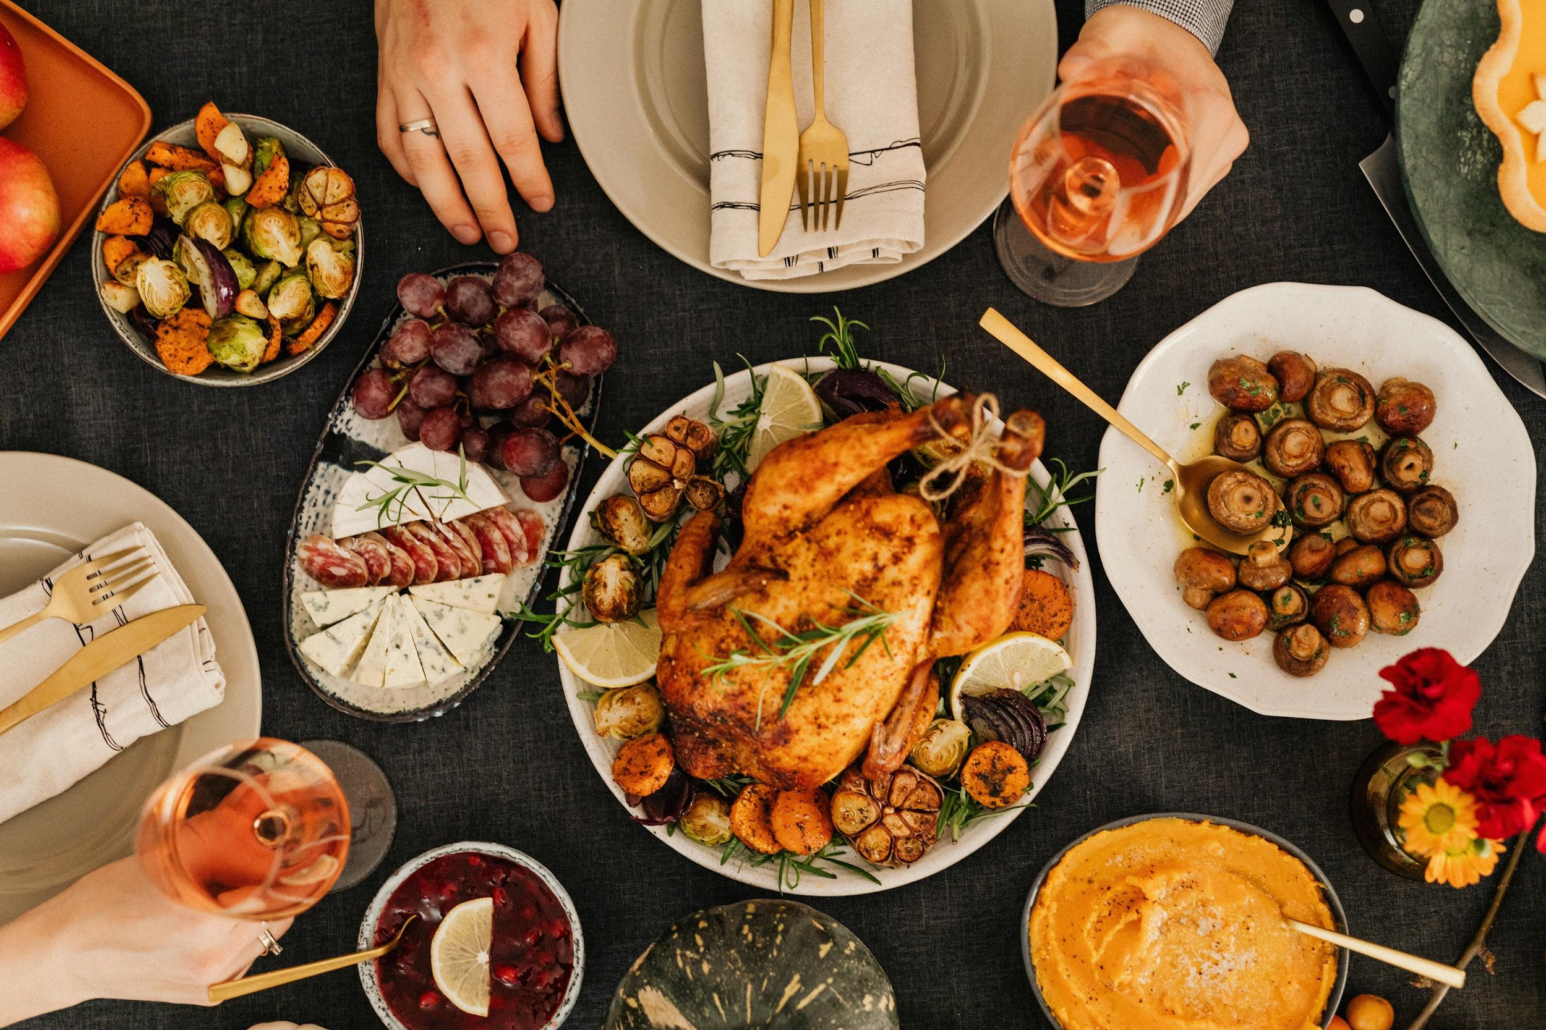
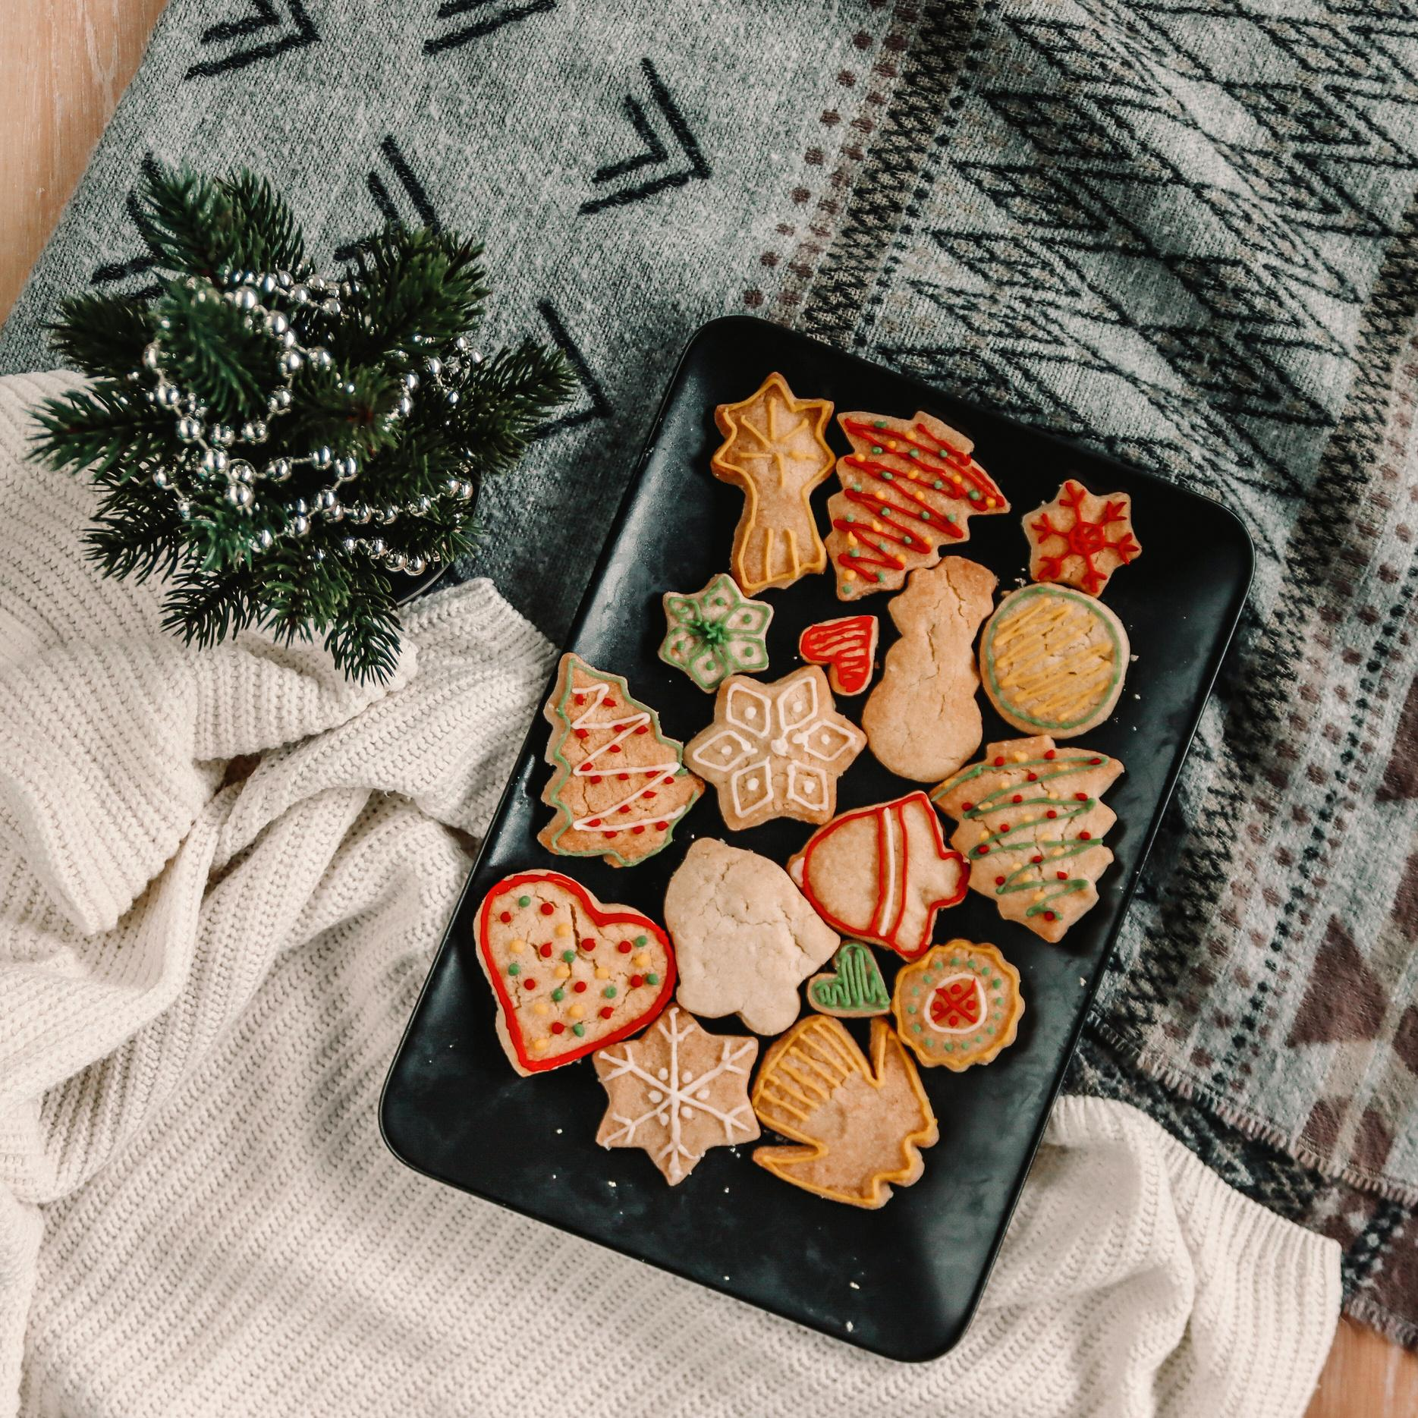


Christmas
Best Recipes
www.MunchiesKitchen.com

Slide 6


Resource Page
  Use these design resources in your Canva template.
Fonts
Colors
This presentation template
uses the following free fonts:
TITLES AND HEADER:
#C82222
Cinzel
#791A1A
#01443C
BODY COPY:
  Libre Franklin
  You can find these fonts online too.
##F5F0EA
#D8AB3D
#FBF19D
  Design Elements

Slide 7

Credits
  This design template is free for
  everyone to use thanks to the following:
  for the presentation template
Pexels, Pixabay
  for the photos
Happy designing!

